Slide 1
New Instruments for LS2
Ray VENESS
Thanks to William, Morad, Gerhard

Slide 2
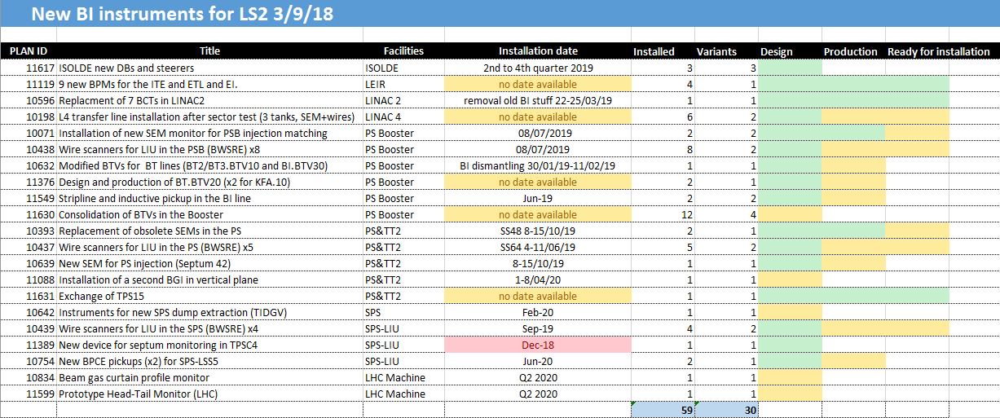

Slide 3
Maintenance in LS2
Ray VENESS
Thanks to Ana Miarnau

Slide 4
General Instrument maintenance during LS2
General principles:
  Maintain the maximum flexibility for BI people working across several machines and with unpredictable maintenance tasks
  Ensure safety (co-activity, local and general limits to access for other projects)
  Shutdown progress follow-up is important for the CERN management
Some areas are easier than others…
  LHC and SPS are delimited in access areas, allowing access by point
  PS and PSB do not have this, which makes (in particular) PS access difficult to manage
Proposed strategy:
  Upto three ‘maintenance’ IMPACTs per system separated chronologically (eg, preliminary inspection, core maintenance, final check-out)
  In addition, different IMPACTs per access point for the SPS and LHC as required
  Create specific IMPACTs if we need to more than maintain (eg, remove or use other services)

Slide 5
Preventive Maintenance of electro-mechanical systems
21 February 2018 to 6 March 2018, Zurich, Switzerland
~ 320 instruments contain moving mechanisms
  Whole complex, except missing some info on LINAC 4, ISOLDE, nTOF, CTF3, North and East Areas
  BBS, BCF, BSF, BSG, BTV, BWS
  Limited number of different mechanisms and systems to maintain
Preventive Maintenance (PM) strategy is based on procedures for each mechanism/system
Procedures will be linked to “asset codes” for instruments which will allow us to automatically produce checklists of work to be done
Pneumatic cylinder
Leadscrew
Belt and pulleys
Maltese cross
Switches
Viewports
Bellows
Motors
Notes:
Preventive Maintenance (PM) strategy is based on procedures for each mechanism – rather than per instrument…
Can be filtered for example by periodicity, location

