Slide 1
Multiple solutions for the quasiparticle populations in BCS superconductors
Dragos-Victor Anghel
Horia Hulubei National Institute for Physics and Nuclear Engineering
Romania

Slide 2
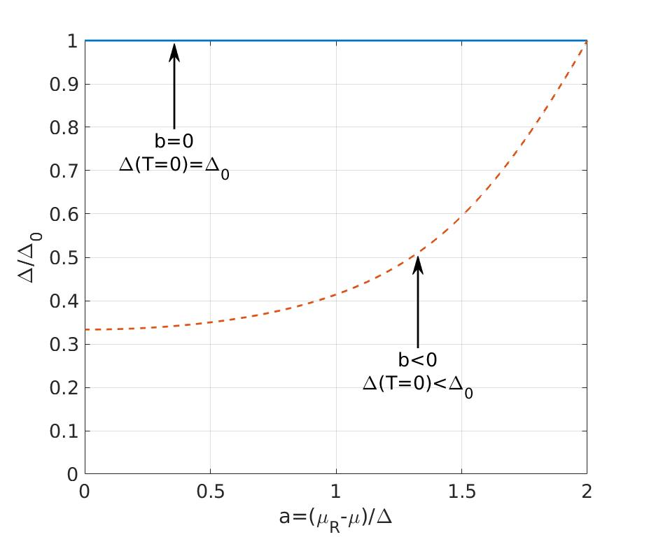
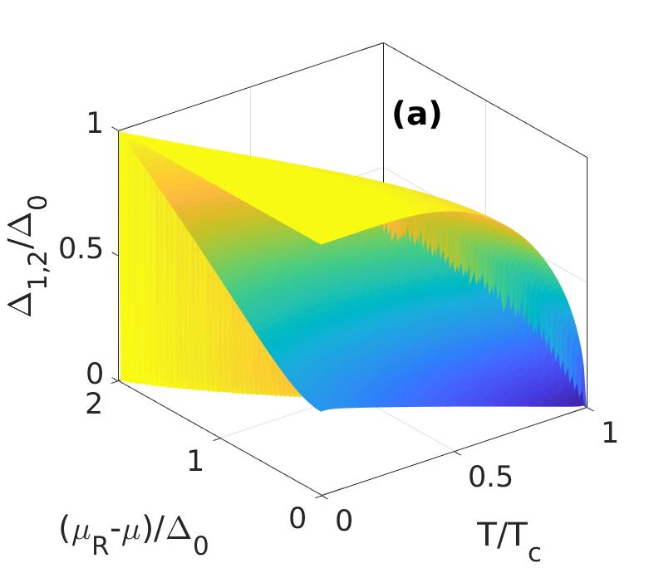
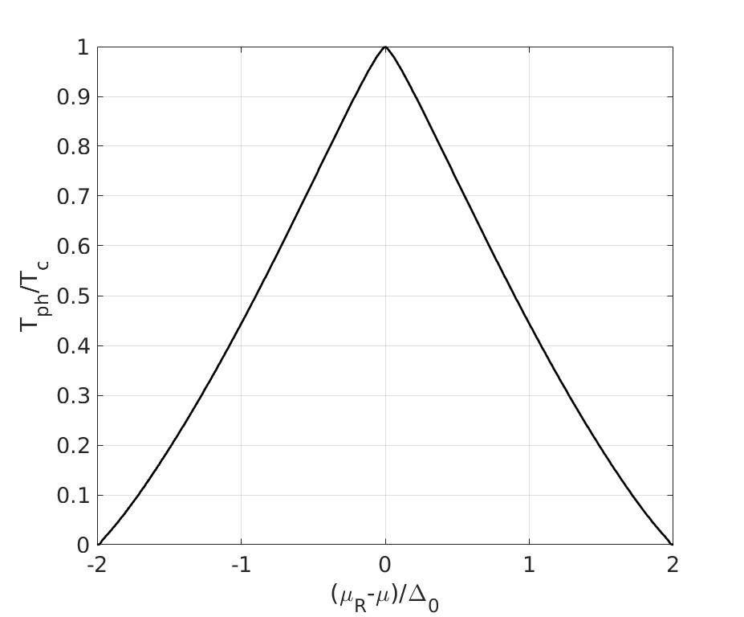
New phenomenology from an old theory
Phase transition
temperature
DVA and G. A. Nemnes, Physica A 464, 74 (2016).
DVA, Physica A 531, 121804 (2019).
DVA, arXiv:1908.06017.

Slide 3
Outline
Motivation
Background
Equilibrium distribution of the system in contact with a reservoir
Conclusions

Slide 4
Motivation

Slide 5
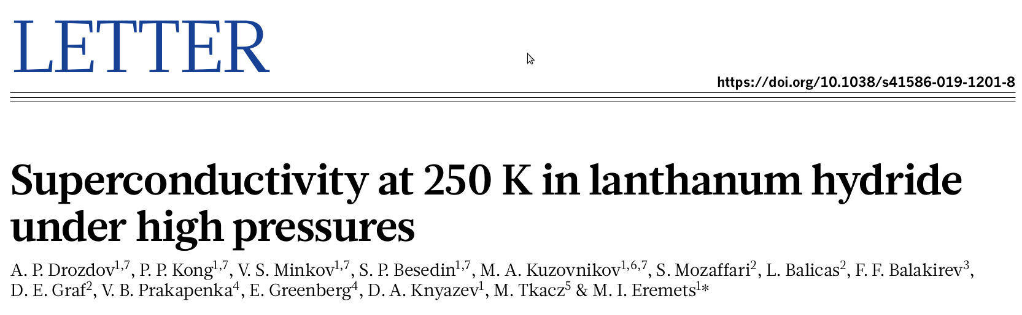
Nature 569, 528 (2019).

Slide 6
Applications of fractional exclusion statistics (FES)
FES is a generalization of the Pauli exclusion principle, pioneered by
  F. D. M. Haldane, Phys. Rev. Lett. 67, 937 (1991).
  Y.-S. Wu, Phys. Rev. Lett. 73, 922 (1994).
  S. B. Isakov, Phys. Rev. Lett. 73, 2150 (1994).
This is a method to describe interacting particle systems as ideal gases, by assimilating the interaction into the statistics
  DVA, Phys. Lett. A 372, 5745 (2008).
  DVA, EPL 87, 60009 (2009).
  DVA, Phys. Scr. 2012, 014079 (2012).
  DVA, G.A. Nemnes, and F. Gulminelli, Phys. Rev. E, 88, 042150 (2013).

Slide 7
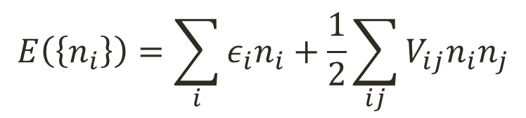
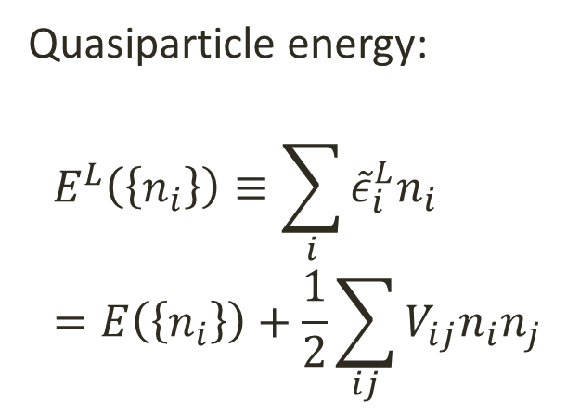
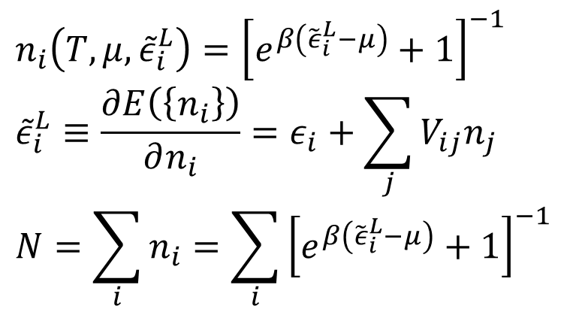
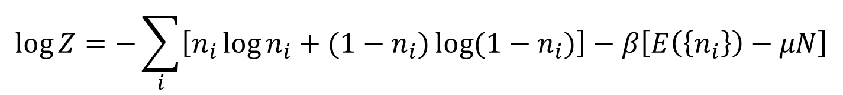
Example 1: the Fermi liquid
$$E\left(\left\{n_{i}\right\}\right)=\sum_{i}{ε_{i}n_{i}}+\frac{1}{2}\sum_{ij}{V_{ij}n_{i}n_{j}}$$
Total energy of the system:
$$\log{Z=−\sum_{i}{\left[n_{i}\log{n_{i}}+(1−n_{i})\log{(1−n_{i})}\right]}}−β\left[E\left(\left\{n_{i}\right\}\right)−μN\right]$$
maximization of Z
Quasiparticle energy:
$$E^{L}\left(\left\{n_{i}\right\}\right)≡\sum_{i}{{\tilde{ε}}_{i}^{L}n_{i}} \\ =E\left(\left\{n_{i}\right\}\right)+\frac{1}{2}\sum_{ij}{V_{ij}n_{i}n_{j}}$$
$$n_{i}\left(T,μ,{\tilde{ε}}_{i}^{L}\right)={\left[e^{β\left({\tilde{ε}}_{i}^{L}−μ\right)}+1\right]}^{−1} \\ {\tilde{ε}}_{i}^{L}≡\frac{∂E\left(\left\{n_{i}\right\}\right)}{∂n_{i}}=ε_{i}+\sum_{j}{V_{ij}n_{j}} \\ N=\sum_{i}{n_{i}=\sum_{i}{{\left[e^{β\left({\tilde{ε}}_{i}^{L}−μ\right)}+1\right]}^{−1}}}$$
Notes:
We want to calculate the thermodynamic properties of a gas that has this total energy or is described by the qp of energies epsilon_i.

Slide 8

The standard procedure
$$\frac{∂n_{i}^{L}(T,μ)}{∂(k_{B}T)}=\frac{∂n_{i}^{L}(T,μ,{\tilde{ε}}_{i}^{L})}{∂(k_{B}T)}+\frac{∂n_{i}^{L}(T,μ,{\tilde{ε}}_{i}^{L})}{∂{\tilde{ε}}_{i}^{L}}\frac{∂{\tilde{ε}}_{i}^{L}(T,μ,{\tilde{ε}}_{i}^{L})}{∂(k_{B}T)} \\ \frac{∂{\tilde{ε}}_{i}^{L}(T,μ,{\tilde{ε}}_{i}^{L})}{∂(k_{B}T)}=\sum_{j}{\frac{∂{\tilde{ε}}_{i}^{L}(T,μ)}{∂n_{j}}}\frac{∂n_{j}^{L}(T,μ)}{∂(k_{B}T)}=\sum_{j}{V_{ij}}\frac{∂n_{j}^{L}(T,μ)}{∂(k_{B}T)} \\ \frac{∂n_{i}^{L}(T,μ)}{∂(k_{B}T)}=\frac{β^{2}({\tilde{ε}}_{i}^{L}−μ)e^{β({\tilde{ε}}_{i}^{L}−μ)}}{{\left[e^{β({\tilde{ε}}_{i}^{L}−μ)}+1\right]}^{2}}\left[1−\frac{1}{β({\tilde{ε}}_{i}^{L}−μ)}\sum_{j}{V_{ij}}\frac{∂n_{j}^{L}(T,μ)}{∂(k_{B}T)}\right]$$
Similarly,
$$\frac{∂n_{i}^{L}(T,μ)}{∂μ}=\frac{βe^{β({\tilde{ε}}_{i}^{L}−μ)}}{{\left[e^{β({\tilde{ε}}_{i}^{L}−μ)}+1\right]}^{2}}\left[1−\sum_{j}{V_{ij}}\frac{∂n_{j}^{L}(T,μ)}{∂μ}\right]$$

Slide 9
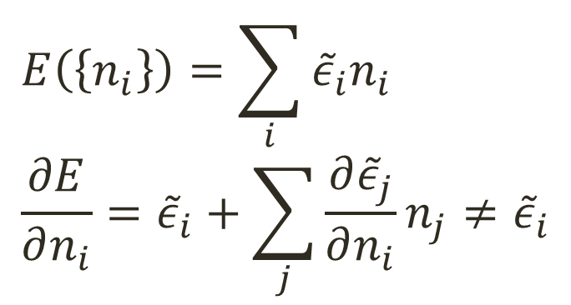

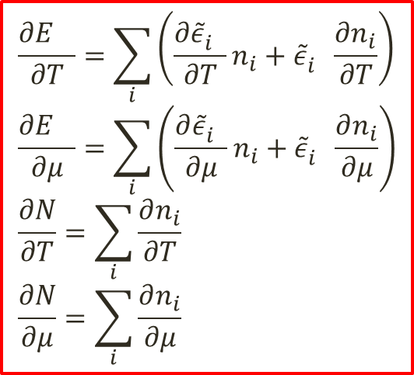
General gas of quasiparticles
$${\tilde{ε}}_{i}≡{\tilde{ε}}_{i}(ε_{i},\left\{n_{j}\right\})$$
$$\frac{∂E^{}}{∂T}=\sum_{i}{\left(\frac{{∂\tilde{ε}}_{i}^{}}{∂T}n_{i}+{\tilde{ε}}_{i}^{}\frac{∂n_{i}}{∂T}\right)} \\ \frac{∂E^{}}{∂μ}=\sum_{i}{\left(\frac{{∂\tilde{ε}}_{i}^{}}{∂μ}n_{i}+{\tilde{ε}}_{i}^{}\frac{∂n_{i}}{∂μ}\right)} \\ \frac{∂N}{∂T}=\sum_{i}{\frac{∂n_{i}}{∂T}} \\ \frac{∂N}{∂μ}=\sum_{i}{\frac{∂n_{i}}{∂μ}}$$
$$E\left(\left\{n_{i}\right\}\right)=\sum_{i}{{\tilde{ε}}_{i}n_{i}} \\ \frac{∂E}{∂n_{i}}={\tilde{ε}}_{i}+\sum_{j}{\frac{{∂\tilde{ε}}_{j}}{∂n_{i}}n_{j}}≠{\tilde{ε}}_{i}$$

Slide 10
Background

Slide 11
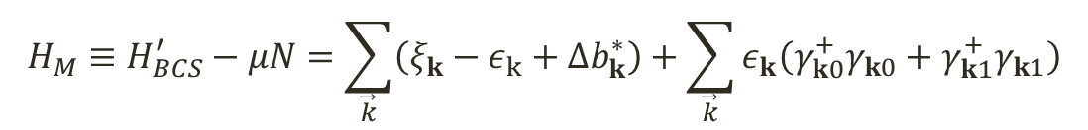
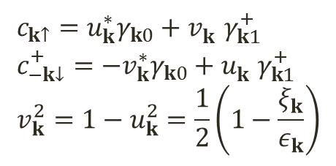
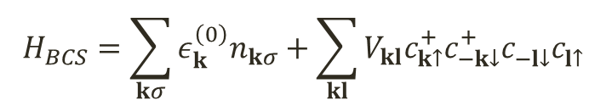


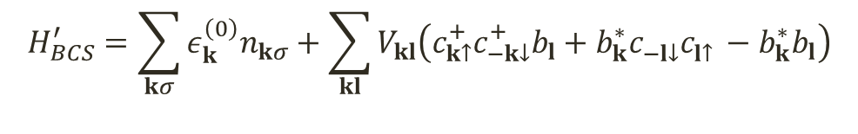
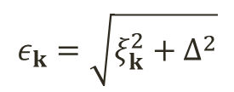

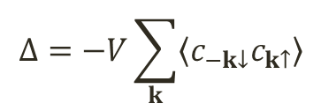


The BCS model
$$b_{\vec{k}}=〈c_{−\vec{k}↓}c_{\vec{k}↑}〉$$
$$H_{BCS}=\sum_{kσ}{ε_{k}^{\left(0\right)}n_{kσ}}+\sum_{kl}{V_{kl}c_{k↑}^{+}c_{−k↓}^{+}c_{−l↓}^{}c_{l↑}^{}}$$
$$c_{−\vec{k}↓}c_{\vec{k}↑}=b_{\vec{k}}+\left(〈c_{−\vec{k}↓}c_{\vec{k}↑}〉−b_{\vec{k}}\right)$$
Keeping only 2nd order terms
$$H_{BCS}^{′}=\sum_{kσ}{ε_{k}^{\left(0\right)}n_{kσ}}+\sum_{kl}{V_{kl}\left(c_{k↑}^{+}c_{−k↓}^{+}b_{l}+b_{k}^{∗}c_{−l↓}^{}c_{l↑}^{}−b_{k}^{∗}b_{l}\right)}$$
$$ξ_{\vec{k}}≡ε_{\vec{k}}^{\left(0\right)}−μ$$
Middle of the attraction band
$V_{\vec{k}\vec{l}}=V$, for $ξ∈\left[−ℏω_{c},ℏω_{c}\right]$
$$H_{M}≡H_{BCS}^{′}−μN=\sum_{\vec{k}}{\left(ξ_{k}−ε_{k}+Δb_{k}^{∗}\right)}+\sum_{\vec{k}}{ε_{k}\left(γ_{k0}^{+}γ_{k0}+γ_{k1}^{+}γ_{k1}\right)}$$
$$c_{k↑}=u_{k}^{∗}γ_{k0}+v_{k}^{}γ_{k1}^{+} \\ c_{−k↓}^{+}={−v}_{k}^{∗}γ_{k0}+u_{k}^{}γ_{k1}^{+} \\ v_{k}^{2}=1−u_{k}^{2}=\frac{1}{2}\left(1−\frac{ξ_{k}}{ε_{k}}\right)$$
$$ε_{k}=\sqrt{ξ_{k}^{2}+Δ^{2}}$$
$$Δ=−V\sum_{k}{〈c_{−k↓}c_{k↑}〉}$$
$$n_{ki}=γ_{ki}^{+}γ_{ki}$$
$γ=$quasiparticle creation and annihilation operators

Slide 12
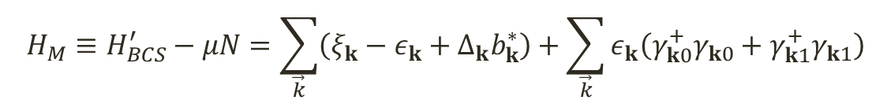

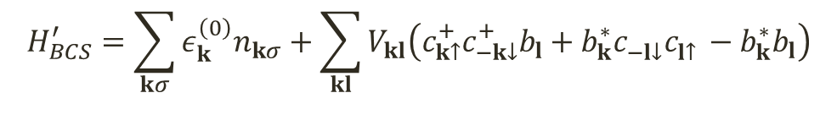
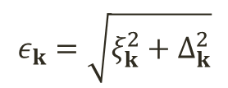
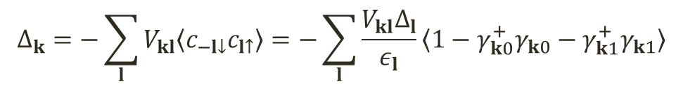
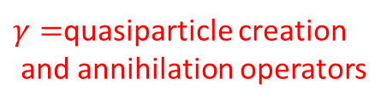
The BCS model
$$b_{\vec{k}}=〈c_{−\vec{k}↓}c_{\vec{k}↑}〉$$
$$H_{BCS}=\sum_{kσ}{ε_{k}^{\left(0\right)}n_{kσ}}+\sum_{kl}{V_{kl}c_{k↑}^{+}c_{−k↓}^{+}c_{−l↓}^{}c_{l↑}^{}}$$
$$c_{−\vec{k}↓}c_{\vec{k}↑}=b_{\vec{k}}+\left(〈c_{−\vec{k}↓}c_{\vec{k}↑}〉−b_{\vec{k}}\right)$$
Keeping only 2nd order terms
$$H_{BCS}^{′}=\sum_{kσ}{ε_{k}^{\left(0\right)}n_{kσ}}+\sum_{kl}{V_{kl}\left(c_{k↑}^{+}c_{−k↓}^{+}b_{l}+b_{k}^{∗}c_{−l↓}^{}c_{l↑}^{}−b_{k}^{∗}b_{l}\right)}$$
$$ξ_{k}≡ε_{k}^{\left(0\right)}−μ$$
$$H_{M}≡H_{BCS}^{′}−μN=\sum_{\vec{k}}{\left(ξ_{k}−ε_{k}+Δ_{k}b_{k}^{∗}\right)}+\sum_{\vec{k}}{ε_{k}\left(γ_{k0}^{+}γ_{k0}+γ_{k1}^{+}γ_{k1}\right)}$$
$γ=$quasiparticle creation
and annihilation operators
$$c_{k↑}=u_{k}^{∗}γ_{k0}+v_{k}^{}γ_{k1}^{+} \\ c_{−k↓}^{+}={−v}_{k}^{∗}γ_{k0}+u_{k}^{}γ_{k1}^{+} \\ v_{k}^{2}=1−u_{k}^{2}=\frac{1}{2}\left(1−\frac{ξ_{k}}{ε_{k}}\right)$$
$$ε_{k}=\sqrt{ξ_{k}^{2}+Δ_{k}^{2}}$$
$$n_{ki}=γ_{ki}^{+}γ_{ki}$$
$$Δ_{k}=−\sum_{l}{V_{kl}〈c_{−l↓}c_{l↑}〉}=−\sum_{l}{\frac{V_{kl}Δ_{l}}{ε_{l}}〈1−γ_{k0}^{+}γ_{k0}−γ_{k1}^{+}γ_{k1}〉}$$

Slide 13



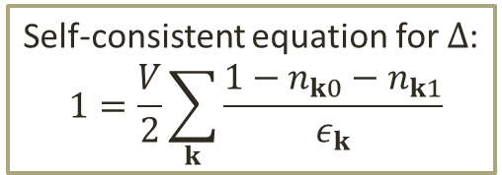
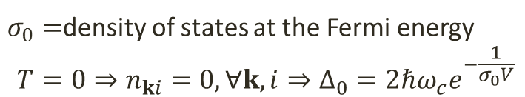
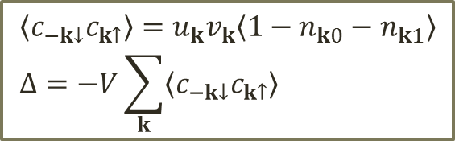
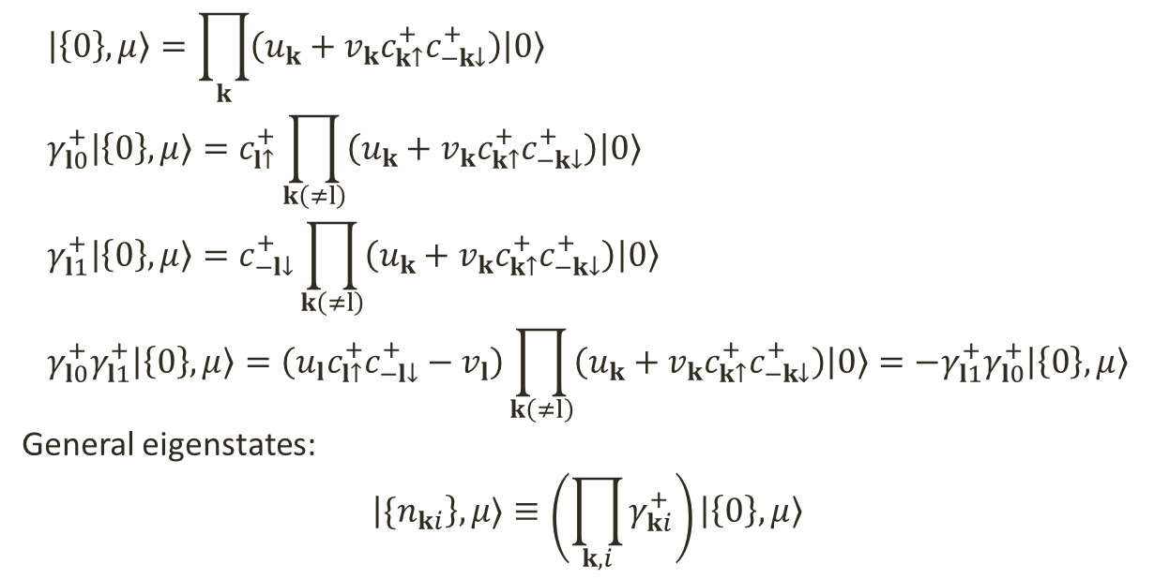
Eigenvectors of the model Hamiltonian and the gap equation
$$c_{k↑}=u_{k}^{∗}γ_{k0}+v_{k}^{}γ_{k1}^{+} \\ c_{−k↓}^{+}={−v}_{k}^{∗}γ_{k0}+u_{k}^{}γ_{k1}^{+} \\ v_{k}^{2}=1−u_{k}^{2}=\frac{1}{2}\left(1−\frac{ξ_{k}}{ε_{k}}\right)$$
$$|\left\{0\right\},μ〉=\prod_{k}{\left(u_{k}+v_{k}c_{k↑}^{+}c_{−k↓}^{+}\right)|0〉} \\ γ_{l0}^{+}|\left\{0\right\},μ〉=c_{l↑}^{+}\prod_{k\left(≠l\right)}{\left(u_{k}+v_{k}c_{k↑}^{+}c_{−k↓}^{+}\right)|0〉} \\ γ_{l1}^{+}|\left\{0\right\},μ〉=c_{−l↓}^{+}\prod_{k\left(≠l\right)}{\left(u_{k}+v_{k}c_{k↑}^{+}c_{−k↓}^{+}\right)|0〉} \\ γ_{l0}^{+}γ_{l1}^{+}|\left\{0\right\},μ〉=\left(u_{l}c_{l↑}^{+}c_{−l↓}^{+}−v_{l}\right)\prod_{k\left(≠l\right)}{\left(u_{k}+v_{k}c_{k↑}^{+}c_{−k↓}^{+}\right)|0〉}={−γ_{l1}^{+}γ}_{l0}^{+}|\left\{0\right\},μ〉$$
General eigenstates:
$$\left|{\{n}_{ki}\right\},μ〉≡\left(\prod_{k,i}{γ_{ki}^{+}}\right)|\left\{0\right\},μ〉$$
$$〈c_{−k↓}c_{k↑}〉=u_{k}v_{k}〈1−n_{k0}−n_{k1}〉 \\ Δ=−V\sum_{k}{〈c_{−k↓}c_{k↑}〉}$$
Self-consistent equation for $Δ$:
$$1=\frac{V}{2}\sum_{k}{\frac{1−n_{k0}−n_{k1}}{ε_{k}}}$$
$$ξ_{k}≡ε_{k}^{\left(0\right)}−μ$$
Middle of the attraction band
$σ_{0}=$density of states at the Fermi energy
$$T=0⇒n_{ki}=0, ∀k,i⇒Δ_{0}=2ℏω_{c}e^{−\frac{1}{σ_{0}V}}$$
$V_{kl}=V$, for $ξ∈\left[−ℏω_{c},ℏω_{c}\right]$

Slide 14
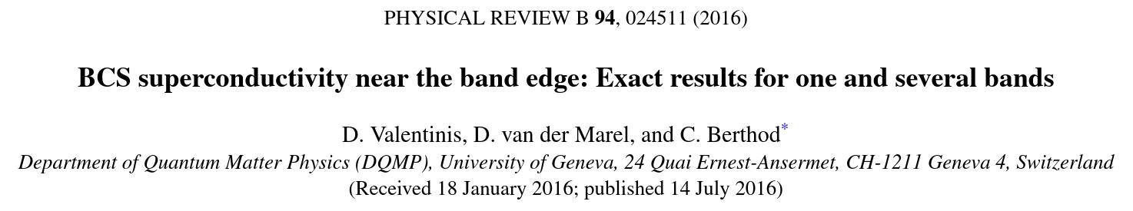
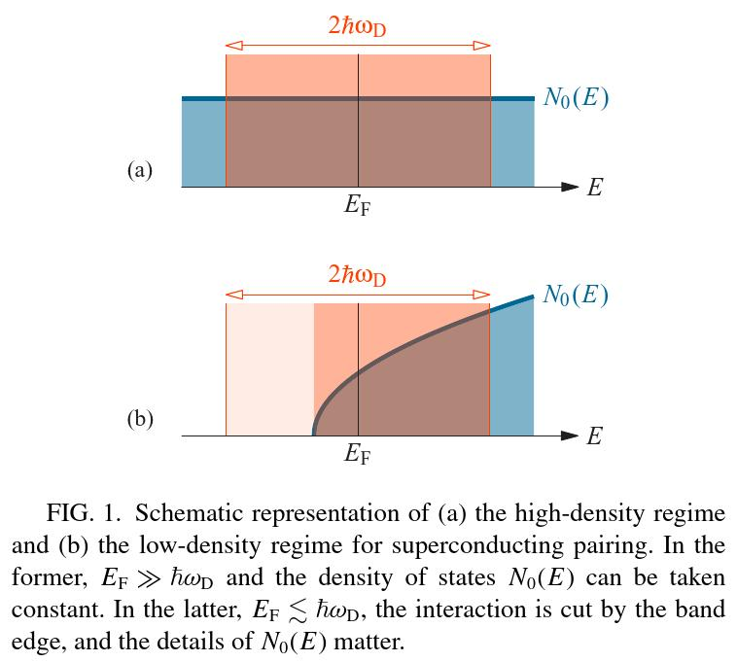
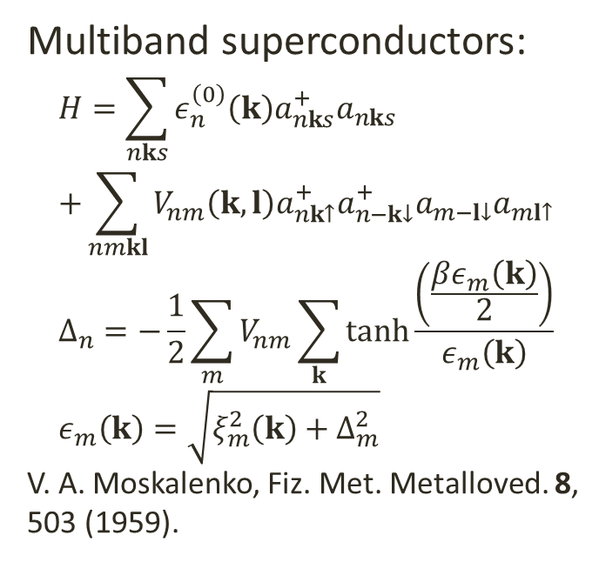
Energy bands and models of pairing potentials
Multiband superconductors:
$$H=\sum_{nks}{ε_{n}^{\left(0\right)}\left(k\right)a_{nks}^{+}a_{nks}} \\ +\sum_{nmkl}{V_{nm}\left(k,l\right)a_{nk↑}^{+}a_{n−k↓}^{+}a_{m−l↓}a_{ml↑}} \\ Δ_{n}=−\frac{1}{2}\sum_{m}{V_{nm}\sum_{k}{\tanh{\frac{\left(\frac{βε_{m}\left(k\right)}{2}\right)}{ε_{m}\left(k\right)}}}} \\ ε_{m}\left(k\right)=\sqrt{ξ_{m}^{2}\left(k\right)+Δ_{m}^{2}}$$
V. A. Moskalenko, Fiz. Met. Metalloved. 8,
503 (1959).

Slide 15
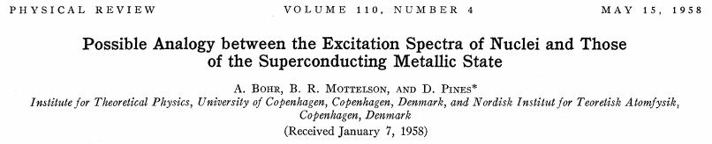
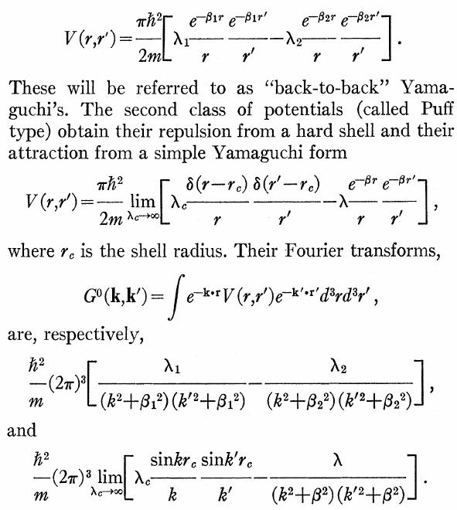
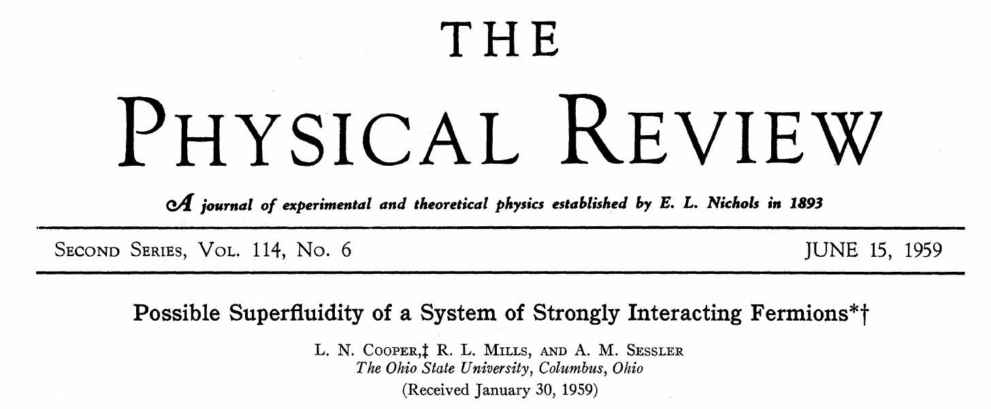
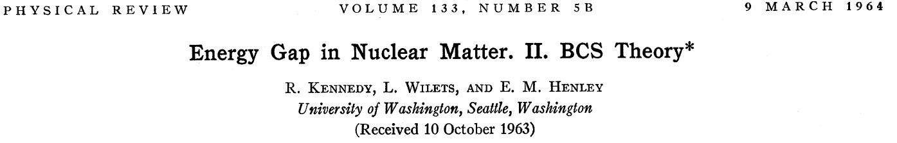
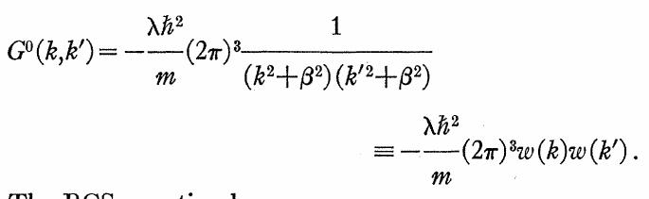
Applications in nuclear physics

Slide 16
Equilibrium distribution of the system in contact with a reservoir

Slide 17
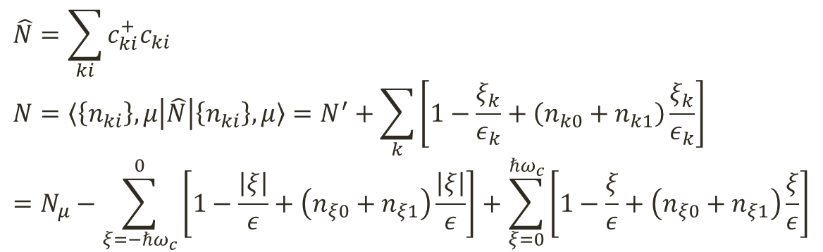
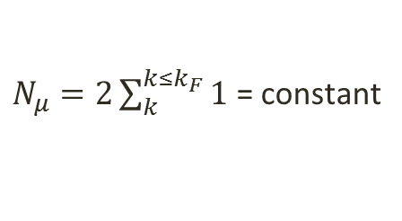
The total number of particles
$$\hat{N}=\sum_{ki}{c_{ki}^{+}c_{ki}} \\ N=〈\left\{n_{ki}\right\},μ\left|\hat{N}\right|\left\{n_{ki}\right\},μ〉=N^{′}+\sum_{k}{\left[1−\frac{ξ_{k}}{ε_{k}}+\left(n_{k0}+n_{k1}\right)\frac{ξ_{k}}{ε_{k}}\right]} \\ =N_{μ}−\sum_{ξ=−ℏω_{c}}^{0}{\left[1−\frac{\left|ξ\right|}{ε}+\left(n_{ξ0}+n_{ξ1}\right)\frac{\left|ξ\right|}{ε}\right]}+\sum_{ξ=0}^{ℏω_{c}}{\left[1−\frac{ξ}{ε}+\left(n_{ξ0}+n_{ξ1}\right)\frac{ξ}{ε}\right]}$$
Number of particles outside the interval $\left[μ−ℏω_{c},μ+ℏω_{c}\right]$
$N_{μ}=2\sum_{k}^{k≤k_{F}}{1}$ = constant

Slide 18

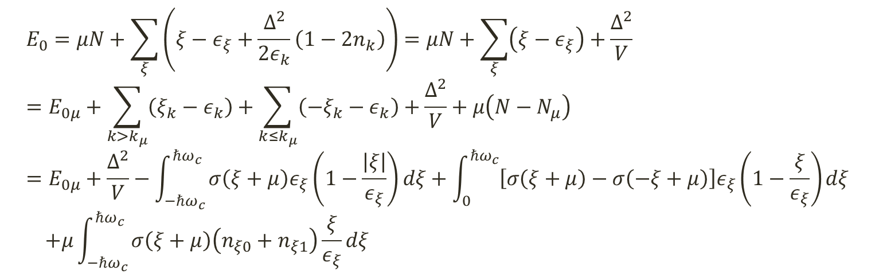
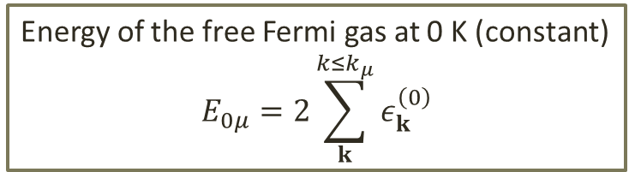
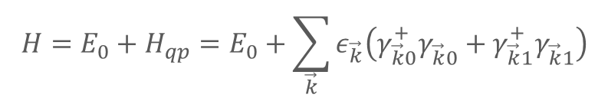

The energy of the system
$$H=E_{0}+H_{qp}=E_{0}+\sum_{\vec{k}}{ε_{\vec{k}}\left(γ_{\vec{k}0}^{+}γ_{\vec{k}0}^{}+γ_{\vec{k}1}^{+}γ_{\vec{k}1}^{}\right)}$$
The quasiparticle contribution
The condensate contribution
$$E_{0}=μN+\sum_{ξ}{\left(ξ−ε_{ξ}+\frac{Δ^{2}}{2ε_{k}}\left(1−2n_{k}\right)\right)}=μN+\sum_{ξ}{\left(ξ−ε_{ξ}\right)}+\frac{Δ^{2}}{V} \\ =E_{0μ}+\sum_{k>k_{μ}}{\left(ξ_{k}−ε_{k}\right)}+\sum_{k≤k_{μ}}{\left({−ξ}_{k}−ε_{k}\right)}+\frac{Δ^{2}}{V}+μ\left(N−N_{μ}\right) \\ =E_{0μ}+\frac{Δ^{2}}{V}−\int_{−ℏω_{c}}^{ℏω_{c}}{σ\left(ξ+μ\right)ε_{ξ}\left(1−\frac{\left|ξ\right|}{ε_{ξ}}\right)dξ}+\int_{0}^{ℏω_{c}}{\left[σ\left(ξ+μ\right)−σ\left(−ξ+μ\right)\right]ε_{ξ}\left(1−\frac{ξ}{ε_{ξ}}\right)dξ} \\ +μ\int_{−ℏω_{c}}^{ℏω_{c}}{σ\left(ξ+μ\right)\left(n_{ξ0}+n_{ξ1}\right)\frac{ξ}{ε_{ξ}}dξ}$$
$$E_{01}$$
$$E_{qp}$$
Energy of the free Fermi gas at 0 K (constant)
$$E_{0μ}=2\sum_{k}^{k≤k_{μ}}{ε_{k}^{\left(0\right)}}$$

Slide 19
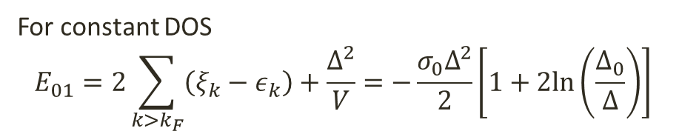
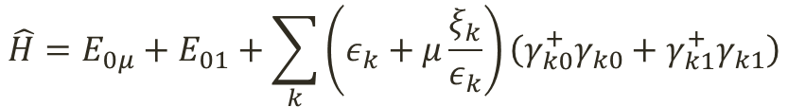
The energy of the system
$$\hat{H}=E_{0μ}+E_{01}+\sum_{k}{\left(ε_{k}+μ\frac{ξ_{k}}{ε_{k}}\right)\left(γ_{k0}^{+}γ_{k0}+γ_{k1}^{+}γ_{k1}\right)}$$
For constant DOS
$$E_{01}=2\sum_{k>k_{F}}{\left(ξ_{k}−ε_{k}\right)}+\frac{Δ^{2}}{V}=−\frac{σ_{0}Δ^{2}}{2}\left[1+2ln\left(\frac{Δ_{0}}{Δ}\right)\right]$$

Slide 20

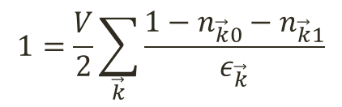


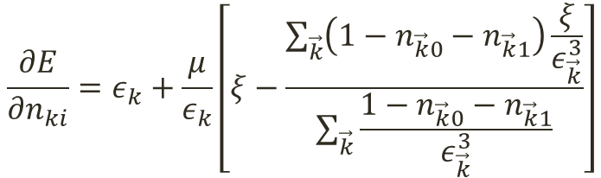
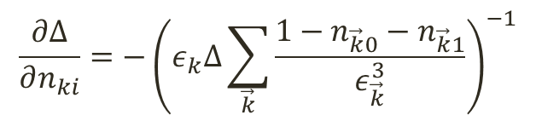
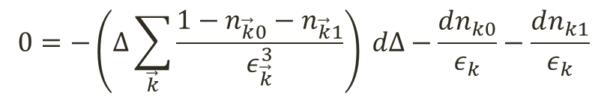
The variation of the energy with the number of quasiparticles
$$\frac{∂E_{01}}{∂n_{ki}}=\frac{∂E_{01}}{∂Δ}\frac{∂Δ}{∂n_{ki}}≡ε_{ki}^{′} \\ \frac{∂E_{qp}}{∂n_{ki}}=ε_{k}+μ\frac{ξ}{ε}+\frac{∂E_{qp}}{∂Δ}\frac{∂Δ}{∂n_{ki}}=ε_{k}+ε_{k}^{′′} \\ \frac{∂E}{∂Δ}=\frac{∂\left(E_{01}+E_{qp}\right)}{∂Δ}=Δμ\sum_{\vec{k}}{\left(1−n_{\vec{k}0}−n_{\vec{k}1}\right)\frac{ξ}{ε_{\vec{k}}^{3}}}$$
$$1=\frac{V}{2}\sum_{\vec{k}}{\frac{1−n_{\vec{k}0}−n_{\vec{k}1}}{ε_{\vec{k}}}}$$
$$0=−\left(Δ\sum_{\vec{k}}{\frac{1−n_{\vec{k}0}−n_{\vec{k}1}}{ε_{\vec{k}}^{3}}}\right) dΔ−\frac{dn_{k0}}{ε_{k}}−\frac{dn_{k1}}{ε_{k}}$$
$$\frac{∂Δ}{∂n_{ki}}=−{\left(ε_{k}Δ\sum_{\vec{k}}{\frac{1−n_{\vec{k}0}−n_{\vec{k}1}}{ε_{\vec{k}}^{3}}}\right)}^{−1}$$
$$\frac{∂E}{∂n_{ki}}=ε_{k}+\frac{μ}{ε_{k}}\left[ξ−\frac{\sum_{\vec{k}}{\left(1−n_{\vec{k}0}−n_{\vec{k}1}\right)\frac{ξ}{ε_{\vec{k}}^{3}}}}{\sum_{\vec{k}}{\frac{1−n_{\vec{k}0}−n_{\vec{k}1}}{ε_{\vec{k}}^{3}}}}\right]$$
$$\frac{∂N}{∂Δ}=Δ\sum_{\vec{k}}{\frac{1−n_{\vec{k}0}−n_{\vec{k}1}}{ε_{\vec{k}}^{3}}} \\ \frac{∂N}{∂n_{ki}}=\frac{ξ_{k}}{ε_{k}}$$
$$\frac{∂N}{∂n_{ki}}=\frac{1}{ε_{k}}\left[ξ−\frac{\sum_{\vec{k}}{\left(1−n_{\vec{k}0}−n_{\vec{k}1}\right)\frac{ξ}{ε_{\vec{k}}^{3}}}}{\sum_{\vec{k}}{\frac{1−n_{\vec{k}0}−n_{\vec{k}1}}{ε_{\vec{k}}^{3}}}}\right]$$

Slide 21
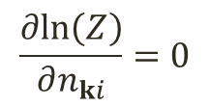
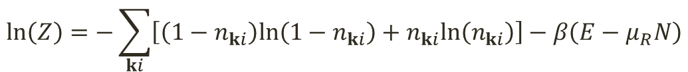


Equilibrium configuration
The system is in contact with a heat and particle reservoir, at temperature $T$ and chemical potential $μ_{R}$.
We calculate the partition function and we maximize it (introducing $β=1/k_{B}T$):
$$ln\left(Z\right)=−\sum_{ki}{\left[\left(1−n_{ki}\right)ln\left(1−n_{ki}\right)+n_{ki}ln\left(n_{ki}\right)\right]}−β\left(E−μ_{R}N\right)$$
$$\frac{∂ln\left(Z\right)}{∂n_{ki}}=0$$
$$0=ln\left(\frac{1−n_{ki}}{n_{ki}}\right)−β\left\{ε_{k}−\frac{μ_{R}−μ}{ε_{k}}\left[ξ_{k}−\frac{\sum_{\vec{k}}{\left(1−n_{\vec{k}0}−n_{\vec{k}1}\right)\frac{ξ}{ε_{\vec{k}}^{3}}}}{\sum_{\vec{k}}{\frac{1−n_{\vec{k}0}−n_{\vec{k}1}}{ε_{\vec{k}}^{3}}}}\right]\right\}$$
$$n_{ki}=\frac{1}{e^{β\left(ε_{k}−\tilde{μ}\right)}+1} \\ \tilde{μ}=\frac{μ_{R}−μ}{ε_{k}}\left[ξ_{k}−\frac{\sum_{\vec{k}}{\left(1−n_{\vec{k}0}−n_{\vec{k}1}\right)\frac{ξ}{ε_{\vec{k}}^{3}}}}{\sum_{\vec{k}}{\frac{1−n_{\vec{k}0}−n_{\vec{k}1}}{ε_{\vec{k}}^{3}}}}\right]$$

Slide 22



Equilibrium configuration for constant DOS
$$n_{ki}=\frac{1}{e^{β\left(ε_{k}−\tilde{μ}\right)}+1} \\ \tilde{μ}=\frac{μ_{R}−μ}{ε_{k}}\left[ξ_{k}−\frac{\sum_{\vec{k}}{\left(1−n_{\vec{k}0}−n_{\vec{k}1}\right)\frac{ξ}{ε_{\vec{k}}^{3}}}}{\sum_{\vec{k}}{\frac{1−n_{\vec{k}0}−n_{\vec{k}1}}{ε_{\vec{k}}^{3}}}}\right]$$
$$y=βΔ \\ y_{R}=β\left(μ_{R}−μ\right) \\ x_{F}=β\frac{\sum_{\vec{k}}{\left(1−n_{\vec{k}0}−n_{\vec{k}1}\right)\frac{ξ}{ε_{\vec{k}}^{3}}}}{\sum_{\vec{k}}{\frac{1−n_{\vec{k}0}−n_{\vec{k}1}}{ε_{\vec{k}}^{3}}}}$$
DOS $σ_{0}$
$$x_{F}=\frac{\int_{y}^{βℏω_{c}}{\frac{n_{−x}−n_{x}}{x^{2}}dx}}{\int_{y}^{βℏω_{c}}{\frac{1−n_{−x}−n_{x}}{x^{2}\sqrt{x^{2}−y^{2}})}dx}} \\ n_{x}={\left\{exp\left[x−\frac{y_{R}\left(\sqrt{x^{2}−y^{2}}−x_{F}\right)}{x}\right]+1\right\}}^{−1} ←ξ>0 \\ n_{−x}={\left\{exp\left[x−\frac{y_{R}\left(−\sqrt{x^{2}−y^{2}}−x_{F}\right)}{x}\right]+1\right\}}^{−1}←ξ<0 \\ \frac{1}{σ_{0}V}=\int_{y}^{βℏω_{c}}{\frac{{1−n}_{−x}−n_{x}}{\sqrt{x^{2}−y^{2}}}dx}$$

Slide 23



Results at finite T
There are solutions for $Δ$ only if $\left|μ_{R}−μ\right|<2Δ_{0}$

Slide 24









Calculations at T=0
$$x_{F}=\frac{\int_{y}^{βℏω_{c}}{\frac{n_{−x}−n_{x}}{x^{2}}dx}}{\int_{y}^{βℏω_{c}}{\frac{1−n_{−x}−n_{x}}{x^{2}\sqrt{x^{2}−y^{2}})}dx}} \\ n_{ξ_{x}}={\left\{exp\left[x−\frac{y_{R}\left(\sqrt{x^{2}−y^{2}}−x_{F}\right)}{x}\right]+1\right\}}_{}^{−1} \\ n_{−ξ_{x}}={\left\{exp\left[x−\frac{y_{R}\left(−\sqrt{x^{2}−y^{2}}−x_{F}\right)}{x}\right]+1\right\}}_{}^{−1} \\ \frac{1}{σ_{0}V}=\int_{y}^{βℏω_{c}}{\frac{{1−n}_{−x}−n_{x}}{\sqrt{x^{2}−y^{2}}}dx}$$
$$r≡\frac{ε}{Δ}=\frac{x}{y}≥1, a=\frac{μ_{R}−μ}{Δ}=\frac{y_{R}}{y}, b=\frac{F}{Δ}=\frac{x_{F}}{y}$$
$$n_{ξ_{x}}≡{\left[exp\left(βm_{ξ_{x}}\right)+1\right]}^{−1} \\ n_{−ξ_{x}}≡{\left[exp\left(βm_{−ξ_{x}}\right)+1\right]}^{−1} \\ m_{ξ_{x}}=\frac{Δ}{r}\left(r^{2}−a\sqrt{r^{2}−1}+ab\right) \\ m_{−ξ_{x}}=\frac{Δ}{r}\left(r^{2}+a\sqrt{r^{2}−1}+ab\right)$$
$$≶0$$
$$m_{ξ_{x}}=\frac{Δ}{\sqrt{t^{2}+1}}\left(t^{2}−at+ab+1\right) \\ m_{−ξ_{x}}=\frac{Δ}{\sqrt{t^{2}+1}}\left(t^{2}+at+ab+1\right)$$
$$t=\sqrt{r^{2}−1}$$
$$t_{1}=\frac{a−\sqrt{D}}{2},t_{2}=\frac{a+\sqrt{D}}{2}$$
$$t_{1}^{′}=−t_{2}, t_{2}^{′}=−t_{1}$$
$$D=a^{2}−4ab−4>0$$

Slide 25






Results at T=0
Two solutions for $Δ$ even if $μ_{R}=μ$
Quasiparticle imbalance

Slide 26





Multiple results at finite temperatures
$$1=\frac{V}{2} \sum_{k}{\frac{1−n_{k0}−n_{k1}}{ε_{k}}}$$
$$n_{ki}=\frac{1}{e^{β\left(ε_{k}−{\tilde{μ}}_{k}\right)}+1} \\ {\tilde{μ}}_{k}≡\frac{μ_{R}−μ}{ε_{k}}\left[ξ_{k}−\frac{\sum_{k}{\left(1−n_{k0}−n_{k1}\right)ξ_{k}ε_{k}^{−3}}}{\sum_{k}{\left(1−n_{k0}−n_{k1}\right)ε_{k}^{−3}}}\right]$$
$$\frac{2}{σ_{0}V}=\int_{−ℏω_{c}}^{ℏω_{c}}{\frac{1−2n_{ξ}}{\sqrt{ξ^{2}+Δ^{2}}}dξ}$$
$F\left(μ_{R}−μ\right)≡$ $\frac{\int_{−ℏω_{c}}^{ℏω_{c}}{\left(1−2n_{ξ}\right)\frac{ξ}{ε^{3}}dξ}}{\int_{−ℏω_{c}}^{ℏω_{c}}{\frac{1−2n_{ξ}}{ε^{3}}dξ}}$
$$n_{ξ}\left(μ_{R}−μ\right)=\frac{1}{e^{β\left[ε_{ξ}−\frac{\left(μ_{R}−μ\right)\left(ξ−F\right)}{ε_{ξ}}\right]}+1}$$

Slide 27



Two solutions even when $μ_{R}=μ$
$$M_{1,2}\left(μ_{R}−μ, T\right)≡\left(μ_{R}−μ\right)F_{1,2}\left(μ_{R}−μ, T\right), M_{1,2}^{\left(0\right)}\left(T\right)≡\lim_{μ_{R}→μ} M_{1,2}\left(μ_{R}−μ, T\right)$$

Slide 28
Conclusions

Slide 29

We differentiate between $μ$, the center of the free-particle energy interval in which the pairing interaction is manifested ($V_{kl}≠0$), and the chemical potential of the system, which is determined by the external conditions.
If $μ≠μ_{R}$, the results differ quantitatively and qualitatively from the BCS results:
  first order superconductor-normal metal phase transition
  quasiparticle imbalance in equilibrium
  formation of a structure like the superconducting dome
If $\left|μ−μ_{R}\right|>2Δ_{0}$, the superconducting phase does not exist.
There are two solutions for the energy gap equation, even at $μ=μ_{R}$

