Slide 1
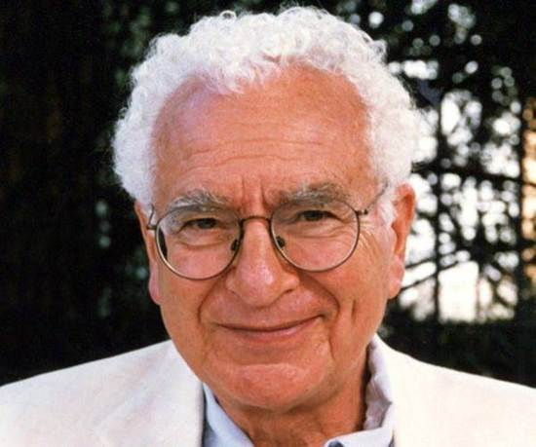
From SU(3) to 3 quark families: completing the picture of matter constituents
ICNFP VIII, Kolymbari, 26 August 2019
Gell-Mann memorial session
c
t
b
Tommaso Dorigo, INFN – Sezione di Padova

Slide 2
Prologue
The scenery in which arose the bold prediction of hadron constituents by Murray Gell-Mann and George Zweig in 1964 was a very confusing one, both theoretically and experimentally
The same Gell-Mann found the idea of quarks difficult to reconcile with the ideas of "nuclear democracy", whereby baryons would contain mesons and mesons would contain baryons – little space was left to quarks
On the experimental side, experimentalists soon started to look for objects that would not fit in the eightfold way – exotic hadrons
Three stories on that exciting, crazy time may serve as a prologue to a recollection of how we played the endgame of the Standard Model verification
Free quark speculations from in airborne bubble chamber tracks
Arthur Rosenfeld and the 5-sigma criterion
Leon Lederman's shoulder

Slide 3
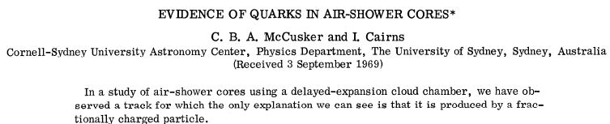
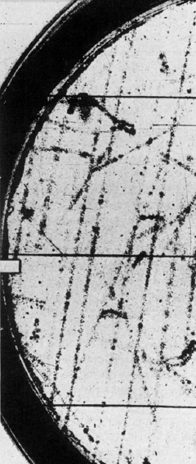
PRL 23, 658 (1969)
In 1968 the gentlemen named in the above clip observed four tracks in a Wilson chamber whose apparent ionization was compatible with the one expected for particles of charge ²/₃ e.
Successively, they published a paper where they showed a track which could not be anything but a fractionary charge particle!
In fact, it produced 110 counted droplets per unit path length against an expectation of 229 (from the 55,000 observed tracks).
The probability of such a phenomenon must be very small, right?
Note that if you are strong in nuclear physics and thermodynamics, you may know that a scattering interaction produces on
average about four droplets. The scattering and the
droplet formation are independent Poisson processes.
However, this subtlety might escape those of us who do not pay
attention to Statistics...

Slide 4
The Compound Poisson distribution
We all know what the Poisson distribution is:
  The expectation value of a Poisson variable with mean μ is E(n) = μ
  its variance is V(n) = μ
Less known than the Poisson is the compound Poisson distribution, which describes the sum of N Poisson variables, all of mean μ, when N is also a Poisson variable of mean λ:
  Obviously the expectation value is E(n)=λμ
  The variance is V(n) = λμ(1+μ)
One seldom has to do with this distribution in practice. Yet it is necessary for a physicist to know it exists, and to recognize it is different from the simple Poisson distribution.

Slide 5
Significance of the observation
Approximate treatment: single Poisson process, with μ=229:
  Since they observed 55,000 tracks, seeing at least one track with P = 1.6x10⁻¹⁸ has a chance of occurring of 1-(1-P)⁵⁵⁰⁰⁰, or about 10⁻¹³
  But this is incorrect, as we know the sampling distribution is a compound Poisson. Can we say it's a fair approximation, though ? Hmmm, let's check the correct calculation...
Correct treatment: compound Poisson process, with λμ=229, μ=4:
  One should rather compute
  from which one gets that the probability of seeing at least one such track is rather 1-(1-P’)⁵⁵⁰⁰⁰, or 92.5%. Ooops!

Slide 6
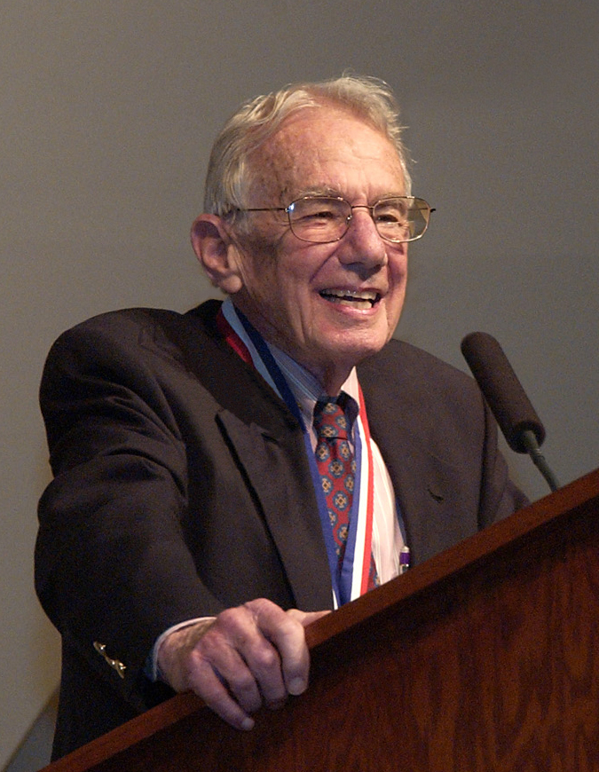
The Birth of the Five-Sigma Criterion
Arthur H. Rosenfeld (Univ. Berkeley)

Slide 7
Far-Out Hadrons
In 1968 Rosenfeld wrote a paper titled "Are There Any Far-out Mesons or Baryons?“, where he demonstrated that the number of published claims of discovery of exotic particles agreed with the number of statistical fluctuations that one would expect in the analyzed datasets.
The issue: large trial factors coming into play due to the massive use of combinations of observed particles in deriving mass spectra containing potential resonances
  “[...] This reasoning on multiplicities, extended to all combinations of all outgoing particles and to all countries, leads to an estimate of 35 million mass combinations calculated per year. How many histograms are plotted from these 35 million combinations? A glance through the journals shows that a typical mass histogram has about 2,500 entries, so the number we were looking for, h is then 15,000 histograms per year […]"

Slide 8
More Rosenfeld
  “[...] Our typical 2,500 entry histogram seems to average 40 bins. This means that therein a physicist could observe 40 different fluctuations one bin wide, 39 two bins wide, 38 three bins wide...”
“[...] I conclude that each of our 150,000 annual histograms is capable of generating somewhere between 10 and 100 deceptive upward fluctuations”.
That was indeed a problem ! Rosenfeld concluded:
“[...] To the theorist or phenomenologist the moral is simple: wait for nearly 5σ effects. For the experimental group who has spent a year of their time and perhaps a million dollars, the problem is harder... go ahead and publish... but they should realize that any bump less than about 5σ calls for a repeat of the experiment.”
  The 5-sigma criterion, born in 1968, was not immediately accepted. It played a crucial role over 25 years later, as we will see below

Slide 9
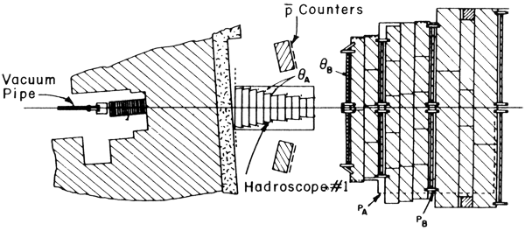
A notable experiment
At the AGS, 30-GeV protons were seen to produce muons in beam dump interactions, which were believed to come from W boson decays. However, Y. Yamaguchi (1966) and L. Okun (1966) pointed out they could be the result of virtual photon interactions
So Lederman, Limon, Christenson, and Zavattini in 1967-69 study proton-Uranium collisions in search of muon pairs, to understand the properties of virtual photon production of lepton pairs and to see if the expected smooth spectrum is interrupted by vector meson resonances
Alas, their spectrometer measures the muon momenta by range in steel...

Slide 10
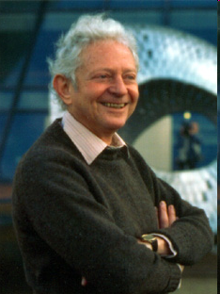
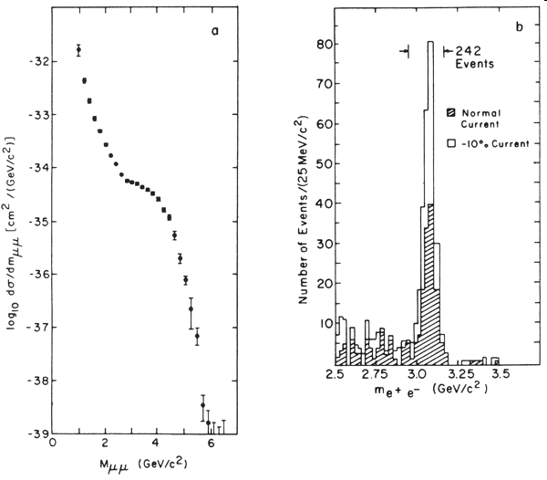
Lederman's Shoulder
"The yield of muon pairs decreased rapidly from 1 GeV to the kinematic limit of nearly 6 GeV with the exception of a curious shoulder near 3 GeV. The measurement of muons was by range as determined by liquid and plastic scintillation counters interspersed with steel shielding. Each angular bin (there were 18) had four range bins, and for two muons this made a total of only 5000 mass bins into which to sort the data. Multiple scattering in the minimum of 10 feet of steel made finer binning useless. Thus we could only note that "Indeed, in the mass region near 3.5 GeV, the observed spectrum may be reproduced by a composite of a resonance and a steeper continuum."
In 1974, Aubert et al. resolve
the resonance (more later)
(http://history.fnal.gov/GoldenBooks/gb_lederman.html):

Slide 11
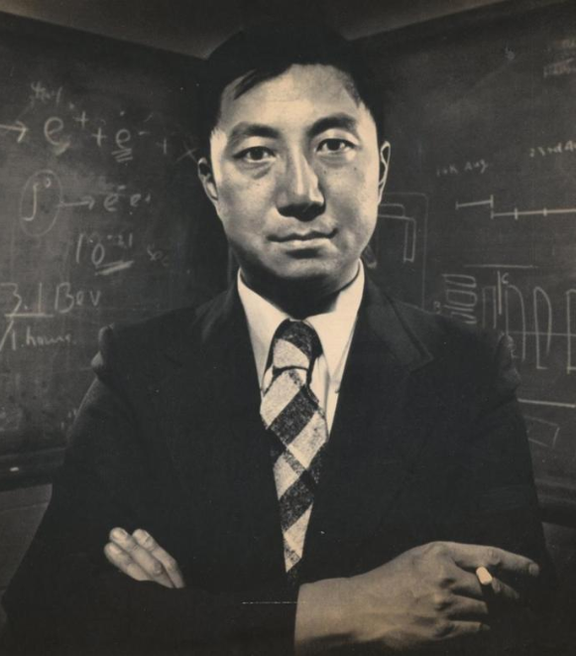
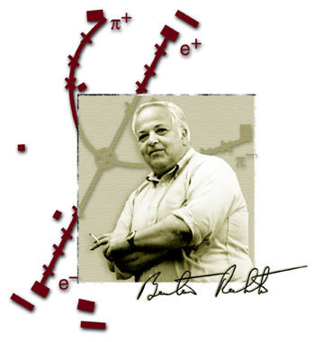
Toward charm
Apparently, to discover charm striking a pose with crossed arms is not sufficient:
you also need a poker face and a smoke

Slide 12
More than three?
In the early '70 two theoretical inputs already suggested that quarks could be more than three. Maybe 4, or maybe even at least six.
It is important to note that these theoretical ideas arose from experimental input!
An extension to 4 flavours was suggested to account for the failure to observe neutral kaon decays to muon pairs
  The possible explanation of that phenomenon is put forth by Glashow, Iliopoulos and Maiani
A small CP symmetry violation in weak decays of neutral kaons is observed in 1964 by Christenson, Cronin, Fitch and Turlay.
  → This is the input to the speculation on a 3-family structure by Kobayashi and Maskawa

Slide 13
K decays
μ
The charged kaon (K⁺, e.g.) is composed in the static quark model by an up quark and an anti-s quark. Its mass is 494 MeV, and it decays mostly into muon-neutrino pairs (μ⁺ν), 63% of the time, or to two pions (π⁺π⁰), or other final states
The neutral kaon (K⁰_{L}, e.g.) is a d quark bound to an anti-s quark. Its mass is 498 MeV, and it decays to various final states (3 pions, πeν, πμν). The branching fraction to muon pairs, K⁰→μμ, is of 7*10⁻⁷.
The question is: if there exist both charged and neutral weak currents, what prevents neutral kaons from decaying into μ⁺μ⁻?
u
W
K⁺
s
ν
Β.R.=0.63
?
μ
d
Z
K⁰
s
μ
Β.R.=0.0000007
To understand it we
need to recall the
Cabibbo angle

Slide 14
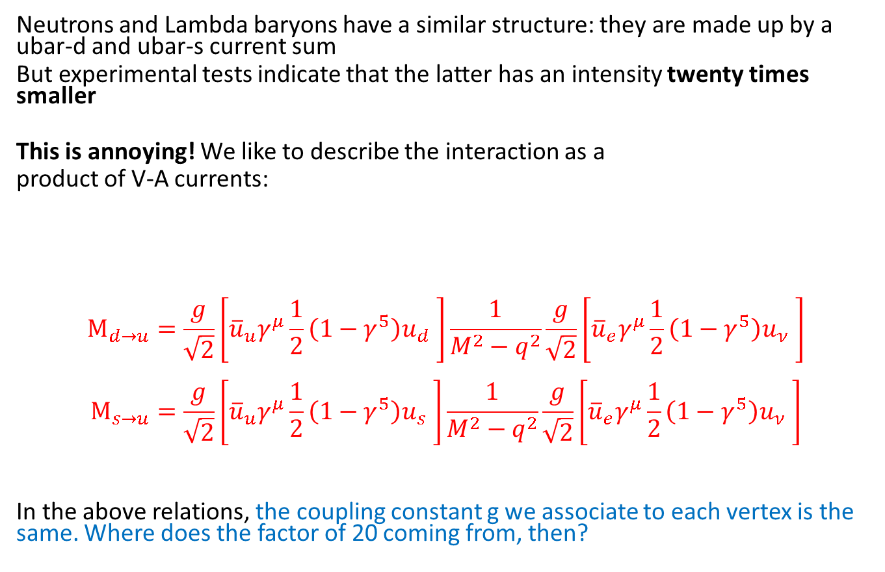
Charged current universality
Neutrons and Lambda baryons have a similar structure: they are made up by a ubar-d and ubar-s current sum
But experimental tests indicate that the latter has an intensity twenty times smaller
This is annoying! We like to describe the interaction as a
product of V-A currents:
$$M_{d→u}=\frac{g}{\sqrt{2}}\left[{{\overline{u}}_{u}^{}γ}^{μ}\frac{1}{2}\left(1−γ^{5}\right)u_{d} \right]\frac{1}{M^{2}−q^{2}}\frac{g}{\sqrt{2}}\left[{{\overline{u}}_{e}^{}γ}^{μ}\frac{1}{2}\left(1−γ^{5}\right)u_{ν} \right]$$
$$M_{s→u}=\frac{g}{\sqrt{2}}\left[{{\overline{u}}_{u}^{}γ}^{μ}\frac{1}{2}\left(1−γ^{5}\right)u_{s} \right]\frac{1}{M^{2}−q^{2}}\frac{g}{\sqrt{2}}\left[{{\overline{u}}_{e}^{}γ}^{μ}\frac{1}{2}\left(1−γ^{5}\right)u_{ν} \right]$$
In the above relations, the coupling constant g we associate to each vertex is the same. Where does the factor of 20 coming from, then?
d (s)
u
g
g
ν
e

Slide 15
The Cabibbo angle
To preserve the universality of the weak current, Cabibbo had formulated in 1963 a mixing of strong interaction eigenstates (u,d,s) by an angle theta as
d’ = d cos θ + s sin θ
This indicates that strong and weak interactions see different properties of quarks
Following this transformation, amplitudes of weak neutral currents with Δs=0 and Δs=1 depend on cosθ and sinθ, and intensities and lifetimes on cos²θ and sin²θ:
J_{μ}⁺(ud) ~ g cosθ for Δs=0 currents
J_{μ}⁺(us) ~ g sinθ for Δs=1 currents
For the Cabibbo angle one can then estimate a value of about 13 degrees. E.g. for neutron and lambda decays
Γ(Λ→peν) / Γ(n→peν) ~ g⁴ sin²θ/g⁴ cos²θ
(on top of it one must of course account for PS factors)
Γ(μ→eνν) ~ g⁴
Γ(n→peν) ~ g⁴cos²θ_{C}
Γ(Λ→peν) ~ g⁴sin²θ_{C}

Slide 16
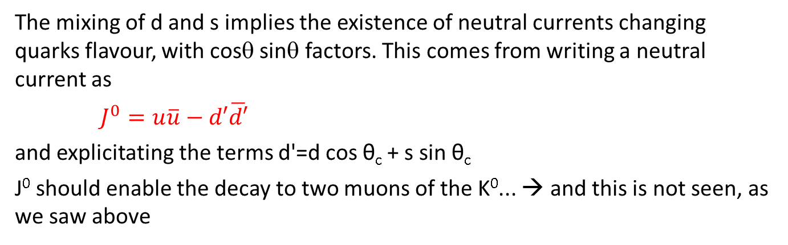
The GIM mechanism
The mixing of d and s implies the existence of neutral currents changing quarks flavour, with cosθ sinθ factors. This comes from writing a neutral current as
$J^{0}=u\overline{u}−d′\overline{d′}$
and explicitating the terms d'=d cos θ_{c} + s sin θ_{c}
J⁰ should enable the decay to two muons of the K⁰... → and this is not seen, as we saw above
d
g cosθ
g
μ
In 1970 Glashow, Iliopoulos and Maiani solve the problem radically: the existence of a fourth quark may cancel the mixing contribution, making neutral currents incapable of changing quark flavors at leading order
There remain box diagrams where the incomplete cancellation can be attributed to different quark masses → GIM thus predict that there be a fourth quark AND that its mass be in the 1-3 GeV range
u
ν
s
μ
g sinθ
g
d
g sinθ
g
μ
c
ν
s
μ
g cosθ
g

Slide 17
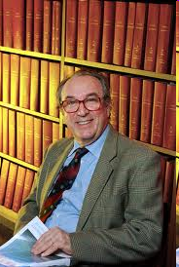
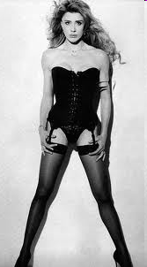

A Colour Note
In 2008 Luciano Maiani, after an illustrious career, is proposed as a new president for CNR (the largest research institute in Italy), in substitution of Fabio Pistella (who could boast three scientific publications and had been appointed by the Berlusconi government previously).
Ex soubrette Gabriella Carlucci, now a congressperson in Berlusconi's party, vocally questions Maiani's appointment, claiming that he “has not produced anything scientifically relevant". Carlucci even motivates this, by throwing discredit on other Italian theorists, among them Petronzio, Parisi, etc) discussing the mistakes of Maiani in his research!
“Maiani in 1969 had the luck to work for a semester in Harvard with Sheldon Glashow" (Nobel laureate in Physics in 1979), "with whom he published his only work of interest. A work which he signed but which he clearly did not understand since in 1974 he disowned it by publishing another work" (nota bene: together with Cabibbo, Parisi and Petronzio) "...where they confused elementary particles of different physical properties.”
Luckily Carlucci gets submerged by the ridicule she deserves, including by Glashow and Iliopoulos. For more detail see:
http://dorigo.wordpress.com/2008/02/22/glashow-humiliates-carlucci-on-maianis-appointment/

Slide 18
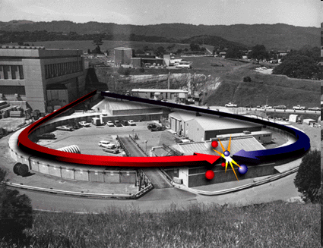
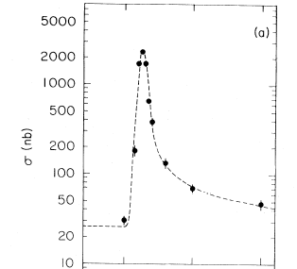
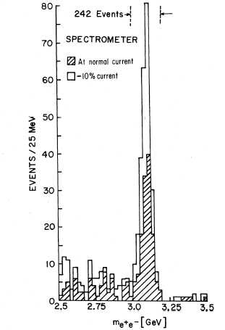
The charm discovery
In November 1974 two experiments see the J/ψ particle, immediately recognized as a charm-anticharm system
  Sam Ting et al. at Brookhaven (fixed target with 30 GeV protons on Beryllium) search for electron-positron resonances and sees a peak at 3.1 GeV
  Burton Richter et al. at SLAC (SPEAR e+e- collider) measure the cross section as a function of s, and see a large resonant structure at the same mass value
Also Adone (an e+e- collider in Frascati) observes the new particle and confirms the SPEAR result

Slide 19
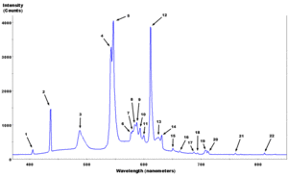
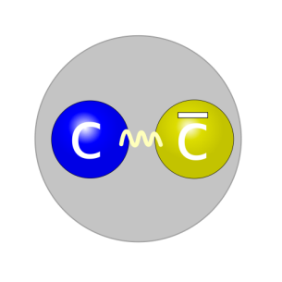
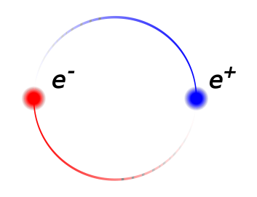
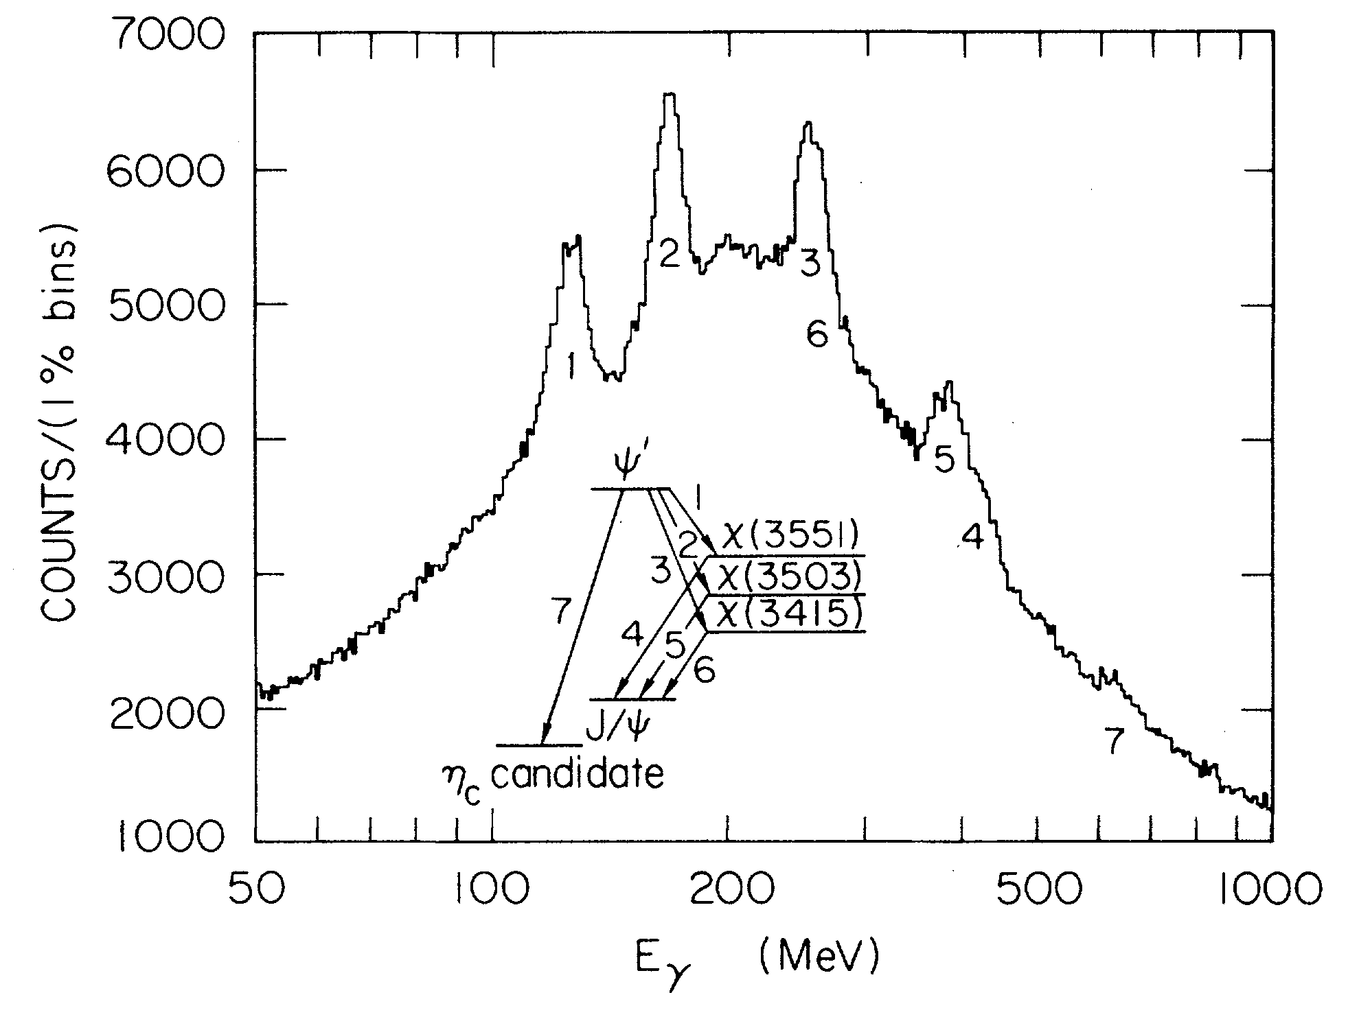
Charmonium proves the existence of quarks
The study of excited states of charmonium, soon performed by the Crystal Ball experiment, allows to verify that the physics model (two interacting, point-like, charged particles orbiting one another) is accurate
Above: positronium spectrum;
Below: charmonium spectrum

Slide 20
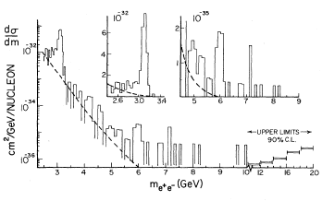
On to the b-quark: The Oops-Leon
The charm discovery, soon followed by the discovery of a third-generation lepton (the tau, by Martin Perl's team at SLAC in 1975) and the theoretical indication of CP violation all point to the existence of a third generation of quarks.
→ Several experiments start looking for a b-antib bound state
One of them is E288, Leon Lederman's experiment at FNAL: a double-arm spectrometer benefitting from 400-GeV proton collisions.
In 1976 the group publishes an article where they claim to have found it in muon pair decays at 6 GeV
  “Clusters of events as observed occurring anywhere from 5.5 to 10.0 GeV appeared less than 2% of the time⁸. Thus the statistical case for a narrow (<100 MeV) resonance is strong although we are aware of the need for a confirmation.”

Slide 21
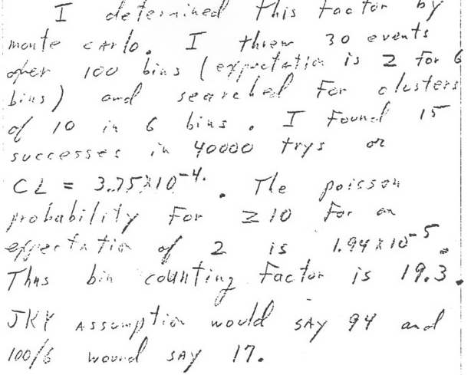
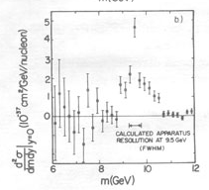
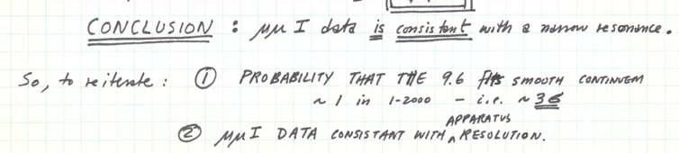

The true Upsilon
Nov 19th 1976
The true Upsilon (1977) discovery came slowly: burnt by the Oops-leon, the E288 scientists waited for a long time after seeing a >3 sigma peak at 9.5 GeV
  The final discovery announcement does not even mention an estimate of statistical significance
Nov 21st 1976
June 6th 1977

Slide 22
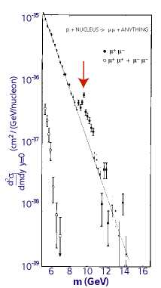
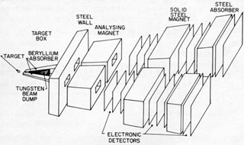
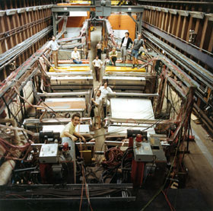
The b quark discovery at Fermilab
The E288 experiment observes an accumulation of dimuon events at masses in the 9-10 GeV range, soon identifying three different resonances: Y(1S,2S,3S).
The properties of the new quark are successively studied also at e⁺e⁻ colliders (PLUTO/DASP), confirming charge and weak isospin of the new quark

Slide 23
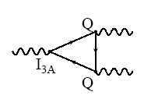
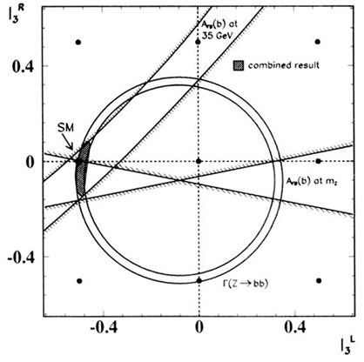
There must be a top
Once the b-quark is established there can be no doubts that a sixth quark, the top, is needed. There are several reasons:
Anomaly-free: renormalization of the theory is based on Ward identities, which require cancelation of anomalies from triangle diagrams connecting vector and axial currents
FCNC: UA1 first showed that there was no hint of B→ll, which should be 12% of B→lν if the b is an isosinglet
EW forward-backward asymmetry and other observables allowed to measure the weak isospin of the b quark – it had to have a partner
ARGUS finally measured a large B mixing, showing that a top quark had to contribute with a large mass (M>40 GeV)

Slide 24
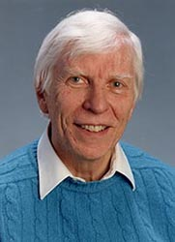
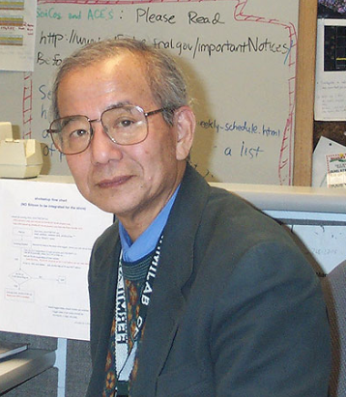
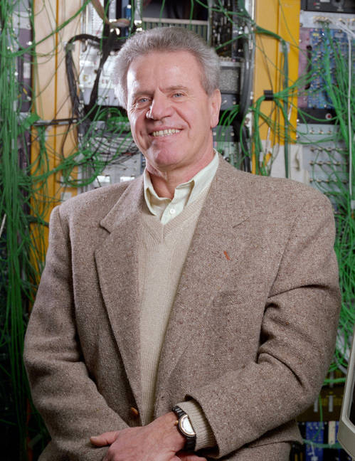
Building a detector for top
At the end of the '70, while the SppS was being built, FNAL responded with plans for an even higher-energy collider. After many other designs were discarded, Wilson's plan became to construct a 2-TeV proton-antiproton collider.
The detector project was put in the hands of Alvin Tollestrup, who convinced Kuni Kondo to "bring 5 people and 5 million dollars" to construct the collider detector. They were joined by Giorgio Bellettini from Italy.
Eventually CDF maintained, throughout its long history, a 15% contribution from Japanese scientists, as well as an even stronger Italian group

Slide 25
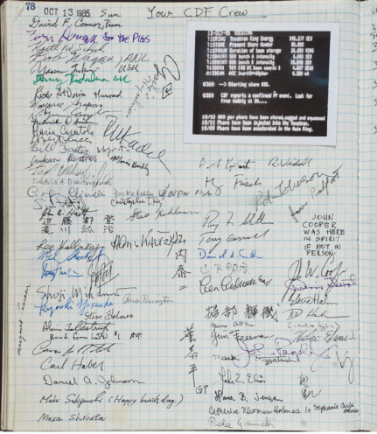
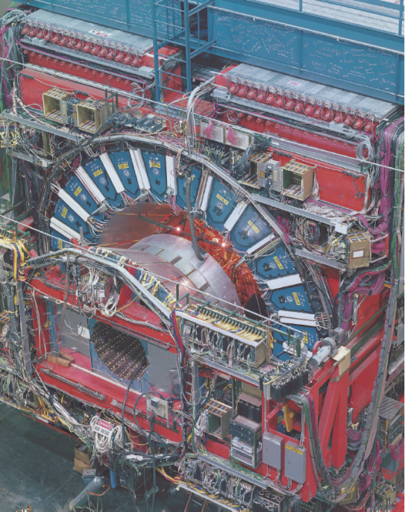
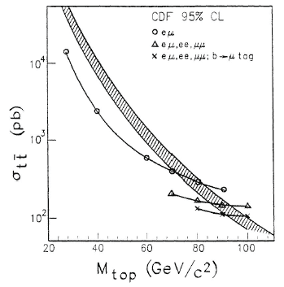
CDF and early claims
The CDF detector was built in the early '80s, and started operations in 1985
UA1 tried to find the top quark in their data and in 1987 produced a soon retracted discovery paper, where a dozen W+jet events not well modeled by the primitive MC then in place could infer a 40 GeV top mass.
CDF ran in 1987-88 collecting 4/pb of data, where one notable dilepton event candidate was seen. While the experiment only set a lower limit on the top mass, three physicists (Dalitz, Goldstein, Sliwa) published independently a kinematic analysis, claiming the event was a top pair decay...
For the next run, due to start in 1992, CDF would be joined by the competitor D0, but CDF in the meantime got equipped with the first silicon microvertex detector built to operate in hadronic environment, SVX

Slide 26
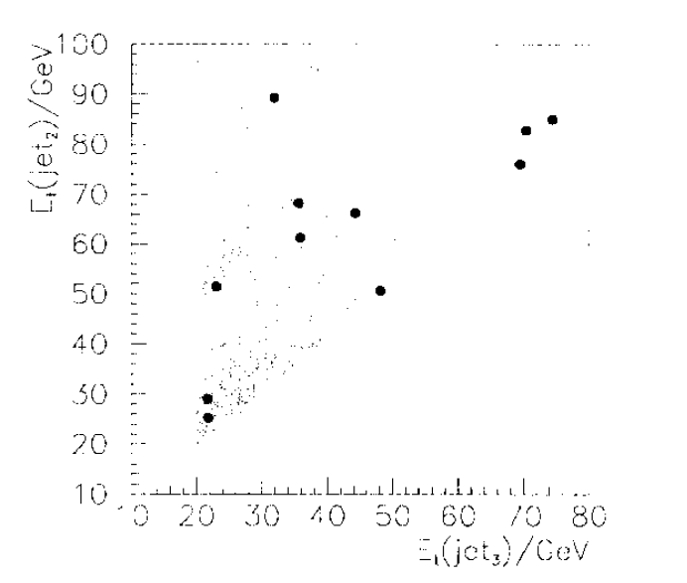

Kinematical evidence for top
E_{T} of 2nd jet
By mid 1993 an Italian group (with Marina Cobal, a PhD student, doing most of the work) claimed that there was evidence of top pairs in the kinematics of jets produced with a leptonic W, in the 20/pb of data until then collected
A new controversy followed the experiment sabotaged the analysis with endless requests for new checks, and did not let the information become an article (the events were later accepted as high-purity top candidates though)
CDF only allowed a public note to be published simultaneously with the "evidence" paper (see below)
E_{T} of 3rd jet

Slide 27
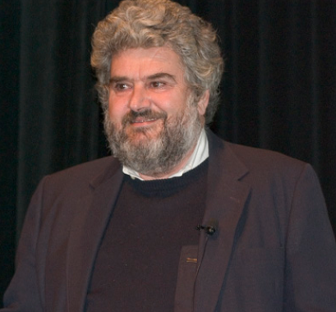
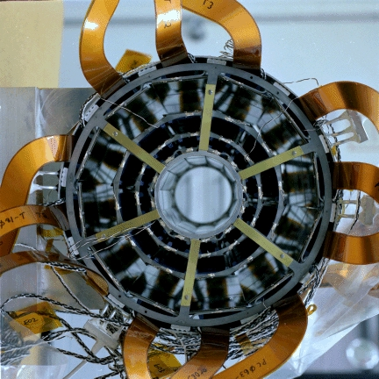
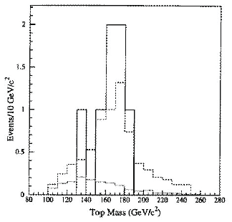
The SVX and the first top evidence
Already in 1986, the Italian physicist Aldo Menzione managed to convince the experiment leaders that CDF needed a silicon detector. It was a wild bet, and the detector took much longer to build than predicted, but it turned out to be a very successful project.
The 1992-93 run allowed CDF to collect 20/pb of data with an operating SVX. These data allowed the first evidence of the top quark
The silicon detector was crucial to convince the collaborators that those observed were events with b-quark decays inside the observed jets
In the end, the 3 standard deviation excess observed in single lepton and dilepton final states was compounded by a similar evidence coming from the mass reconstruction of 4-jet single lepton events, but Rosenfeld's criterion kicked in, and a paper was published in April 1994 with the word "Evidence" in the title
The mass was measured at m_{t}=174 GeV

Slide 28
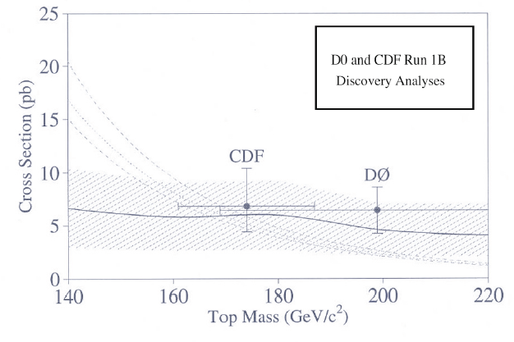
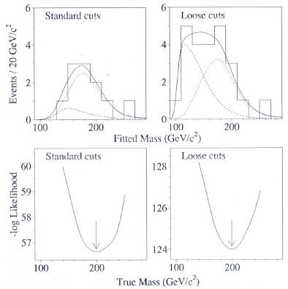
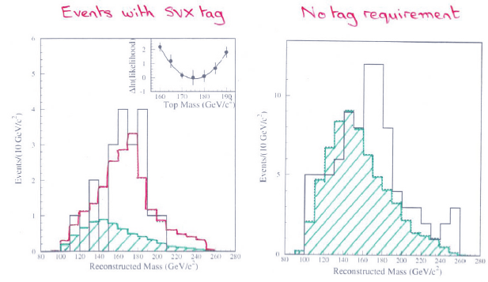
1995: the official top discovery
With the 1994-1995 run more data are collected, and CDF reaches a 5-sigma counting significance, warns D0 (a 1-week warning had been agreed, then extended to 2).
The two experiments publish together their observation of the last quark, although clearly the D0 analysis was rushed, and their mass measurement rather imprecise. Still, it is a shared discovery

Slide 29
A concluding remark
It took 20 years to complete the picture of matter constituents, from Gell-Mann's and Zweig's original intuition. That was a monumental breakthrough, but it was of course possible only thanks to decades of painstaking collection of measurements of particle properties
As an experimentalist, I cannot fail to see that theoretical ideas (like the existence of 3,4,6 quarks) are usually fueled by experimental input
For this reason, I believe it is foolish to question the needs of continuing our quest of the unknown at the high-energy frontier with the design of new, more powerful machines, on the grounds that "there are insufficient theoretical arguments" for the existence of new physics at experimental reach

Slide 30
Backup

Slide 31
Gerry Lynch and GAME
Rosenfeld’s article also cites the half-joking, half-didactical effort of his colleague Gerry Lynch at Berkeley:
  “My colleague Gerry Lynch has instead tried to study this problem ‘experimentally’ using a ‘Las Vegas’ computer program called Game […]
When a friend comes showing his latest 4-sigma peak,
  You draw a smooth curve […] (based on the hypothesis that the peak is just a fluctuation) [and] call for 100 Las Vegas histograms […]
  You and your friend then go around the halls, asking physicists to pick out the most surprising histogram in the printout. Often it is one of the 100 phoneys, rather than the real ‘4-sigma’ peak.”
The proposal to raise to 5-sigma of the threshold above which a signal could be claimed was an earnest attempt at reducing the flow of claimed discoveries, which distracted theorists and caused confusion.

