Slide 1



Gentner Programme
Main Programme points
  special German Doctoral Student Programme
    in addition to the existing CERN Doctoral Student Programme
    (almost) identical conditions except funding (subsistence) by BMBF
    extra funds for Students’ travel to Germany and for Supervisors’ travel to CERN
    open to EU nationals from CERN Members (Member States + Associate Member States)
  mid- and long term goals
    better usage of CERN resources by Germany
    better connection between German Universities and CERN
    long-term: more German staff at CERN
      presently only ~6.8% German staff (179/2644), but 20.55% contribution of DE to CERN budget
      IT: 11.8% (10.4% contribution), GB: 8.1% (15.8% contribution), ES: 6.2% (7.0% contribution)

Slide 2
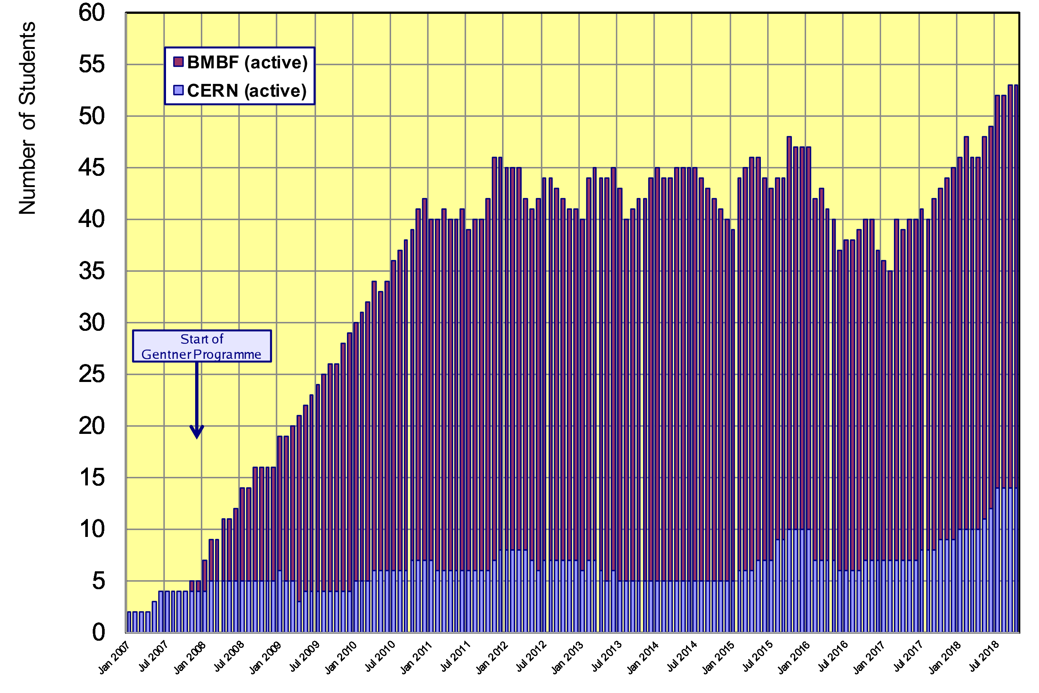
Status Gentner Programme
Presently 39 active Gentner Students (only 5 female = 13%!)
  further 14 Germans in regular CERN Programme
Consequence of fewer number of applications by women over past two years!
Statistical fluctuation or general trend?

Slide 3
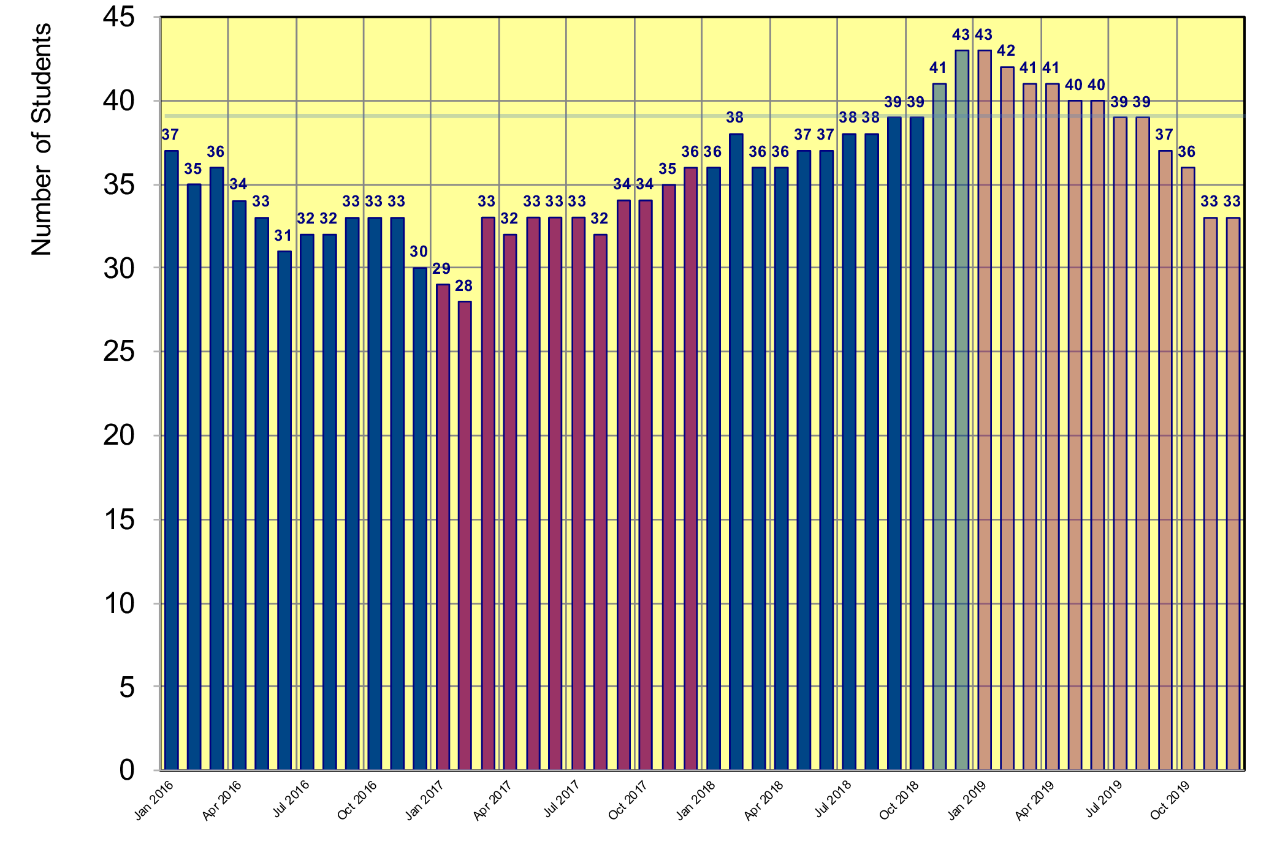
Status Gentner Programme
Projection until end of 2019
  based on preferred starting date given by candidates
Drop due to unfavorable EUR/CHF exchange rate
39 students foreseen in Gentner agreement
first students from 2018-2 selection
first students from 2019-1 selection

Slide 4
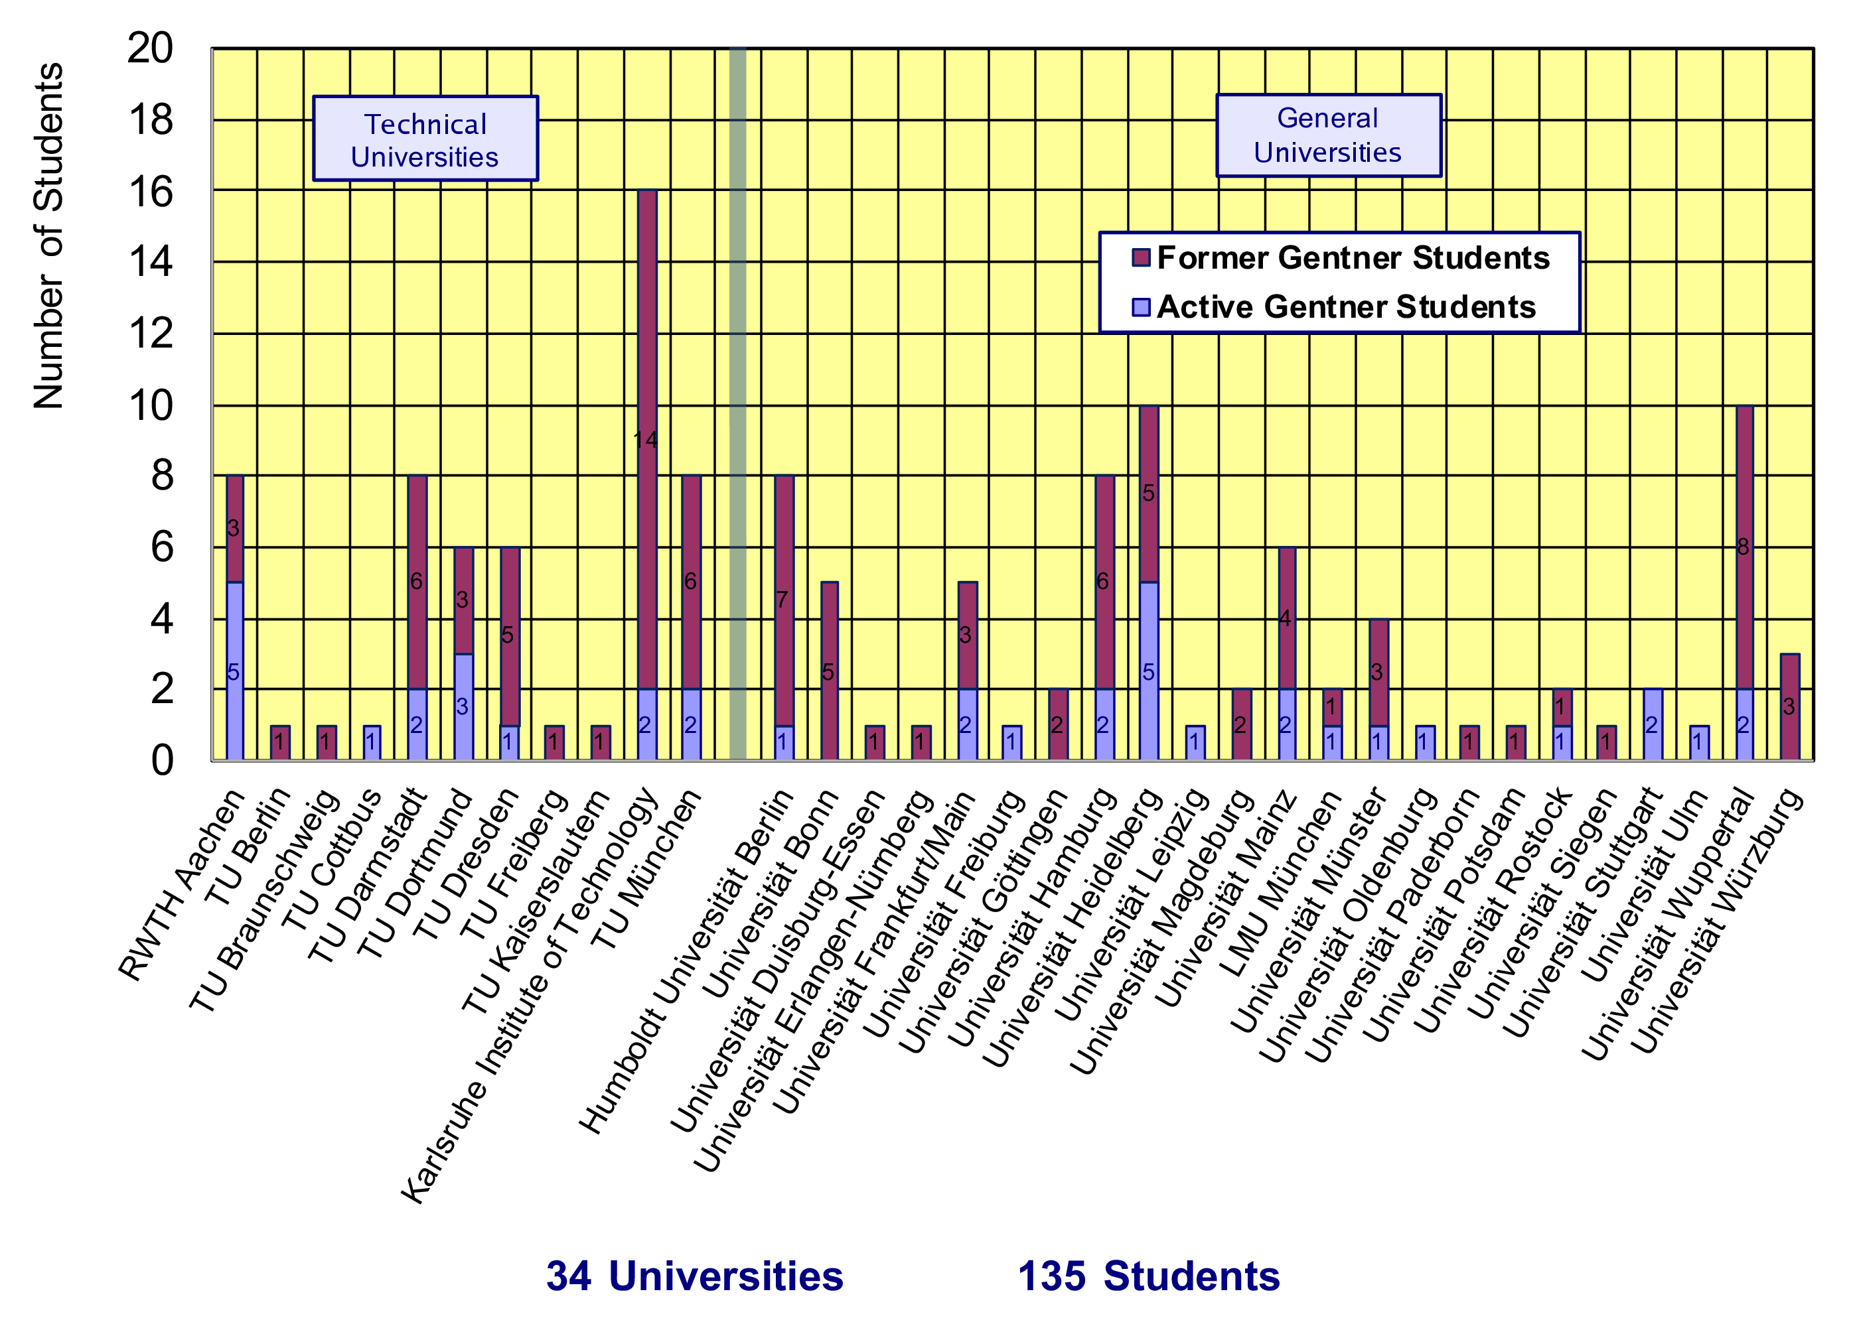
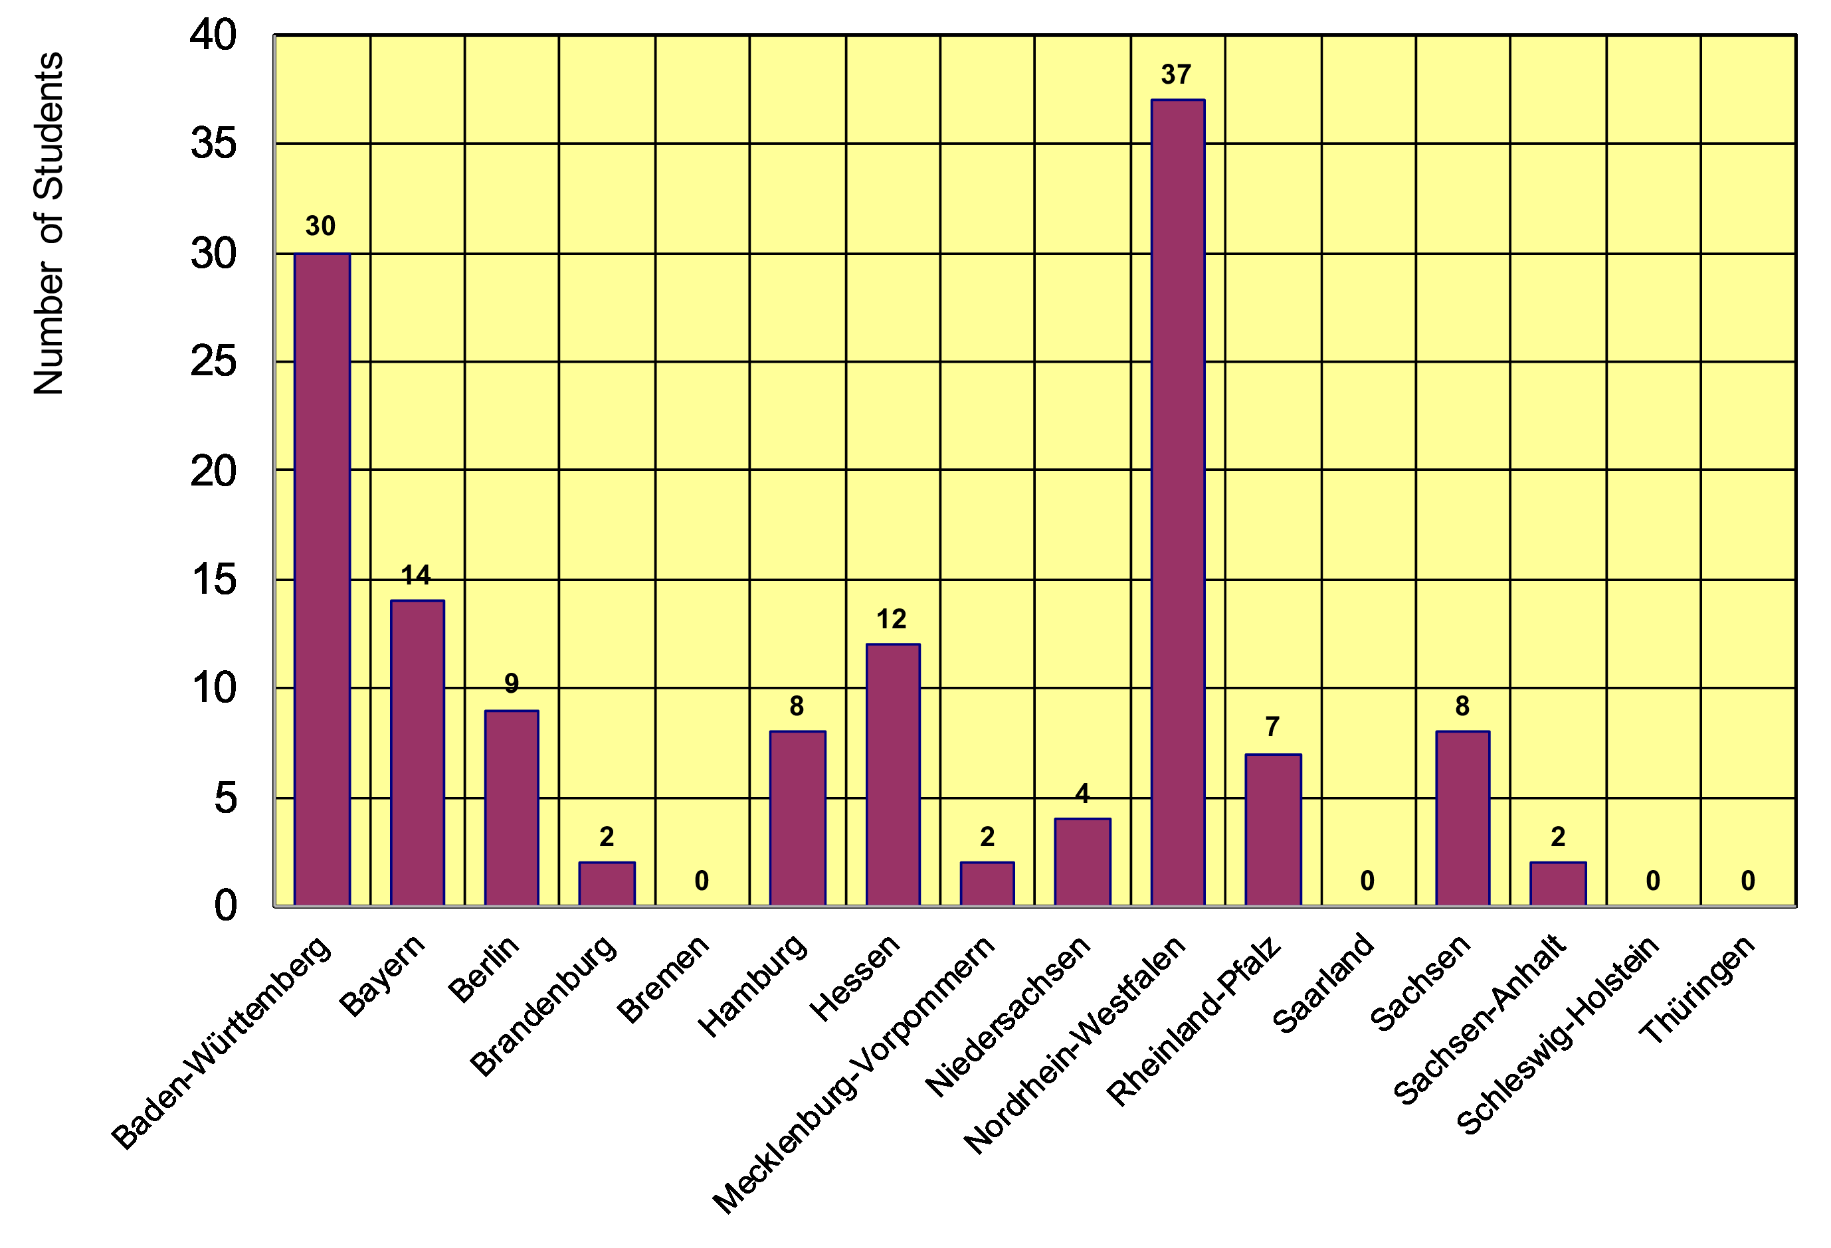
Gentner Students
  coming from 34 different Universities in Germany
    new since April 2018: TU Cottbus Universität Leipzig
  12/16 German States
    NRW and BW are leading
    only a few small(er) States are missing

Slide 5
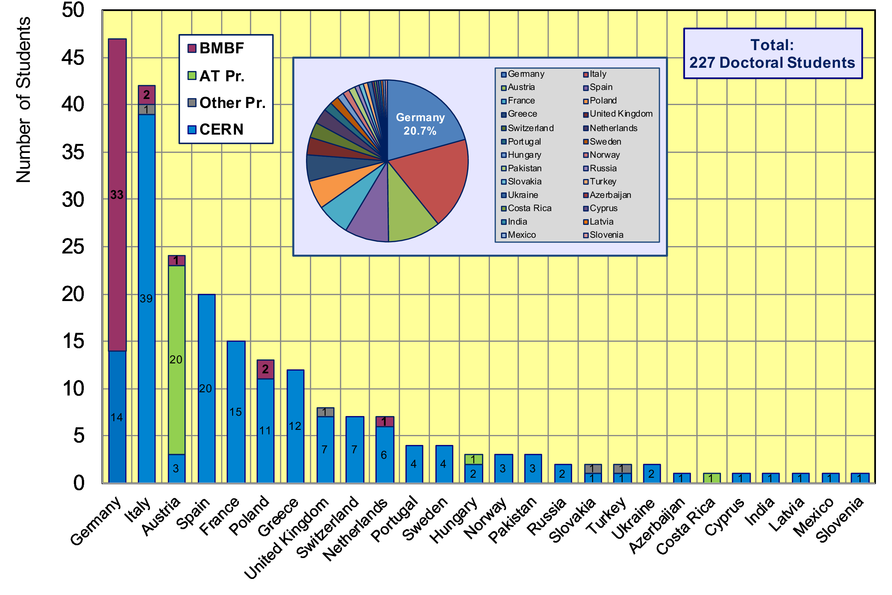
CERN Doctoral Students
Nationalities of all Doctoral Students at CERN
  Germans (47 Students, 20.7%) are leading (first time since many years)

Slide 6
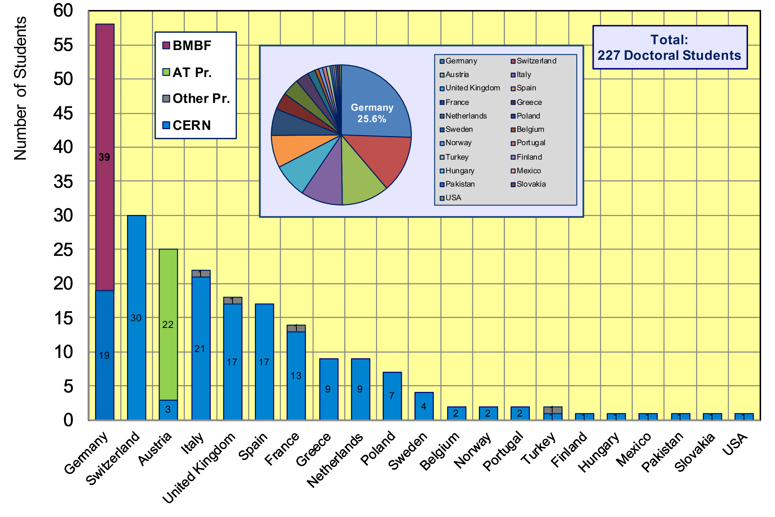
CERN Doctoral Students
Home University Country of all Doctoral Students
  58/227 Students enrolled at German Universities (25.6%)

Slide 7
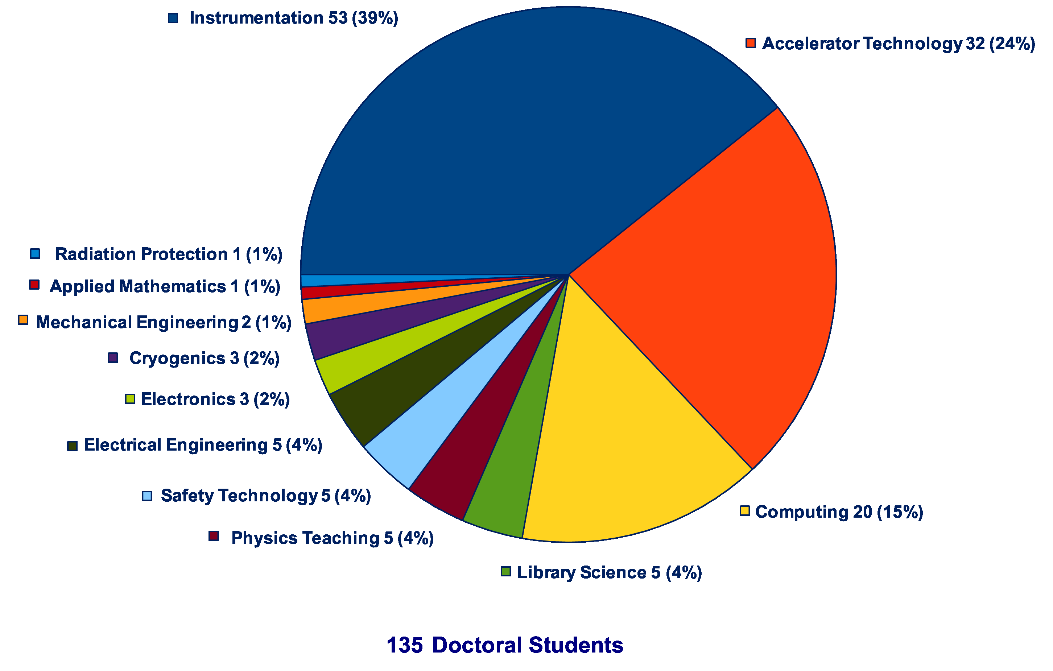
Thesis Topics of Gentner Students
(active + former)
Majority of topics in Instrumentation (39%), Accelerator Technology (24%), Computing (15%), all others = 22%

Slide 8
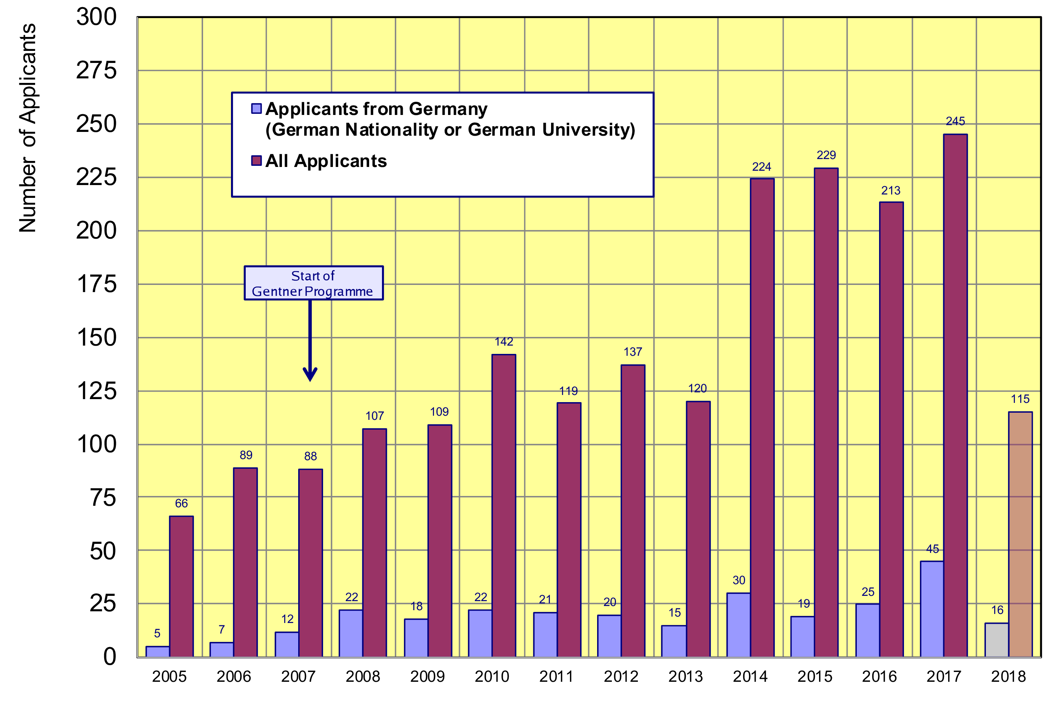
Doctoral Student Applications
Typically ~24 applicants/year from Germany (~stable since 2008)
    45 applications from DE in 2017 (26 in October 2017) → new overall high (DE was leading for the first time)
only one selection
board in 2018 so far
~24

Slide 9
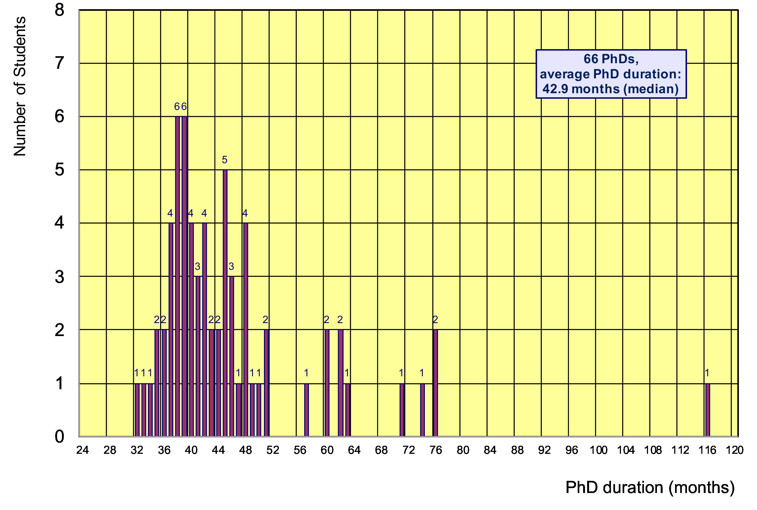
Former Gentner Students
66 PhDs so far (14 female = 21%), 8 Students have cancelled their PhD
    average age at PhD (defense): 30.9 years (median)
    average duration of PhD: 42.9 months (median) = 5.9 months after end of CERN 3-years contract
Physics PhDs in Germany (2017)
24% female PhDs students
30.9 years (median) at PhD
55.2 months (median) duration of PhD
5/66 students (7.5%)
needed < 3 years

Slide 10
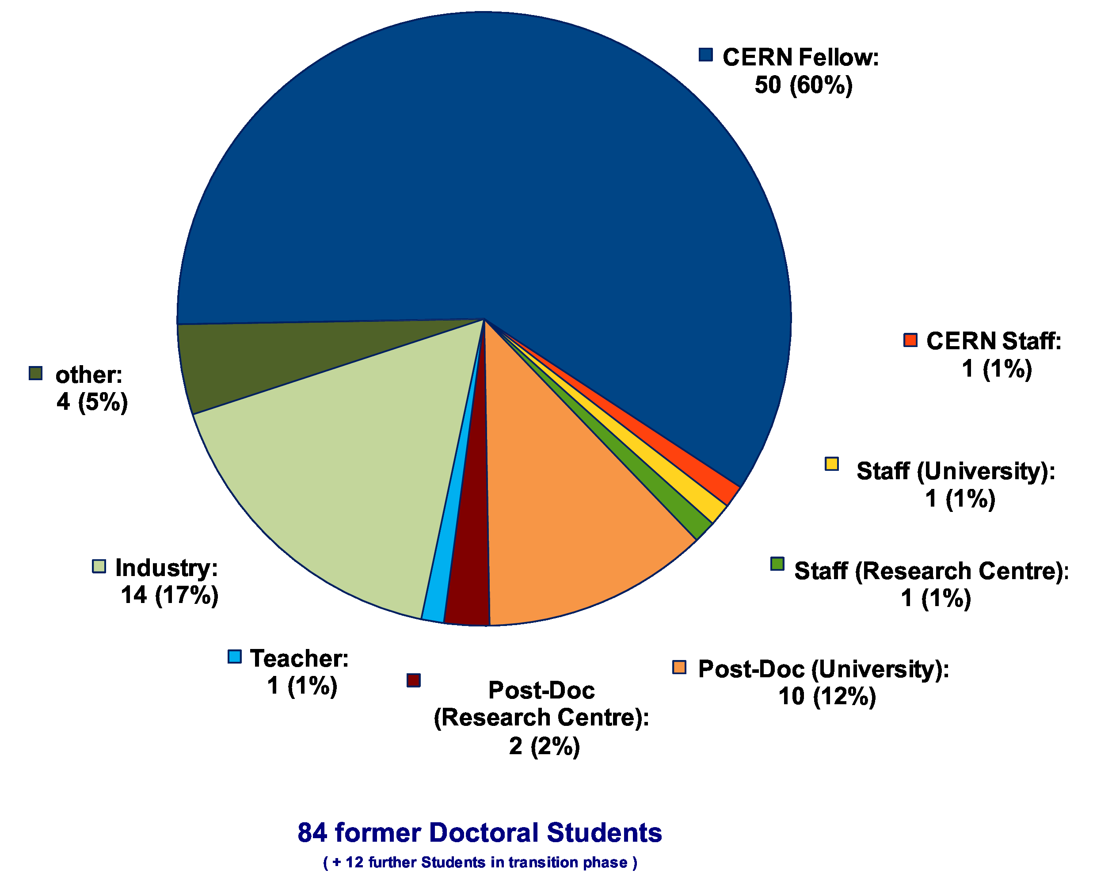
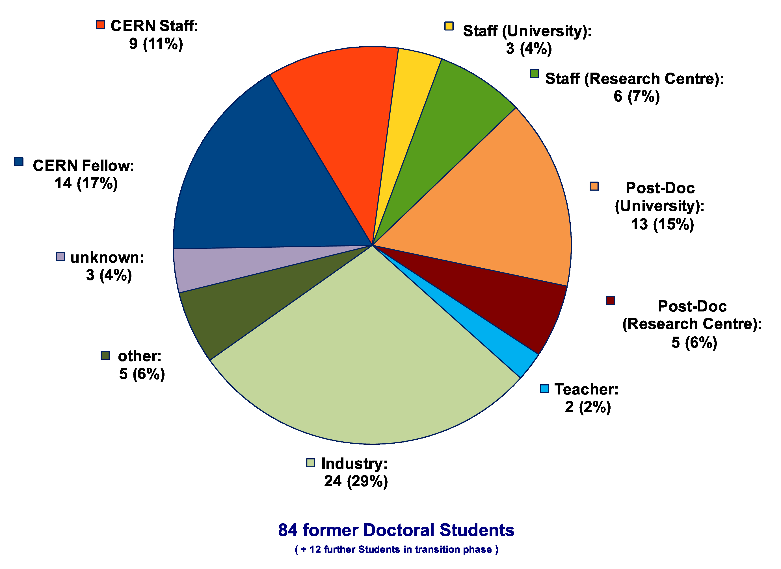
Whereabouts of Gentner Students
  first employment of 60% of the Gentner Students: CERN Fellow(!)
First Employment
Present Employment
presently 9 CERN Staff Members,
2 with indefinite contract
2 (soon 3) Staff are supervising
Gentner students

Slide 11
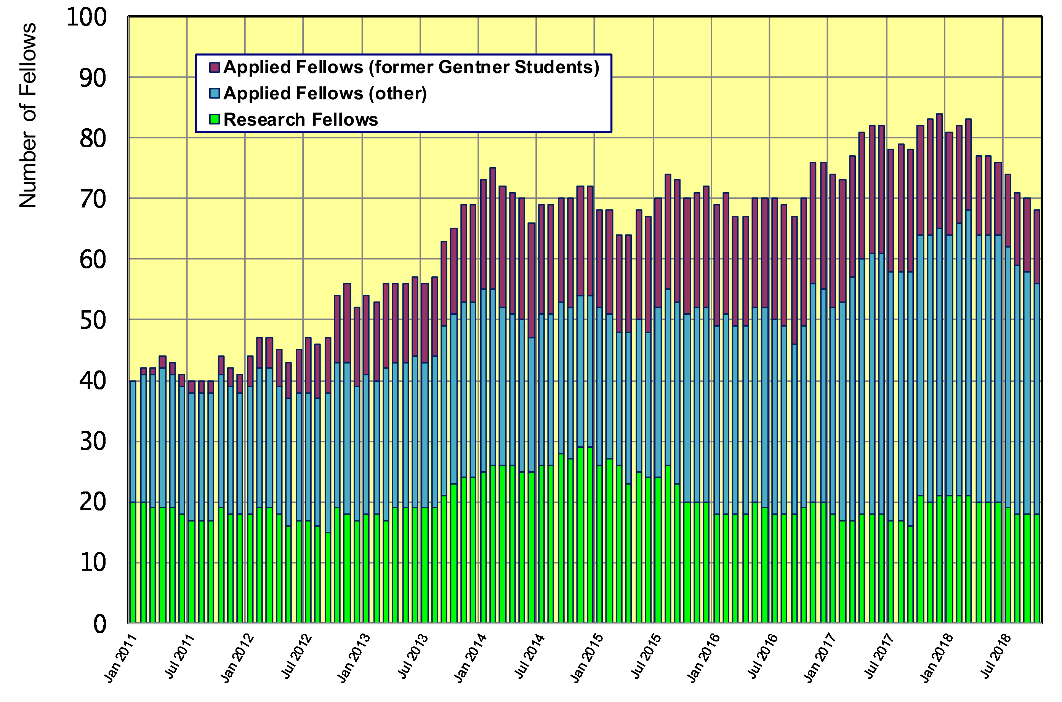
Gentner Students → Fellows
  significant increase of DE Fellows by former Gentner Students
    trend: fewer former Gentner students become Applied Fellow, also generally fewer German Applied Fellows

Slide 12
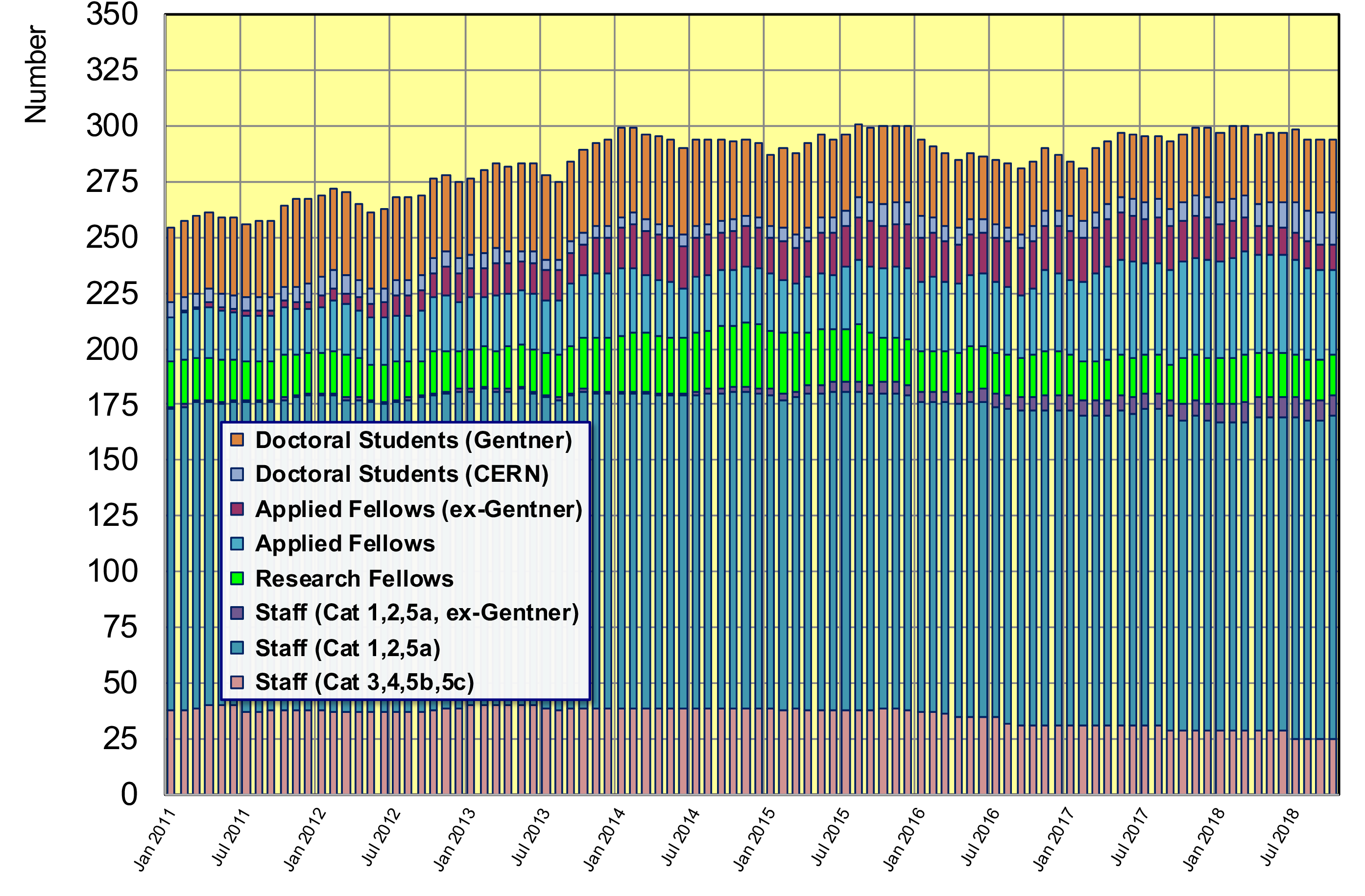
Gentner Students → Fellows, Staff
  294 German Doctoral Students, Fellows and Staff right now
    33 active + 21 former (German) Gentner Students at CERN (=18% of DE personnel)

Slide 13
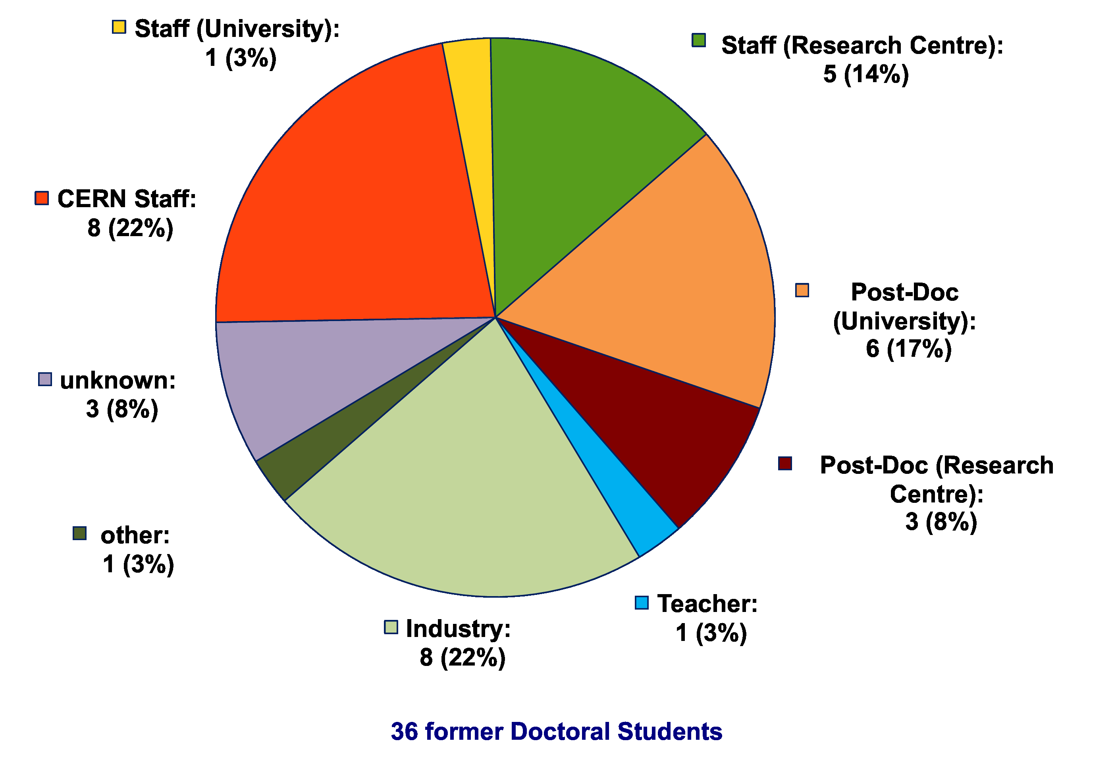
Whereabouts of Fellows
(former Gentner Students)
  many Fellows stay in academic research after their fellowship
    22% become CERN staff, 42% move to University or Research Centre

Slide 14
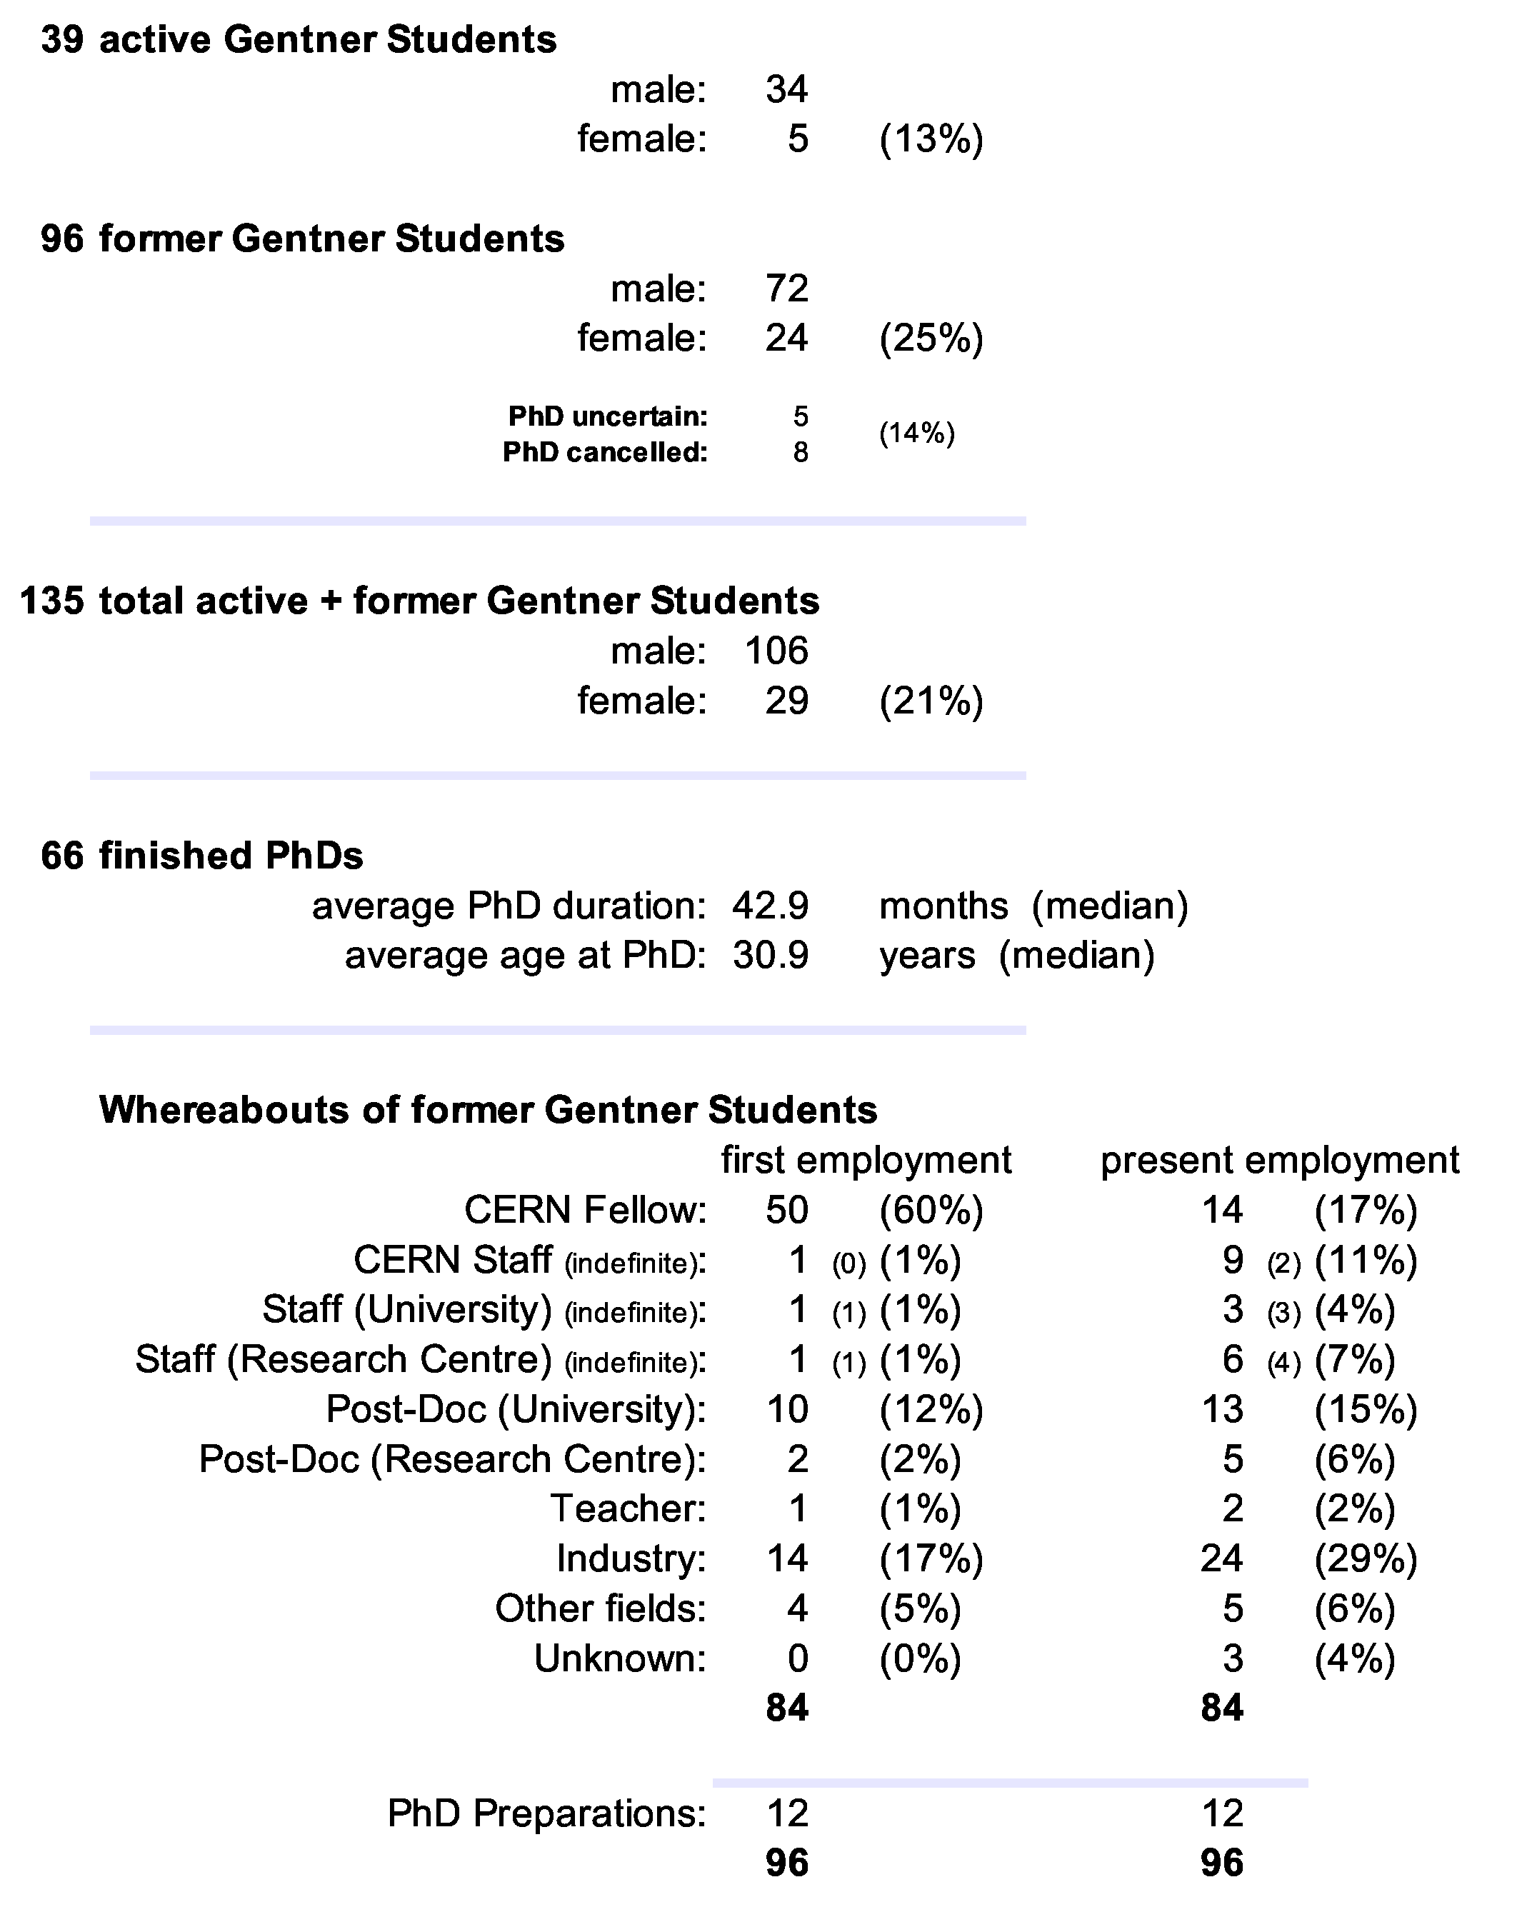
Summary Gentner Programme
  Programme is back to 39 students (slight further increase in next months)
  also increasing number of Germans in regular Programme
  new university groups have joined
  still low number of female applications and students
  number of former Gentner students becoming Fellow went down w.r.t. some years ago
Next Gentner Day:
17 April 2019 (tbc)

