Slide 1


Teleconference #1
Agenda
“Human Document Investigator” Team
September 14, 2018

Slide 2
Agenda
Hello and Welcome!
  Introduction of your coaches and mentors
  Introduction of participants
Organizational stuff
  Travel arrangements and side accommodations
  Your challenge
Project Milestones Week 1
  Decide how to decide
  Future teleconferences (tool, date/time, organization)
  Team name
  Tools
Outlook
  Next teleconference
  Next milestones
AOB, Requests, Questions and open discussion

Slide 3

Topics 2018
Pier Topic (Coach):
  09 Human Aid Knowledge Exchange (Daniel, Karolos)
  18 Human Document Investigator (Karolos, Ben)
  32 The Take-Away Cultural Food Experience (Joao, Josefina, James)
  68 Environmental Sanitation Tricorder (Saco, Oliver)

Slide 4
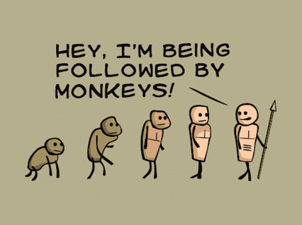
Hello and Welcome!
Your coaches …
  Benjamin Krikler
  Karolos Potamianos
… are here for you to:
  Act as a linking point between you and THEPort
  Assist and support you in your creative endeavors
  Add a bit of structure on the way (milestones, etc.)

Slide 5

Hello and Welcome!
Tell us …
  … 3 words to describe you best?
  … something unusual, surprising or funny about you?
  … a bit about why you wanted to become part of this particular event?

Slide 6

Hello and Welcome!
Benjamin Krikler (UK)
Ben is a particle physicist from the University of Bristol, searching for Dark Matter both on the CMS experiment at CERN and on the LZ experiment at SURF in South Dakota. He finished his PhD at Imperial College London on the COMET experiment, looking for muon-to-electron conversion in Japan. Whilst Ben’s mission in life has always been to understand the universe as best as possible, he also wants to put the data-analysis and problem-solving skills of his research to use on more tangible, real-world problems. In his spare time, Ben enjoys learning languages, traveling, and, after too long, has rediscovered how good it is to read science fiction.

Slide 7
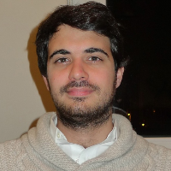
Hello and Welcome!
Karolos Potamianos (GR/BE)
Karolos is a Research Fellow at DESY working on the ATLAS Experiment at CERN. He studied engineering and business administration at the Université Libre de Bruxelles and physics at Purdue University, earning his PhD searching for the Higgs boson using machine learning, before joining the Lawrence Berkeley National Laboratory. Karolos is an expert in large-scale data analysis, silicon pixel detectors, data acquisition and pattern recognition. He co-founded THE Port Humanitarian Hackathons at CERN.

Slide 8
Hello and Welcome!
Ewan Oglethorpe
Ewan is a Data Scientist based in the US who is passionate about applying modern Machine Learning and Natural Language Processing techniques to the humanitarian context. He is the co-founder of DEEP, a collaborative platform for collecting and analyzing secondary data. Through the data collected in DEEP and other avenues, he is excited to develop algorithms and systems to automatically extract data from humanitarian secondary information.

Slide 9
Hello and Welcome!
Wilhelmina Welsch

Slide 10
Hello and Welcome!
Aayush Chadha
Aayush is a third year student of Artificial Intelligence at the University of Manchester. Originally hailing from India, Aayush’s fascination for computers began with the use of chess engines. Since then, the fascination has expanded to natural language processing and data wrangling. His time at university is divided between working at a startup as a developer, assisting with research into Parkinson’s Disease at the University of Manchester and travelling to hackathons on the weekend.

Slide 11
Hello and Welcome!
Andrea Cupertino

Slide 12
Hello and Welcome!
Antonio Gilardi

Slide 13
Hello and Welcome!
Bashir Khoshnevis

Slide 14
Hello and Welcome!
Bibek Pandey
I am Bibek Pandey from Togglecorp Solutions, Kathmandu, Nepal. And I've been working here for around a year. I mostly work in Natural Language Processing and occasionally write web apps in Django. I am particularly interested in NLP/Machine Learning, algorithms, mathematics and generative arts. I got a Bachelor of Computer Engineering Degree from Institute of Puchowk Campus, Tribhuwan University, in 2016.

Slide 15
Hello and Welcome!
Lennart Heim
Lennart is currently pursuing his master’s degree in Electrical Engineering with the specialisation Computer Engineering at RWTH Aachen in Germany. His studies are focussed on embedded systems, electronic design automation and wireless networks. During his studies he works in two research groups - one in the field of human chemosensory perception, where he helps designing, building and running hardware setups for olfactory stimuli, often during fMRI experiments. The other one focuses on networked systems, where he’s doing research in the field of mm-wave wireless networks. In his freetime, Lennart reads and learns about topics to enable a positive future for humankind, like environmental sustainability, the impact of technologies on society, and neuroscience. For more information you can visit his personal website: https://heim.xyz.

Slide 16
Hello and Welcome!
Natalia Gutanu
Natalia is a 2nd year Human-Computer Interaction student at the University of Manchester. She sees technology as a means for enhancing human life, so she often engages herself in projects that describe her view. Currently, she’s part of a startup where she develops a social platform that tries to minimize the risks of hiking in her native country of Romania. She has an immense passion for learning and extending her knowledge, whether that comes from coding, reading, travelling, watching movies, listening to music, writing a novel or dancing salsa.

Slide 17
Hello and Welcome!
Roy Allela
Roy Allela is a Technical Evangelist for Artificial Intelligence and the Internet of Things at Intel. He is also an Intel Innovator and he has a strong passion for the application of nascent technologies to solving everyday problems. He is a Royal Academy of Engineering 2018 LIF Fellow and he emerged the Global Winner of the 2017 Edition of American Society of Mechanical Engineers ISHOW competition. He has a background in Microprocessor Technology and Instrumentation from The University of Nairobi.

Slide 18
Hello and Welcome!
Safar Ligal

Slide 19

Organizational stuff
Travel arrangements
  Event: 5th October (morning) to 7th October (evening)
  Arrival & Warm-up day: 4th October (optional, but recommended)
  Accommodation: Will be provided only to external participants from 4th October to 8th October (4 nights)
  Only few transportation cost will be covered partially for special cases
  Any questions or issues? – Contact: info@theport.ch

Slide 20
Your challenge
  THE Port Pier 18 –
  Human Document Investigator
An overwhelming flood of information is available in today's humanitarian emergencies. Identifying key information and meaningful knowledge for prompt situation analysis is a challenge as it effects the ability to efficiently respond to crises. By automating the process of information extraction from data through Machine Learning and Natural Language Processing algorithms, we have the potential to allow for more informed decisions in crisis situations.

Slide 21
Your challenge
Goal of the THE Port hackathon:
  What are your first thoughts on this challenge?
  First ideas and comments
  Why do you think we need YOUR skills as they are given in this team?
  Create a tangible prototype!

Slide 22
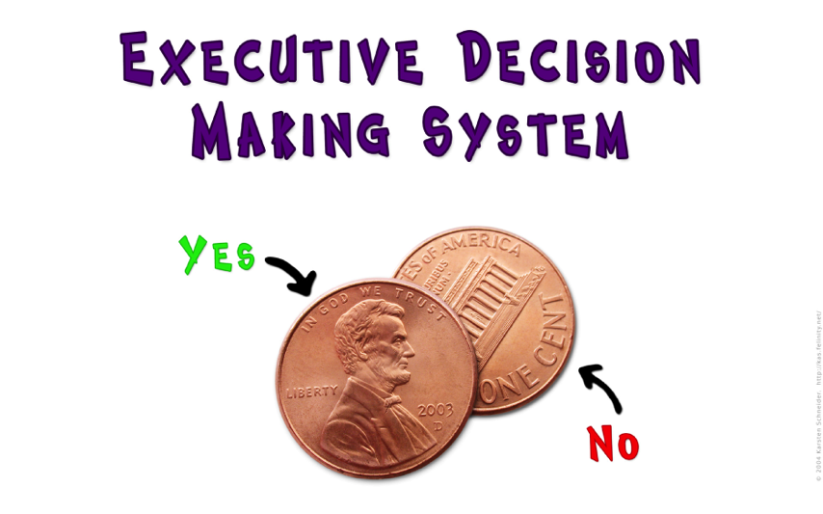
Project milestones #1
Decide how to decide
  Majority vote
  Expert vote
  Majority vote, Expert veto
  Benevolent dictator
  Decision makers change every week
  Email-voting for different options with 48hr deadline
  …

Slide 23
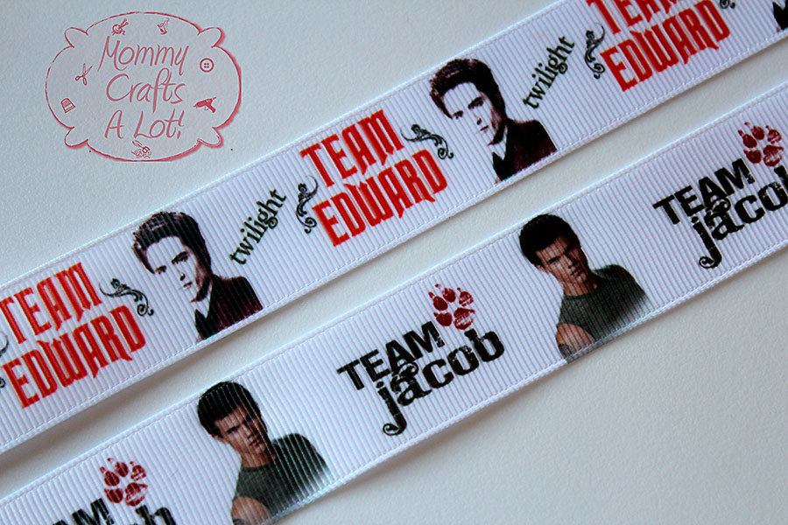
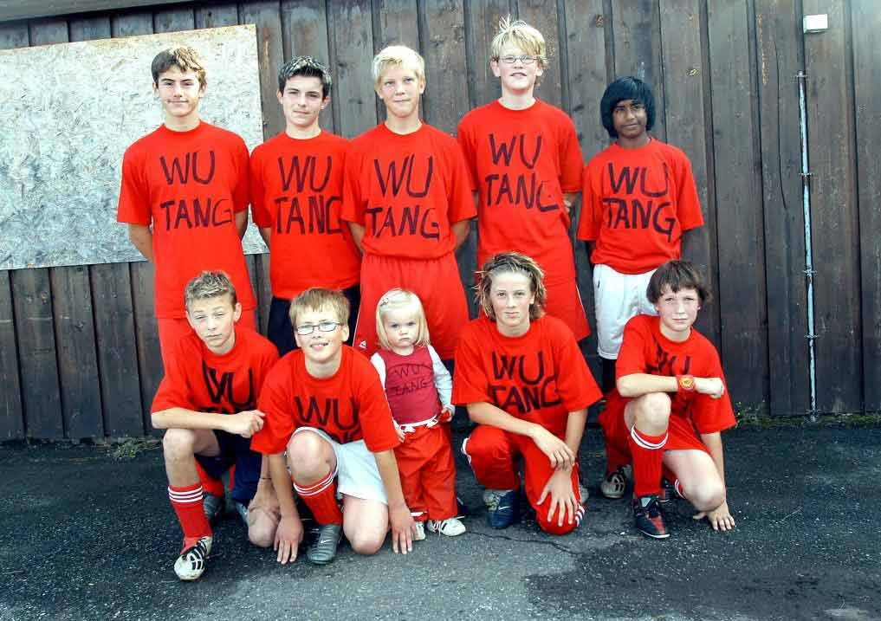

Project milestones #1
Team name
  No illegal or inappropriate disambiguity
  No copyright/trademark infringements

Slide 24

Project milestones #1
Team teleconferences
  Fixed date/time or doodle every week?
  Individual/additional teleconferences

Slide 25
Useful tools
Tools for video/tele-conferencing
Recommendation:
  VIDYO (standard)
    None of coaches had problems with VIDYO in 2015, some in 2016
    VIDYO has “fixed” virtual rooms that can be accessed by the same link all the time (very useful)
  Skype (as backup)
  Google hangouts
  ZOOM (free for some time, or pay small fee)

Slide 26
Useful tools
File and document sharing
Recommendation:
  Sharepoint (standard)
    External participants need CERN “lightweight” account!
    One needs to be part of the egroup
  Dropbox (as backup)
  Google drive
  CERN box (folder with passwords, etc)

Slide 27
Useful tools
Drafting/editing of documents and text
Examples:
  Sharepoint
  Excel/Word web apps
  Slack
  Trello
  Etherpad
    https://etherpad.net/p/Test_pad
    Alternatives?

Slide 28
Useful tools
Other useful tools:
  Doodle (for setting dates/times, e.g. for video conferences)
  Team homepage (same URL as sharepoint) - tbc
  CERN email distributor for coaches
  Ideas for other useful tools?
    …

Slide 29
Useful tools
Link compilation:
  Email: THEPort-Pier18@cern.ch
  Indico: https://indico.cern.ch/event/755309/
  Vidyo: THEPort2018_Pier18, extension: 10755309, auto-join URL: https://vidyoportal.cern.ch/join/OOA699zlGb
  GitHub: https://github.com/orgs/THEPortatCERN/teams/hackathon2018-pier18 and https://github.com/THEPortatCERN/Hackathon2018-Pier18
  Google Drive: https://drive.google.com/drive/folders/1wfav3wuKpvdbBMQ6P4XhskEKD_0F_BGH

Slide 30
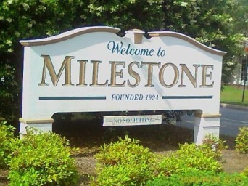
Outlook
Milestone #2 – Statement of Work
  Paragraph of 4-5 sentences
  Coarse requirements, specifications
  Probably the most important and most time consuming milestone, because it will state what you want to achieve and set the direction that you want to go in the next weeks
  Research and coordination among you necessary
  Should include a tangible, physical prototype in the end

Slide 31
Statement of work
Example
  Statement of work - Inflatable fridge team:
  "Our goal is to build an inflatable fridge prototype in order to produce a cheap and easily transportable cooling device.
  It should be based on either traditional fridge thermodynamic technology (mechanical) or a thermo-electric system and include a rigid base to house the associated technology, with an inflatable box above.
  It should be applicable in situations where transport of the fridge is difficult and a power supply might not be available (for example camping, transporting prepared foods from home to an office/school, humanitarian aid and other field operations).
  Applications in the future might include facilitating transportation of vaccine during the last mile, or preventing biological samples and sensitive drugs from decay. Some of these applications should be investigated as a case study."

Slide 32
Statement of work
Example
  Statement of work - Body bag Team:
  "Our goal is to build a body bag prototype improving common models in order to greatly delay body decomposition.
  Current models are well suited for handling and transportation of the bodies, but they do not properly address the factors which might influence decay. However, preventing decomposition is extremely important for postmortem identification. Our prototype aims to provide reduced temperature, humidity and oxygen concentration within the bag by increasing water and air impermeability. We believe that this is possible to achieve while maintaining a price range similar to current alternatives.
  We also intend to study alternative use cases for the same device, such as food storage. Further developments could include active cooling, destruction of bacteria and microorganism which provoke decomposition or MSF epidemiology certification for cases like Ebola. In case our prototype should prove to be successful, we aim to set the prerequisites for large scale production.“

Slide 33
Outlook
Milestone #3 – Wishlist
  What will you need for the hackathon event?
  Deadline: 28 September
Further Milestones
  Project-specific (tbd)

Slide 34
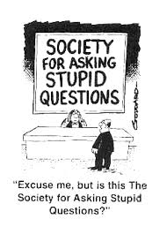
AOB
Requests, Discussions, etc.
  Questions?

