Slide 1

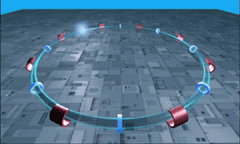




XIII Escola de
Professores em
Língua Portuguesa
13th
Portuguese
Teachers
School
CERN 2019
Bem Vindos

Slide 2
Sumário
Introdução ao CERN
e à Física de Altas Energias (HEP)
  A Organização
  O Laboratório
  Física de Altas Energias
  Os Aceleradores e as Experiências
Isto e’ uma “escola” portanto…perguntem!!
“Não há perguntas estúpidas”
Programa da Escola :
https://indico.cern.ch/event/755350/timetable/
Página FACEBOOK (grupo) :
Escola de Professores no CERN em Lingua Portuguesa
https://www.facebook.com/groups/escolacern2013/

Slide 3
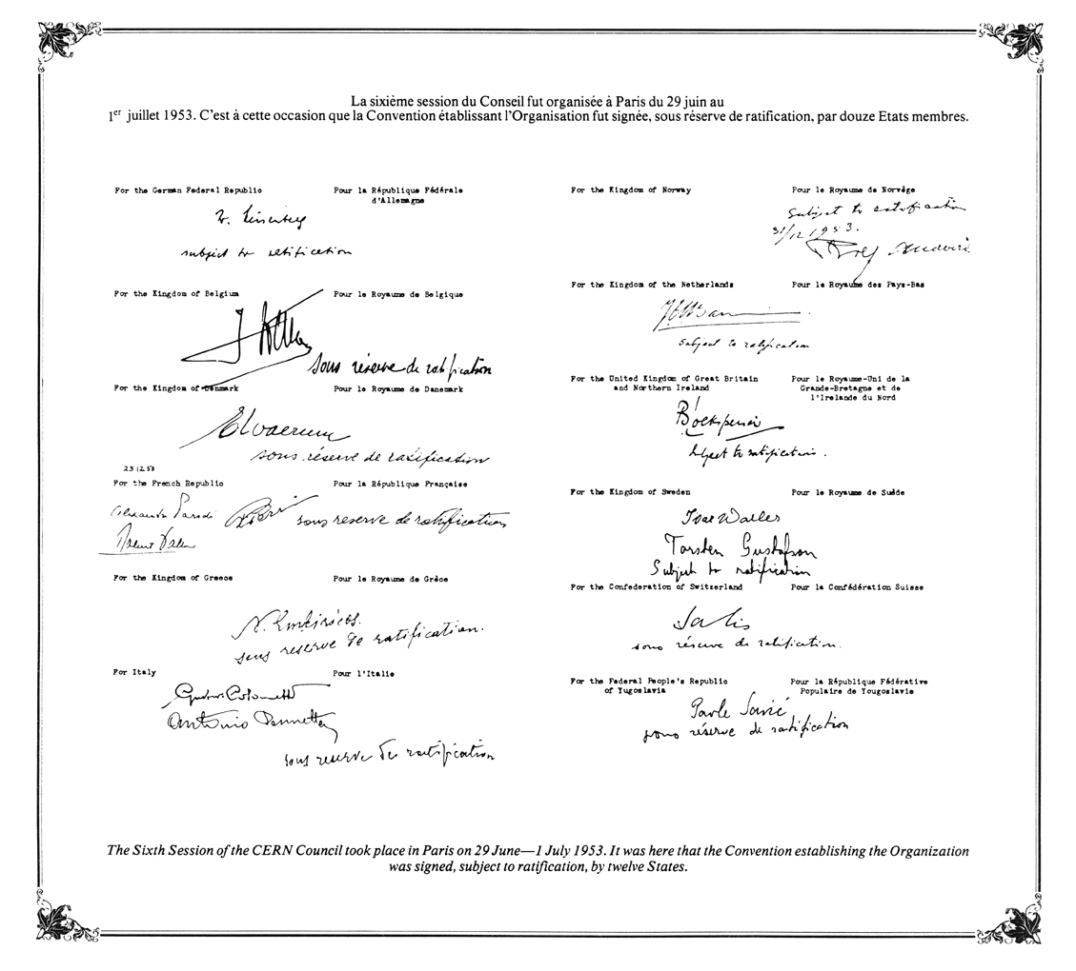
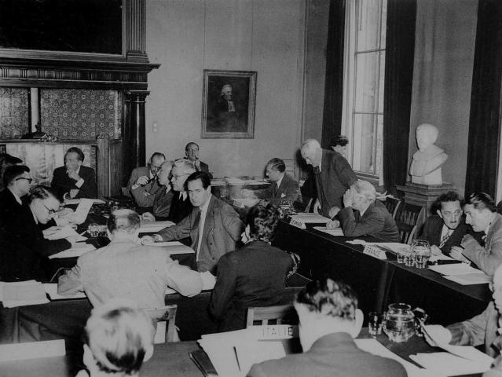
CERN
European Organization for Nuclear Research
Fundado em 1954 por 12 países Europeus
23 estados membros
Mais de 13000 utilizadores , dos quais 2300 são funcionários e cerca de 1400 subvencionados (2013)
Orçamento anual de ~1200 Milhões Francos Suíços (2018) (~1000 M.Euros)
1954: Convention establishing the organisation - original signatures
1st CERN Council meeting, 1952

Slide 4
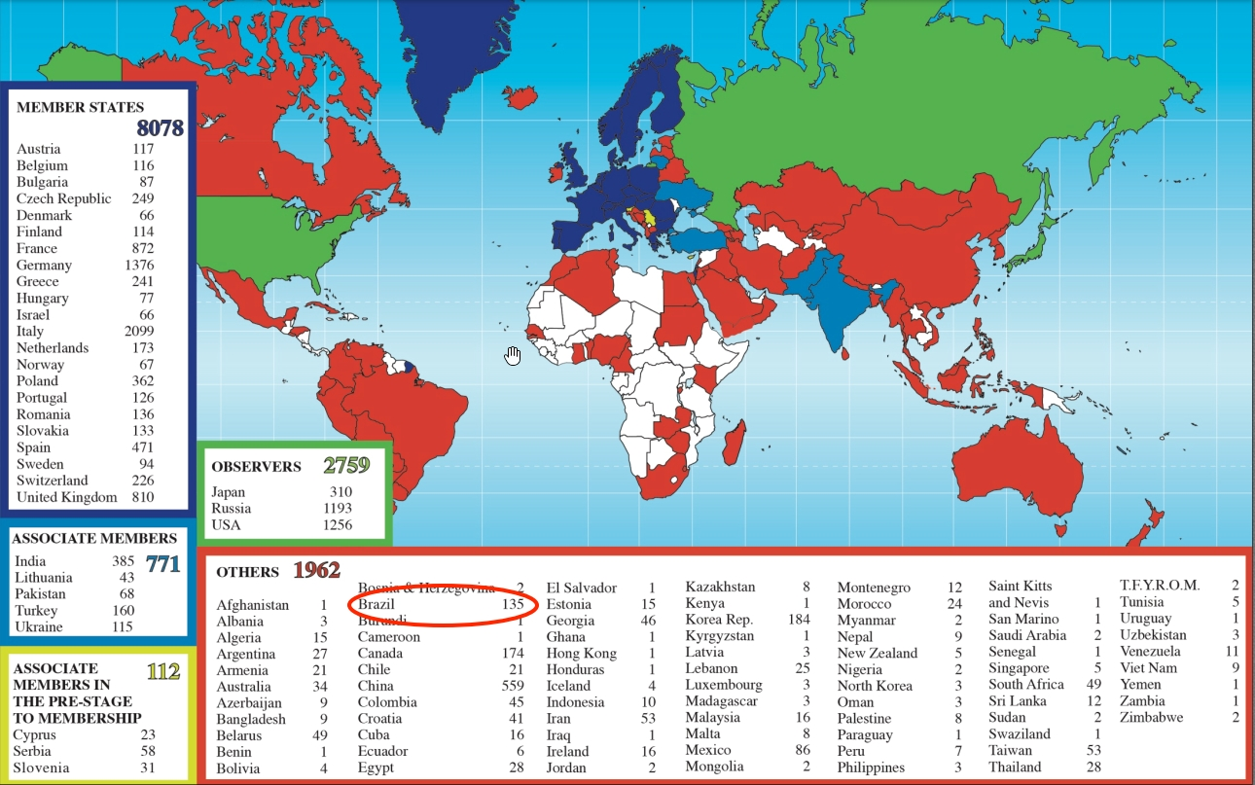
LIP, IST Users
Distribuição dos Utilizadores do CERN por país
(em 2018) >13000 utilizadores

Slide 5










~15’000!
Quantas pessoas?
2’500 funcionários
600 fellows &
aprendizes
500 estudantes
11’000
2’000 companhias
«externas»
Notes:
CERN employs «only» 2500 persons. In which there are «only» 70 research physicists (you can ask the audience if they can guess this).
As Fellows and Apprentices are here for a first employement experiences.
The number of students can vary from 300 to 600 depending of the time of the year. It’s mostly university students.
The core population of CERN is made of about 11’000 «users», called like that because they are here to «use» CERN’s facilities.
They are NOT employed by CERN and come in the frame of the collaborations.
They are not all the time at CERN. Some spend 5% of their time at CERN (a few days a year), some spend 100% of their time. It really depends on their function in the collaboration, on the need for them to be on site, or, on the other hand, the possibility for them to work remotely.
Given the size for CERN’s population, many services are externalized (mail, transport, restaurants, etc) to firms.

Slide 6
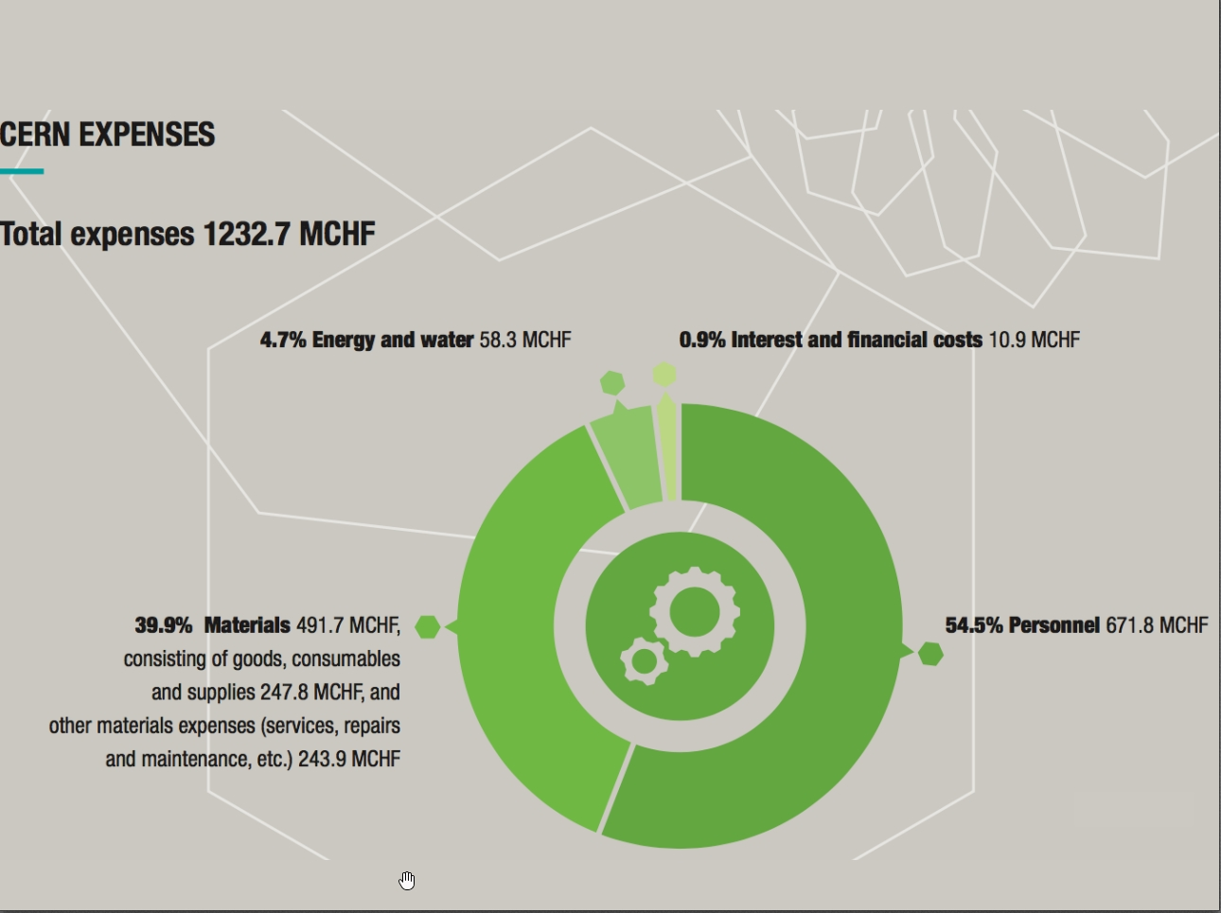
Notes:
CERN employs «only» 2500 persons. In which there are «only» 70 research physicists (you can ask the audience if they can guess this).
As Fellows and Apprentices are here for a first employement experiences.
The number of students can vary from 300 to 600 depending of the time of the year. It’s mostly university students.
The core population of CERN is made of about 11’000 «users», called like that because they are here to «use» CERN’s facilities.
They are NOT employed by CERN and come in the frame of the collaborations.
They are not all the time at CERN. Some spend 5% of their time at CERN (a few days a year), some spend 100% of their time. It really depends on their function in the collaboration, on the need for them to be on site, or, on the other hand, the possibility for them to work remotely.
Given the size for CERN’s population, many services are externalized (mail, transport, restaurants, etc) to firms.

Slide 7
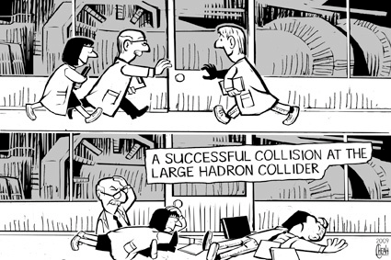
O CERN visto:
pelos media:

Slide 8
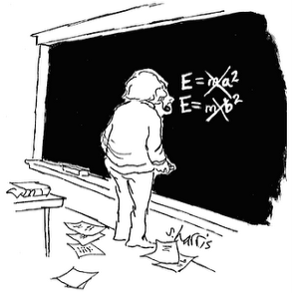
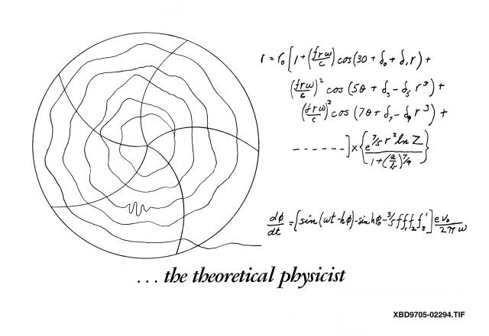
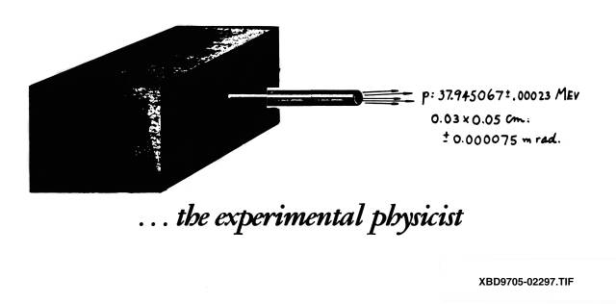
…físico teórico
…físico experimental

Slide 9
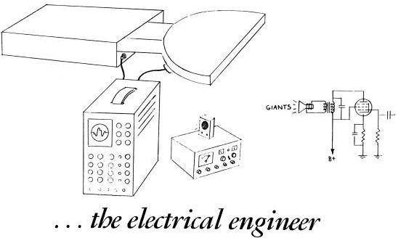
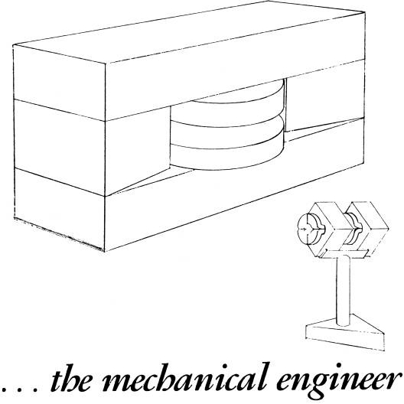
…Eng. Electrónica
…Eng. mecânico

Slide 10
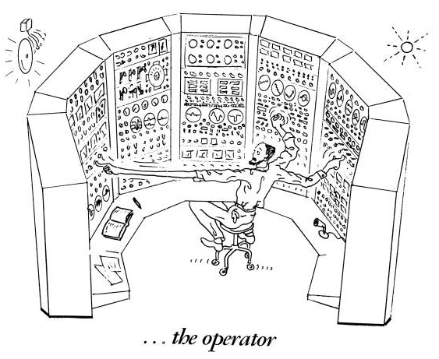
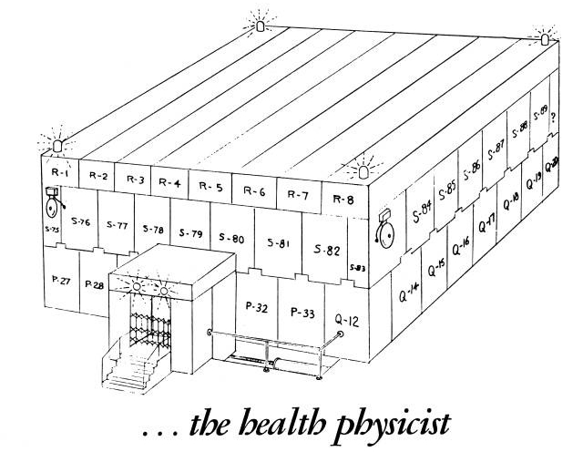
…operador
…rádio protecção

Slide 11
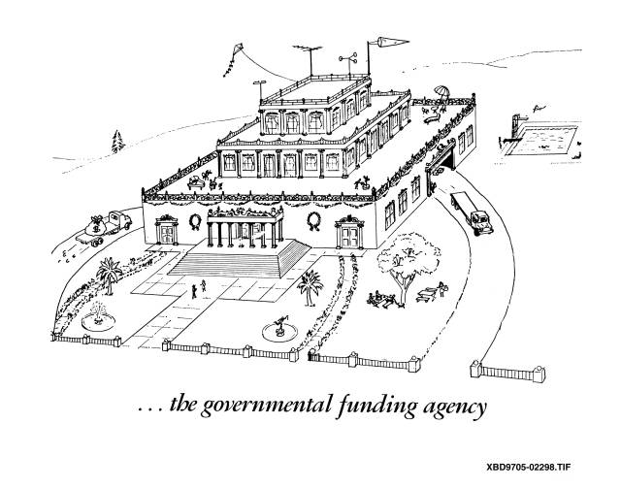
…agências de financiamento

Slide 12
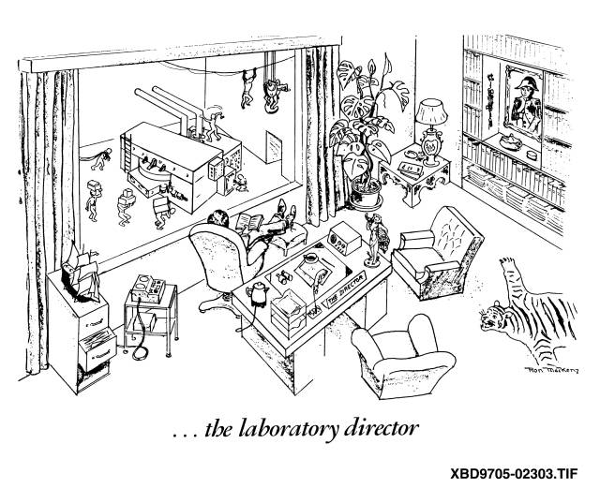
…director geral

Slide 13
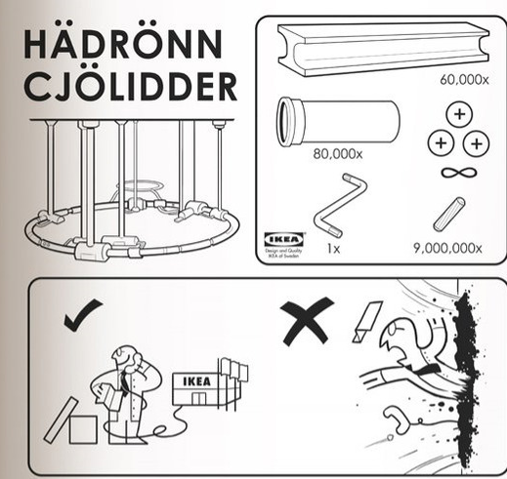
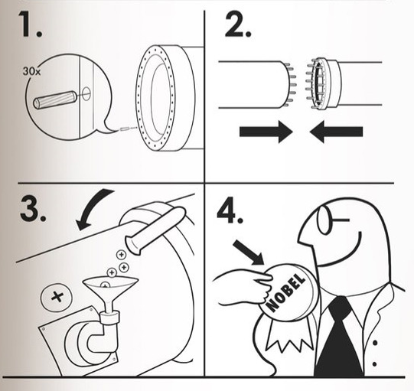
…método IKEA

Slide 14
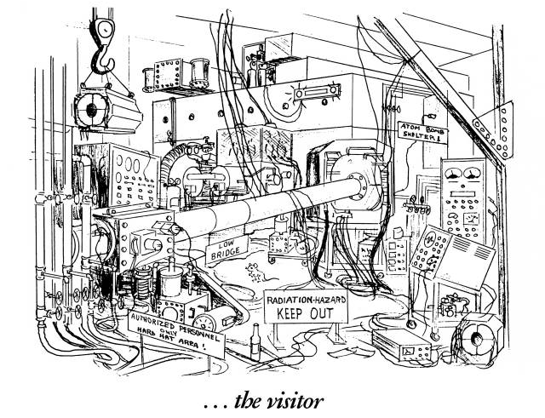
…por vocês!!

Slide 15
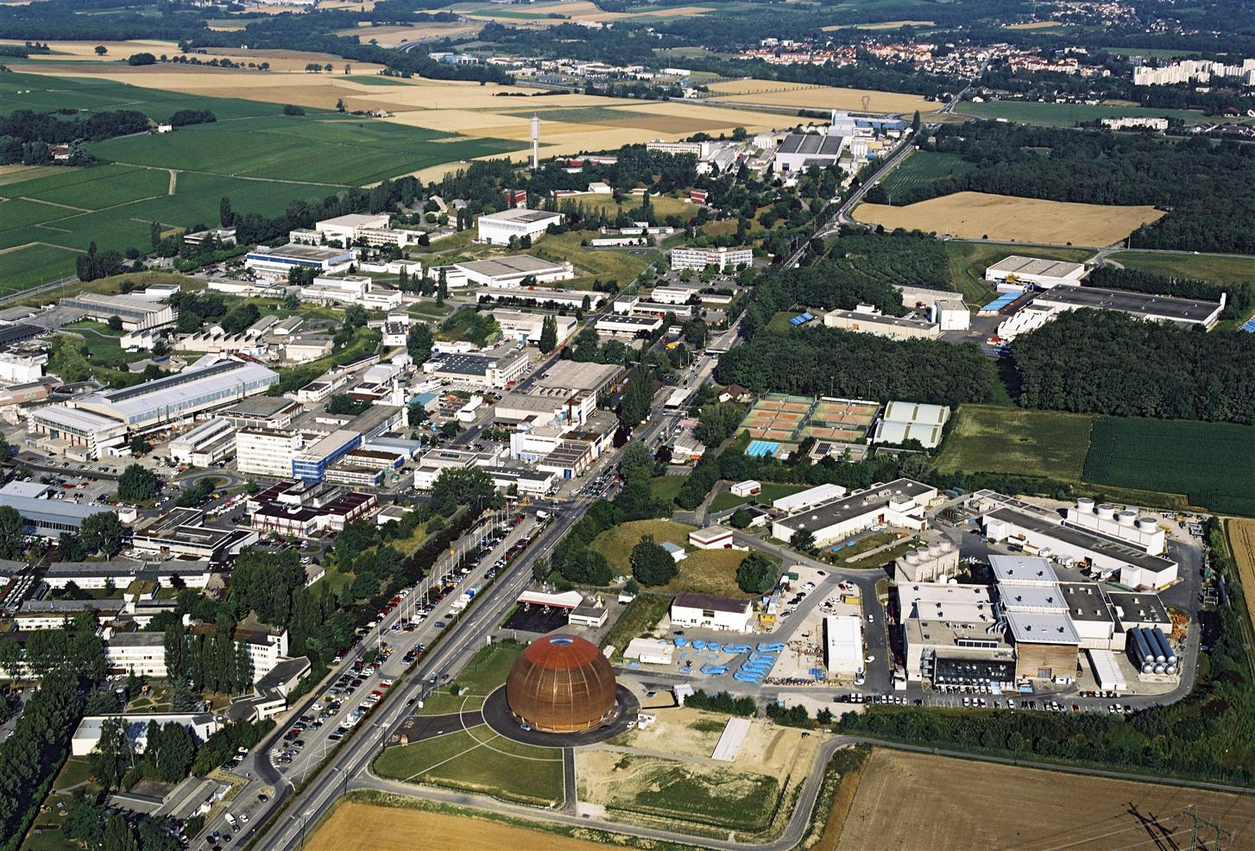
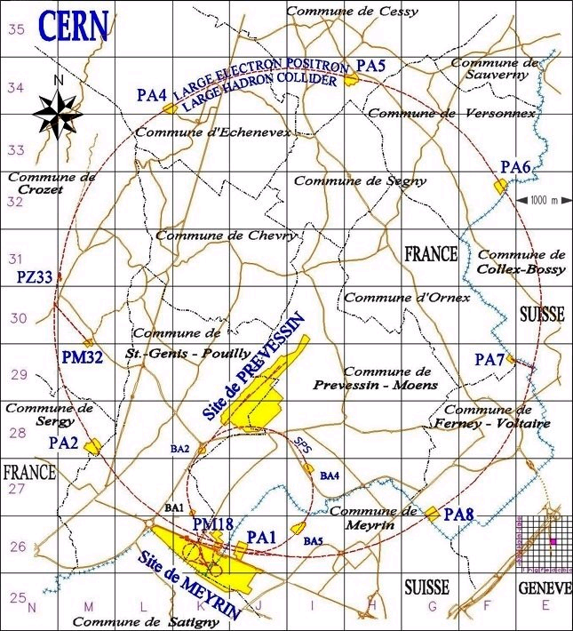
CERN – O(s) Laboratório(s)
no total
19 locais
  195 ha
  25 km de estradas
  750 espaços verdes
  574 edifícios
    379000 m² área à superf.
    556000 m² área coberta
    498000 m² área útil
  23 poços de acesso
  251 áreas subterrâneas
    1701 áreas diferentes
2264 locais de construção
191 projectos

Slide 16
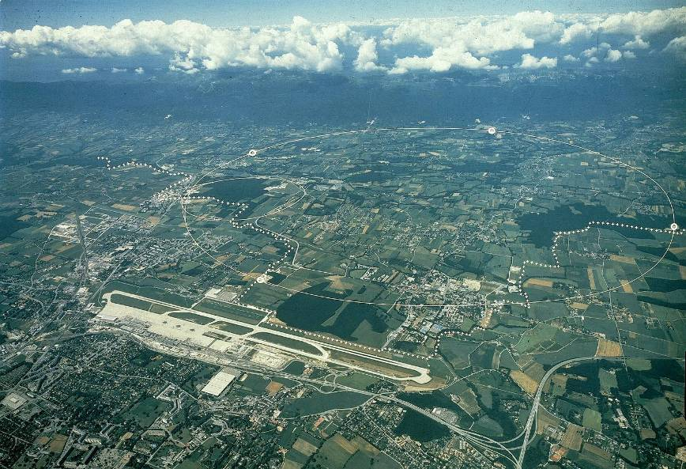

Area do CERN
We are here
F
ALICE
CMS
CH
ATLAS
CERN Prévessin
SPS
Super Proton Synchrotron
CERN Meyrin
LHCb
LHC
Large Hadron Collider

Slide 17
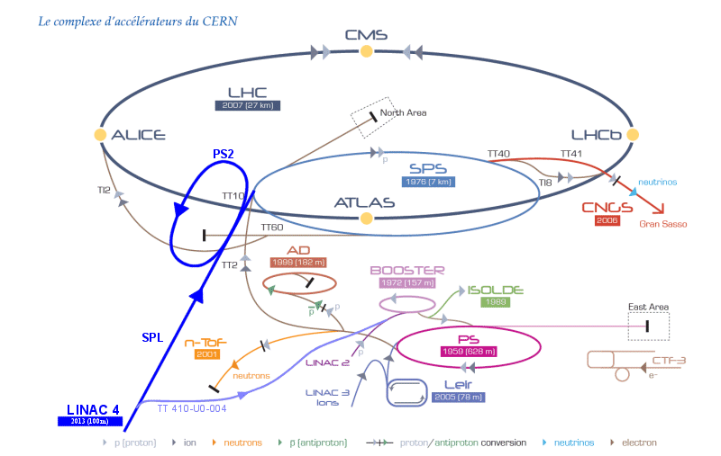
{Aceleradores do CERN}

Slide 18
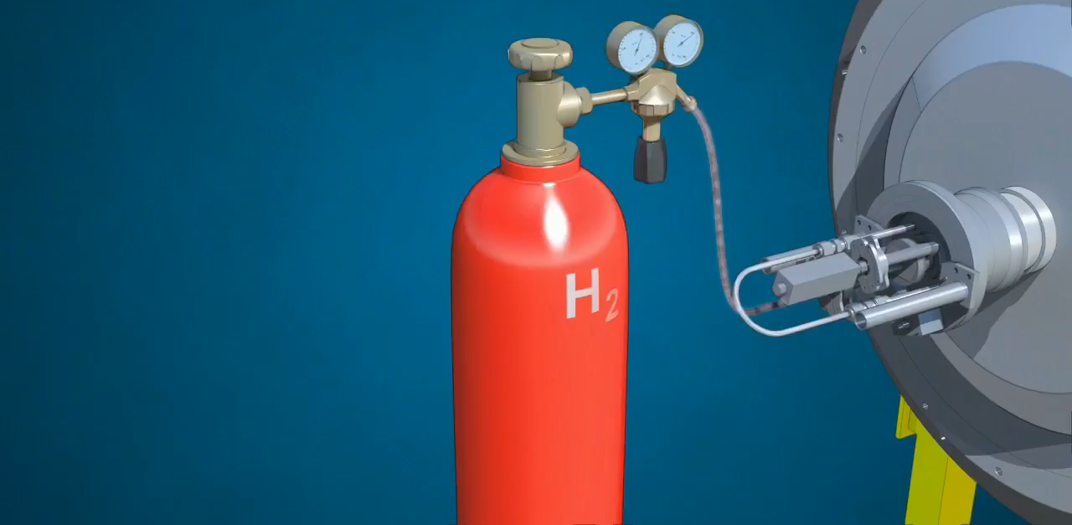
Accelerators
chain
Notes:
But how do we produce protons and grant them the energy of a flying mosquito?
First we start with a bottle of hydrogen gas.
Hydrogen is quite close to what we want. It’s made of protons. With one electron orbitting around.
We send hydrogen gas through an electric field. Proton which has a positive charge goes through. Electron whic has negative charges bounces back and it removed. We are then left only with protons.
They are sent through the LINAC (LINear Accelerator) which uses alternating electric fields to either attract or push the protons. It is so efficient that after only 45m they have been accelerated to a 1/3 of the speed of light, that is 100’000 km per second. Needless to say that continuing in straight lines will be impractical.
We then send the protons to the Booster which will prepare bunches of protons in 4 superposed rings.
They are then sent in the PS (Proton Synchrotron). This machine is 600m circumference, was built in 1959 and is still in use! In 1.2 seconds it accelerate protons to 99% of the speed of light. Very efficient. But cannot go faster. We then need to transfer protons to the «2nd gear of our accelerator complex».
The SPS (Super Proton Synchrotron) build in 1976 and of 7km curcumference. In 3 seconds, it accelerate particle to 99.9% of the speed of light. Once again cannot go faster.
Then half of the particles are sent clockwise and half anti-clockwise into the LHC (Large Hadron Collider). This machine is the largest machine on Earth: 27 km circumference. It will take about 20 minutes to reach our maximum velocity: 99.9999991% of the speed of light which correspond to 7 TeV energy.

Slide 19
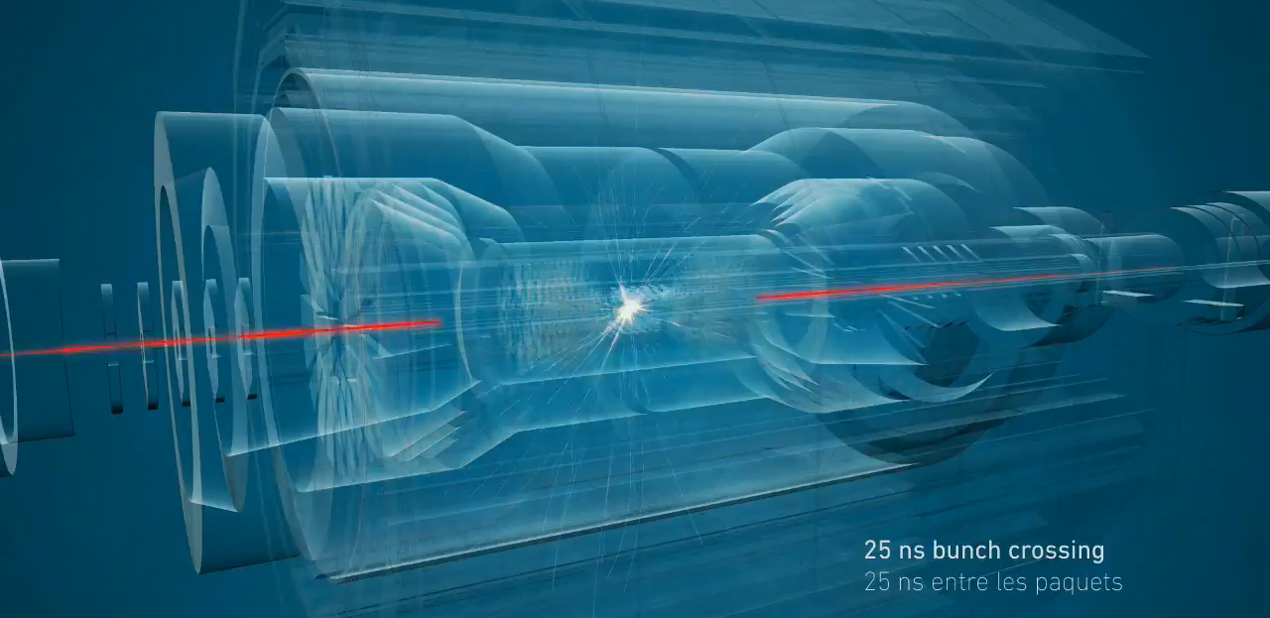
Million of collisions
Notes:
The 2 beams are circulating in separate pipes and in 4 places we cross the 2 pipes over so that collision occur there and only there.
We have built particle detectors which will observe and record the traces of new particles created in the collision.
There are so many protons and they go so fast that around 600 million collisions will occur every SECOND in each of the 4 detectors.
These detectors are a bit like huge digital cameras of about 100 Megapixel resolution. Guess the size of the SD card to store the LHC’s pictures?

Slide 20
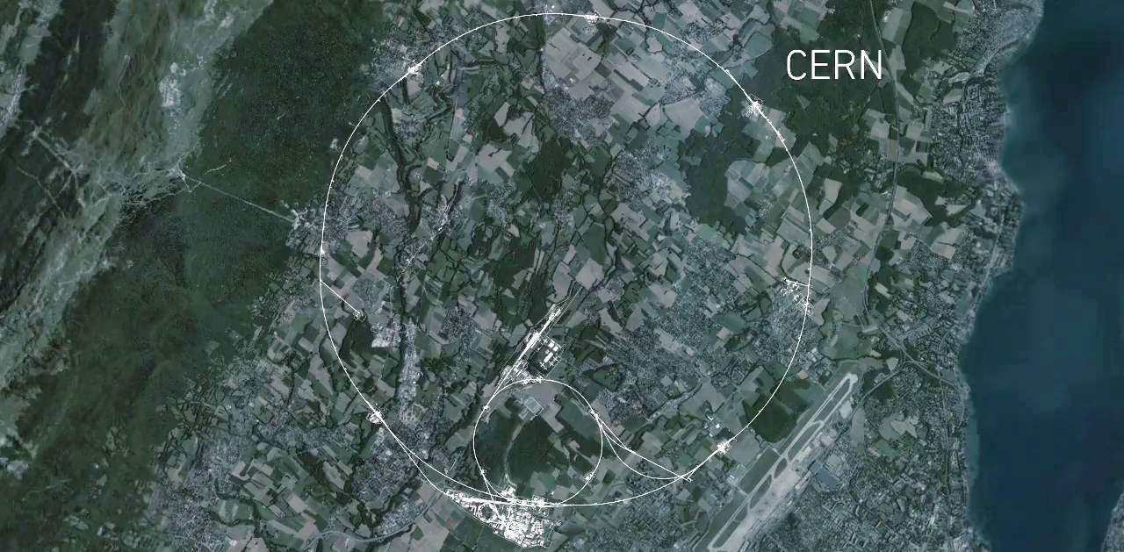
A maior maquina do planeta
CMS
ALICE
ATLAS
LHCb
Notes:
This is a map of the complex of main accelerators of CERN.
The dotted line is the French-Swiss border.
The 2 main CERN sites are Meyrin and Prévessin (as big, but not as built nor populated)
The PS is the tiny 600m ring on the Meyrin site, the SPS goes accross the border and the LHC takes all the space between Geneva airport and the Jura (dark green on the left).
The 4 red dots represent where the 4 detectors are located.

Slide 21
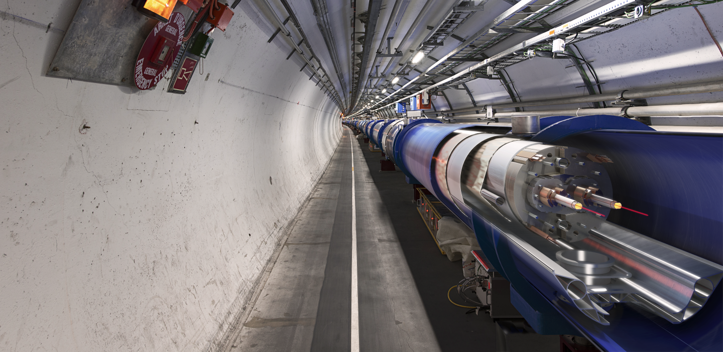
Os magnétos mais poderosos
~9000 magnetos supercondutores
Notes:
The LHC is built underground, mainly for financial reasons (would have cost too much to buy all the land and would have been impractical anyway).
It also provide natural shielding of radiations for the population but also shielding from cosmic rays to the 4 detectors.
The LCH is mainly hosted in a 3m diameter tunnel containing mostly superconducting magnets and some accelerating devices.
You can see on the picture that the 2 counter-rotating beams are hosted in different pipes, making collisions impossible there.

Slide 22
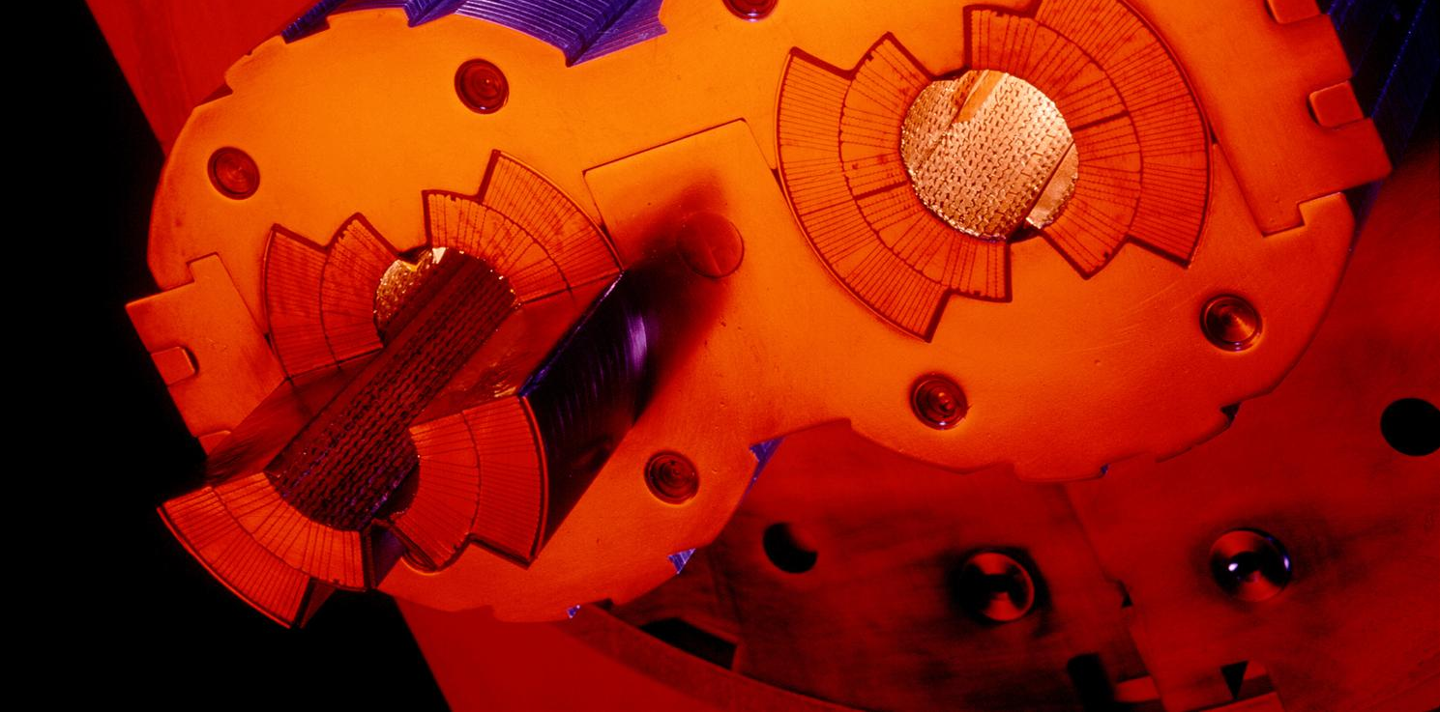
O Vazio mais « forte »
Notes:
These 2 pipes need to be as empty as possible (otherwise protons would hit air molecules all the time).
Thanks to turbo-molecular pumps and other technologies, we reach a vacuum of 10^-13 atmosphere in the centre of the pipes: this is 10 times emptiers than on the surface of the Moon or as empty as in the solar system.
The magnetic field which curves the beam, is provided by the coils surrounding the pipes. As each beam holds as much energy as in a high-speed train, the magnets must deliver a tremendous magnetic field of 9 T (tesla). This equates to 200’000 times the magnetic field of Earth (ca 45 micro tesla)
For that, each of the small electric cableyou see around the vacuum pipes (1mm by 10mm section) a current of 11’000 amperes (in comparison in your home there is a current of about 20 amperes in the wires).

Slide 23
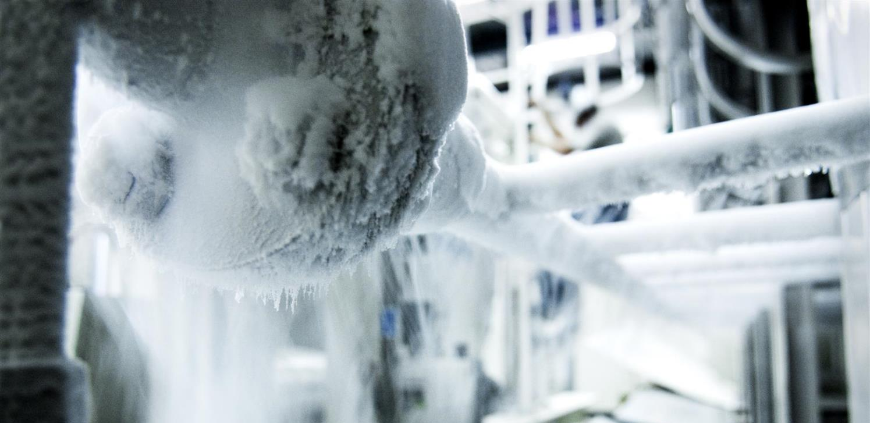
A
temperatura
mais
baixa
-271 Celsius ( 1.9K)
Notes:
That’s why we need to cool down the cables to the lowest temperature possible.
We have to reach -271°C (or 1.9° kelvin, which is 1.9° above the absolute zero).
At that temperature, the cables made of Niobium Titanium (NbTi) are «superconducting», it means they don’t heat up anymore as they have no electric resistance.
LHC is colder than the vast majority of the Universe whose average temperature is 2.725° kelvin (if you look for a «cool» place to work, CERN is a good one)
This is possible thanks to cryogenic facilities using 120 tonnes or 700’000 litres of Helium!

Slide 24
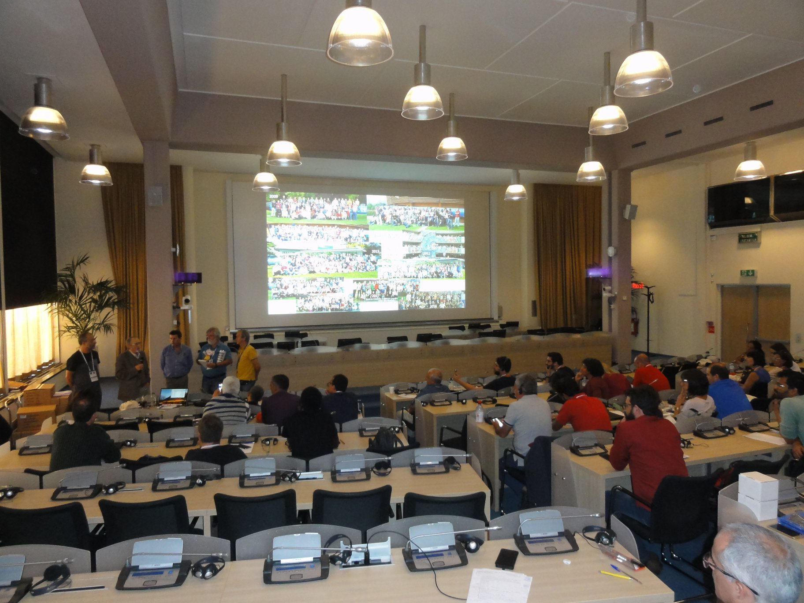
Os
melhores
professores
do mundo!!
Notes:
That’s why we need to cool down the cables to the lowest temperature possible.
We have to reach -271°C (or 1.9° kelvin, which is 1.9° above the absolute zero).
At that temperature, the cables made of Niobium Titanium (NbTi) are «superconducting», it means they don’t heat up anymore as they have no electric resistance.
LHC is colder than the vast majority of the Universe whose average temperature is 2.725° kelvin (if you look for a «cool» place to work, CERN is a good one)
This is possible thanks to cryogenic facilities using 120 tonnes or 700’000 litres of Helium!

Slide 25
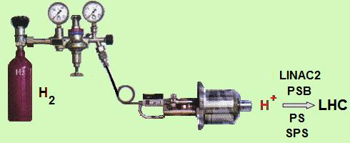
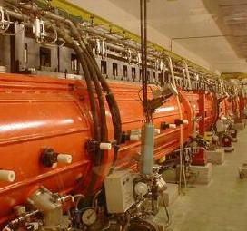
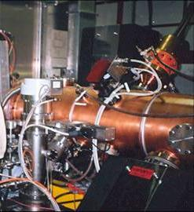
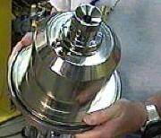
Gerador de Protões
Fonte de Protões
RF quadripolo - 90 KeV
LINAC2 - 50 MeV

Slide 26
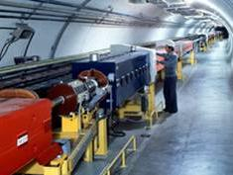
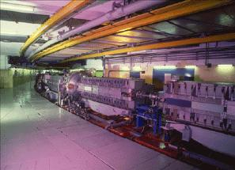
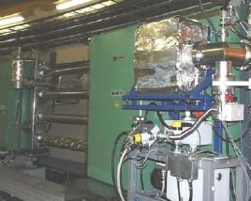
Acelerar Partículas
PS Booster 1.4 GeV | Proton Synchrotron 25 GeV | Super PS 450 GeV
Entre criar os grupos de protões e leva-los a circular no SPS demora entre 5.86 seconds e 17.86 seconds No SPS a energia dos protões sobe ate 450GeV e demoram 4.3s a serem injectados no LHC

Slide 27

Túnel LHC
13 000 Amp ( TeV)
1232 dipolos
392 quadripolos

Slide 28
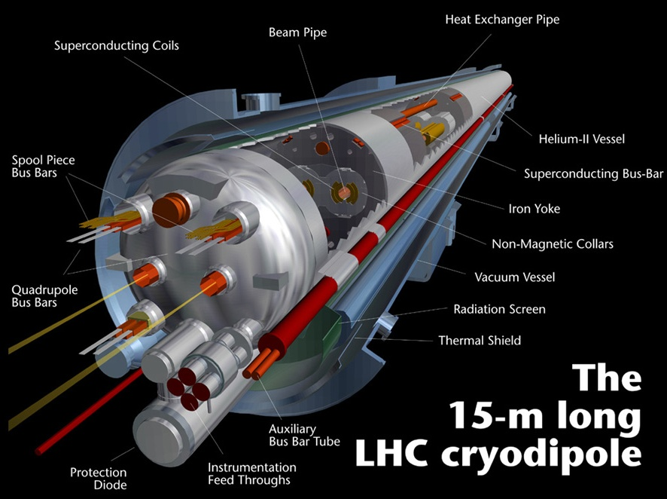
Íman Dipolar ou Dipolo

Slide 29
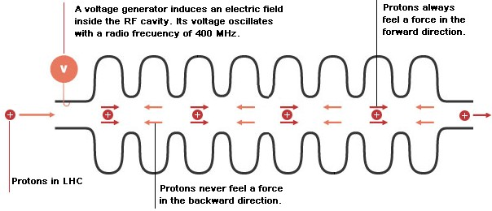
Acelerar as partículas
Cada Protão que passa nas cavidades de radiofrequência fica sujeito a:
2 x 8 MV = 16 MV
Recebe, portanto 16 MeV de energia extra
E como cada protao da 11245 voltas ao LHC pro segundo recebe :
(16 MeV/lap) x (11245 laps/s)= 1.8·10⁵ MeV/s or 0.18 TeV/s
Jose C Silva, ESAP Agueda

Slide 30
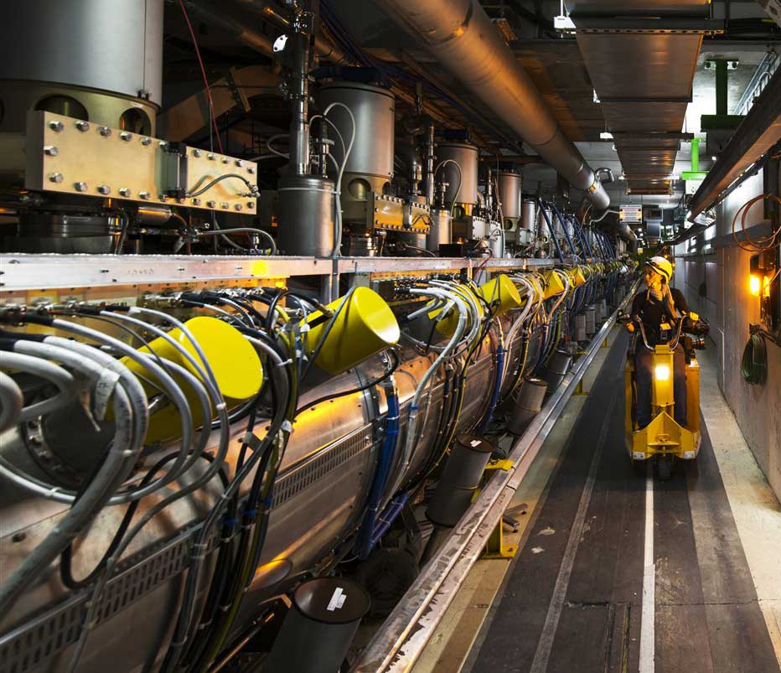
Acelerar as partículas
Cavidades RF LHC
Jose C Silva, ESAP Agueda

Slide 31
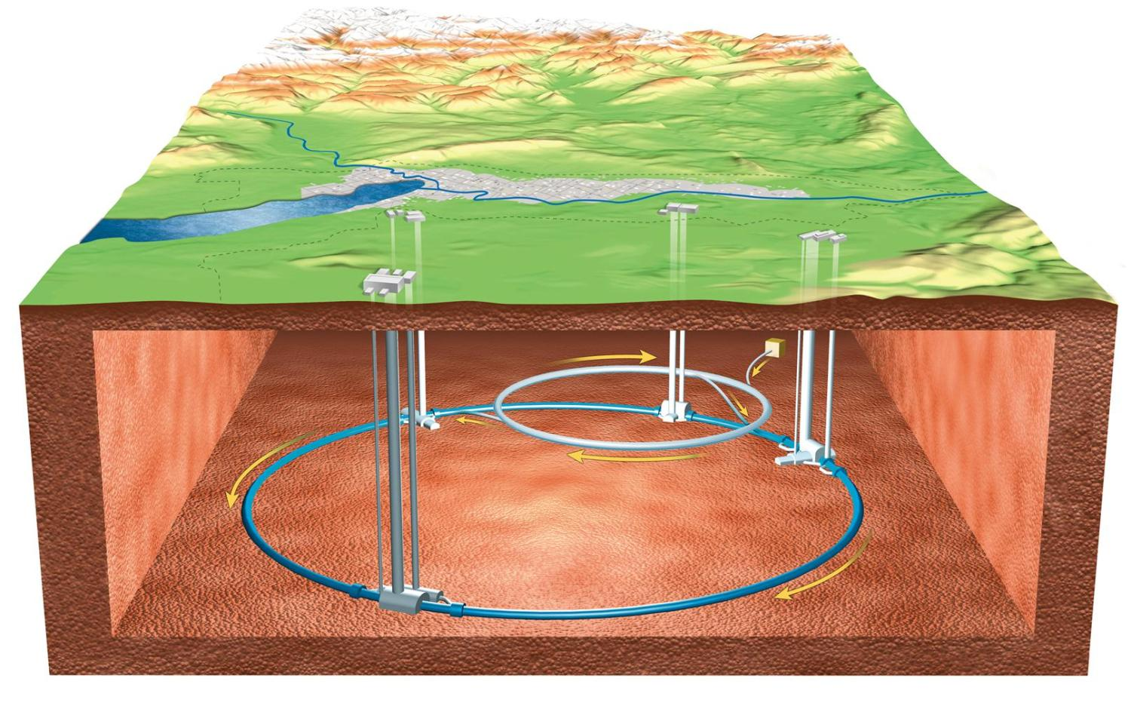
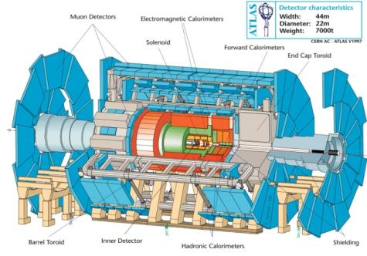
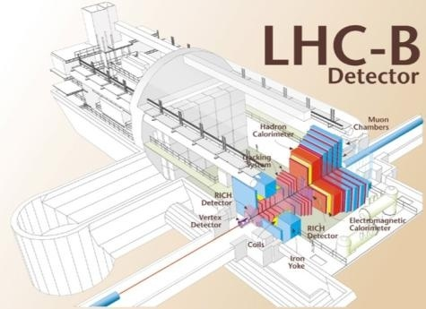
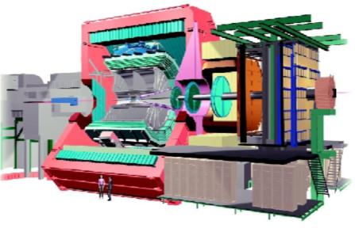
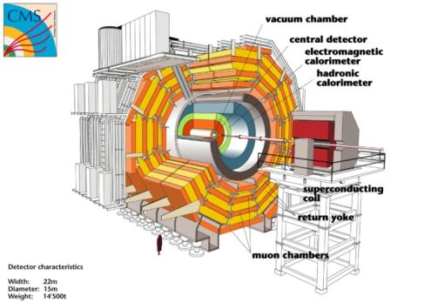
ALICE

Slide 32
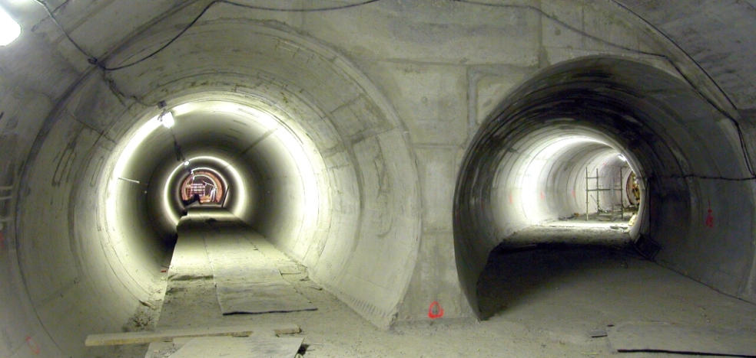
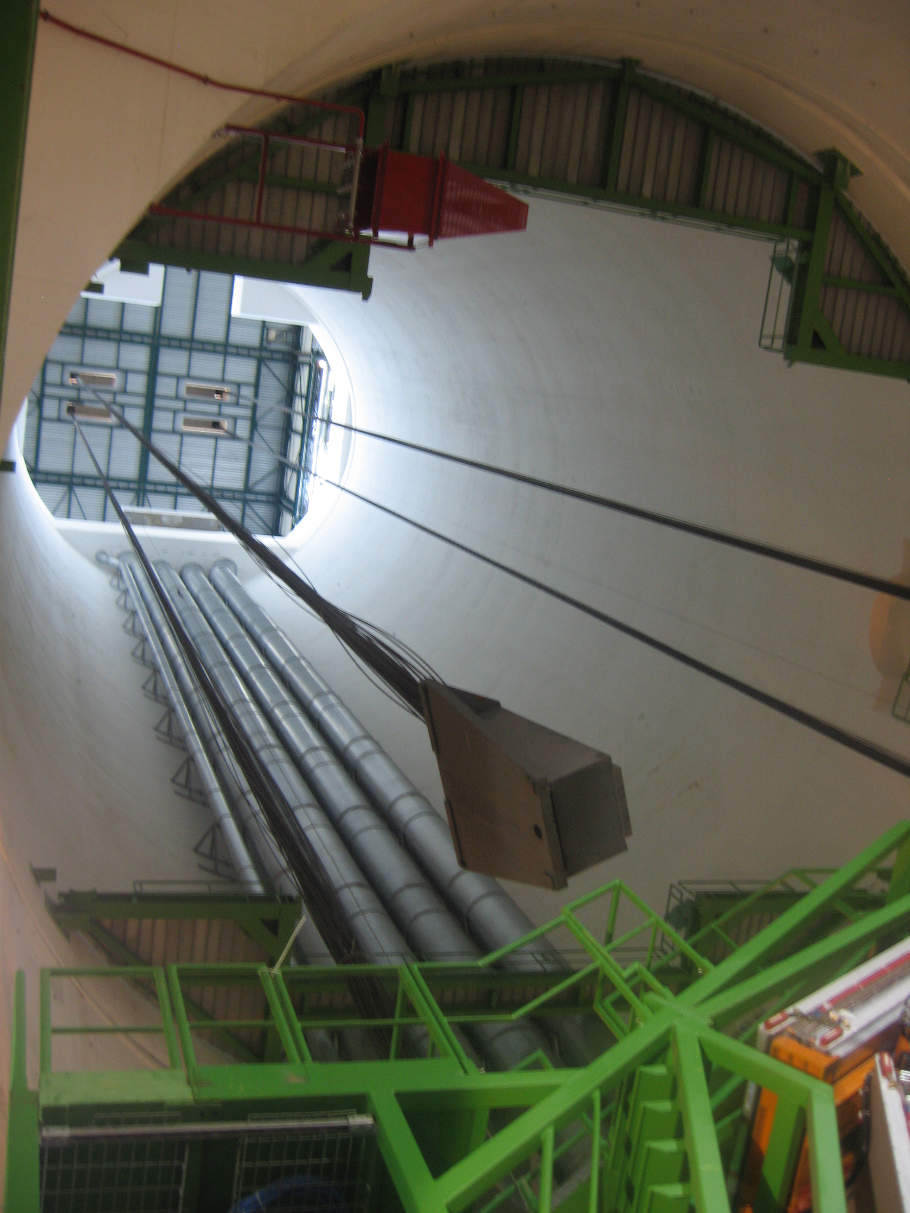
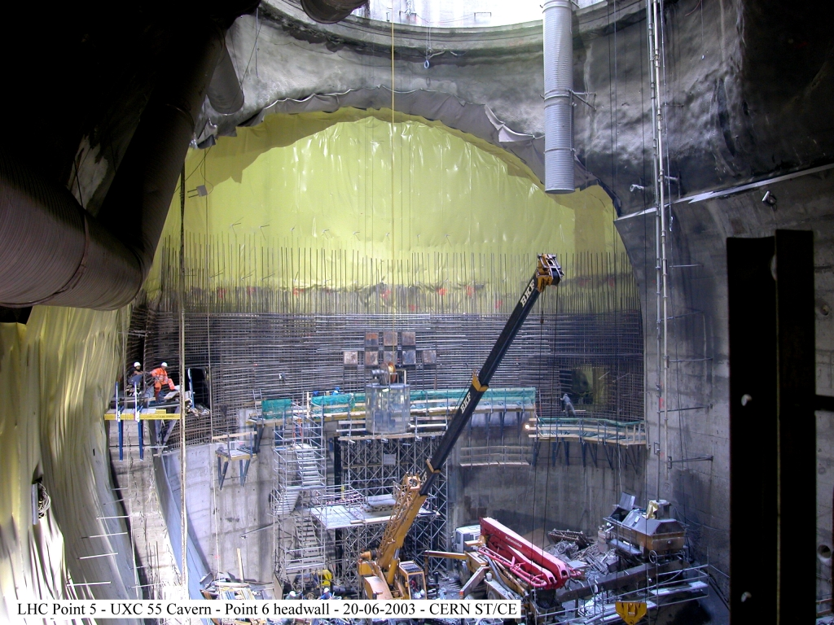
LHC
27 km perímetro
100 m profundidade

Slide 33
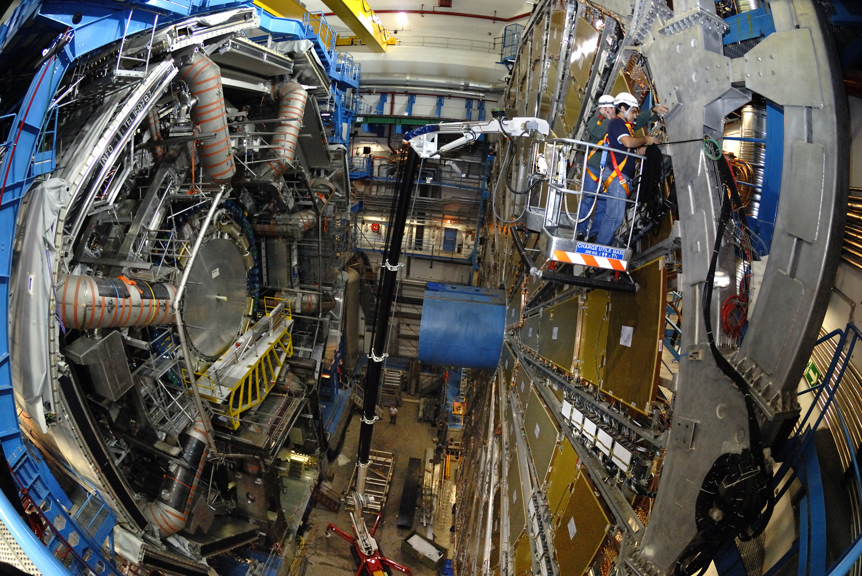
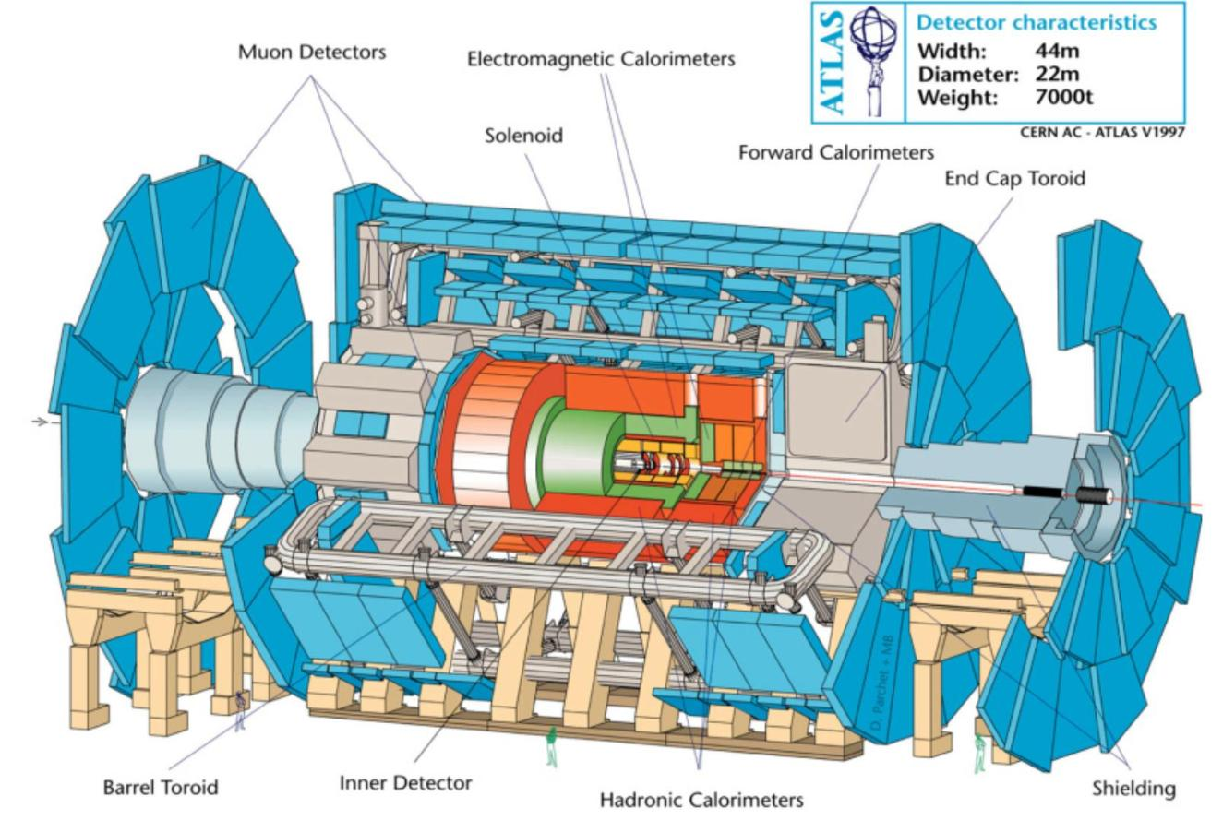
ATLAS Experiment

Slide 34


CMS Experiment

Slide 35
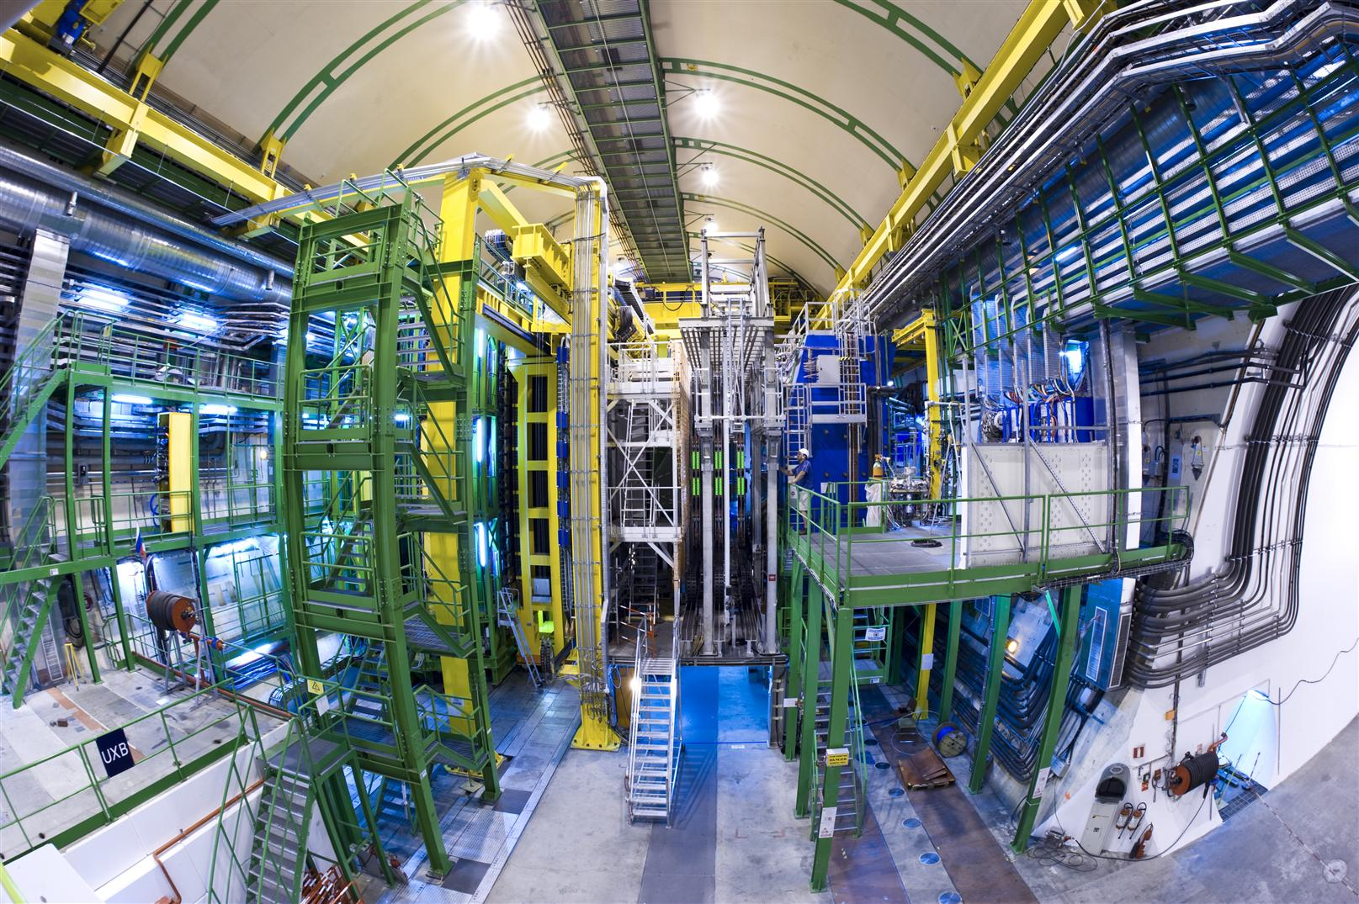

LHCb Experiment

Slide 36


ALICE Experiment

Slide 37





Alpha Magnetic Spectrometer, AMS-02
AMS Centro de Operações
@CERN Prevessin

Slide 38


The GRID: a possible solution to CERN computing needs
The LHC computing GRID is a project funded by the European Union. The objective is to build the next generation computing infrastructure providing intensive computation and analysis

Slide 39






“home made” (CMS, PET, MT)

Slide 40







“home made” (CMS, PET, MT)
www.petsyselectronics.pt

Slide 41
LHC (plano de utilização )
LHC
HL LHC
Long
technical
shutdown 1
LS1
Long technical
shutdown 2
LS2
Long
technical
shutdown 3
LS3
2035
2011
2012
2013
2014
2015
2016
2017
2018
2019
2020
2021
2022
2023
2024
2025
13-14 TeV
14 TeV
energy
3000 fb⁻¹
luminosity
7 TeV
8 TeV
300 fb⁻¹
30 fb⁻¹
150 fb⁻¹
Notes:
The LHC is planned to be run until around 2035.
It takes about 6 months to start or stop the LHC. Therefore, we plan long «Run» periods of about 2-3 years with «Long Shutdown» periods of 2-3 years in between.
3 Long Shutdowns have been planned.
We are now in the Run 2 period where the energy (speed) of the beams has bee increased compared to previous Run.
Later on we will increase the «Luminosity» (i.e. the capacity of producing many collisions per second) by increasing the number of bunches in each beam and the number of protons in each bunch.
Run 1 has only produced 1% of the collision we plan to make wiht the LHC over its lifetime. More discoveries ahead!

Slide 42

Esta semana:

Slide 43

Basics:
Jose Carlos : +41754112406
(internal : 162406)

Slide 44


ITW2017_Basics - PDF-XChange Editor
Para todas as visitas :

Slide 45


ITW2017_Basics - PDF-XChange Editor
2.9.18
8.9.18
Portuguese Teachers Program
Pedro.Abreu@cern.ch

Slide 46




Slide 47




Obrigado e
Uma Boa Escola!
Colaboração Internacional
Pesquisa
Física Fundamental
Formação
Tecnologia

