Slide 1
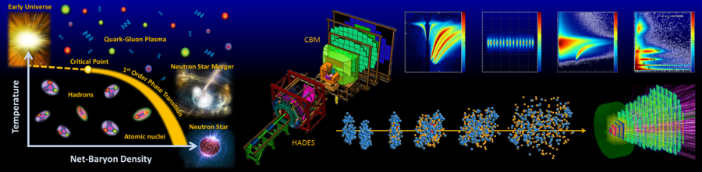
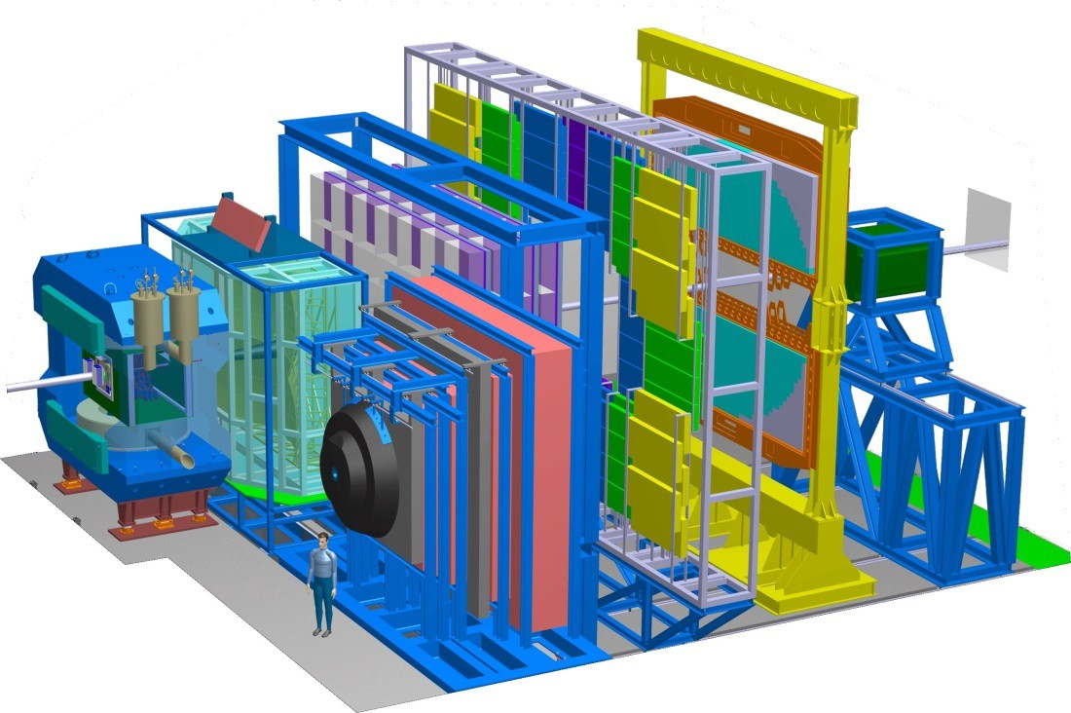
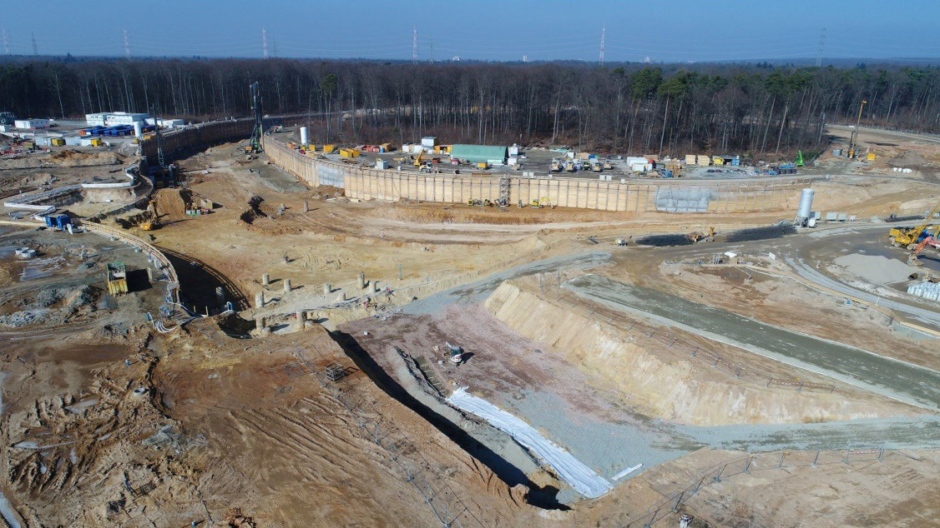
Perspectives on strangeness physics with the CBM experiment at FAIR
I.Vassiliev for the CBM Collaboration
TOF
TRD
RICH
ECAL
PSD
STS MVD
MUCH
Physics case
MSH reconstructions
BES-I MSH measurements, models and predictions
Tests with experimental data
Summary
13 June 2019 Bari

Slide 2
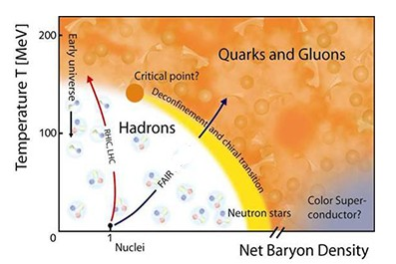
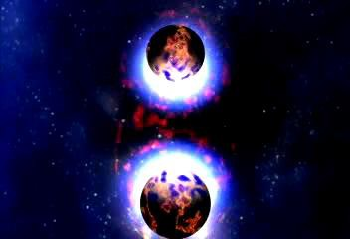
Physics case: Exploring the QCD phase diagram
LHC RHIC
SPS-CERN
The equation-of-state at high ρ_{B}
collective flow of hadrons,
particle production at threshold energies:
multi-strange hyperons, hypernuclei
Deconfinement phase transition at high ρ_{B}
excitation function and flow of strangeness (K, Λ, Σ, Ξ, Ω and ϕ)
Chiral symmetry restoration at high ρ_{B}
in-medium modifications of hadrons (ρ)
excitation function of multi-strange (anti)hyperons
QCD critical endpoint
excitation function of event-by-event fluctuations
(π, K, p, Λ, Ξ, Ω…)
BES
CBM
Projects to explore the QCD phase diagram at large µ_{B}: RHIC (STAR) beam energy-scan, HADES, NA61@SPS, MPD@NICA: bulk observables
CBM: bulk and rare observables, high statistic!
2

Slide 3
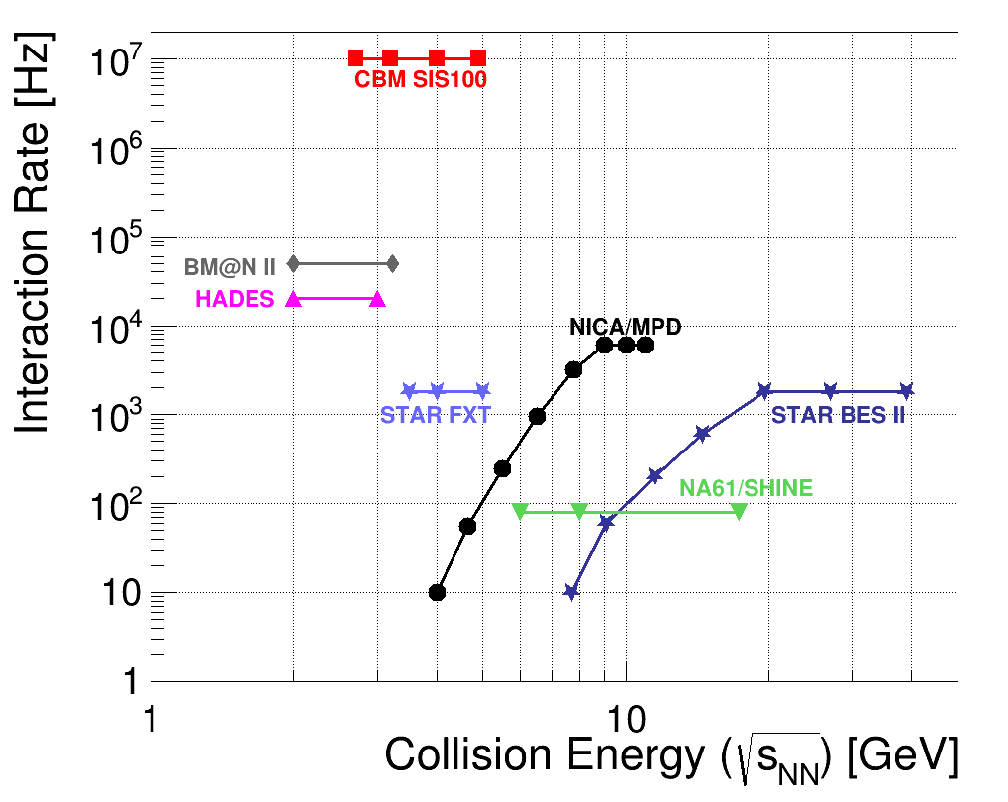

Experiments exploring dense QCD matter
high net-baryon densities
CBM:
unprecedented (high) rate capability
determination of (displaced) vertices with high resolution (≈ 50 μm)
identification of leptons and hadrons
fast and radiation hard detectors
self-triggered readout electronics
high speed data acquisition and
online event selection
powerful computing farm and 4D tracking
software triggers
Day 1
3

Slide 4
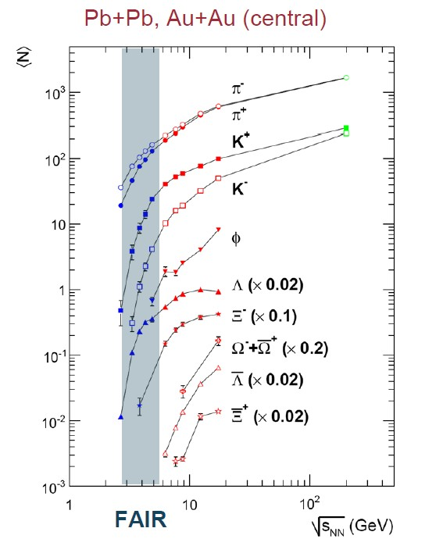
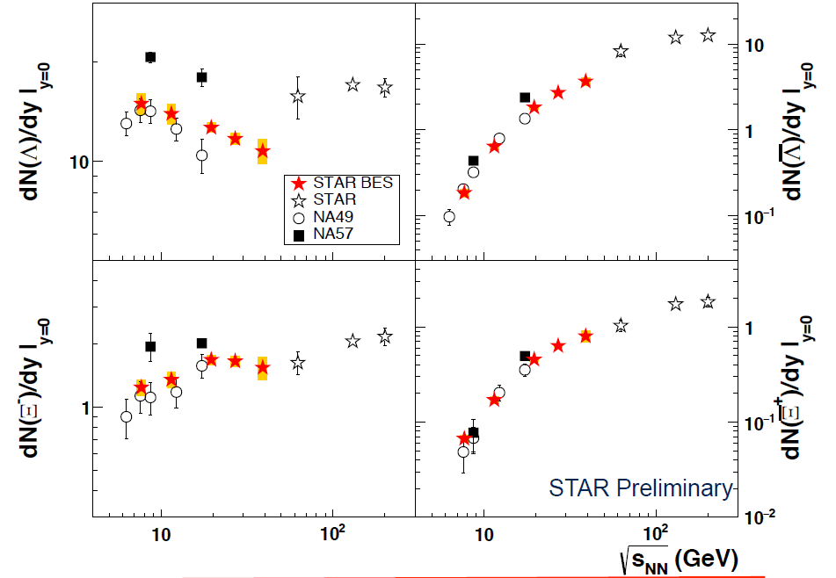
Strangeness world data
STAR BES-I
arXiv:1906.03732v1 [nucl-ex] 9 Jun 2019
No data available at FAIR energy
In the AGS (SIS100) energy range, only about 300 Ξ⁻ hyperons have been measured in Au+Au collisions at 6A GeV
High-precision measurements of exci-tation functions of multi-strange hyperons in A+A collision with different mass numbers A at SIS100 energies have a discovery potential to find a signal for the onset of deconfinement in QCD matter at high net-baryon densities.
What about models?
Non-trivial √s dependence
of strange baryons
Strangeness results submitted
for publication soon
Ω± (!)
Helen Caines
EMMI Workshop
GSI February 2019
4

Slide 5
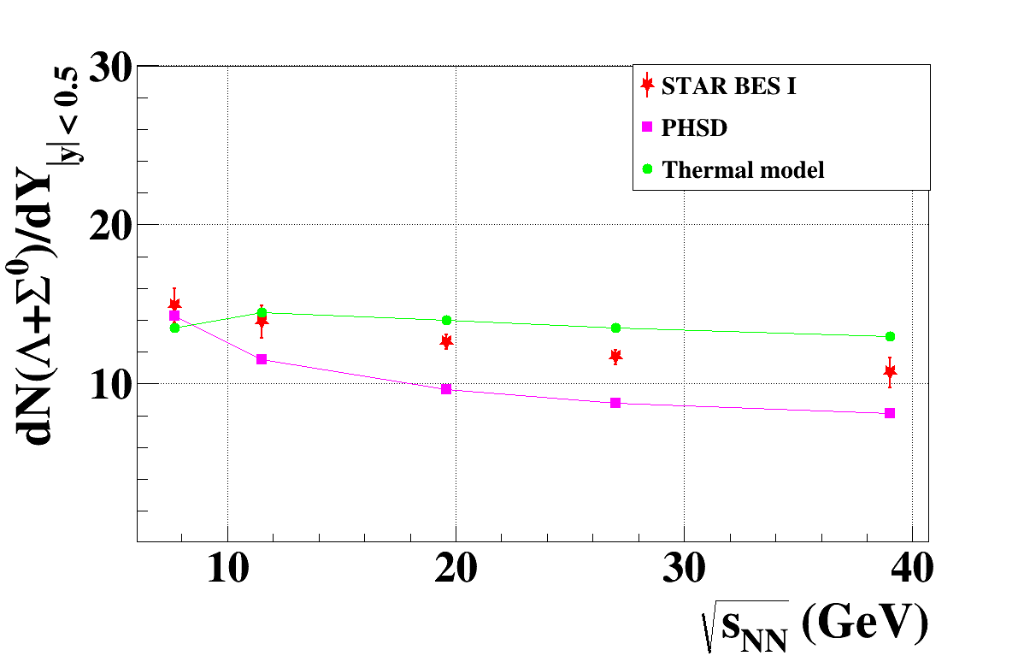
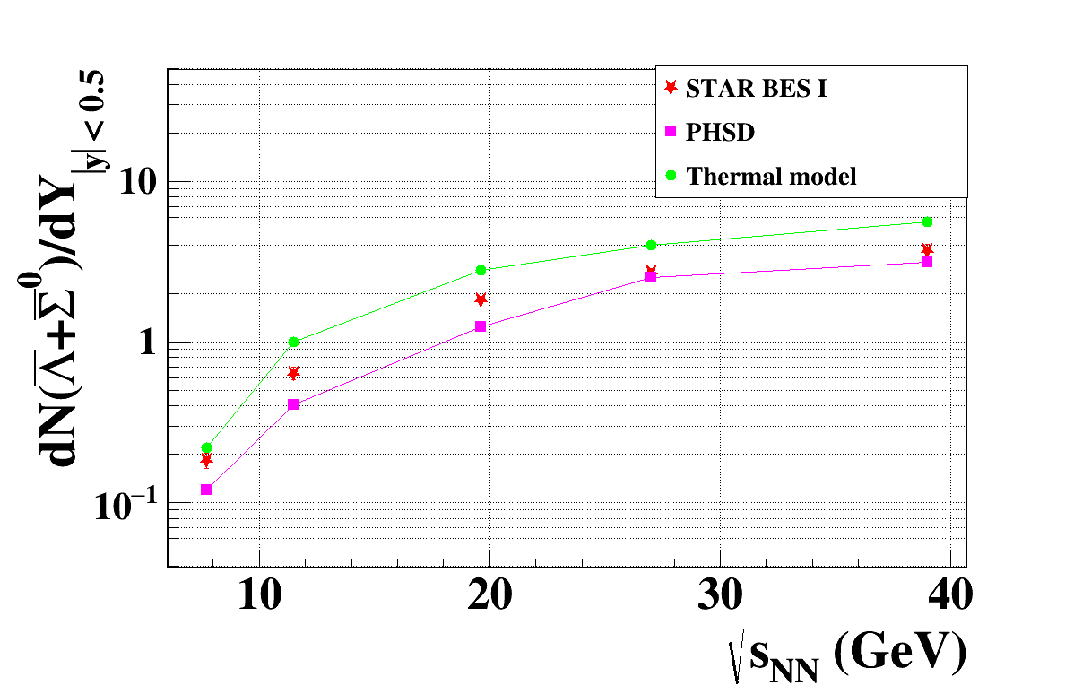
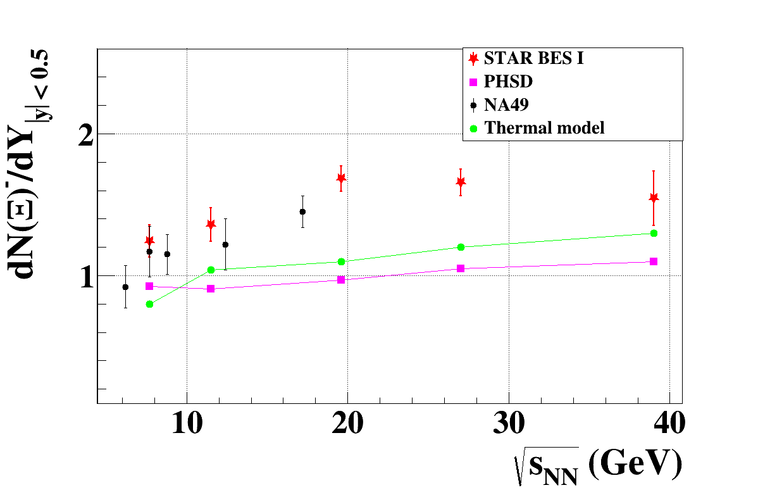
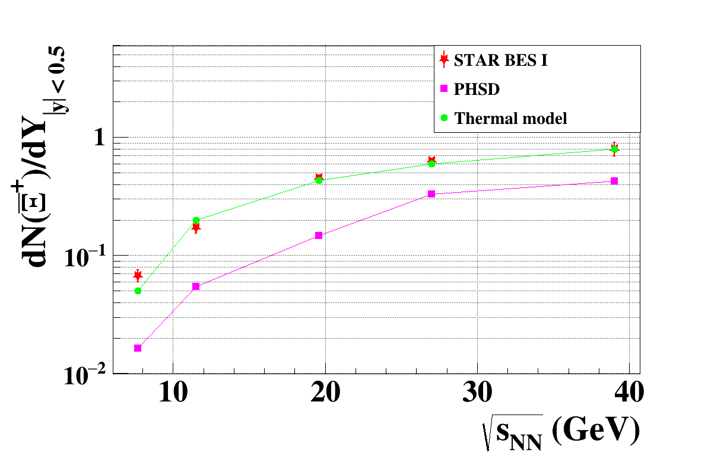
MSH measurements and models
* STAR BES data by
Helen Caines
EMMI Workshop
GSI February 2019
- Thermal model by
A. Andronic
32 CBM week
- PHSD by P.Moreau
SQM 2015
Very reasonable
agreement by both
models
More strangeness
needed (PHSD)

Slide 6
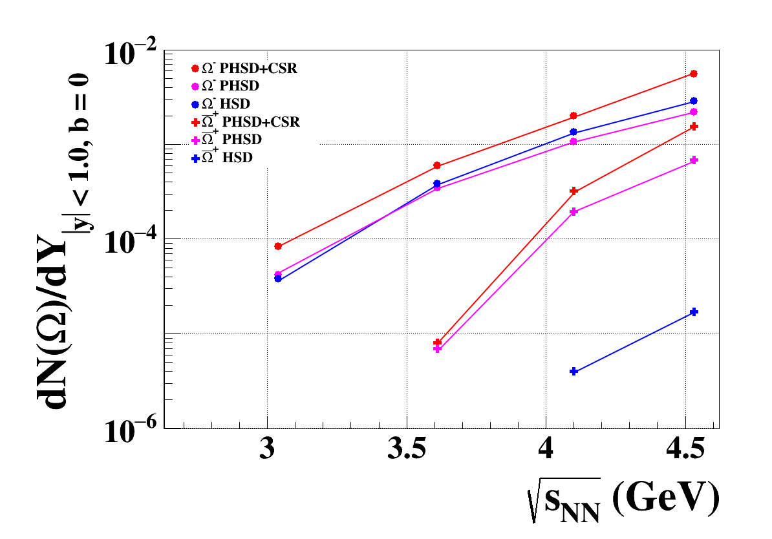

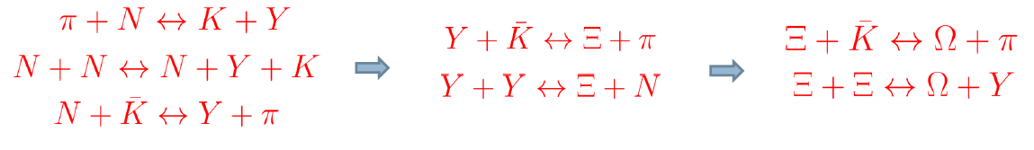
QGP and Chiral symmetry restoration
“Chiral symmetry restoration versus deconfinement in heavy-ion collisions at high baryon density”
W. Cassing, A. Palmese, P. Moreau, and E. L. Bratkovskaya Phys.Rev. C93 (2016), 014902, arXiv:1510.04120 [nucl-th]
preliminary
Chiral symmetry restoration (CSR) change the
flavor decomposition – more s-sbar pairs produced.
w CSR
Ω⁻ (sss)
Droplets of QGP allow to interact s-sbar quarks and create more multi-strange (anti)-baryons.
Ω̅ ⁺ (s̅ s̅ s̅ )
Presence of QGP significantly increase yield of Ω⁺at FAIR energy
w QGP
wo QGP
CSR effect increase yield of Ω⁻ and Ω⁺ at FAIR energy
Multi-step production of multi-strange baryons Ξ and Ω
6

Slide 7
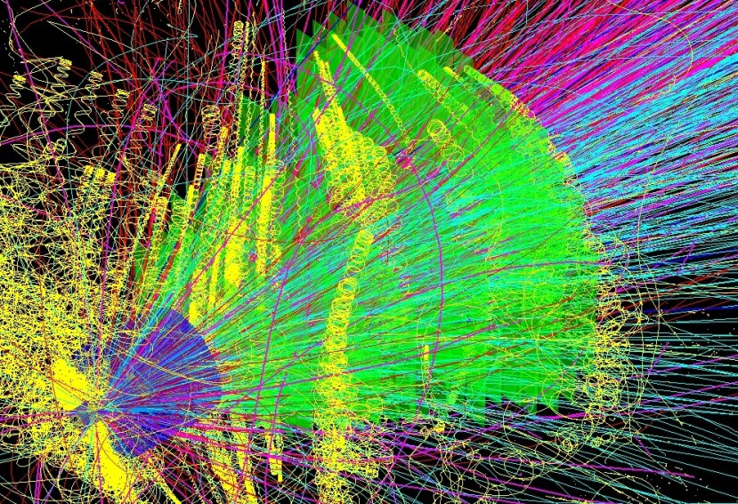
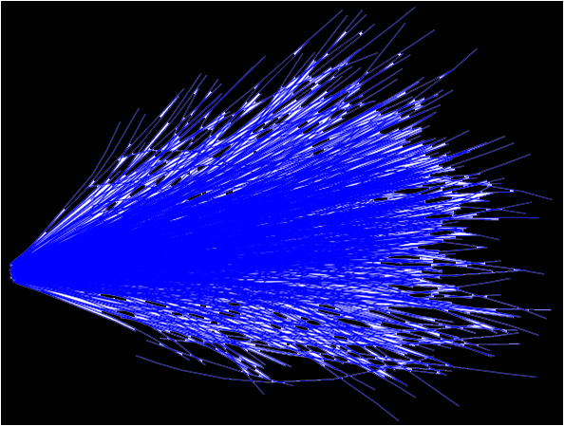
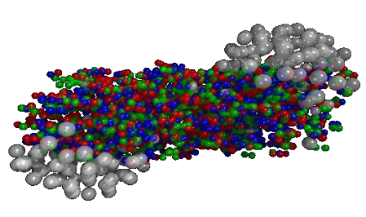

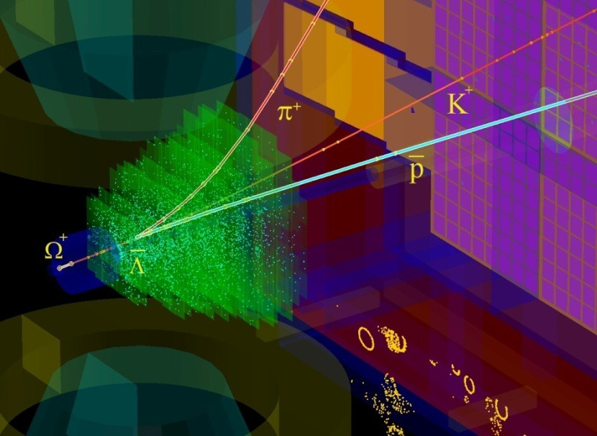
Performance of the CBM track finder
Simulation
Reconstruction
AuAu 10 AGeV/c
165 π
170 p
26 K
15 Λ
20 K_{S}⁰ 0.3 Ξ⁻
UrQMD
2 models
Hyperons selection
For studies several theoretical models like UrQMD and PHSD are used.
Track finder is based on the Cellular Automaton method.
High efficiency for track reconstruction of more then 92%, including fast (more then 90%) and slow (more then 65%) secondary tracks.
Time-based track finder is developed, efficiency is stable with respect to the interaction rate.
Low level of split and wrongly reconstructed (ghost) tracks.
minimum bias : 6ms/core track finder,
1 ms/core particle finder
6

Slide 8
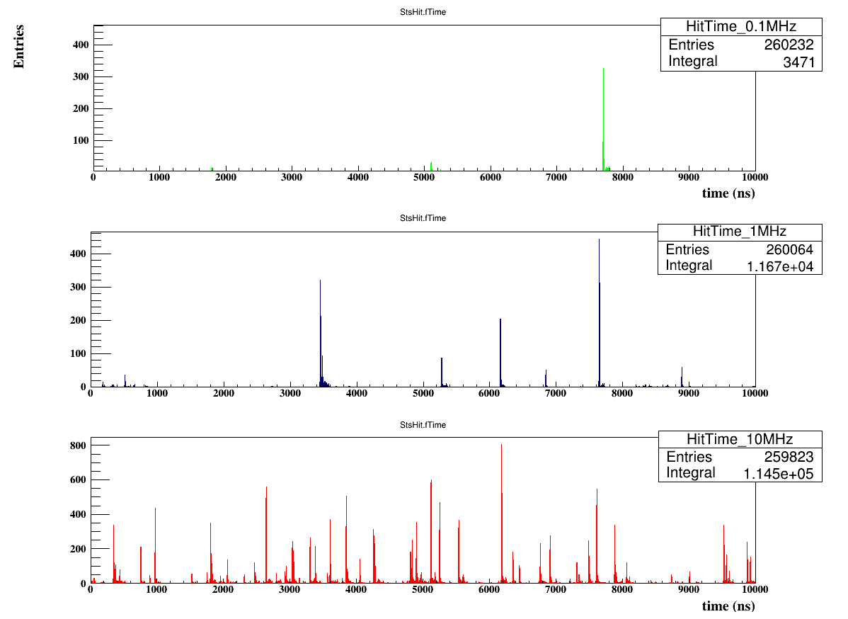
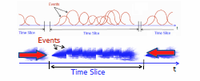
High rate scenario: event reconstruction with 4D tracking
100 kHz
1 MHz
10 μs window
10 MHz

Slide 9
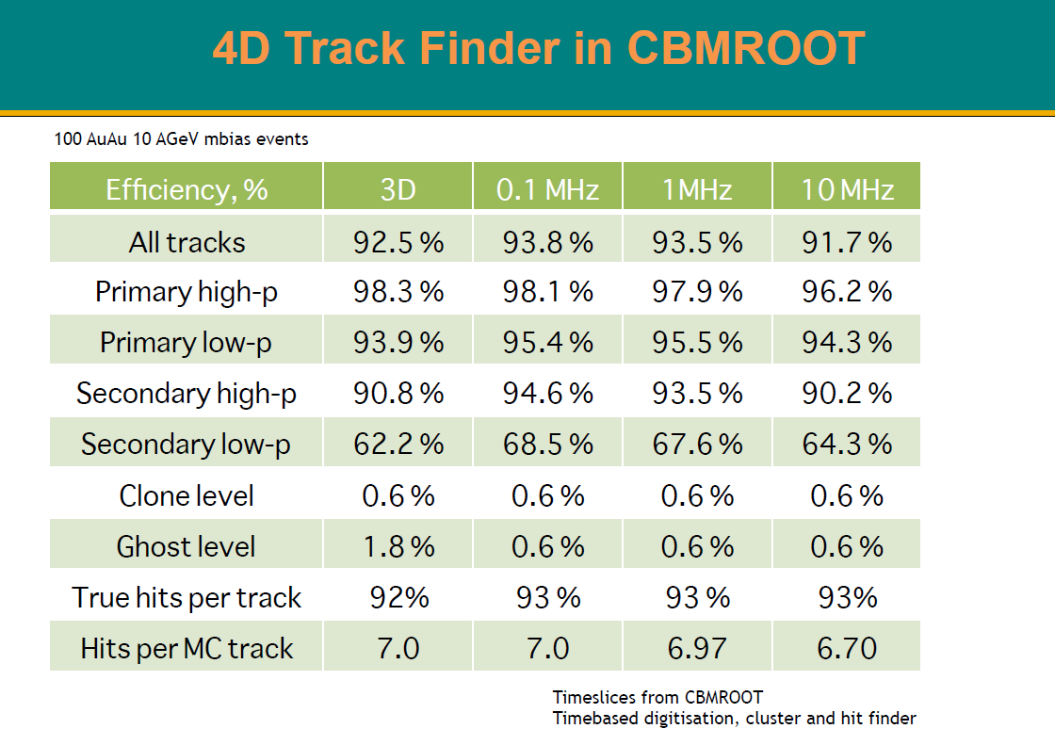
V. Akishina

Slide 10
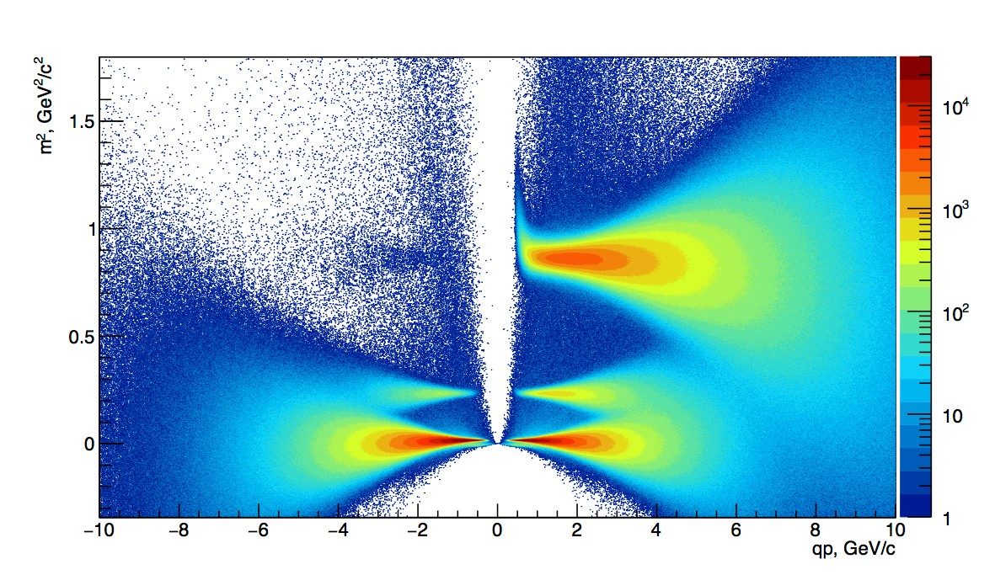
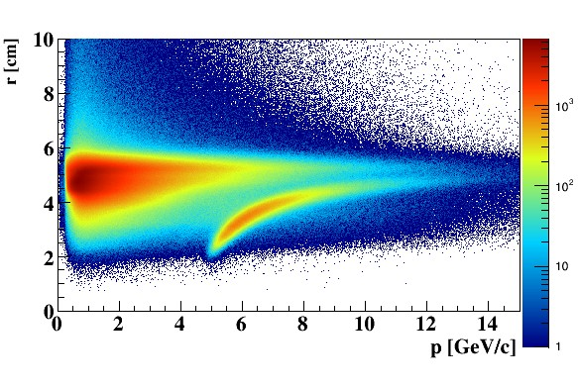
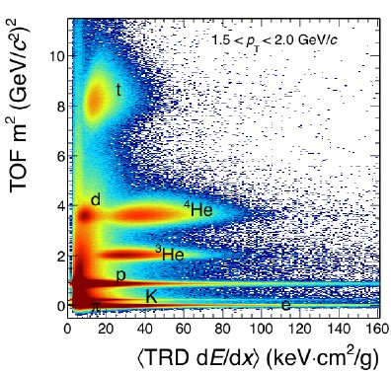
Particle identification with PID detectors
ToF: hadron identification
RICH: electron identification
p̅
p
e
_{K}-
_{K}+
π
(µ⁻,e⁻) π⁻
π⁺ (µ⁺,e⁺)
TRD: d-He separation
PID detectors:
ToF (Time of Filght) — hadron identification;
RICH (Ring Imaging CHerenkov detector) — electron identification;
TRD (Transition Radiation detector) — electron and heavy fragments identification.
PID detectors of CBM will allow a clear identification of charged tracks.

Slide 11
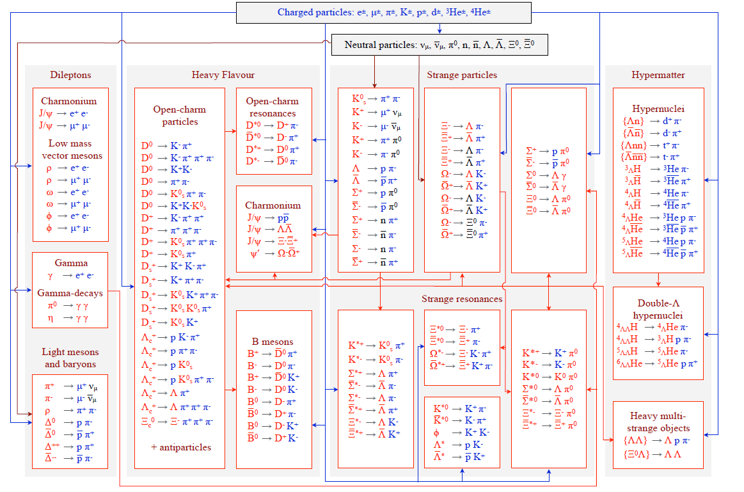
KF Particle Finder for the CBM Experiment
•
•
•
•
More than 150 decays.
All decays are reconstructed
in one go.
Based on the Kalman filter method - mathematically correct parameters and their errors.
KF Particle Finder is successfully tested in STAR and allows to reconstruct up to 2 times more signal.
STAR developments are fully merged with the KF Particle Finder repository.

Slide 12

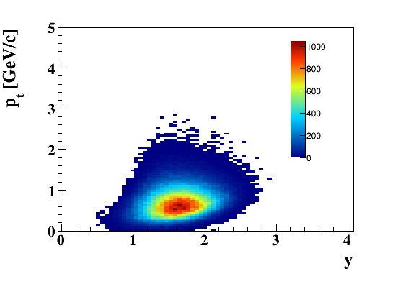
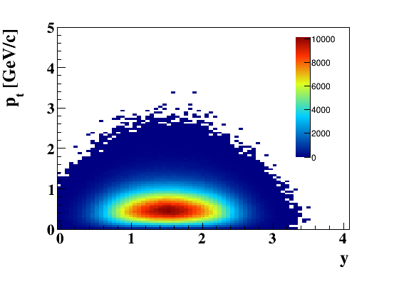
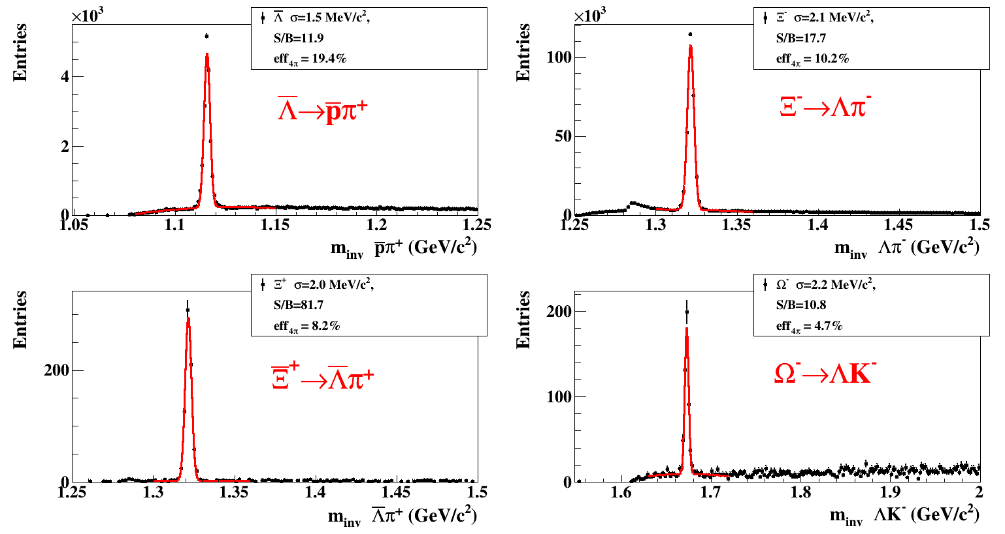
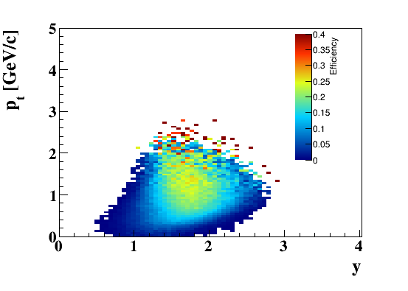
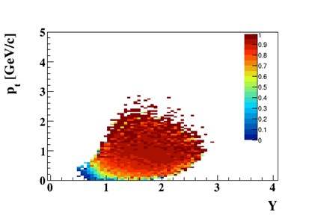
Multi Strange particle reconstruction performance
5M central AuAu collisions 10AGeV/c
Reco Ξ⁻
MC Ξ⁻
Efficiency Ξ⁻
Purity Ξ⁻
CBM will allow clean reconstruction of rare strange probes with high efficiency and high statistics.
Tools for the multi-differential physics analysis are prepared.

Slide 13
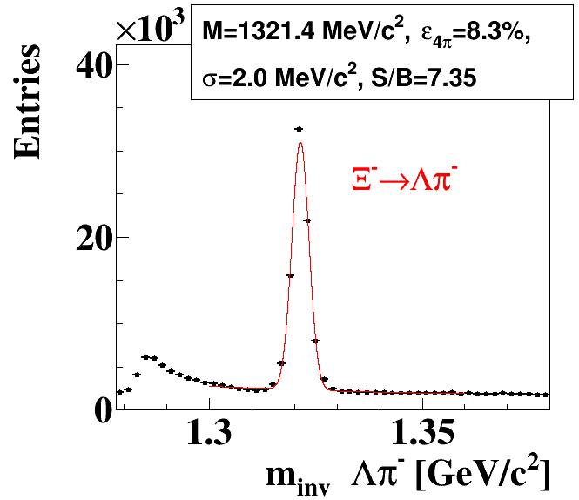
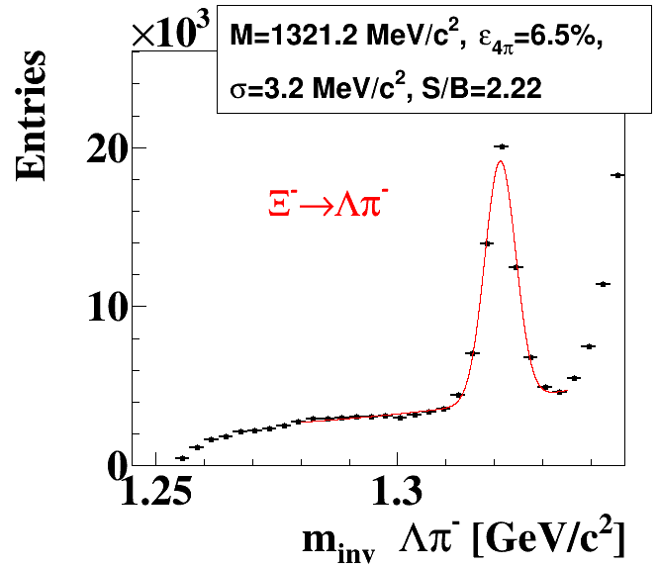
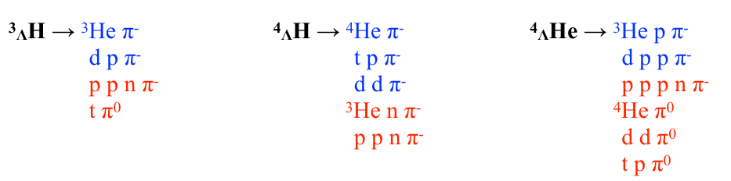
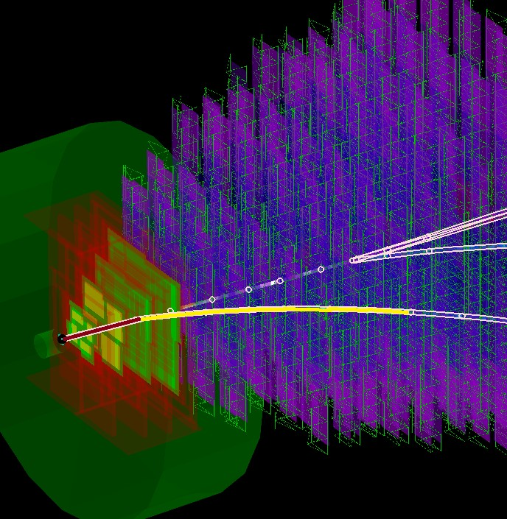
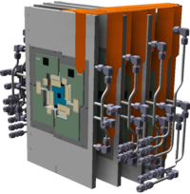
Multi strange hyperons reconstruction with missing mass method
UrQMD
5M central AuAu collisions 10AGeV/c
Comparable efficiencies, better control over the systematic errors
Σ+ and Σ- physics: completes the picture of strangeness production
conventional
m³
100
×10³
- 2
Σ σ = 5.7 MeV/c
_{Σ}+
σ = 5.2 MeV/c²
MVD
Entries
S/B = 16.5
Entries
20
S/B = 3.06
Λ
p
Σ⁻→nπ⁻
+
_{Ξ}-
Σ →nπ
+
_{π}-
50
10
_{π}-
0
1.2
1.25 1.3
m {nπ⁻} [GeV/c²]
0
1.15
1.25
m {nπ⁺} [GeV/c²]
1.2

Slide 14
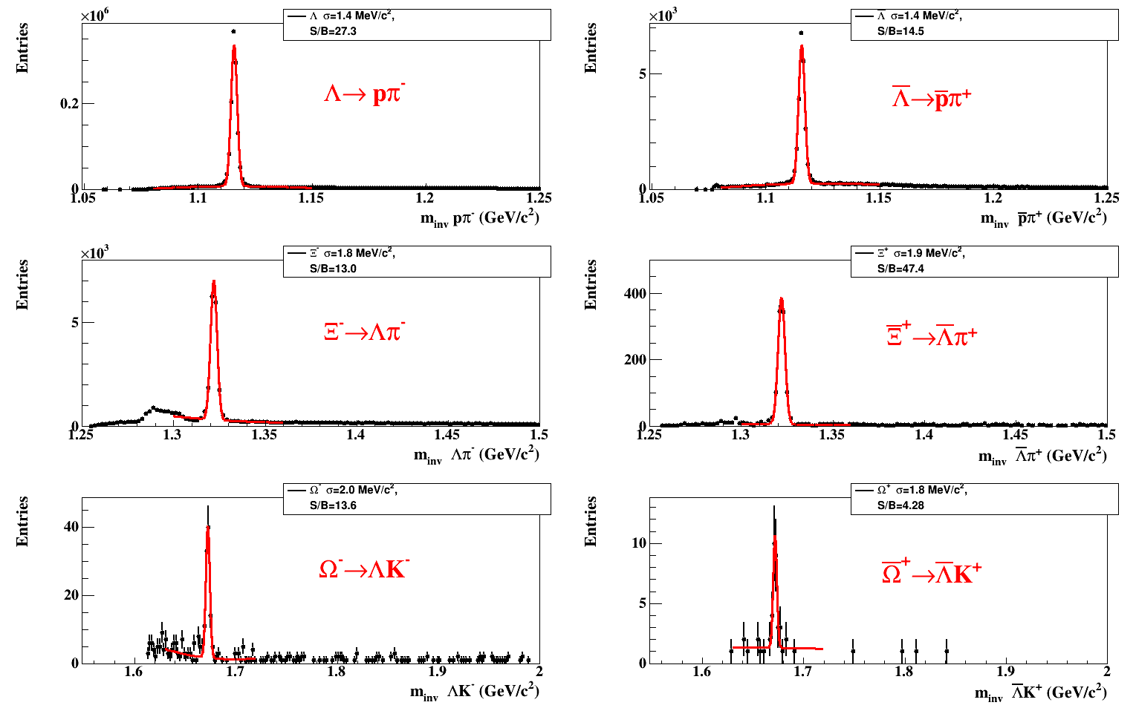
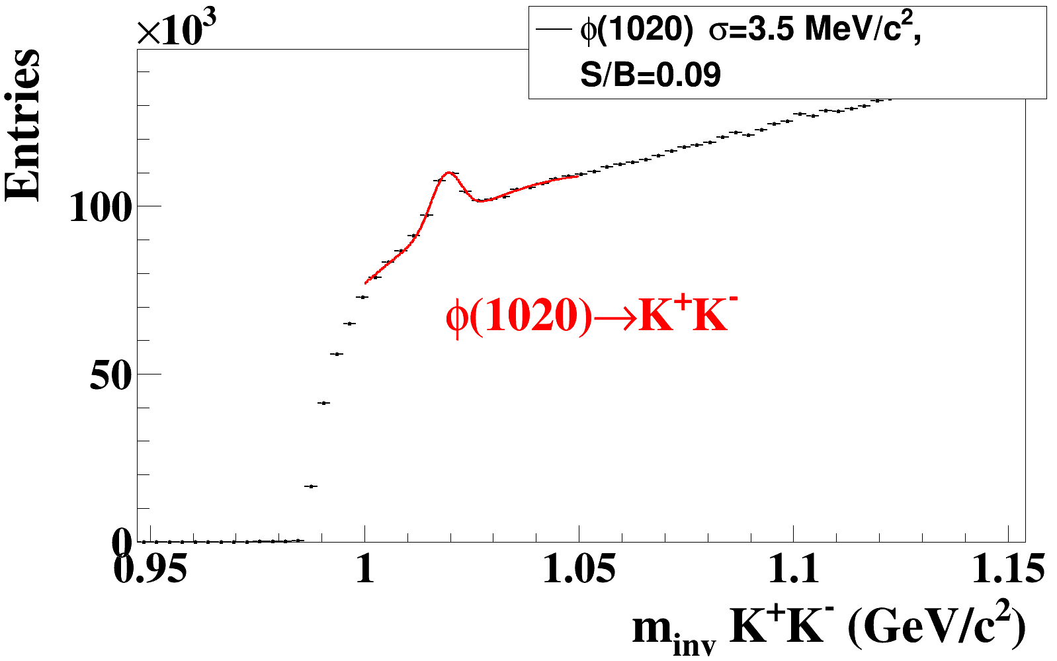
CBM KFParticle Finder test @ STAR 4.4M Au+Au events sqrt(s) = 7.7
all centralities, no cuts on rapidity
CBM KF Particle Finder is successfully applied to the STAR data in a wide energy range.
STAR data are excellent platform to test and improve our reconstruction software.

Slide 15
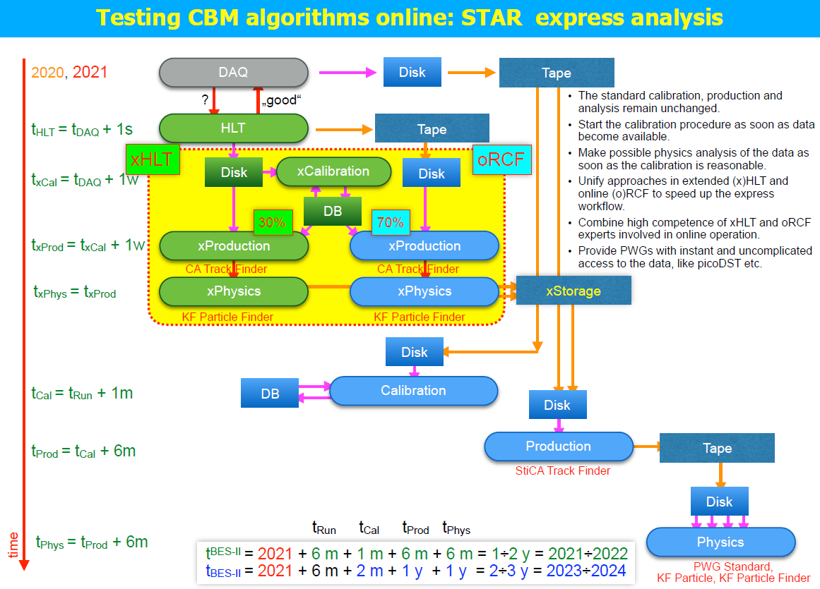

Slide 16
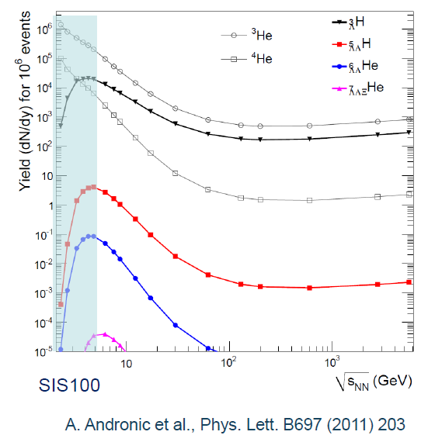
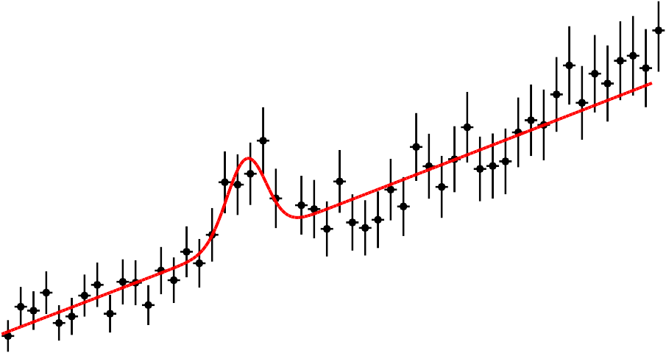
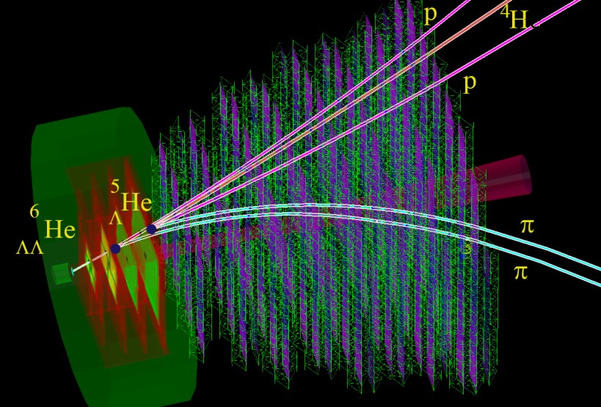
Hypernuclei production in A+A collisions
UrQMD
5M mbias events Au+Au at 10AGeV/c 50 sec at 0.1MHz IR (1.8 k/sec)
Expected collection rate: ~60 ⁶ He
ΛΛ
in 1 week at 10MHz IR (not day-1)
×10³
³H σ = 1.8 MeV/c²
⁶ He σ = 3.1 MeV/c²
ΛΛ
Entries
Λ
S/B = 2.09 ε_{4π} = 12.7%
Entries
bg scaled
S/B = 0.33, ε_{4π} = 1.3%
4
³ H→³Heπ⁻
6
ΛΛ
He→⁵ He pπ⁻
Λ
Λ
50
2
CBM Simulation 10¹² Au+Au events
s_{NN}=4.7 GeV 0-1%
0
3
3.1
5.95
6 6.05
m {³Heπ⁻} [GeV/c²]
m {⁵ He pπ⁻} [GeV/c²]
inv
inv
Λ
According to the current theoretical predictions CBM will be able to perform comprehensive study of hypernuclei, including:
  precise measurements of lifetime;
  excitation functions;
  flow.
It has a huge potential to register and investigate double Λ hypernuclei.
He decay topology
6
ΛΛ

Slide 17
Day-1: Expected particle yields
Au+Au @ 6, 10 AGeV
UrQMD
Particle (mass MeV/c²) | Multiplicity central ev. 6 AGeV | Multiplicity central ev. 10 AGeV | decay mode | BR | ε (%) | yield in 90 days 6AGeV | yield in 90 days 10 AGeV | IR MHz
Λ (1115) | 5.1·10⁻³ | 0.041 | pπ⁺ | 0.64 | 19.7 | 1.2·10⁸ | 1.0·10⁹ | 0.1
Ξ⁻ (1321) | 0.11 | 0.36 | Λπ⁻ | 1 | 9.9 | 2.0·10⁹ | 7.0·10⁹ | 0.1
Ξ⁺ (1321) | 1.8·10⁻³ | 1.5·10⁻² | Λπ⁺ | 1 | 8.7 | 3.0·10⁷ | 2.5·10⁸ | 0.1
Ω⁻ (1672) | 6.8·10⁻⁴ | 4.4·10⁻³ | ΛK⁻ | 0.68 | 4.4 | 4.0·10⁶ | 2.6·10⁷ | 0.1
Ω⁺ (1672) | 1.4·10⁻⁵ | 2.6·10⁻³ | ΛK⁺ | 0.68 | 3.9 | 7.0·10⁴ (0 w/o QGP?) | 1.4·10⁷ | 0.1
³ _{Λ}H (2993) | 4.2·10⁻² | 3.8·10⁻² | ³Heπ⁻ | 0.25 | 12.7 | 2.7·10⁸ | 2.5·10⁸ | 0.1
⁴_{Λ}He (3930) | 2.4·10⁻³ | 1.9·10⁻³ | ³Hepπ⁻ | 0.32 | 11.4 | 1.7·10⁷ | 1.4·10⁷ | 0.1
⁵_{ΛΛ}He(5047) |  | 5.0·10⁻⁶ | ³He2p2π | 0.01 | 3 | 15 | 250 | 0.1
⁶_{ΛΛ}He(5986) |  | 1.0·10⁻⁷ | ⁴He2p2π | 0.01 | 1.2 |  |  | 0.1

Slide 18
Summary
CBM detector is an excellent device to measure not only bulk observables, but strangeness, hypernuclei and other rare probes with high statistic.
The CBM experiment will provide multidifferential high precision measurements of strange hadrons including multi-strange (anti)-hyperons.
High precision measurements of excitation functions of multi-strange hyperons in A+A collision with different mass numbers A at SIS100 energies have a discovery potential to find a signal for the onset of deconfinement in QCD matter at high net-baryon densities
The discovery of (double-) Λ hypernuclei and the determination of their lifetimes will provide information on the hyperon-nucleon and hyperon-hyperon interactions, which are essential ingredients for the understanding of the nuclear matter EoS at high densities, and, hence, of the structure of neutron stars.

