Slide 1


Open charm and beauty states production in proton-lead collisions with LHCb
Di Yang (Tsinghua University)
On behalf of the LHCb Collaboration
JUNE 11th 2019

Slide 2
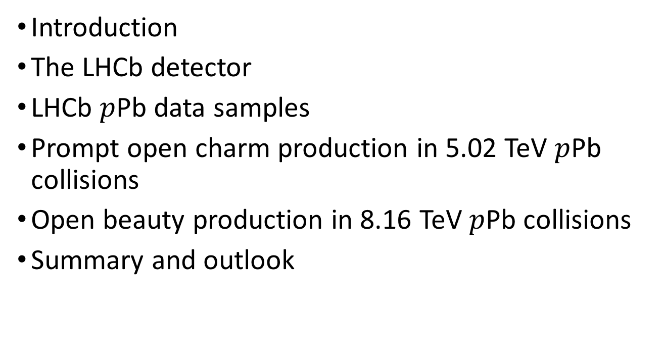
Outline
Introduction
The LHCb detector
LHCb $p$Pb data samples
Prompt open charm production in 5.02 TeV $p$Pb collisions
Open beauty production in 8.16 TeV $p$Pb collisions
Summary and outlook
JHEP 10 (2017) 090
JHEP 02 (2019) 102
Phys. Rev. D99 052011 (2019)

Slide 3
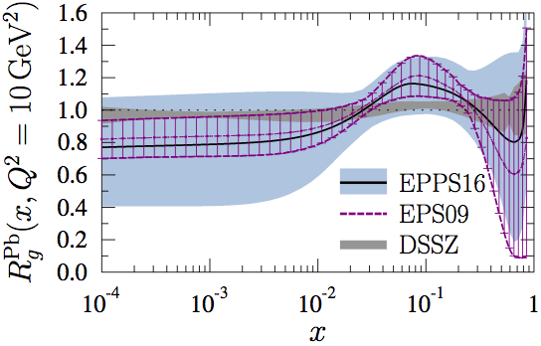
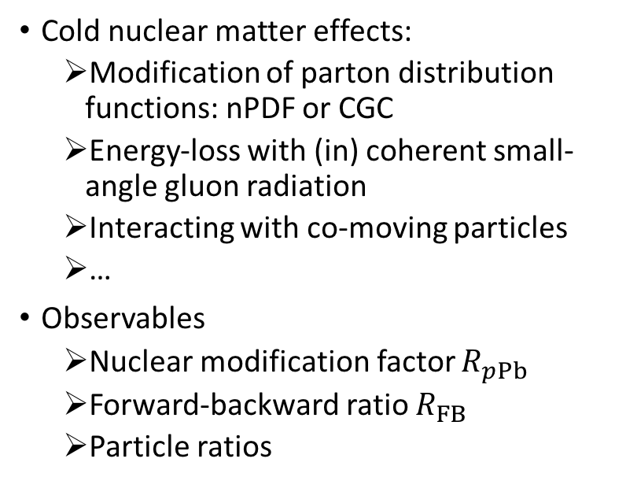
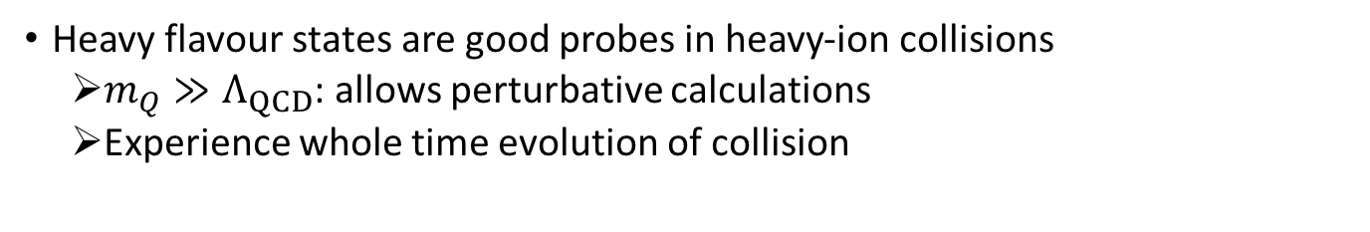
Introduction
Heavy flavour states are good probes in heavy-ion collisions
    $m_{Q}≫Λ_{QCD}$: allows perturbative calculations
    Experience whole time evolution of collision
Cold nuclear matter effects:
  Modification of parton distribution functions: nPDF or CGC
  Energy-loss with (in) coherent small-angle gluon radiation
  Interacting with co-moving particles
  …
Observables
  Nuclear modification factor $R_{pPb}$
  Forward-backward ratio $R_{FB}$
  Particle ratios
Eur. Phys. J. C (2017) 77:163

Slide 4
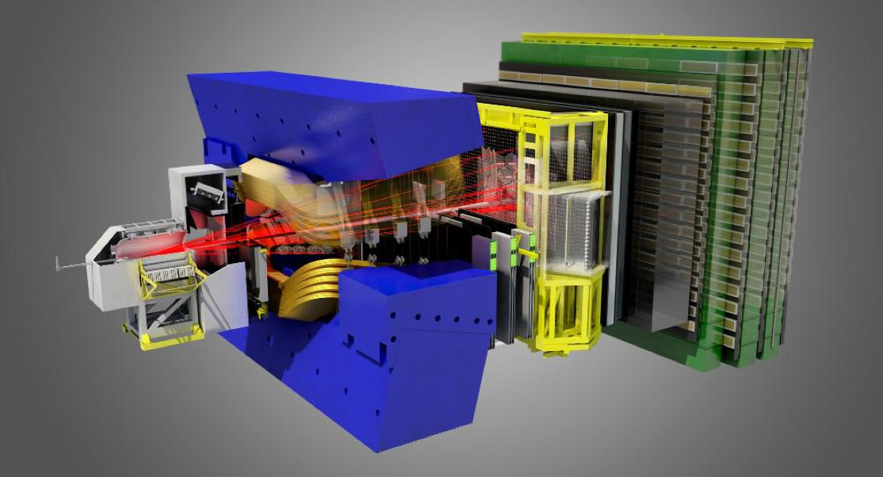

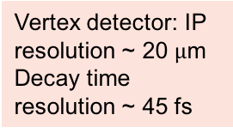
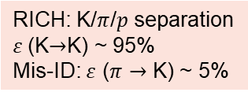
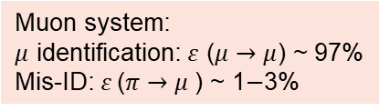
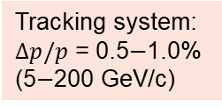
The LHCb detector
A single arm general purpose detector at forward rapidity !
pseudorapidity acceptance $2<η<5$
Muon system:
$μ$ identification: $ε$ ($μ→μ$) ~ 97%
Mis-ID:$ε$ ($π→μ$) ~ 1$−$3%
RICH: K/$π$/$p$ separation
$ε$(K$→$K) ~ 95%
Mis-ID: $ε$ ($π→$ K) ~ 5%
Vertex detector: IP resolution ~ 20 $μ$m
Decay time resolution ~ 45 fs
Dipole magnet Bending power 4 Tm
Electromagnetic + hadronic calorimeters
Tracking system:
$Δp/p$ = 0.5$−$1.0%
(5$−$200 GeV/c)
JINST 3 (2008) S08005
IJMPA 30 (2015) 1530022

Slide 5
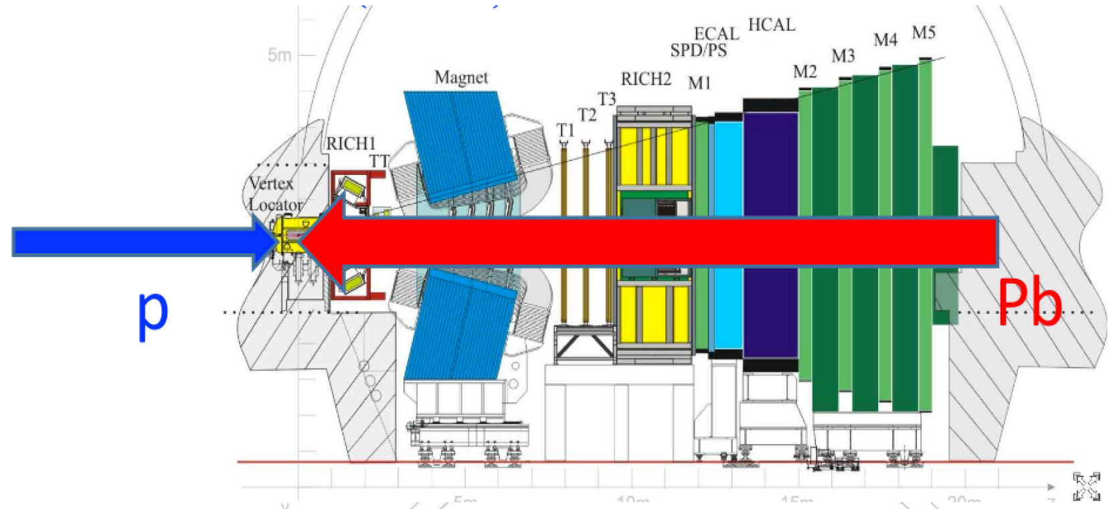
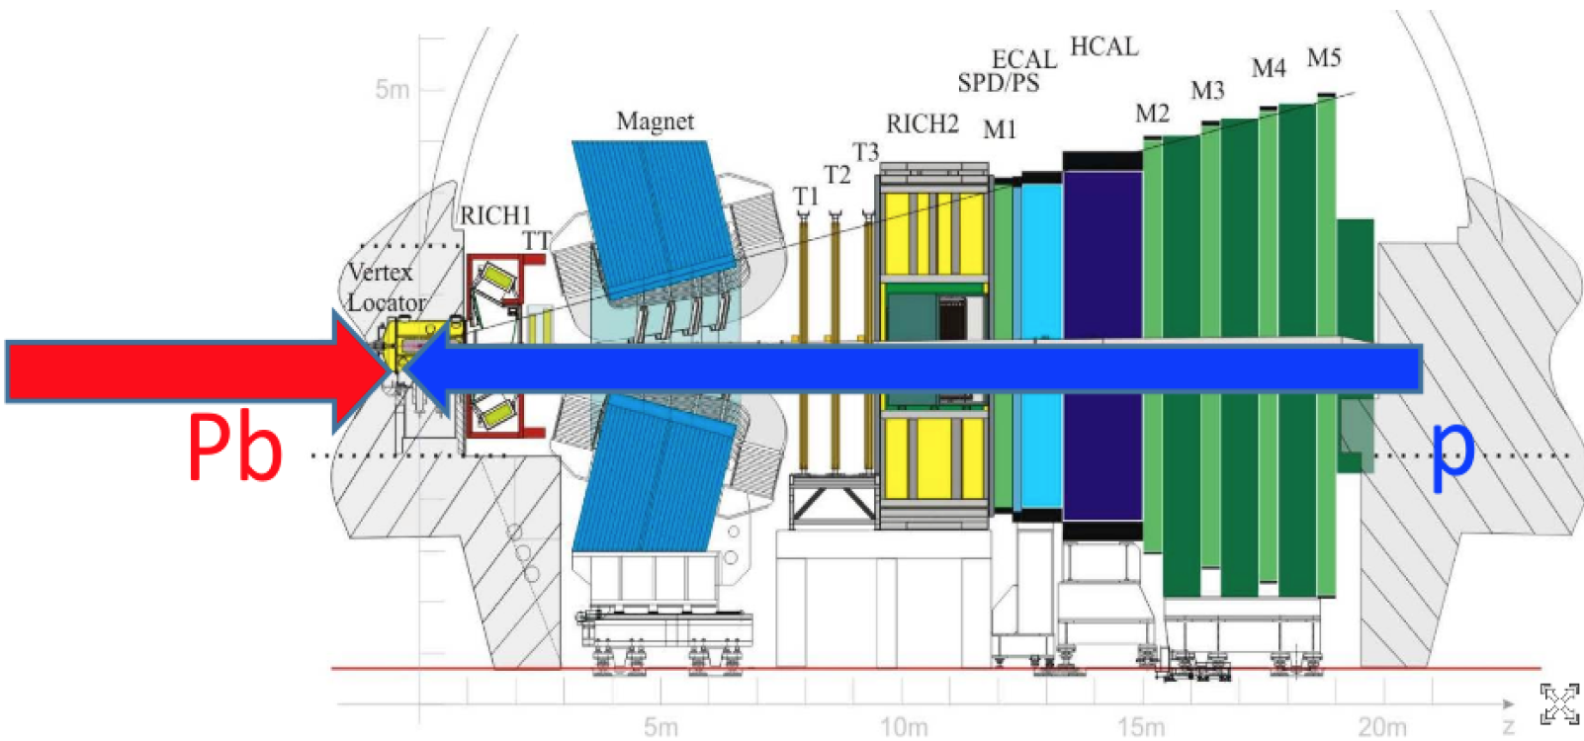
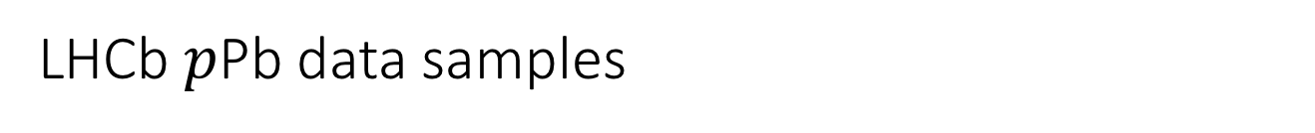
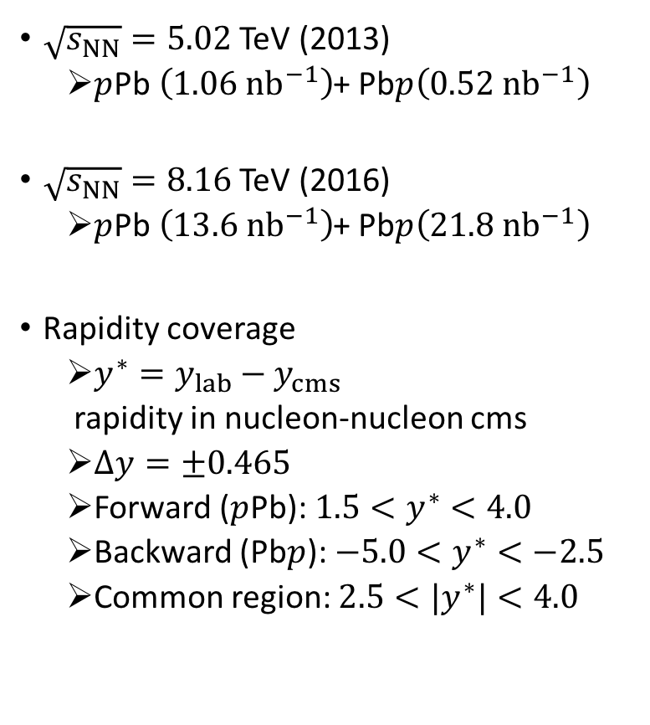
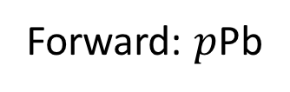
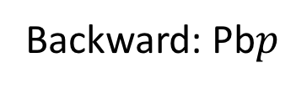
LHCb $p$Pb data samples
Forward: $p$Pb
$\sqrt{s_{NN}}=5.02$ TeV (2013)
  $p$Pb $\left(1.06 {nb}^{−1}\right)$+ Pb$p\left(0.52 {nb}^{−1}\right)$
$\sqrt{s_{NN}}=8.16$ TeV (2016)
  $p$Pb $\left(13.6 {nb}^{−1}\right)$+ Pb$p\left(21.8 {nb}^{−1}\right)$
Rapidity coverage
  $y^{∗}=y_{lab}−y_{cms}$
  rapidity in nucleon-nucleon cms
  $Δy=±0.465$
  Forward ($p$Pb): $1.5<y^{∗}<4.0$
  Backward (Pb$p$): $−5.0<y^{∗}<−2.5$
  Common region: $2.5<{|y}^{∗}|<4.0$
Backward: Pb$p$

Slide 6
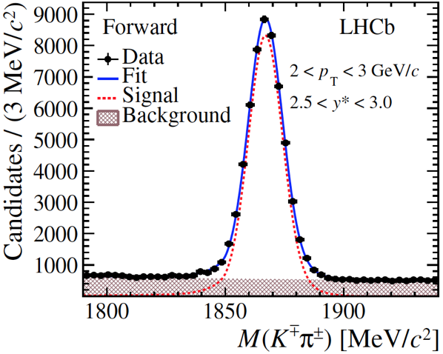
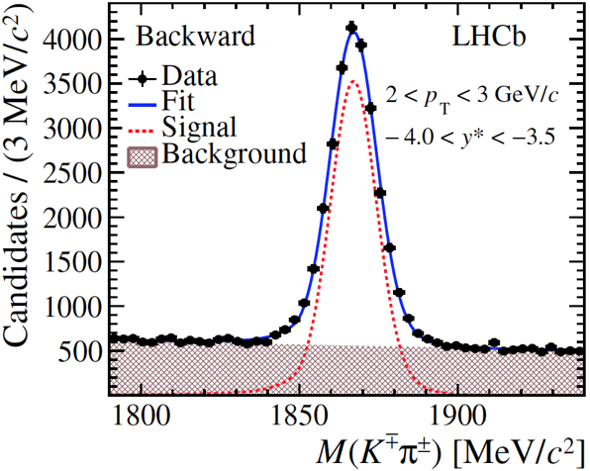
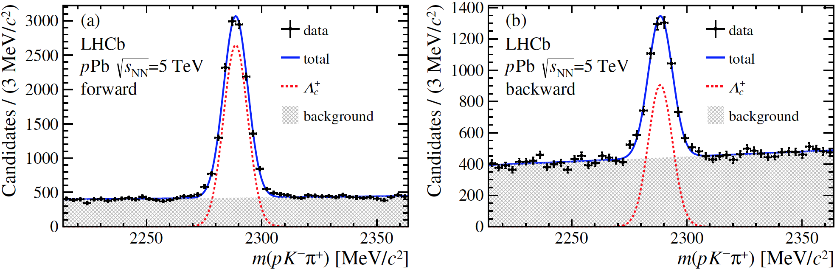
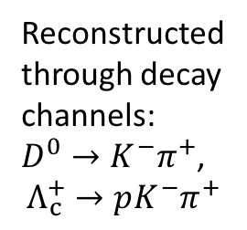

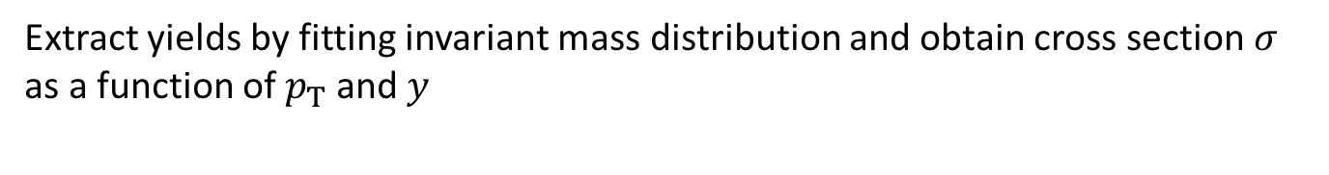



Prompt open charm: signals
Reconstructed through decay channels: $D^{0}→K^{−}π^{+}$,
$$Λ_{c}^{+}→pK^{−}π^{+}$$
$$D^{0}→K^{−}π^{+}$$
$$D^{0}→K^{−}π^{+}$$
$$Λ_{c}^{+}→pK^{−}π^{+}$$
$$Λ_{c}^{+}→pK^{−}π^{+}$$
JHEP 10 (2017) 090
JHEP 02 (2019) 102
Gaussian signal + linear background
Extract yields by fitting invariant mass distribution and obtain cross section $σ$ as a function of $p_{T}$ and $y$

Slide 7
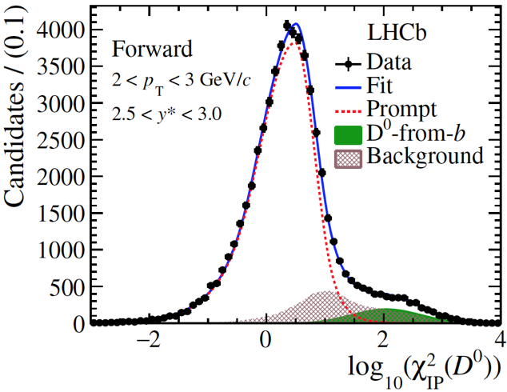
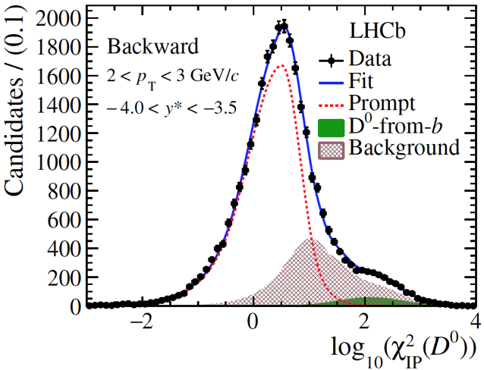
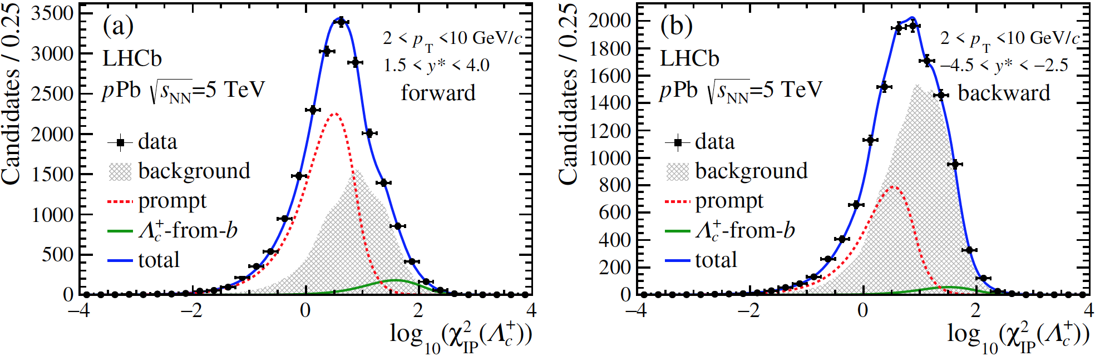









Prompt and non-prompt charm
Distinguish prompt and non-prompt by fitting impact parameter (IP) distribution
$$p\left(K^{−}\right)+p(π^{+})$$
$$D^{0}$$
$$D^{0}$$
$$π^{+}$$
$$K^{−}$$
$$D^{0}$$
b hadron
others
$$PV$$
$$IP$$
Non-prompt: charm produced from b decay (IP>0)
Prompt : charm produced directly in collision (IP=0)
$$Λ_{c}^{+}$$
$$Λ_{c}^{+}$$
Prompt, from b and background are all described by bukin
Prompt charm yields can be extracted
JHEP 10 (2017) 090
JHEP 02 (2019) 102

Slide 8
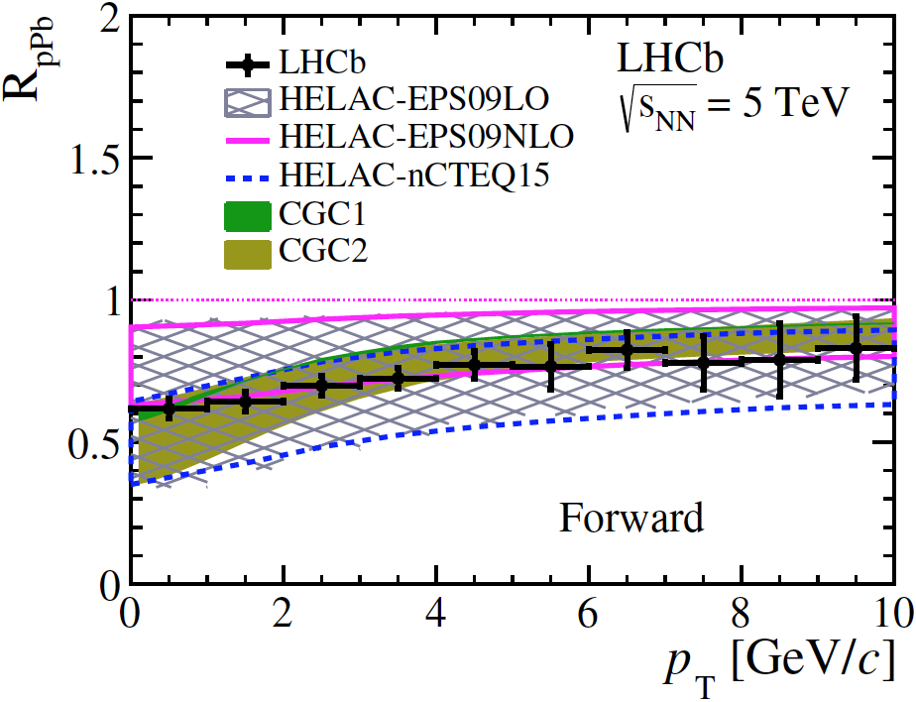
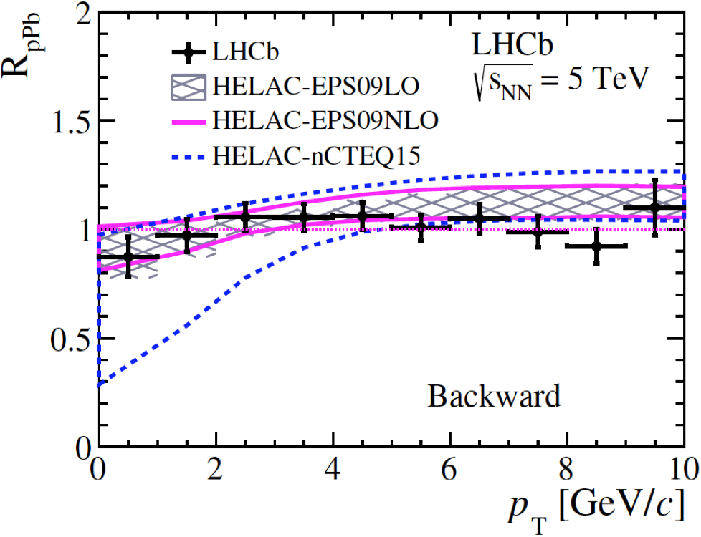
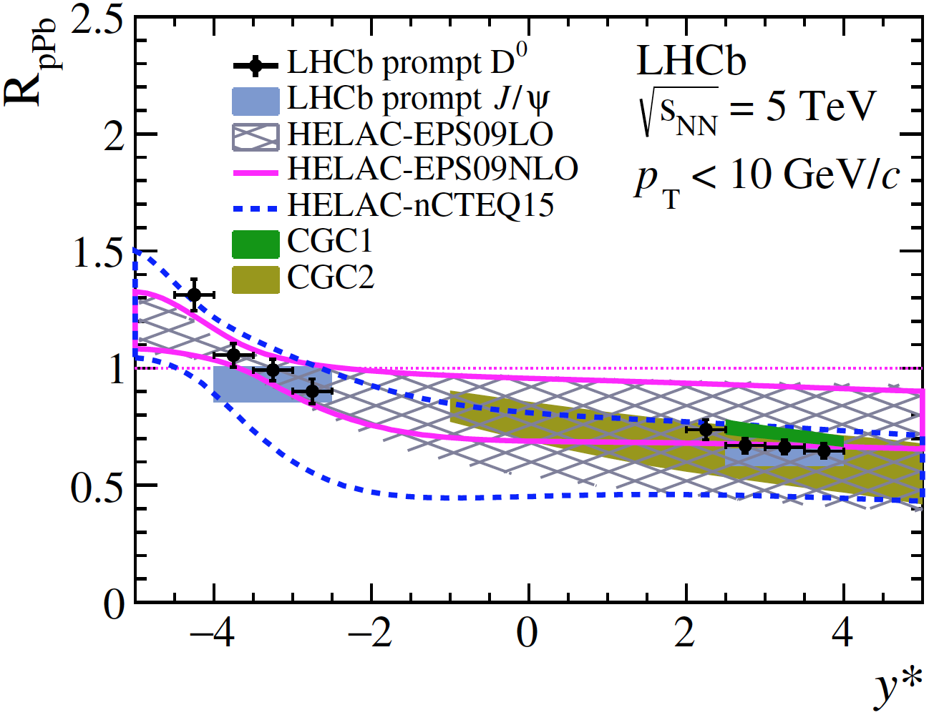
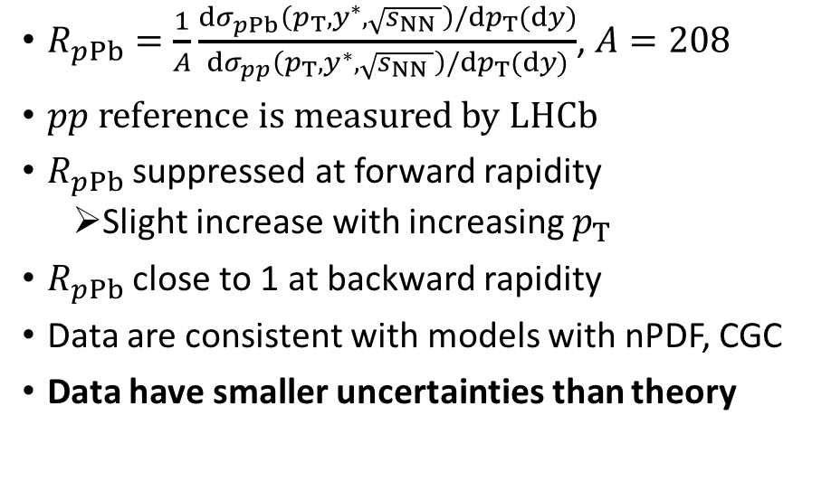


Prompt open charm: nuclear modification factor
$$D^{0}$$
$$D^{0}$$
JHEP 10 (2017) 090
$R_{pPb}=\frac{1}{A}\frac{dσ_{pPb}\left(p_{T},y^{∗},\sqrt{s_{NN }}\right)/dp_{T}(dy)}{dσ_{pp}\left(p_{T},y^{∗},\sqrt{s_{NN }}\right)/dp_{T}(dy)}$, $A=208$
$pp$ reference is measured by LHCb
$R_{pPb}$ suppressed at forward rapidity
  Slight increase with increasing $p_{T}$
$R_{pPb}$ close to 1 at backward rapidity
Data are consistent with models with nPDF, CGC
Data have smaller uncertainties than theory
$$D^{0}$$

Slide 9
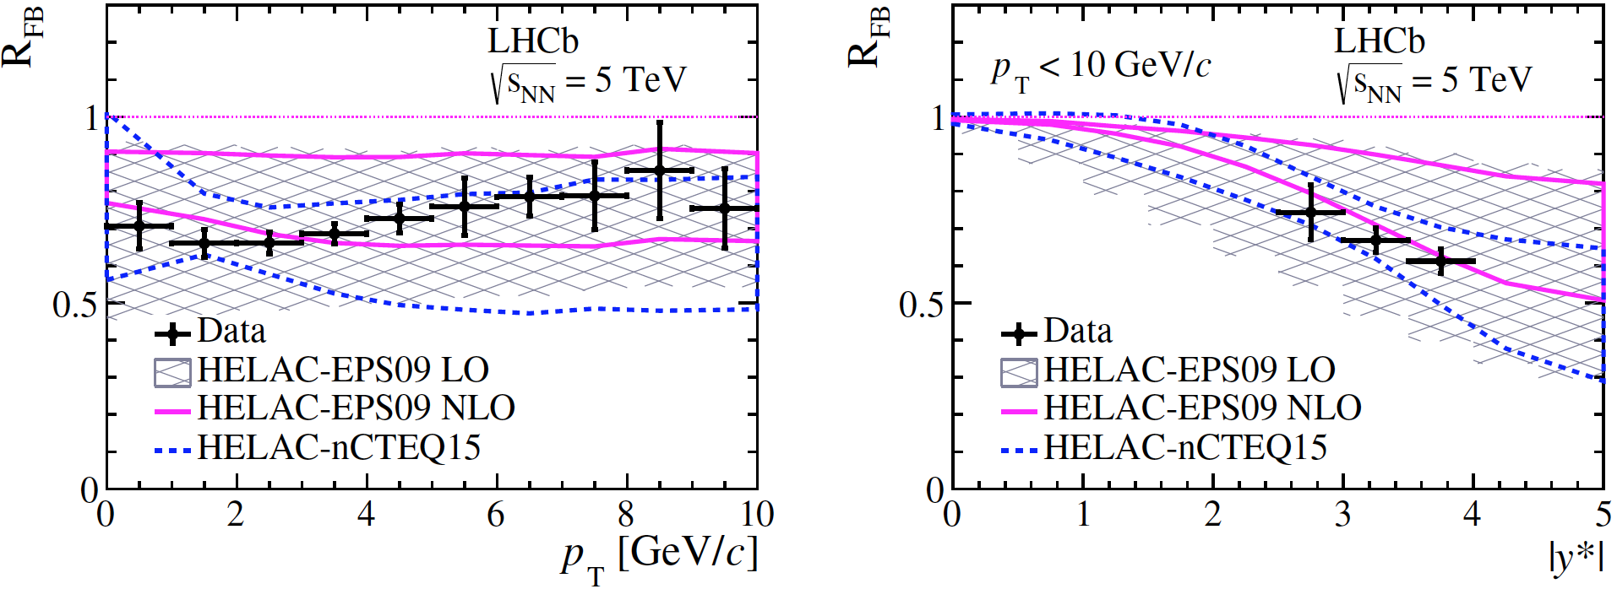
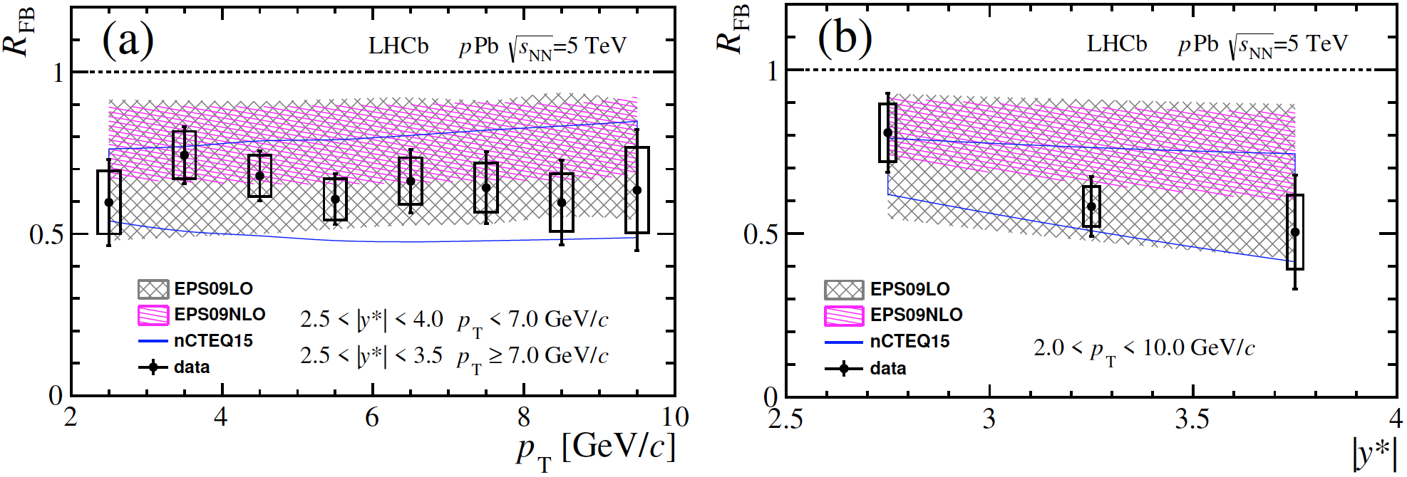
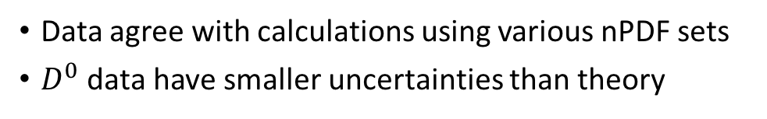


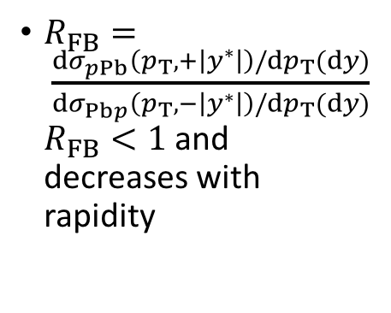
Prompt open charm: forward-backward ratio
$$D^{0}$$
$$D^{0}$$
$R_{FB}= \frac{dσ_{pPb}\left(p_{T},+\left|y^{∗}\right|\right)/dp_{T}(dy)}{dσ_{Pbp}\left(p_{T},−\left|y^{∗}\right|\right)/dp_{T}(dy)}$ $R_{FB}<1$ and decreases with rapidity
$$Λ_{c}^{+}$$
$$Λ_{c}^{+}$$
sys.
sys.
total.
total.
Data agree with calculations using various nPDF sets
$D^{0}$ data have smaller uncertainties than theory
JHEP 10 (2017) 090
JHEP 02 (2019) 102

Slide 10
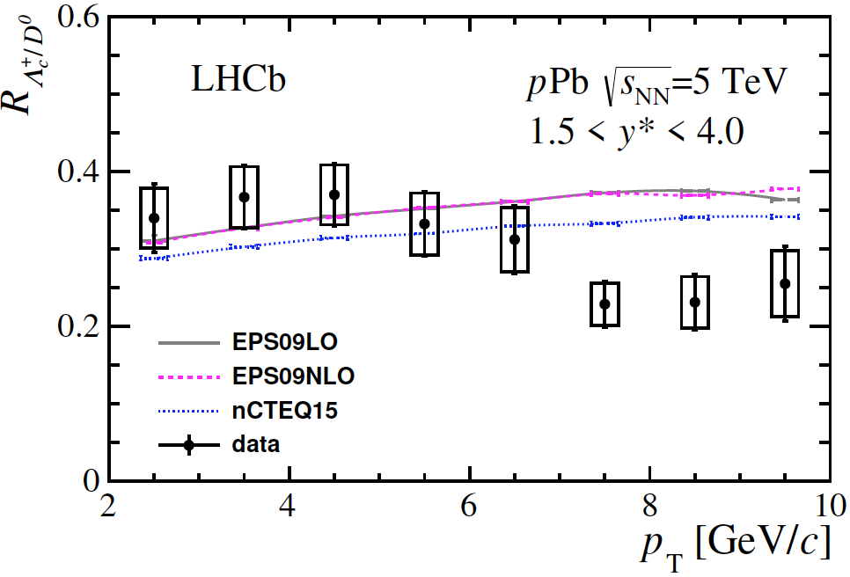
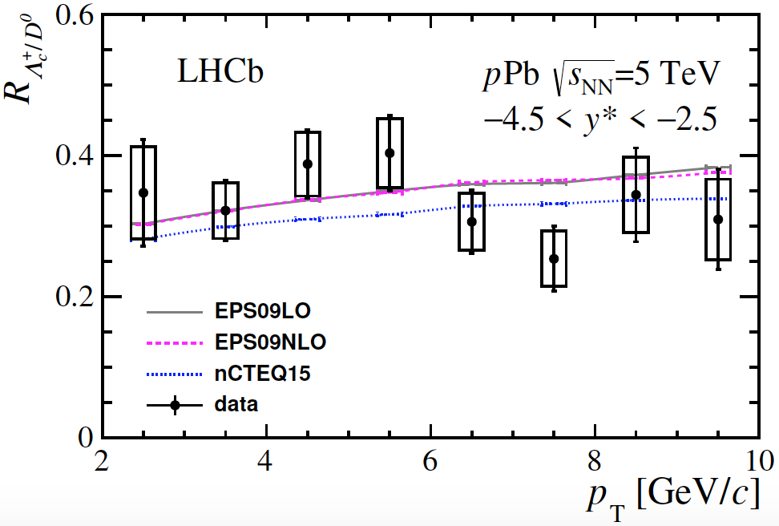
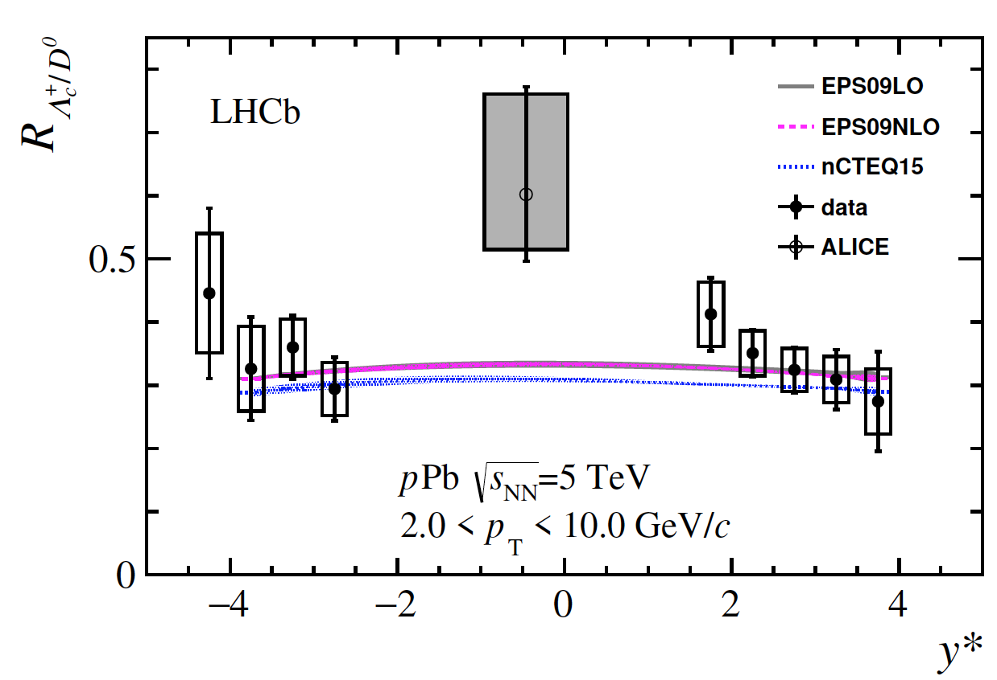
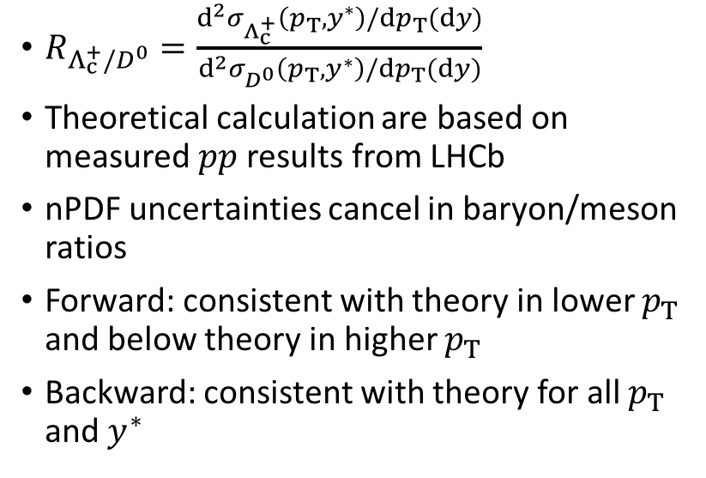
Prompt open charm: particle ratio
Forward
Backward
$R_{Λ_{c}^{+}/D^{0}}=\frac{d^{2}σ_{Λ_{c}^{+}}\left(p_{T},y^{∗}\right)/dp_{T}(dy)}{d^{2}σ_{D^{0}}\left(p_{T},y^{∗}\right)/dp_{T}(dy)}$
Theoretical calculation are based on measured $pp$ results from LHCb
nPDF uncertainties cancel in baryon/meson ratios
Forward: consistent with theory in lower $p_{T}$ and below theory in higher $p_{T}$
Backward: consistent with theory for all $p_{T}$ and $y^{∗}$
JHEP 02 (2019) 102

Slide 11
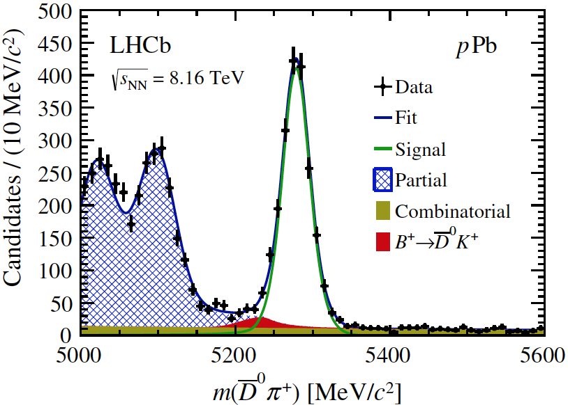
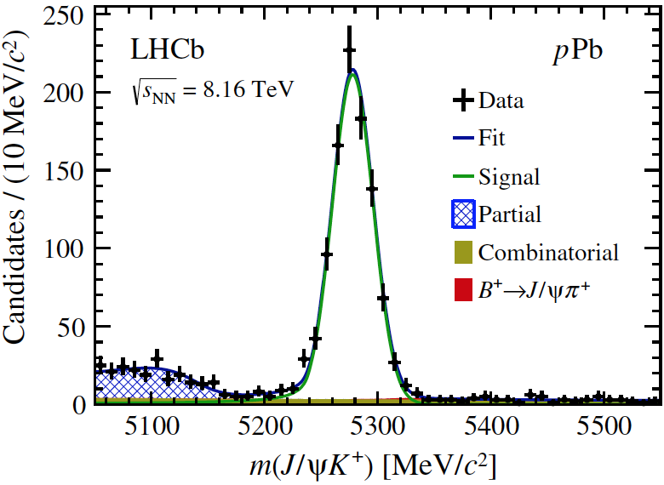
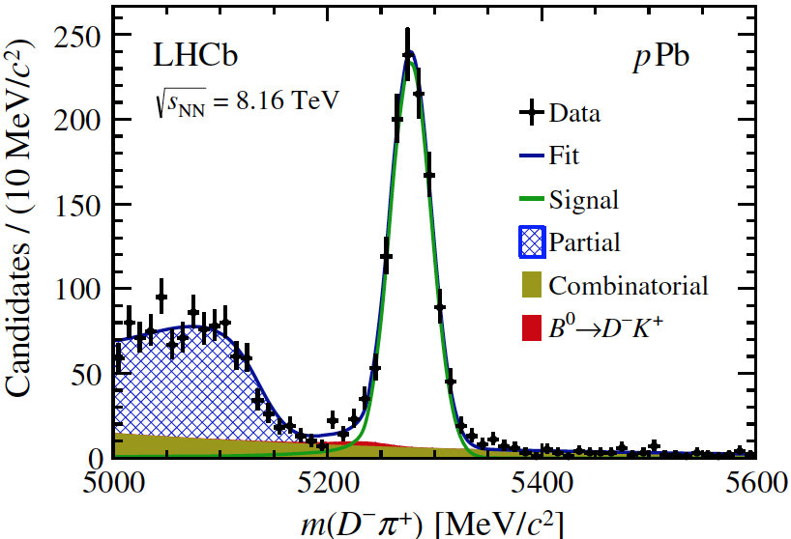
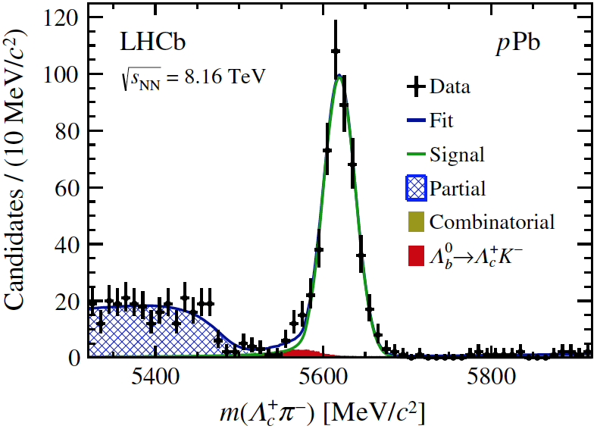




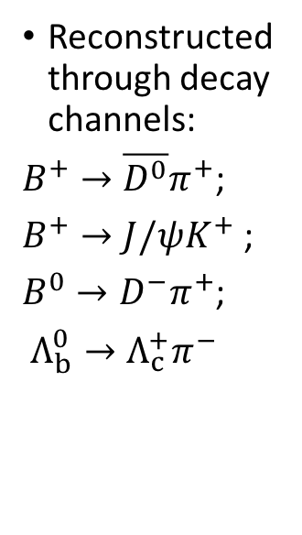
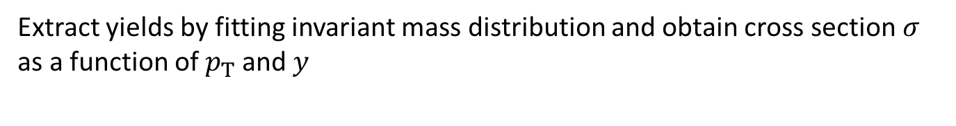
Open beauty: signals
$$B^{+}→\overline{D^{0}}π^{+}$$
$$B^{+}→J/ψK^{+}$$
Reconstructed through decay channels:
$B^{+}→\overline{D^{0}}π^{+}$;
$B^{+}→J/ψK^{+}$ ;
$B^{0}→D^{−}π^{+}$;
$Λ_{b}^{0}→Λ_{c}^{+}π^{−}$
$$B^{0}→D^{−}π^{+}$$
$$Λ_{b}^{0}→Λ_{c}^{+}π^{−}$$
Phys. Rev. D99 052011 (2019)
Extract yields by fitting invariant mass distribution and obtain cross section $σ$ as a function of $p_{T}$ and $y$

Slide 12
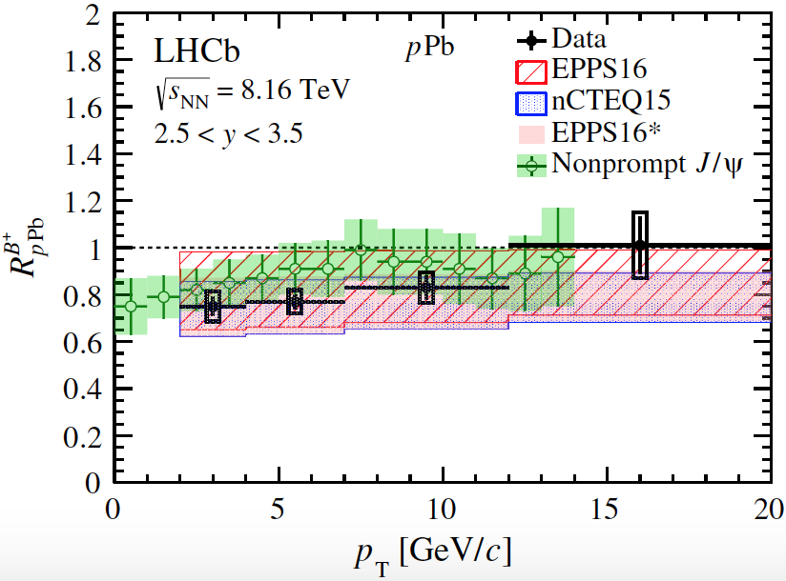
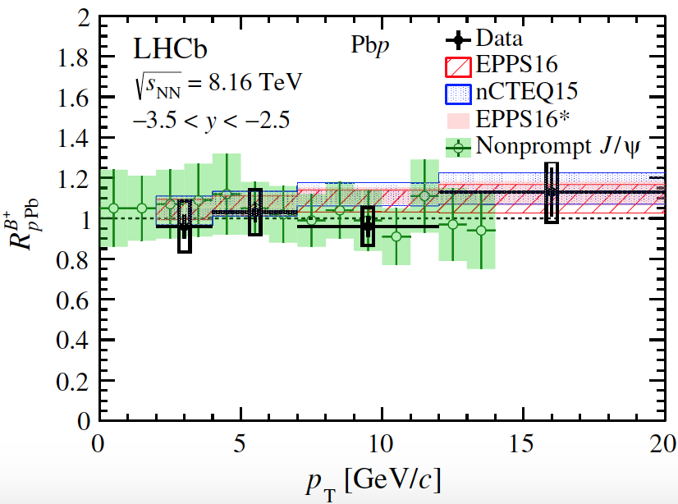
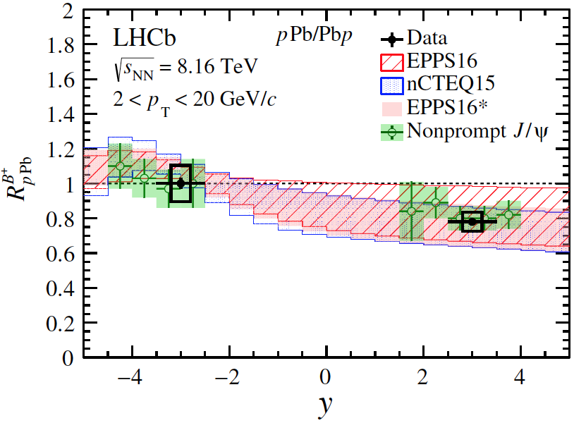
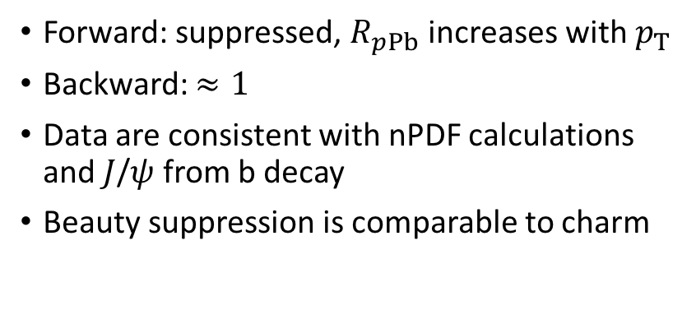
Open beauty: nuclear modification factor
Forward
Backward
tot.
tot.
stat.
stat.
Forward: suppressed, $R_{pPb}$ increases with $p_{T}$
Backward: $≈1$
Data are consistent with nPDF calculations and $J$/$ψ$ from b decay
Beauty suppression is comparable to charm
tot.
stat.
Phys. Rev. D99 052011 (2019)

Slide 13
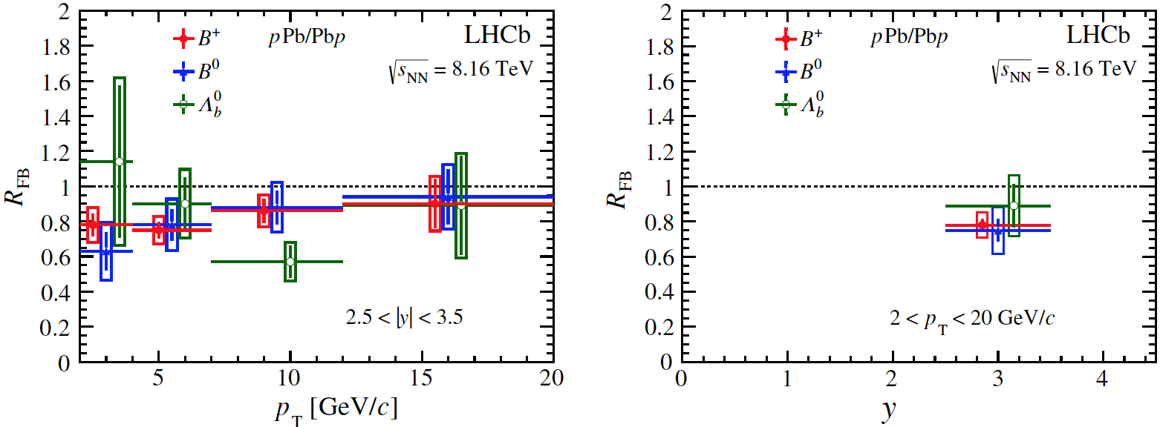
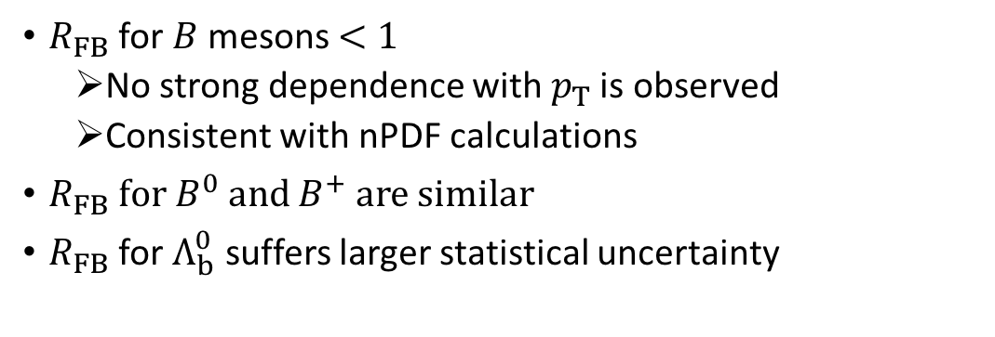
Open beauty: forward-backward ratio
tot.
tot.
stat.
stat.
$R_{FB}$ for $B$ mesons $<1$
  No strong dependence with $p_{T}$ is observed
  Consistent with nPDF calculations
$R_{FB}$ for $B^{0}$ and $B^{+}$ are similar
$R_{FB}$ for $Λ_{b}^{0}$ suffers larger statistical uncertainty
Phys. Rev. D99 052011 (2019)

Slide 14
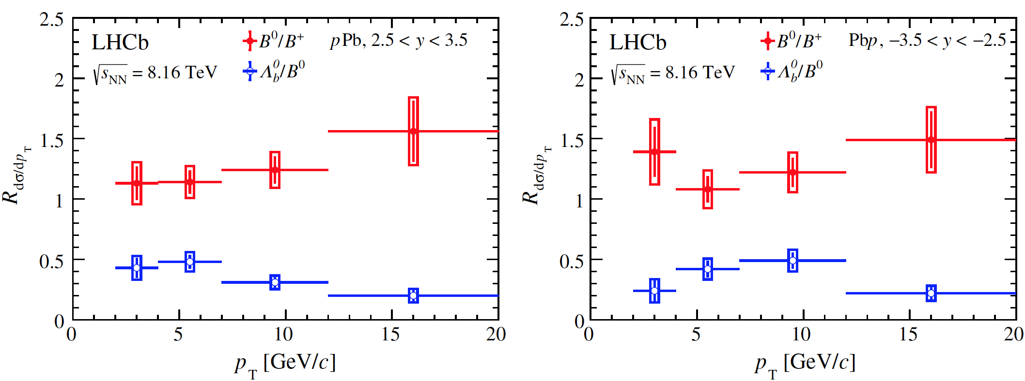
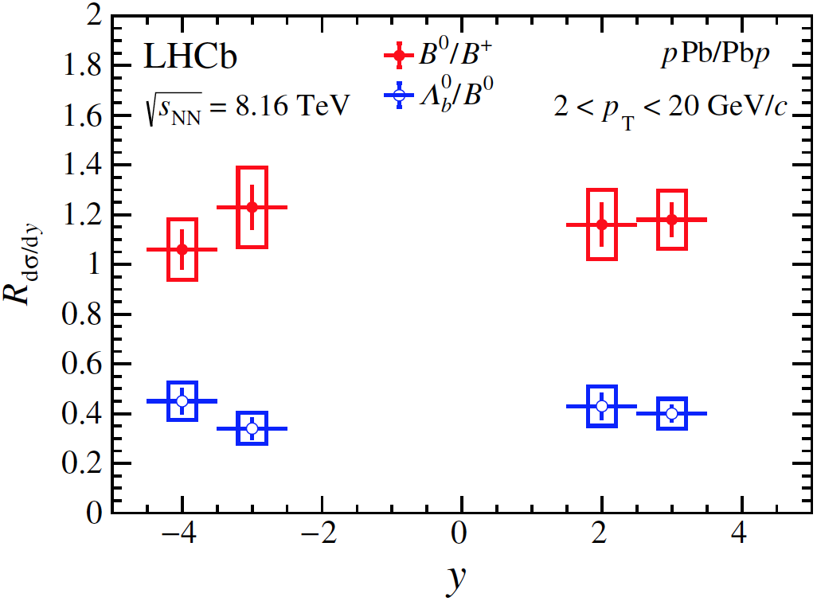
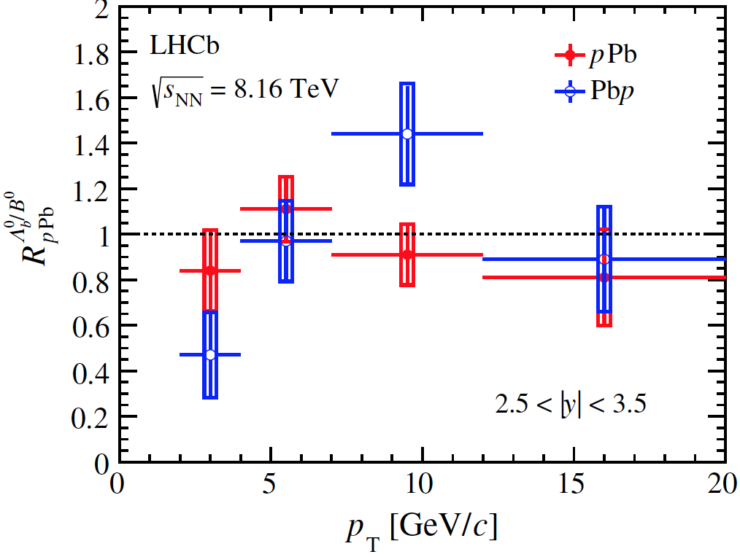




Open beauty: particle ratio
$$\frac{dσ_{B^{0}}/dy(dp_{T})}{dσ_{B^{+}}/dy(dp_{T})}$$
tot.
stat.
$$\frac{dσ_{Λ_{b}^{0}}/dy(dp_{T})}{dσ_{B^{0}}/dy(dp_{T})}$$
tot.
stat.
$B^{0}$/$B^{+}$ about 1-$σ$ from 1, explained by systematic uncertainties
$Λ_{b}^{0}\text{/}B^{0}≈0.4$, decreases at high $p_{T}$, and is compatible to $Λ_{c}^{+}/D^{0}$ in the same region, similar to LHCb $pp$ data [JHEP 08 (2014) 143]
tot.
stat.
tot.
stat.
$R_{pPb}^{Λ_{b}^{0}/B^{0}}≡R_{pPb}^{Λ_{b}^{0}}/R_{pPb}^{B^{0}}≈1$ and is independent of $p_{T}$ at forward rapidity, suffers larger fluctuations due to higher level of background at backward rapidity
Phys. Rev. D99 052011 (2019)

Slide 15

Summary and outlook
LHCb has excellent capabilities to study heavy flavour in heavy ion studies
Production of $D^{0}$ and $Λ_{c}^{+}$ are measured in 5.02 TeV $p$Pb collisions by LHCb
  $R_{pPb}^{D^{0}}$ is significantly suppressed in the forward and more precise than theory so that can be used to constrain model
  $R_{FB}^{D^{0}}$ and $R_{FB}^{Λ_{c}^{+}}$ agree with nPDF calculations and $R_{FB}^{D^{0}}$ has smaller uncertainties than theory
  $R_{Λ_{c}^{+}/D^{0}}$ agrees with model except in forward high $p_{T}$ bins
Production of $B^{+}$, $B^{0}$ and $Λ_{b}^{0}$ are measured in 8.16 TeV $p$Pb collisions by LHCb ($Λ_{b}^{0}$ first measured in heavy ion collisions using exclusive hadronic states)
  $R_{pPb}^{B^{+}}$ agrees with nPDF calculations theory and $J$/$ψ$ from b decay
  $R_{pPb}^{Λ_{b}^{0}}$/$R_{pPb}^{B^{0}}$ $≈1$at forward rapidity
Production of open charm in 8.16 TeV and more species such as $D_{s}^{+}$, $D^{∗}$ in 5.02 TeV $p$Pb collisions are under study
  Multiplicity dependence

Slide 16
Thank you!

Slide 17
Back up slides

Slide 18


Open charm production: prompt $D^{0}$
Reconstructed through decay channel: $D^{0}→K^{−}π^{+}$
Obtain $D^{0}$ yields $N(D^{0}→K^{−}π^{+})$ by fitting invariant mass distribution:
  Signal: Crystal Ball + Gaussian
  Background: linear
JHEP 10 (2017) 090

Slide 19








Open charm production: prompt $D^{0}$
$$p\left(K^{−}\right)+p(π^{+})$$
Extract prompt $D^{0}$ by fitting $χ_{IP}^{2}$ distribution
  Prompt: simulation
  from $b$: simulation
  Background: sideband in data
$$π^{+}$$
$$K^{+}$$
$$D^{0}$$
$$PV$$
others
$$IP$$
JHEP 10 (2017) 090

Slide 20



Prompt $D^{0}$: cross section
Double-differential Cross section: $\frac{d^{2}σ}{dydp_{T}}=\frac{N(D^{0}→K^{−}π^{+};{ p}_{T},y)}{ℒ×ε(p_{T},y)×ℬ(Λ_{c}^{+}→pK^{−}π^{+})×Δy×Δp_{T}}$
The uncertainty is the quadratic sum of the statistical and systematic components
$ε(p_{T},y)$: effeciency estimated from simulation sample
$σ(p_{T}<10 GeV/c$ $, 1.5<y^{∗}<4.0)=230.6±0.5(stat)±13.0(sys)$ mb
$σ(p_{T}<10 GeV/c$ $, −5.0<y^{∗}<−2.5)=252.7±1.0(stat)±20(sys)$ mb
JHEP 10 (2017) 090

Slide 21



Open charm production: prompt $Λ_{c}^{+}$
Reconstructed throught decay channel:$Λ_{c}^{+}→pK^{−}π^{+}$
Obtain $Λ_{c}^{+}$ yields $N(Λ_{c}^{+}→pK^{−}π^{+})$ by fitting invariant mass distribution:
  Signal: Gaussian
  Background: linear
JHEP 02 (2019) 102

Slide 22









Open charm production: prompt $Λ_{c}^{+}$
Extract prompt $Λ_{c}^{+}$ by fitting $χ_{IP}^{2}$ distribution
  Prompt: simulation
  from $b$: simulation
  Background: sideband in data
$$p\left(K^{−}\right)+p\left(π^{+}\right)+p\left(p^{+}\right)$$
$$p^{+}$$
$$π^{+}$$
$$K^{+}$$
$$Λ_{c}^{+}$$
others
$$PV$$
$$IP$$
JHEP 02 (2019) 102

Slide 23



Prompt $Λ_{c}^{+}$: cross section
stat.+sys.
stat.+sys.
Double-differential Cross section: $\frac{d^{2}σ}{dydp_{T}}=\frac{N(Λ_{c}^{+}→pK^{−}π^{+};{ p}_{T},y)}{ℒ×ε(p_{T},y)×ℬ(Λ_{c}^{+}→pK^{−}π^{+})×Δy×Δp_{T}}$
$ε(p_{T},y)$: effeciency estimated from simulation sample
$σ(2<p_{T}<10 GeV/c$ $, 1.5<y^{∗}<4.0)=32.1±1.1(stat)±3.2(sys)$ mb
$σ(2<p_{T}<10 GeV/c$ $, −5.0<y^{∗}<−2.5)=27.7±1.8(stat)±3.8(sys)$ mb
JHEP 02 (2019) 102

Slide 24






Beauty production: cross section
tot.
tot.
tot.
stat.
stat.
stat.
tot.
tot.
tot.
stat.
stat.
stat.
$p_{T}$ and $y$ distribution for $Λ_{b}^{0}$, $B^{+} and B^{0}$ are similar
Phys. Rev. D99 052011 (2019)

