Slide 1

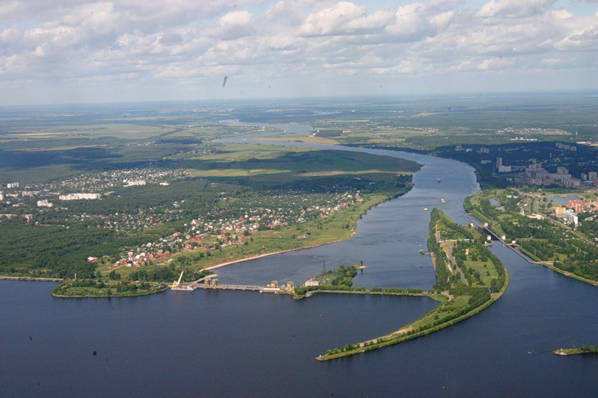

Status and Prospects at
V.Kekelidze,
Joint Institute for Nuclear Research
NICA
Volga river
Notes:
Ladies and gentlemen, dear colleagues, first of all I would like to express my gratitude for the kind invitation and for the given opportunity to present
a progress in MPD and BM@N experiment preparation

Slide 2
NICA (Nuclotron based Ion Collider fAcility)
Goals: to obtain comprehensive information on
hot and dense baryonic matter:
- whether there is a phase transition ?
- is it a first-order phase transition ?
- whether there is a critical end-point?
nucleon spin structure:
- how the spin of proton / neutron is composed?
Essential upgrade of existing accelerator complex
Construction of Collider to provide collisions of
  ion species from p to Au at energy range √S_{NN}= 4 - 11 GeV
  polarized p и d up to energy √S =27 GeV (p)
Construction of 3 detectors: Baryonic Matter @ Nuclotron (BM@N), Multi Purpose Detector (MPD) and Spin Physics Detector (SPD)
Notes:
NICA is a Nuclotron … The main targets of the project are: ..
That has required a development of accelerator facility and construction of

Slide 3
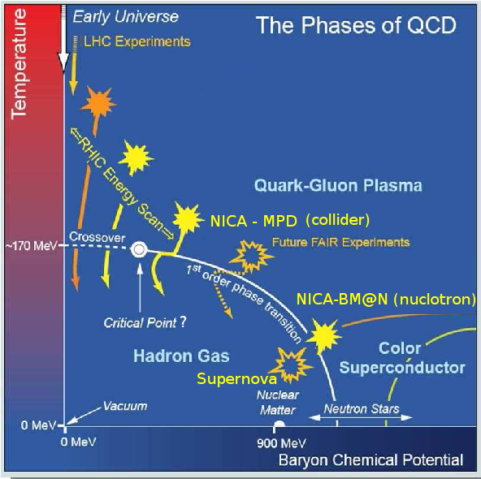
Exploration of the QCD Phase Diagram
Exploring high-density baryonic matter: maximum freeze-out density
SPS
Notes:
One of the most urgent task for the study of QCD phase diagram is density frontier. According various calculations maximum freeze-out density is reached at the energy range around 10 GeV per n. NICA is well suited …

Slide 4
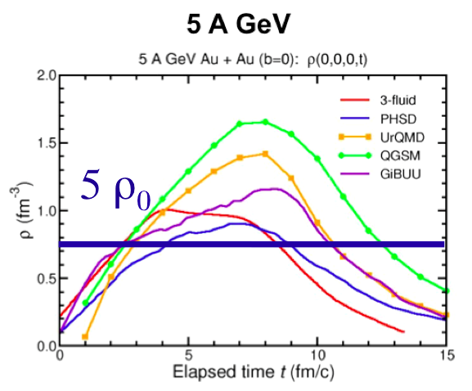
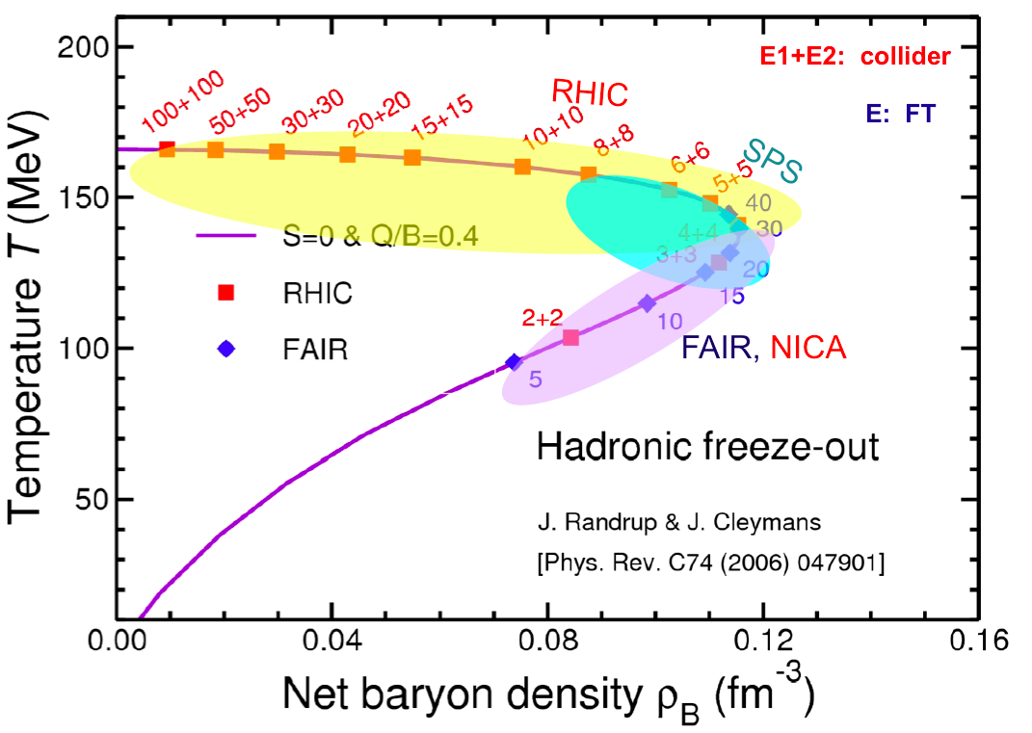
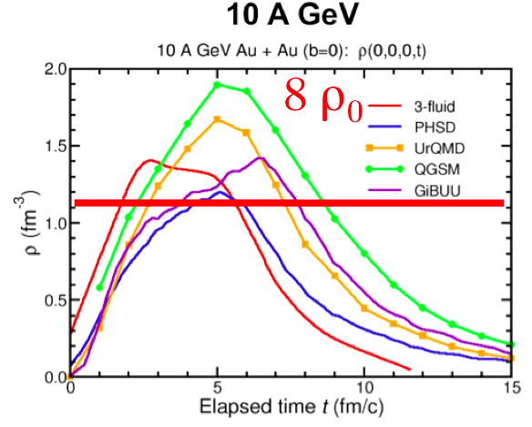
Net Baryonic density to be reached in Au + Au collisions
freeze-out conditions
I.C. Arsene at al.,
Phys. Rev. C75 (2007) 24902.

Slide 5
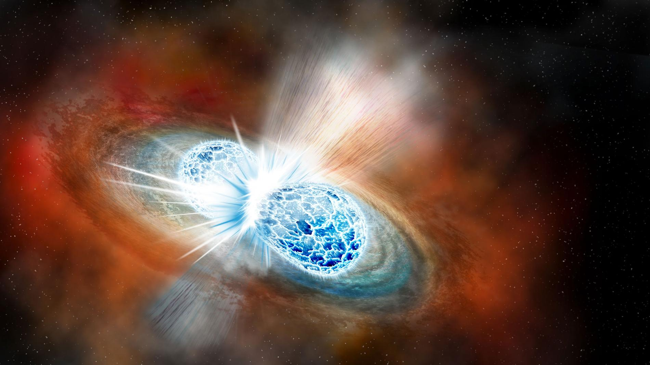
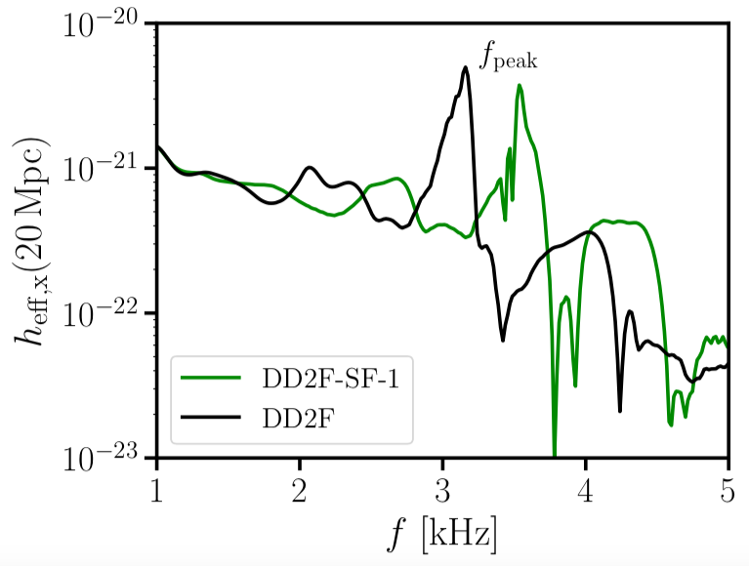
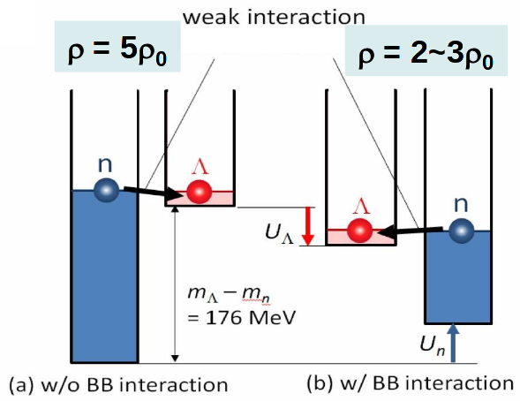
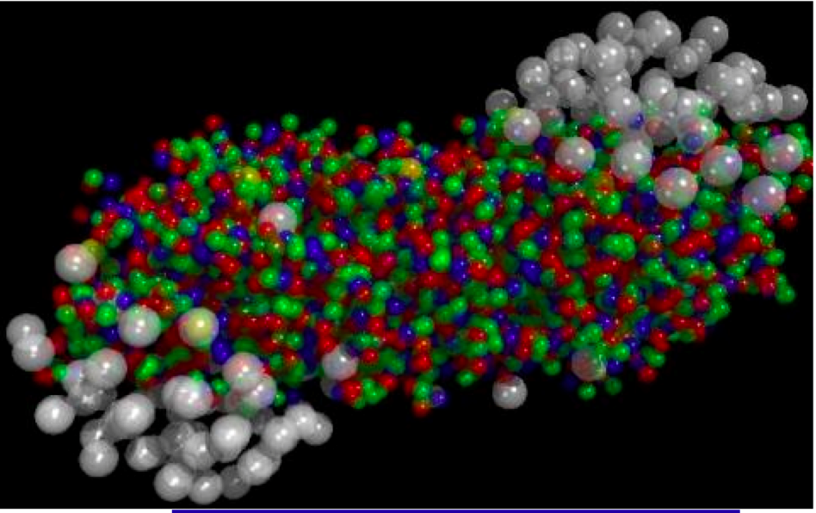
Similarity of Stellar Objects & Heavy Ion Collisions
1st OPT: grav waves from mergers
Neutron Star Merger
appearance of strangeness changes EOS,
depends on strangeness-nucleon interaction
f [kHz]
Bauswein et. al.,
arXiv:1809.01116
H. Tamura,
Hadron 2017
Heavy Ion Collision

Slide 6
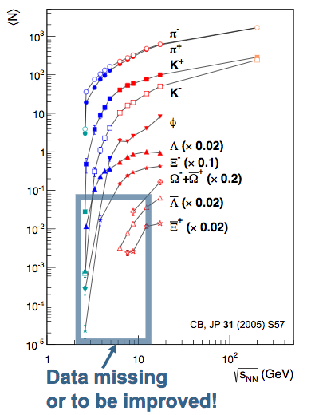
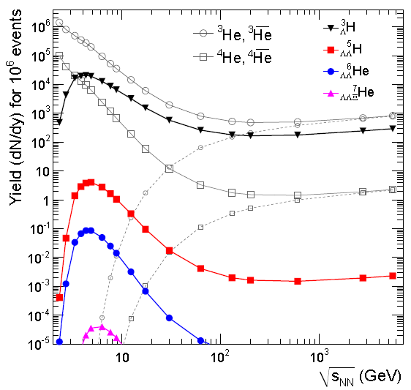

Energy Dependence of Total Yields
Hypernuclei production enhanced at high baryon densities (NICA)
NICA
NICA
data to be improved
C. Blume, SQM-2017
Andronic, P. Braun-Munzinger,
J. Stachel, H. Stoecker

Slide 7
QCD matter at the NICA energies:
high net baryon density – density frontier;
maximum in Κ⁺/π⁺ ratio;
maximum in Λ/π ratio;
transition from a Baryon dominated system
to a Meson dominated one;
maximum of the Λ polarization;
1-st order transition & mixed phase creation;
Critical Endpoint ?

Slide 8

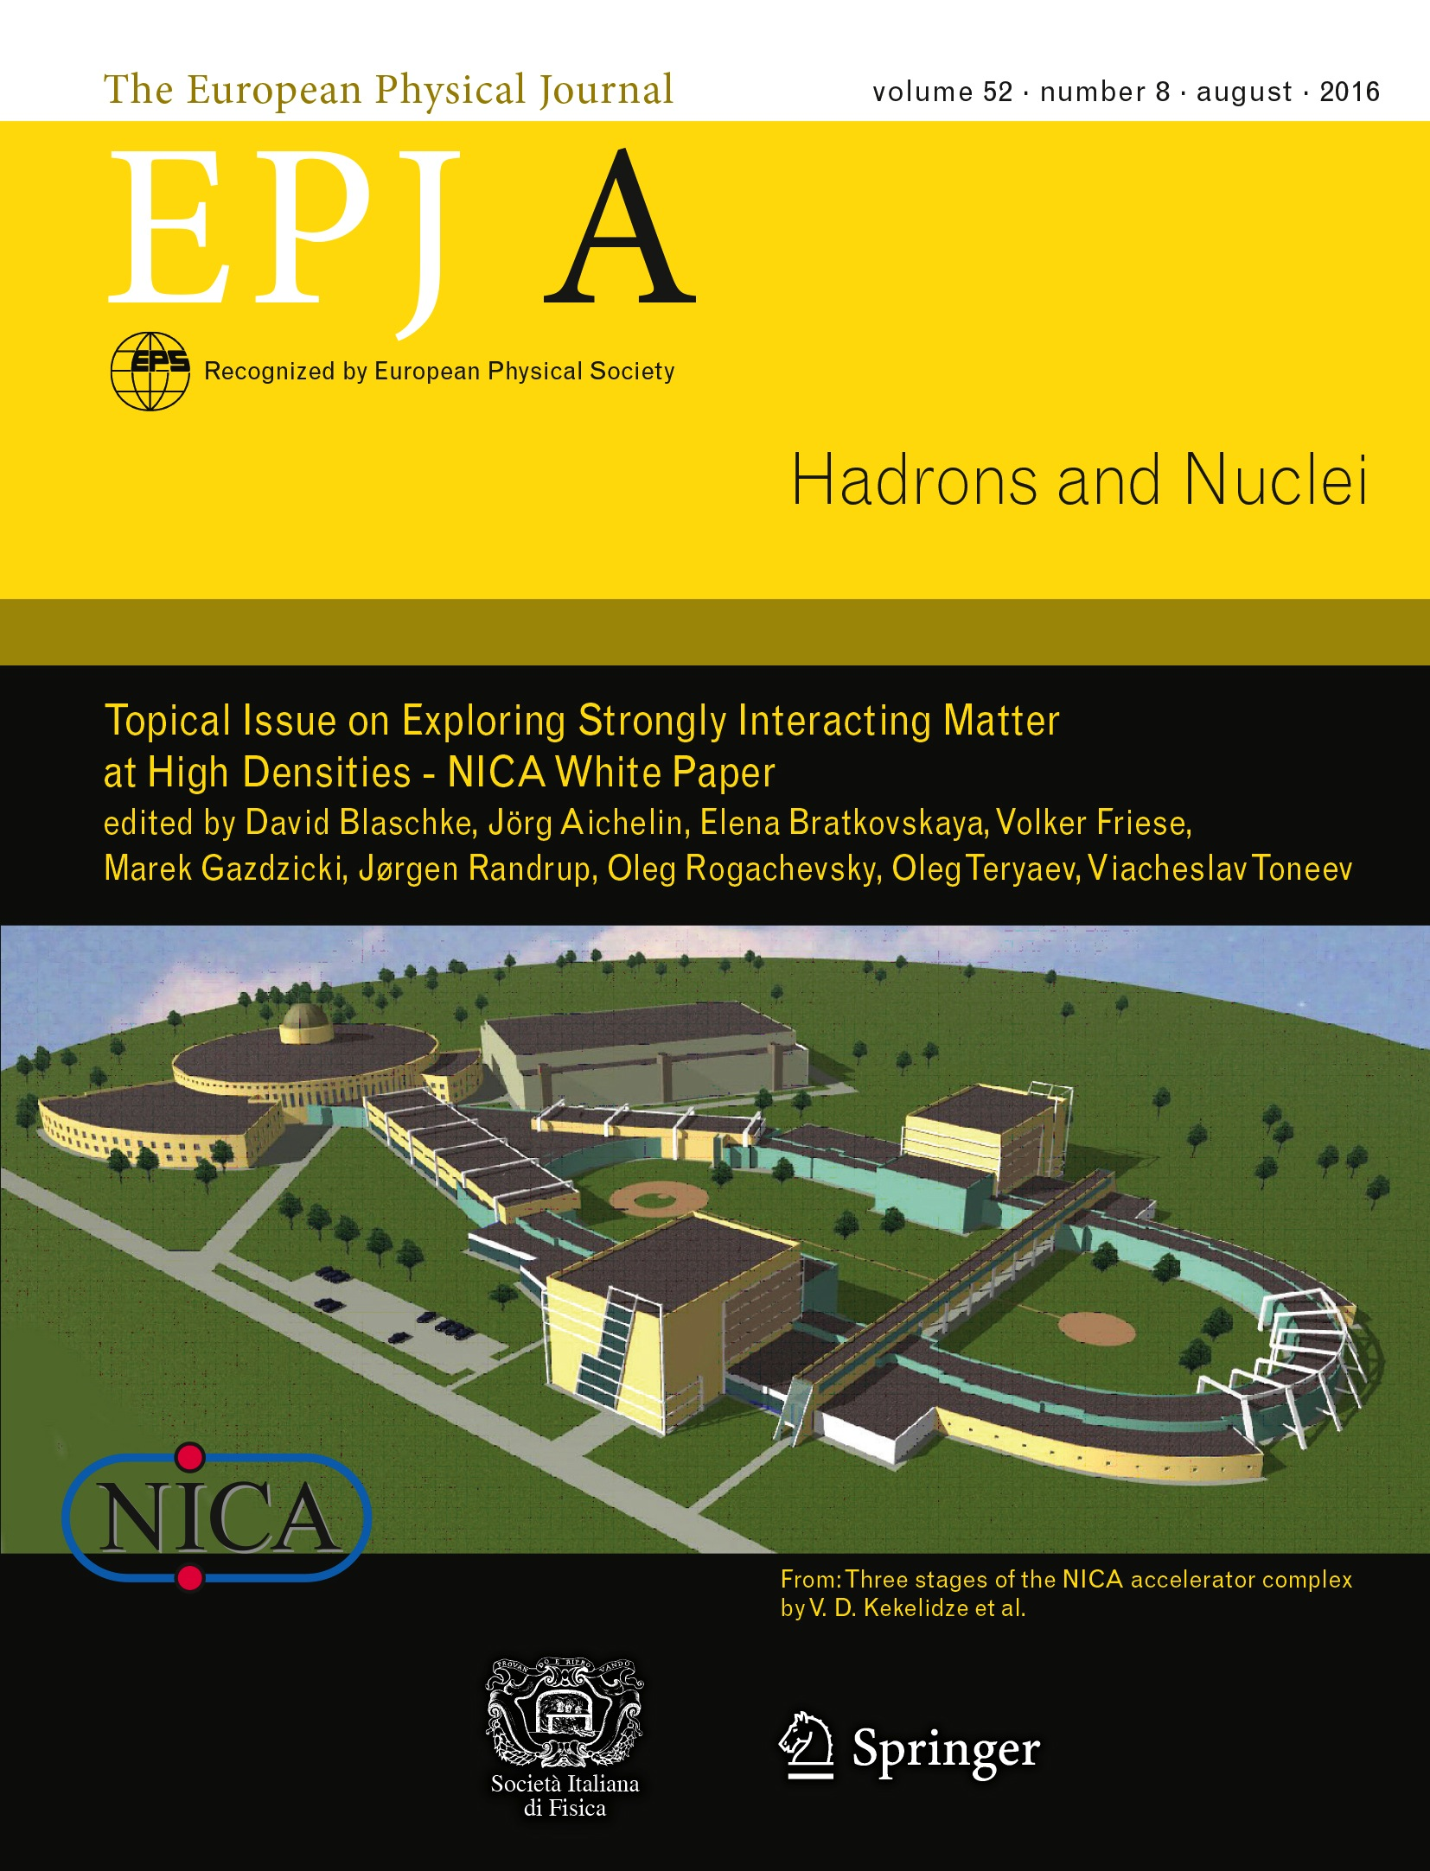
NICA Whte Paper
Physics targets for the exploration of first order phase transitions in the region of the QCD phase diagram accessible to NICA & FAIR and possible observable effects of a “mixed phase indicated in the release of the “NICA White Paper” as a Topical Issue of the EPJ A (July 2016).
111 contributions,
188 authors
from 24 countries

Slide 9
Set-ups: in operation
extracted
beams
10⁷
maximum baryonic density
colliders
10⁶
10⁵
Interaction rate, Hz
10⁴
HADES
SIS-18(GSI)
NA-61/SPS (CERN)
10³
FT STAR
BES STAR/RHIC (BNL)
10²
10
2
5
energy
10
√S_{NN}, GeV(Au+Au)
Notes:
Concerning fixed target experiments –there are several ones including NICA/BMN. CBM/FAIR will provide extremely high interaction rate.

Slide 10
Set-ups: in operation
extracted
beams
10⁷
maximum baryonic density
colliders
10⁶
10⁵
BM@N/NICA (JINR)
Interaction rate, Hz
10⁴
HADES
SIS-18(GSI)
NA-61/SPS (CERN)
10³
FT STAR
BES STAR/RHIC (BNL)
10²
10
2
5
energy
10
√S_{NN}, GeV(Au+Au)
Notes:
Concerning fixed target experiments –there are several ones including NICA/BMN. CBM/FAIR will provide extremely high interaction rate.

Slide 11
Set-ups: in operation
In construction
extracted
beams
CBM/SIS-100(FAIR)
2025
10⁷
maximum baryonic density
colliders
10⁶
10⁵
BM@N/NICA (JINR)
Interaction rate, Hz
MPD/NICA (JINR)
2022
10⁴
HADES
SIS-18(GSI)
NA-61/SPS (CERN)
10³
FT STAR
BES STAR/RHIC (BNL)
10²
10
2
5
energy
10
√S_{NN}, GeV(Au+Au)
Notes:
Concerning fixed target experiments –there are several ones including NICA/BMN. CBM/FAIR will provide extremely high interaction rate.

Slide 12
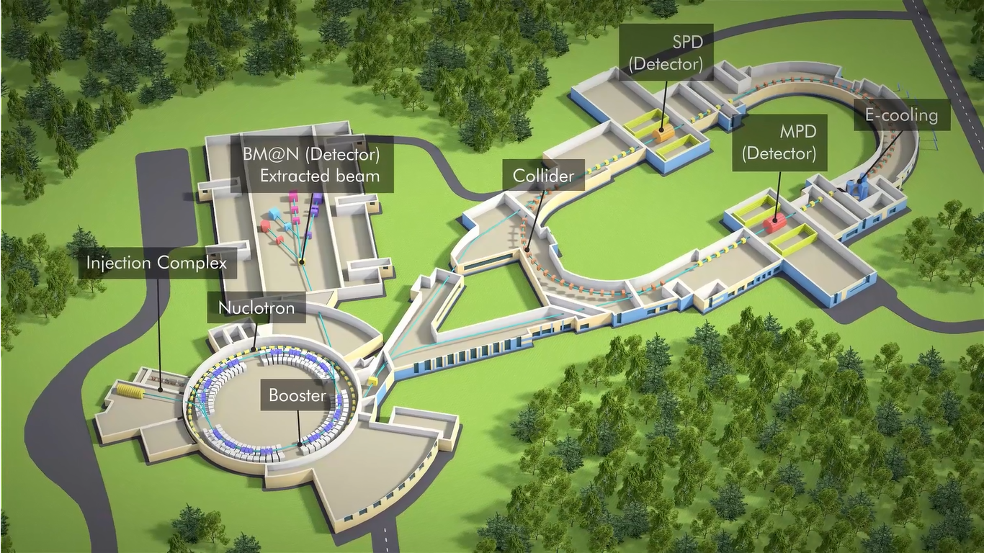
Complex objects
Nuclotron (c=251,5 m)
Notes:
This is a view of major NICA facilities. The Nuclotron – supercoducting synchrotron with circumference of 250 meters was put in operation 24 years ago. The beams from Nuclotron are extracted to the experimental hall, where the first experiment of NICA program BM@N is located. The plan is to put in operation a booster in 2019, and collider - in 2020 simultaneously with the MPD.

Slide 13
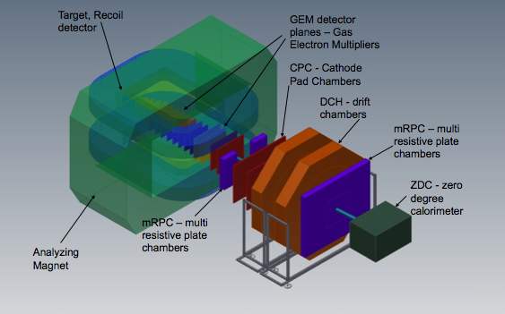
Complex objects
BM@N
data taking
Nuclotron (c=251,5 m)
Notes:
This is a view of major NICA facilities. The Nuclotron – supercoducting synchrotron with circumference of 250 meters was put in operation 24 years ago. The beams from Nuclotron are extracted to the experimental hall, where the first experiment of NICA program BM@N is located. The plan is to put in operation a booster in 2019, and collider - in 2020 simultaneously with the MPD.

Slide 14
Complex objects
BM@N
data taking
Booster- 2019
Nuclotron (c=251,5 m)
Notes:
This is a view of major NICA facilities. The Nuclotron – supercoducting synchrotron with circumference of 250 meters was put in operation 24 years ago. The beams from Nuclotron are extracted to the experimental hall, where the first experiment of NICA program BM@N is located. The plan is to put in operation a booster in 2019, and collider - in 2020 simultaneously with the MPD.

Slide 15
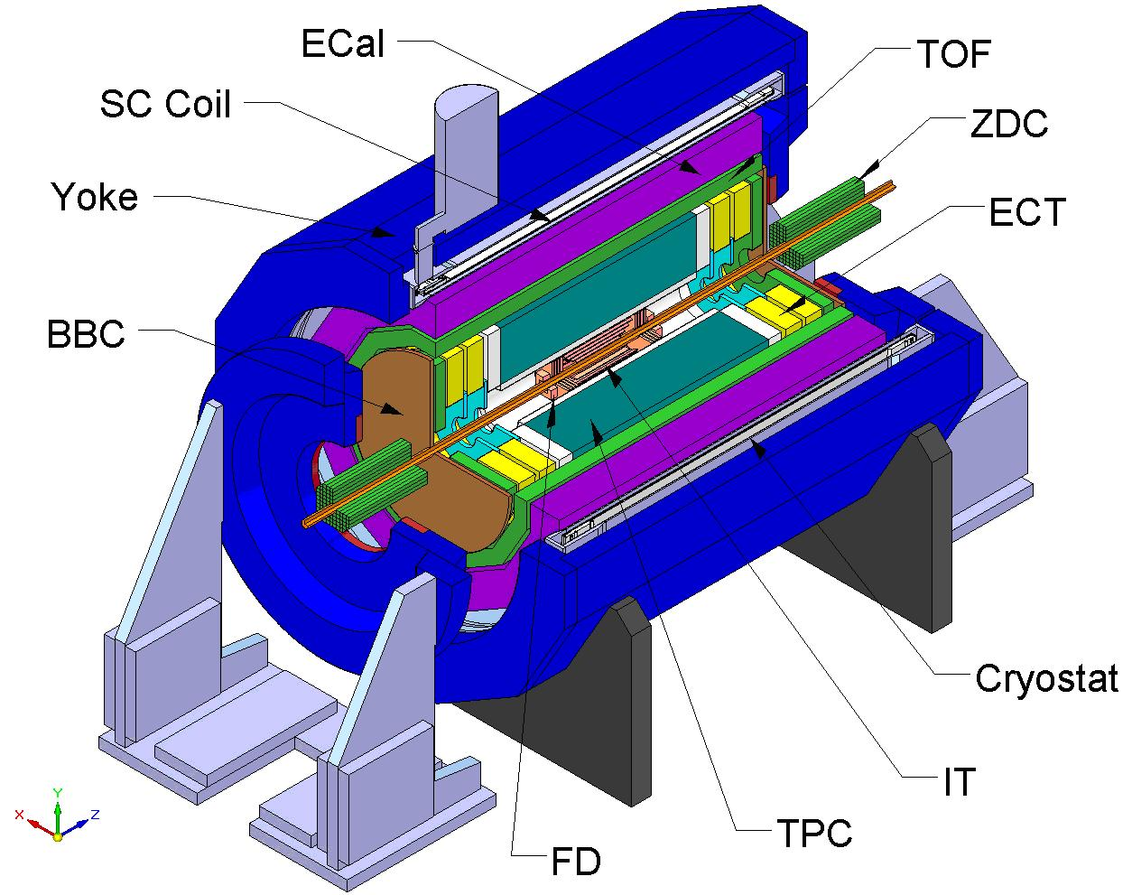
Complex objects
BM@N
data taking
Booster- 2019
MPD - 2020
Nuclotron (c=251,5 m)
Notes:
This is a view of major NICA facilities. The Nuclotron – supercoducting synchrotron with circumference of 250 meters was put in operation 24 years ago. The beams from Nuclotron are extracted to the experimental hall, where the first experiment of NICA program BM@N is located. The plan is to put in operation a booster in 2019, and collider - in 2020 simultaneously with the MPD.

Slide 16
Complex objects
BM@N
data taking
Collider - 2022
Booster- 2019
MPD - 2020
Nuclotron (c=251,5 m)
Notes:
This is a view of major NICA facilities. The Nuclotron – supercoducting synchrotron with circumference of 250 meters was put in operation 24 years ago. The beams from Nuclotron are extracted to the experimental hall, where the first experiment of NICA program BM@N is located. The plan is to put in operation a booster in 2019, and collider - in 2020 simultaneously with the MPD.

Slide 17
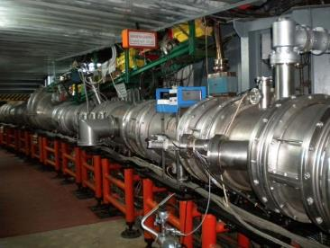
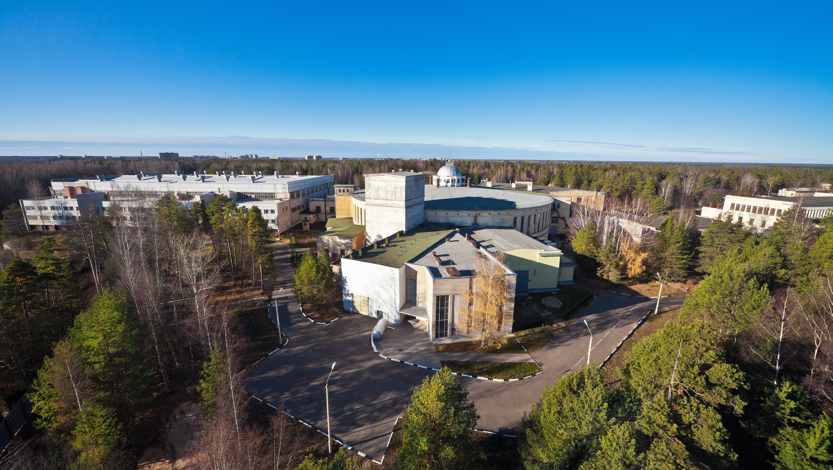
NUCLOTRON in operation since 1993
modernized in 2010-2015
Parameters
type | SC synchrotron
particles | p, d, nuclei
max. kin. energy, GeV/u | 12.07 ( p); 5.62 ( d) 4.38 (Au)
injection energy, MeV/u | 5 ( p, d) 570-685 (Au)
magnetic rigidity, T m | 25 – 43.25
circumference, m | 251.52
vacuum, Torr | 10⁻⁹
intensity, Au /pulse | 1 10⁹
Notes:
The Nuclotron, synchrotron based on the SC magnets developed at JINR, was put in operation in 1993. In was essentially modernized in 2010-2015. It will provide acceleration of gold ions up to kinetic energy 4,4 GeV/u, and protons up to 12 GeV.

Slide 18
Structure and Operation Regimes
Ion sources
Linac LU-20
Fixed Target Area
Nuclotron (45 Tm)
injection bunch
~ 2×10⁹ ions
acceleration up to
1 - 4.5 GeV/u
Notes:
The structure and operation regime of NICA accelerator complex are the following. An existing facility, injection block and superconducting synchrotron Nuclotron, which have been modernized, provide beams to the hall with experimental set-ups. The complex development include: construction of a new injection complex for heavy ions, booster, and two storage rings with two interaction points.

Slide 19
Structure and Operation Regimes
Ion sources
Linac LU-20
Fixed Target Area
BM@N
in operation
Nuclotron (45 Tm)
injection bunch
~ 2×10⁹ ions
acceleration up to
1 - 4.5 GeV/u
Notes:
The structure and operation regime of NICA accelerator complex are the following. An existing facility, injection block and superconducting synchrotron Nuclotron, which have been modernized, provide beams to the hall with experimental set-ups. The complex development include: construction of a new injection complex for heavy ions, booster, and two storage rings with two interaction points.

Slide 20
Structure and Operation Regimes
Linac HILac
KRION
Booster (25 Tm)
storage of
(2 ÷ 4)×10⁹ ions,
acceleration
up to 600 MeV/u
Ion sources
Linac LU-20
Fixed Target Area
BM@N
in operation
Stripping (80%) ¹⁹⁷Au³¹⁺ => ¹⁹⁷Au⁷⁹⁺
Nuclotron (45 Tm)
injection bunch
~ 2×10⁹ ions
acceleration up to
1 - 4.5 GeV/u
Notes:
The structure and operation regime of NICA accelerator complex are the following. An existing facility, injection block and superconducting synchrotron Nuclotron, which have been modernized, provide beams to the hall with experimental set-ups. The complex development include: construction of a new injection complex for heavy ions, booster, and two storage rings with two interaction points.

Slide 21
Structure and Operation Regimes
Linac HILac
KRION
Booster (25 Tm)
storage of
(2 ÷ 4)×10⁹ ions,
acceleration
up to 600 MeV/u
Ion sources
Linac LU-20
Fixed Target Area
BM@N
in operation
Stripping (80%) ¹⁹⁷Au³¹⁺ => ¹⁹⁷Au⁷⁹⁺
Nuclotron (45 Tm)
injection bunch
~ 2×10⁹ ions
acceleration up to
1 - 4.5 GeV/u
IP-2
Two SC collider rings
~ 2 x 22 injection cycles
22 bunches per ring
IP-1
Notes:
The structure and operation regime of NICA accelerator complex are the following. An existing facility, injection block and superconducting synchrotron Nuclotron, which have been modernized, provide beams to the hall with experimental set-ups. The complex development include: construction of a new injection complex for heavy ions, booster, and two storage rings with two interaction points.

Slide 22
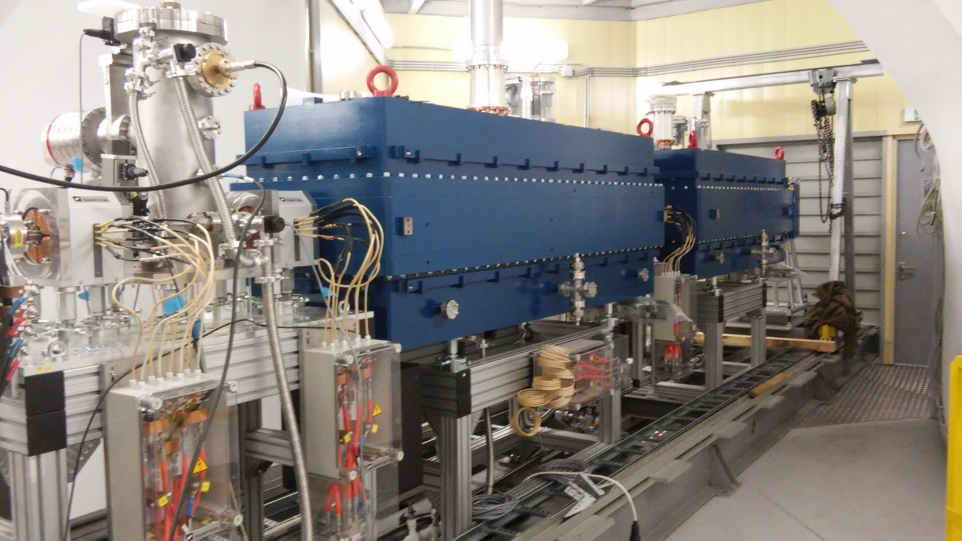
Structure and Operation Regimes
Linac HILac
KRION
Ion sources
Booster (25 Tm)
storage of
(2 ÷ 4)×10⁹ ions,
acceleration
up to 600 MeV/u
HILAC: “BEVATECH OHG”
Linac LU-20
Fixed Target Area
Stripping (80%) ¹⁹⁷Au³¹⁺ => ¹⁹⁷Au⁷⁹⁺
Nuclotron (45 Tm)
injection bunch
~ 2×10⁹ ions
acceleration up to
1 - 4.5 GeV/u
IP-2
Two SC collider rings
~ 2 x 22 injection cycles
22 bunches per ring
extraction energy, MeV/amu | 3.24 (A/Z=6)
injection energy, keV/amu | 17
input current, mA | up to 10
IP-1
Notes:
The structure and operation regime of NICA accelerator complex are the following. An existing facility, injection block and superconducting synchrotron Nuclotron, which have been modernized, provide beams to the hall with experimental set-ups. The complex development include: construction of a new injection complex for heavy ions, booster, and two storage rings with two interaction points.

Slide 23
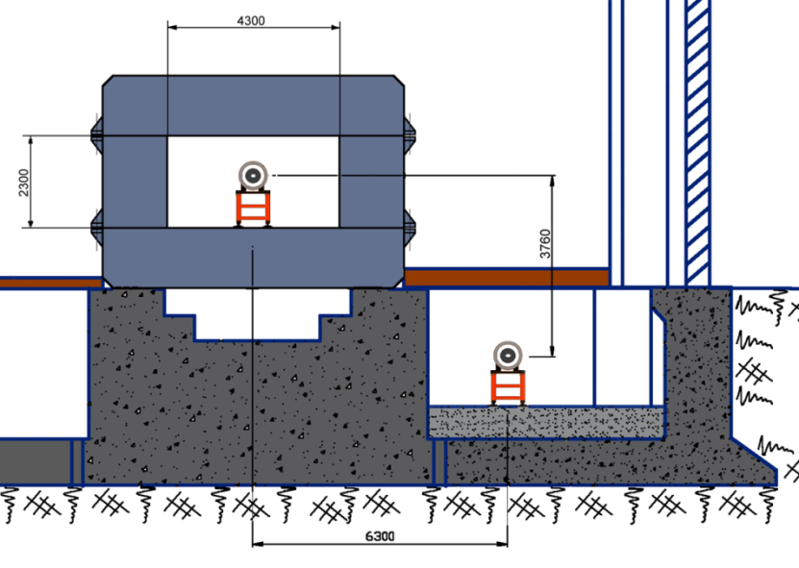
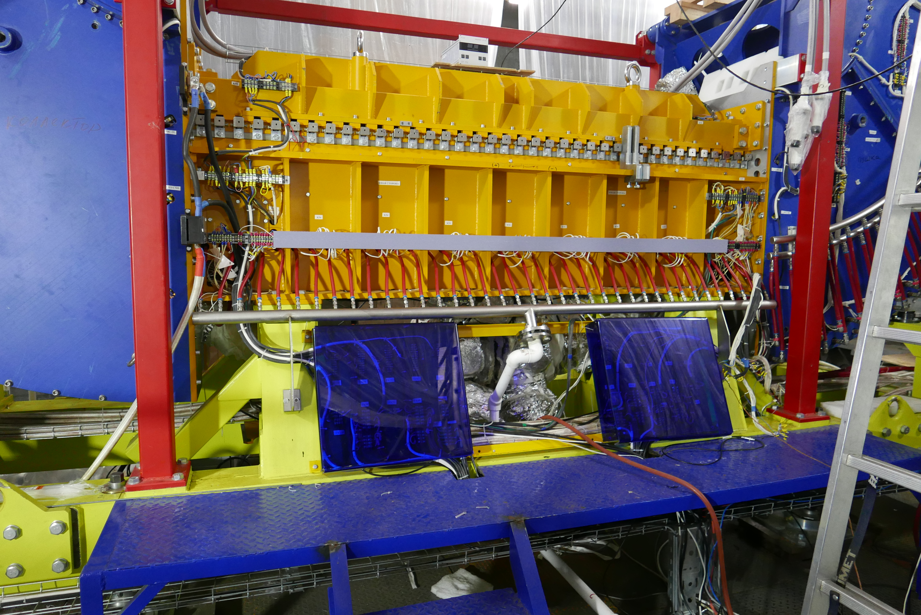
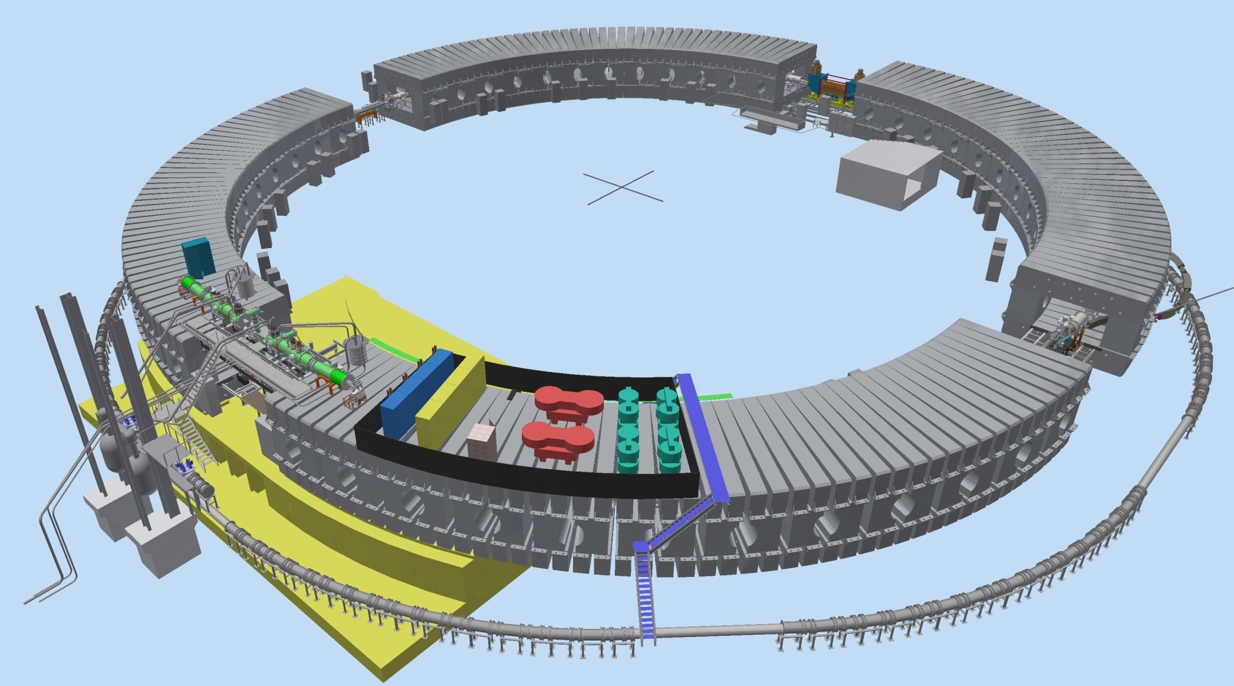
Booster
Booster: assembly since 2018
E-cooling system
injection
Nuclotron
Feed box
Power supply
extraction
Accelerating station
Nuclotron

Slide 24
Booster
Booster: assembly since 2018
E-cooling system
injection
Nuclotron
Commissioning – December 2019
Feed box
 | value
ion species | A/Z < 3
max. energy, MeV/u | 600
injection energy, MeV/u | 3.2
magnetic rigidity, T m | 1.6 – 25.0
circumference, m | 210.96
vacuum, Tor | 10⁻¹¹
intensity, Au /p | 1.5 10⁹
RF region,MHz | 0.5 -2.53
Power supply
extraction
Accelerating station
Nuclotron

Slide 25

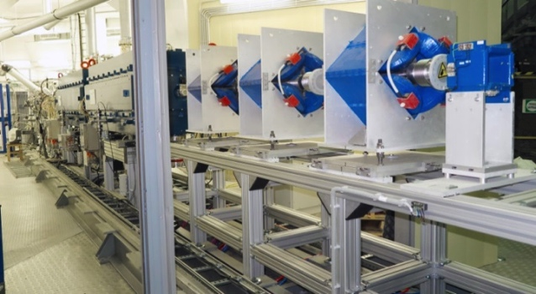
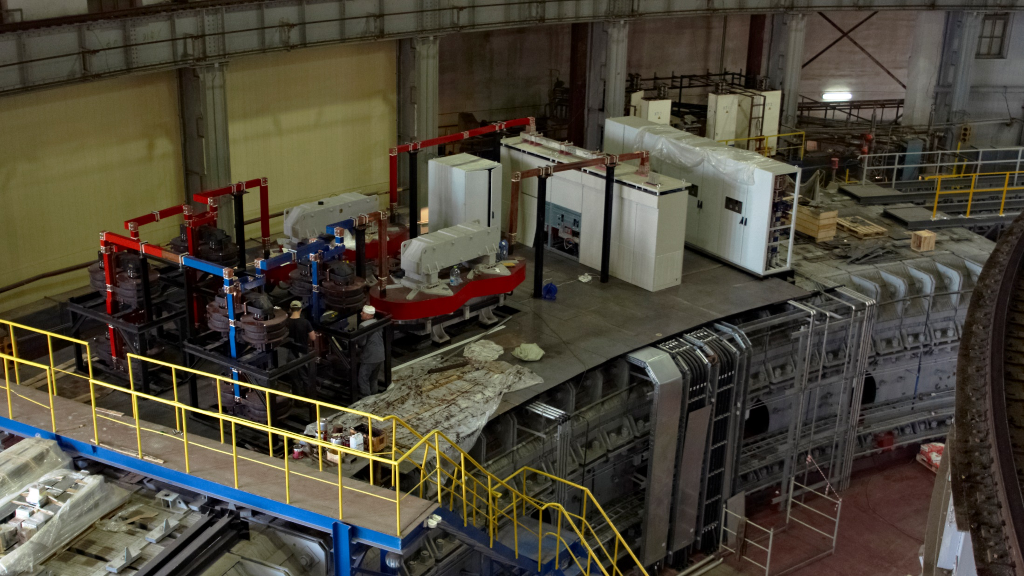
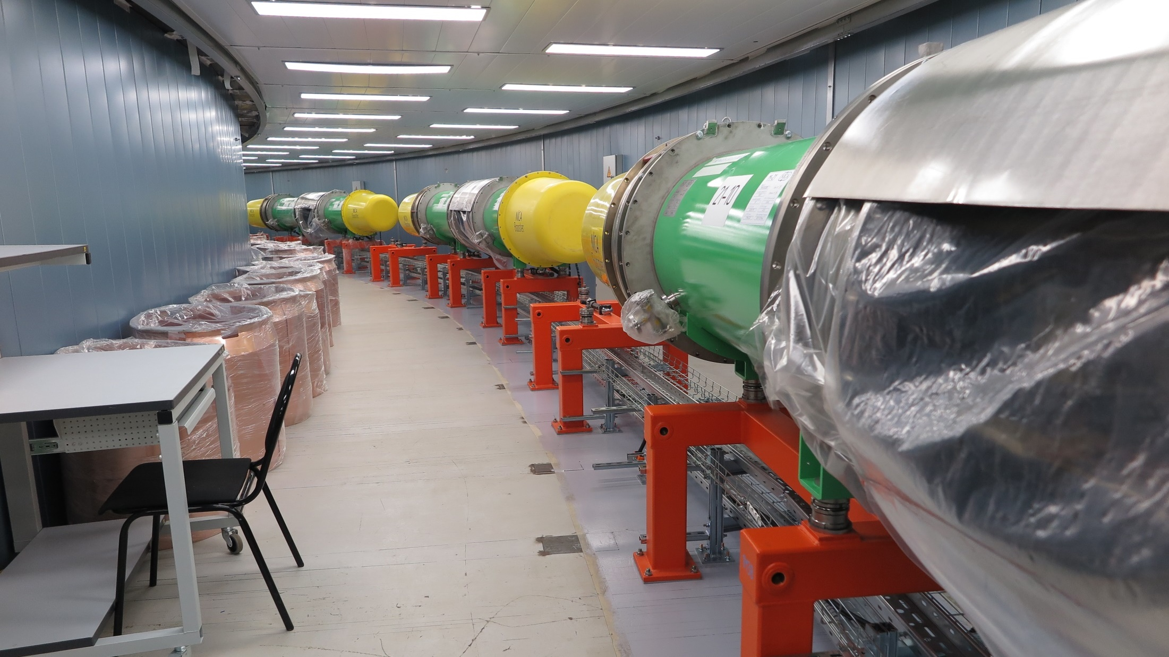
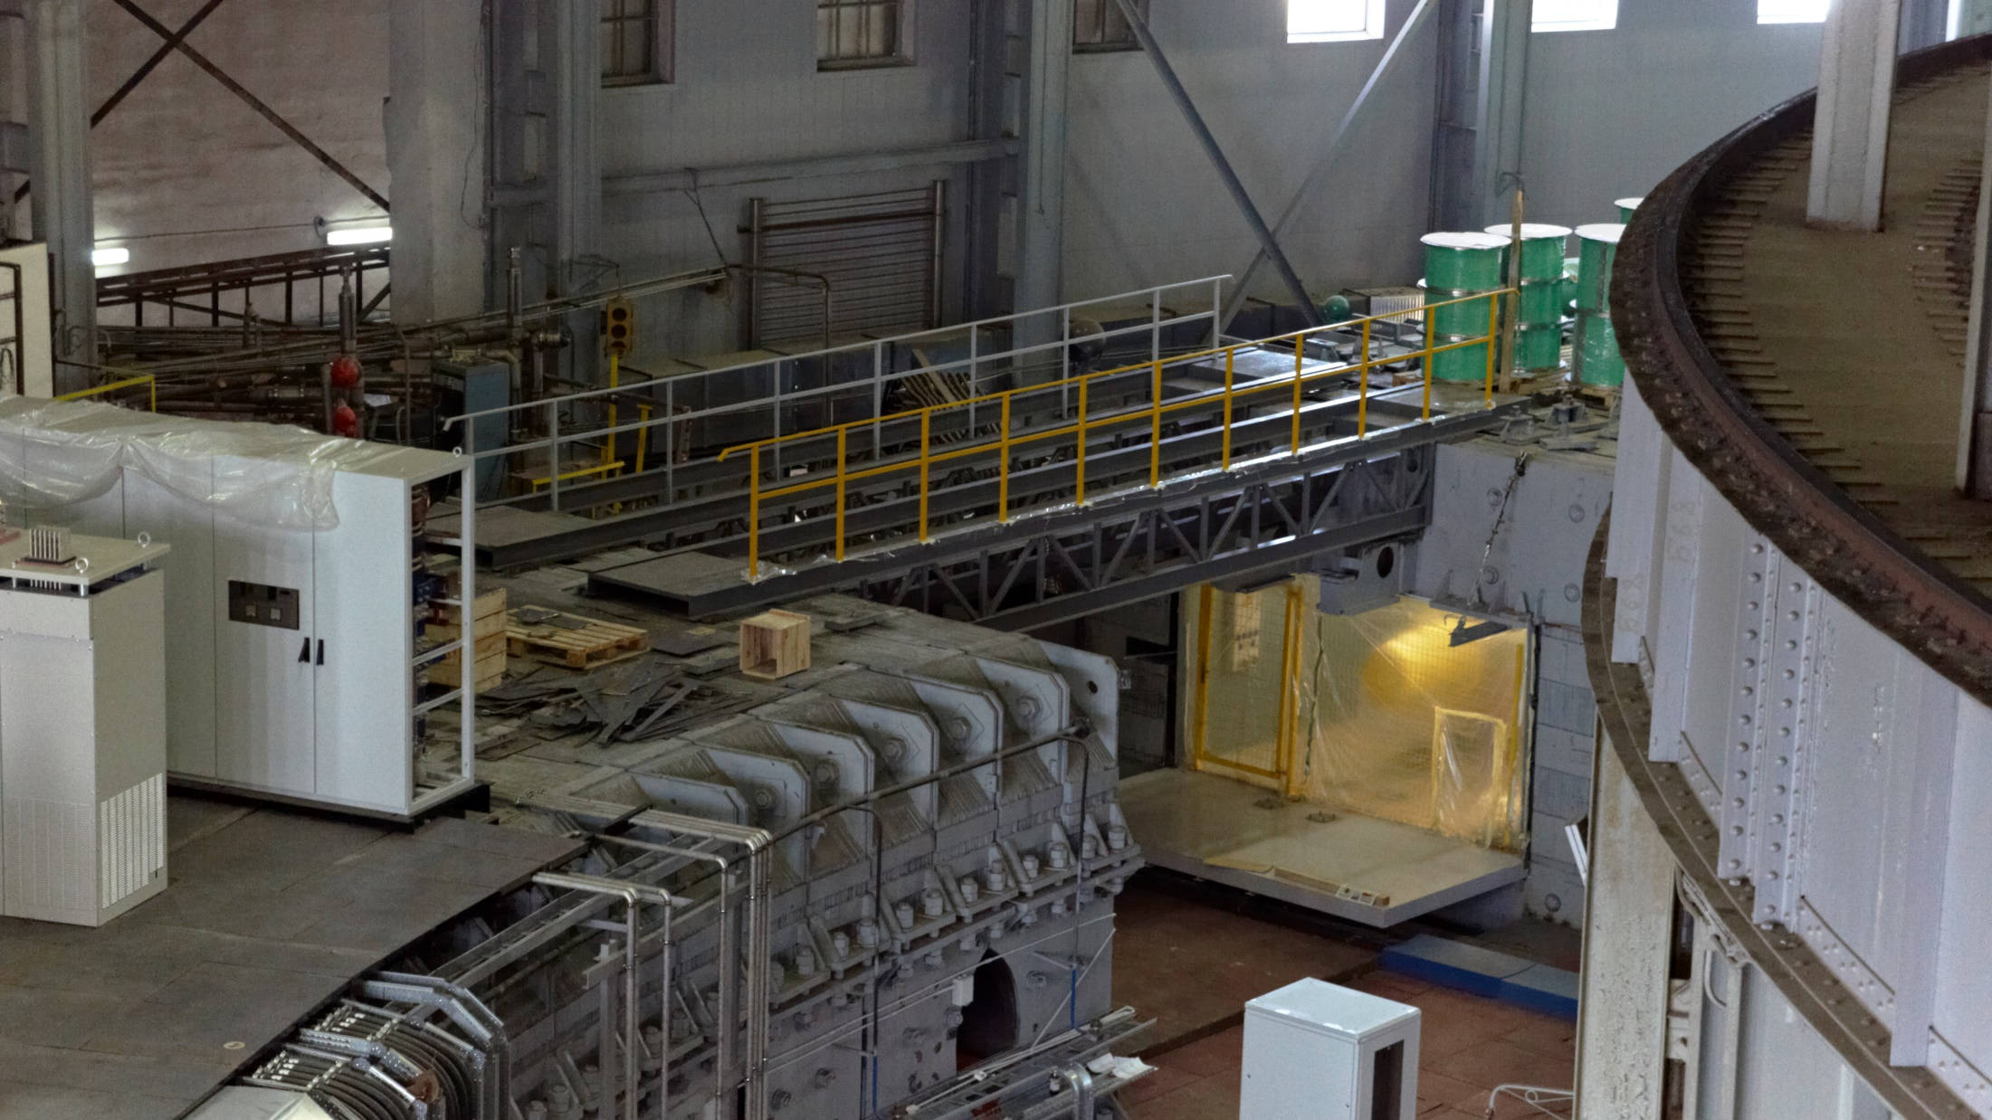
Injection channel
power supply system
Dipole modules in tunnel
section with reference magnets
dipoles in the tunnel
25

Slide 26

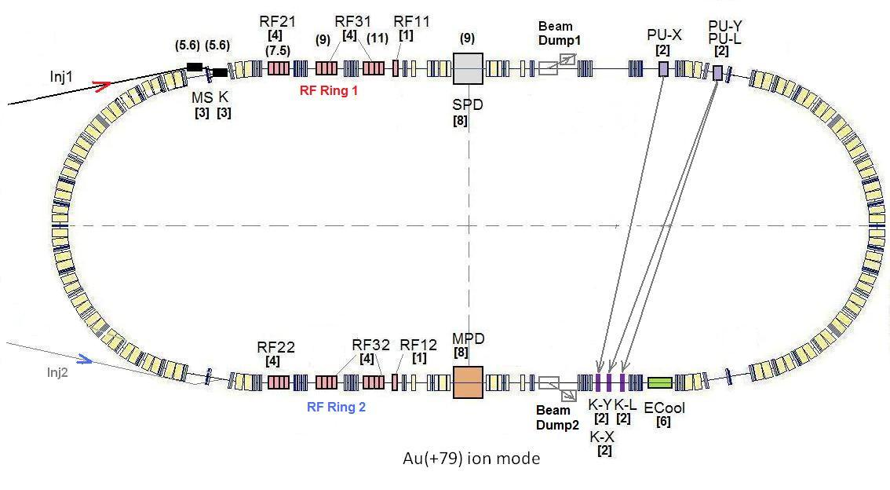
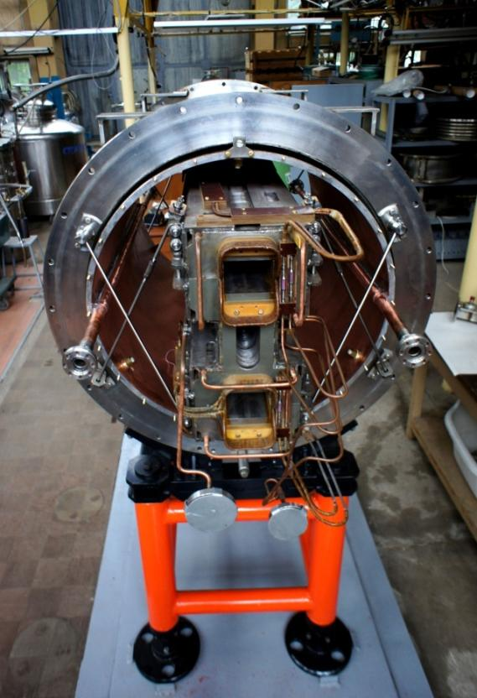
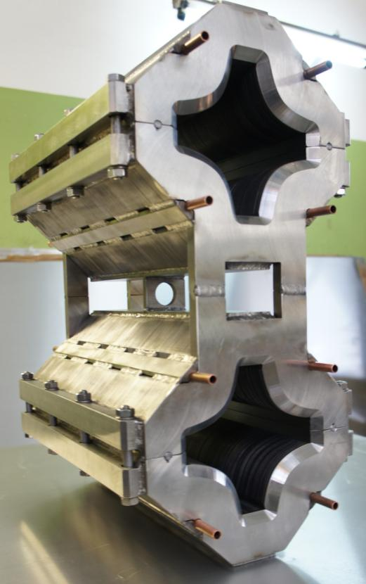
The Collider
Commissioning – 2022
45 T*m, 4.5 GeV/u for Au⁷⁹⁺
SPD
Ring circumference, m | 503,04
Number of bunches | 22
r.m.s. bunch length, m | 0,6
β, m | 0,35
max. int. Energy, Gev/u | 11,0
r.m.s. Δp/p, 10-3 | 1,6
IBS growth time, s | 1800
Luminosity, cm-2 s-1 | 1x10²⁷
Double aperture magnets:
dipole & quadrupole
prototypes
MPD
Notes:
The lattice design and prototyping of most collider elements are completed. The ring circumference is twice as one of the Nuclotron. For the gold beam a Luminosity at the energy above 10 GeV per nucleon will be 10 to the 27

Slide 27
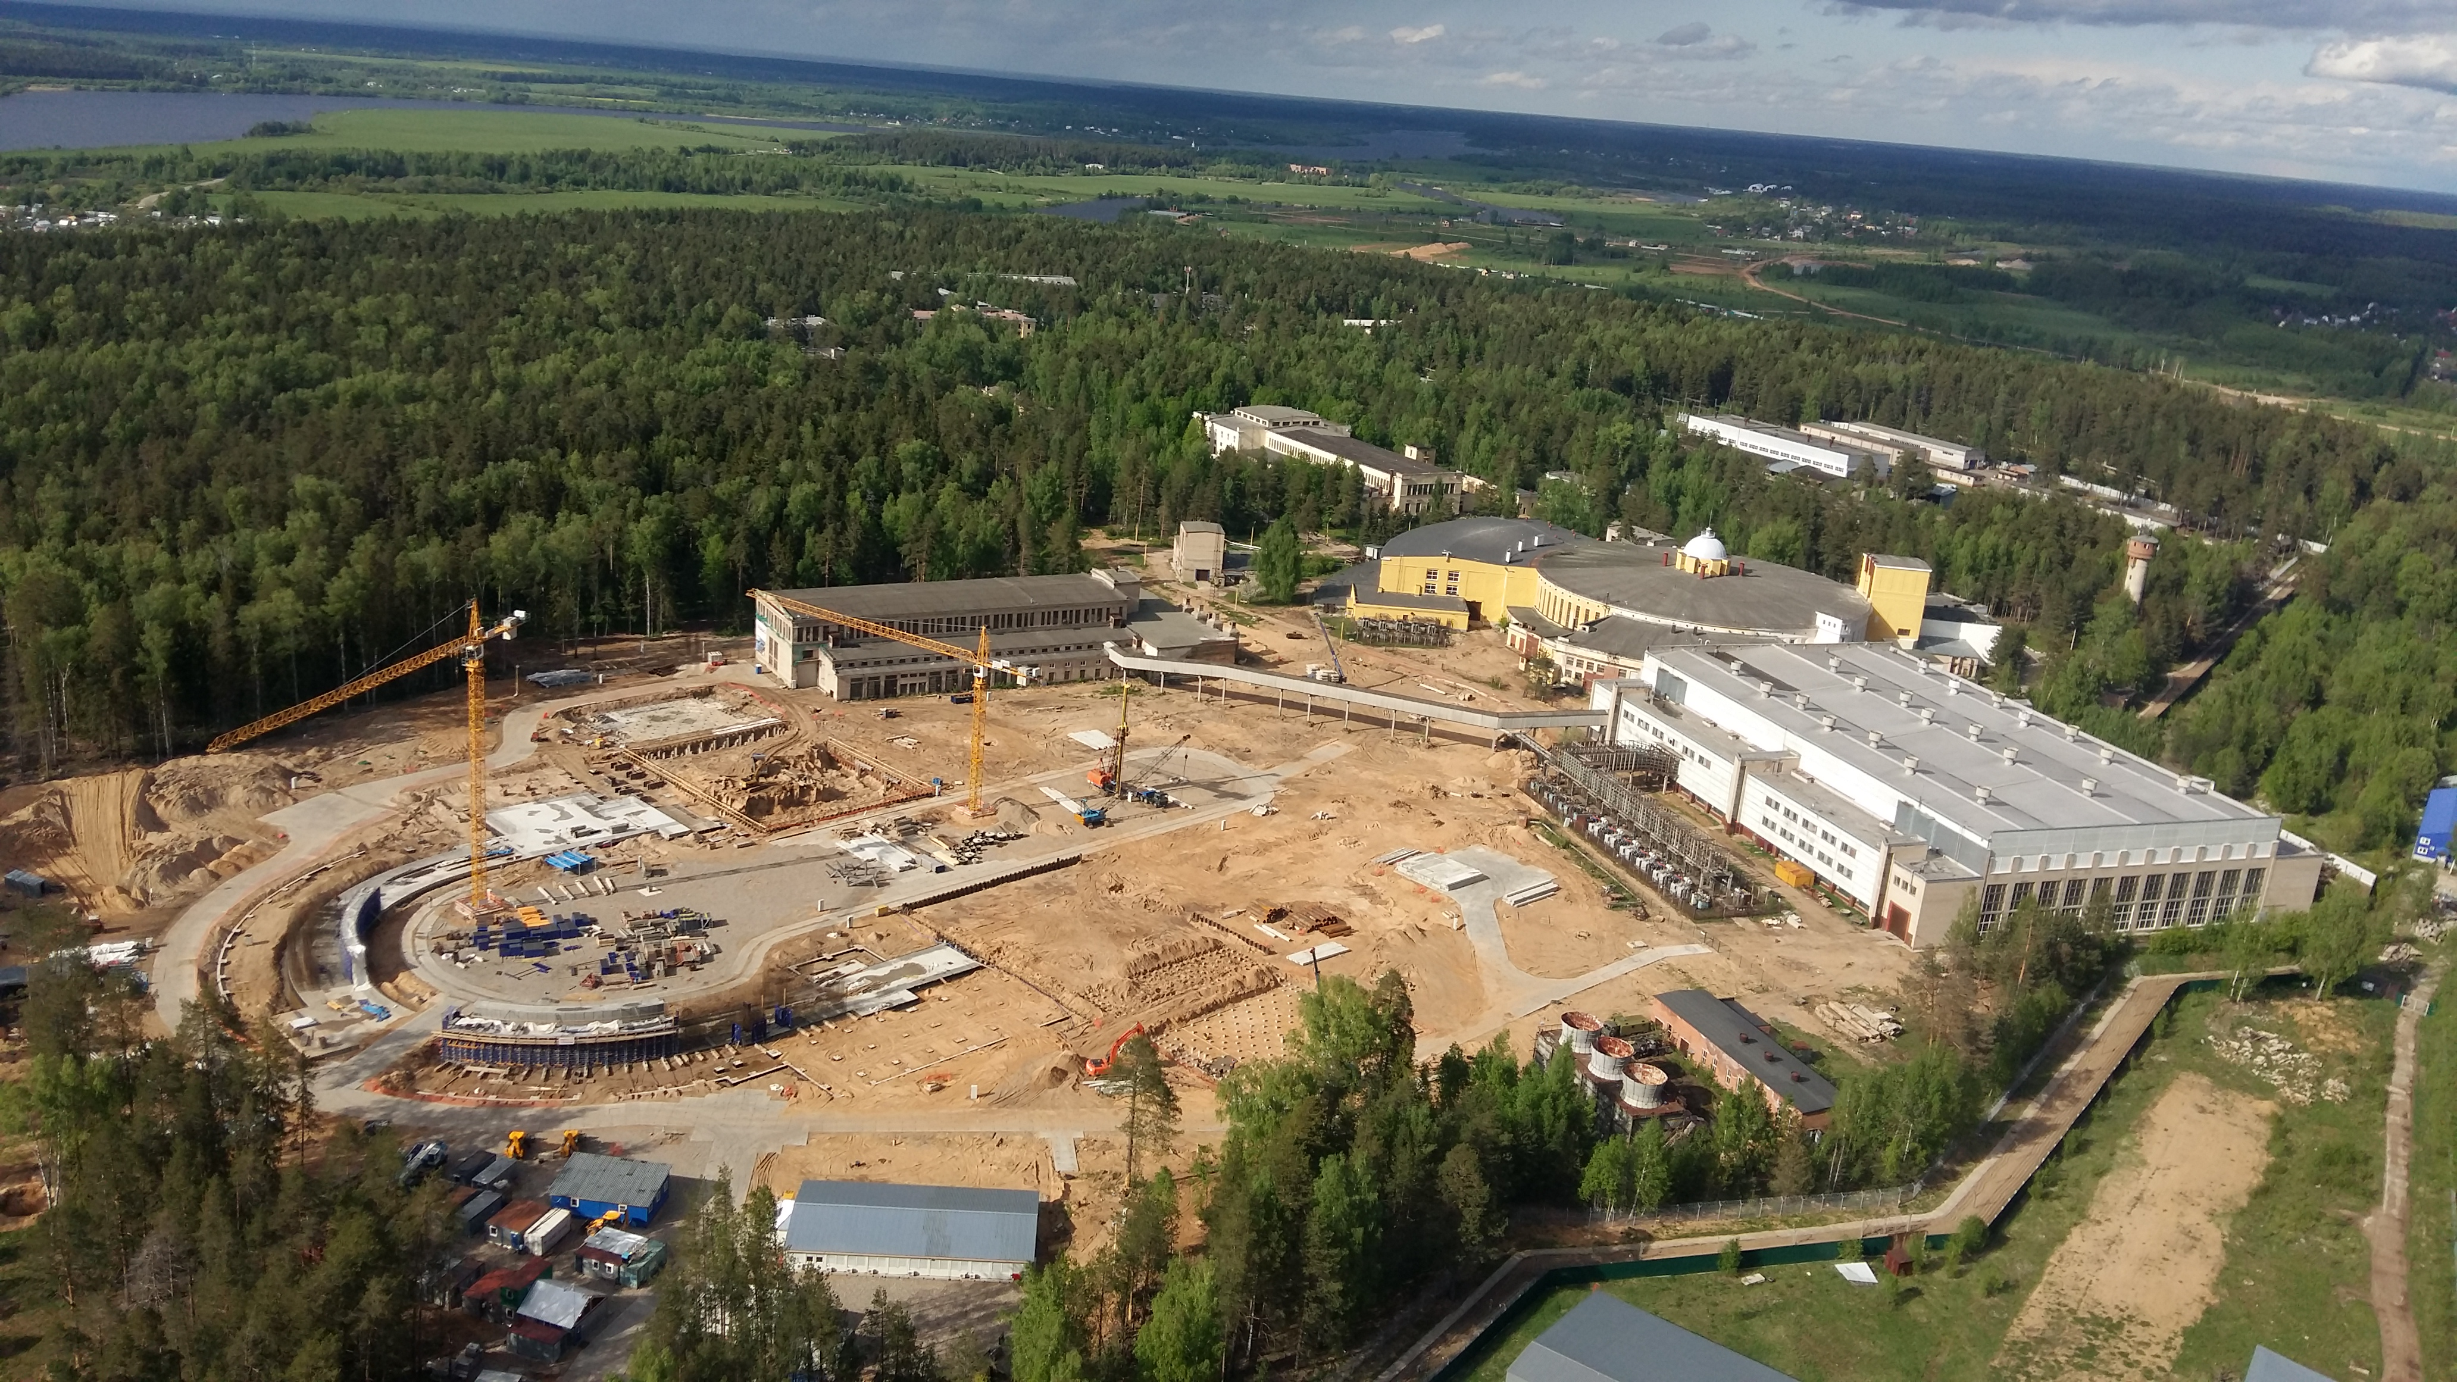
Civil Construction 2017
Nuclotron
Notes:
The civil construction of the collider complex is going on in accordance with the plans. the MPD hall will be ready by the summer of 2018, and the entire complex will be completed in 2019.

Slide 28
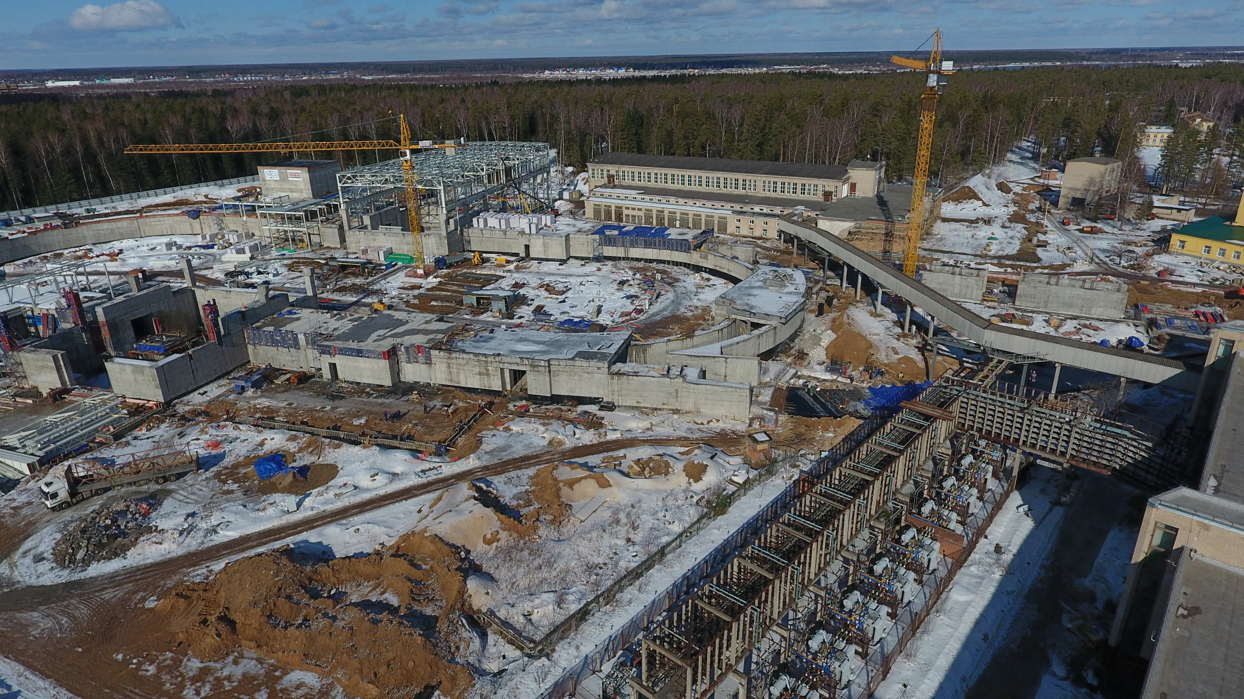
Civil Construction 2019
Civil Construction 2017
MPD hall
Notes:
The civil construction of the collider complex is going on in accordance with the plans. the MPD hall will be ready by the summer of 2018, and the entire complex will be completed in 2019.

Slide 29
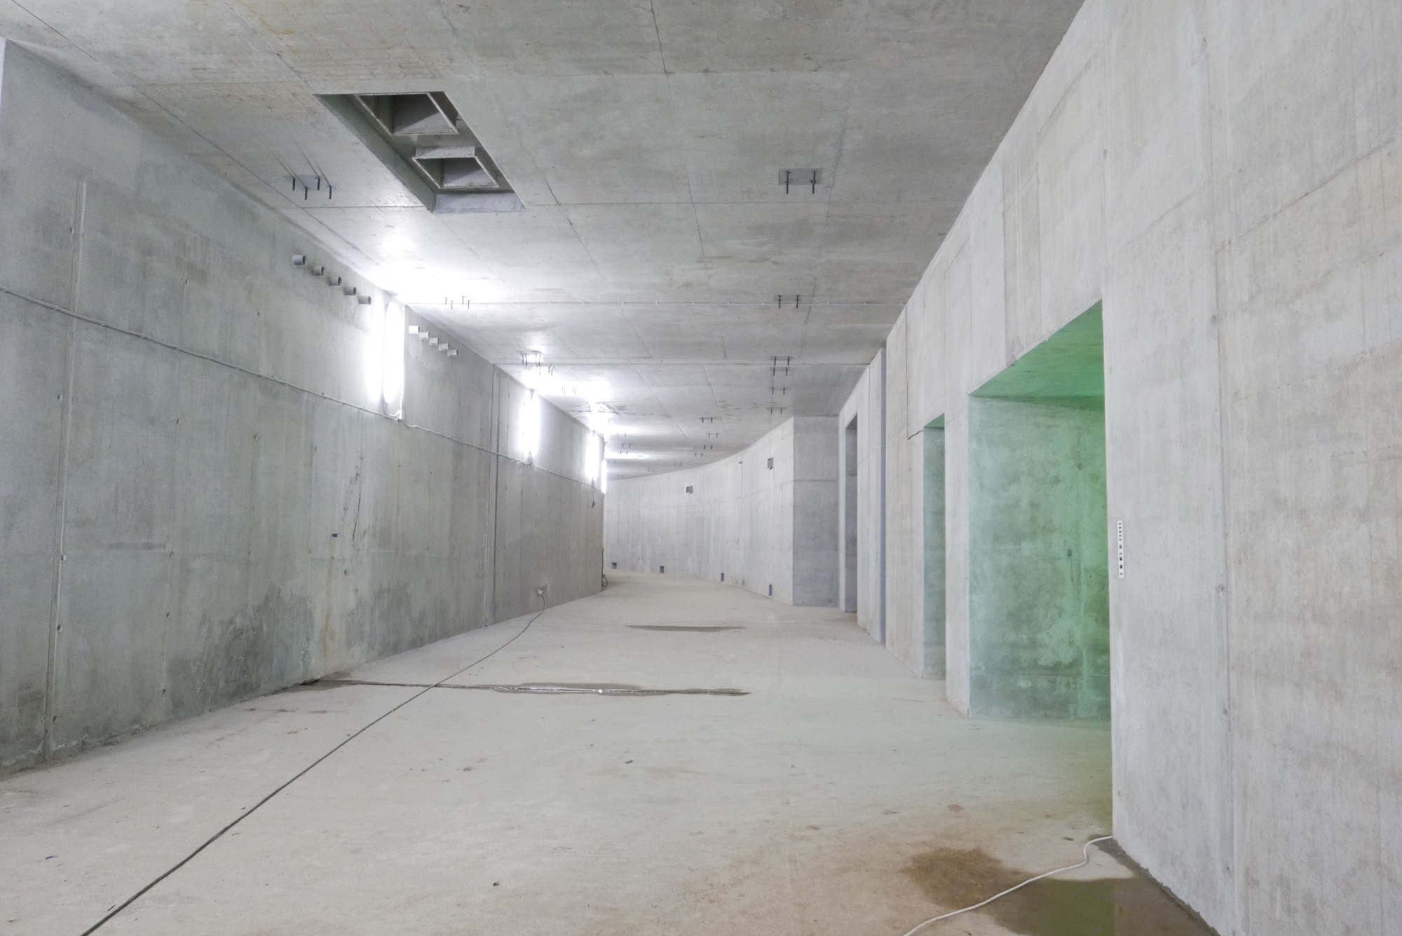
Civil Construction 2019
Civil Construction 2017
MPD hall
tunnel circuit (503 m) completed
Notes:
The civil construction of the collider complex is going on in accordance with the plans. the MPD hall will be ready by the summer of 2018, and the entire complex will be completed in 2019.

Slide 30
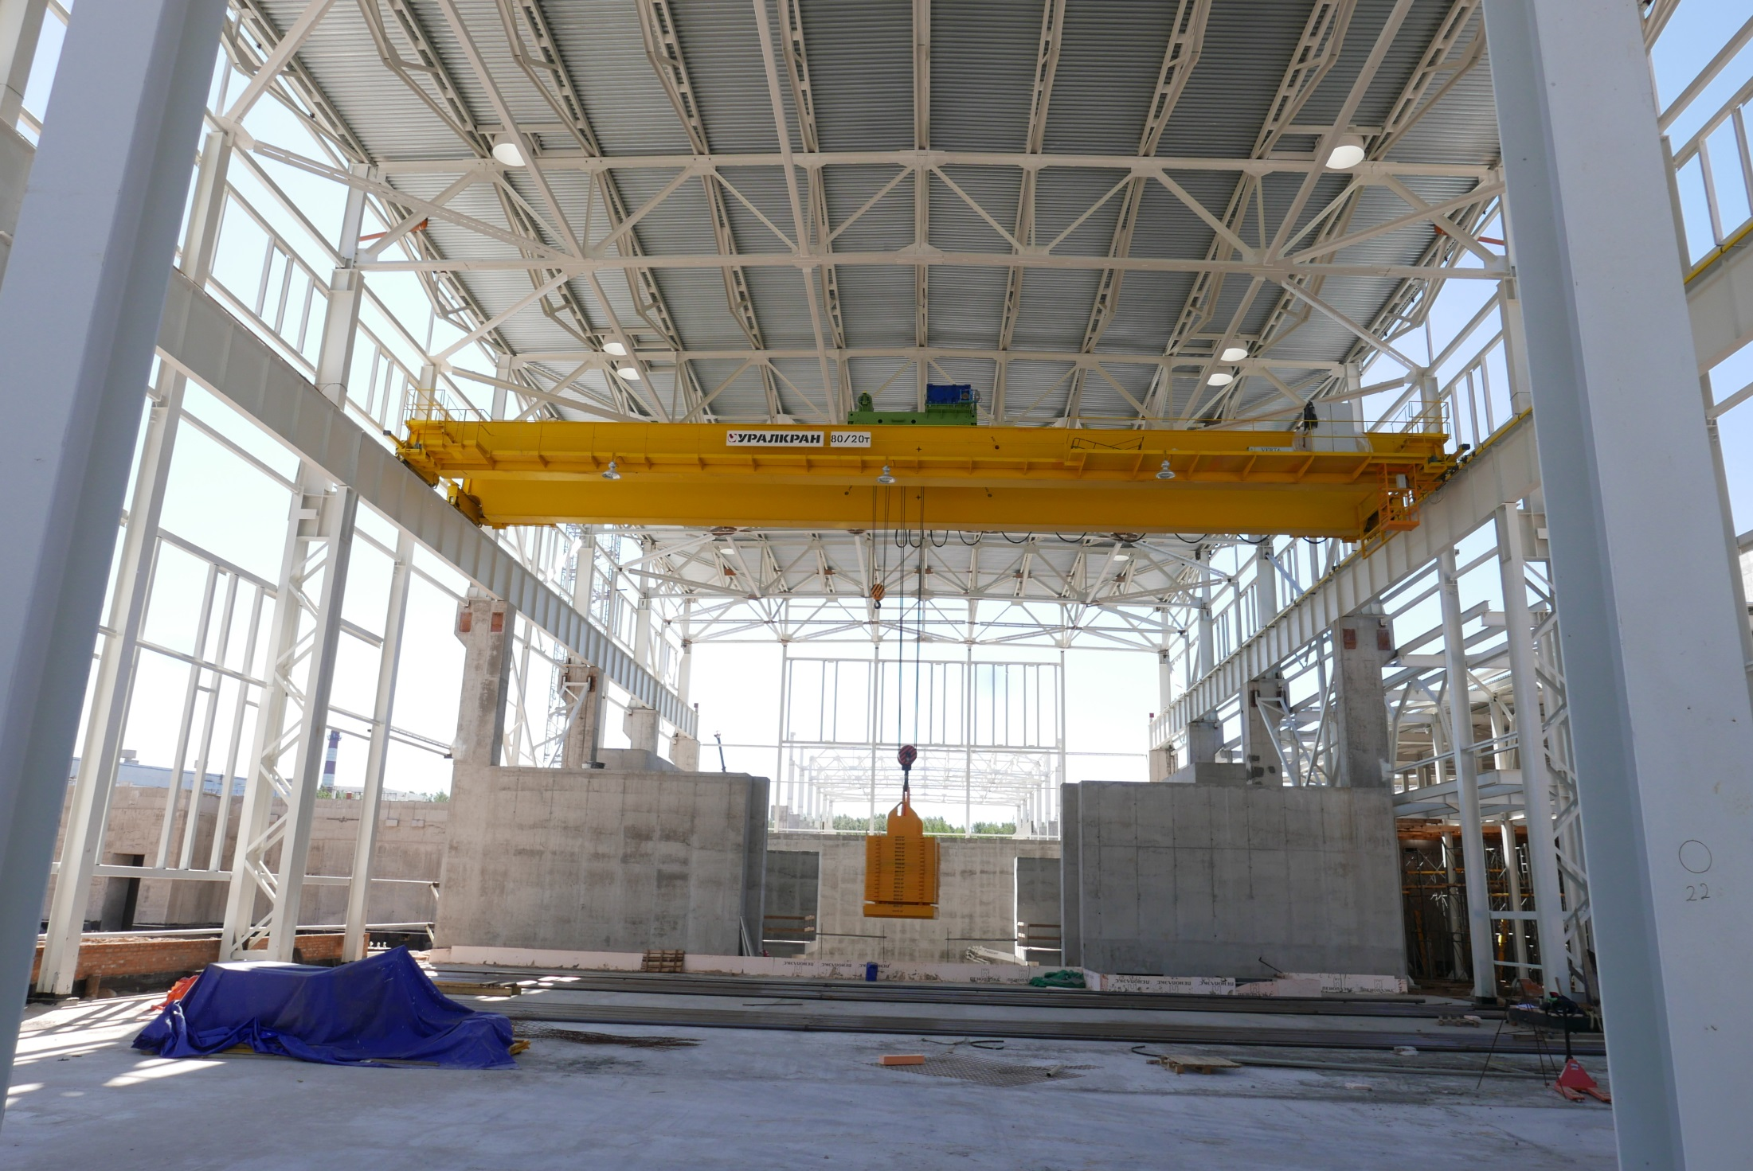
Civil Construction 2019
Civil Construction 2017
MPD Hall
MPD hall
tunnel circuit (503 m) completed
100 t
Notes:
The civil construction of the collider complex is going on in accordance with the plans. the MPD hall will be ready by the summer of 2018, and the entire complex will be completed in 2019.

Slide 31
Civil Construction 2019
Civil Construction 2017
MPD Hall
MPD hall
MPD hall: ready for detector installation - IV q. 2019
readiness of the whole collider building - IV q. 2020
tunnel circuit (503 m) completed
100 t
The MPD magnet will be assembled in 2019
Notes:
The civil construction of the collider complex is going on in accordance with the plans. the MPD hall will be ready by the summer of 2018, and the entire complex will be completed in 2019.

Slide 32
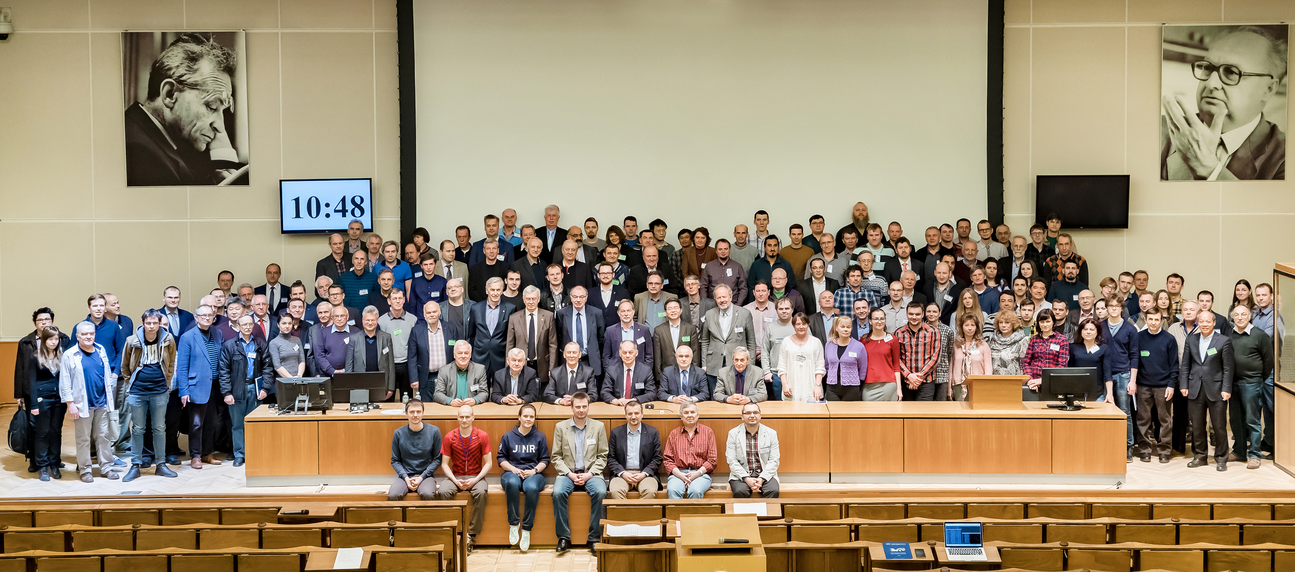
kick-off meeting on formation of
the MPD and BM@N Collaborations
carried out in Dubna on 11-13 April, 2018
https://indico.jinr.ru/conferenceDisplay.py?ovw=True&confId=385
The II and III meetings took place in October 2018 and April 2019

Slide 33
Baryonic Matter at Nuclotron
(BM@N) Collaboration:
11 Countries, 21 Institutions,
230 paricipants
spokesperson – M. Kapishin, JINR
University of Plovdiv, Bulgaria;
Institute of High Energy Physics, China;
Shanghai Institute of Nuclear and Applied Physics, CFS, China;
Tsinghua University, Beijing, China;
Nuclear Physics Institute CAS, Czech Republic;
Tubingen University, Germany;
Tel Aviv University, Israel;
Joint Institute for Nuclear Research;
Almaty Institute of Physics & Technology, Kazakhstan;
Institute of Applied Physics, Chisinev, Moldova;
Warsaw University of Technology, Poland;
University of Wroclaw, Wroclaw, Poland;
Institute of Nuclear Research RAS, Moscow, Russia;
Institute of Theoretical & Experimental Physics, NRC KI, Moscow, Russia;
NRC Kurchatov Institute, Moscow, Russia;
Moscow Engineer and Physics Institute, Russia;
Skobeltsin Institute of Nuclear Physics, MSU, Russia;
Massachusetts Institute of Technology, Cambridge, USA.

Slide 34

MPD Collaboration:
spokesperson – A. Kiesel WUT, Poland
10 Countries, 32 Institutes, 465 participants
IHEP, Beijing, China;
University of South China, China;
Palacky University, Olomouc, Czech Republic;
NPI CAS, Rez, Czech Republic;
Tbilisi State University, Tbilisi, Georgia;
Tubingen University, Tubingen, Germany;
Tel Aviv University, Tel Aviv, Israel;
Joint Institute for Nuclear Research;
IPT, Almaty, Kazakhstan;
FHCal
UNAM, Mexico City, Mexico;
Institute of Applied Physics, Chisinev, Moldova;
WUT, Warsaw, Poland;
NCN, Otwock – Swierk, Poland;
UW, Wroclaw, Poland;
Jan Kochanowski University, Kielce, Poland;
INR RAS, Moscow, Russia;
MEPhI, Moscow, Russia;
PNPI, Gatchina, Russia;
INP MSU, Moscow, Russia;
KI NRS, Moscow, Russia;
SPSU - Dept. of NP, Russia;
St. Petersburg, Russia;
SPSU – Dept. of HEP, St. Petersburg, Russia;
North Ossetia State University, Vladikavkaz, Russia;
Baku State University, NNRC, Azerbaijan;
University of Plovdiv, Bulgaria;
University Tecnica Federico Santa Maria, Valparaiso, Chili;
Tsinghua University, Beijing, China;
USTC, Hefei, China;
Huizhou University, Huizhou, China;
Institute of Nuclear and Applied Physics, CAS, Shanghai, China;
Central China Normal University, China;
Shandong University, Shandong, China;

Slide 35
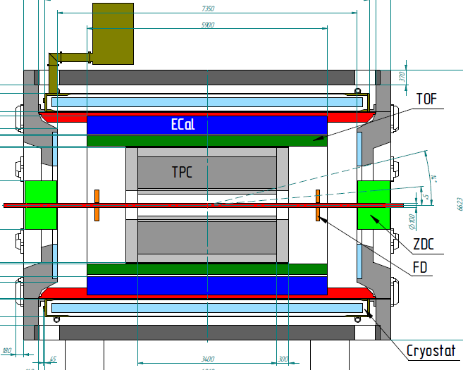
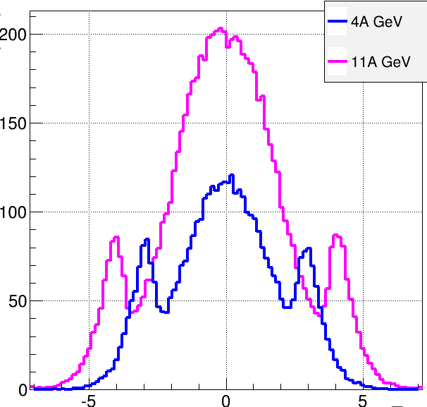
Multi-Purpose Detector (MPD)
stage I: TPC, TOF, ECAL, FHCal, FFD
acceptance
URQMD
charged
b<11 fm
11 A GeV
4 A GeV
dN/dη
TPC
TOF
ECal
FFD
FHCal
FHCal
FFD
η
stage I: put in operation in 2022
Notes:
The MPD will be put in operation at two stages. At the first one the barrel part will be equipped with major tracking detector TPC, TOF end ECAL. FHC and FD will be operational as well.
At the second stage the detector will be supplemented with IT and end cap subdetectors.

Slide 36
Multi-Purpose Detector (MPD)
stage I: TPC, TOF, ECAL, FHCal, FFD
stage II ( 2023): + ITS + EndCap (CPC, Straw, TOF, ECAL)
stage II
acceptance
URQMD
charged
b<11 fm
11 A GeV
4 A GeV
dN/dη
TPC
CPC
TOF
ECal
FFD
FHCal
FHCal
FFD
η
stage I: put in operation in 2022
Notes:
The MPD will be put in operation at two stages. At the first one the barrel part will be equipped with major tracking detector TPC, TOF end ECAL. FHC and FD will be operational as well.
At the second stage the detector will be supplemented with IT and end cap subdetectors.

Slide 37
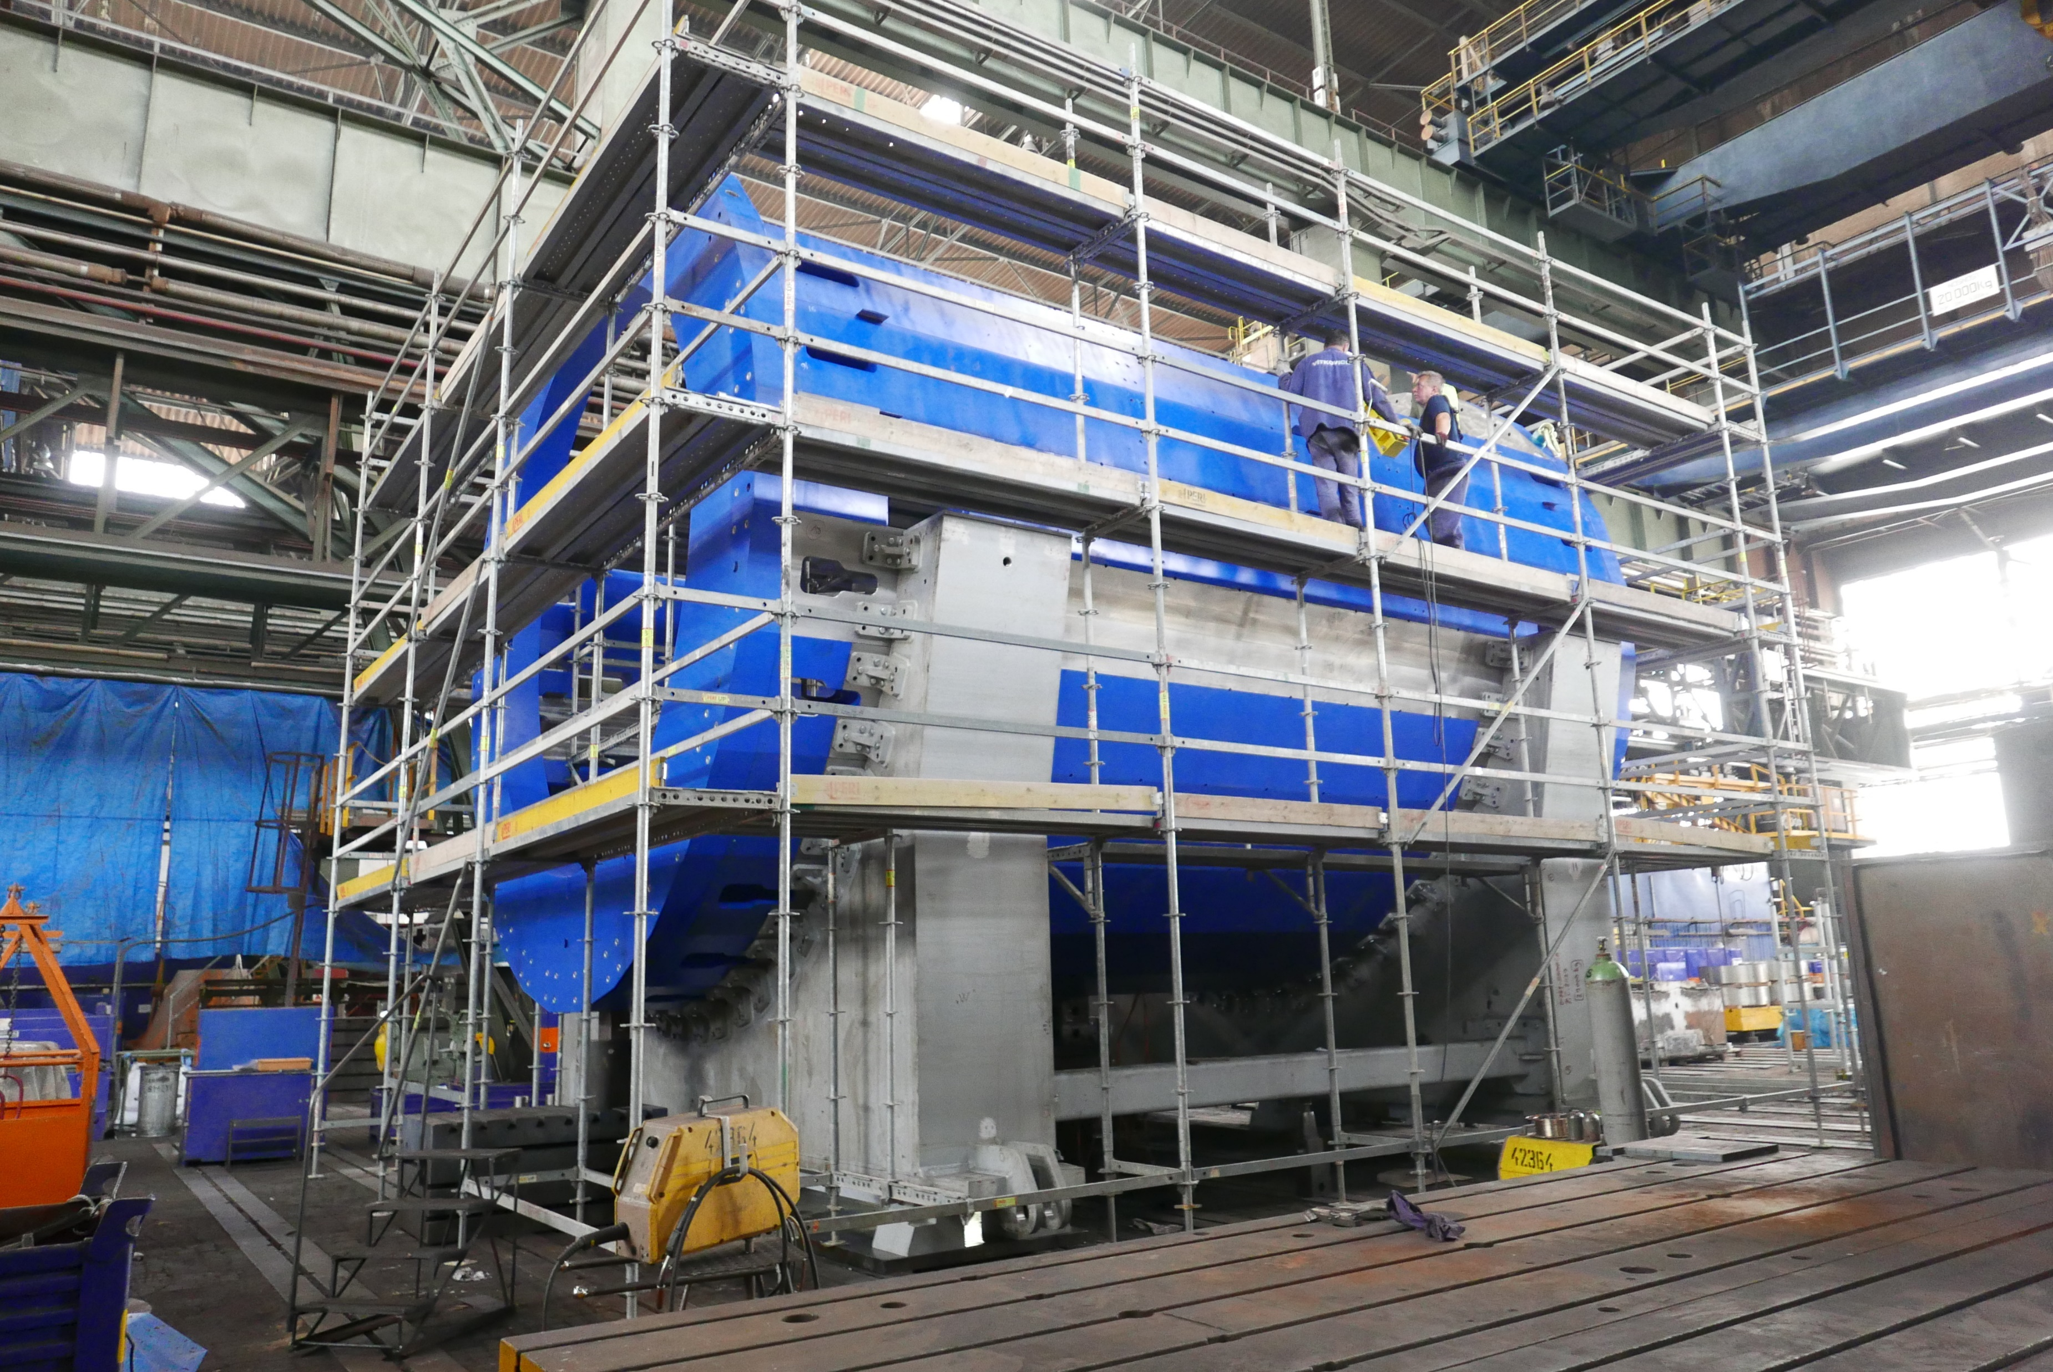
The yoke
Control assembly at HM Vitkovice:
tolerances ~ 0,5 mm
Notes:
8 contracts have been signed for the construction of large superconducting solenoid. All works are well progressing. The yoke production is going on at Vitkovice heavy machinery in Czech Republic. The cold mass is under production in other European enter[prizes.

Slide 38
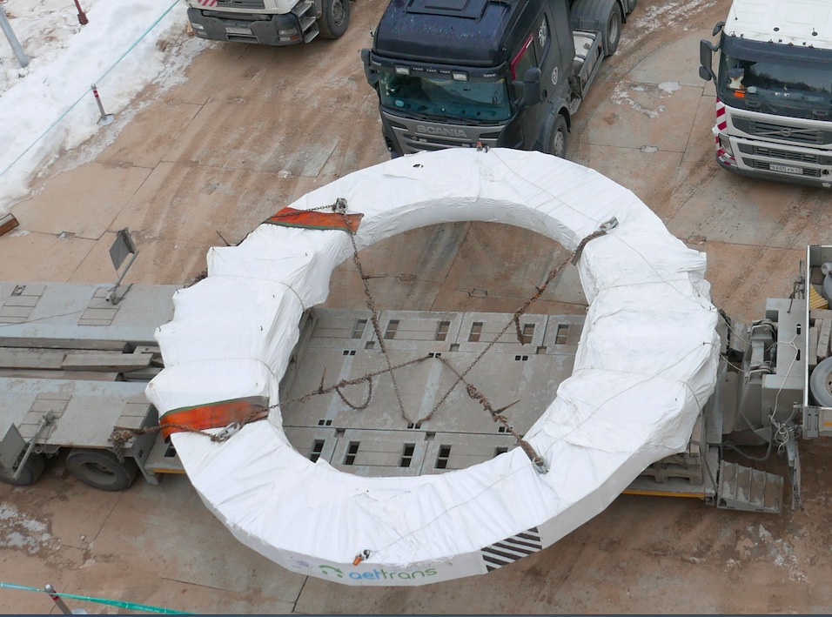
The yoke
Control assembly at HM Vitkovice:
tolerances ~ 0,5 mm
Dubna
March 10, 2019
Notes:
8 contracts have been signed for the construction of large superconducting solenoid. All works are well progressing. The yoke production is going on at Vitkovice heavy machinery in Czech Republic. The cold mass is under production in other European enter[prizes.

Slide 39
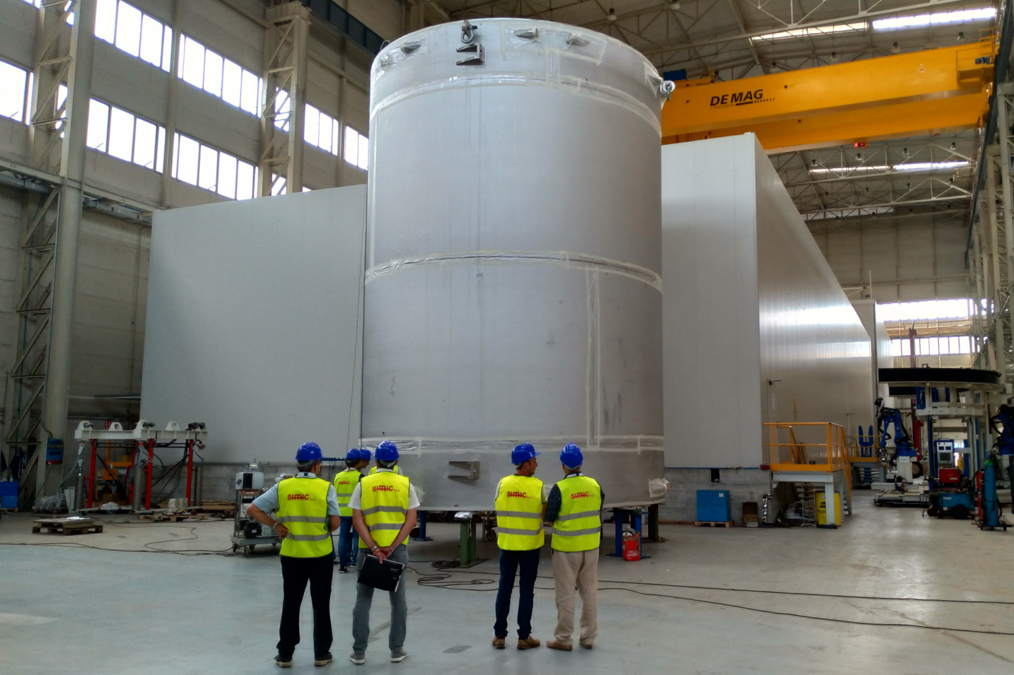
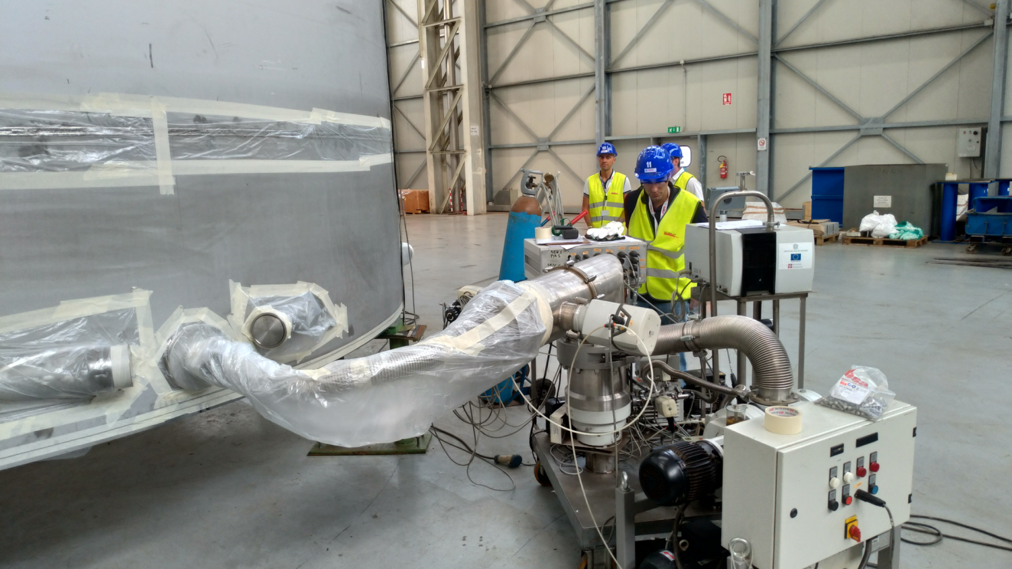
The SC Coil and cold mass
cryostat
vacuum test

Slide 40
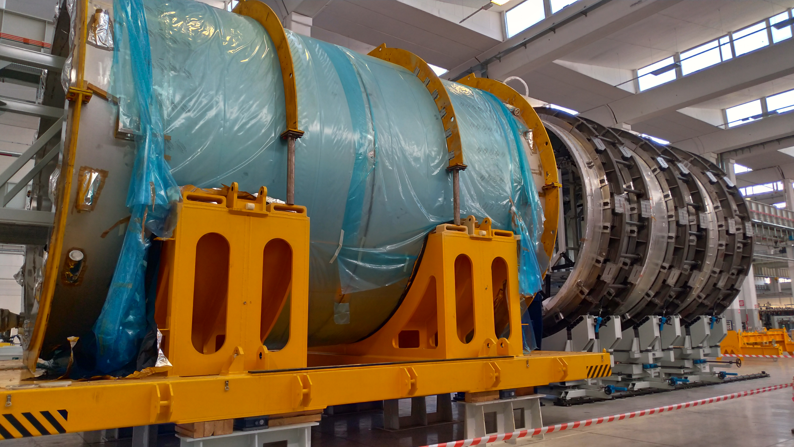
The SC Coil and cold mass
cryostat
vacuum test
module assembly

Slide 41
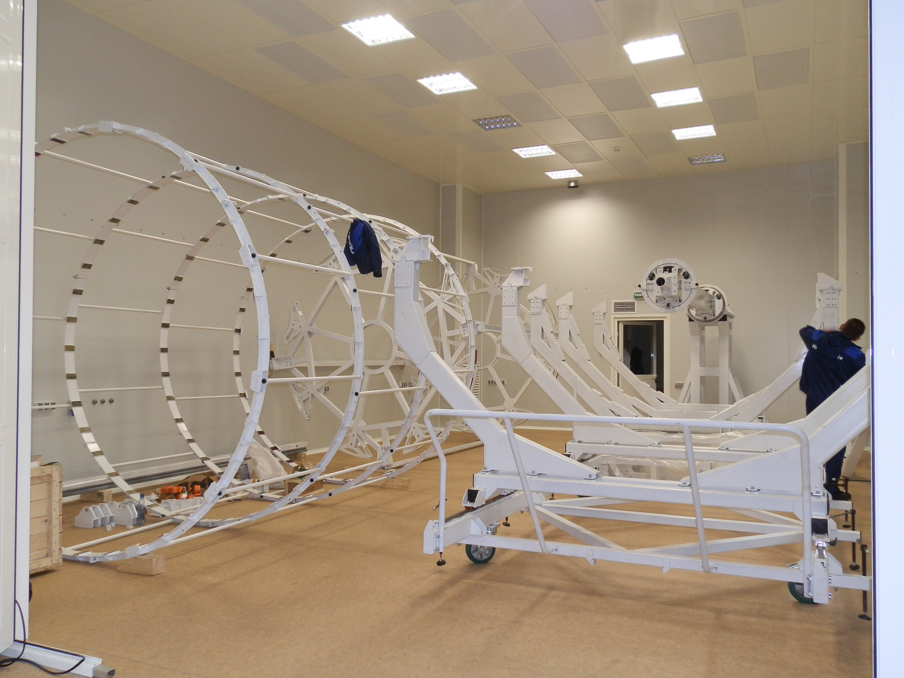
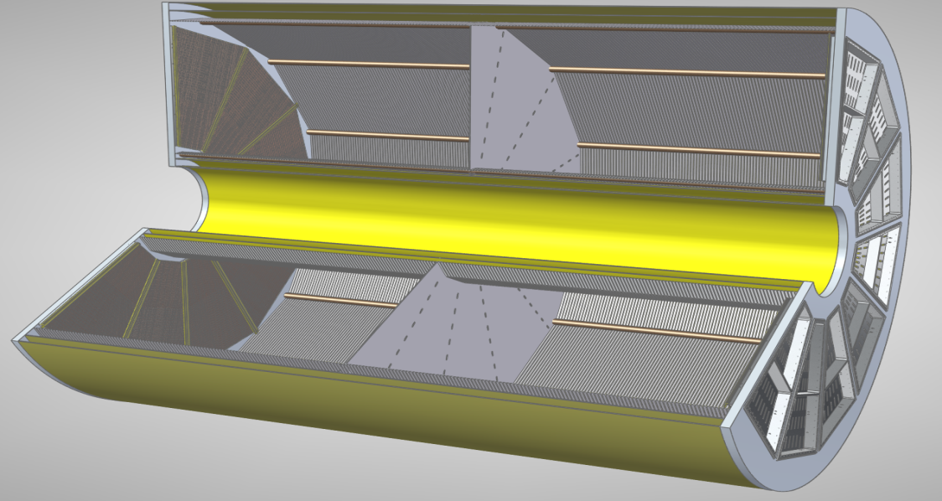
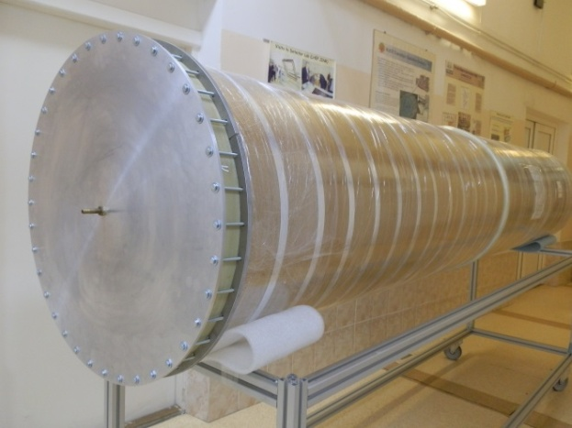
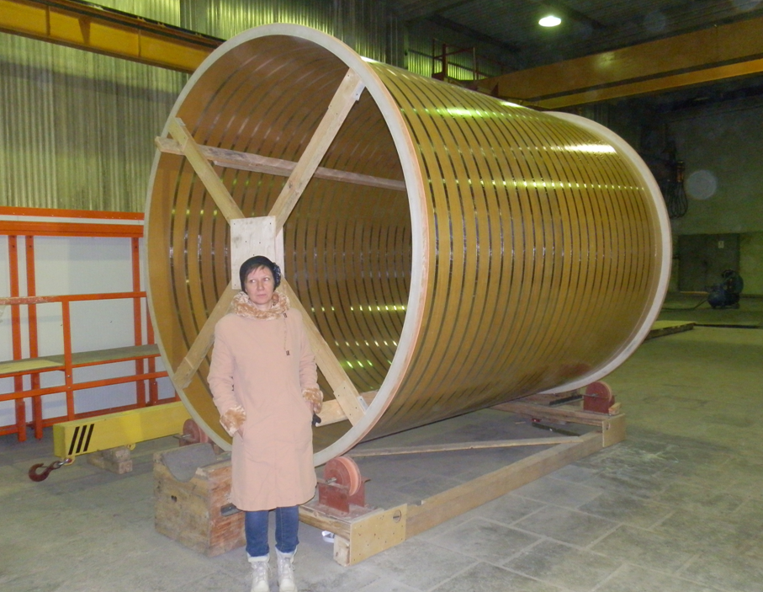
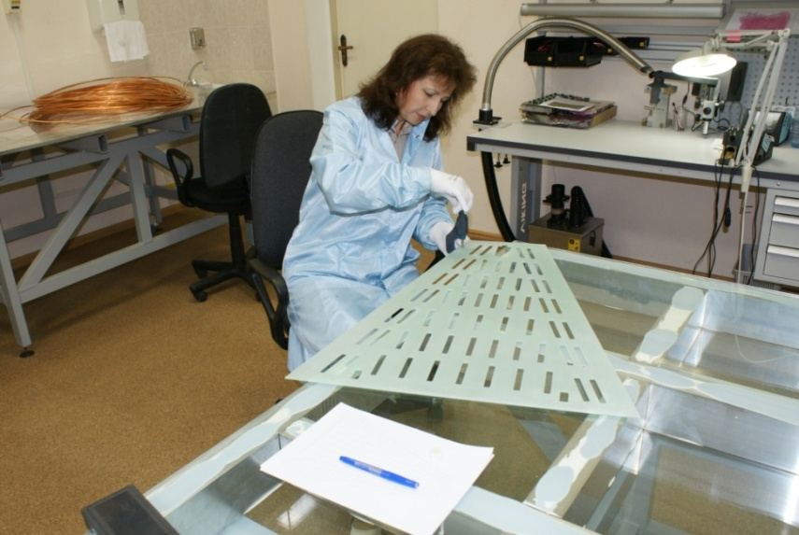
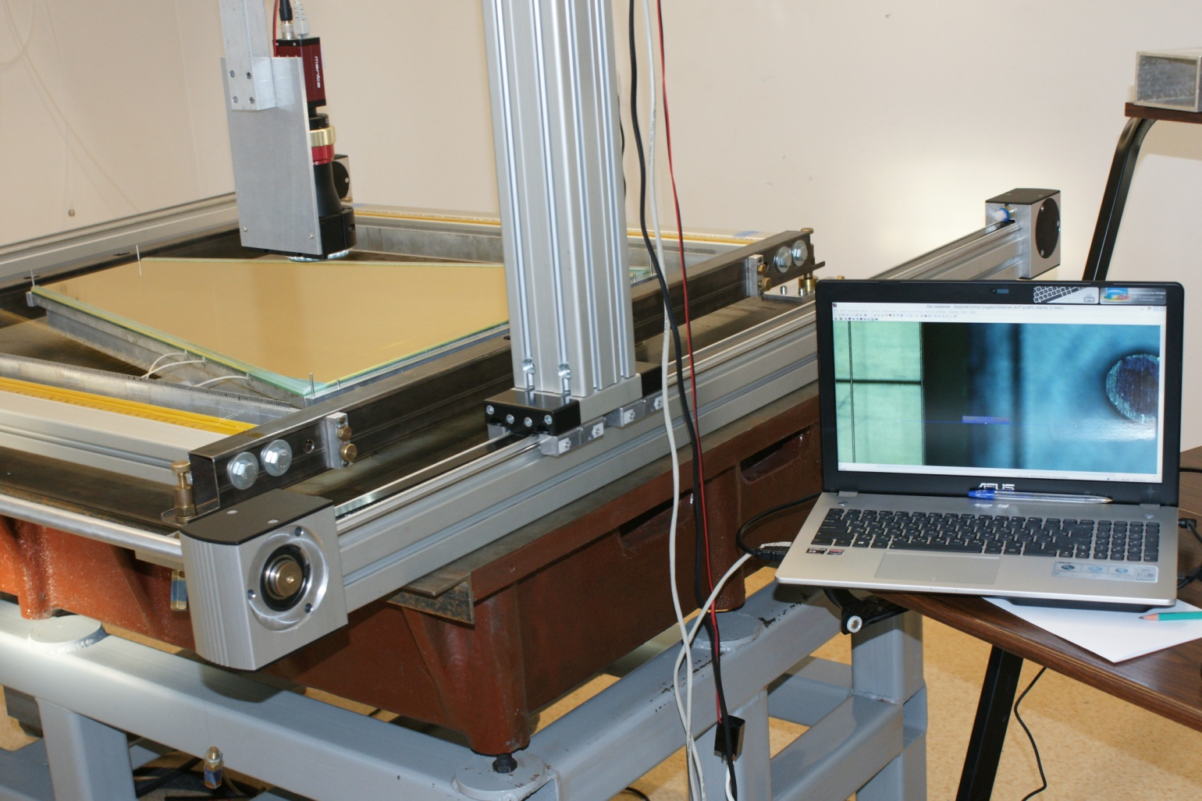
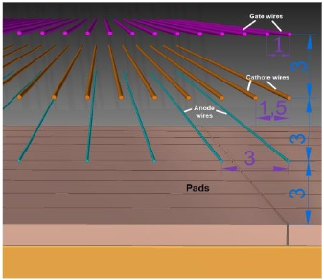
TPC: assembly stage
Sketch of TPC
HV-electrode
~ 28 kV
3400
Ø2800
12 Readout
chamber
E
E
beam
beam
~ 95 232 RO channels
assembly workshop
(clean room) & tooling
C2
C3
production of RO Chambers
Notes:
The TPC is at the assembly stage. Assembly workshop in clean room and assembly tooling are ready. The r/o chambers are at the production stage.
We are planning to cooperate with ALICE on the RO electronics development and on the upgrade with GEM RO chambers at the second stage

Slide 42
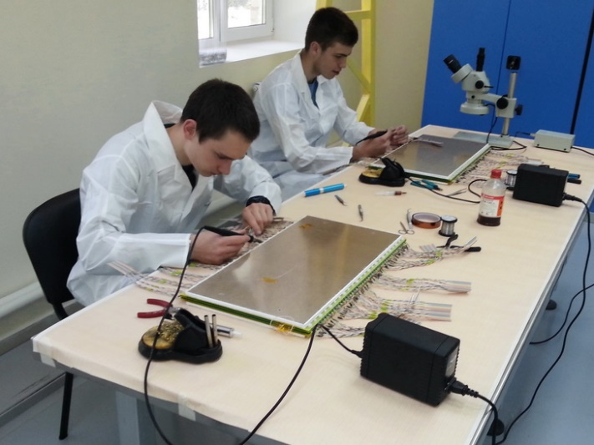
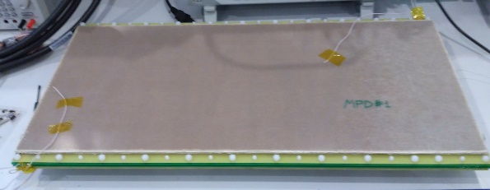
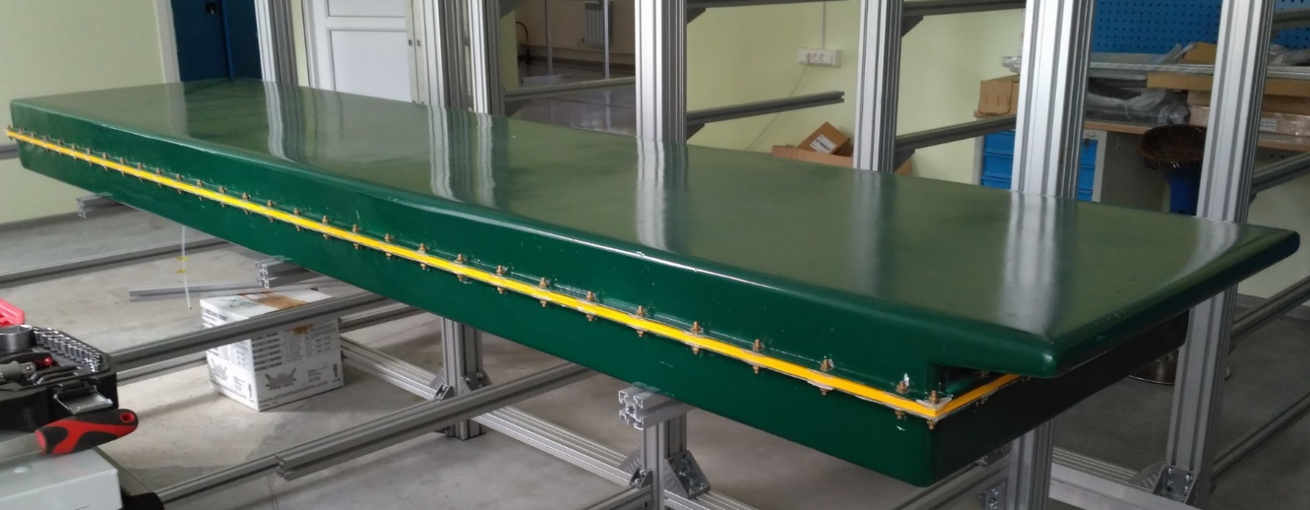






TOF Barrel: MRPC ready for mass production
MRPC
module box housing 10 PRC’s
28 modules
280 MPRC’s
13 440 channels
workshop for the MRPC mass-production
basic elements - NINO &
HPTDC chips have been
Purchased to produce
read-out electronics
for the TOF + reserve
Notes:
Другим совместным проектов в рамках эксперимента MPD является время-пролетная система, основанная на многоканальных RPC камерах. Такая система позволяет измерять время пролета заряженных частиц с точностью лучше чем 70 пикосекунд. В этом проекте принимает участие Циньхуа университет (Пекин).

Slide 43




FHCAL: for determination of reaction plane and centrality
responsibility of INR RAS
2-arm (left/right) calorimeter (at ~3.2 m from the IP)
arm consists of 45 modules - 15x15 cm² each
module - 42 lead/scintillator layers
E_{in}
E_{out}
FHCal coverage: 2.2<|η|< 4.8
Transverse granularity allows to measure:
the reaction plane with the accuracy ~ 20⁰-30⁰
the centrality with accuracy below 10%.
σ(E)/(E) = 53%/√E(GeV) +10%
modules production – in progress
FHCal provides required resolution
Notes:
The acceptance of FHC will cover the pseudo rapidity region from 2,2 to 4,8. Simulation shows reaction plane reconstruction with accuracy of 20-30 degree. The construction is progressing well.

Slide 44




ECAL:
common project with Tsinghua University, China
ECAL ~ 43 000 modules of various shapes
Pb+Sc “Shashlyk”
read-out: WLS fibers + MAPD
L ~35 cm (~ 14 X₀)
Segmentation (4x4 cm²),
σ(E) better than 5% @ 1 GeV;
time resolution ~500 ps
module prototype
projective
geometry
block of modules
Notes:
One of the unique high-tech projects within the framework of the MPD experiment is the large scale electromagnetic calorimeter of the shashlik type with projection geometry. This is a joint project with Tsinghua University (Beijing). It is required to produce more than 40 thousand modules and assemble them into a single cylindrical system, calibrate and put into operation.

Slide 45



Inner Tracker System
technology from ALICE / CERN
MAPS of new ALICE ITS
carbon fiber space frames;
D⁺
K⁻
π⁺
π⁺
ALPIDE MAPS
in 5 cylinders of 2 barrels
tentative assembly
layout
4,9۰10⁹ pixels, active area 3,9 m².
beam pipe: berrilium
Stage II:
38 mm in diameter
Stage I: 64 mm in diameter

Slide 46



Integration
support structure of carbon fiber
power skeleton
ECal barrel
~ 100 t

Slide 47

MPD feasibility study
UrQMD Au+Au √s=11 AGeV event
Simulated within MpdROOT

Slide 48
MPD Physiscs Working Groups
PWG1
Global observables
Total event multiplicity
Total event energy
Centrality determination
Total cross-section measurement
Vertex determination
Event plane measurement at all rapidities
Spectator measurement
PWG2
Spectra of light flavor and hypernuclei
Light flavor spectra
Hyperons and hypernuclei
Total particle yields and yield ratios
Kinematic and chemical properties of the event
Mapping QCD Phase diagram
PWG3
Correlations and Fluctuations
Collective flow for hadrons
Vorticity, Λ polarization
E-by-E fluctuation of multiplicity, momentum and conserved quantities
Femtoscopy
Forward-Backward corr.
Jet-like correlations
PWG4
Electromagnetic probes
Electromagnetic calorimeter measurements
Photons in ECAL and central barrel
Low mass dilepton spectra and search for in-medium modification of resonances and intermediate mass region
PWG5
Heavy flavor
Study of open charm production
Charmonium with ECAL and central barrel
Charmed meson through secondary vertices in ITS and HF electrons
Explore production at charm threshold

Slide 49




Study of hyperons
V. Vasendina, A. Zinchenko, V. Kolesnikov
8M minbias Au+Au @ 11 GeV (PHSD model)
TPC & TOF, |η|< 1.3
track reconstruction and PID (dE/dx+TOF)
secondary vertex finding technique
Yields for 10 weeks of running
PV - primary vertex;
V0 - vertex of decay;
dca- distance of closest approach;
path – decay length
Λ | Λ | Ξ⁻ | Ξ⁺ | Ω⁻ | Ω⁺
6 10⁹ | 7.3 10⁷ | 3 10⁷ | 1 10⁶ | 1 10⁶ | 3 10⁵

Slide 50




Ξ⁻ reconstruction, phase space, invariant spectra
reconstruction of hyperons in pT intervals
invariant pT-spectra in centrality bins
T ~ 200 MeV

Slide 51






Resonances
D. Ivanishchev, D. Kotov, M. Malaev, V. Riabov, Yu. Ryabov
Minbias Au+Au@11 (UrQMD modle)
Full event reconstruction and realistic PID
Topoly cuts and secondary vertex finding for hyperons
Event mixing for background estimation
Σ(1385)± → π±Λ (Λ→pπ)
φ(1020) → K⁺K⁻,
K*(892)⁰ → K±π±
pT=1.0-1.5 GeV/c
pT=1.0-1.2 GeV/c
pT=0-0.2 GeV/c
ρ(770)⁰ → π±π±,
K*(892)± → π±K_{s} (K_{s}→π⁺π⁺)
Λ(1520) → pK⁻
pT=2.5-3.0 GeV/c
pT=1.0-1.5 GeV/c
pT=1.0-1.2 GeV/c

Slide 52



ECAL simulation
V. Riabov, A. Zinchenko, M. Martemyanov, V. Kulikov
Realistic ECAL reconstruction & analysis – large acceptance ECAL
of good energy resolution is an ideal tool for measurement of neutral mesons
in a wide momentum range
ECAL resolution for photons
Red – UrQMD, minbias AuAu@11
η-meson in minbias Au+Au
Black – single photons
π⁰-meson in central Au+Au
4<pT<5 GeV/c
1.0<pT<1.5 GeV/c
pT<0.5 GeV/c
π⁰ (η) reconstruction
with ECAL – feasible!

Slide 53





π⁰ and η reconstruction via conversion
D. Ivanishchev, D. Kotov,
E. Kryshen, M. Malaev, V. Riabov, Yu. Ryabov
conversion points
Photon reconstruction, complimentary to ECAL
Direct photons, neutral mesons, geometry scan etc.
Minbias AuAu@11, UrQMD - conversion on the beam pipe and inner layers of the TPC
π⁰ & η reconstruction efficiency vs pT
π⁰ → γγ → (e⁺e⁻)(e⁺e⁻)
γ-conversion efficiency in
the beam pipe & TPC vs pT
η → γγ → (e⁺e⁻)(e⁺e⁻)

Slide 54
π⁰ and η reconstruction via conversion
D. Ivanishchev, D. Kotov,
E. Kryshen, M. Malaev, V. Riabov, Yu. Ryabov
conversion points
Photon reconstruction, complimentary to ECAL
Direct photons, neutral mesons, geometry scan etc.
Minbias AuAu@11, UrQMD - conversion on the beam pipe and inner layers of the TPC
π⁰ & η reconstruction efficiency vs pT
π⁰ → γγ → (e⁺e⁻)(e⁺e⁻)
γ-conversion efficiency in
the beam pipe & TPC vs pT
MPD standard configuration allows
to reconstruct π⁰ and η
via conversion pairs
η → γγ → (e⁺e⁻)(e⁺e⁻)

Slide 55



Hypernuclei @ MPD
P = 1 GeV/c
Hypertritons
central Au+Au @ 5A GeV
(DCM-QGSM)
PID
p
π⁻
d
~ 10⁶ ³_{Λ}H are expected
in 10 weeks
³_{Λ}H → ³He + π –
³_{Λ}H → p + d + π ⁻
Notes:
Hypernuclei could be reliably reconstructed and detected using PID based on the measurements of ToF and energy loss due to ionization in TPC

Slide 56

Femtoscopy correlations
P. Batyuk, L. Malinina, K. Mikhaylov,
G. Nigmatkulov
Study of collective effects, space-time characteristics of the emitting source at kinetic freeze-out, collision dynamics and quark-hadron phase transitions via femtoscopic correlations of hadrons
MC input: vHLLE+UrQMD model implements hydro stage with different EoS,
tuned to reproduce experimental data
Data set : Au+Au collisions at 11 GeV, MPD full reconstruction chain
Kaon particle ID and Correlation Function (CF) reconstruction
Projections of 3D kaon CF on the Out-Side-Long directions
Green – first order phase transition (1PT), Red – crossover (XPT)

Slide 57
Femtoscopy correlations
P. Batyuk, L. Malinina, K. Mikhaylov,
G. Nigmatkulov
Study of collective effects, space-time characteristics of the emitting source at kinetic freeze-out, collision dynamics and quark-hadron phase transitions via femtoscopic correlations of hadrons
MC input: vHLLE+UrQMD model implements hydro stage with different EoS,
tuned to reproduce experimental data
Data set : Au+Au collisions at 11 GeV, MPD full reconstruction chain
Kaon particle ID and Correlation Function (CF) reconstruction
Projections of 3D kaon CF on the Out-Side-Long directions
Green – first order phase transition (1PT), Red – crossover (XPT)
Gaussian shapes for kaon 3D CF
“Long” CF projections for kaons differ for 1PT and XPT

Slide 58
Concluding remarks
Density frontier is less explored area and its study
could lead to new interesting results
NICA complex has a potential for competitive research
in the field of baryon rich matter
The BM@N experiment has already started data taking
The construction of both NICA Collider and detector (MPD)
are going close to the schedule
New participants are welcome to join NICA

Slide 59

Thank you

