Slide 1

J-PARC
Heavy Ion Program
And
K. Ozawa (KEK, University of Tsukuba)
for the J-PARC HI collaboration

Slide 2
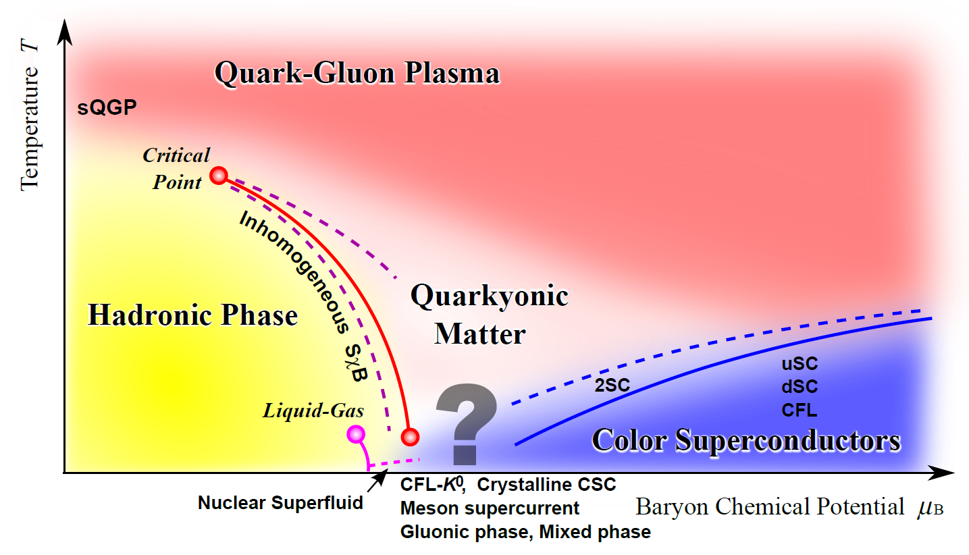
Physics: Finite density QCD medium
K. Fukushima and T. Hatsuda, Rep. Prog. Phys. 74 (2011) 014001
Studies of Finite Density Matter are remaining frontiers in QCD physics
Nucleus
Free Space
At J-PARC, several studies related to finite-density medium are on-going!!
Baryon Chemical Potential μ_{B}

Slide 3
J-PARC Activities
Elementary interactions with strangeness
  Hyperon – Nucleon interactions
    Hyper-nuclei
    Direct scattering measurements
  Kaonic nuclear bound states
Vector mesons in nucleus
  χ sym. restoration in finite density matter
Explore high baryon density medium in Heavy Ion collisions

Slide 4
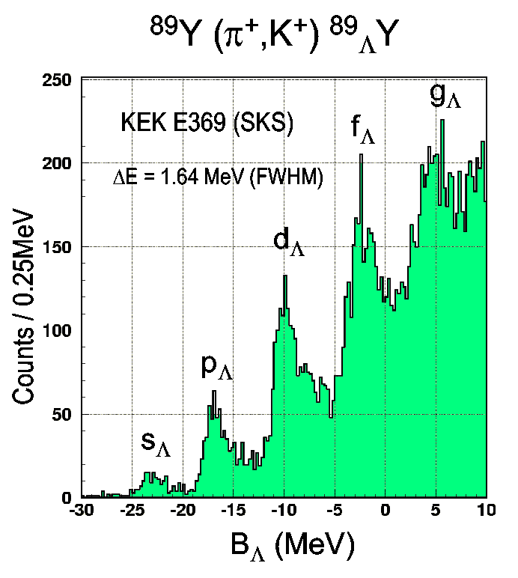
Hypernuclei bound states
Nucleus is a stable object and can have a bound state with hyperons
Measured bound states spectrum by Prof. Nagae
PRC 64 (2001) 044302
If a bound state is observed,
we can measure a binding energy
The binding energy can be interpreted to the strength of interaction between nucleon and hyperon.
-> U_{Λ} = - 30 MeV
(c.f. U_{N} = -50 MeV)
This method is a powerful tool to study hyperon interactions and we extend this study to S=-2 system

Slide 5
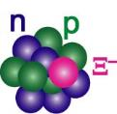
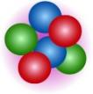
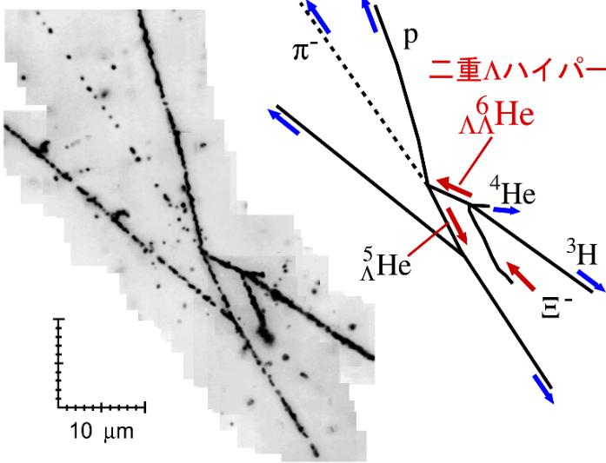


pioneering results for S=-2 system
n
Nagara event
p
Λ
Kiso event
H. Takahashi et al., PRL 87 (2001) 212502
K. Nakazawa et al. PTEP 2015, 033D02
e
α
p
⁸Li
⁸Be
α
p
d
⁶_{ΛΛ}He -> ⁵_{Λ}He + p + π⁻
Ξ⁻ + ¹⁴N -> _{Ξ}¹⁵C -> _{Λ}¹⁰Be + _{Λ}⁵He
=
ΔB_{ΛΛ}= 0.67±0.17 MeV
∼
Λ-Λ is weakly attractive
Ξ-N is attractive !

Slide 6
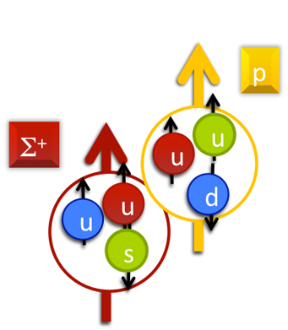
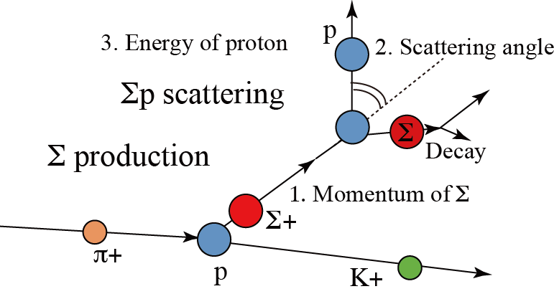
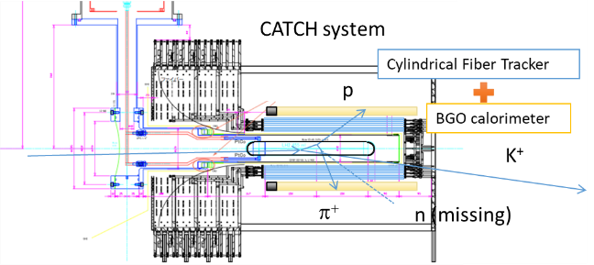
Σ± – proton scattering
Physics Motivation:
  Systematic study of the Σp interaction
    Σp interactions are repulsive and Σ hyper-nuclei formation is difficult
  Pauli blocking effect between quarks
    Origin of repulsive force in Σ⁺p interaction
    Suggested by HAL QCD Lattice calc.
    (H. Nemura et al. Few-Body Syst (2013) 54:1223-1226)
J-PARC E40: Prof. K. Miwa (Tohoku univ.)
Two successive two-body reactions
Detection of Σp scattering event
by CATCH detector
Half of data is already collected in 2019!

Slide 7
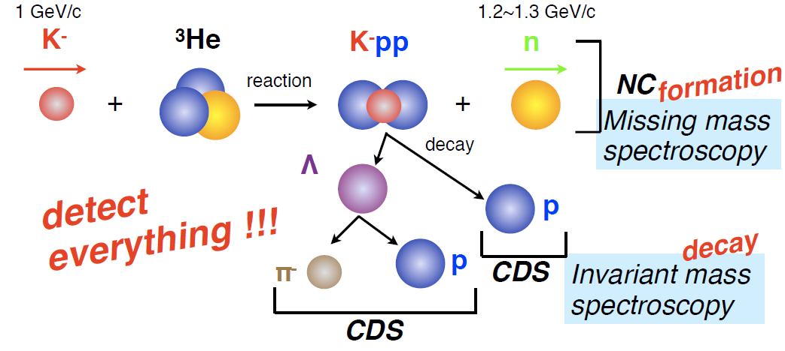
K⁻NN bound system
To study a finite density system, understanding of three-body system is important.
Especially, K⁻NN system is interesting
  Attractive K⁻N interaction in I=0 is suggested by properties of Λ(1405)
  A bound state of K⁻pp system is predicted by several theoretical calculations
    Various predicted values of binding energy and width
    Existing experimental data is not agree with theoretical predictions
A new experiment is executed using a new technique!
J-PARC E15: Prof. Iwasaki (RIKEN)

Slide 8
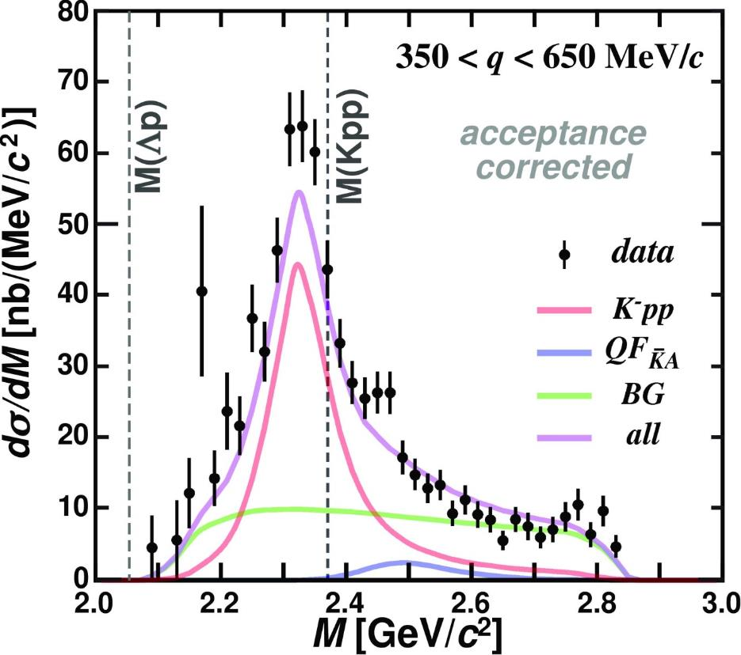
Clear K⁻pp bound state is observed
E15 collab., PLB789(2019)620.
Invariant mass distribution of Λp
Quasi-Free and Background contributions are evaluated using missing mass information
Binding energy: ~50 MeV
Width: ~100 MeV

Slide 9
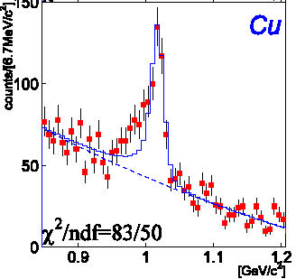
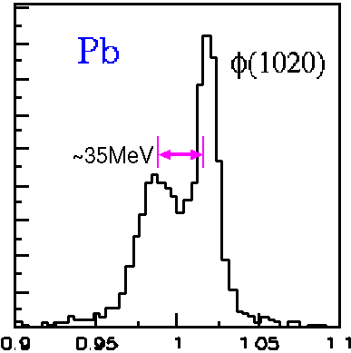
Vector mesons in nucleus
Spectral changes of vector mesons in QCD medium provide crucial information on the non-trivial structure of QCD medium
  Spontaneously broken chiral symmetry and its (partial) restoration in a finite density matter.
  Upgrades of the KEK-PS E325 experiment
KEK E325 results
J-PARC expectation
φ (1020)
High Statistics
Better Resolution
e⁺e⁻ invariant mass
e⁺e⁻ invariant mass

Slide 10
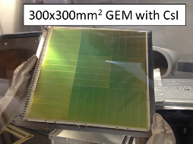
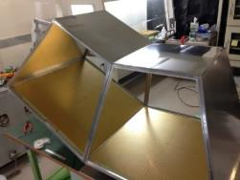
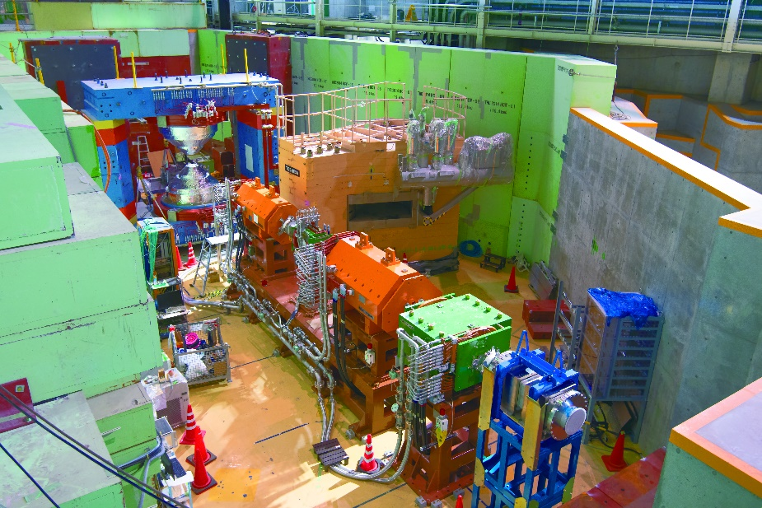
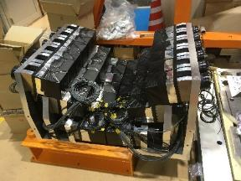
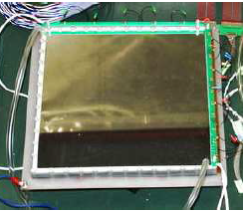
J-PARC E16 Experiment
Measurements of e⁺e⁻ pair invariant mass spectra in nucleus
10 times larger statistics compared to the KEK experiment
  10¹⁰ protons per spill (10 times higher than KEK)
  Counting rate: 5 kHz/mm² (maximum)
Two times better resolution than KEK
  Larger magnetic field
  Better Position resolution (~100 μm)
Magnet
Electron ID
GEM Tracker
We will start data acquisition in 2020 spring

Slide 11
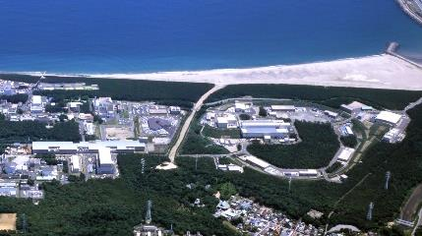
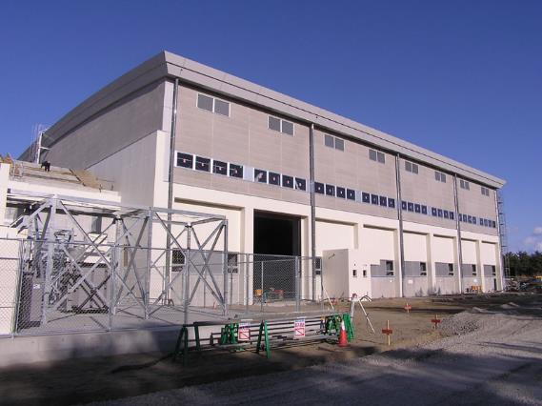
J-PARC Heavy Ion Program
MR
30 GeV Synchrotron
HI Booster Ring
HI Linac
RCS
3 GeV Synchrotron
Hadron Experimental Facility
Hadron Experimental Facility
400 MeV Linac
Hadron Hall
RCS provides
U92+ of 4x10^11/MR cycle
Only Linac and Booster ring are required for Heavy Ion!
Designed by H. Harada and P.K. Saha

Slide 12
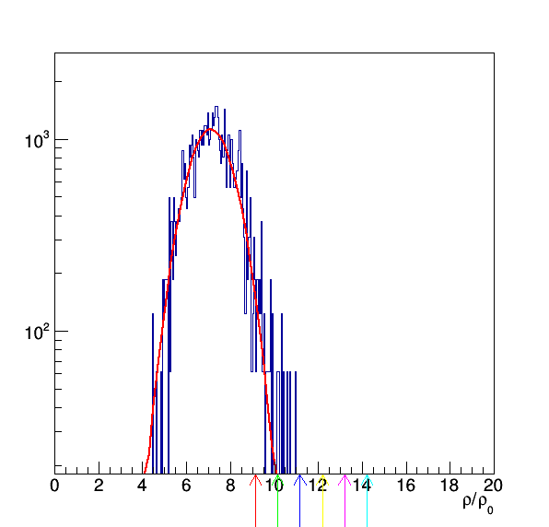
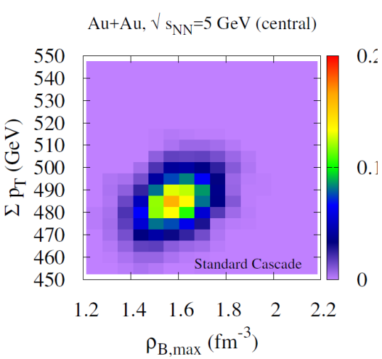
High Baryon density matter at J-PARC
Energy range: √S_{NN} = 2~5 GeV, Maximum interaction rate: 10⁸ Hz
With a collaboration with theorists, we are evaluating achievable baryon density
If we can select “rare event”,
higher baryon density can be studied
Selection of higher baryon density matter
  We are looking for suitable valuables
  e.g. p_{T} sum of charged particles
Max Baryon density distribution (JAM)
Max Baryon density vs Σ p_{T} (JAM)
2σ
→9ρ₀
6σ
→13ρ₀
Statistics-starved “rare event” selection feasible at J-PARC-HI

Slide 13
“Fluid” exists at the J-PARC Energy?!
An issue in this energy region is that theoretical calculations for thermalized phase is not enough
  Recently, a Japanese group develops an “unified” hydro-cascade model
Akamatsu, et.al, PRC98, 024909 (2018)
Unified model
Cascade only
Simultaneously evolve both fluid element and hadrons in time
  High density hadrons → “parton fluid”
  Cooled “parton fluid” → hadrons
Unified model describes data very well, while cascade only doesn’t
  It seems we can expect parton fluid phase even at the J-PARC energy
e: fluid energy density

Slide 14
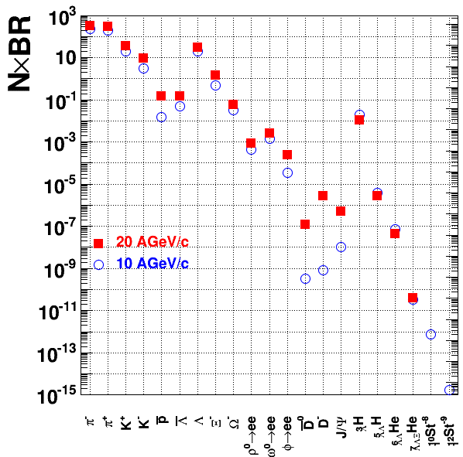
Our staging approach & Goals
First step
  Interaction rate: 10⁵ Hz
  E16 di-electron spectrometer
  ρ, ω, φ → e⁺e⁻ : 10⁴ events
Second step
  Interaction rate: 10⁶ Hz
  Dipole hadron spectrometer
  Flow, event-by-event fluctuation
Third step
  Interaction rate: 10⁷ Hz
  Dipole muon spectrometer
  Precise low mass vector meson
  Heavy Flavor
Final step
  Interaction rate: 10⁸ Hz
  Rare events: Highest Density matter
  Hyper nuclear physics
  Strangelet search
AGS
HSD calculations in FAIR Baseline Technical Report (Mar 2006)
A. Andronic, PLB697 (2011) 203
P. Braun-Munzinger J.Phys.G21 (1995)L17

Slide 15
Dipole hadron spectrometer
Charged particles + neutrons , ~4π acceptance
  Silicon Pixel Tracker (SPT) (θ < 4o), TPC (θ > 4o)
  MRPC-TOF, neutron counter
Rate : <=10⁶ Hz interaction
Centrality : Multiplicity counter + zero-degree calorimeter
Top view
45º
Magnet yoke
Charge
veto
Beam view
MRPC-TOF
Neutron counter
Magnet pole
41.4º
38.7º
2.75m
3.4m
TPC
E
SPT
Target
ZCAL
5.6
4º
3
B=1.5T
2
2m
B=1.5T
2
MC
2m
3.4
6.8
3.5
1.5
Measurements:
Higher order Flow, event-by-event fluctuation

Slide 16
Dimuon spectrometer
Replace TPC by:
  Pb absorbers and GEM trackers
    Dimuon Online Trigger
  7-layer forward and barrel Silicon Pixel Trackers
Interaction Rate : 10⁷ Hz
Top view
45º
Magnet yoke
Beam view
Magnet
pole
41.4º
38.7º
Silicon Pixel Trackers
0.8
3.4m
0.6
4º
ZCAL
2
3
5.6
Target
2m
0.5
2m
2
Magnet
pole
3.4
0.6
6.8
3.5m
2.75
Measurements:
Low mass dilepton, Heavy flavor

Slide 17
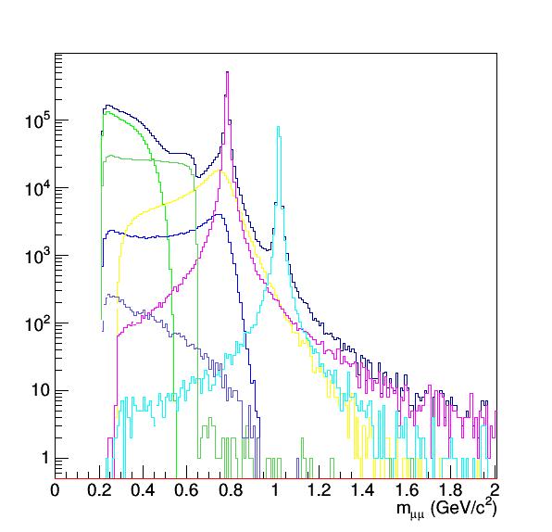
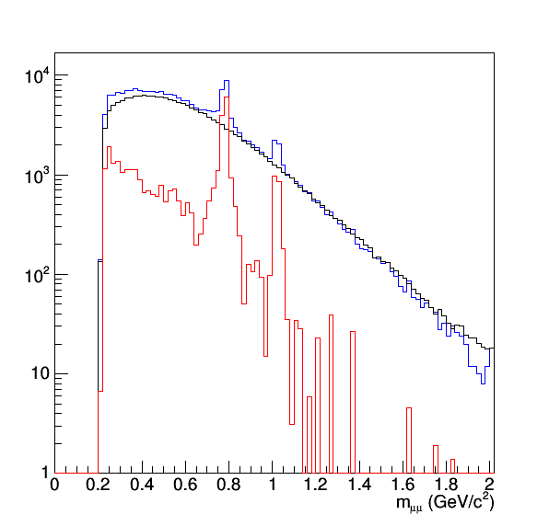
Expected dimuon spectrum
We have evaluated performance of our dimuon spectrometer
Embed μ⁺μ⁻ into JAM events and process by GEANT
  U+U, √s_{NN}=4.5 GeV, Minbias JAM events
Reconstruct tracks passing through 4 λ_{I} muon absorbers
θ_{ee}>2º, 2º<θ<80º, p_{T}>0.1GeV/c
U+U√s_{NN}=4.5 GeV, Min-bias (54k)
Generated cocktail
Reconstructed spectrum
η→μμγ
Blue: Signal+BG
Black: BG
Red: Net signal
η’→μμγ
ω→π⁰μμ
ρ→μμ
ω→μμ
φ→μμ
η→μμγ
η’→μμγ
ω→π⁰μμ
ρ→μμ
ω→μμ
φ→μμ
Enough Resolution even in low mass region

Slide 18
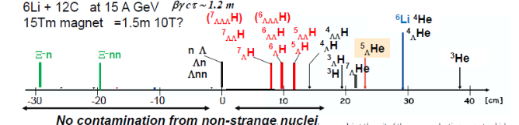
Hypernuclear Spectrometer
Hypernuclei at beam rapidity
  1st dipole magnet + collimator → Only beam fragments reach 2nd dipole magnet
  Lifetime and Magnetic moment
  Interaction Rate : 10⁸ Hz
Strangelet search
Top view
45º
Magnet yoke
MRPC-TOF
Charge veto
Sweep magnet (3T)
Neutron counter
Collimator
Target
3.4m
TPC
π-
SPT
Decay of Hyper
nucleus
Beam
4º
ZCAL
2m
fragment
0.5
MC
B=1.5T
Add a sweep magnet and a collimator upstream
2m
2m
1m
1.8m
H. Tamura, Reimei Workshop, Aug. 2016
3.5
1.5

Slide 19
Summary
Several studies related with finite density matter is on-going at J-PARC
  Hypernuclei
  Hyperon-Nucleon scattering
  Kaon bound states
  Vector mesons in nucleus
We can have much results in a few years
Future Heavy ion program at J-PARC is being prepared
  We need Linac and Booster for heavy ion acceleration
  First, we can start with di-electron spectrometer, which is being built for a pA experiment
  Then, further study of high baryon density matter will be done using upgrade detectors

Slide 20
J-PARC-HI Collaboration
94 members :
Experimental and Theoretical Nuclear Physicists and Accelerator Scientists
Experiment
H. Sako, S. Nagamiya, K. Imai, K. Nishio, S. Sato, S. Hasegawa, K. Tanida, S. H. Hwang, H. Sugimura, Y. Ichikawa K. Ozawa, K. H. Tanaka, S. Sawada, M. Chu, G. David, T. Sakaguchi, K. Shigaki, A. Sakaguchi, T. Chujo, S. Esumi, Y. Miake, O. Busch, T. Nonaka, B. C. Kim, S. Sakai, K. Sato, H. Kato, T. Ichizawa, M. Inaba, T. Gunji, H. Tamura, M. Kaneta, K. Oyama, Y. Tanaka, H. Hamagaki, M. Ogino, Y. Takeuchi, M. Naruki, S. Ashikaga, S. Yokkaichi, T. Hachiya, T. R. Saito, X. Luo, N. Xu, B. S. Hong, J. K. Ahn, E. J. Kim, I. K. Yoo, M. Shimomura, T. Nakamura, S. Shimansky, J. Milosevic, M. Djordjevic, L. Nadjdjerdj, D. Devetak, M. Stojanovic, P. Cirkovic, T. Csorgo, P. Garg, D. Mishra
Theory
M. Kitazawa, T. Maruyama, M. Oka, K. Itakura, Y. Nara, T. Hatsuda, C. Nonaka, T. Hirano, K. Murase, K. Fukushima, H. Fujii, A. Ohnishi, K. Morita, A. Nakamura, Y. Akamatsu, M. Asakawa, M. Harada
Accelerator
H. Harada, P. K. Saha, M. Kinsho, Y. Liu, J. Tamura, M. Yoshii, M. Okamura, A. Kovalenko, J. Kamiya, H. Hotchi, A. Okabe, F. Tamura, Y. Shobuda, N. Tani, Y. Watanabe, M. Yamamoto, M. Yoshimoto
ASRC/JAEA, J-PARC/JAEA, J-PARC/KEK, Tokyo Inst. Tech, Hiroshima U, Osaka U, U Tsukuba, Tsukuba U Tech, CNS, U Tokyo, Tohoku U, Nagasaki IAS, Kyoto U, RIKEN, Akita International U, Nagoya U, Sophia U, U Tokyo, YITP/Kyoto U, Nara Women’s U, KEK, BNL, Mainz U, GSI, Central China Normal U, Korea U, Chonbuk National U, Pusan National U, JINR, U Belgrade, Wigner RCP, KRF, Stony Brook U, Bhaba Atomic Research Centre, Far Eastern Federal U

Slide 21
Back up

Slide 22
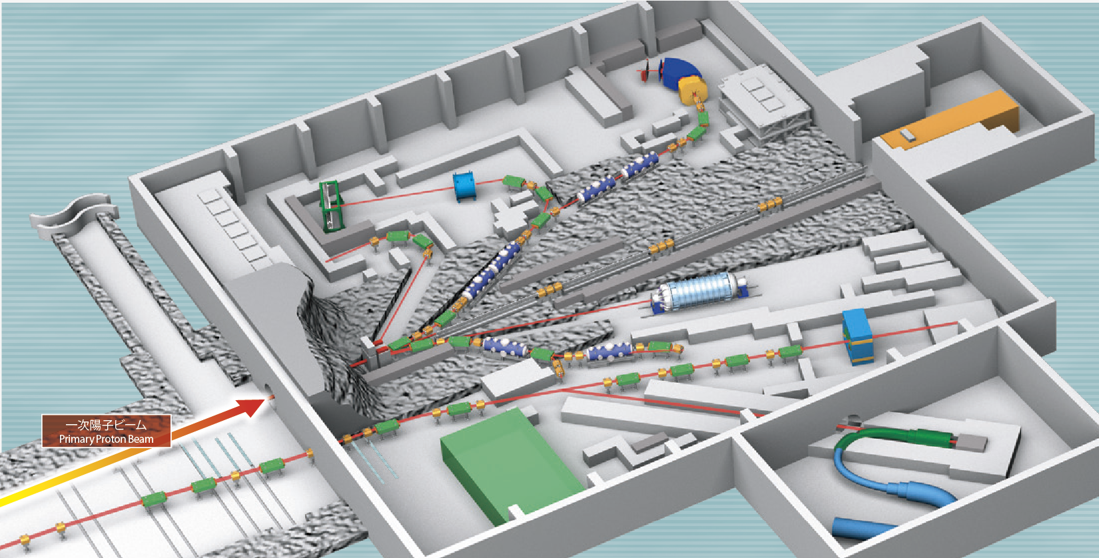
Hadron
Experimental Facility
K1.8
K1.8BR
KL
K1.1
High-p
Name | Species | Energy | Intensity
K1.8 | π±, K± | < 2.0 GeV/c | ~10⁵ Hz for K⁺
K1.8BR | π±, K± | < 1.0 GeV/c | ~ 10⁴ Hz for K⁺
K1.1 | π±, K± | < 1.1 GeV/c | ~ 10⁴ Hz for K⁺
New
Beamline
High-p | proton | 30GeV | ~ 10¹⁰ Hz
 | Unseparated | < 20GeV/c | ~ 10⁸ Hz

Slide 23
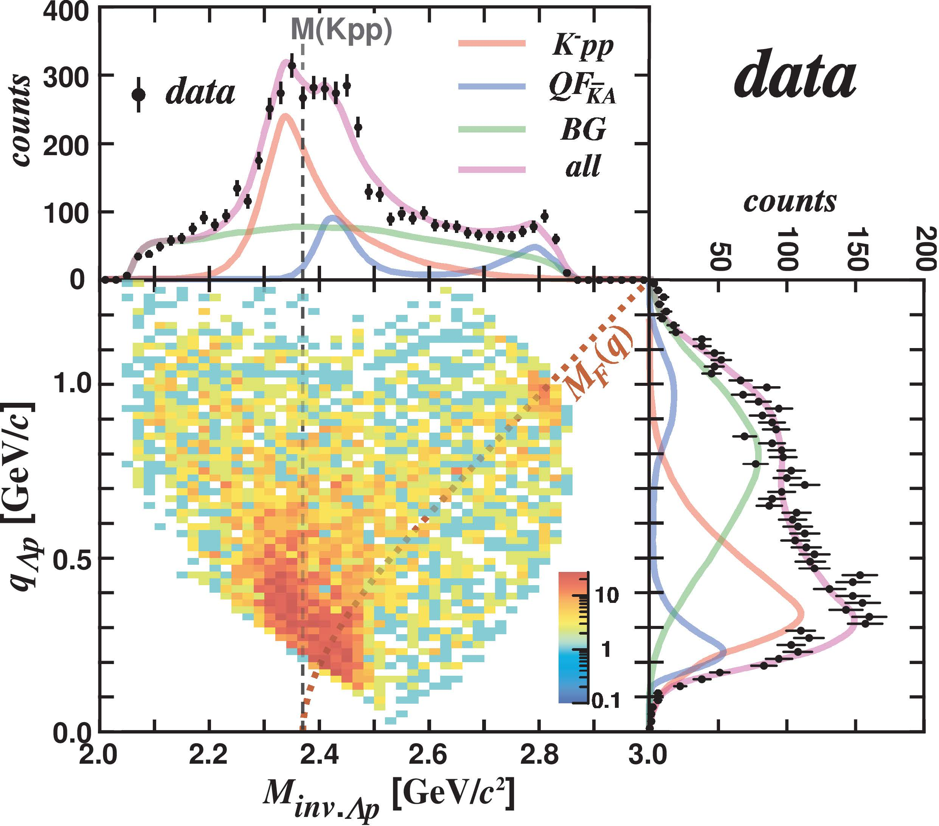
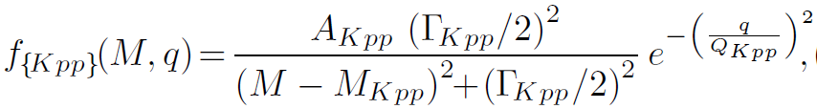
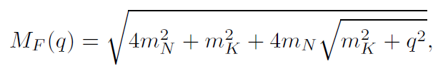
IM(Λp) vs. Momentum Transfer q_{Kn}
E15 collab., PLB789(2019)620.
IM(Λp)
Fit with 3 components
  Bound state
    centroid DOES NOT depend on q_{Kn}
    BW*(Gauss form-factor)
  Quasi-elastic K⁻ abs.
    centroid depends on q_{Kn}
    Followed by Λp conversion
  Background
    Broad distribution
q_{Kn}

Slide 24
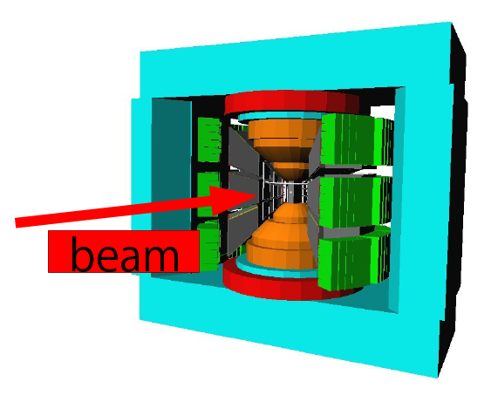
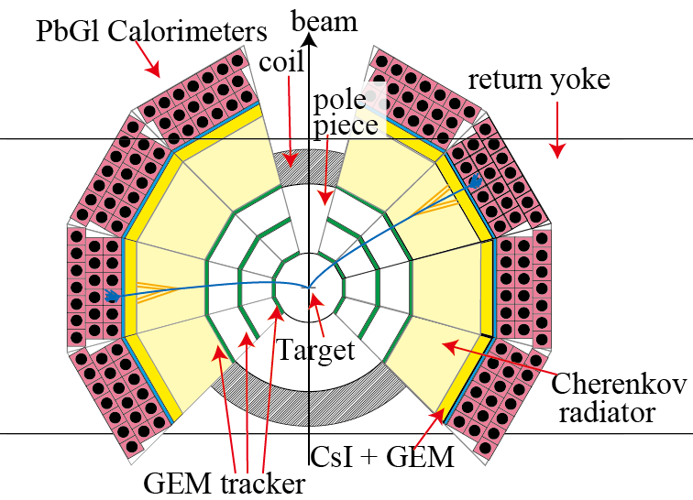
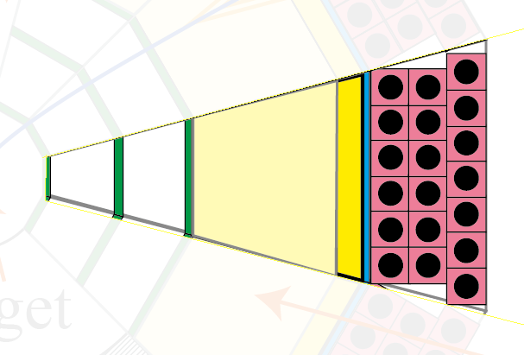
The J-PARC E16 spectrometer
5 m
Magnet (used for KEK E325)
A module
SSD : Tracking
GTR : Tracking
HBD : eID (Cherenkov)
LG : eID (Calorimeter)
26 modules in total. 8 for the 1st physics run.
X 26

Slide 25
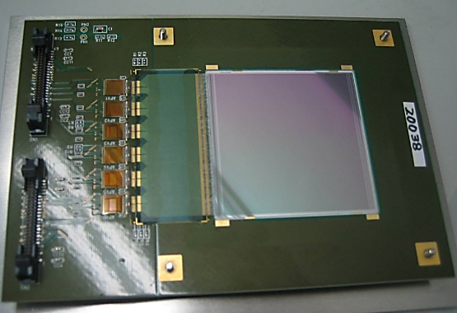
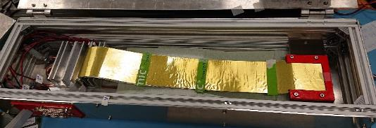
Silicon Strip Detector
120 mm
Run0
  Existing 6 SSDs used for another J-PARC experiment.
    ATLAS sensor
    Sensitive area: 61 mm x 62mm
    Strip pitch 80 um. (1D)
    Timing Resolution 4ns
    It has large unwanted frame.
    The readout ASIC is APV-25
Run1
  Starting collaboration with FAIR-CBM
    CBM developed sensor
    Sensitive area: 60 mm x 60 mm
    Strip pitch 50um (Double sides)
    Almost no frame
    The readout ASIC is a CBM special chip
      Developed for the streaming DAQ, however it can be used for a triggered DAQ
61 mm
ASIC chips
62 mm
Micro strip Cable
Sensor
under a foil

Slide 26
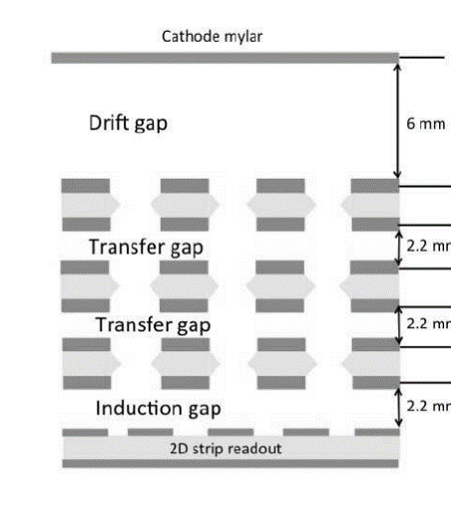

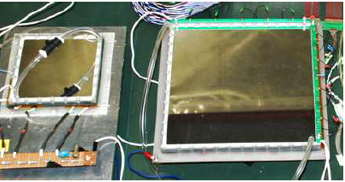
GTR (GEM Tracker)
Mesh electrode
Drift Gap
3 mm
GEM
Ionization electrons in the drift gap are collected and amplified by GEMs.
Charge collected on to 2D strip readout.
  X: 350um pitch
    Sensitive to bending direction.
    100 um resolution required.
  Y: 1400um pitch
Assembly works are on-going.
GEM
GEM
readout
Trigger
X2
X1
X3
Y1
Y2

Slide 27
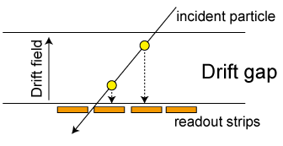
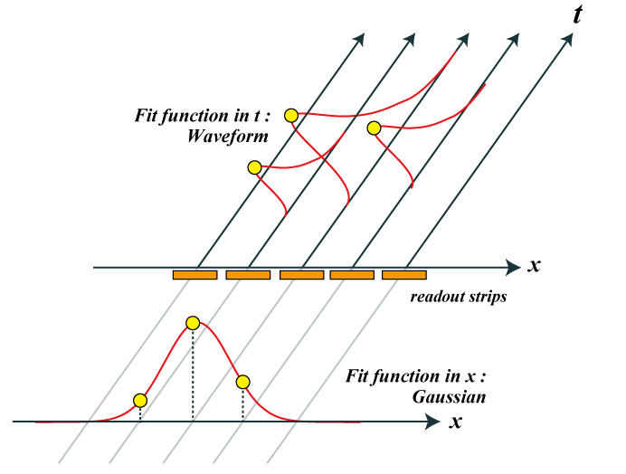
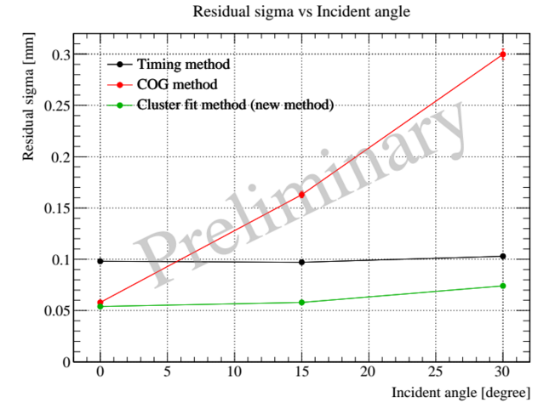
GTR Performance
Center Of Gravity (COG) Method
  Ordinal analysis method
  ~ 60 μm @ 0 degree of incident angle
  Worse results for inclined tracks
Timing method
  Distance in drift field dir. Can be obtained using flight time like mini-TPC
  ~ 100 μm for all tracks
2D fit (COG + Timing)
Timing method
COG method
2D fit
300
Residual sigma [um]
200
100
Required
0
0
15
30
Incident angle [degree]

Slide 28
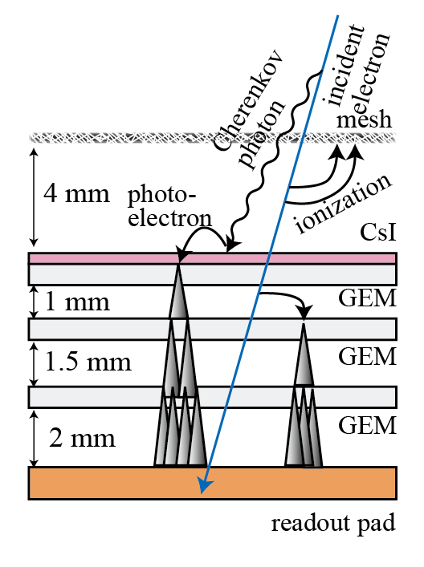
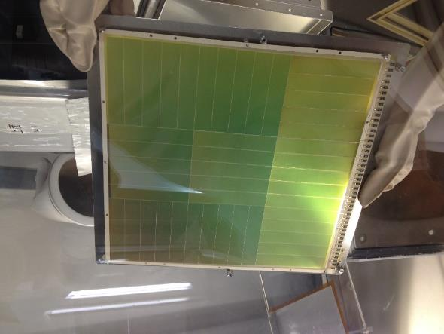
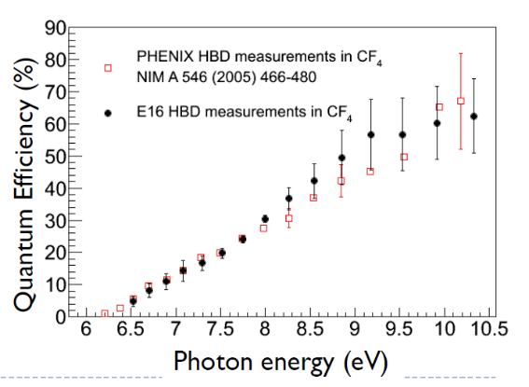
HBD
(Hadron Blind Detector)
Based on PHENIX HBD.
CF4 serves as radiator and amplification gas
  Radiator 50 cm. / p.e. ~ 11
Gas Electron Multiplier (GEM) for amplification
CsI is evaporated on top GEM
  Photocathode (> ~6eV)
Trigger
300x300mm² GEM with CsI

Slide 29
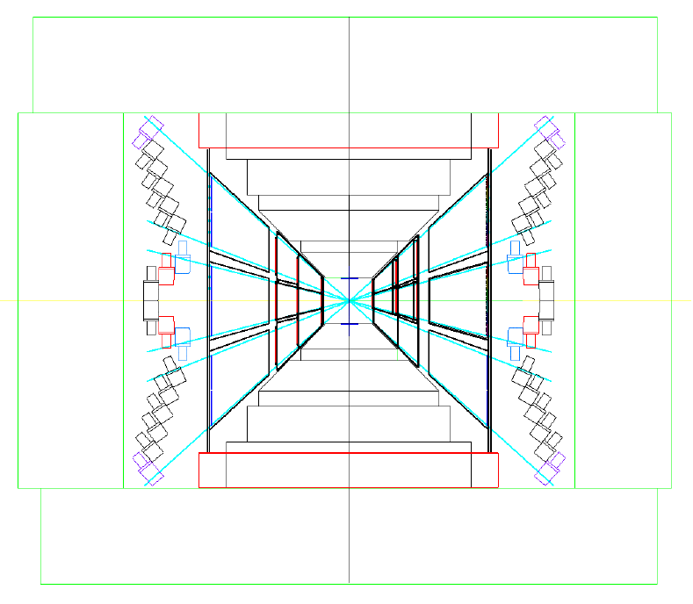
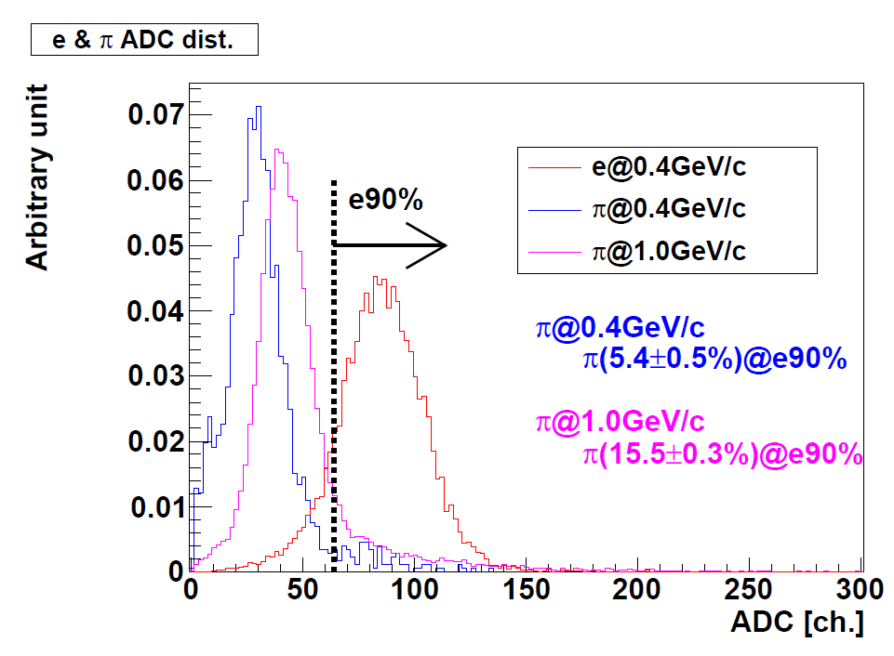
LG (Lead Glass Calorimeter)
Reuse from TOPAZ
  ~300 at the 1st stage.
  ~1000 in total
  We have all we need.
Expected Rejection Power
  ~25 offline (energy dep. th.)
  ~10 online (fixed th.)
We’ve got all we need.

Slide 30
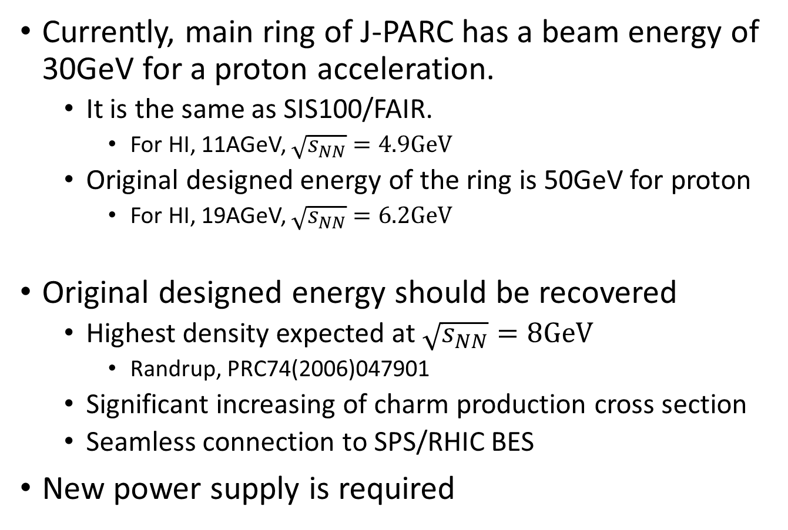
Beam Energy Consideration
Currently, main ring of J-PARC has a beam energy of 30GeV for a proton acceleration.
  It is the same as SIS100/FAIR.
    For HI, 11AGeV, $\sqrt{s_{NN}}=\text{4.9}\text{GeV}$
  Original designed energy of the ring is 50GeV for proton
    For HI, 19AGeV, $\sqrt{s_{NN}}=\text{6}\text{.}\text{2}\text{GeV}$
Original designed energy should be recovered
  Highest density expected at $\sqrt{s_{NN}}=\text{8}\text{GeV}$
    Randrup, PRC74(2006)047901
  Significant increasing of charm production cross section
  Seamless connection to SPS/RHIC BES
New power supply is required

Slide 31
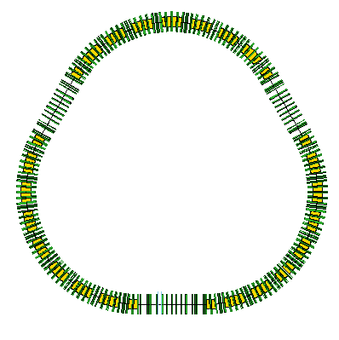
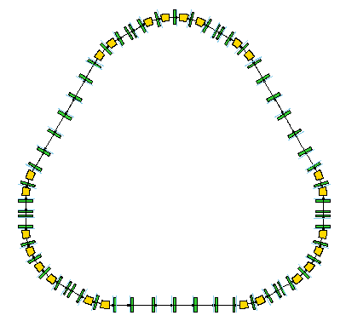

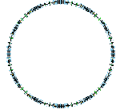
J-PARC HI Project
Acceleration Scheme for Uranium case(Proposed by H. Harada, J-PARC)
U³⁵⁺→U⁵⁵⁺
20.0→19.86
MeV/u
U⁶⁶⁺→U⁸⁶⁺
67.0→62.34
MeV/u
U⁸⁶⁺→U⁹²⁺
735.21→727.0MeV/u
stripping
stripping
stripping
HI LINAC
HI booster
RCS
MR
stripping
U³⁵⁺
20.0MeV/u
U⁵⁵⁺→U⁶⁶⁺
19.86→67.0
MeV/u
U⁸⁶⁺
62.34→735.21MeV/u
U⁹²⁺
727.0Mev/u→11.15
GeV/u
(30GeV@p)
New LINAC and Booster for HI must be constructed.

Slide 32
HI acceleration scheme in nutshell
World’s highest intensity ~10¹¹ Hz, Interaction rate ~ 10⁸ Hz
E_{lab}=1-19AGeV, √s_{NN}=1.9-6.2GeV (U)
Ion species: p, Si,…, Au, U
HI Booster Ring
stripping
HI Linac
p/HI to HD
Parallel oper.
HI(MR)
p(MLF)
50 GeV MR
3→30 GeV (p)
U³⁵⁺
20 AMeV
U³⁵⁺→U⁶⁶⁺
20 → 67 AMeV
3 GeV RCS
(p)
0.4 → 3 GeV
MLF
p to NU
stripping
proton (existing)
HI (under plan)
U⁸⁶⁺
62 → 735 AMeV
U⁹²⁺
0.73 → 11.2 AGeV
H⁻ Linac: 0.4 GeV

Slide 33
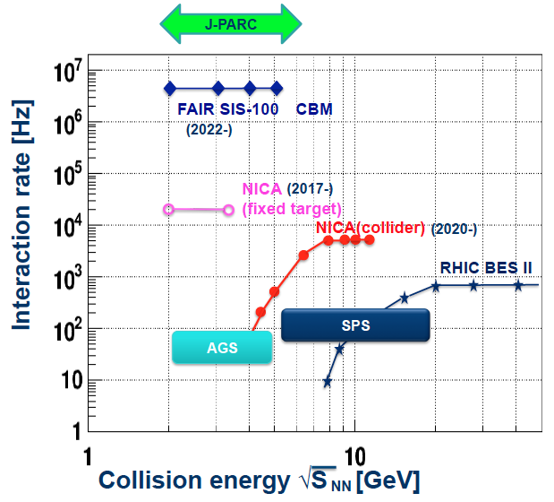
Available beam and rate
Statistics
1 year at AGS = 5 min at J-PARC-HI
Assumed beam rate: 10¹¹ Hz
0.1% λ_{I} target →Event rate: 100MHz
In one month experiment:
ρ,ω,φ→ee: 10¹⁰ - 10¹²
Hypernuclei: 10⁴ - 10¹²
Strangelets: 1 - 10²
Ref: HSD calculations in FAIR Baseline Technical Report (Mar 2006)
A. Andronic, PLB697 (2011) 203
Strangelets: P. Braun-Munzinger,
J.Phys.G21 (1995)L17

Slide 34
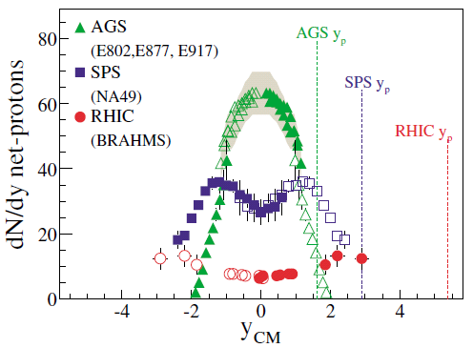
What’s expected at J-PARC energy?
Baryon is highly stopping at mid-y, at AGS (=J-PARC) energy
  → High density matter. Nucleons pass through each other at SPS and above
(K⁺, Λ, Ξ,)/π ratio have maximum at √s_{NN}~5GeV
  → Strangeness fraction is largest at J-PARC energy. (π is a proxy of multiplicity)
Au+Au: ~6ρ₀ , U+U: ~8.6ρ₀
K⁺/π⁺
Λ/π⁻
Stopping
High μ_{b}
Ξ/π⁻
K⁻/π⁻
NPA772(2006)167

Slide 35

Observables: Dileptons
No dilepton measurement at ⍻s_{NN}~5GeV
Very low mass region (<100MeV)
  Soft mode associated with phase transition
Low mass region: ρ/ω/φ (~10⁻³)
  Chiral symmetry restoration study by spectra shape analysis with high statistics
  →Comparison to models with q/g condensation (Hayano and Hatsuda, RMP82, 2949)
Intermediate mass
  Thermal radiation. c-cbar free at J-PARC energy
High mass region: J/ψ?
$$\int{dm_{ee}N\left(m_{ee}\right){m_{ee}}^{n} (n=1,2,…)}$$
Fully exploiting high luminosity at J-PARC

Slide 36

Observables: Event-by-event fluctuation
Event-by-event fluctuations of conserved charge:
  Observable to shoot the critical point
4th, 6th, 8th baryon number fluctuations
  Sensitive to chiral transition (even for crossover)
  2-order more statistics required with 1-order higher fluct.
J-PARC
B. Friman et al., EPJ C 71 (2011) 1694
X. Luo, Quark Matter 2015

Slide 37

Observables: Flow (constraining EOS)
Sign of v₁ slope changes around phase transition
Measurement of dv₁/dy is a key to understand EOS
Higher order flow (3rd, 4th, 5th) is of great interest
  1-order higher flow→1 order higher statistics
dv1/dy < 0 :softening of EOS (due to phase transition?)
Assuming phase transition (crossover), JAM becomes closer to data.
EOS in JAM model
A. Ohnishi, Reimei HI, Aug 2016
Y. Nara, KEK Theory group Workshop, Feb 2017
Y. Nara, et al, PLB769 (2017), EPJA54 (2018)
J-PARC

Slide 38


More observables…
Λ−Λ correlation
  Baryon-baryon interaction measurement in high density matter?
Ω−Ω bound states?
  A recent Lattice result suggests a weak bound-states (B.E.=1.6MeV) of two Ω‘s
More exotics?
  Λ(1405), Dibaryon (H-dibaryon,…)
  Kaonic nucleus (K-pp,…), Strangelet..
  6, 8, 10 quark states?
…..
Λ−Λ corr.
STAR, PRL114, 022301 (2015)
Ω−Ω correlation
Ω−Ω potential
d
s
u
s
s
s
d
s
u
u
Gongyo et al.,
PRL120, 212001 (2108)
d
u
s
d
K. Morita, et.al.

Slide 39
Strategy for high-rate measurements
10MHz DAQ system
  Continuous readout + online data reduction
  Online triggers (Centrality, dimuon, ….)
High rate detectors
  Silicon pixel trackers
Large acceptance (~4π)
  E-b-e fluctuations, etc.
New design of Dipole magnet spectrometer
As beam intensity increases;
Dipole hadron spectrometer (10⁶ Hz)
Dipole dimuon spectrometer (10⁷ Hz)
Hypernuclear spectrometer (10⁸ Hz)

Slide 40





Basic spectrometer Performance
PID with TOF
40
Detector simulation using GEANT
U+U √s_{NN}=4.5 GeV, MinBias JAM events
y-p_{T} Acceptance
Protons
π⁺
Κ⁺
PID with TPC dE/dx

Slide 41



Status and plan
Accelerator side
  JAEA and J-PARC are positive for building an ion source, a linac and a booster (~$140M)
  We are documenting a project proposal for the Masterplan of Science Council of Japan (5 year-plan starting 2019 )
Facility side
  Identified location for detectors on the high-momentum beamline
R&D and Phase-0 experiment
  Continuous readout and online tracking
  MRPC-TOF (σ=50ps) test and hadron measurements in p+A in Jan. 2020.
    At J-PARC E16 exp.
Hadron Experimental Facility
Extended area
(will start in few years)
(planned)
MRPC-TOF
J-PARC E16

