Slide 1

Can we save some lost sensors?
Taejun Kim (Yonsei Univ.), M. Mager (CERN)
Notes:
This is Taejun Kim of Yonsei University. I will present the yield of production test.

Slide 2
Status summary
Yonsei university group is grateful for the cordial support from CERN in setting up the test system, and we are finally in stable operation phase to deliver promise to the collaboration, efficient operation of production test. We started to look into the test data in consultation with Magnus and CERN crew, and hope to contribute towards detector construction in time.
Notes:
We conceived two way of saving lost chips. One is by selecting chips with its best results among multiple tests.
The other way is by relaxing parameter cut. Especially I inspected one parameter failing cases.

Slide 3
Shifter house

Slide 4
Contents summary
The best results among multiple tests
Only one classification parameter failing and relaxed selection criteria
Notes:
We conceived two way of saving lost chips. One is by selecting chips with its best results among multiple tests.
The other way is by relaxing parameter cut. Especially I inspected one parameter failing cases.

Slide 5
The best results among multiple tests
Period: 2018-02-09 ~ 2018-06-02
Chips : 12,973
Chip | 1st | 2nd | current | relaxed
1 | ok | ok | ok | ok
2 | ok | nk | nk | ok
3 | nk | ok | ok | ok
4 | nk | nk | nk | nk
5 | ok |  | ok | ok
6 | nk |  | nk | nk
Current criteria | Relaxed criteria
Classify from last the test | Classify from best results among multiple tests
Yield:61.10%(7,927) | Yield: 61.20%(7,940)
0.10%(13)↑
Notes:
We retest sensors following test script.
Only last tests are analysed for now. So I selected period that analyse results all tests are available.
From Feb 9th to June 2nd, 12,973 sensors are tested.
Current classification is based on last test.
From right chart chip number 2 is classified as bad for current criteria, and classified as ok for relaxed criteria.
If we select chip based on best results, we can get 0.1 %, 13 chips.

Slide 6
13 chips, “Destroyed chip” or “Test error”?
Period: 2018-02-09 ~ 2018-06-02
Chips : 12,973
Total cases | 13
Minimum Backbias Voltage become bad | 7
Maximum Backbias Current become bad | 2
Aborted at SEU test (test not completed) | 2
Threshold become bad | 1
Digital current become bad | 1
Notes:
From these 13 chips, I checked if they are destroyed, or test error.
7 of them is minimum backbias voltage become bad.
And 2 of them is killed with SEU test modules.

Slide 7
Only one classification parameter failing and relaxed selection criteria
Period: 2018-02-09 ~ 2018-11-10
Chips: 28,995
Yield: 62.53% (18,130)
Interest of investigation: Only one classification parameter failing sensors
There are 47 classification parameters per test, and we investigated the cases 46 classification parameters pass selection criteria (BRONZE).
Plots shown below are from chips that failing ‘the only one’ classification parameter.
Notes:
From Feb 9th to November 10th, 28,995 chips are tested. Yield is 62.53%.
There are 47 classification parameters per test, we investigate the cases 46 classification parameters are in range.

Slide 8
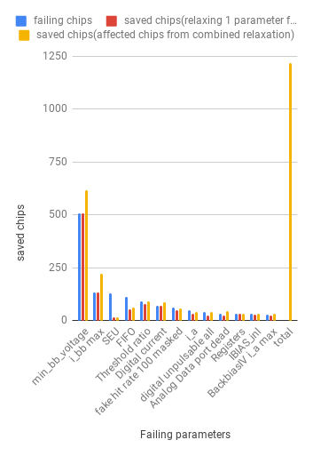
Relaxed Selection Criteria
Total: 28,995
Failing parameters | chips | fraction | Current cut | Relaxed cut | saved chips (relaxing 1 parameter from original) | saved fraction | saved chips (affected chips from combined relaxation)
Minimum Backbias Voltage | 509 | 1.76% | [-6,-4] | [-6,0] | 509 | 1.76% | 617
Maximum Backbias Current | 135 | 0.47% | [-999,6] | [-999,7.1] | 135 | 0.47% | 220
SEU | 127 | 0.44% | [0,0] | [0,17] | 16 | 0.06% | 16
FIFO | 112 | 0.39% | [0,0] | [0,10] | 55 | 0.19% | 63
Threshold ratio | 92 | 0.32% | [0.1,0.5] | [0.1,0.62] | 79 | 0.27% | 93
Digital current | 71 | 0.24% | [35,70] | [35,96] | 69 | 0.24% | 86
Fake Hit Rate 100 masked | 62 | 0.21% | [0,1e-5] | [0,3.4e-5] | 51 | 0.18% | 58
Analog current | 47 | 0.16% | [10.42,15.54] | [10.42,27] | 31 | 0.11% | 42
Digital scan unpulsable | 42 | 0.14% | [0,5243] | [0,10000] | 23 | 0.08% | 41
Analog scan dead pixels | 34 | 0.12% | [0,5243] | [0,9000] | 22 | 0.08% | 46
Registers | 33 | 0.11% | [0,0] | [0,1] | 33 | 0.11% | 34
IBIAS inl | 31 | 0.11% | [-0.01,0.05] | [-0.01,0.08] | 30 | 0.10% | 31
Backbias Maximum Analog Current | 30 | 0.10% | [11.05,17.11] | [10.7,19] | 23 | 0.08% | 31
total |  |  |  |  |  | 4.21% | 1,220
Notes:
This is 13 main 1 parameter failing cases. I compared current cut and relaxed cut.
If we adopt all relaxed cut, we can save 1,220 chips, 4.21% point of yield

Slide 9
Combined Relaxed Selection Criteria
Total: 1,220
Min Backbias Voltage | Max Backbias Current | SEU | FIFO | Threshold ratio | Digital current | Fake Hita rate 100 masked | Analog current | Digital scan unpulsable | Analog scan dead | Registers | IBIAS_inl | Backbias max analog current | chips
TRUE | FALSE | FALSE | FALSE | FALSE | FALSE | FALSE | FALSE | FALSE | FALSE | FALSE | FALSE | FALSE | 509
FALSE | TRUE | FALSE | FALSE | FALSE | FALSE | FALSE | FALSE | FALSE | FALSE | FALSE | FALSE | FALSE | 135
FALSE | FALSE | FALSE | FALSE | TRUE | FALSE | FALSE | FALSE | FALSE | FALSE | FALSE | FALSE | FALSE | 79
FALSE | FALSE | FALSE | FALSE | FALSE | TRUE | FALSE | FALSE | FALSE | FALSE | FALSE | FALSE | FALSE | 69
TRUE | TRUE | FALSE | FALSE | FALSE | FALSE | FALSE | FALSE | FALSE | FALSE | FALSE | FALSE | FALSE | 69
FALSE | FALSE | FALSE | TRUE | FALSE | FALSE | FALSE | FALSE | FALSE | FALSE | FALSE | FALSE | FALSE | 55
FALSE | FALSE | FALSE | FALSE | FALSE | FALSE | TRUE | FALSE | FALSE | FALSE | FALSE | FALSE | FALSE | 51
FALSE | FALSE | FALSE | FALSE | FALSE | FALSE | FALSE | FALSE | FALSE | FALSE | TRUE | FALSE | FALSE | 33
FALSE | FALSE | FALSE | FALSE | FALSE | FALSE | FALSE | TRUE | FALSE | FALSE | FALSE | FALSE | FALSE | 31
FALSE | FALSE | FALSE | FALSE | FALSE | FALSE | FALSE | FALSE | FALSE | FALSE | FALSE | TRUE | FALSE | 30
FALSE | FALSE | FALSE | FALSE | FALSE | FALSE | FALSE | FALSE | FALSE | FALSE | FALSE | FALSE | TRUE | 23
FALSE | FALSE | FALSE | FALSE | FALSE | FALSE | FALSE | FALSE | TRUE | FALSE | FALSE | FALSE | FALSE | 23
FALSE | FALSE | FALSE | FALSE | FALSE | FALSE | FALSE | FALSE | FALSE | TRUE | FALSE | FALSE | FALSE | 22
FALSE | FALSE | TRUE | FALSE | FALSE | FALSE | FALSE | FALSE | FALSE | FALSE | FALSE | FALSE | FALSE | 16
FALSE | FALSE | FALSE | FALSE | FALSE | FALSE | FALSE | FALSE | TRUE | TRUE | FALSE | FALSE | FALSE | 14
TRUE | FALSE | FALSE | FALSE | FALSE | TRUE | FALSE | FALSE | FALSE | FALSE | FALSE | FALSE | FALSE | 8
FALSE | FALSE | FALSE | FALSE | TRUE | FALSE | TRUE | FALSE | FALSE | FALSE | FALSE | FALSE | FALSE | 6
TRUE | FALSE | FALSE | TRUE | FALSE | FALSE | FALSE | FALSE | FALSE | FALSE | FALSE | FALSE | FALSE | 5
TRUE | TRUE | FALSE | FALSE | FALSE | TRUE | FALSE | FALSE | FALSE | FALSE | FALSE | FALSE | FALSE | 5
TRUE | FALSE | FALSE | FALSE | FALSE | FALSE | FALSE | TRUE | FALSE | FALSE | FALSE | FALSE | FALSE | 5
TRUE | FALSE | FALSE | FALSE | TRUE | FALSE | FALSE | FALSE | FALSE | FALSE | FALSE | FALSE | FALSE | 4
FALSE | FALSE | FALSE | FALSE | FALSE | FALSE | FALSE | TRUE | FALSE | FALSE | FALSE | FALSE | TRUE | 4
TRUE | FALSE | FALSE | FALSE | FALSE | FALSE | FALSE | FALSE | FALSE | TRUE | FALSE | FALSE | FALSE | 3
...else |  |  |  |  |  |  |  |  |  |  |  |  | 21
Total: 617 | Total: 220 | Total: 16 | Total: 63 | Total: 93 | Total: 86 | Total: 58 | Total: 42 | Total: 41 | Total: 46 | Total: 34 | Total: 31 | Total: 31
Notes:
This is how 1,220 chips are saved from multiple parameter relaxation.

Slide 10
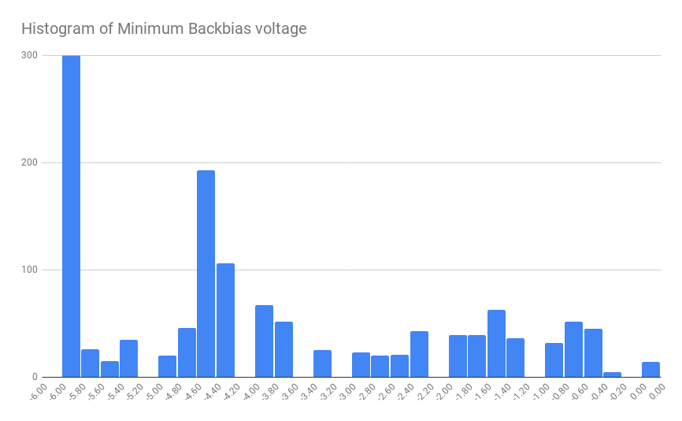
Minimum Backbias Voltage
Current cut: [-6, -4]
Relaxed cut: [-6, 0]
62.53%
1.76%
(509)
Notes:
Minimum backbias voltage is main failing parameter. We can save 1.76%p by adopt this relaxation

Slide 11
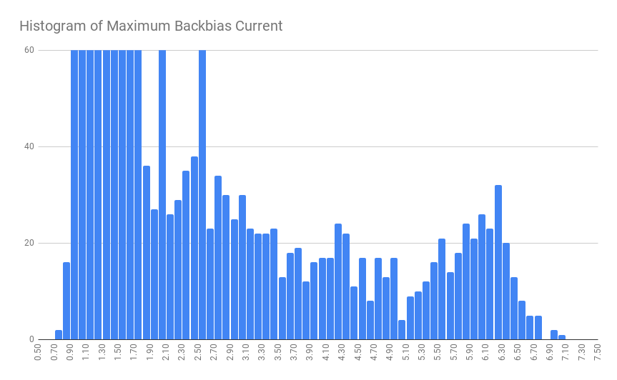
Maximum Backbias Current
Current cut: [-999, 6]
Relaxed cut: [-999, 7.1]
62.53%
0.47%
(135)
Notes:
Second largest portion due is maximum backbias current from 1 paramert we can seve 0.47%

Slide 12
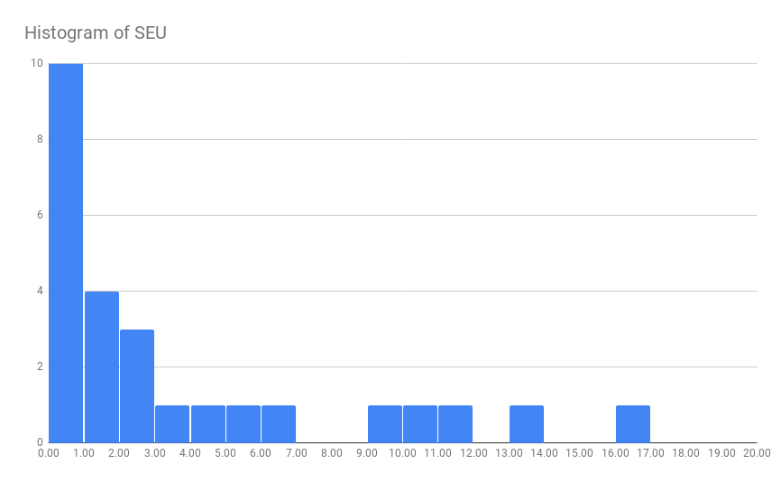
SEU
Current cut: [0, 0]
Relaxed cut: [0, 17]
62.53%
0.06%
(16)
Notes:
small fraction of SEU failing chips may can be saved.

Slide 13
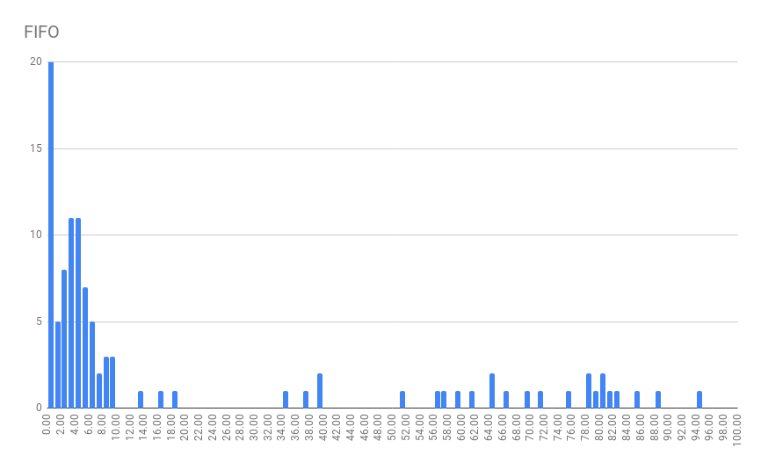
FIFO
Current cut: [0, 0]
Relaxed cut: [0, 10]
62.53%
0.19%
(55)
Notes:
No pattern in FIFO error location and large number of fifo error count are common

Slide 14
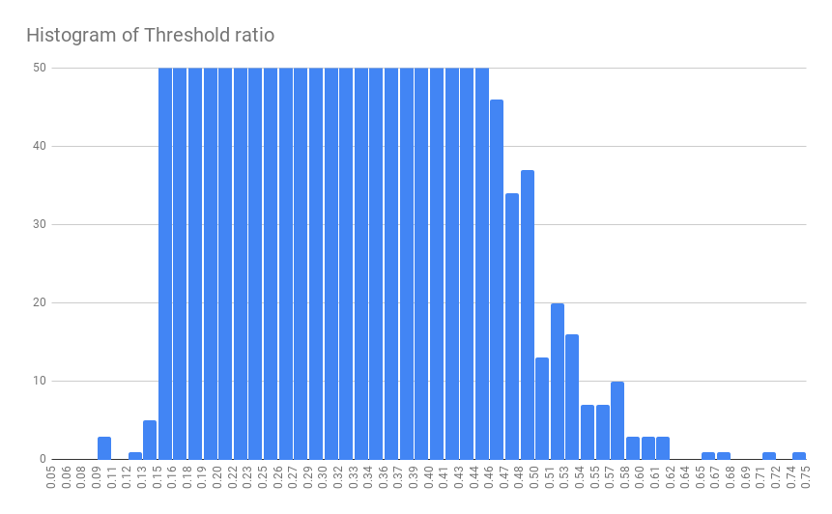
Threshold data port ratio
Current cut: [0.1, 0.5]
Relaxed cut: [0.1, 0.62]
62.53%
0.27%
(79)
Notes:
Threshold ratio relaxation can save 0.27%

Slide 15
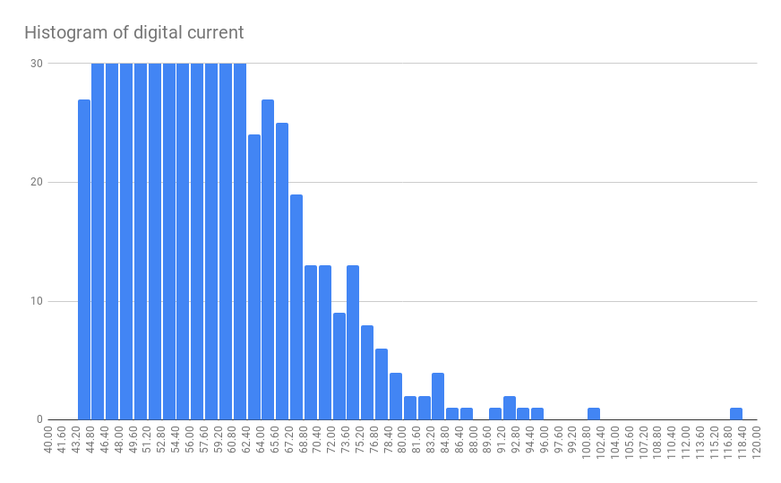
Digital current
Current cut: [35, 70]
Relaxed cut: [35, 96]
62.53%
0.24%
(69)
Notes:
Digital current relaxation can save 0.24%

Slide 16
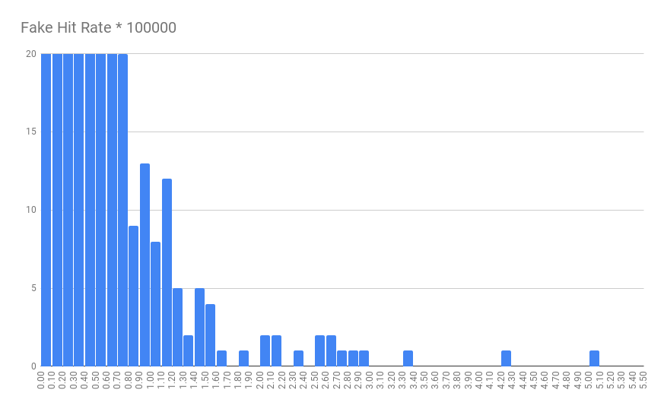
Fake hit rate 100 masked
Current cut: [0, 1e-5]
Relaxed cut: [0, 3.4e-5]
62.53%
0.18%
(51)
Notes:
Fake hit rate relaxation can save 0.18

Slide 17
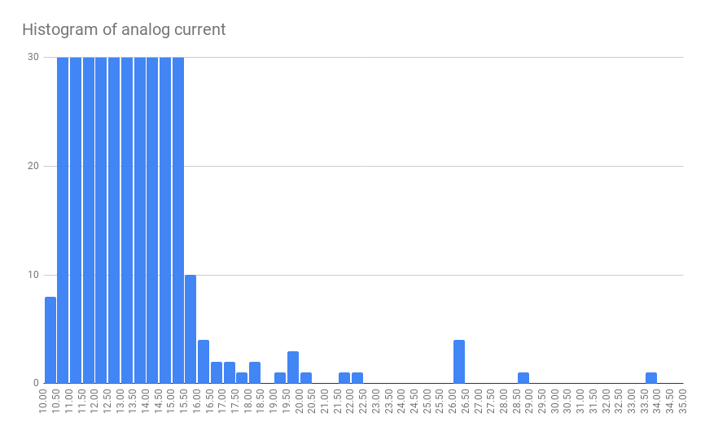
Analog current
Current cut: [10.42, 15.54]
Relaxed cut: [10.42, 27]
62.53%
0.11%
(31)
Notes:
Analog current relaxation can save 0.11%

Slide 18
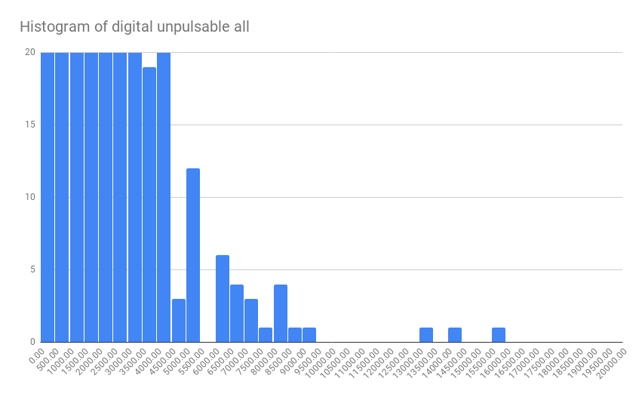
Digital scan unpulsable
Current cut: [0, 5243]
Relaxed cut: [0, 10000]
62.53%
0.08%
(23)
Notes:
Digital scan unpulsable is next main failure

Slide 19
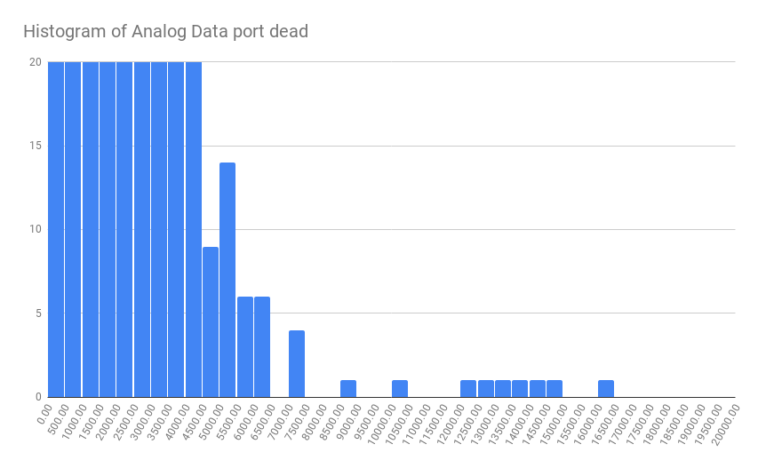
Analog scan dead pixels
Current cut: [0, 5243]
Relaxed cut: [0, 9000]
62.53%
0.08%
(23)
Notes:
Analog scan use larger pulse than Threshold scan’s. So there can be dead pixel in analog pulse but not in threshold scan

Slide 20
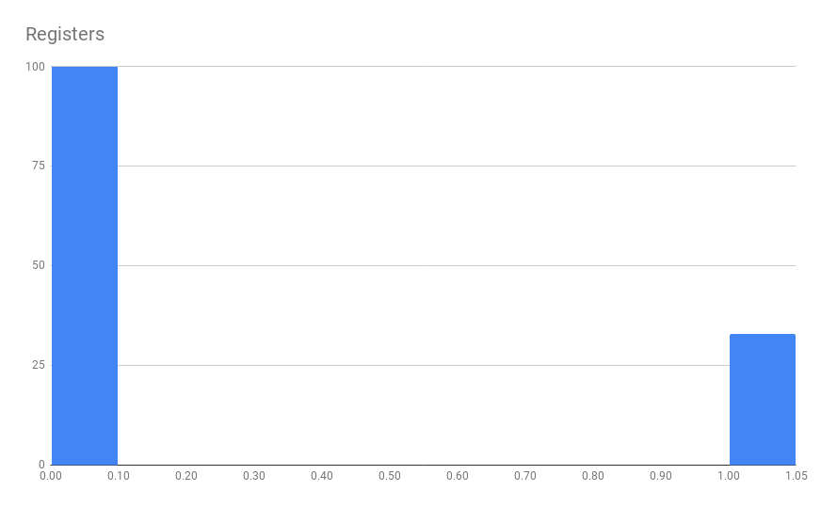
Registers
Current cut: [0, 0]
Relaxed cut: [0, 1]
62.53%
0.11%
(33)
Notes:
Register error is 1 or 0

Slide 21
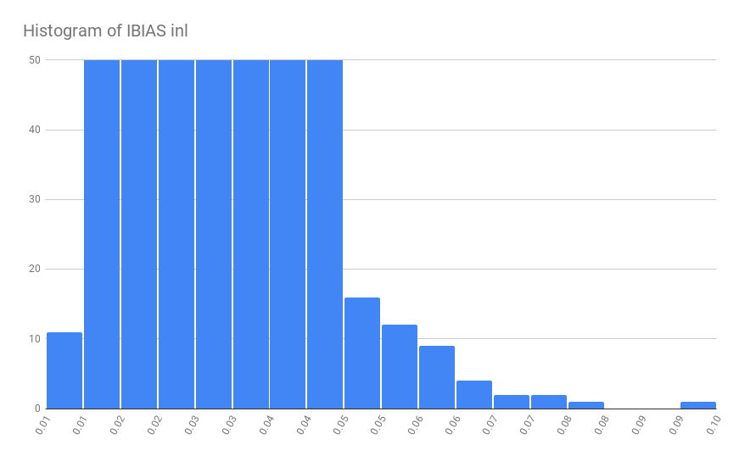
IBIAS inl
Current cut: [-0.01, 0.05]
Relaxed cut: [-0.01, 0.08]
62.53%
0.10%
(30)
Notes:
In Between DAC parameters, IBIAS was main failing parametrt

Slide 22
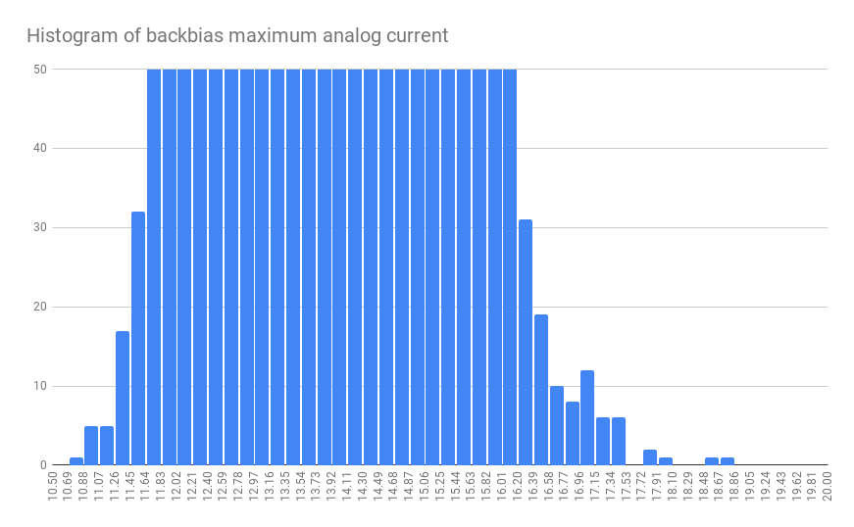
Backbias Maximum Analog Current
Current cut: [11.05, 17.11]
Relaxed cut: [10.7, 19]
62.53%
0.08%
(23)
Notes:
Backbias maximum analog current relaxation can save 0.08%

