Slide 1

OB HIC QA at CERN
12th ALICE ITS upgrade, MFT, and O2 Asian workshop
INHA University
November 19-20, 2018
Petra Riedler, CERN

Slide 2
OB HIC QA at CERN
QA tests on a sub-set of OB-HICs from each center
Started in 2018 to provide feed-back in addition to QA done in the centers and have a monitor for production homogeneity across the centers from one location.
OB HIC Centers
Bari
Liverpool
Non-working HICs
Storage at CERN
Pusan
Strasbourg
QA at CERN
Visual inspection (overall, bonds, flex,..)
Pull tests
Peel test
Thermal cycling
Wuhan
2
Aging test

Slide 3
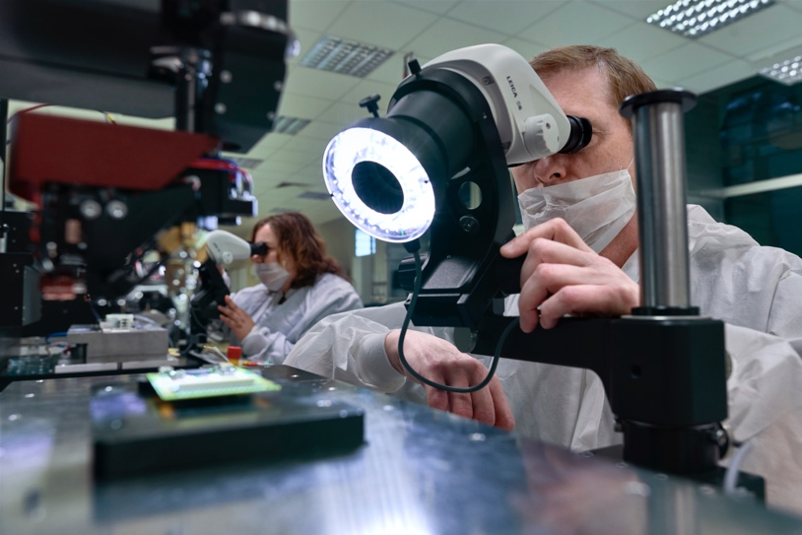
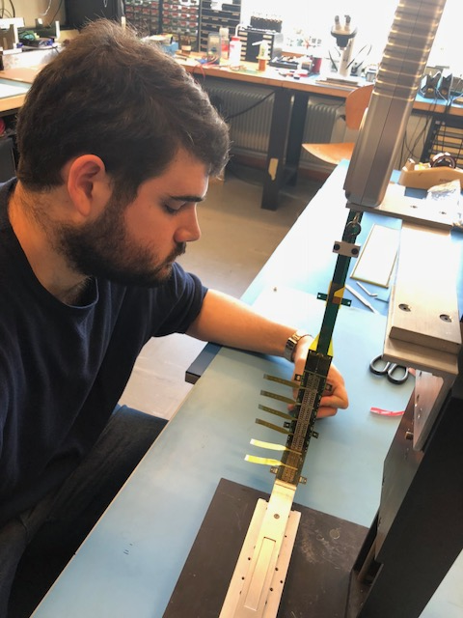
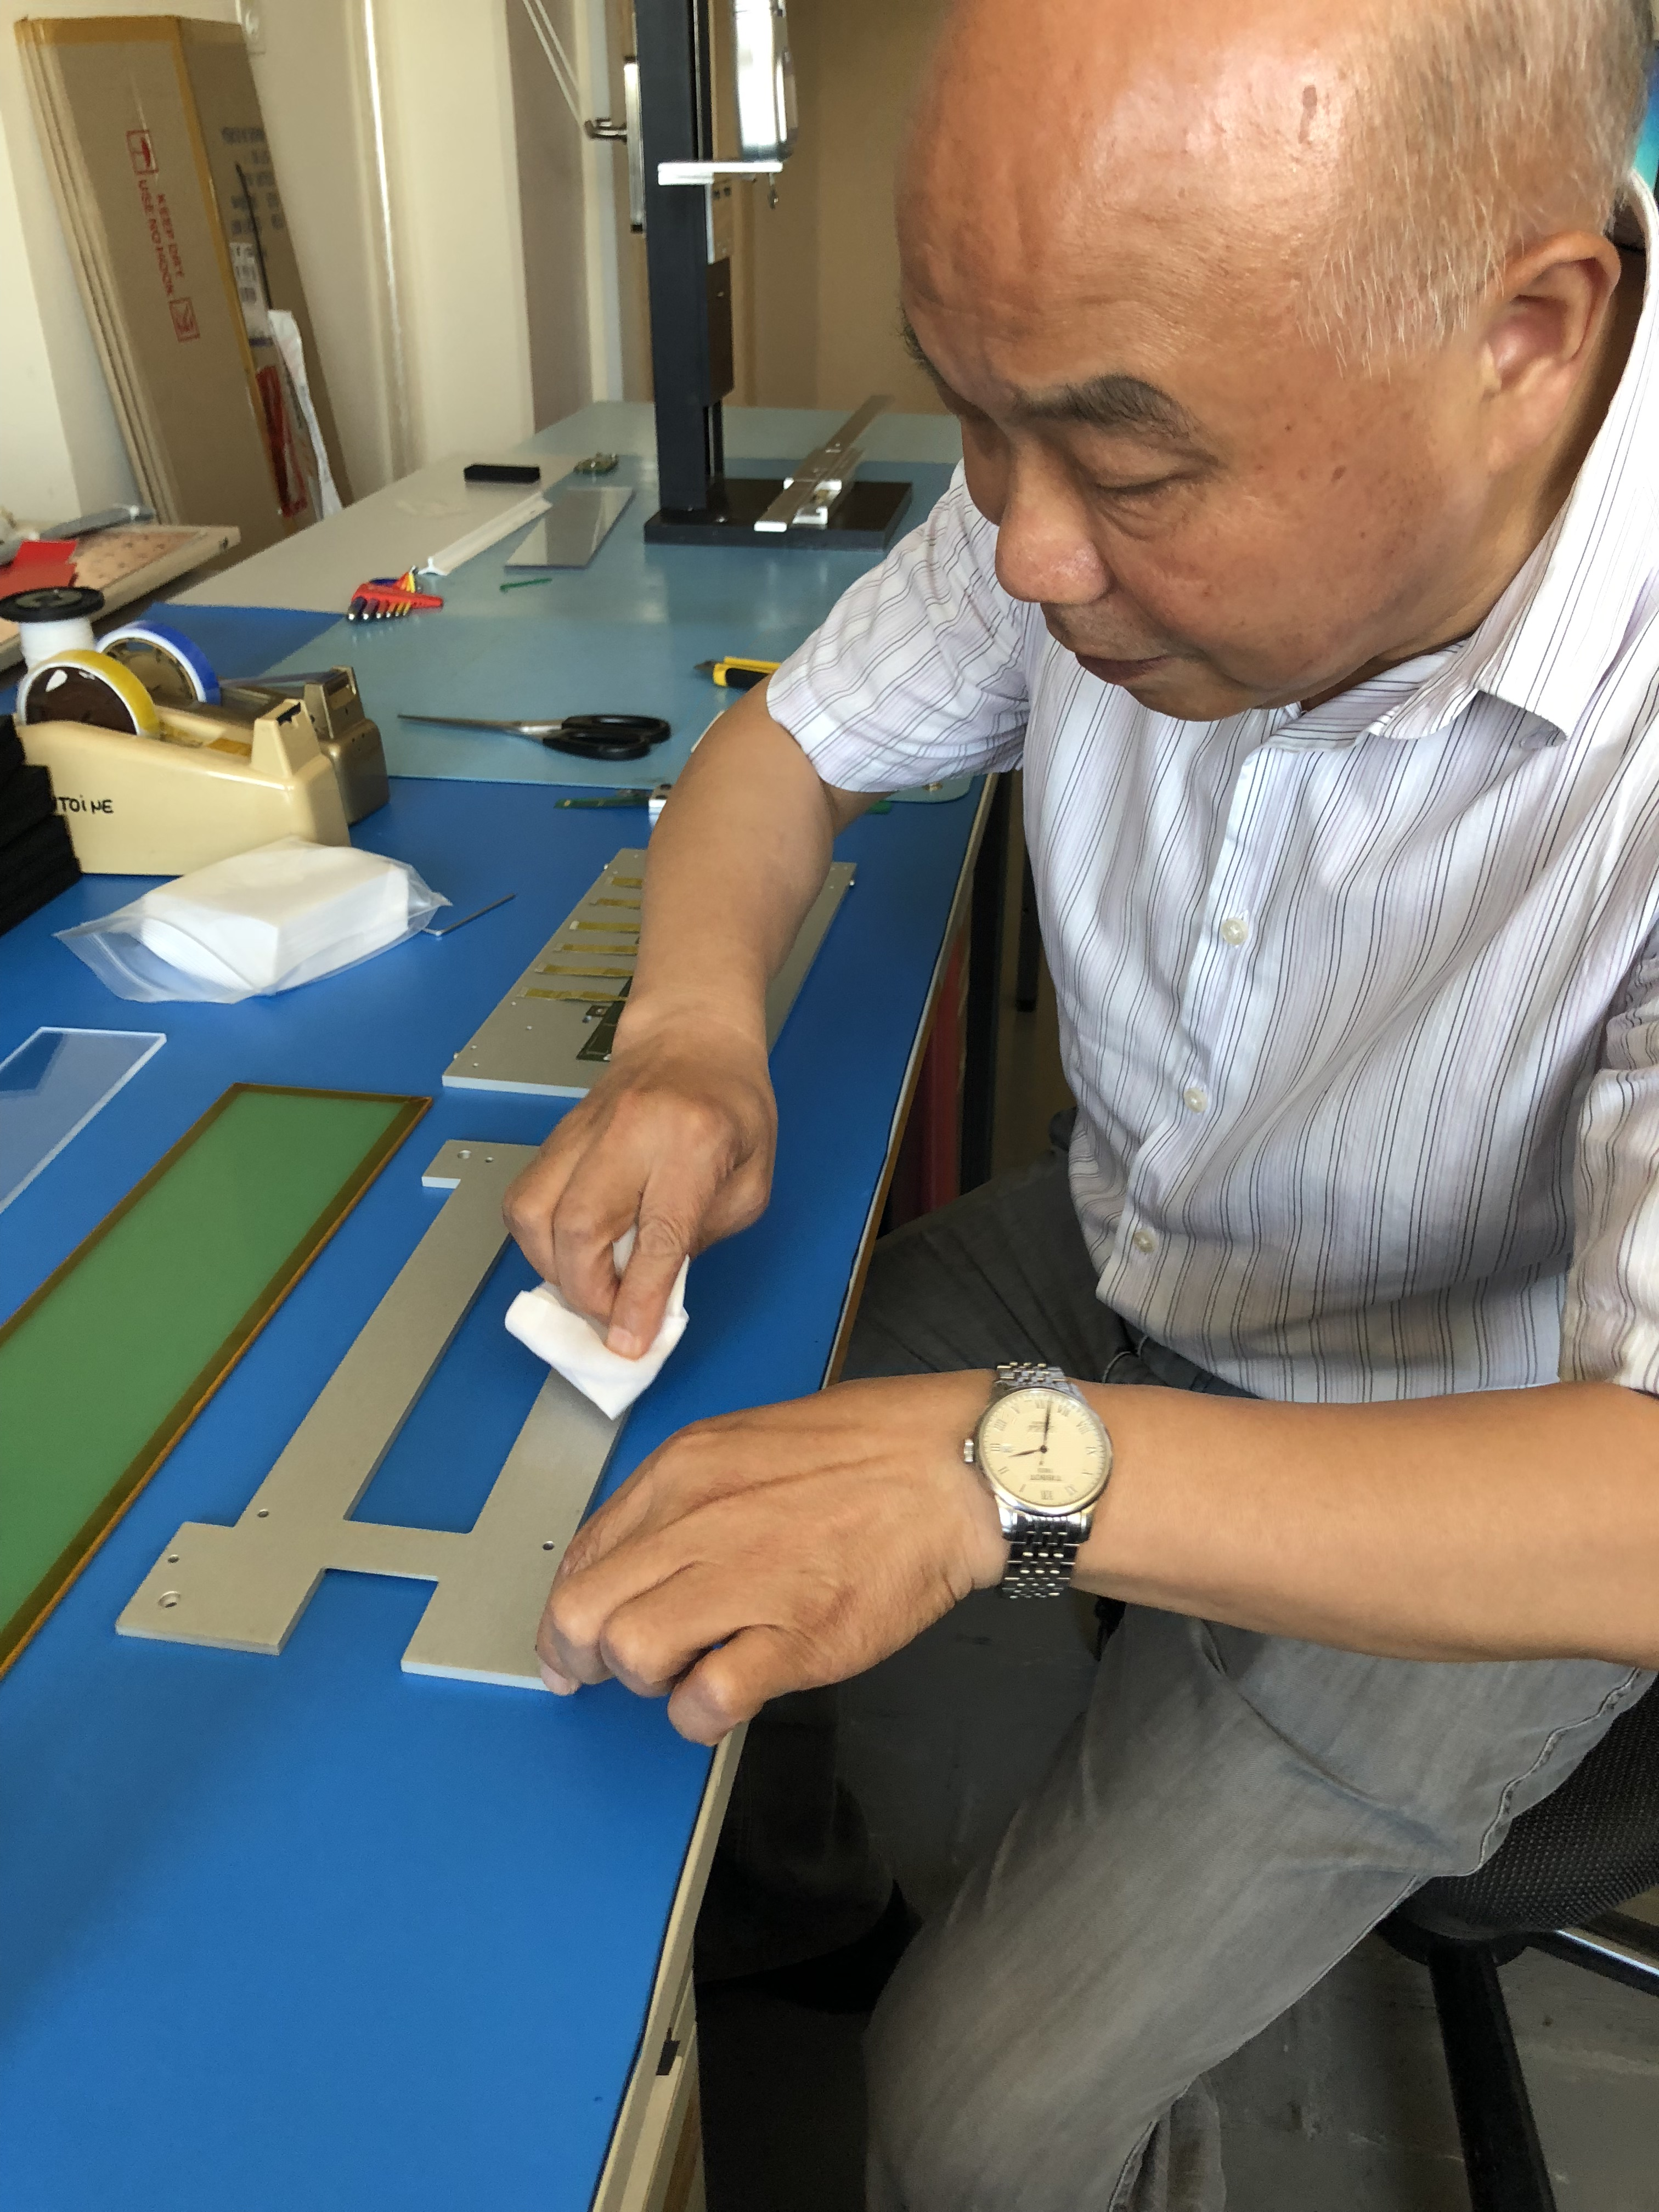
OB HIC tests at CERN
Many people involved
  Florentina, Ian, Daicui, Andres, Vladimir, Petra
Progress reports are given weekly at the TC and HIC meetings as well as in plenary meetings
All tests and pictures of each HIC are stored in a dedicated folder on cernbox
Data transferred into construction database

Slide 4
Procedure
Reception: inspect for any damages on the package, sealing of the wrapping or transport plate, contamination
Inspection: with a digital microscope of the FPC, bonding connections, glue spots, possible contaminations,…
Bondlab inspection: visual inspection with a high performace optical microscope (Leica), wire bonding pull tests
Peel test: glue adhesion strength between FPC and chips, followed by high magnification microscope inspection
Cycling test: thermal cycling of the HIC, including pull tests before, during and after cycling, followed by peel tests
The procedure has been tuned and improved continuously, adding more detailed inspections, additional information on individual tests, videos, etc.

Slide 5
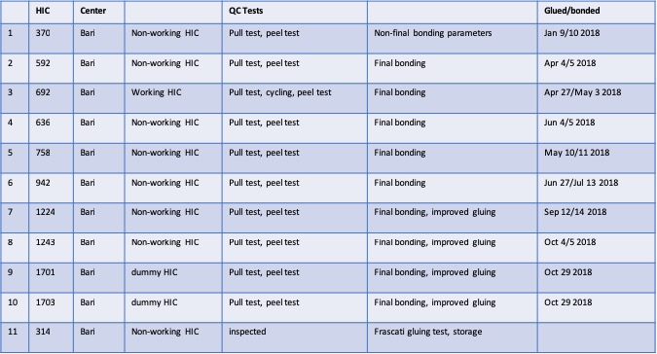
Example: QA tests on HICs from Bari
Since spring 40 HICs have undergone QA testing

Slide 6
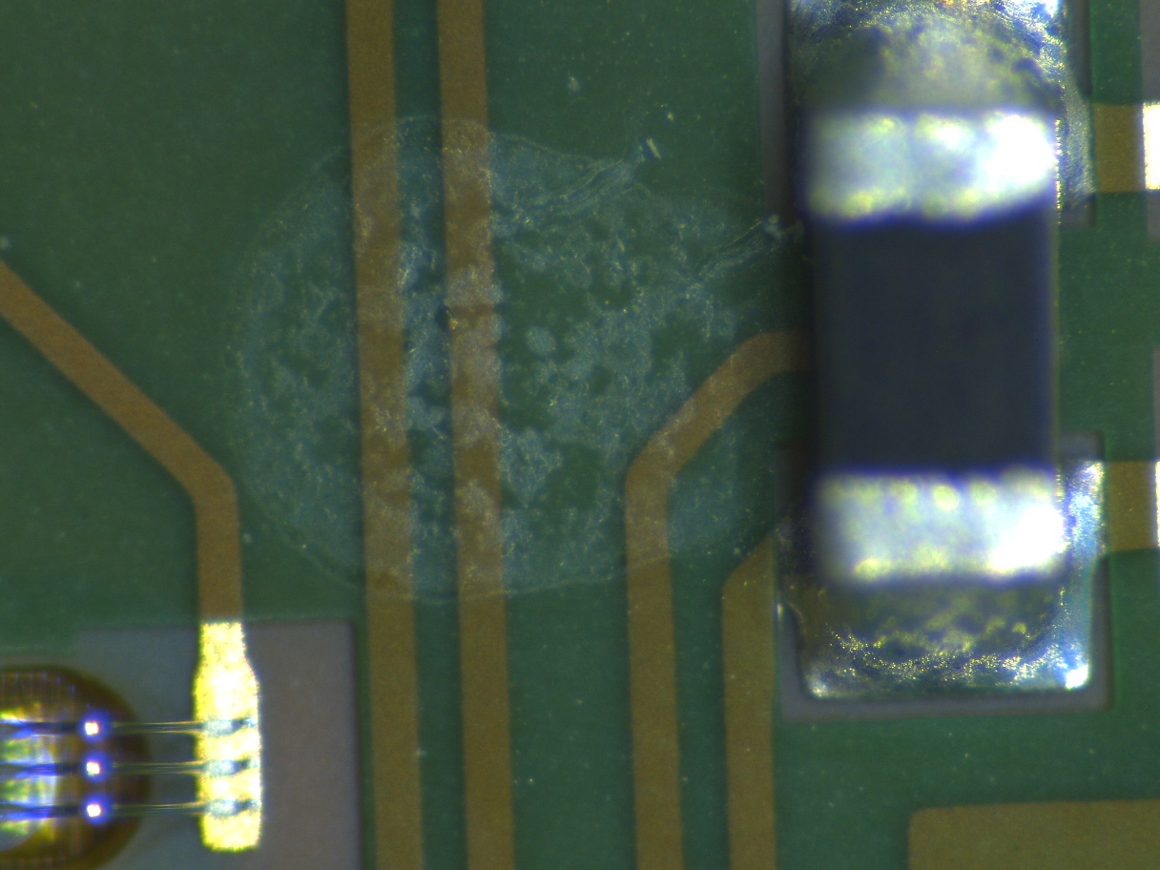
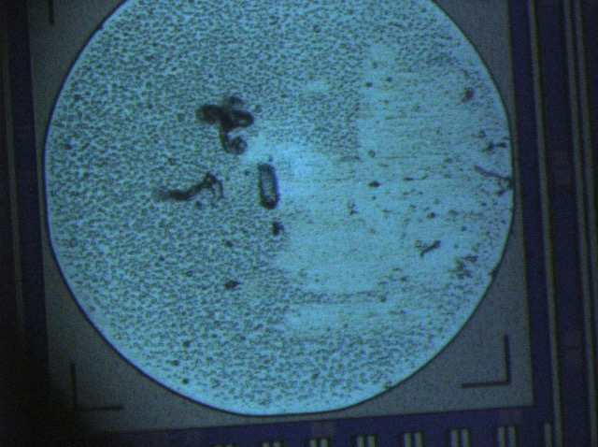
Examples – visual inspection
Issues flagged:
Contamination of the carrier plate
Contamination/patterns on FPCs
Chip pad contamination
Particle contamination in general

Slide 7
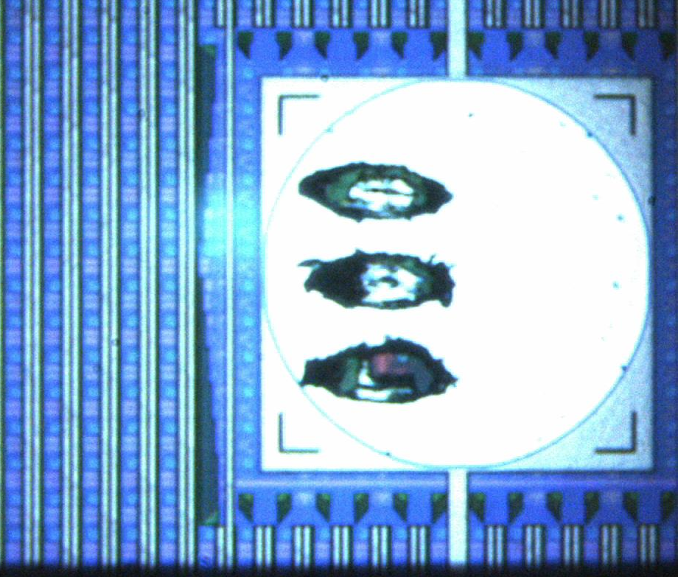
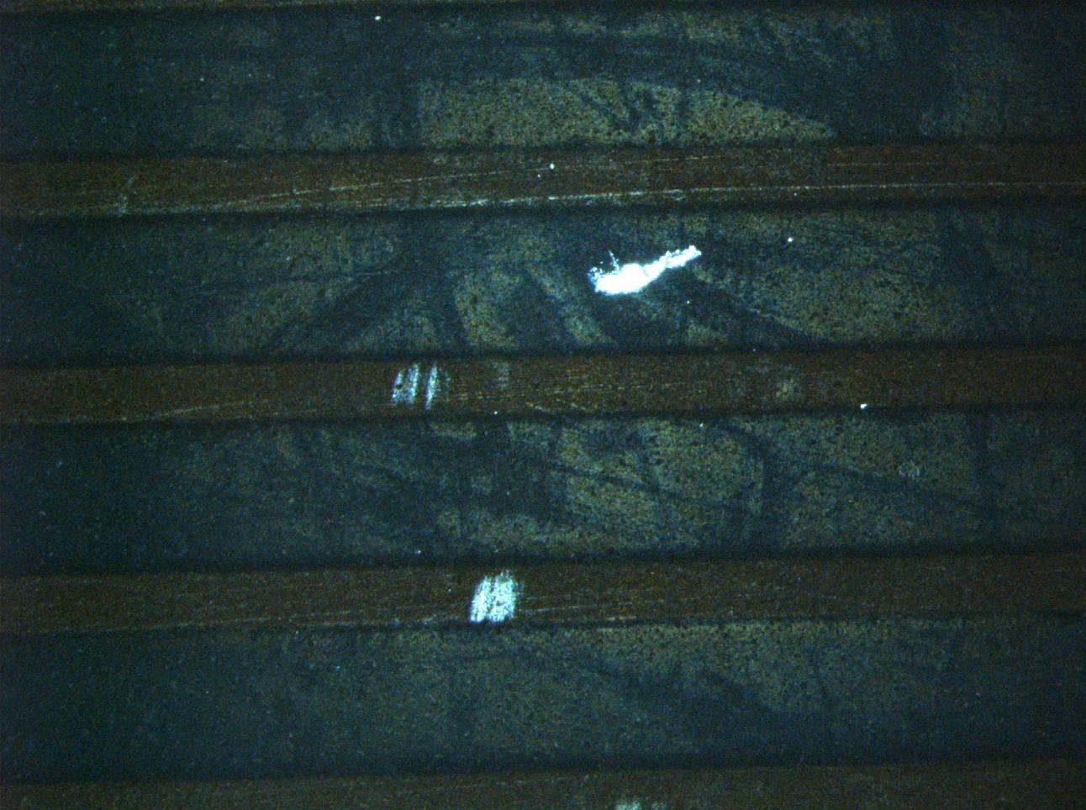
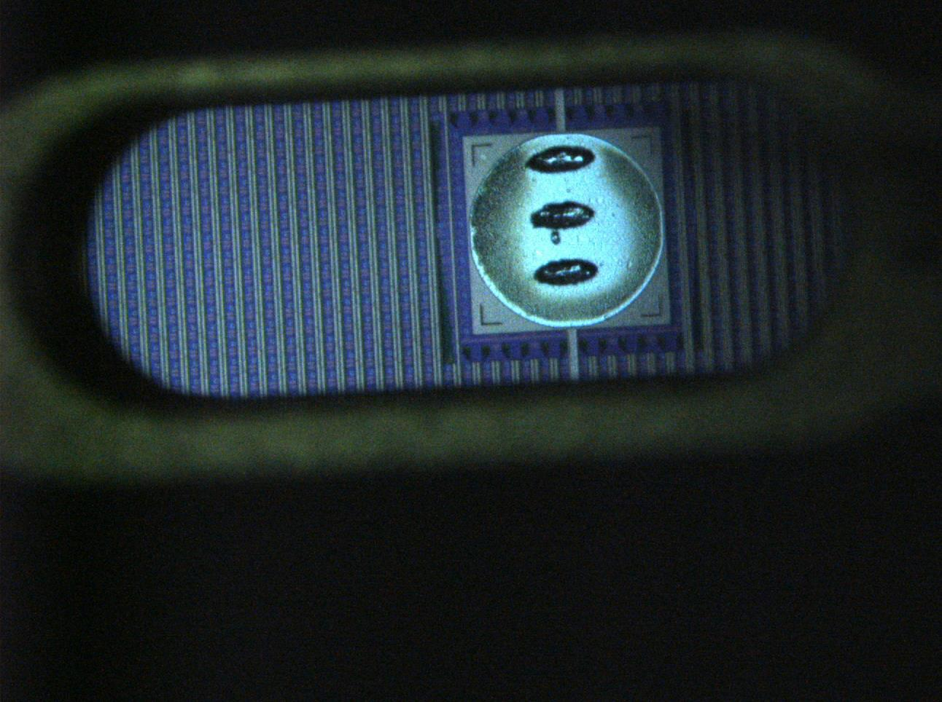
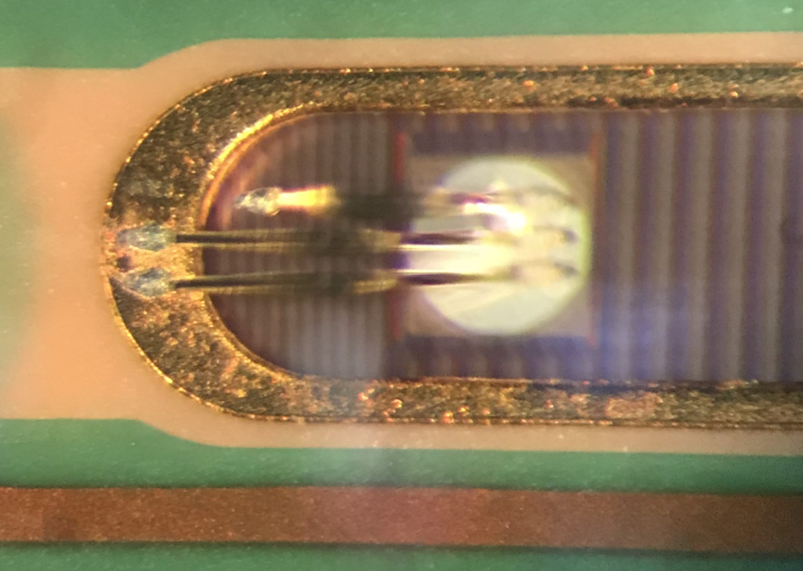
Examples – bond inspection
Pull test and visual inspection carried out by the CERN bondlab
Issues flagged include:
Too low pull test values
Contaminations on chip pad or FPC
Deformed or irregular bond feet
Cratering
Bond foot lift

Slide 8
Pull tests
(update in plenary 13/11/18)
 | Min [g] | Max [g] | Mean [g] | Stdv [g] | inspection
Bari 942 | 10.6 | 14.6 | 12.8 | 0.8 | ok
Bari 636 | 9.5 | 16.1 | 13.4 | 1 | ok
IPHC 1127 | 8.2 | 11.9 | 10 | 0.8 | ok
Lvpl 398 | 8.3 | 11.8 | 10 | 0.7 | ok
Lvpl 776* |  |  | 9.6 | 1.3 | ok
Lvpl 1110* |  |  | 9.7 | 1.1 | ok
CCNU1215 | 5.3 | 11.2 | 8.5 | 0.9 | Worsening of first bond heel fracture; possible tool degradation
CCNU 932* | 4.7 | 10.1 | 7 | 1.1 | Worsening of first bond heel fracture; possible tool degradation
Bari 1243 | 11.5 | 14.5 | 13 | 0.7 | ok
Bari 1701 | 10.6 | 14.9 | 12.3 | 0.8 | ok
Bari 1703 | 11 | 14.3 | 12.4 | 0.5 | ok
CCNU 1215 | 5.3 | 11.2 | 8.5 | 0.9 | Worsening of first bond heel fracture; possible tool degradation
New results reported in weekly HIC meeting and to sites at end of tests
*cycling

Slide 9
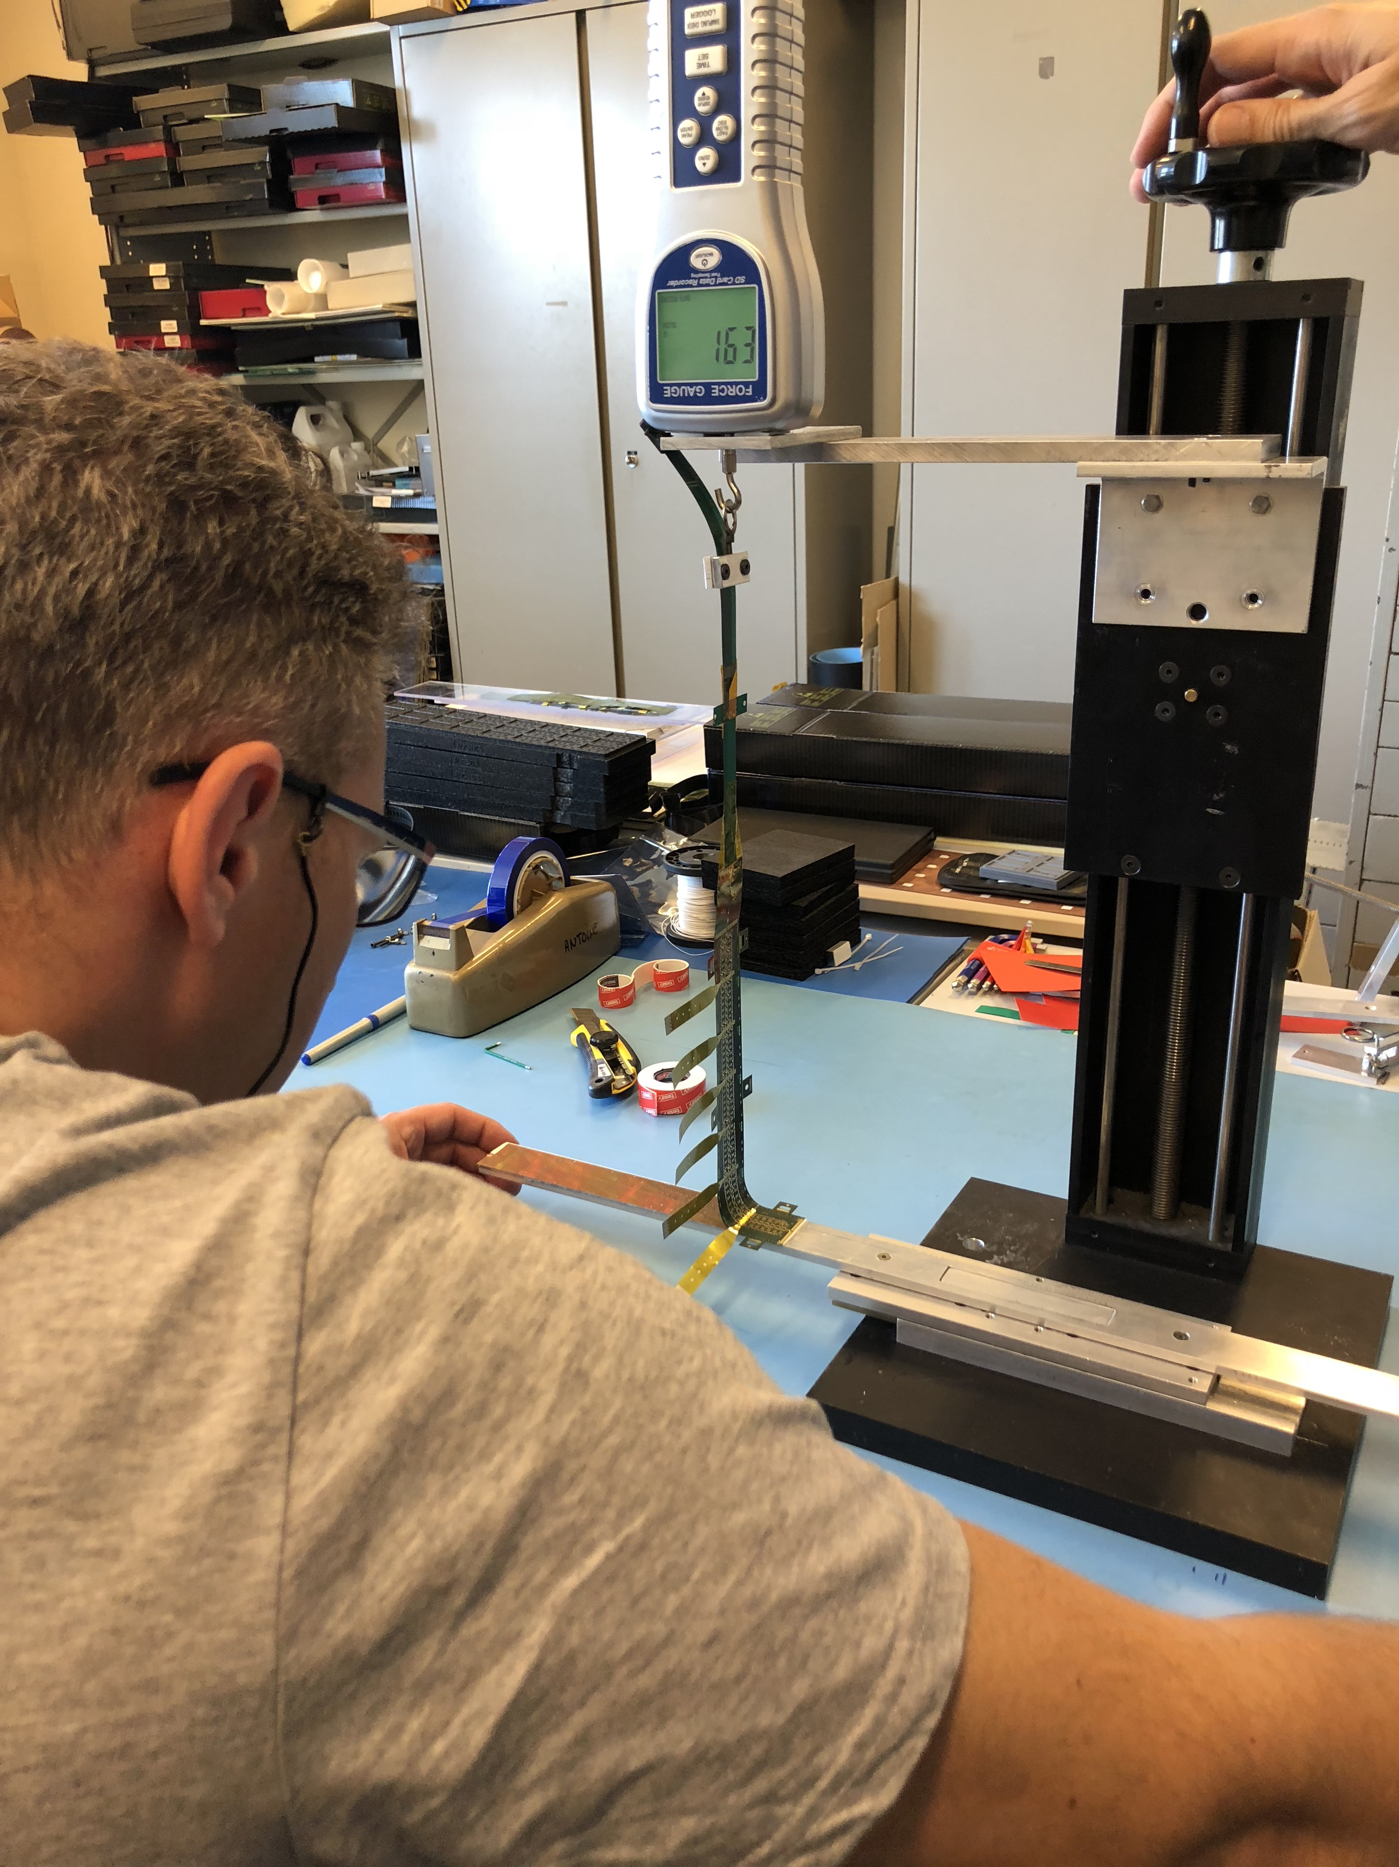
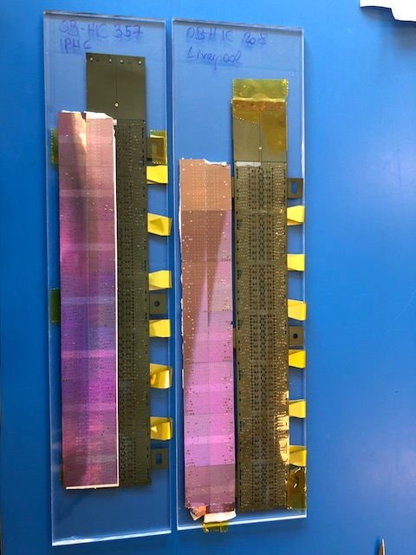
Peel test
In order to do a peel test (measure adhesion strength between chips and FPC, all wire bonds are removed.
The HIC is mounted on a translation stave and the FPC is peeled off from the chips.
The adhesion strength is measured with a force gauge.

Slide 10
Peel tests
HIC |  | average | stdv
370 | bari | 136.81 | 34.39
592 | bari | 315.20 | 91.75
220 | pusan | 134.28 | 86.58
90 | liverpool | 194.62 | 55.94
208 | liverpool | 412.54 | 70.72
260 | liverpool | 593.75 | 217.04
357 | iphc | 270.14 | 54.99
199 | ccnu | 320.64 | 111.85
1027 | ccnu | 207.01 | 103.95
168 | ccnu | 481.93 | 131.79
684 | iphc | 201.89 | 64.94
172 | ccnu | 315.37 | 123.45
758 | bari | 66.04 | 23.48
182 | ccnu | 290.55 | 134.30
692 | bari | 97.86 | 31.70
819 | ccnu | 314.82 | 123.70
91 | ccnu | 336.12 | 129.13
167 | ccnu | 342.63 | 117.11
1110 | lvpl | 394.91 | 117.21
636 | bari | 73.01 | 30.97
942 | bari | 70.59 | 21.11
1127 | iphc | 192.76 | 48.27
1224 | bari | 222.74 | 52.31
1243 | bari | 140.00
1701 | bari | 333.97 | 73.75
1703 | bari | 160.00
1215 | ccnu | 212.41 | 76.48
Most HICs are peel tested after bond inspection and pull test, 3 have been peel tested after thermal cycling.
Average peel force and standard deviation are important indications for good/bad adhesion, but also other aspects need to be monitored closely:
Form of the curve
Glue filaments during the peel test
Inspection of FPC and chips after peel test

Slide 11
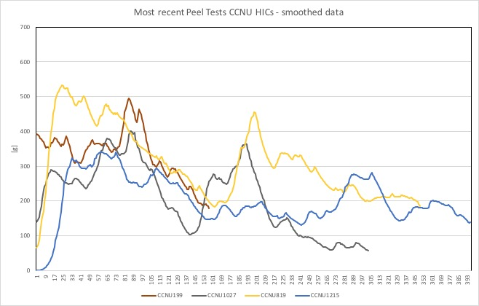
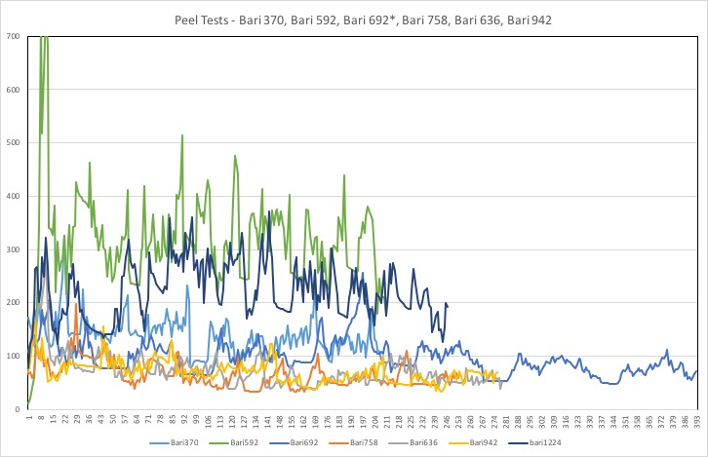
Peel test curves examples

Slide 12
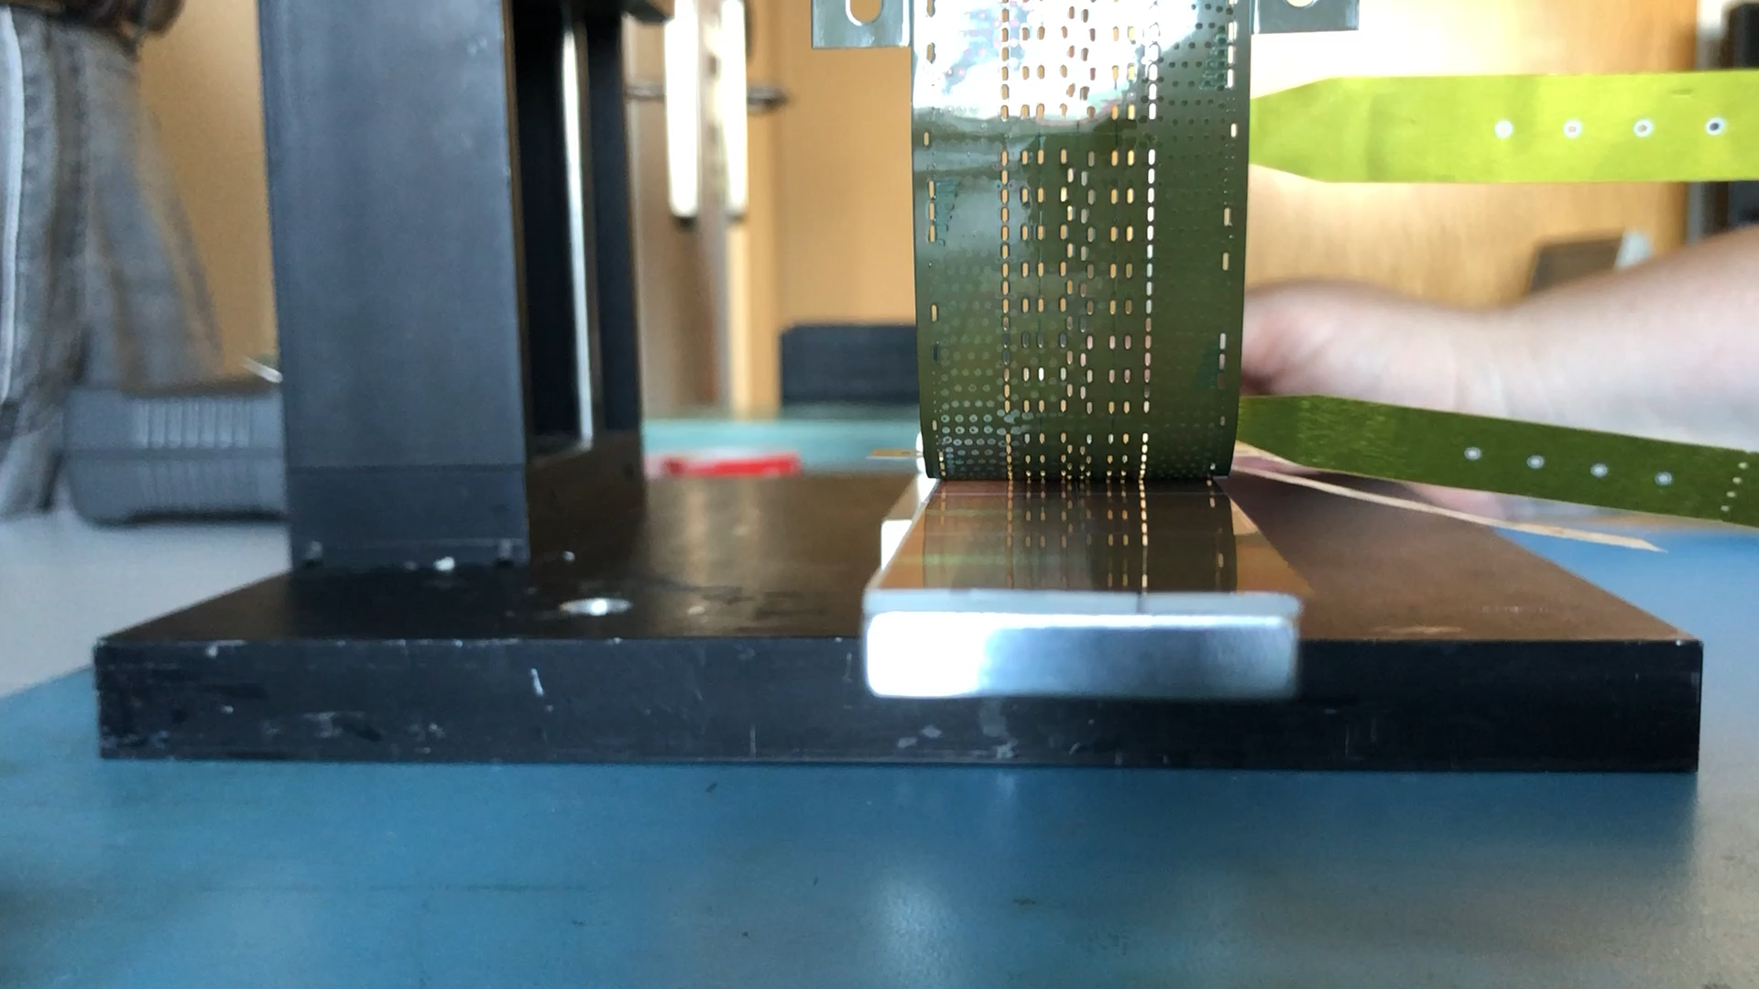
Bari 758

Slide 13
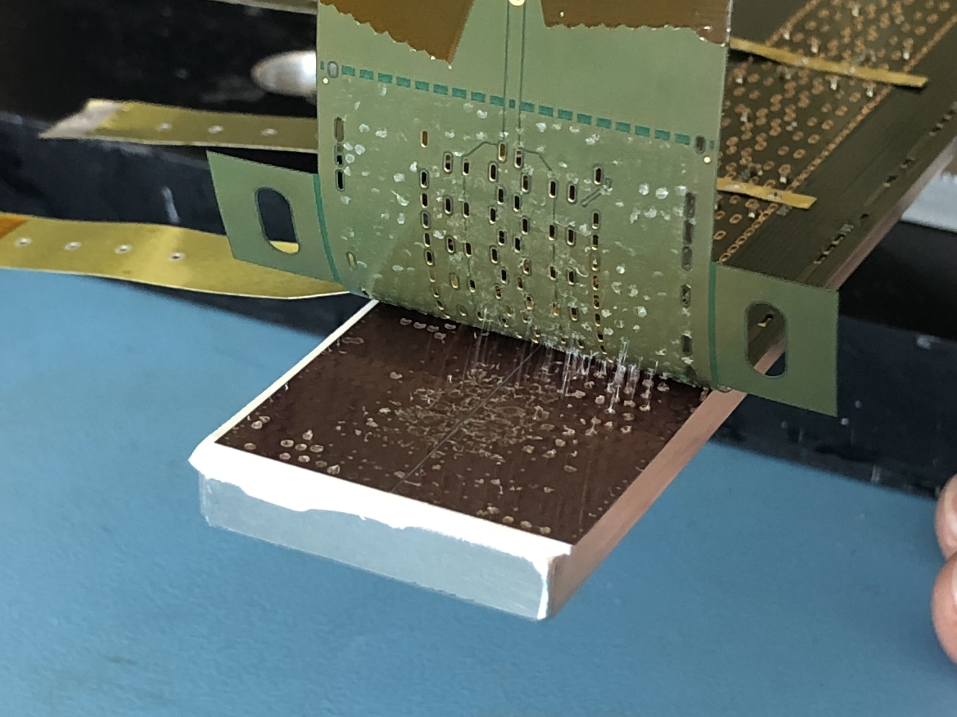
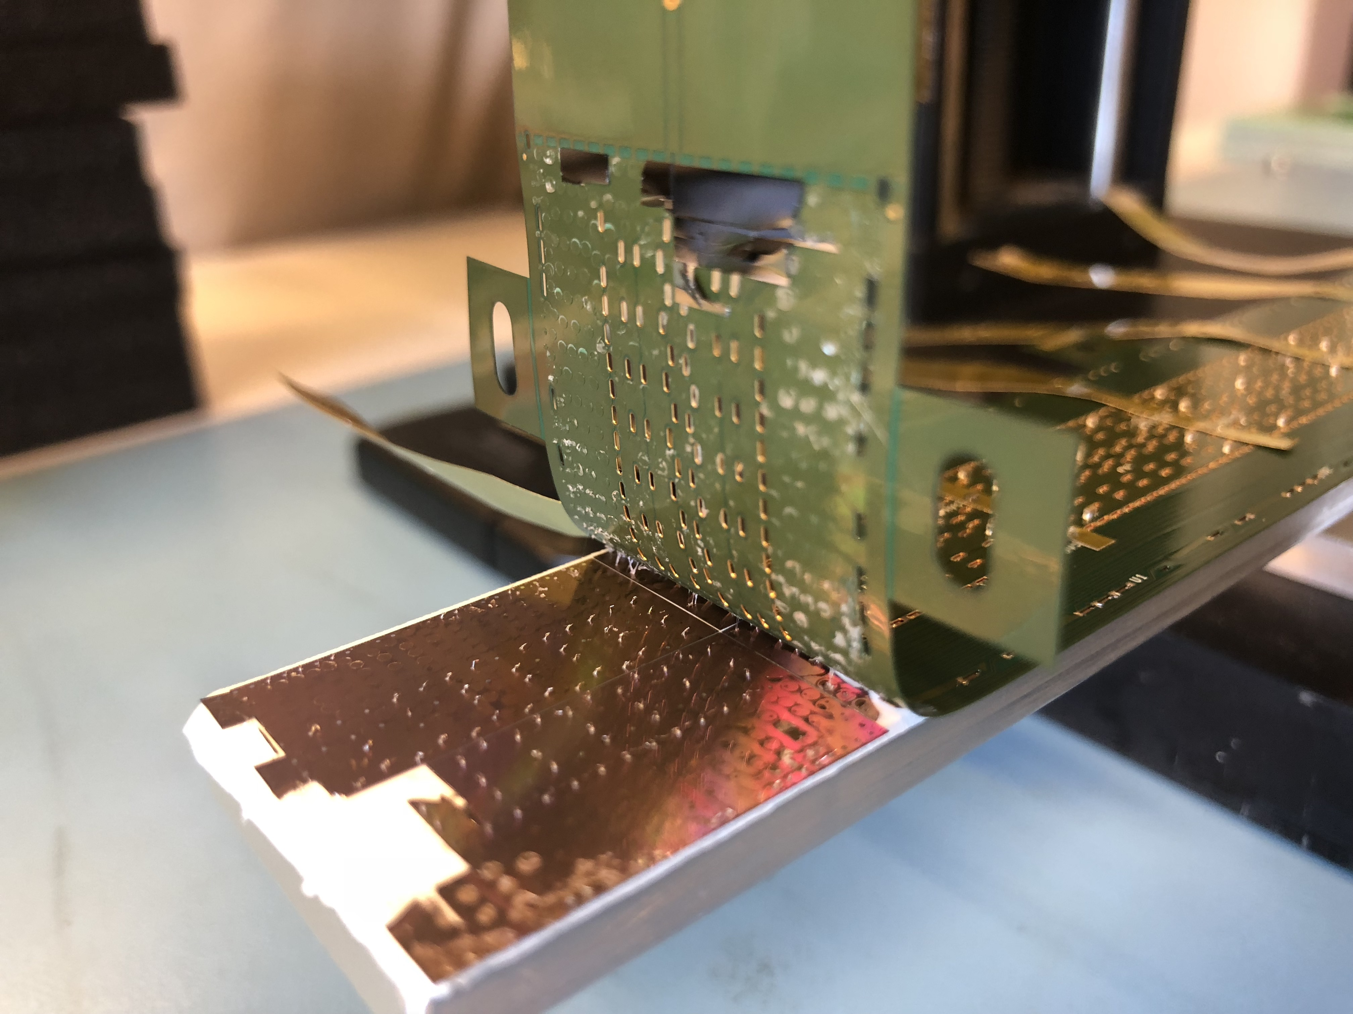
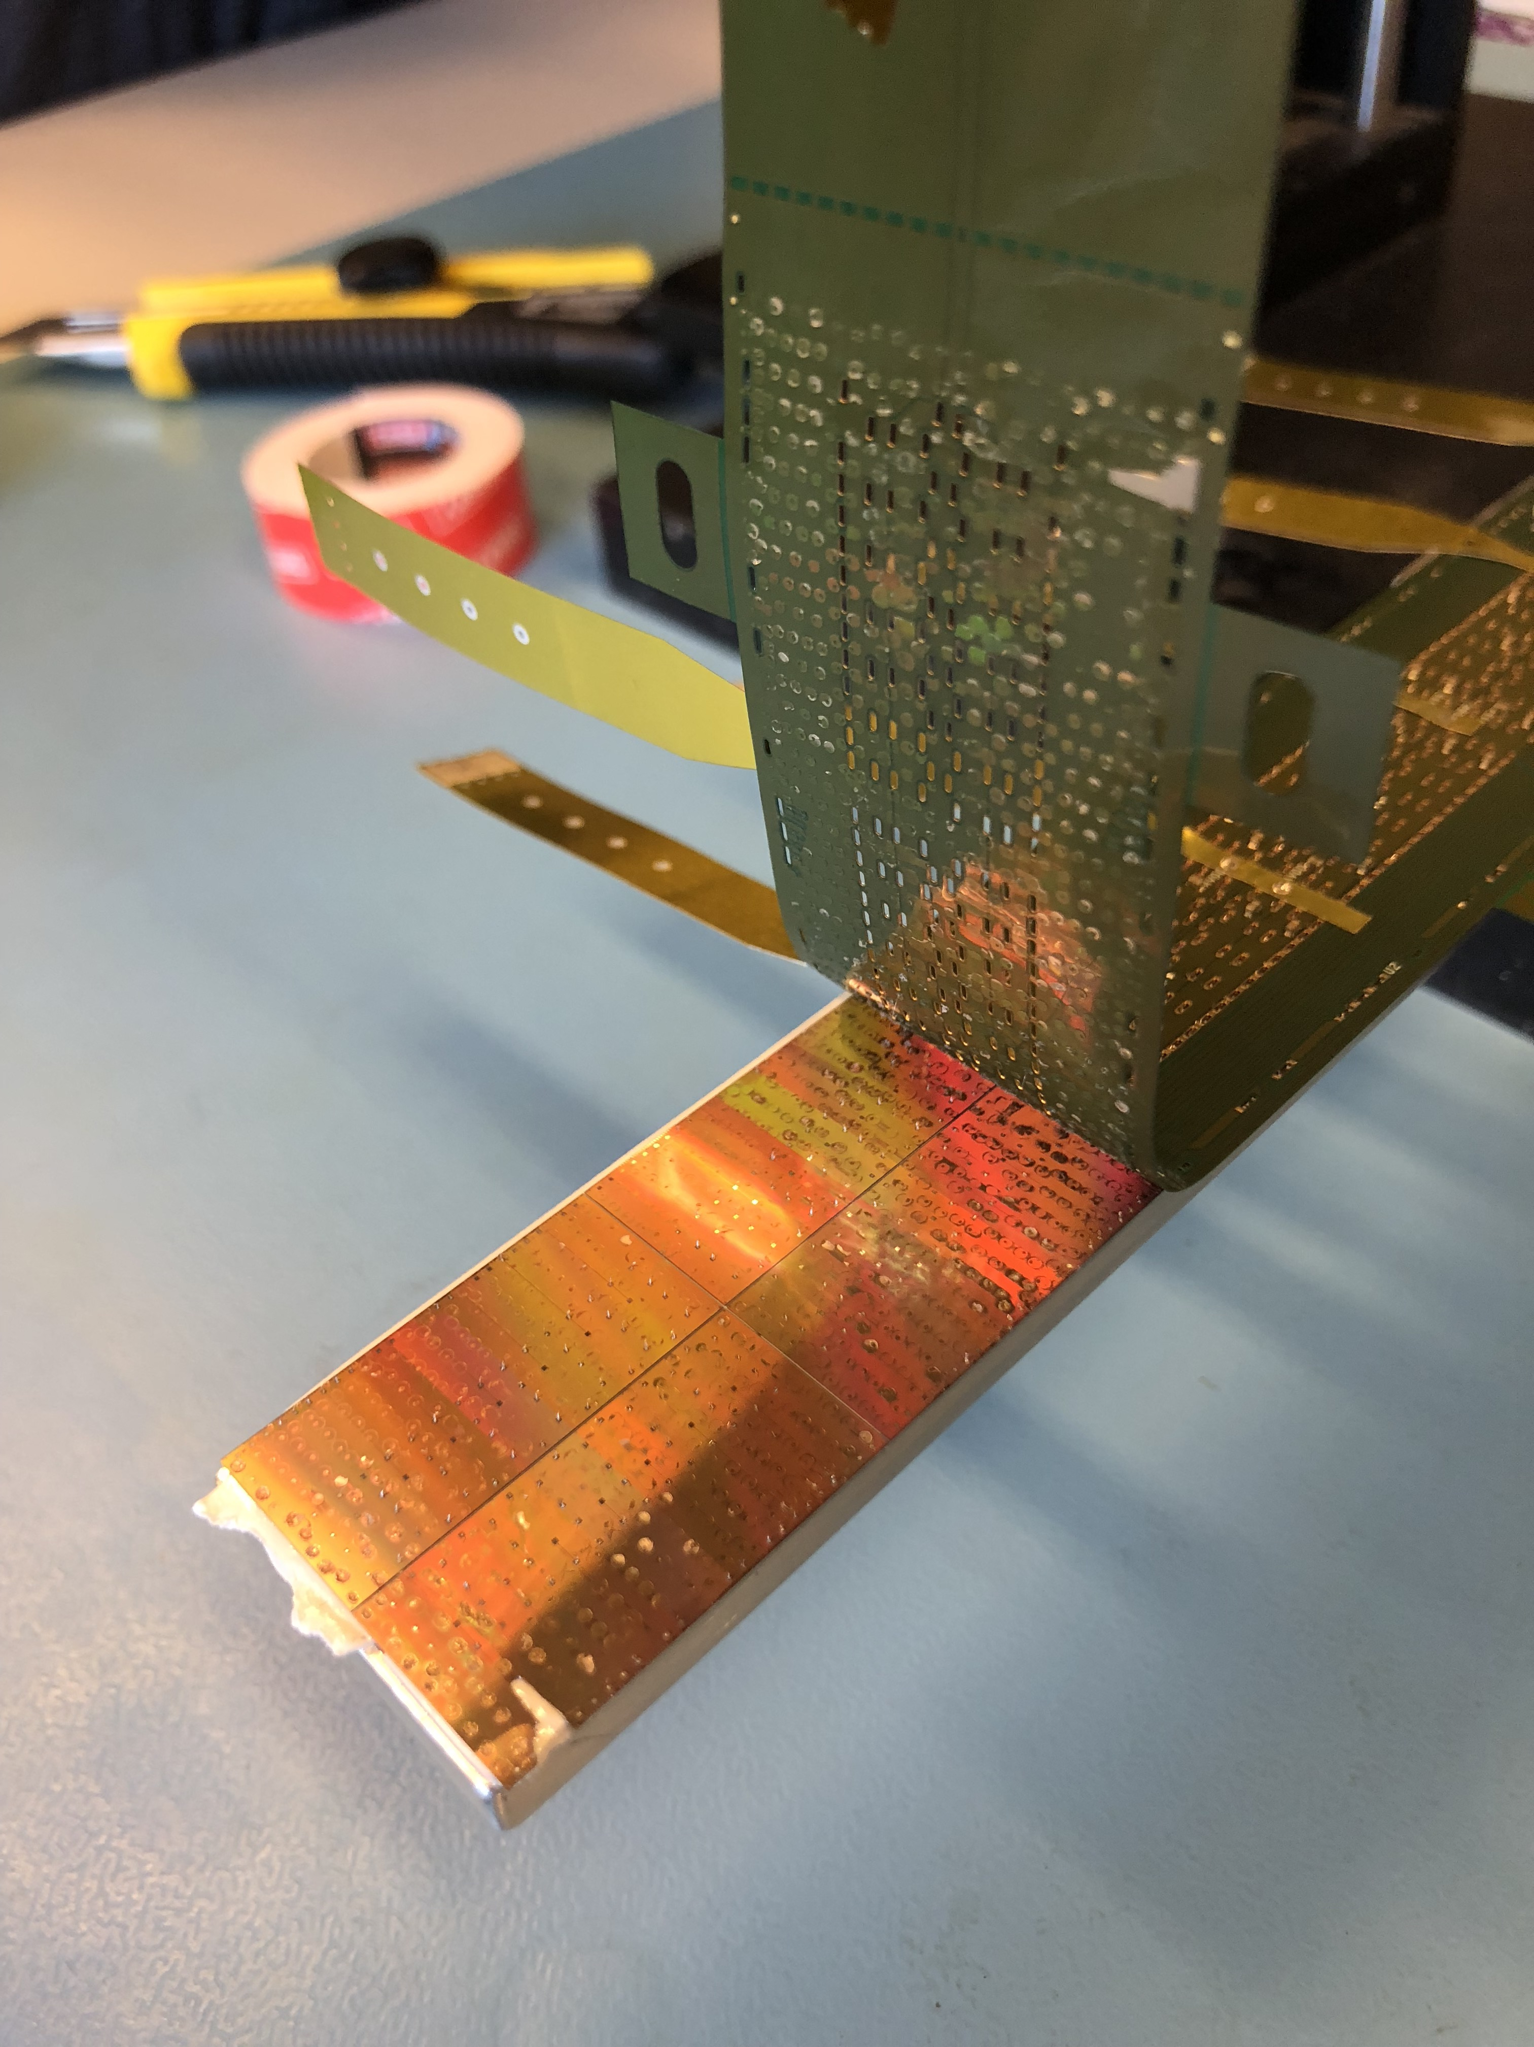
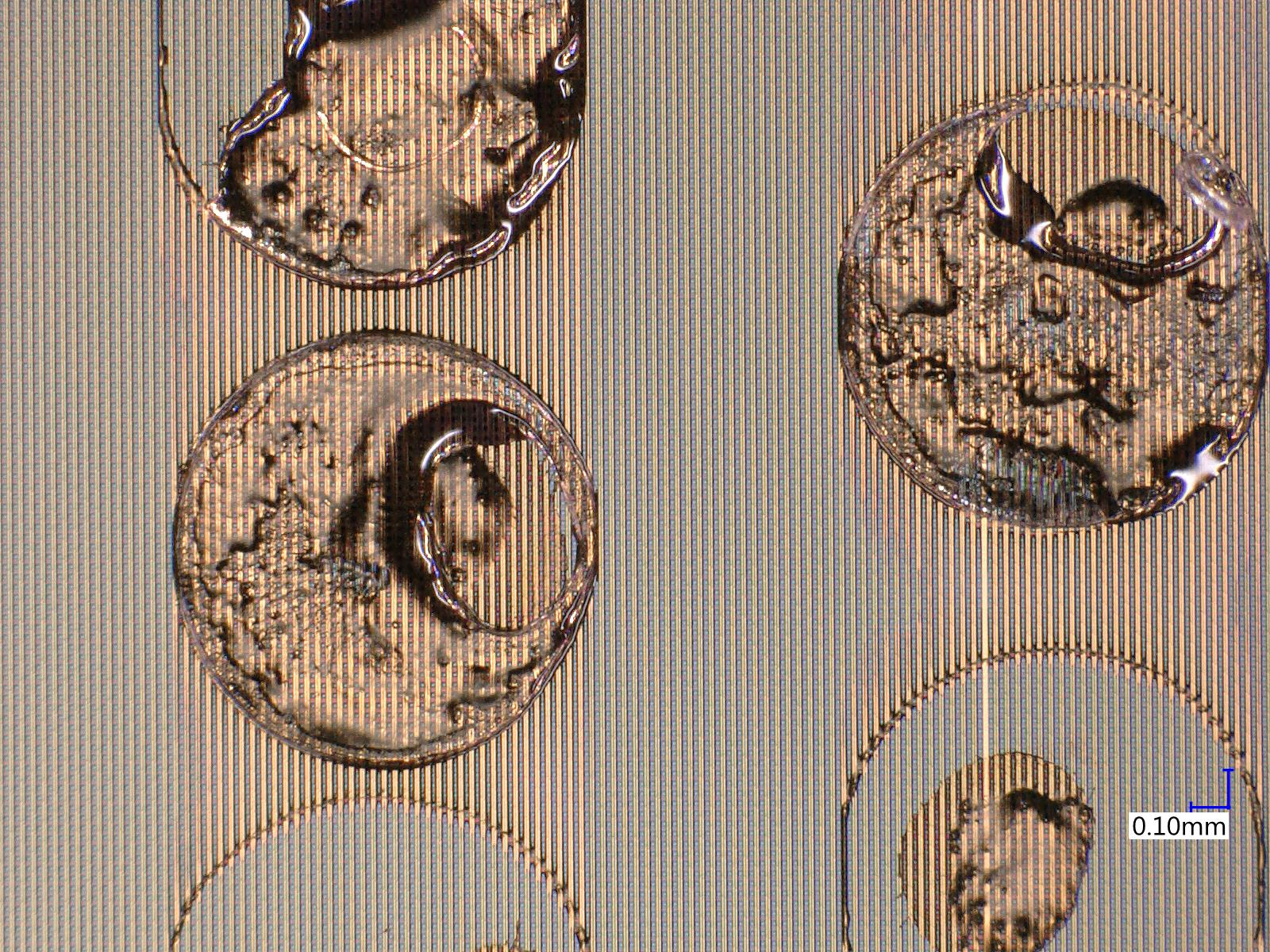
Peel test – most recent CCNU HICs
1027 (TC 22.10.2018)
819 (plenary 25.9.2018)
Filaments observed since summer when we started to take pictures during the peel process
Further details became visible with access to a high magnification microscope
1215 (video page 24)

Slide 14
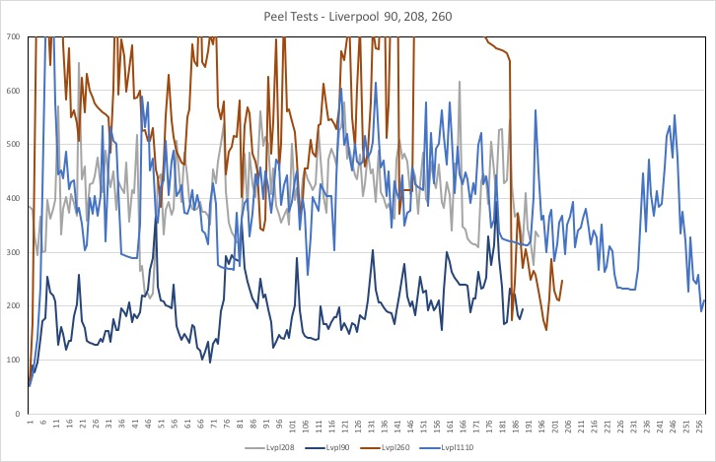
Peel tests – Liverpool HICs
HIC | center | Average [g] | Stdv [g] | Gluing/bonding
90 | Liverpool | 194.62 | 55.94 | Jan 11/15 2018
208 | Liverpool | 412.54 | 70.72 | Dec 11/15 2017
260 | Liverpool | 593.75 | 217.04 | Jan 16/24 2018
1110 | Liverpool | 394.91 | 117.21 | Jul 20/30 2018
2 HICs (398, 776) in cycling

Slide 15
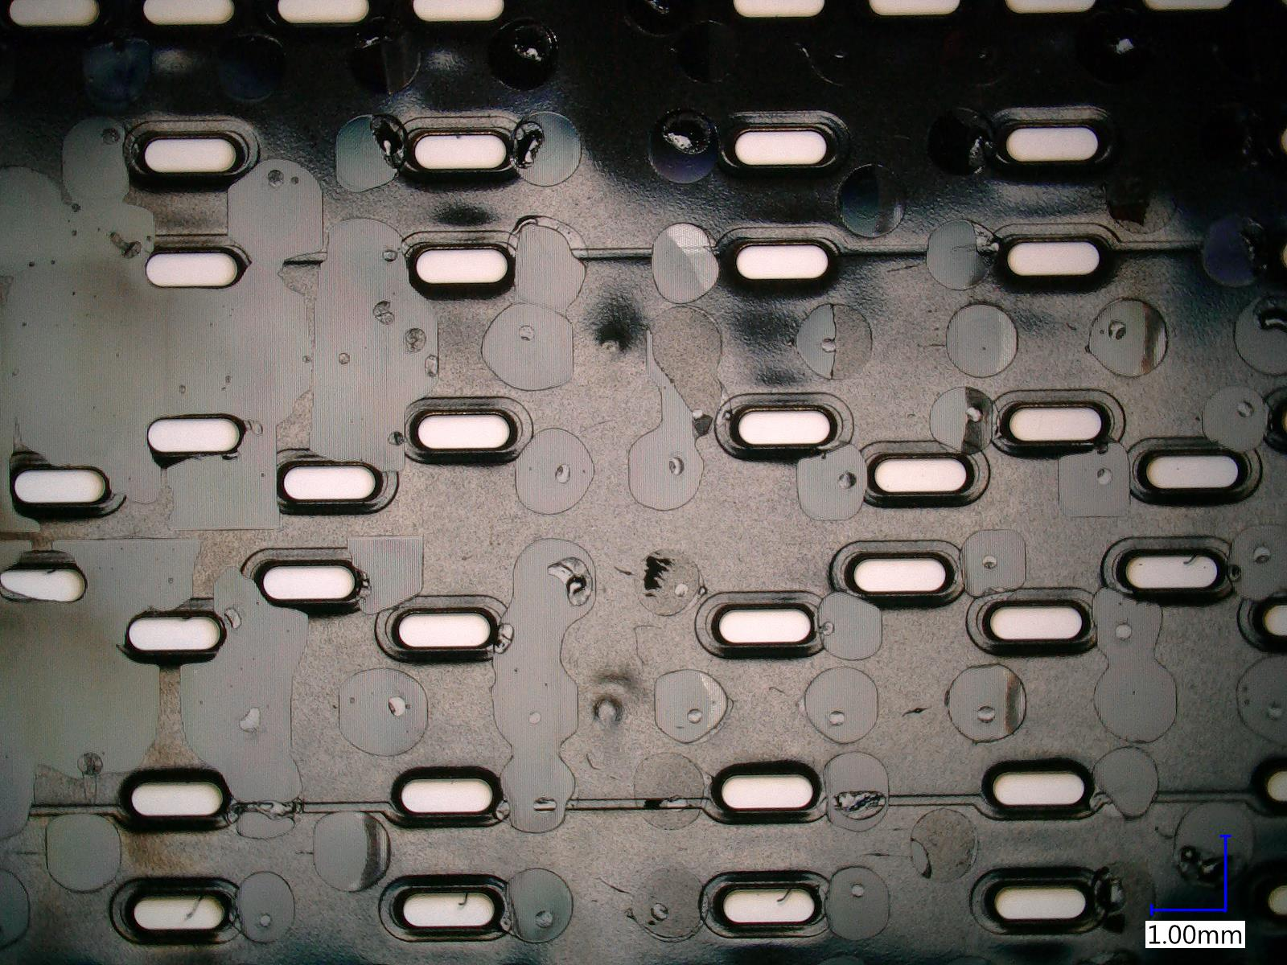
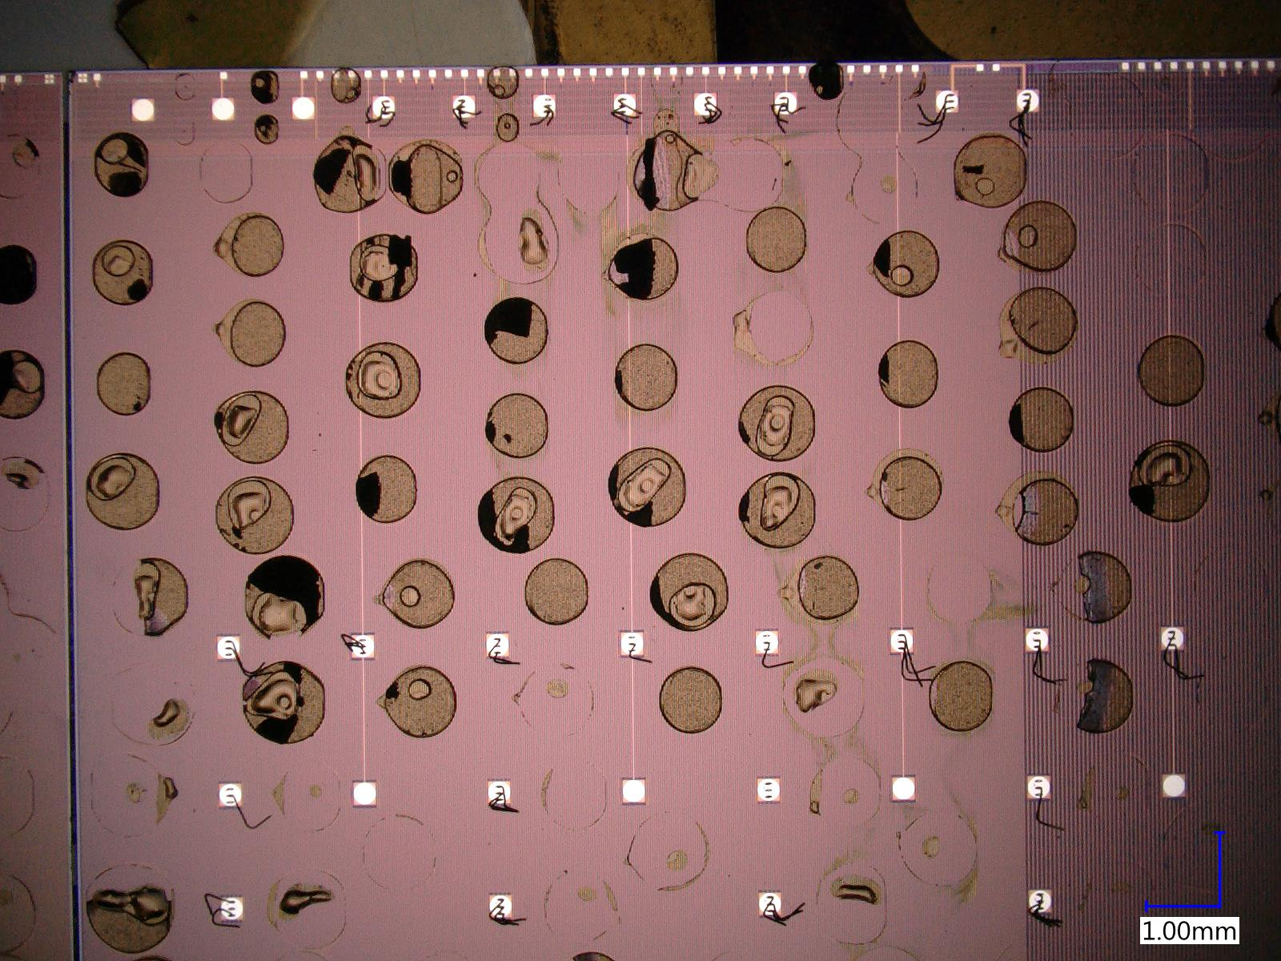
Liverpool 1110
Inspection after peel-test is important!

Slide 16
Thermal Cycling Tests – 1st test
3 HICs: CCNU167, CCNU 819, Bari 692 completed in July/August
Note: Bari 692 has already done 90 cycles before this test!
Pull test results at T0, T=30 and 68cycles; T=158 cycles (Bari692 only)
Mean | OB_HIC_167 | OB_HIC_819 | OB_HIC_692
T0 | 12.9g | 11.2g | No results
T1=30cycles | 12.7g | 11.4g | 11.5g
T2=68cycles | 12.5g | 10.9g | 11.3g
T2'=158 cycles |  |  | 11.5g
StDev | OB_HIC_167 | OB_HIC_819 | OB_HIC_692
T0 | 0.8g | 0.9g | No results
T1=30cycles | 0.9g | 0.9g | 1g
T2=68cycles | 0.9g | 0.9g | 1g
T2'=158 cycles |  |  | 1.1g
Failure Mode | OB_HIC_167 | OB_HIC_819 | OB_HIC_692
T0 | no FPC lifts | no FPC lifts | No results
T1=30cycles | no FPC lifts | no FPC lifts | no FPC lifts
T2=68cycles | no FPC lifts | no FPC lifts | no FPC lifts
T2'=158 cycles |  |  | no FPC lifts
68 cycles completed so far
Conditions : tmin chamber : 10C, tmax chamber : 50C, ramp rate : 5C/mn, dwell time : 10mn
→ Pull test results before, during and after cycling are comparable

Slide 17
Thermal Cycling Tests – 2nd test
3 HICs: Liverpool 398, Liverpool 776, CCNU 932, completed Friday 16/11/18
Pull test results at T0, T=30 cycles and T=68 cycles
Mean | OB_HIC_398 | OB_HIC_776 | OB_HIC_932
T0 | 10g | 9.6g | 7g
T1=15cycles | 10.3g | 9.1g | 6.9g
T2=30cycles | 10.1g | 10g | 7g
T3=68cycles | 10.2 | 9g | 7.3g
StDev | OB_HIC_398 | OB_HIC_776 | OB_HIC_932
T0 | 0.7g | 1.3g | 1.1g
T1=15cycles | 0.7g | 0.6 | 0.6g
T2=30cycles | 0.9g | 0.7g | 0.6g
T3=68cycles | 0.8g | 0.6g | 0.8g
Failure Mode | OB_HIC_398 | OB_HIC_776 | OB_HIC_932
T0 | no FPC lifts | no FPC lifts | no FPC lifts
T1=15cycles | no FPC lifts | no FPC lifts | no FPC lifts
T2=30cycles | no FPC lifts | no FPC lifts | no FPC lifts
T3=68cycles | no FPC lifts | no FPC lifts | no FPC lifts
68 cycles completed so far
Conditions : tmin chamber : 10C, tmax chamber : 50C, ramp rate : 5C/mn, dwell time : 10mn
→ Pull test results before, during and after cycling are comparable
Next: HICs are now being prepared for peel test

Slide 18
Summary
OB HIC QA at CERN as complementary information for QA done in the centers.
HICs from all assembly centers received and inspected, focus on HICs produced with final procedure.
Procedure more refined now, adding further information and using new equipment for inspection.

