Slide 1


Status of MFT Disks
Ni Fang, Dong Wang, Jun Liu – CCNU
12th ALICE ITS Upgrade, MFT, and O2 Asian Workshop – 2018, November 20th
Notes:
We would appreciate feed-back from our referees

Slide 2
Outline
Status of electronics in the cone area of MFT
  disk0~disk4
Disk Power dropout testing
Plan

Slide 3
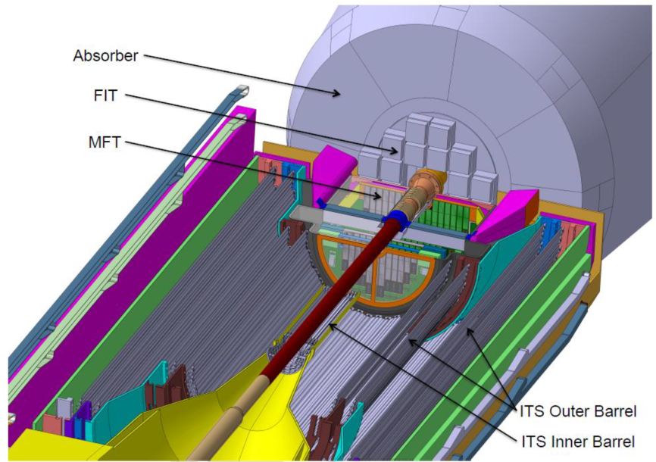
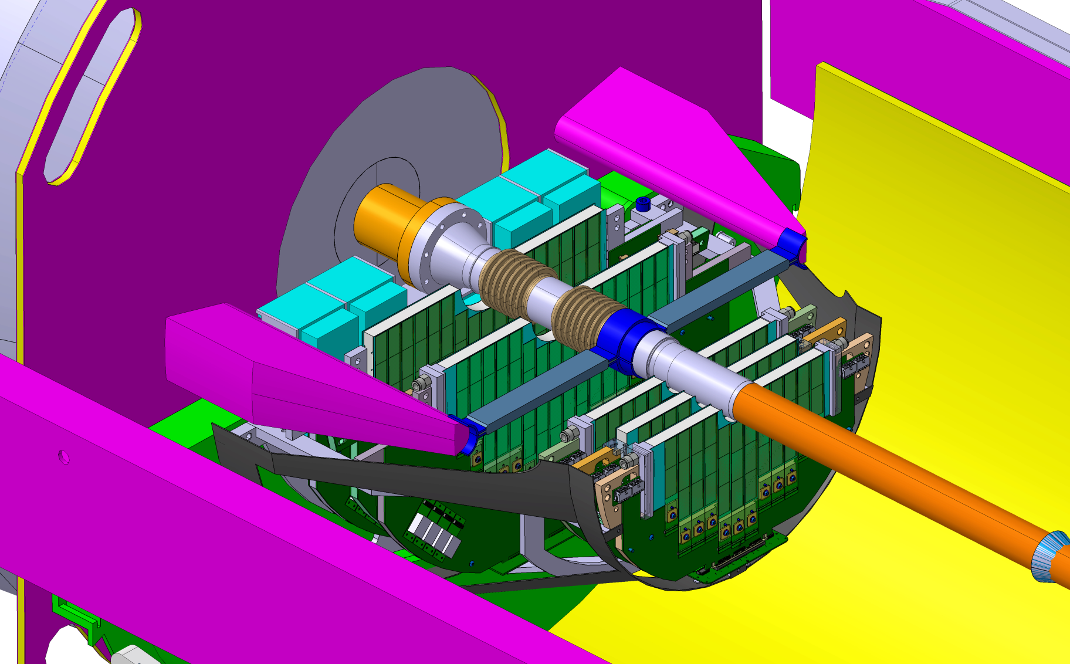
The MFT Detector
Zoom out
General layout of the MFT half-barrel and its environment
Zoom out of the MFT half-barrel
MFT is a sub detector of ALICE in front of the FIT and absorber
MFT is composed by 5 disks
Each disk is a couple of front and back PCB space fixed on a mechanical support
Several FPC with detection sensors are connected on each PCB(front & back)

Slide 4
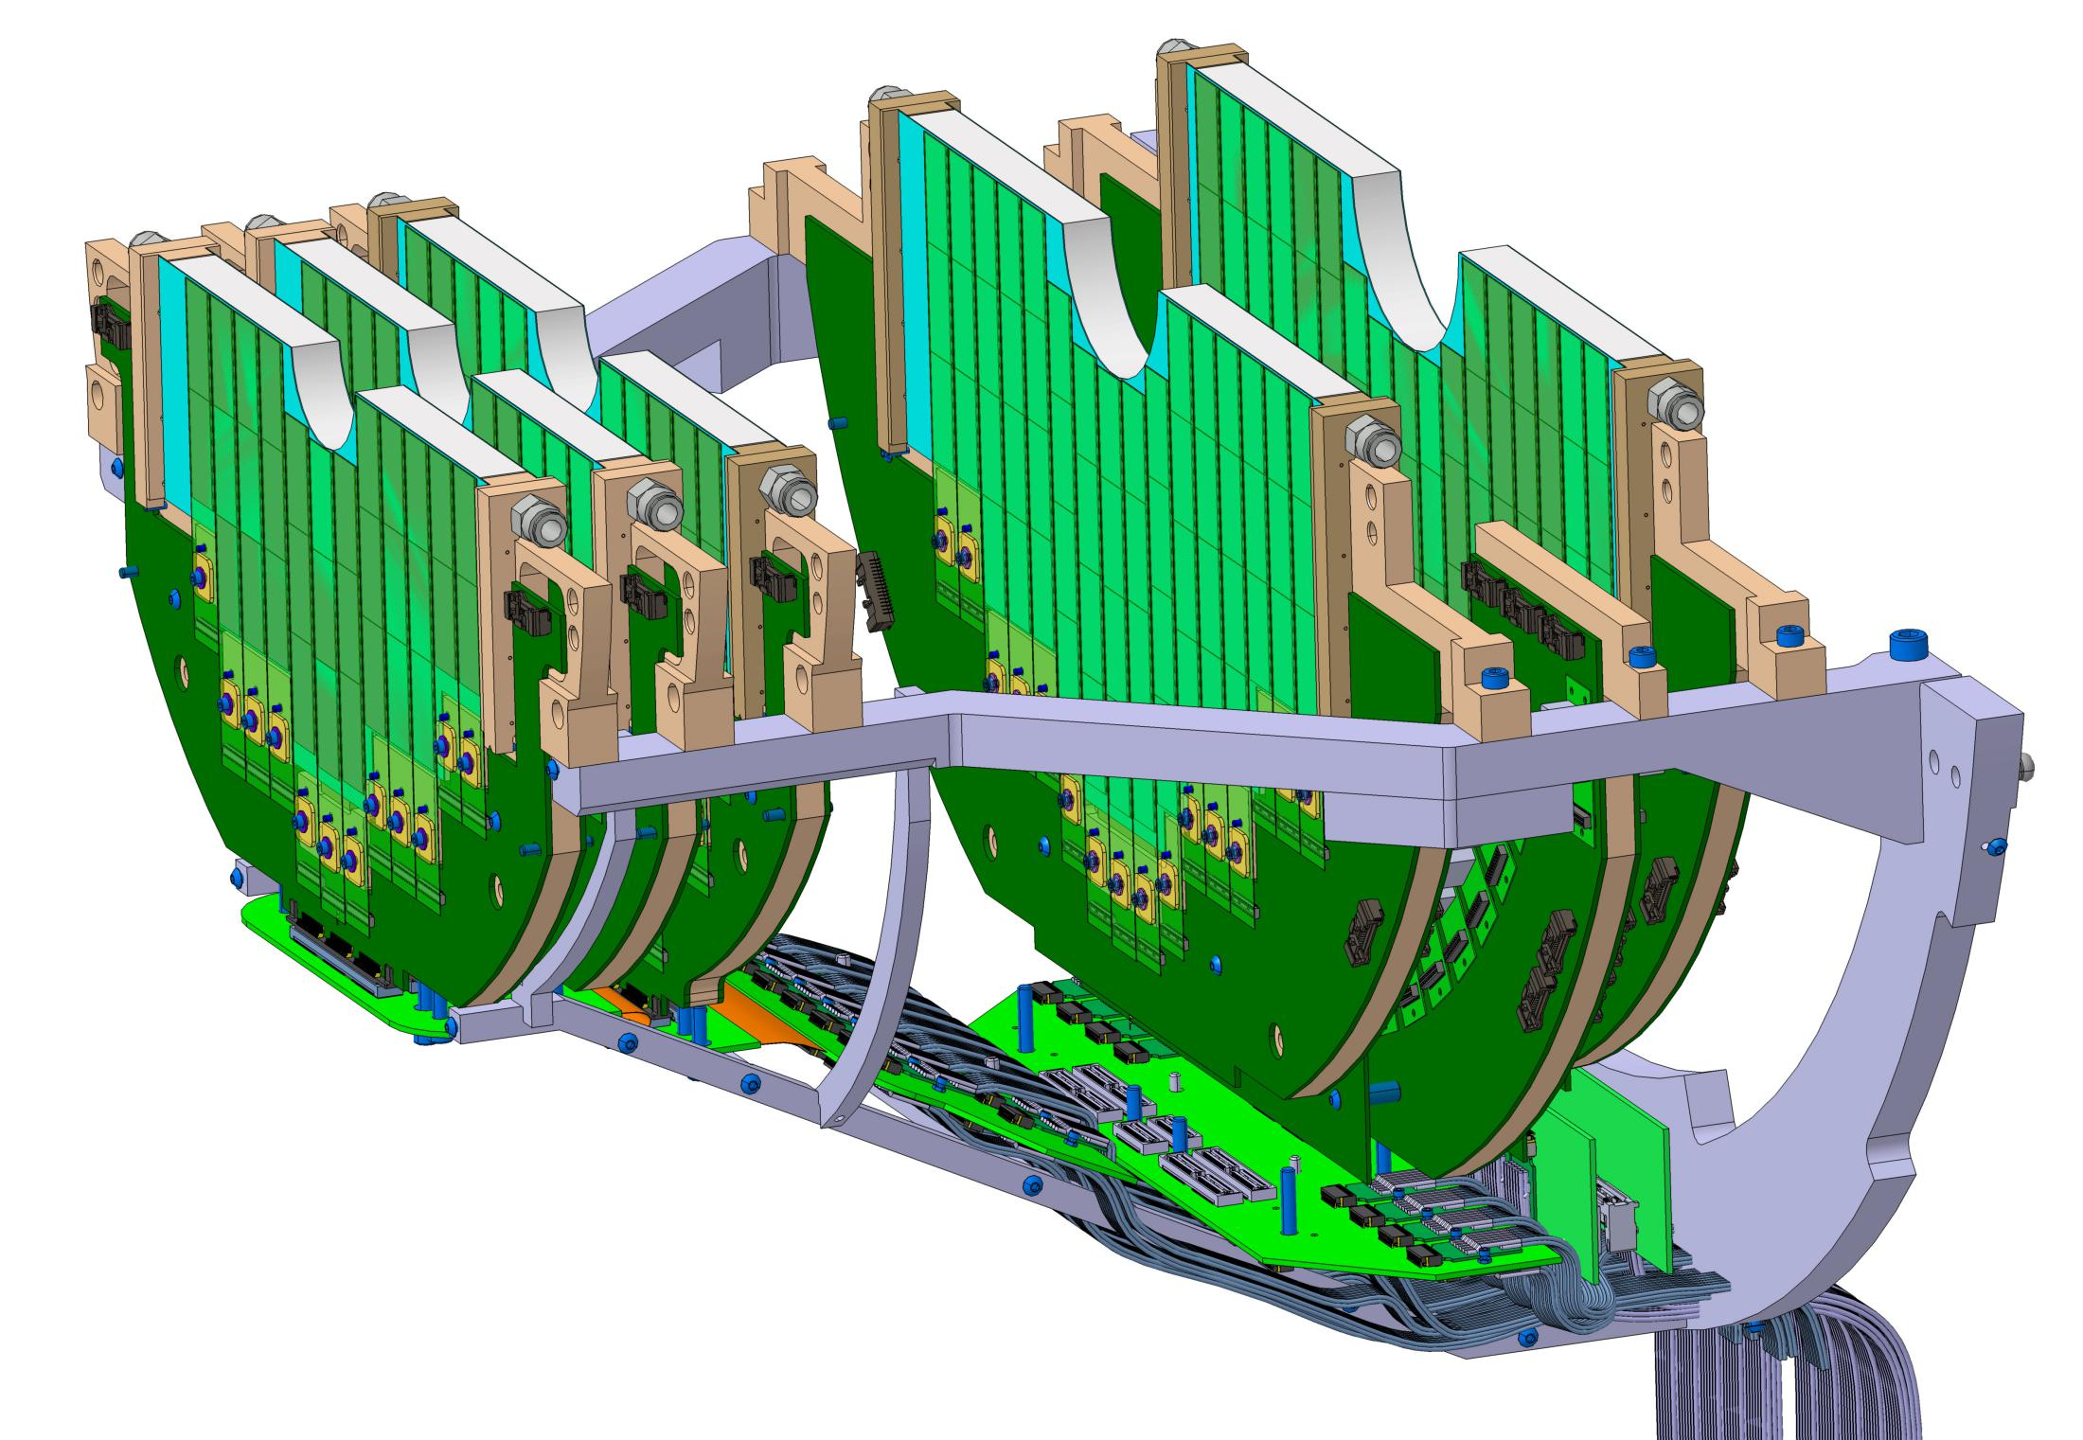
Structure of MFT
disk3
disk4
disk0
disk1
disk2
Each disk has different size to have different number of ladders connect with FPCs
The bottom picture shows mother boards for those five disks
The connect disks and readout units

Slide 5
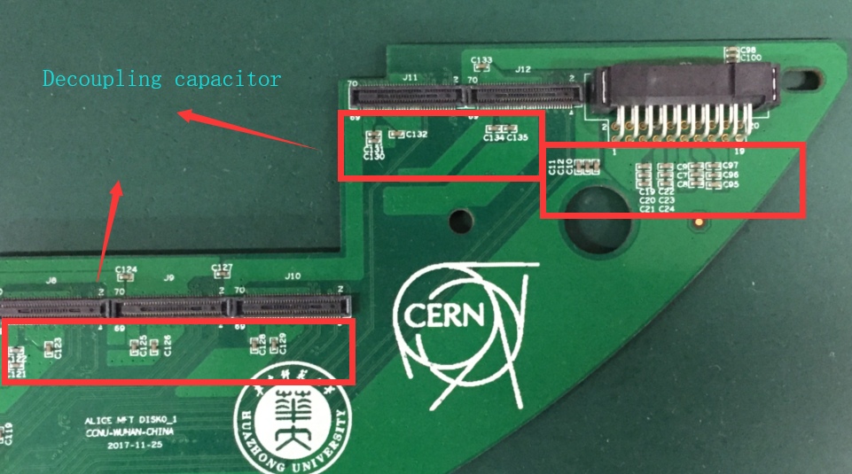
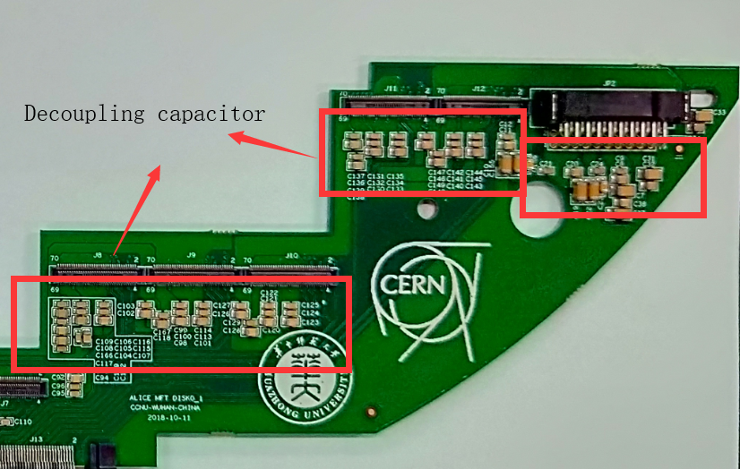
Layout update information
We revised the specifications of the decoupling capacitor according to the French colleague's proposal.
The specific modifications are as follows：
the Original version of disk0/1
the Current version of disk0/1
Use different packaging specifications
This is mainly for the modification of the decoupling capacitor around the power supply

Slide 6
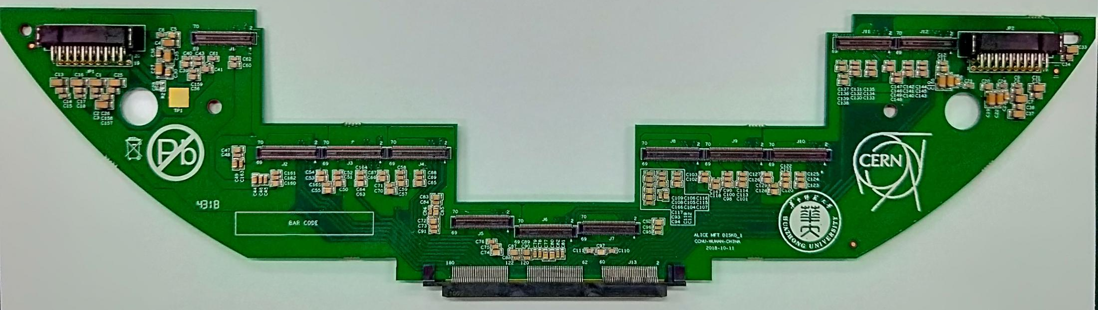
Disk0/1
status:
This is the fourth version of disk0/1
This prototype has been produced in November, 2018.
We have sent three pieces to France for test.

Slide 7
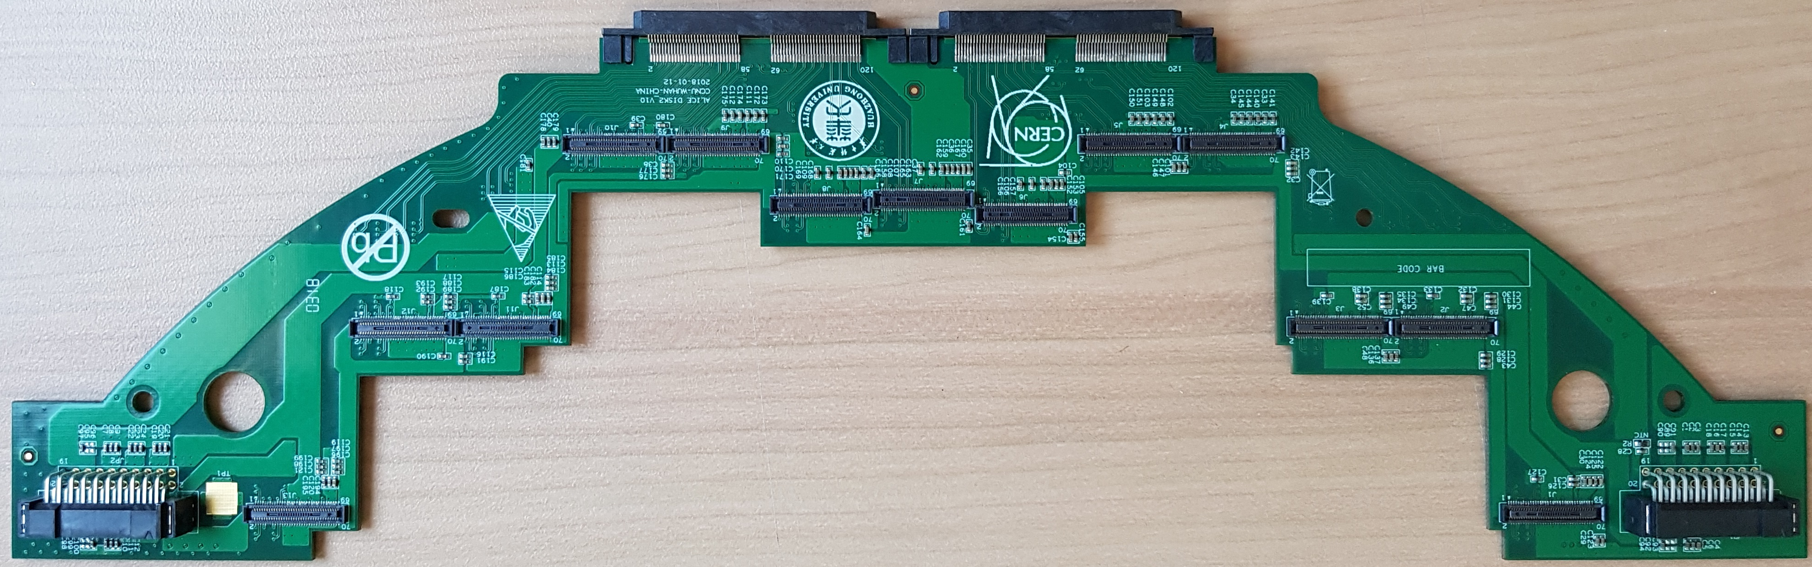
Disk2
status:
This is disk2
The prototype has been produced in January, 2018
We have sent 8 pieces of PCB to France
Now version of the schematic has been modified and ready for layout

Slide 8
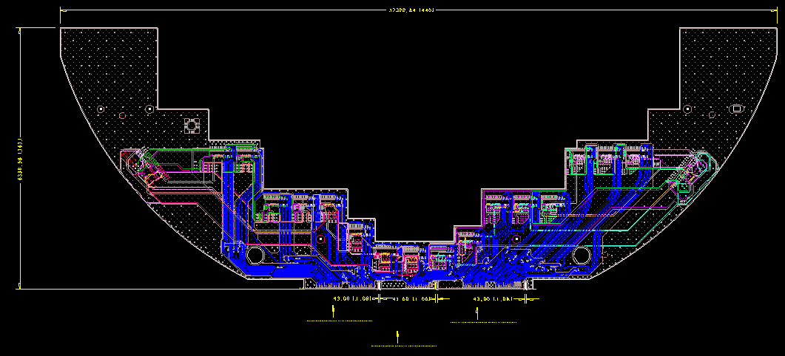
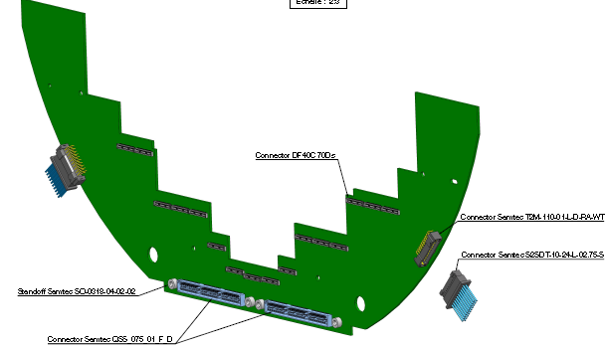
Disk3
First vision
Second vision
Status:
This is disk3
The layout of first vision is finished.
Because the space between disk3 and disk4 is too limited to integrate all the cables, we modify disk3 and disk4
We have finished the schematic for new version.

Slide 9
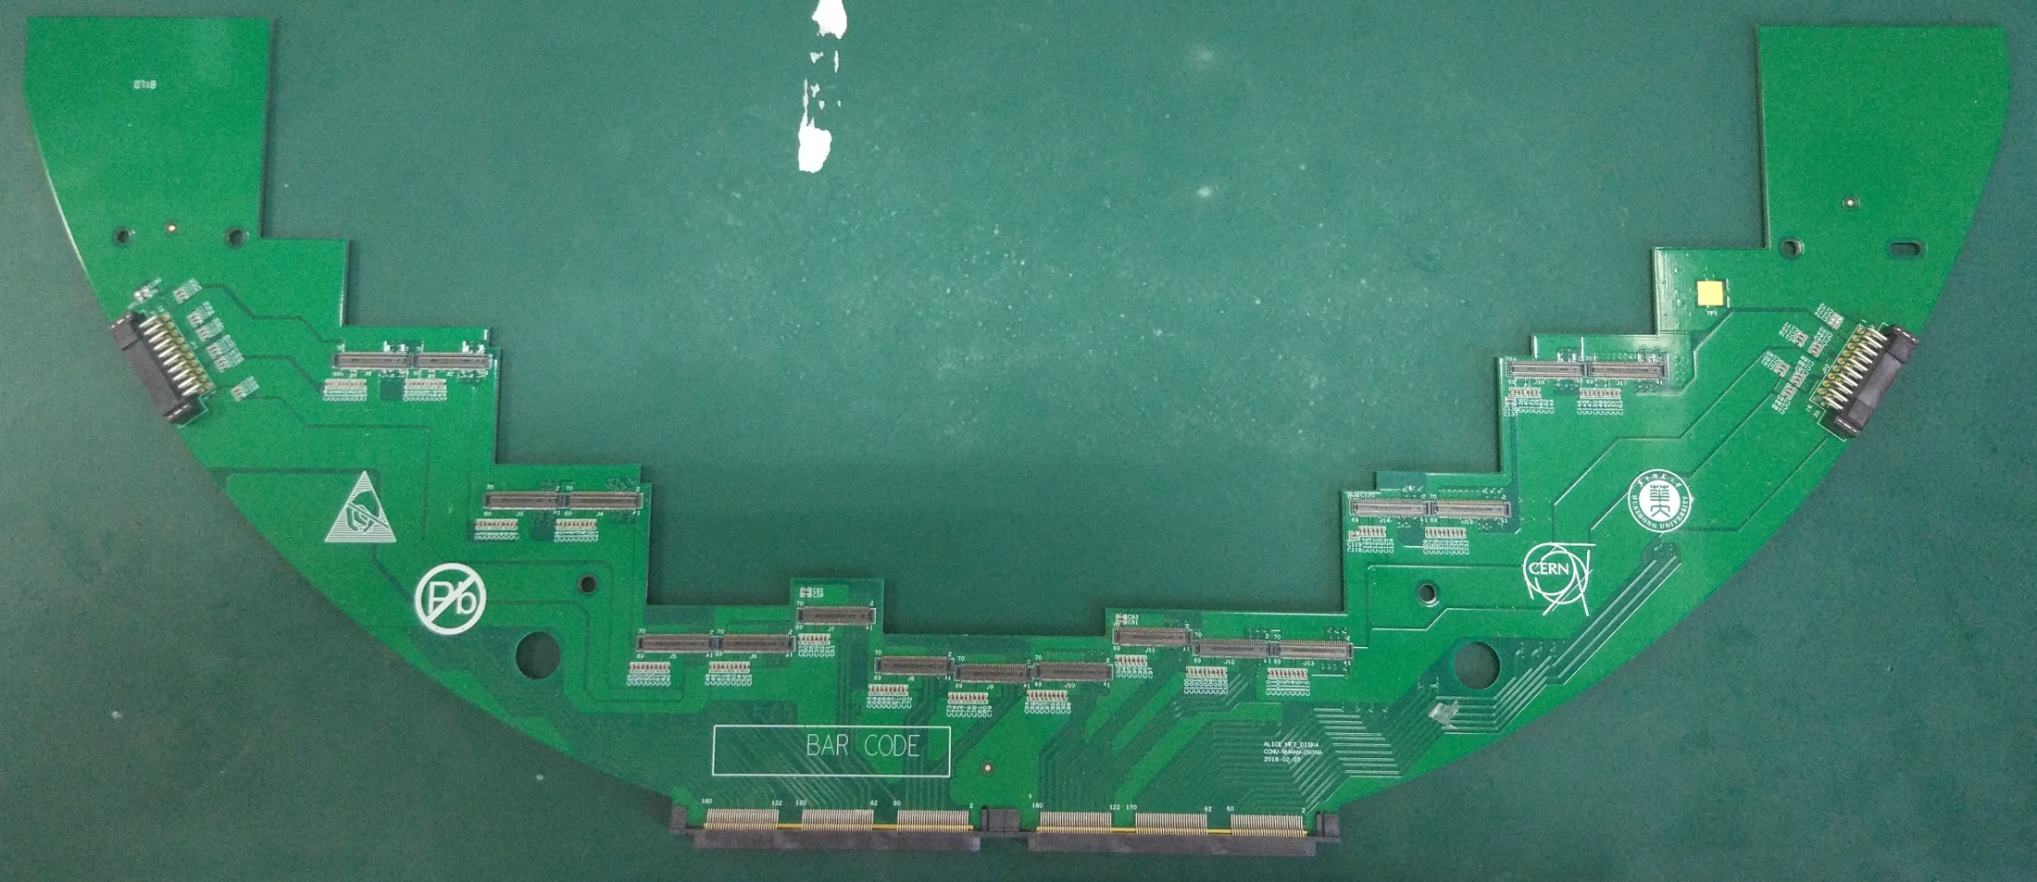
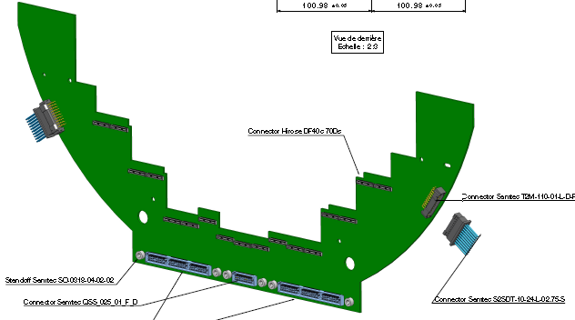
Disk4
Status:
We have produced the prototype of disk4 and sent 8 pieces to France
For same reason with disk3, we modify disk4
We have finished the schematic for the new version.
Comparing to the first one, the second version uses different contactors and has different structure
First vision
Second vision

Slide 10
Status
Electronic Boards | Waiting | Schematic Under design | PCB layout Under design | Prototype Produced
disk0/1 PCB--version 1
disk0/1 PCB--version 2
disk0/1 PCB--version 3
disk0/1 PCB--version 4
disk2 PCB--version 1
disk2 PCB--version 2
disk2 PCB--version 3
disk2 PCB--version 4
disk3 PCB--version 1
disk3 PCB--version 2
disk3 PCB--version 3
disk4 PCB--version 1
disk4 PCB--version 2
disk4 PCB--version 3

Slide 11
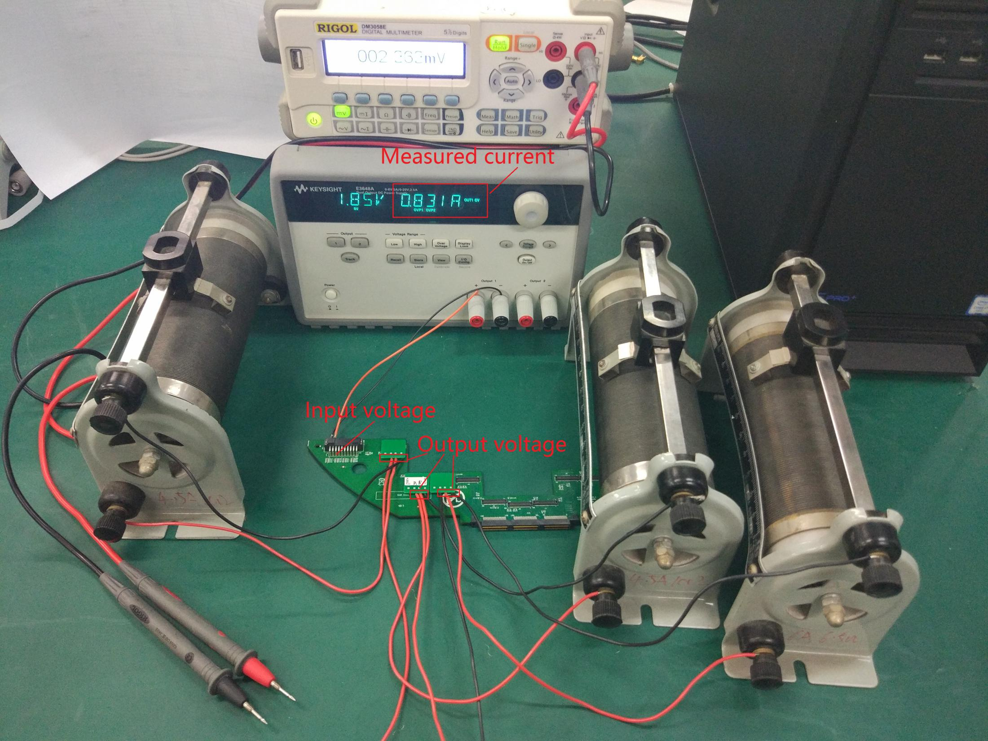
Disk Power dropout testing
the boards power dropout should be controled in 5%
This shows a test for the second version of disk0/1.
We use this power to provide power, and a Sliding resistance as load.
The difference between Actual input and Actual output should be smaller than 5 percent of Actual input.
The system is in a stable state
We made a small board to help test power dropout

Slide 12
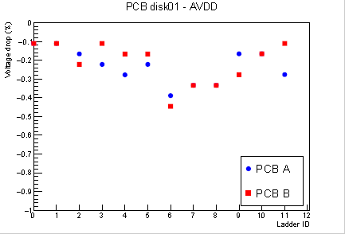
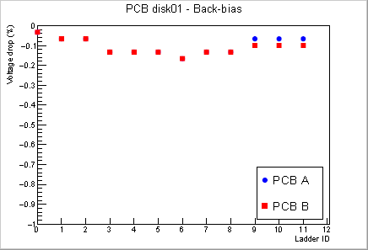
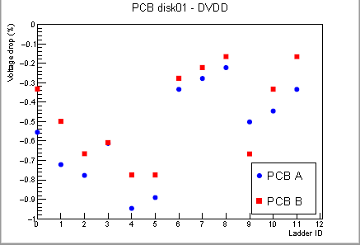
Disk Power dropout testing
This is the Power dropout reasult for disk01.
The power for every zone is different and they have different shape copper on the layers, which reasults the Irregularity between zones.
For every zone, the voltage drop is Declines

Slide 13
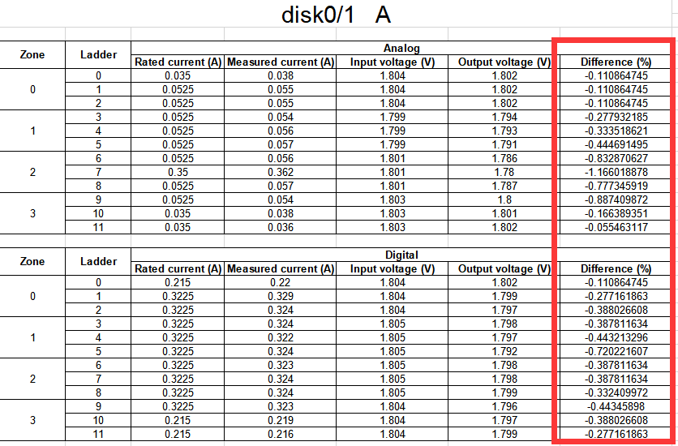
Disk Power dropout testing
It is obvious from the board’s voltage drop is designed to meet the design requirements.

Slide 14
Plan in the near future
Produce all the PCB of Disk2,3,4 in parallel after the testing of Disk0.
Verify the power voltage drop out on all Disks.
Thanks for your attention

