Slide 1
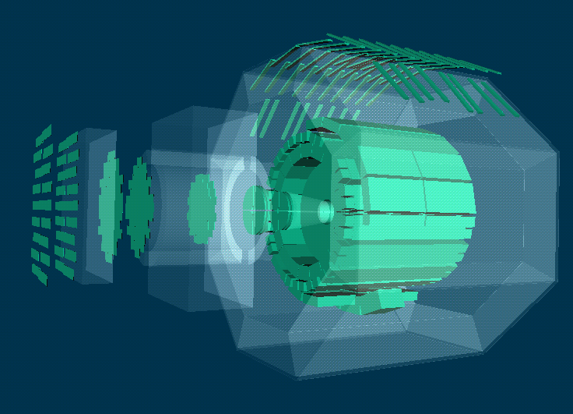
DCS Status and Plans
The 12th ALICE ITS Upgrade and MFT, O2 Asian Workshop ,
November 2018, Incheon Korea
Peter Chochula , CERN

Slide 2
Few keywords to start with

Slide 3
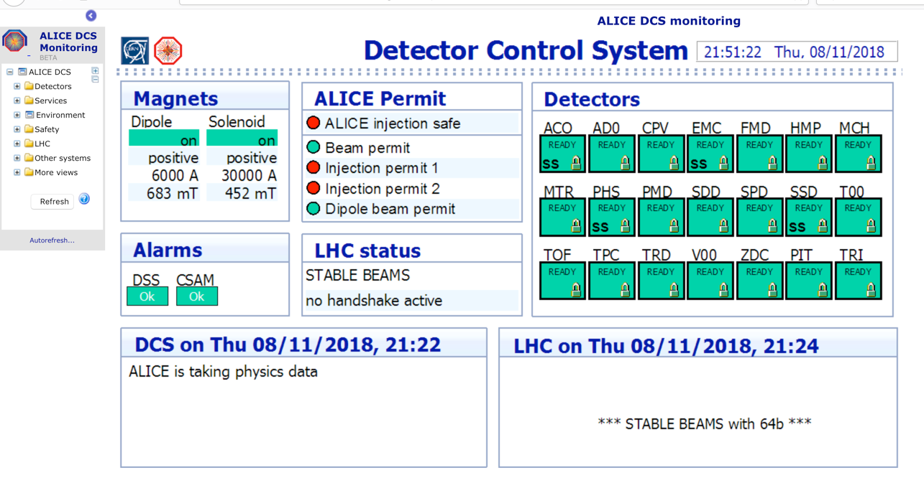
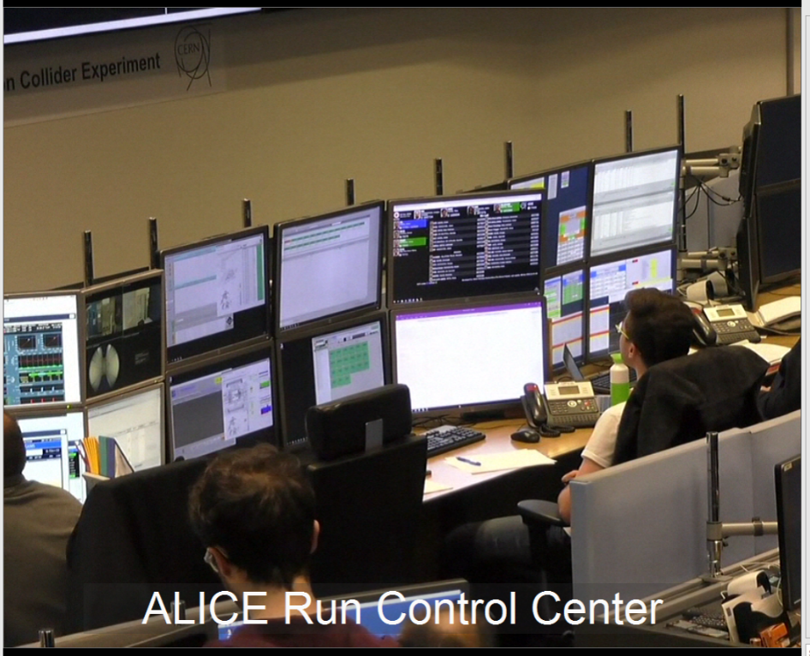
DCS is reliable
2018 first ion beams

Slide 4
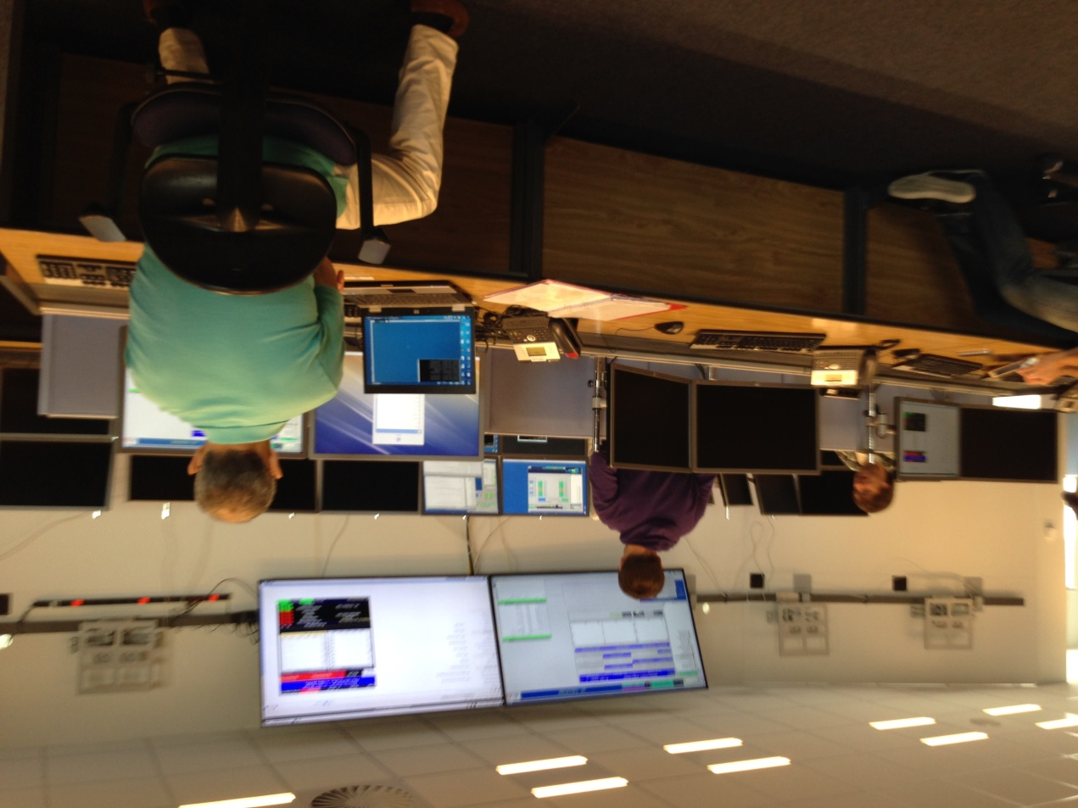
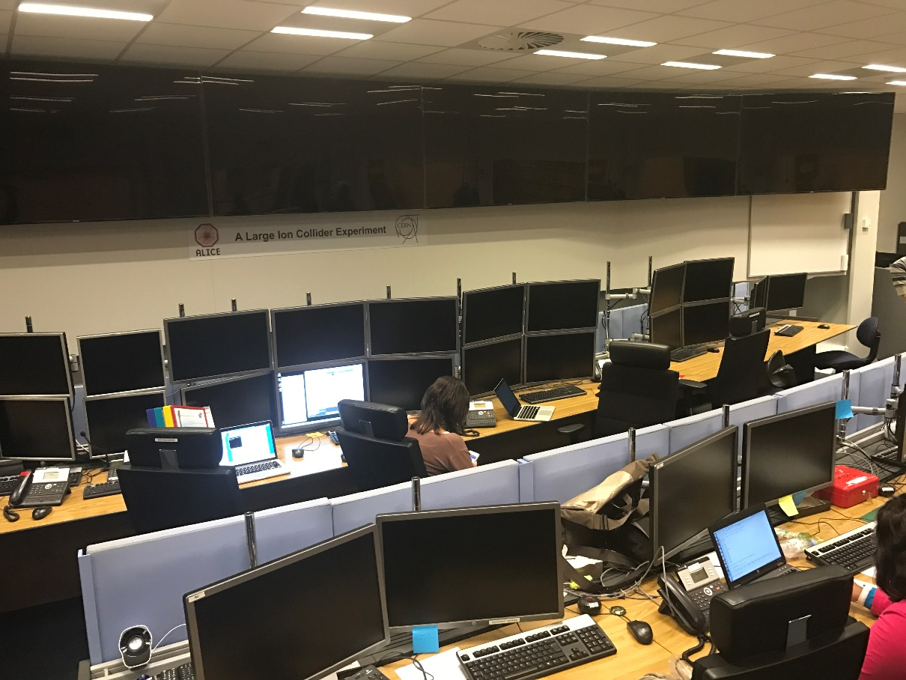
DCS is always with you
From the beginning…
… till the end
First service installed in the ARC
Only DCS survived the massive power cut in ALICE in 2016

Slide 5
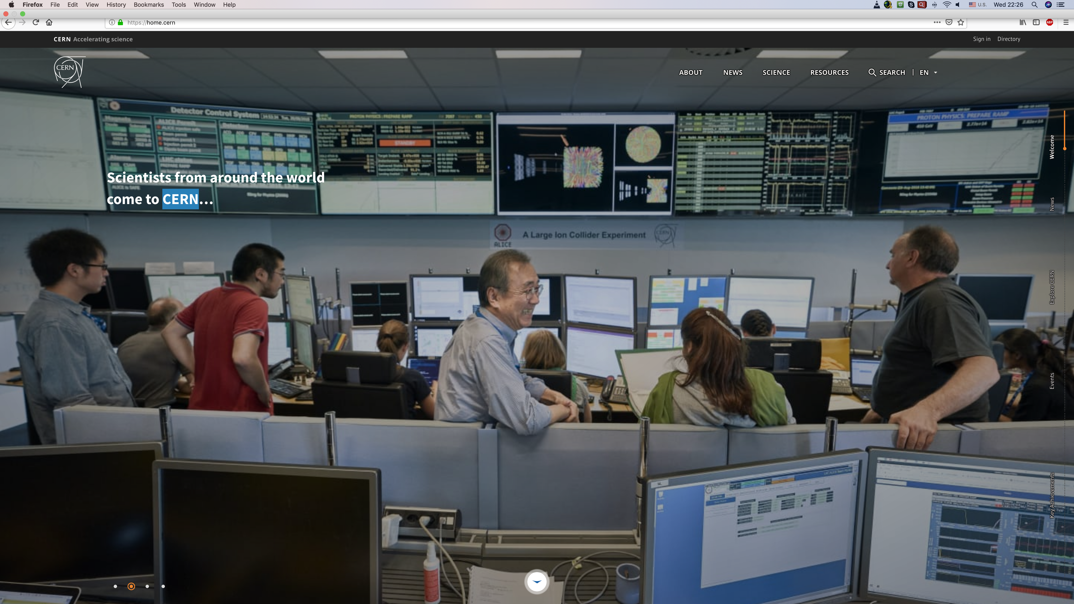
DCS is visible
New official CERN home page with NOT ONLY the DCS in main screen the center

Slide 6
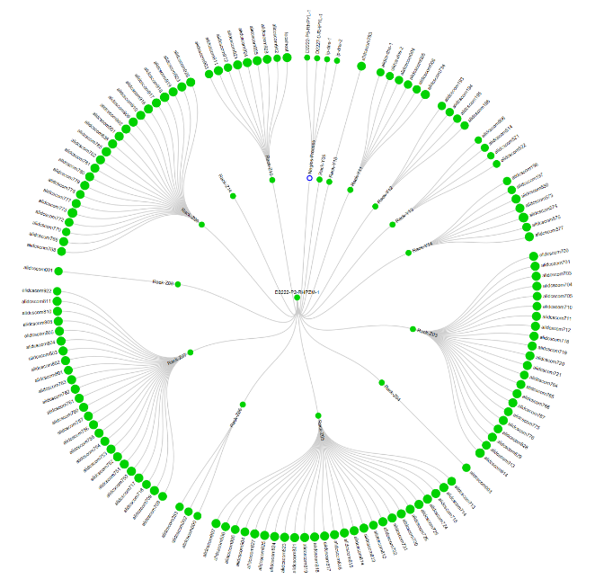
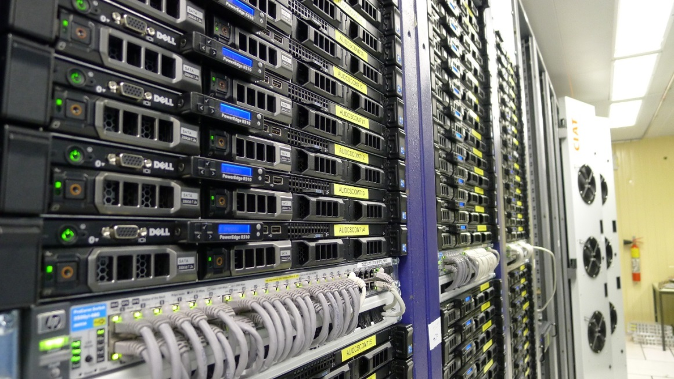
DCS RUN2 performance
DCS scale:
  200 servers
  1200 network attached devices
Excellent stability
  No Data loss due to DCS
In 2018, the DCS uptime is so far 99.95%
  Downtime caused by maintenance and safety tests
Operational incidents in 2018
  Replacement of 2 disks in the shadow of other activities – no data loss
  Replacement of TOF operator node mainboard, not affecting ongoing datataking
  Replacement of 2+1 storage disks – transparent
NAGIOS monitoring of DCS cluster

Slide 7
Why shall we then touch such a stable system?
DCS architecture defined more than 10 years ago (first proposal in 2002)
  Infrastructure in place since 2007!
  The RUN1 and RUN2 operation proved, that the technology choice and system design was:
    correct
    based on solid components and tools
    scales very well
RUN3 does not require major changes in the conservative system architecture, evolution would be sufficient
  Device control strategy remains the same
  Controls logic and implementation (FSM based on SMI++) will not change
BUT…. there are 2 exceptions triggering a major upgrade:
  Need for data streaming to O2
  Need for new front-end access mechanism for GBT based detectors

Slide 8
ALICE DCS architecture: RUN 2
Detector
Cooling
HV / LV
Front-End electronics
Gas
Auxiliary systems

Slide 9
ALICE DCS architecture: RUN 2
OFFLINE
AMANDA
ORACLE DATABASE
RDB MANAGER
DARMA
WINCC OA
Custom code
DRIVERS
OPC / Proprietary
Detector
OPC
FED
Cooling
HV / LV
Front-End electronics
Gas
Auxiliary systems

Slide 10
ALICE DCS architecture: RUN 2
OFFLINE
AMANDA
ORACLE DATABASE
RDB MANAGER
DARMA
WINCC OA
Custom code
DRIVERS
OPC / Proprietary
SAFETY SYSTEM
Detector
OPC
FED
Cooling
HV / LV
Front-End electronics
Gas
Auxiliary systems

Slide 11
What will change?

Slide 12
ALICE DCS architecture: RUN 2
OFFLINE
AMANDA
ORACLE DATABASE
RDB MANAGER
DARMA
WINCC OA
Custom code
DRIVERS
OPC / Proprietary
Detector
OPC
FED
Cooling
HV / LV
Front-End electronics
Gas
Auxiliary systems

Slide 13
ALICE DCS architecture: RUN 3
Completely redesigned data flow
New generation of WINCC OA
OFFLINE
AMANDA
ORACLE DATABASE
RDB MANAGER
DARMA
New computing hardware and management
WINCC OA
Custom code
DRIVERS
OPC DA replaced with OPC OA
Completely redesigned front-end access
OPC / Proprietary
Integration of new services for new detectors
Detector
New detectors
OPC
FED
Cooling
New hardware
HV / LV
Front-End electronics
Gas
Auxiliary systems

Slide 14
Some upgrade highlights

Slide 15
Redesigned Frontend Access for RUN3
OFFLINE
AMANDA
ORACLE DATABASE
RDB MANAGER
DARMA
WINCC OA
Custom code
DRIVERS
OPC / Proprietary
Detector
OPC
FED
Cooling
HV / LV
Front-End electronics
Gas
Auxiliary systems

Slide 16
Redesigned Frontend Access for RUN3
New GBT-based detectors will be accessed using the ALF-FRED
  Unified low-level access (ALF)
  Framework for development of custom code (FRED)
AMANDA
ORACLE DATABASE
RDB MANAGER
DARMA
WINCC OA
Custom code
DRIVERS
FRED Server
FRED
OPC / Proprietary
FLP
Detector
ALF
OPC
FED
Cooling
HV / LV
Front-End electronics
Gas
Auxiliary systems

Slide 17
Redesigned frontend access (ALF-FRED)
ALF-FRED in ITS
WINCC OA
FRED
ALF
  Low level detector-independent device access
  runs on FLP
  Capable of scanning SCA/SWT sequences
  Can create services with periodic execution
FRED
  Flexible framework customizable by detectors
  Runs on dedicated DCS server
  Translates low level sequences to WINCC compatible format (services)
  Can perform specialized tasks (like monitoring) and take fast action
ALF
CRU driver
CRU
RU
PB ….

Slide 18
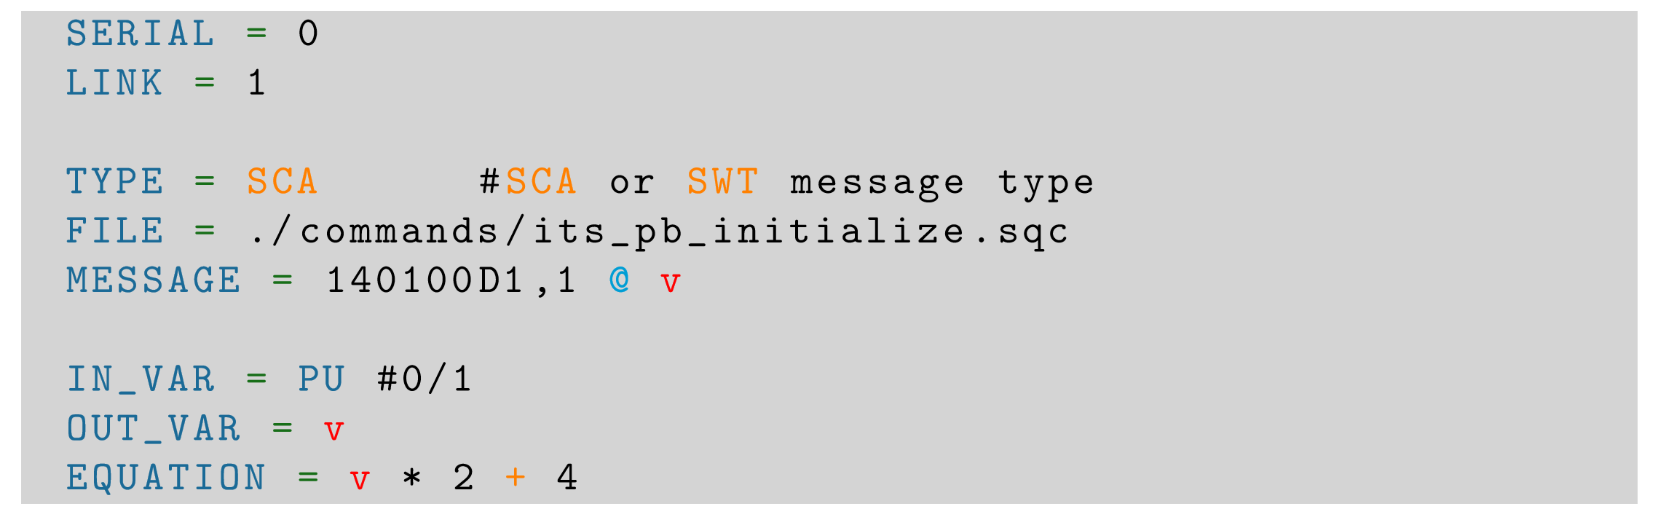
ALF status
Sequence can be specified in service config or taken from a file/database
Repetitive sequences can be generated ‘on fly’ following a recipe
Taken over by Kosice team in summer 2018
SWT support added
Release (code+documentation) available on GIT
Easy installation (already tested by independent users)
TODO
  Depending on HW availability
    Implement CRU addressing (use ID instead of PCI address)
    Test with multiple CRUs in a single FLP
    ADD CAN interface for ITS ALF
Raw messages can be manipulated by the service by applying an equation (like calibration constant)

Slide 19
Redesigned frontend access (ALF-FRED)
Massive modification in summer 2018
  Support for SWT
  Configuration moved to external files
  Multiple ALF supported by 1 FRED
  WINCC OA interface completed
  Release on GIT including documentation and examples
  Example WINCC project available
ALF-FRED kit installed in:
  DCS lab – reference and development system
  ITS lab in bldg. 167 – installed remotely by Kosice, ITS and DCS teams
  MID setup, MFT setup – unbiased testers (Roni and Kosei, help of Ombretta)

Slide 20
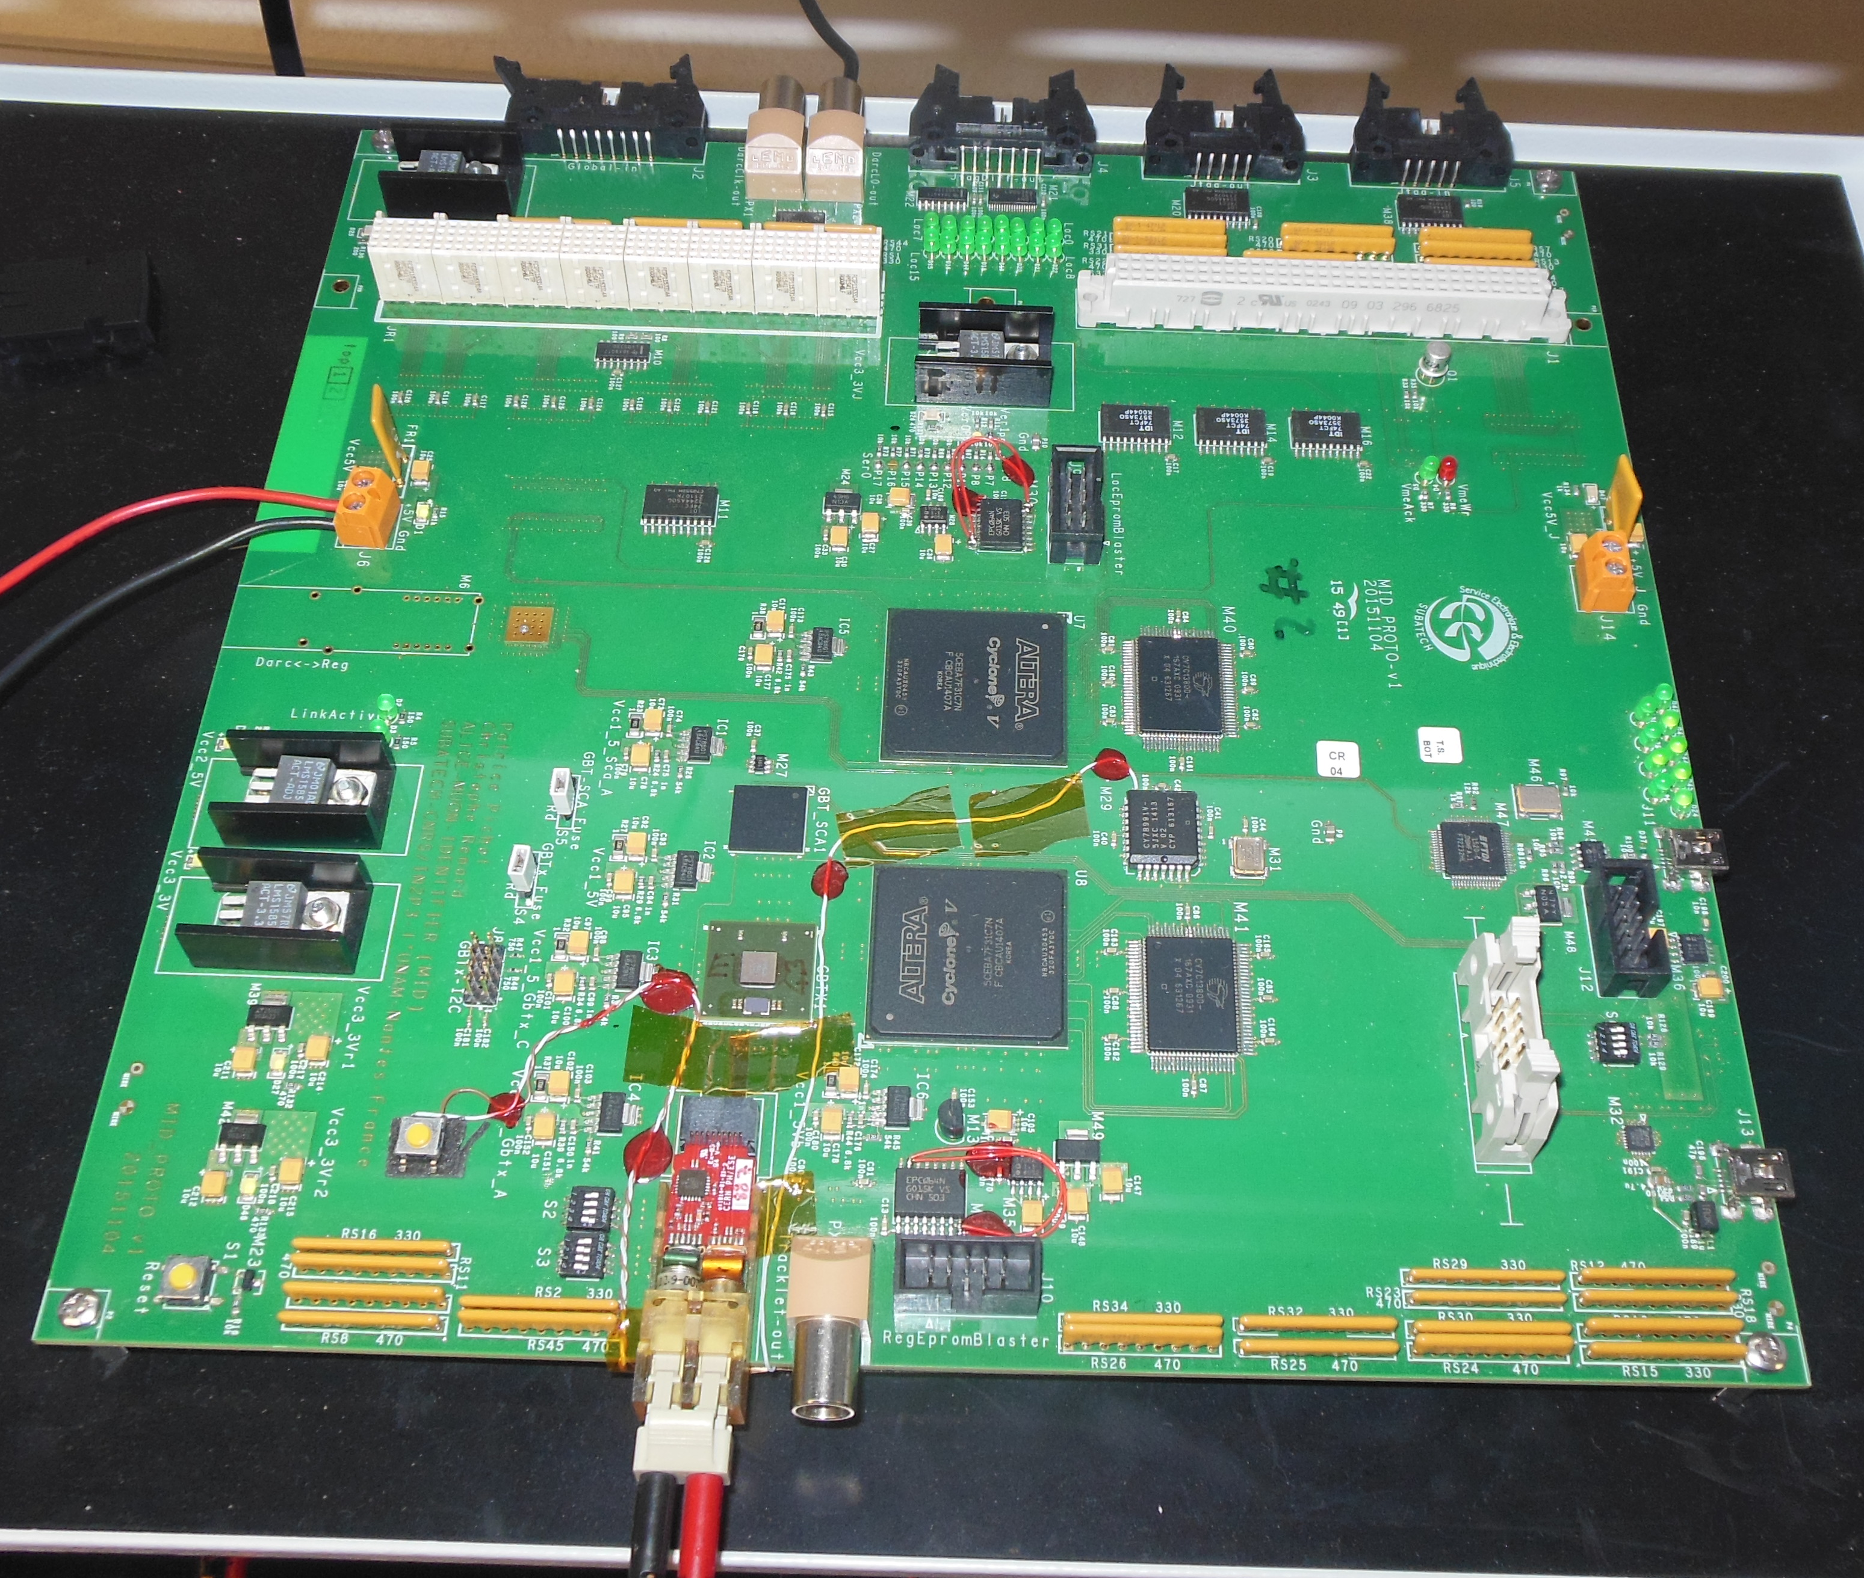
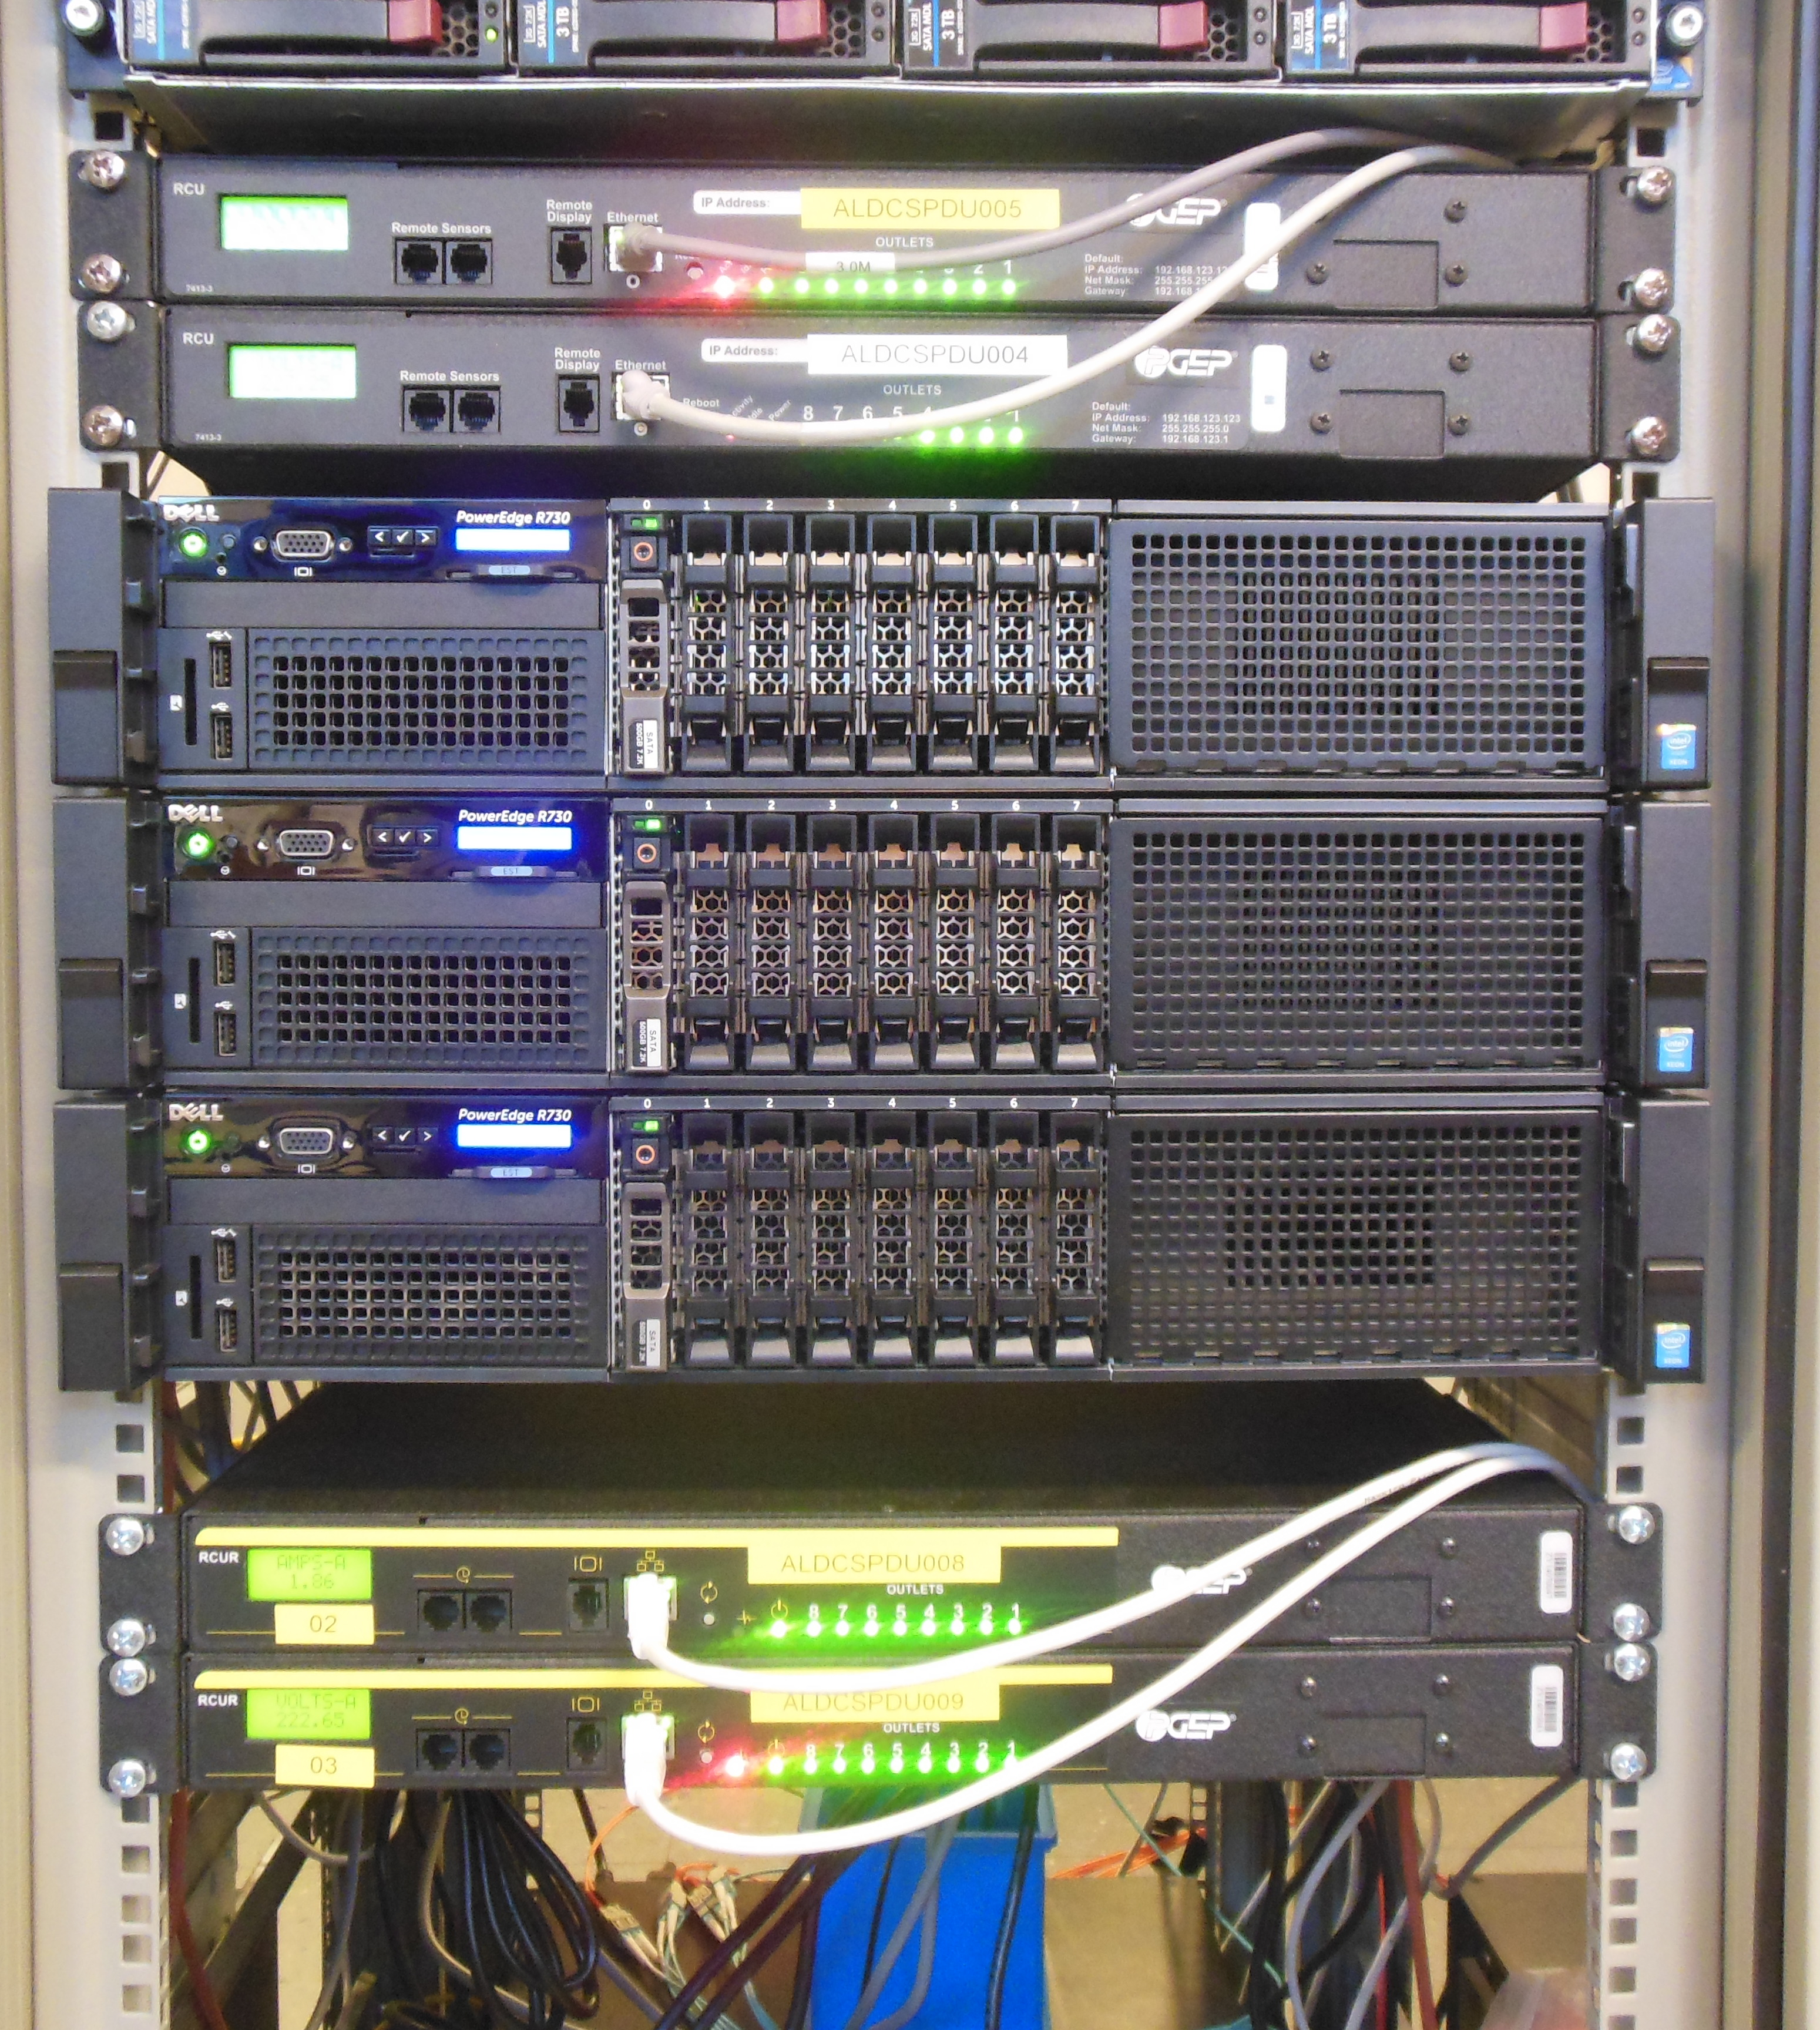
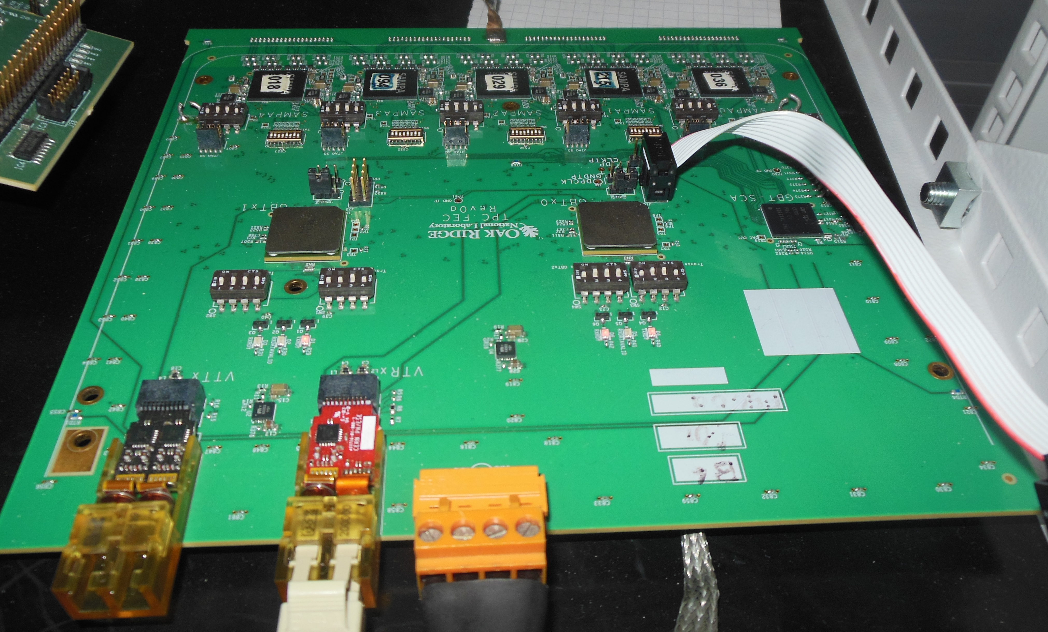
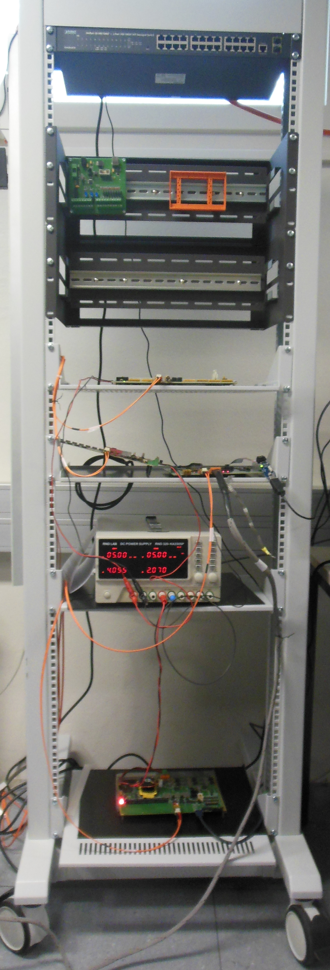
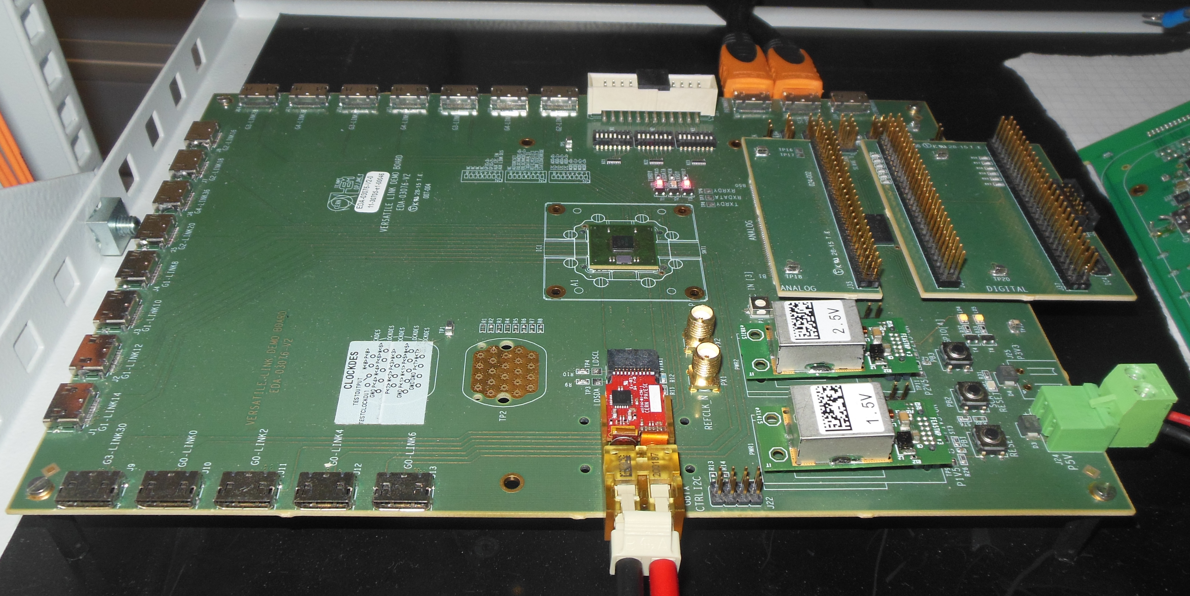
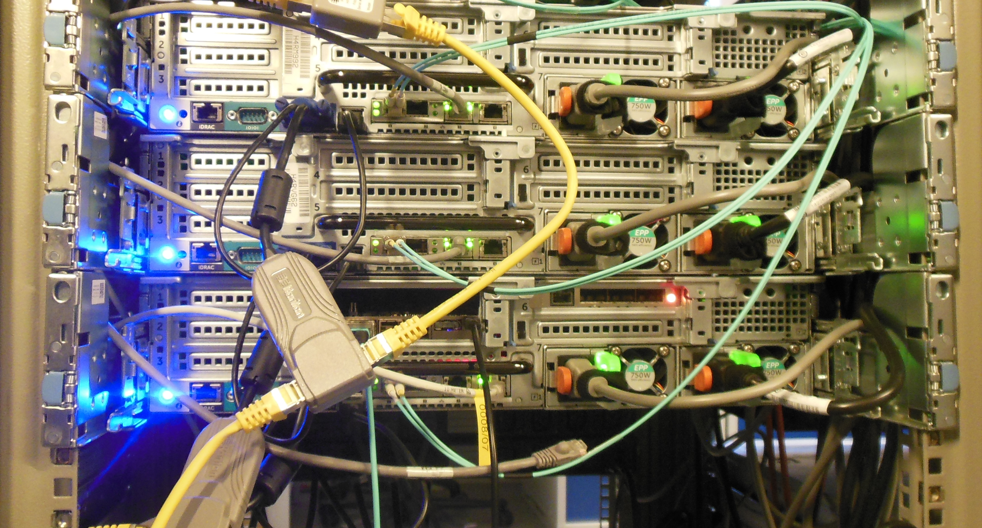
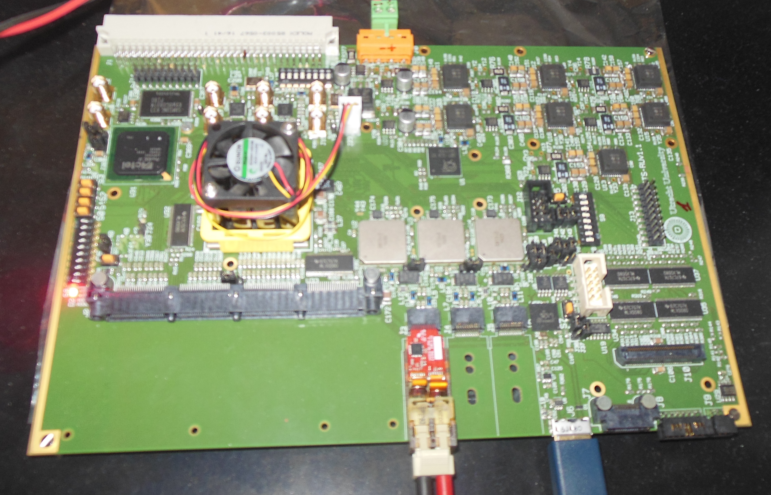
Reference DCS setup in photos
MID
FLP with CRU
Rack with power supply and boards
TPC
VLDB
ITS

Slide 21
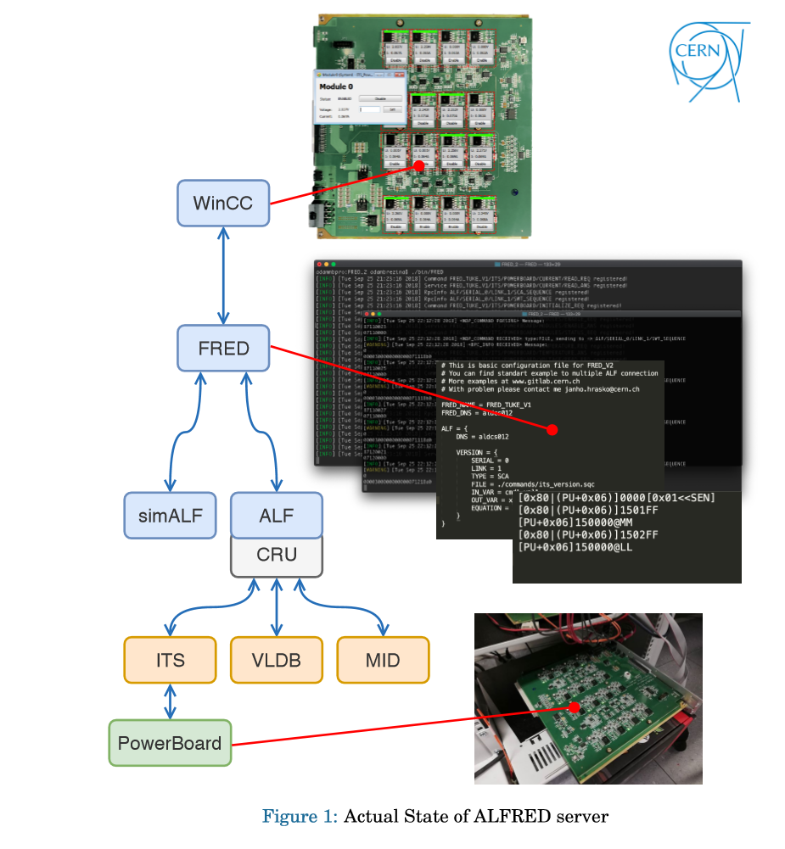
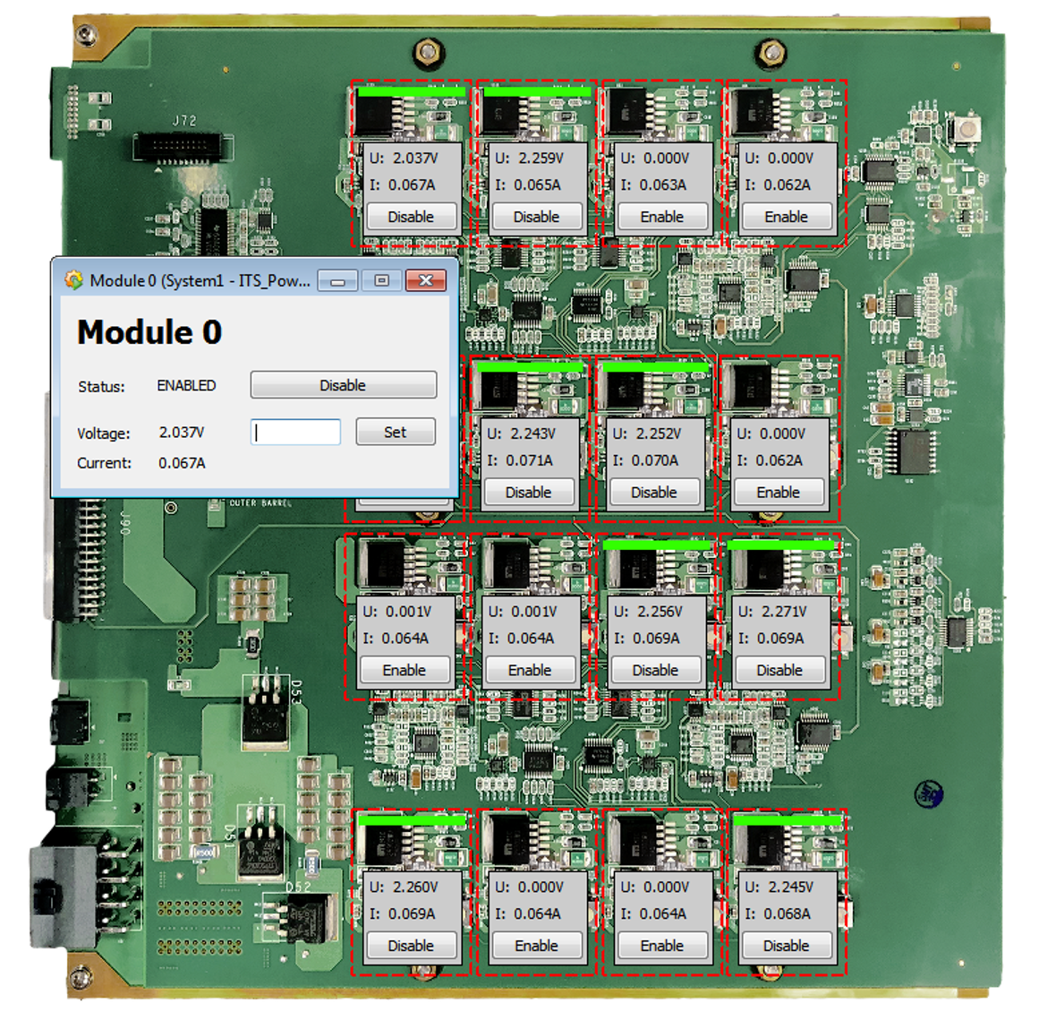
ITS test bench
Full chain from WINCC to PB
  Uses SWT
  Installed in DCS lab and bldg. 167
Working WINCC OA Application!

Slide 22
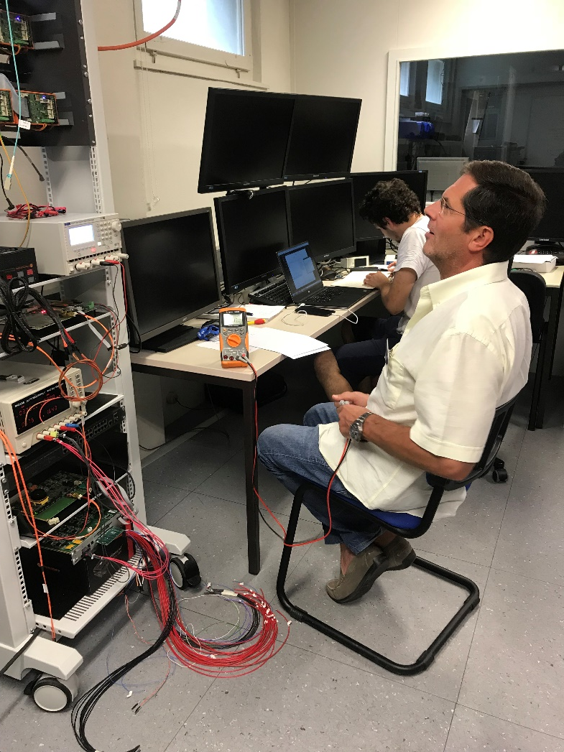
ITS progress
First successful test of ALF-FRED using the Power board in the DCS lab
Due to the lack of detector hardware , we controlled Paolo
PMD: Paolo as a Measuring Device

Slide 23
ALF-FRED next steps
Modifications foreseen to accommodate the monitoring mechanisms implemented by ITS
Tests with realistic configuration sequences are needed
  Functional tests
  Performance
  Optimization – caching config on FLP, database management
Implementation of complex operations : i.g. ITS scan

Slide 24
Redesigned Data flow
AMANDA
ORACLE DATABASE
RDB MANAGER
DARMA
WINCC OA
Custom code
DRIVERS
FRED Server
FRED
OPC / Proprietary
FLP
Detector
ALF
OPC
FED
Cooling
HV / LV
Front-End electronics
Gas
Auxiliary systems

Slide 25
The Next Generation Archiver - NGA
Completely redesigned dataflow component provided by SIEMENS
  Acts as a fanout, allowing for splitting the data stream into multiple configurable data channels
Backend plugins
  Custom modules written in C++
  Receive data from NGA
  INFLUX DB plugin developed by Siemens
  ORACLE plugin developed at CERN by BE ECS and OPENLAB (will be handed over to Siemens)
  ADAPOS plugin developed in ALICE to interface with the O2

Slide 26
Redesigned Data Flow
AMANDA
ORACLE DATABASE
RDB MANAGER
DARMA
WINCC OA
Custom code
DRIVERS
FRED Server
FRED
OPC / Proprietary
FLP
Detector
ALF
OPC
FED
Cooling
HV / LV
Front-End electronics
Gas
Auxiliary systems

Slide 27
RUN2 Conditions data flow
OFFLINE
ORACLE DATABASE
ORACLE Backend
AMANDA
NGA
DARMA
WINCC OA
AMANDA
DRIVERS
During RUN2 all conditions data is sent to offline after each run
FRED Server
FRED
OPC / Proprietary
FLP
Detector
ALF
OPC
FED
Cooling
HV / LV
Front-End electronics
Gas
Auxiliary systems

Slide 28
RUN3 Conditions data flow
OFFLINE
ORACLE DATABASE
ORACLE Backend
ADAPOS Backend
… O2
AMANDA
NGA
DARMA
WINCC OA
AMANDA
DRIVERS
During RUN2 all conditions data is sent to offline after each run
O2 will require real time updates of the conditions data
FRED Server
FRED
OPC / Proprietary
FLP
Detector
ALF
OPC
FED
Cooling
HV / LV
Front-End electronics
Gas
Auxiliary systems

Slide 29
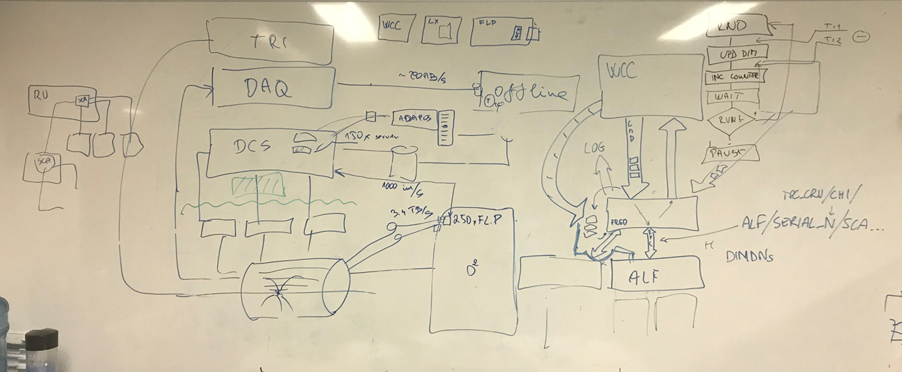
ADAPOS
Data streaming mechanism from DCS to O2
ALL DCS data is collected in a buffer
  The buffer contains full snapshot of all current DCS parameters
The Buffer is sent to O2 each 50ms to DCS FLP and from there to EPNs
New values overwrite old ones in the buffer
Designed and tested for continuous streaming of 100k parameters by 1 ADAPOS server
  Current O2 requirements dropped from 100k to 20k parameters
  New request to deliver conditions data also to detector FLP (TPC)

Slide 30
ADAPOS and NextGen tests in ALICE
Conservative setup compatible with present system
  If anything else fails, this will do the job!
Successful large scale tests – 150 systems running in parallel
Successful long-term tests – several weeks of running (reproducing all DCS data produced since 2007)
Tested performance better by 2 orders of magnitude compared to requirements
  But…. There is a risk of ADAPOS overflow due to the lack of smoothing in the WINCC publisher

Slide 31
ADAPOS and NextGen tests in ALICE
Test setup based on NGA beta release
  Single DCS system with heavy data generation
Long-term tests – several weeks of running
  Measured performance limited only by WINCC capabilities
    NGA can digest all what WINCC can produce
TODO: large scale tests after the ion run
  test setup is ready, waiting for the end of ions

Slide 32
ADAPOS in Education
ADAPOS and ADAPRO framework is used as a model example at Utrecht University in academic year 2018-2019
  Course on Program Semantics and Verification
  Proposed and carried out by our former ADAPOS developer and technical student John Larry Lang
Thesis on ADAPOS defended by our technical student Kevin Cifuentes Sallaz won the price for the best master final project at Bilbao University in 2018

Slide 33
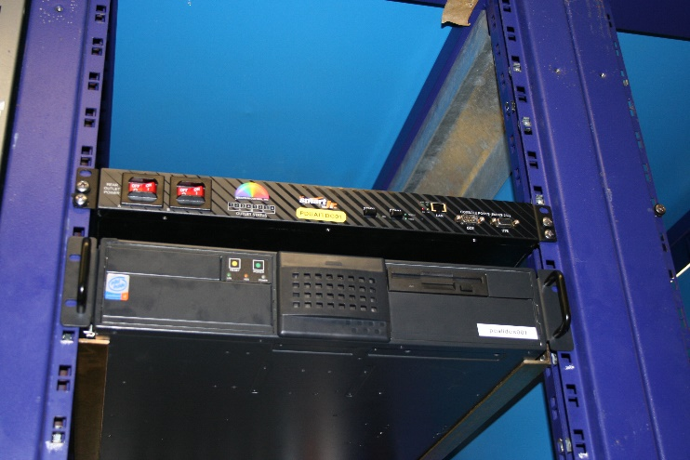
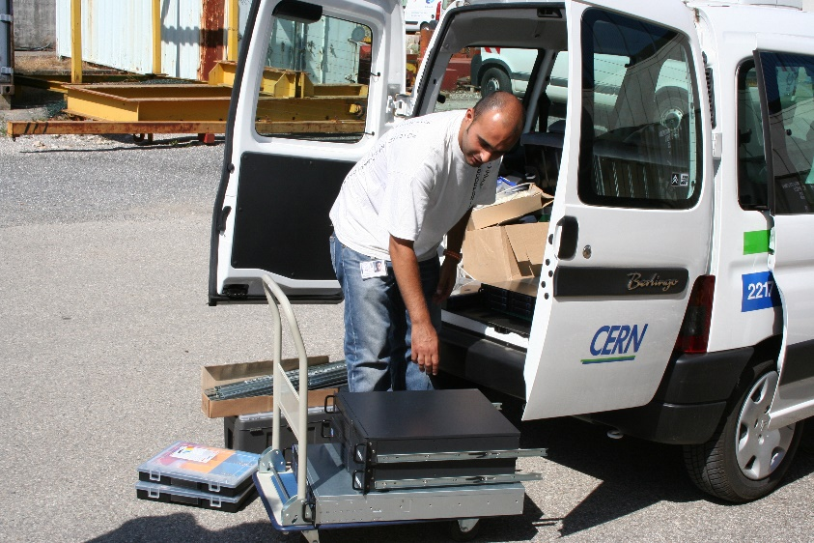
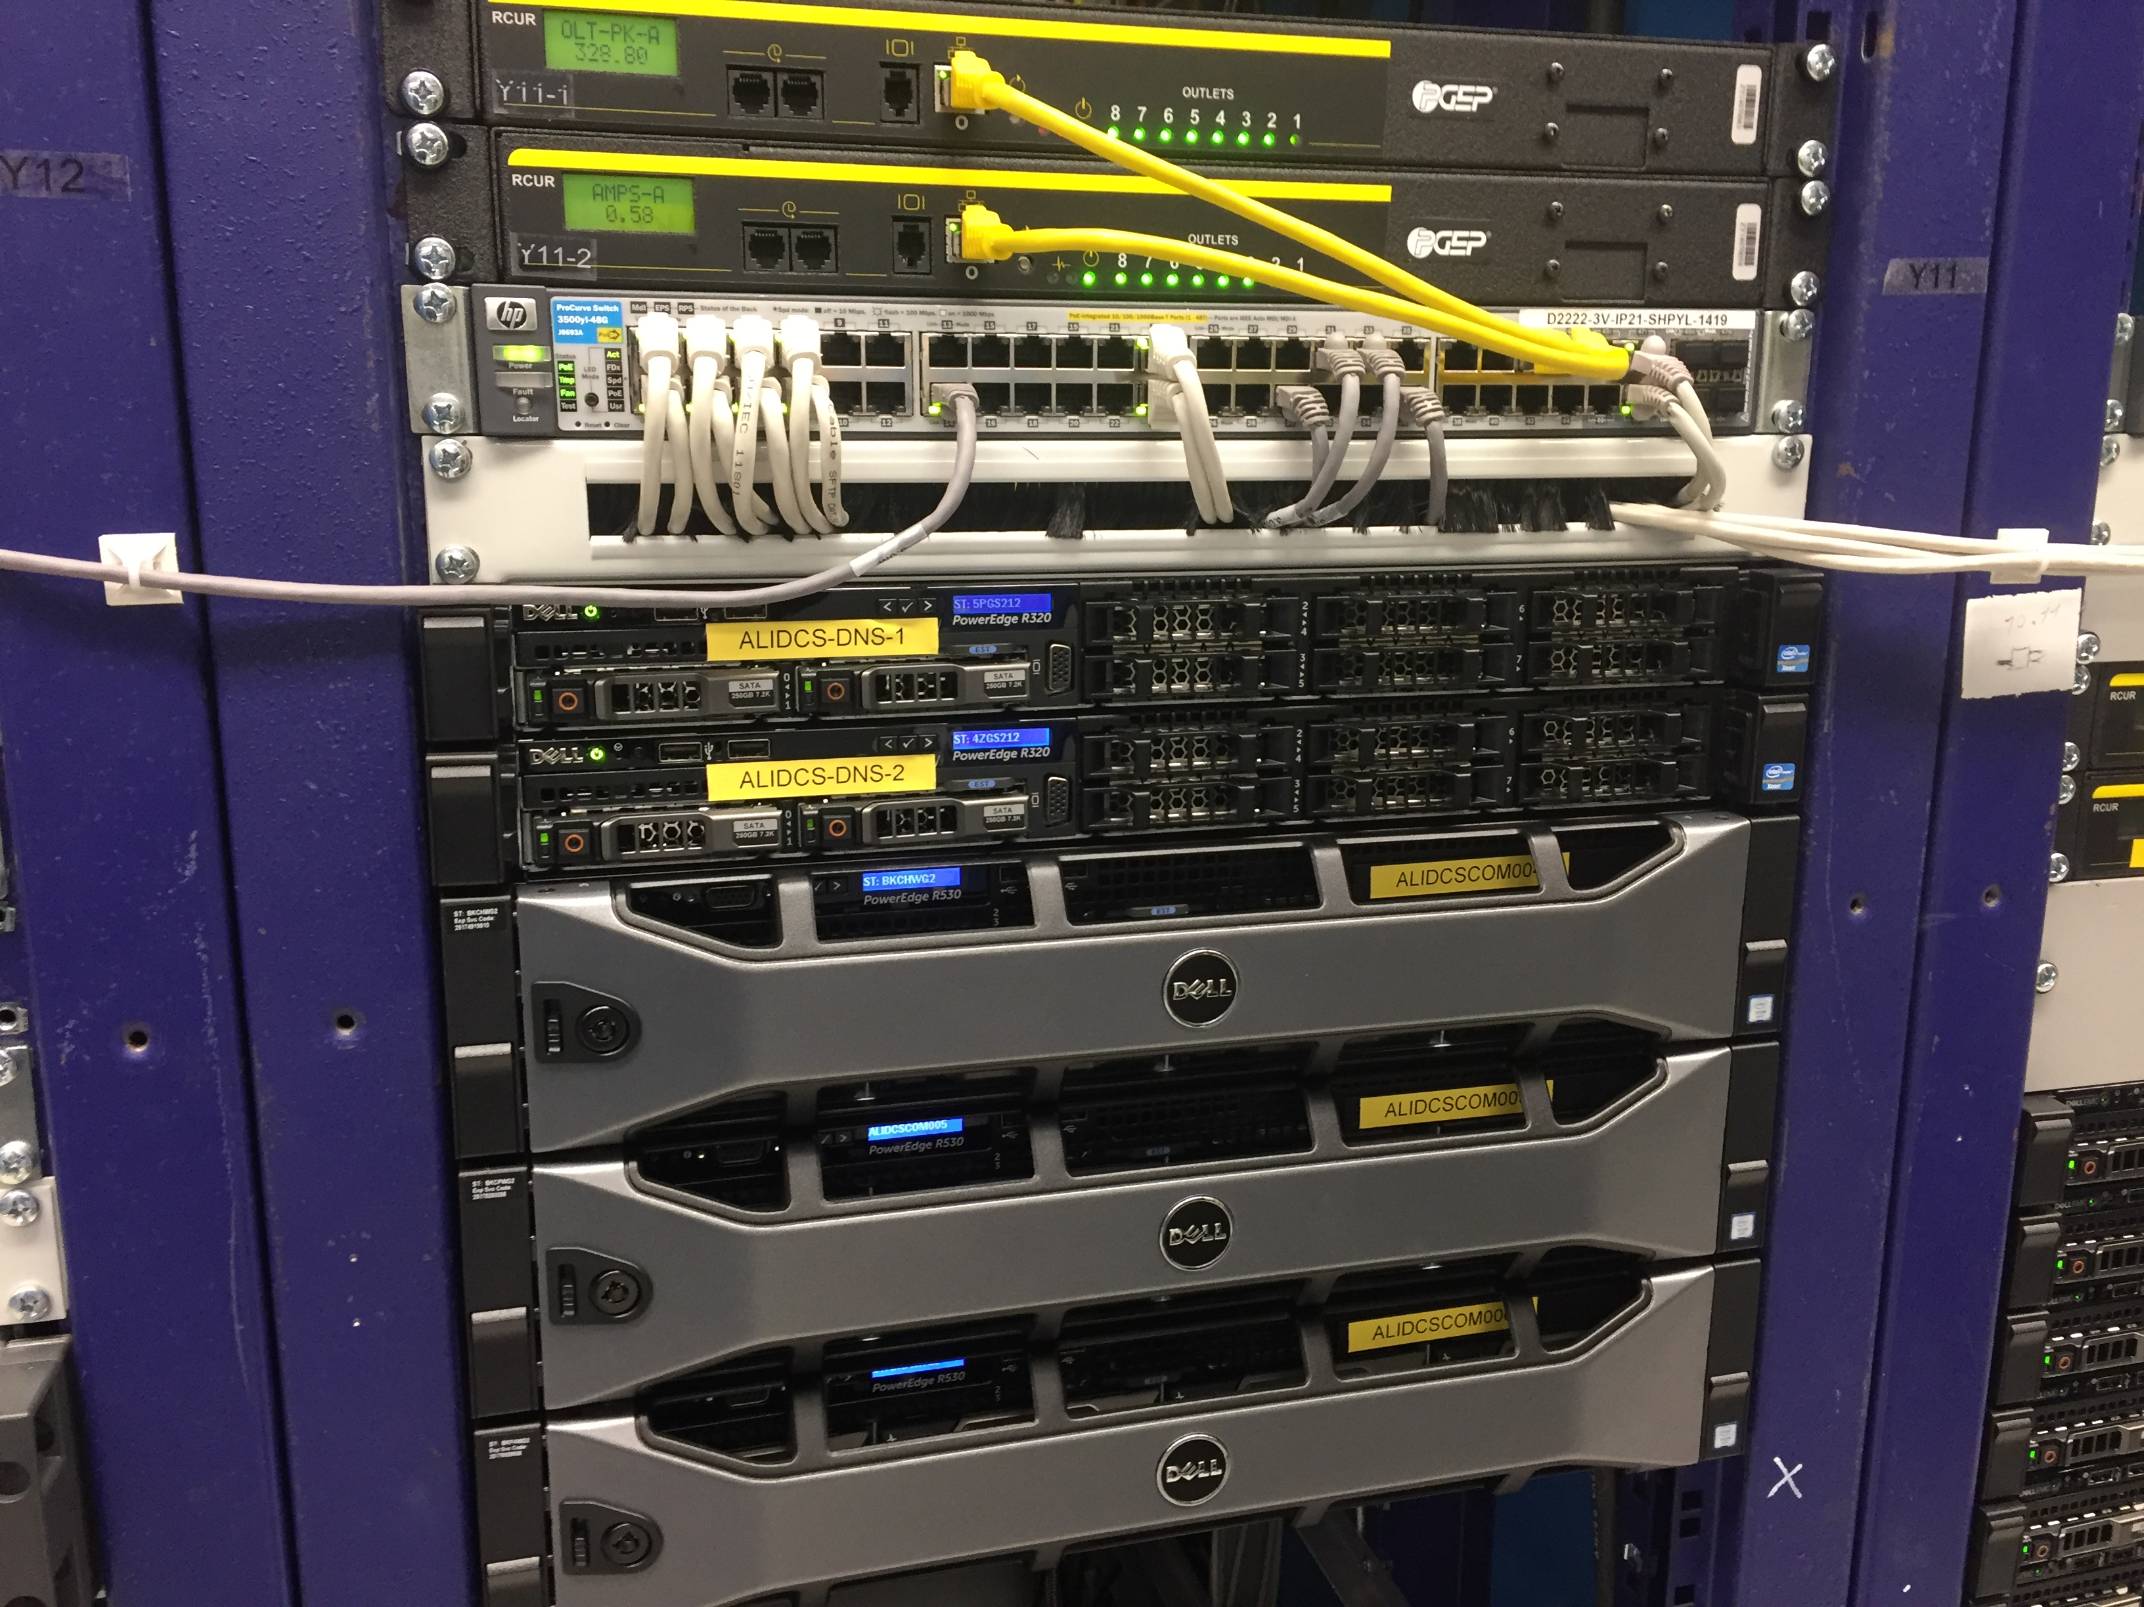
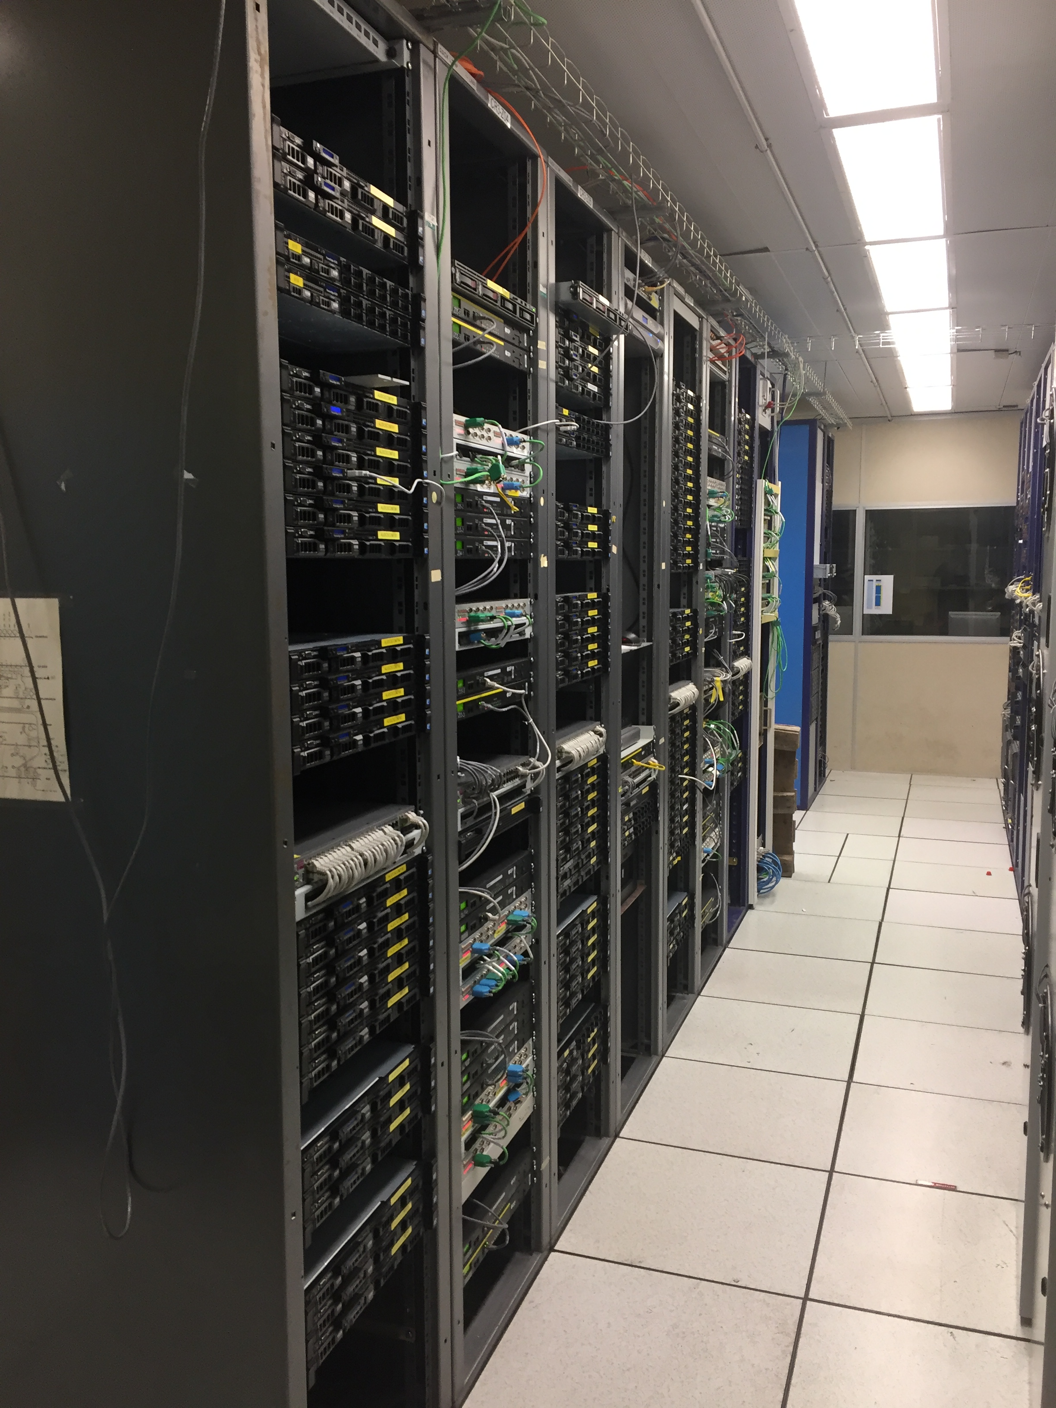
DCS Cluster upgrade
Very first DCS server (2006)
Cluster designed in 2007 and extended to cope with ALICE needs
Today we run 200 computers
  Most of the servers are more than 5 years old
    Warranty recently expired or expiring in early 2019
Network infrastructure
  Reliable
  Managed by IT
  But… installed in 2007 reusing older switches…
Network infrastructure installed in 2006/2007
DCS computers today
Currently we run 3rd generation of the DCS cluster consisting of
  150 servers (100 running the central SCADA system)
  ORACLE database service
  Redundant file servers
  Other servers and network equipment supervising 1200 network attached devices

Slide 34
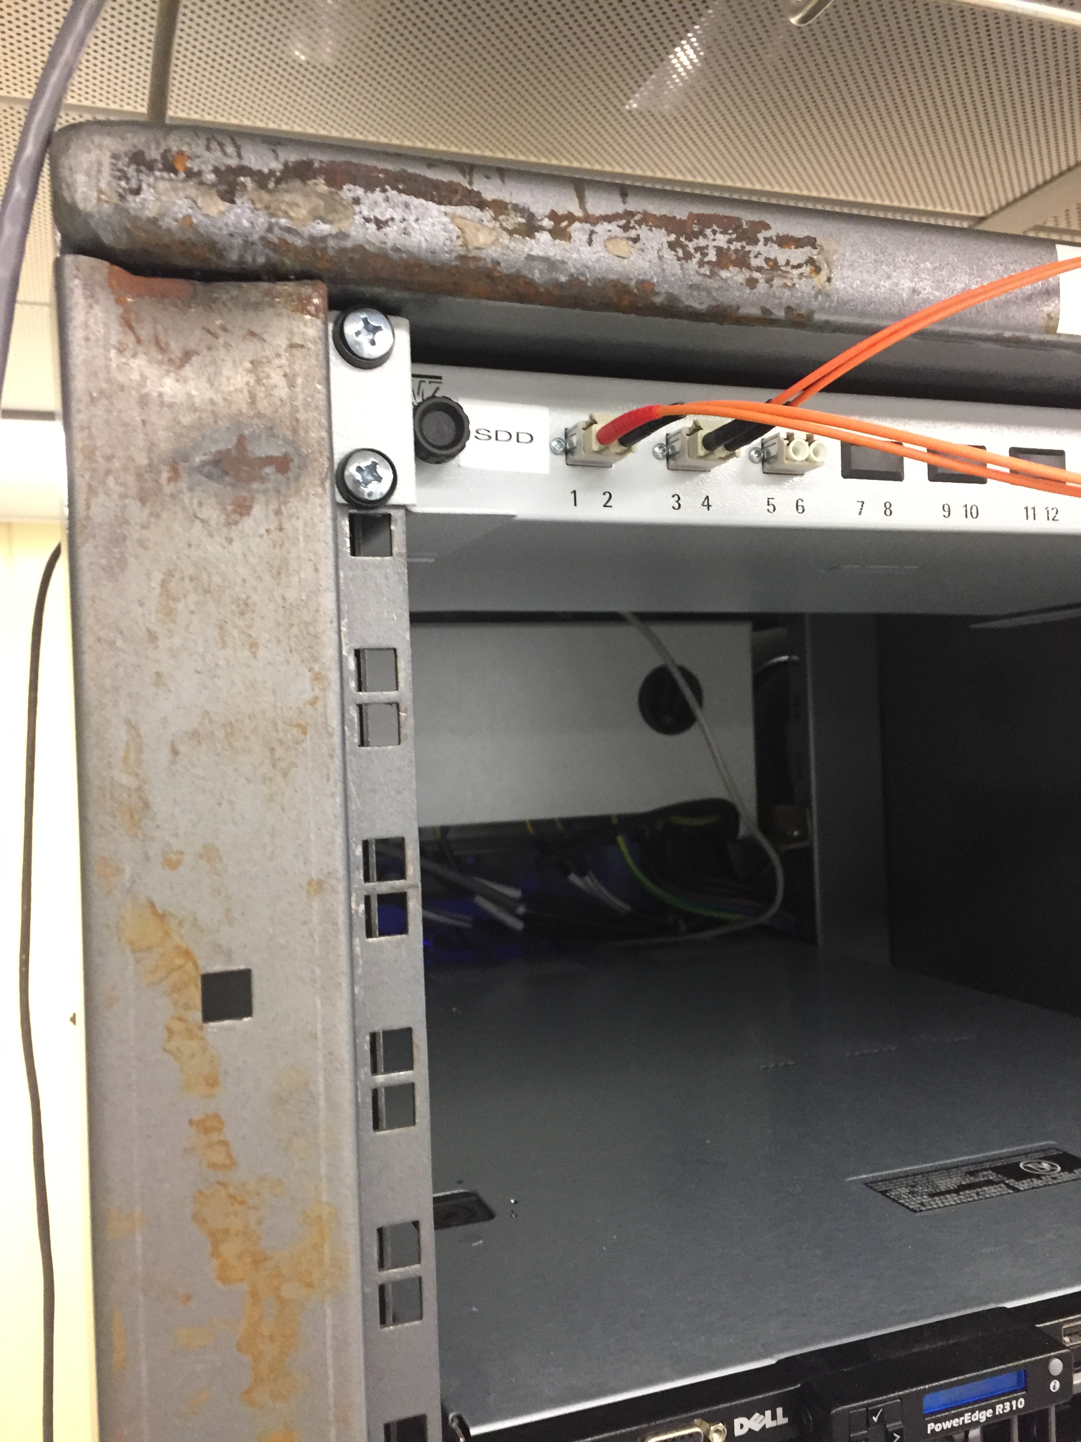
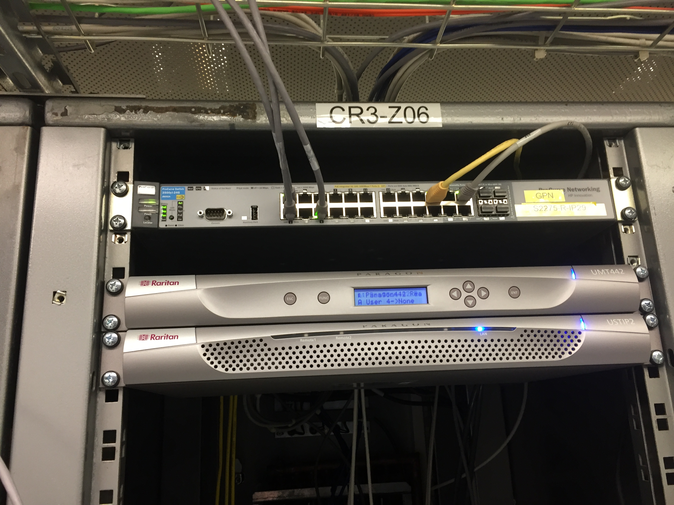
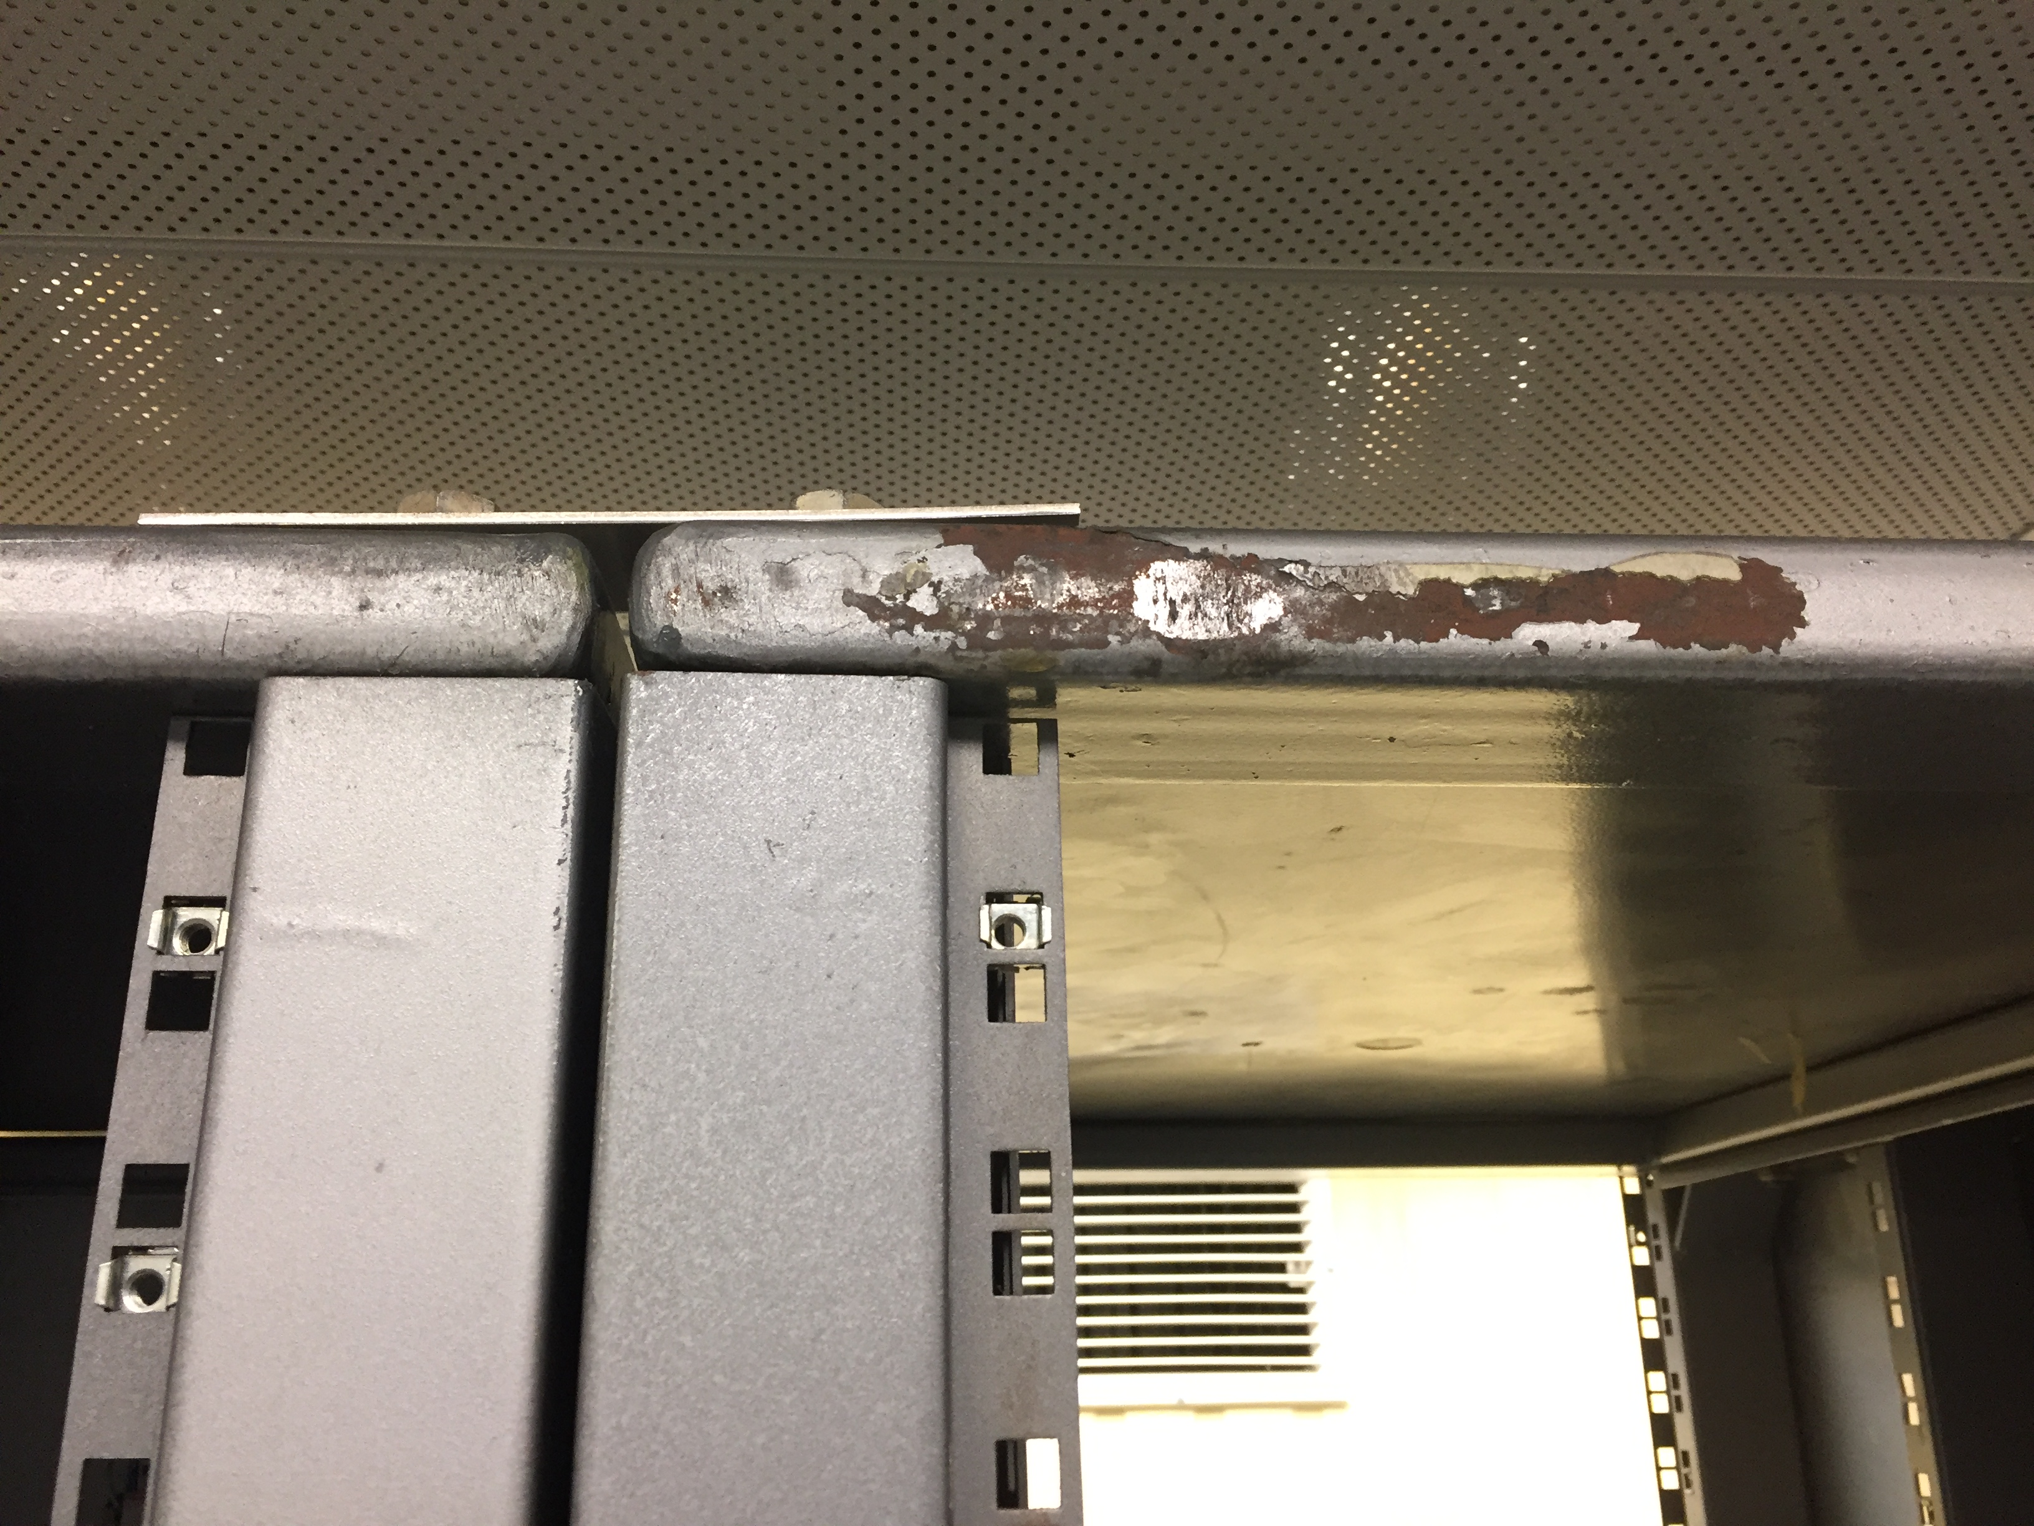
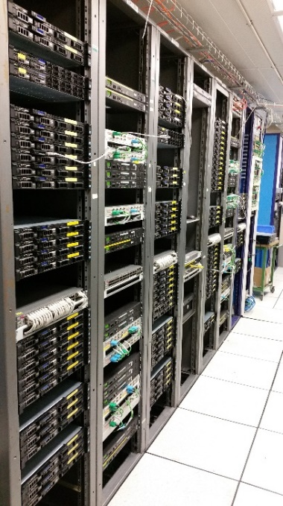
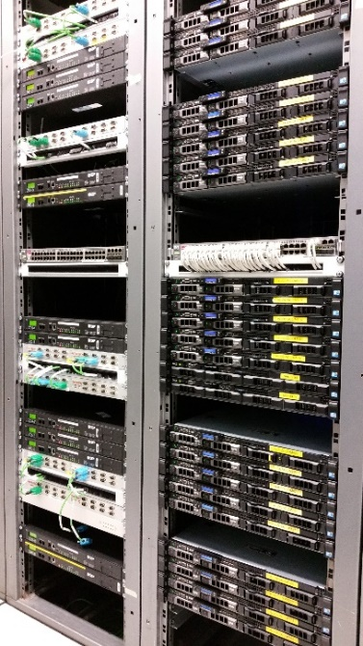
Racks need resuscitation
Installed in the previous millennium (1980-ies)
  A little bit tired by now
Mechanically deformed
Cannot host big servers
Incompatible with rails
Cooling doors develop leaks

Slide 35

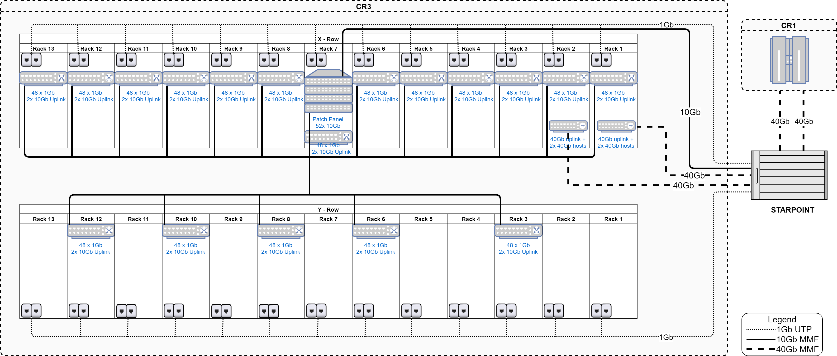
New CR3 layout
Current CR3 layout with 3 rows
New CR3 layout with 3 rows
82
44
102
115
220
ALL DCS racks and network infrastructure will be replaced
All DCS computers will be replaced
New CR3 network topology

Slide 36
“Standard” Central DCS evolution
DCS computers, including the ORACLE service will be replaced
OS upgrades
  Centos (ALICE O2 brew)
  Windows Server 2019 as a preferred target
    Windows Server 2016 as a conservative target
WINCC OA upgrade to latest version
JCOP FW upgrade
OPC servers, drivers upgrade
Reconsolidation of DCS monitoring (using JCOP farm monitoring suite)
Revision of software deployment procedures

Slide 37
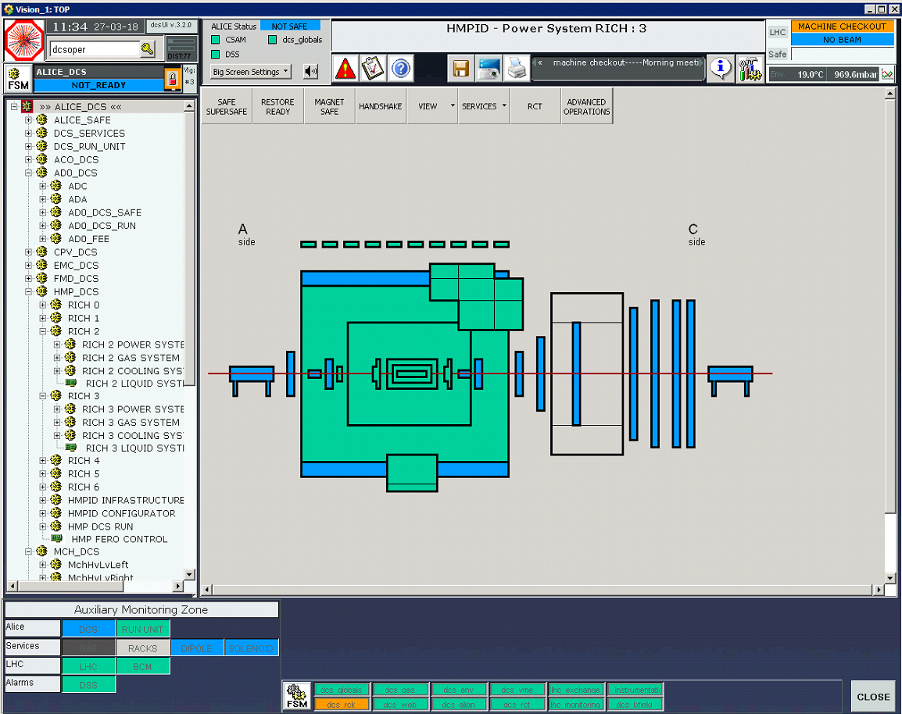
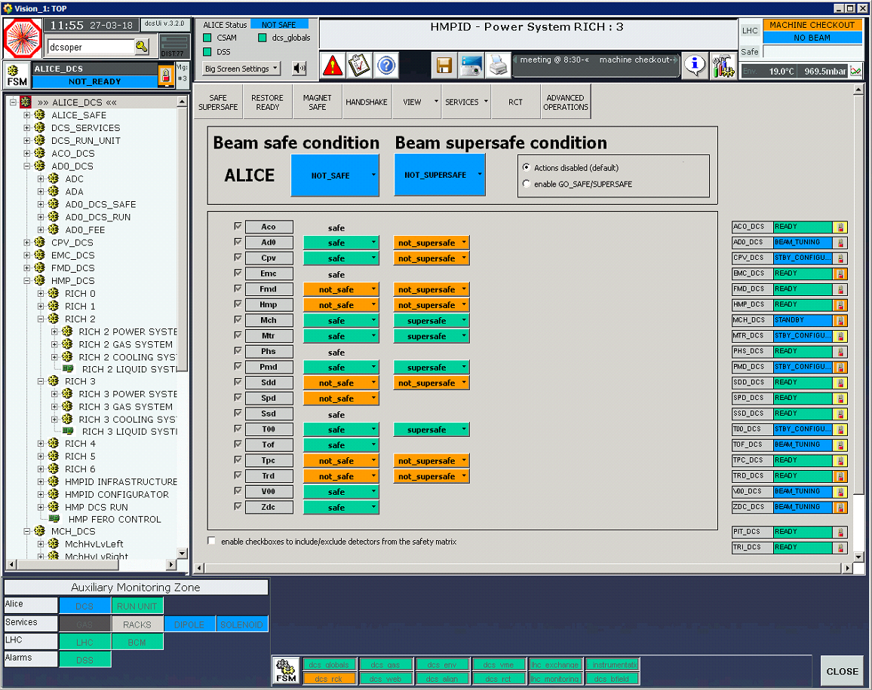
ALICE framework upgrades
New/lighter User Interface
Improved Web publishing tools
Enhanced logging of operator actions
Cleanup of FSM
Simplified top level FSM
New O2 interface not based on FSM needs to be developed
Improved advanced procedures (GO SAFE…)
Clear reporting of progress during the transition

Slide 38
Advanced system diagnostics based on logfile analytics
Elastic Stack
New project for log analysis launched in collaboration with BE ICS
Based on Elastic Stack
Aim: logfile analysis and early problem detection
BE ICS setup

Slide 39
BE-ICS WINCCOA dashboard
BE-ICS advanced ORACLE archival analysis

Slide 40

IOT components in the DCS

Slide 41
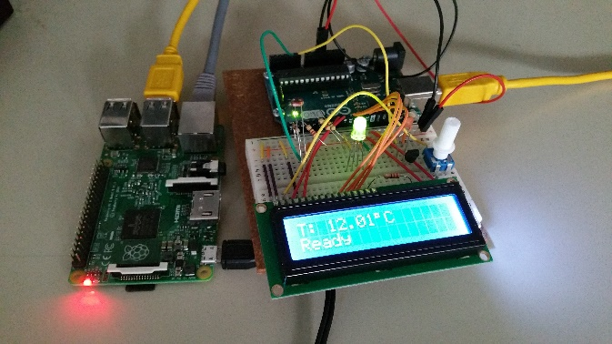
IOT components in the DCS
Pioneering work in DCS to integrate cheap IOT components:
  Readout prototyping
  Environment control
  Student training and education
Price of the IOT setup significantly lower than the traditional ELMB based solution

Slide 42
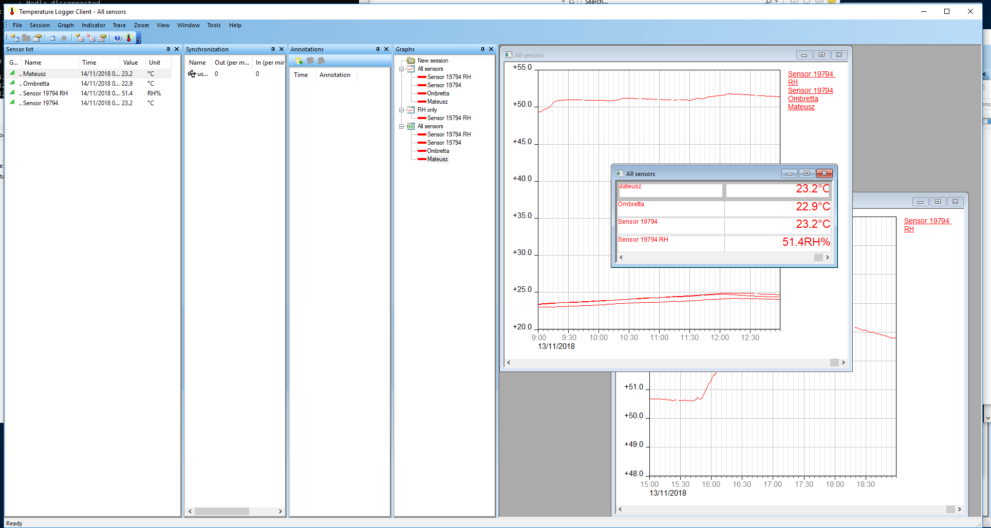
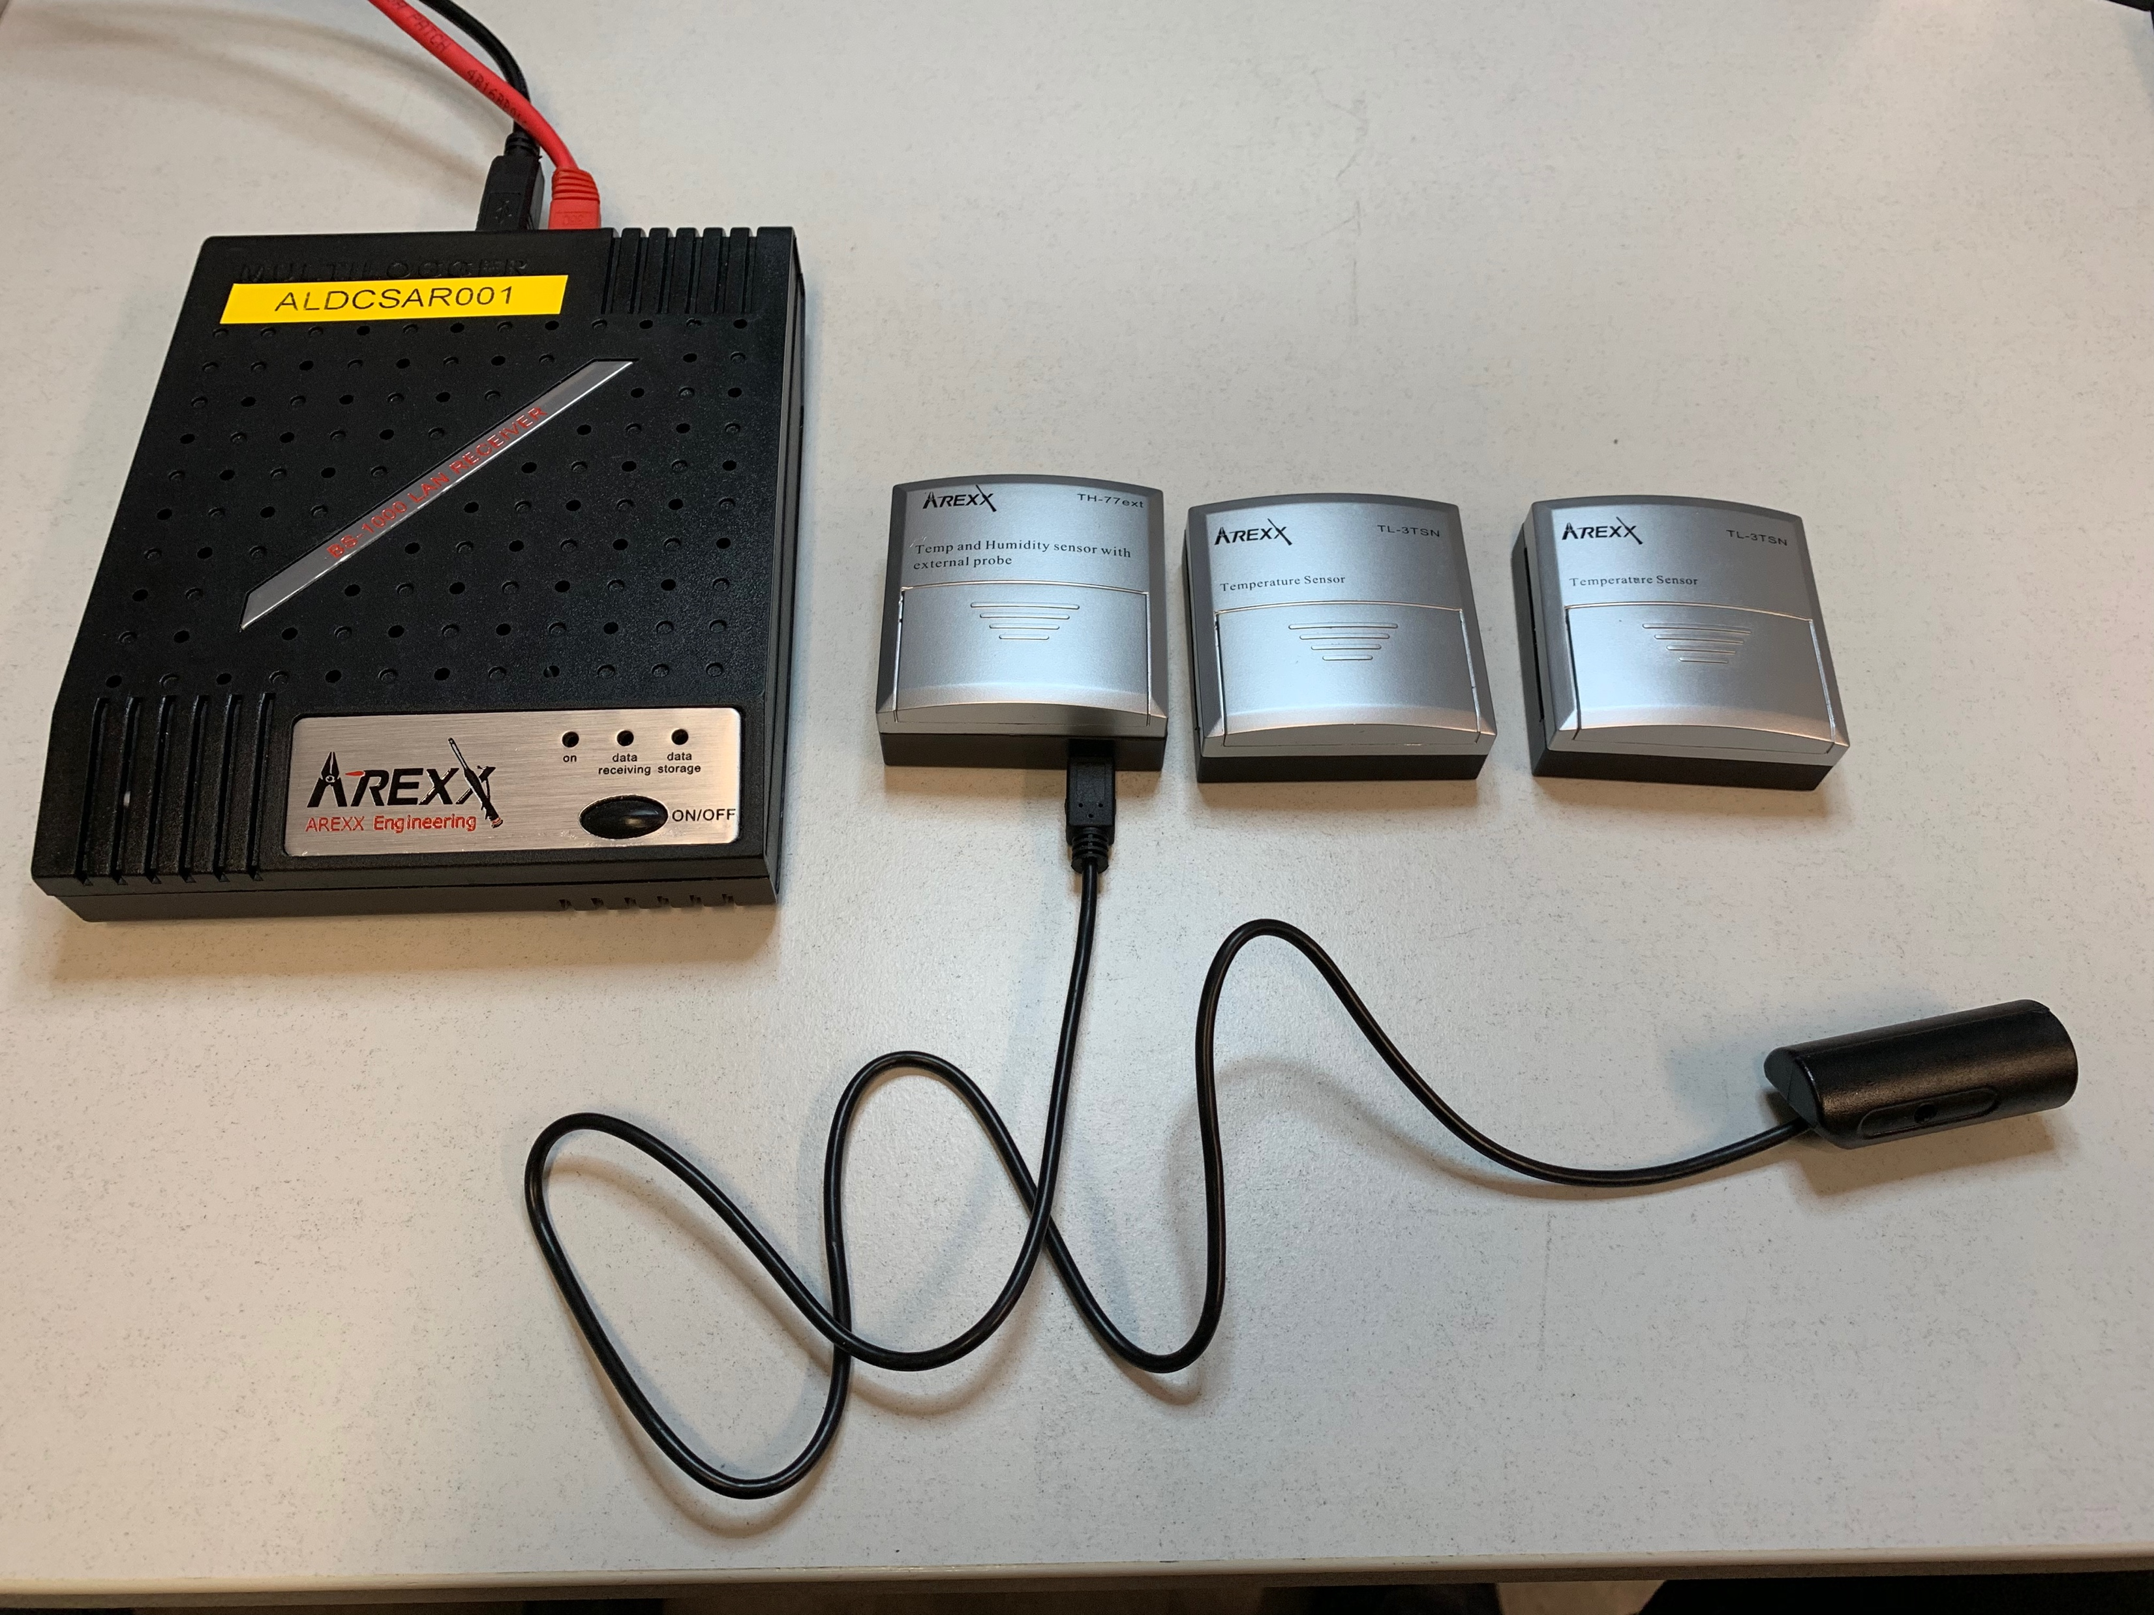
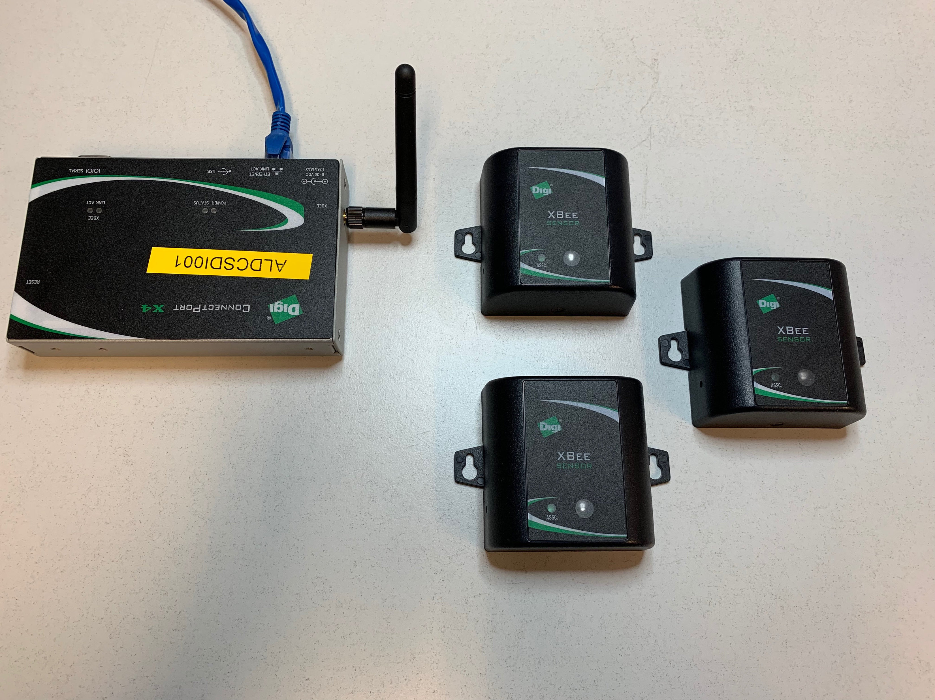
Industrial IOT components
… meanwhile the industry followed
Cheap sets available
DCS investigates 2 candidates for rack monitoring based on industrial kits
  Price comparable to RPI setups
  Significant savings on cabling cost and efforts if Zigbee modules are used
AREX test setup
DIGI test setup

Slide 43
Important dates for DCS computing
DCS computing infrastructure will remain operational until late summer 2019
  Upgrades will start in Q1 2019
  Flexible to adopt detector requirements
  ‘reversible’ upgrades
September – November 2019
  DCS NOT AVAILABLE
    But still awesome
November 2019
  NEW DCS
  start of reintegration and system commissioning

Slide 44
DCS Milestones in 2019
December 2018
WINCC OA backups
January 2019
WINCC OA upgrades v 3.16 on central systems
February-March2019
WINCC OA upgrades on detector systems
DCS operational
April 2019
ORACLE schemas upgraded to NGA compatible version
RDB manager replaced by NGA and ORACLE backend
Point of no return!
ADAPOS backend deployed to detector systems

Slide 45
DCS Milestones in 2019
Summer 2019
New dataflow commissioning, stability tests
September 2019
CR3 dismantled
November 2019
New DCS in P2

Slide 46
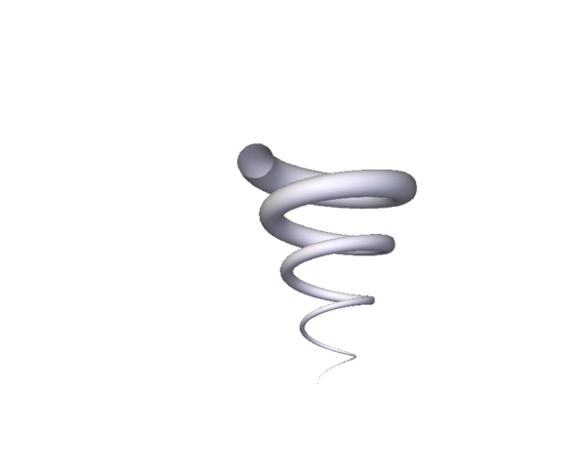
Conclusions
We will now disassemble an unprecedentedly stable system to make it more stable
DCS2 (2019)
DCS1 (2007)
Mankind
Big Bang

