Slide 1
Update on the detector read-out and slow control
Filippo Costa
CRU - CERN

Slide 2
OUTLINE
test on-going with detectors
measurements with TPC full FPGA, FW, LHCb full FPGA, ALICE full FPGA firmware

Slide 3
CRU TEST SUMMARY
DET | FLP | CRU | GBT | FEE | READOUT | DCS through CRU (custom script)
TPC @ CERN | 5 | 4 (2 in one FLP) | 36 | 18 | CONTINUOUS⁽¹⁾ | SCA
ITS @ CERN | 2 | 4 (4 in one FLP) | 5 | 5 | PACKET⁽¹⁾ | SCA – SWT
ITS @ USA (Univ. of Texas) | 1 | 1 | 1 | 1 | PACKET⁽¹⁾ | SCA – SWT
MID @ SUBATECH | 1 | 1 | 1 | 1 | CONTINUOUS⁽²⁾ | SCA
MFT @ IPNL | 1 | 1 | 1 | 1 | PACKET⁽²⁾ | SCA – SWT
TOF @ INFN Bologna | 1 | 1 | 2 | 2 | PACKET⁽²⁾ | Not used
MCH @ CERN | 1 | 1 | 1 | 1 | CONTINUOUS⁽¹⁾ | SCA
TRD @ GERMANY (MUENSTER UNIV) | 1 | 1 | TRD custom link (under dev) | 1 | CONTINUOUS⁽²⁾ | Not used
TRG @ CERN | Communication between LTU and 8 CRUs -> tested. Trigger delivery to CRU and forwarding to FEE -> tested
DCS @ CERN | DCS Slow Control chain (ALF-FRED) -> tested. Installation in detector set-up -> on going
CRU FW >= 2.5.0
O2 Readout⁽¹⁾ >= 14.0.1
O2 ReadoutCard⁽²⁾ >= 8.12.1
SCA: slow control protocol used by SCA chip on the FEE
SWT: custom slow control protocol implemented over GBT data payload

Slide 4
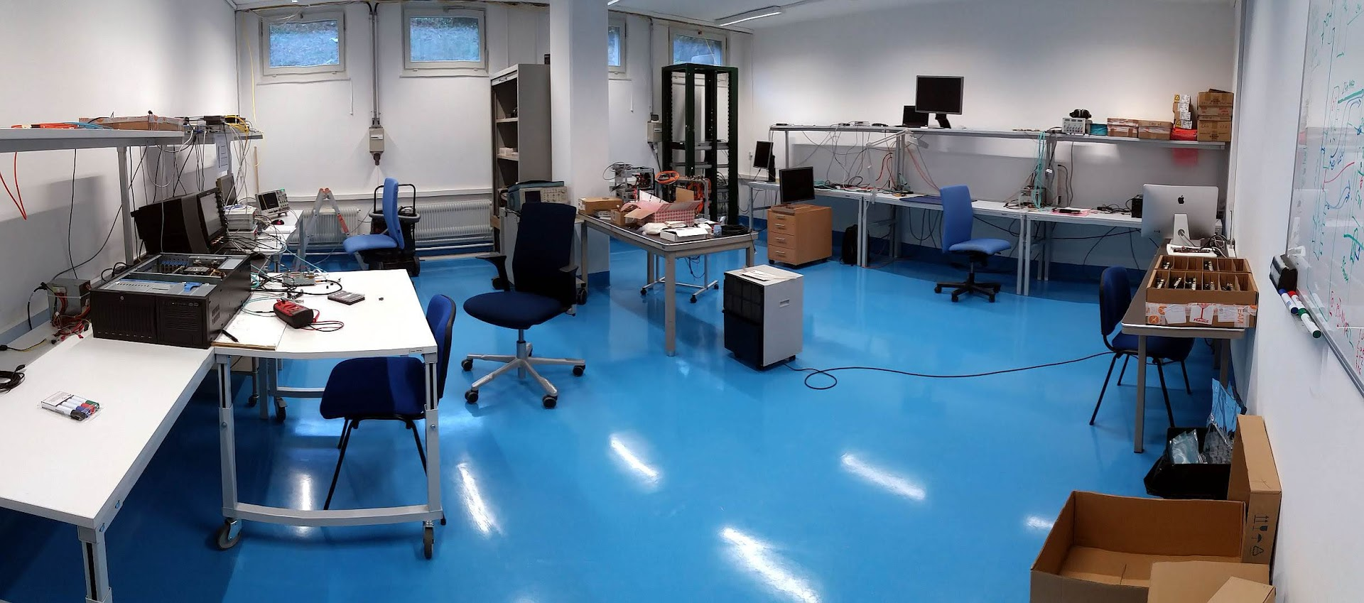
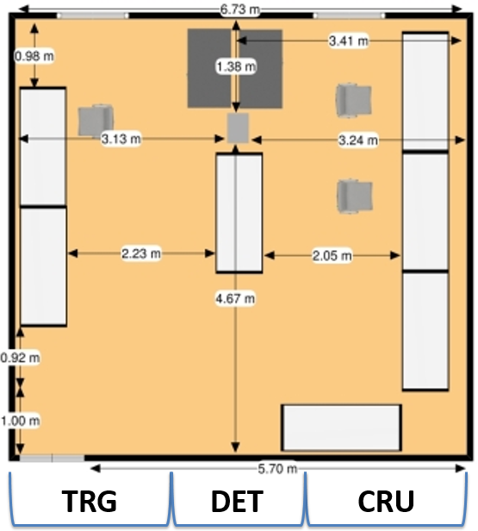
CRU – TRG test lab @ CERN (4 / S-059)

Slide 5
Tests ongoing with ITS
5 RUs (5 GBT links) connected to 1 CRU:
  SCA, SWT configuration and monitoring -> OK.
  DMA :
    readout in packet mode,
    triggers generated from CRU (ctp-emulator),
    readout.exe used, official O² readout software.
Work in progress:
  Final CRU – RU link configuration
    1 link for trigger and 1 link for SWT. Currently is one link used for both.
    LTU integration.
  Detector configuration using DCS framework (ALF-FRED). DCS chain installed in bld.167, waiting for feedback.
  Evaluation of SWT protocol requirements:
    Time needed to configure 1 RU
    Request for broadcast (still under evaluation) … see next slide

Slide 6
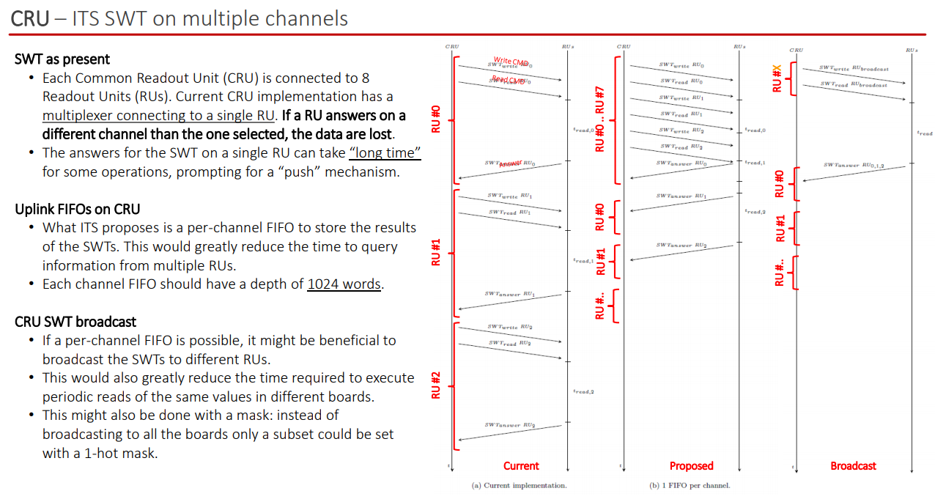
Tests ongoing with ITS (under evaluation)
https://indico.cern.ch/event/771625/contributions/3206178/attachments/1752568/2840239/20181114_WP10_ITS_SUF_v1.pdf

Slide 7
Tests ongoing with MFT
1 RUs (1 GBT link) connected to 1 CRU:
  SCA, SWT configuration and monitoring -> OK.
  DMA (to be tested, same ITS firmware):
    readout in packet mode,
    triggers generated from CRU,
    readout.exe used, official O² readout software.
Some issues reported in the past, to be checked if they are still valid.

Slide 8
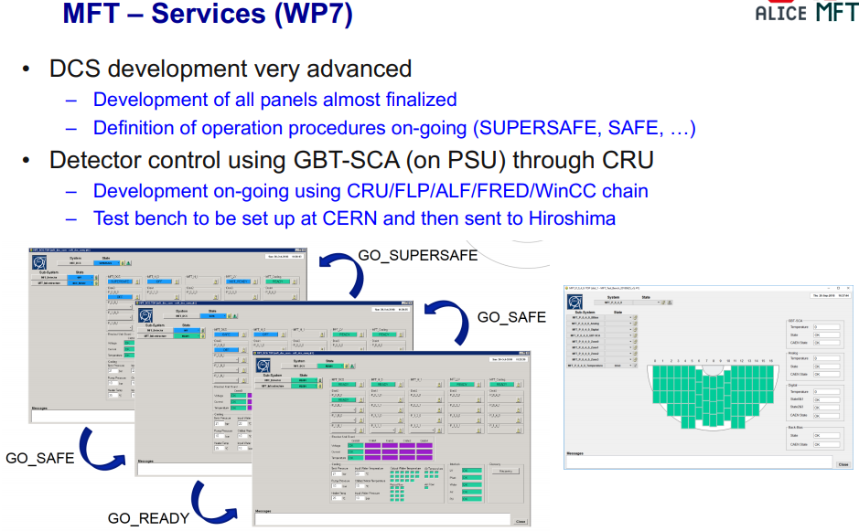
Tests ongoing with MFT
Additional SCA feature to control multiple SCA chips with one GBT link
GBT WORD
GBT SC (4 bit)
GBT DATA (80 bit)
IC/EC
DATA
GBT SC (4 bit)
GBT SC (80 bit)
IC/EC
40 x EC [2 bit]

Slide 9
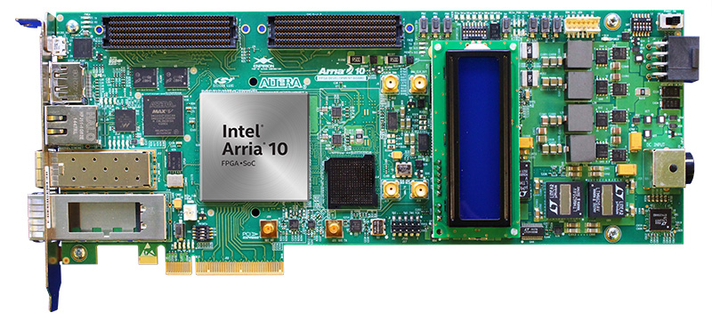
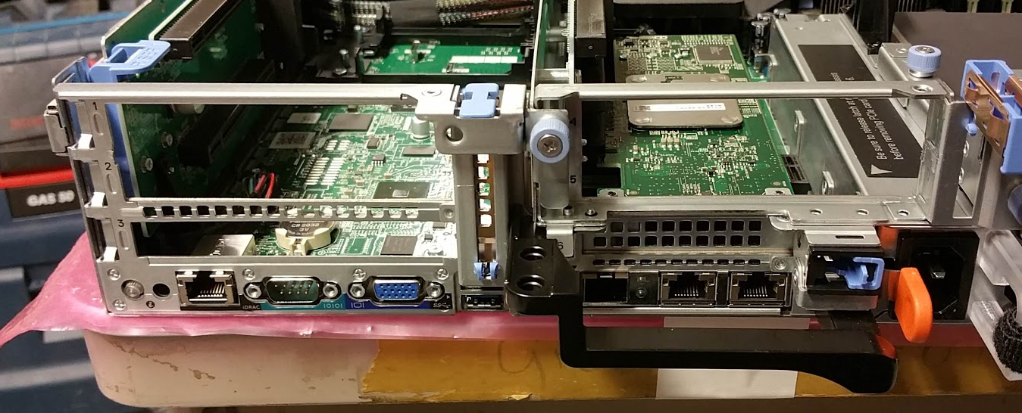
Tests ongoing with MFT-Japan
1 FLP delivered at CERN
  Preparation at CERN in progress:
    Cutting of the FLP chassis.
    O² software.
    CRU software.
  Arria X development kit available.

Slide 10
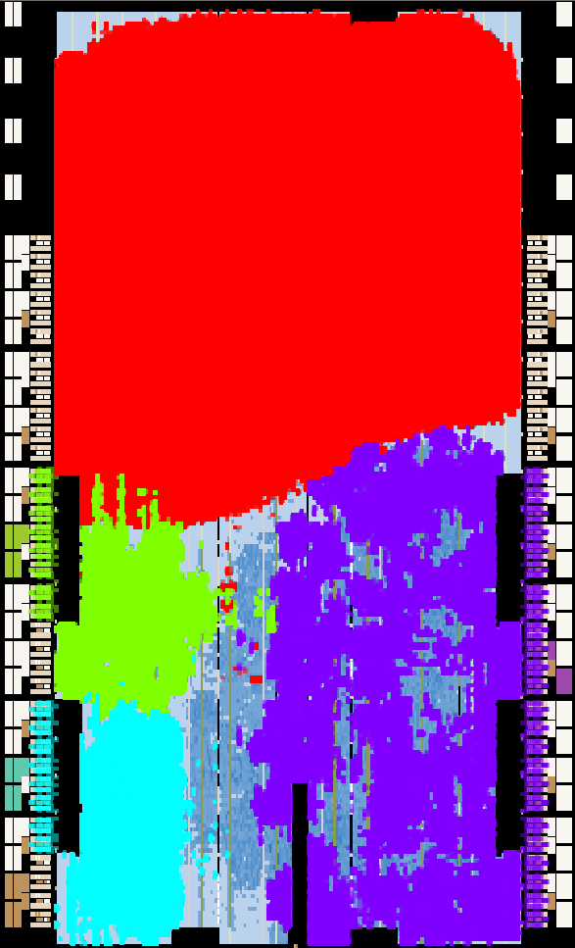
CRU STRESS TEST - 750K FFs
+--------------------------------------------------------------------------+
; Flow Summary ;
+-----------------------------+--------------------------------------------+
; Logic utilization (in ALMs) ; 312,636 / 427,200 ( 73 % ) ;
; Total registers ; 997490 ;
; Total block memory bits ; 17,917,984 / 55,562,240 ( 32 % ) ;
; Total DSP Blocks ; 0 / 1,518 ( 0 % ) ;
; Total HSSI RX channels ; 41 / 72 ( 57 % ) ;
; Total HSSI TX channels ; 41 / 72 ( 57 % ) ;
; Total PLLs ; 56 / 144 ( 39 % ) ;
+-----------------------------+--------------------------------------------+
Shift Registers
GBT
PCIe

Slide 11
Errors per Second vs Toggling Rate (250K FFs)
Different cards show different level of sensitivity
Different links (in the same card) show different level of sensitivity (link #8 looks to be the most sensitive)
Error rates are proportional to the toggling rate
Only transmitters affected (this can be seen when we switch between internal/external loopback mode due to link order reversion in the MiniPODs)
The low rate errors detected in wide bus mode are completely eliminated by the FEC in GBT mode (the FEC error counters show all the corrections)

Slide 12
CRU STRESS TEST – TPC UL stress test
TPC-UL firmware based on CRU firmware 2.5.0
CRU FPGA
GBT
#0
DDG
TPC UL
GBT
#1
DMA
DG
DMA
FLP
GBT
#23

Slide 13
CRU STRESS TEST – TPC UL stress test
===========================================================================================
# Type PCI Addr Vendor ID Device ID Serial FW Version Card ID
-------------------------------------------------------------------------------------------
0 CRU 02:00.0 0x1172 0xe001 0 0-0-bc5a2739 00000002-00000000
1 CRU 03:00.0 0x1172 0xe001 0 0-0-bc5a2739 00000002-00000000
2 CRU 81:00.0 0x1172 0xe001 0 0-0-bc5a2739 00000002-00000000
3 CRU 82:00.0 0x1172 0xe001 0 0-0-bc5a2739 00000002-00000000
===========================================================================================
python report.py -i 2:0.0
Link ID GBT TX mode GBT RX mode GBT mux Datapath mode Enabled in datapath
---------------------------------------------------------------------------------------------------
Link 0 : GBT GBT TTC:CTP packet Enabled
Link 1 : GBT GBT TTC:CTP packet Enabled
Link 2 : GBT GBT TTC:CTP packet Enabled
Link 3 : GBT GBT TTC:CTP packet Enabled
Link 4 : GBT GBT TTC:CTP packet Enabled
Link 5 : GBT GBT TTC:CTP packet Enabled
Link 6 : GBT GBT TTC:CTP packet Enabled
Link 7 : GBT GBT TTC:CTP packet Enabled
Link 8 : GBT GBT TTC:CTP packet Enabled
Link 9 : GBT GBT TTC:CTP packet Enabled
Link 10 : GBT GBT TTC:CTP packet Enabled
Link 11 : GBT GBT TTC:CTP packet Enabled
Link 12 : GBT GBT TTC:CTP packet Enabled
Link 13 : GBT GBT TTC:CTP packet Enabled
Link 14 : GBT GBT TTC:CTP packet Enabled
Link 15 : GBT GBT TTC:CTP packet Enabled
Link 16 : GBT GBT TTC:CTP packet Enabled
Link 17 : GBT GBT TTC:CTP packet Enabled
Link 18 : GBT GBT TTC:CTP packet Enabled
Link 19 : GBT GBT TTC:CTP packet Enabled
Link 20 : GBT GBT TTC:CTP packet Enabled
Link 21 : GBT GBT TTC:CTP packet Enabled
Link 22 : GBT GBT TTC:CTP packet Enabled
Link 23 : GBT GBT TTC:CTP packet Enabled
GBT loopback test
python loopback.py -i 2:0.0 -l all -c 30bit -s all > /tmp/loopback_data_1917
seconds
1
1489381439/ 2715 1489349983/ 1917 1489350882/ 2270 1489366729/ 2730 1489370967/ 2574 1489358271/ 1963 1489364077/ 2148 1489360610/ 2198 1489363277/ 2469 1489357000/ 2138 1489353075/ 2223 1489353204/ 2000 1489370168/ 1944 1489354773/ 1887 1489389404/ 1981 1489358021/ 2037 1489361021/ 2693 1489365931/ 3062 1489353553/ 2429 1489379736/ 2111 1489356288/ 2923 1489380347/ 2397 1489358005/ 1909 1489389097/ 2763
2
1489381439/ 2715 1489349983/ 1917 1489350882/ 2270 1489366729/ 2730 1489370967/ 2574 1489358271/ 1963 1489364077/ 2148 1489360610/ 2198 1489363277/ 2482 1489357000/ 2138 1489353075/ 2223 1489353204/ 2000 1489370168/ 1944 1489354773/ 1887 1489389404/ 1981 1489358021/ 2037 1489361021/ 2693 1489365931/ 3062 1489353553/ 2429 1489379736/ 2111 1489356288/ 2923 1489380347/ 2397 1489358005/ 1909 1489389097/ 2763
3
1489381439/ 2715 1489349983/ 1917 1489350882/ 2270 1489366729/ 2730 1489370967/ 2574 1489358271/ 1963 1489364077/ 2148 1489360610/ 2198 1489363277/ 2492 1489357000/ 2138 1489353075/ 2223 1489353204/ 2000 1489370168/ 1944 1489354773/ 1887 1489389404/ 1981 1489358021/ 2037 1489361021/ 2693 1489365931/ 3062 1489353553/ 2429 1489379736/ 2111 1489356288/ 2923 1489380347/ 2397 1489358005/ 1909 1489389097/ 2763
4
1489381439/ 2715 1489349983/ 1917 1489350882/ 2270 1489366729/ 2730 1489370967/ 2574 1489358271/ 1963 1489364077/ 2148 1489360610/ 2198 1489363277/ 2499 1489357000/ 2138 1489353075/ 2223 1489353204/ 2000 1489370168/ 1944 1489354773/ 1887 1489389404/ 1981 1489358021/ 2037 1489361021/ 2693 1489365931/ 3062 1489353553/ 2429 1489379736/ 2111 1489356288/ 2923 1489380347/ 2397 1489358005/ 1909 1489389097/ 2763
Link#8 errors 13 error per sec
DMA test
2 Eps parallel
Seconds 19319.7
Superpages 12781946880
Bytes 1.0471e+14
GB 104710
GB/s 5.41986
Gb/s 43.3588
GiB/s 5.04763
Errors 0
Seconds 19709
Superpages 14250186240
Bytes 1.16738e+14
GB 116738
GB/s 5.92304
Gb/s 47.3844
GiB/s 5.51627
Errors 0
Tests should be repeated … this was the first try before the meeting, it is too early to get conclusions out of these results.

Slide 14
CONCLUSIONs
Many detectors received the CRU to collect data from their FEE.
  CRU and O² are providing support based on the feedback.
Tools to stress test the CRU have been developed and can be used to debug the card:
  ALICE FULL FPGA
  CRU - TPC UL
  LHCb framework
We will repeat the same tests once we gain access to a CRU with the modified PCB

Slide 15
THANK YOU

Slide 16
Tests ongoing with TPC
10 FECs (20 GBT links) connected to 1 CRU:
  SCA configuration and monitoring -> OK.
  DMA :
    readout in continuous mode, limited amount of data before dropping packets (2000 time-bins, ~ 33 packages * 8 kB),
    SYNC trigger generated upon SOx received to start data taking with multiple CRUs,
    readout.exe used, official O² readout software.
Work in progress:
  New firmware features.
  Test with TPC UL in the CRU to check the quality of data.

Slide 17
Tests ongoing with TOF
2 DRMs (2 GBT links) connected to 1 CRU
  DMA :
    readout in packet mode,
    triggers generated from CRU,
      generation of trigger @ fixed BCs.
Work in progress:
  Clock forward from LTU – CRU – FEE to be tested.
  readout.exe used, official O² readout software.

Slide 18
Tests ongoing with MID
1 FEE (1 GBT links) connected to 1 CRU:
  SCA configuration and monitoring -> OK.
  DMA :
    readout in continuous mode,
    triggers generated from CRU,
Work in progress:
  Clock forward from LTU – CRU – FEE to be tested.
  readout.exe used, official O² readout software.

Slide 19
Tests ongoing with MCH
1 SOLAR (1 GBT links) connected to 1 CRU:
  SCA configuration and monitoring -> OK.
  DMA :
    readout in continuous mode,
    SYNC trigger generated upon SOx received to sync more CRUs,
    readout.exe used, official O² readout software.
Work in progress:
  Write software to validate the MCH UL to be developed in firmware.
  Develop the SC using the DCS framework.

Slide 20
Stress tests with FPGA (LHCb framework)
LHCb software/firmware
  installed in our server and modified for our requirements,
  firmware tested on our cards,
  ready to install it and provide support to Indian colleagues.

