Slide 1
CRU core firmware
Filippo Costa
CRU

Slide 2
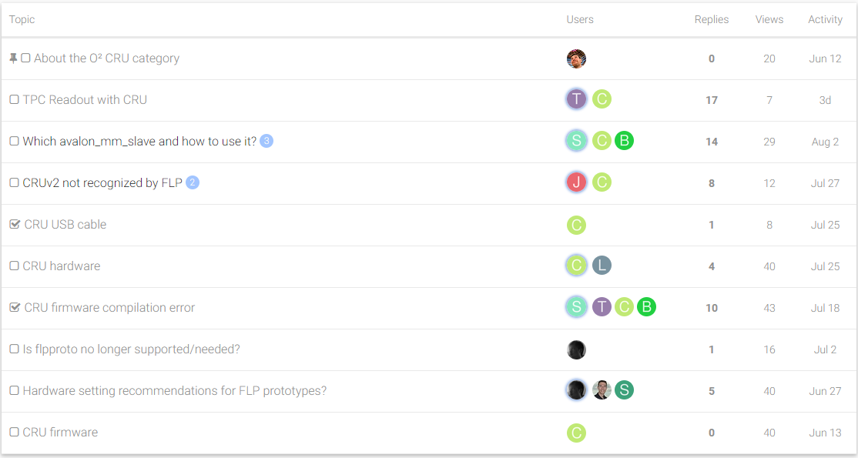
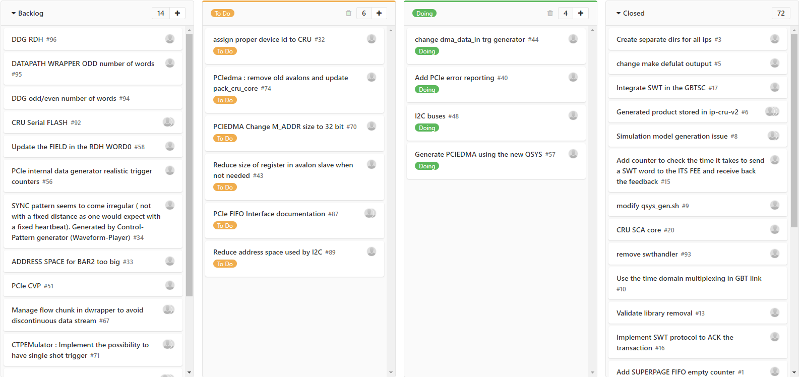
Feedback report with several detector groups
https://alice-talk.web.cern.ch/c/o2-cru
https://gitlab.cern.ch/alice-cru/pcoresng-cru/boards?=

Slide 3
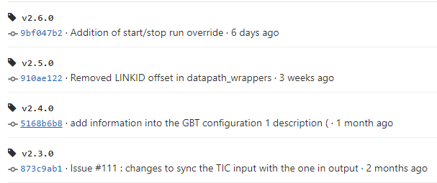
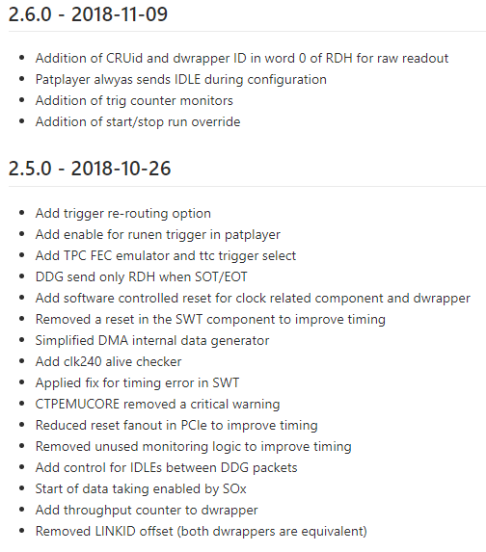
Firmware TAG releases

Slide 4
Main feature currently implemented
Readout :
  Continuous.
  Packet.
TRIGGER :
  CTP emulator : HB and Triggers (Sox, Eox, PHYSICS).
  LTU communication.
  PatPlayer : detector “triggered” specific pattern.
  MID trigger.
Slow Control :
  SCA.
  SWT.
Integration of Detector User Logic.
DDG (Detector Data Generator) : continuous/packet mode.

Slide 5
Next milestone
During the last SYSTEM UPGRADE the CRU Team presented the “Update on the readout control protocol”
For more details click here

Slide 6
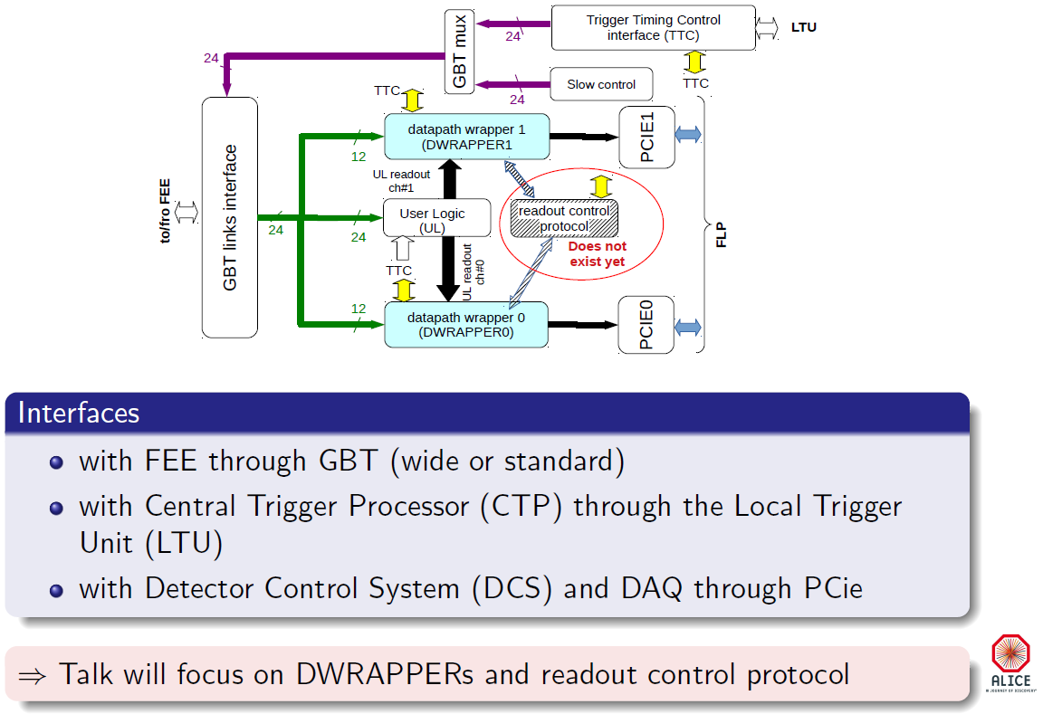
Major highlights
Implementation of the new “readout control protocol” in the CRU

Slide 7
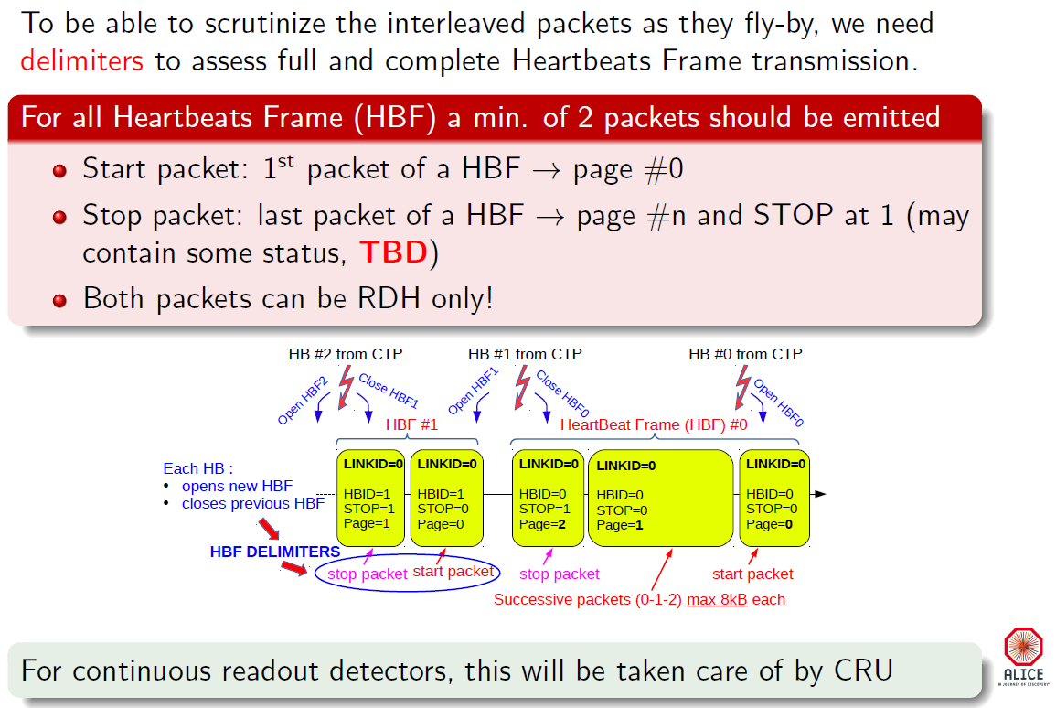
Major highlights
Implementation of the new “readout control protocol” in the CRU
Modification to the data transmission protocol

Slide 8
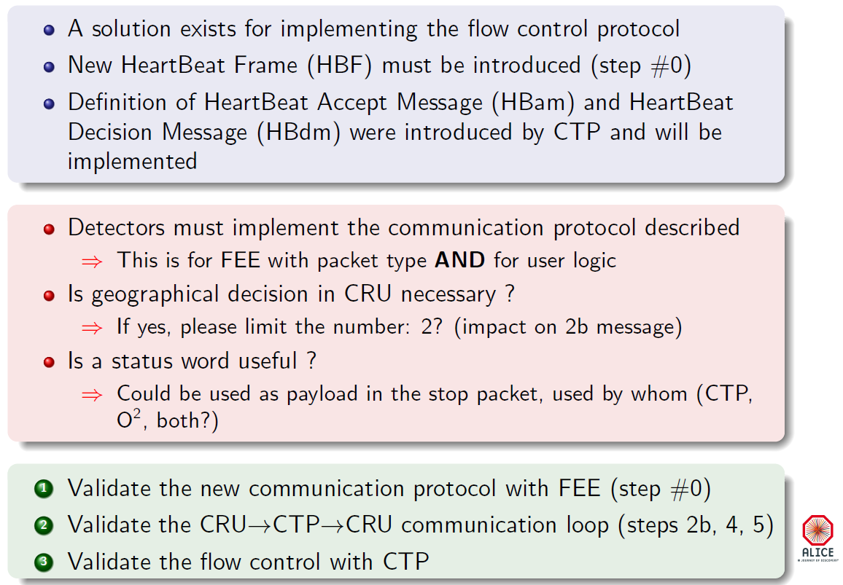
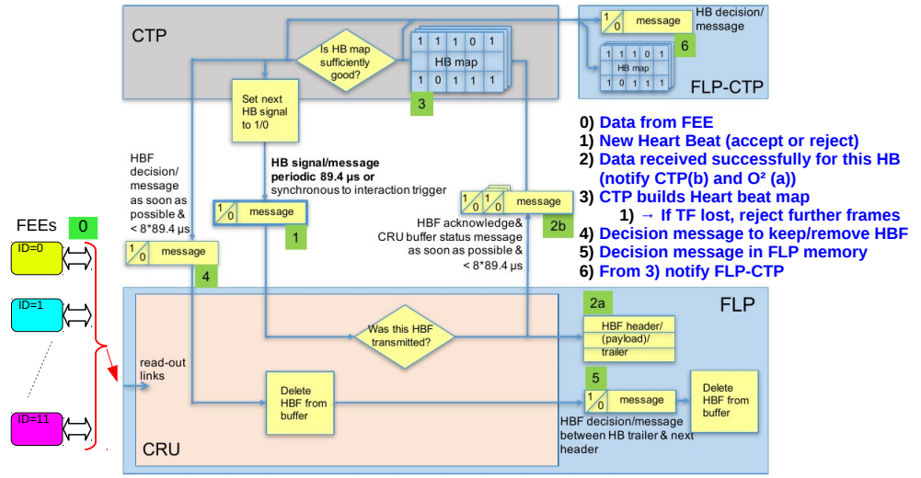
Major highlights
Implementation of the new “readout control protocol” in the CRU
Modification to the data transmission protocol
CONLCUSIONs

