Slide 1
Some considerations on the future
Y. Kwon (Yonsei) in discussion with L. Musa (CERN)

Slide 2
Active target
Initiation by L. Musa
  Beam split option (LHC)
  Event & their reconstruction inside the active target
  Like digital emulsion chamber (based on the fine spatial resolution)

Slide 3




Fixed Target @ LHC
$$7 TeV p$$
→
$$y_{beam}=9.6$$
$$2.5 TeV/u$$
→
$$y_{beam}=8.6$$
(35A GeV + 35A GeV)
RHIC-like condition with large forward acceptance,
pixel detector with extremely fine granule!

Slide 4
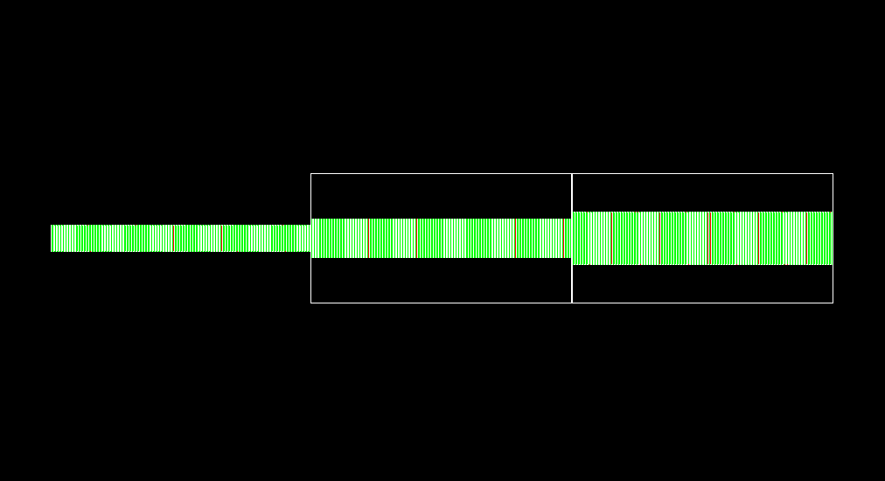
Trial version 6 months ago
Magnet 1 volume
(1T x 1m)
Magnet 2 volume
(1 T x 1 m)
TAct
Active Target
TRAC
TRID
T0
Timing Station
TRAC : Tracking station
TRID : ID & Tracking

Slide 5
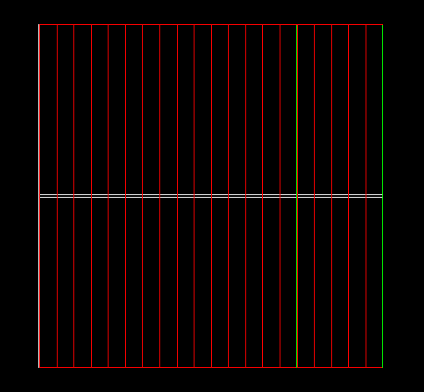
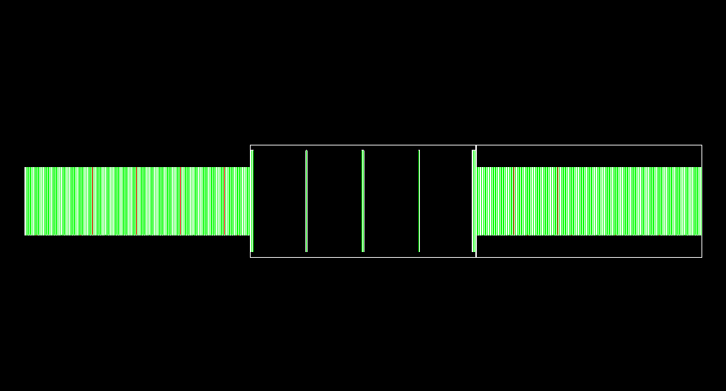
Trial version
Beam
TACT
TRAC
TRID
MUID

Slide 6
Geometric acceptance
Some dependence on the initial distribution, but large acceptance ≥ 80%.
Open issue: Cooperation with barrel in the collider mode towards very fine backward measurement and full kinematic coverage.
  Missing forward & backward measurement at RHIC. “CGC”
  Large rapidity correlation such as beam-target pair related.
  Diffraction physics.

Slide 7
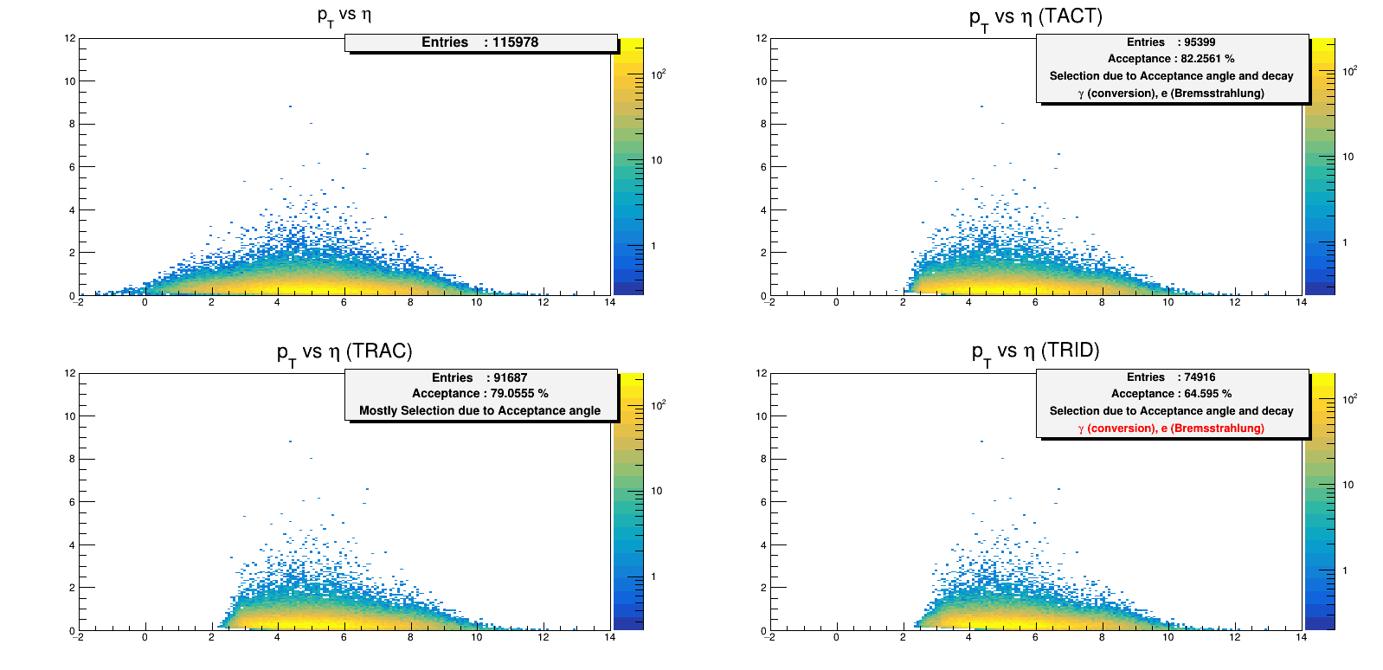

Acceptance analysis for $π^{±}$

Slide 8
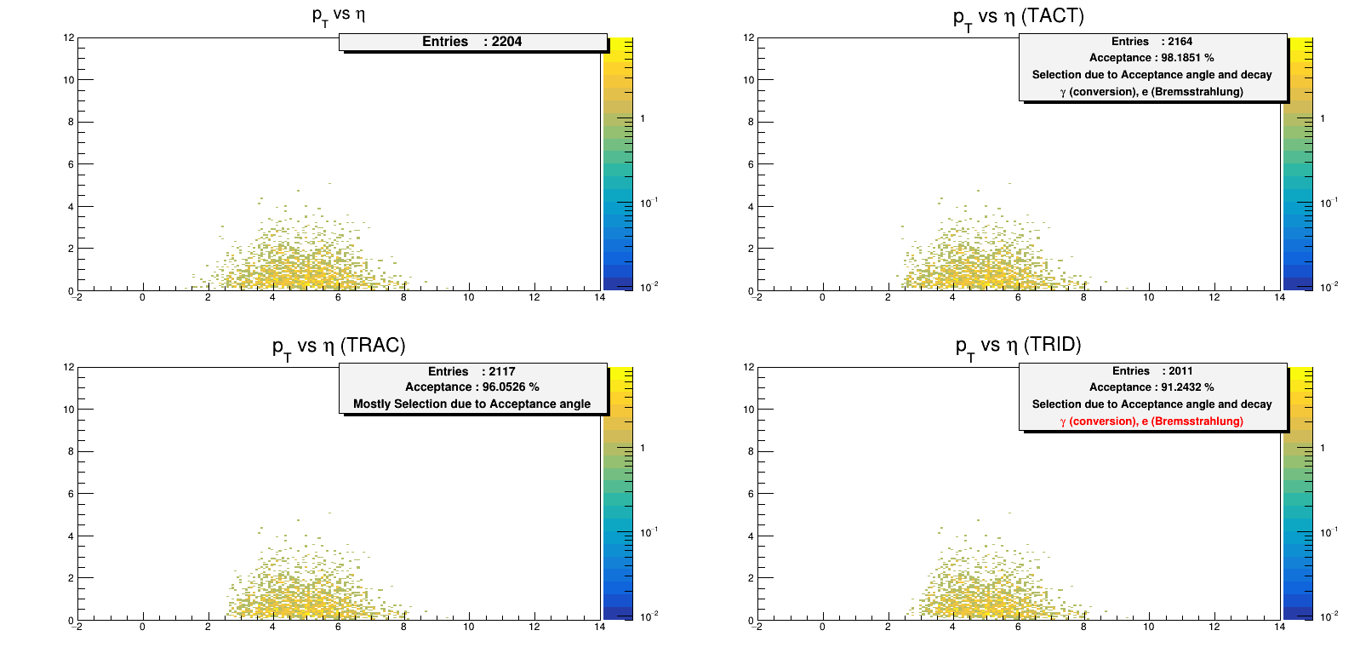

Acceptance analysis for $μ^{−}$

Slide 9
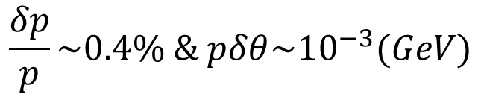


Single particle resolution
Assumed pixel sensor
  Fully depleted model, 20 (μ) x 20 (μ) pixel
  50 (μ) thick
  Additional 50 (μ) thick Aluminum backplane
  Arbitrary spacing between sensor layers, 5 (mm)
$$\frac{δp}{p}\sim 0.4\% \& pδθ\sim {10}^{−3}(GeV)$$
at low momentum and slow increase with p.
Prong vertex: vertex with multi-charged particles
Lateral position resolution
$$\sim 3(μ)$$
Longitudinal position resolution
$$\sim 1(mm)$$

Slide 10
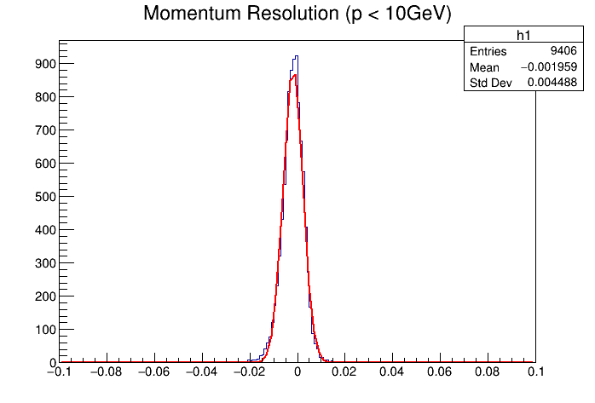
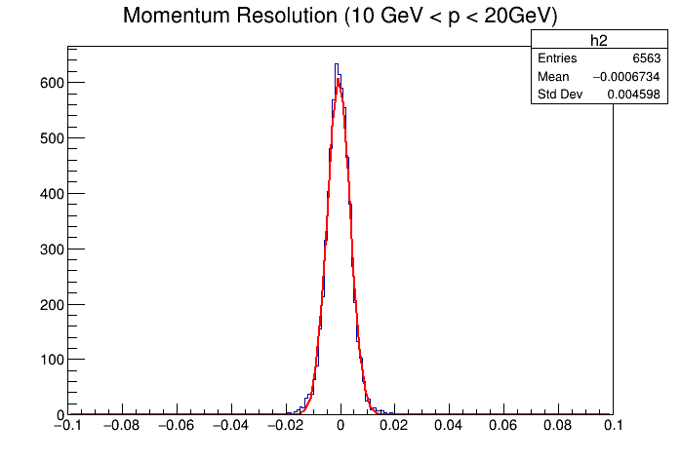
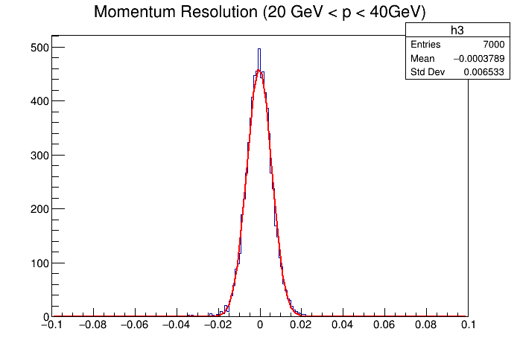
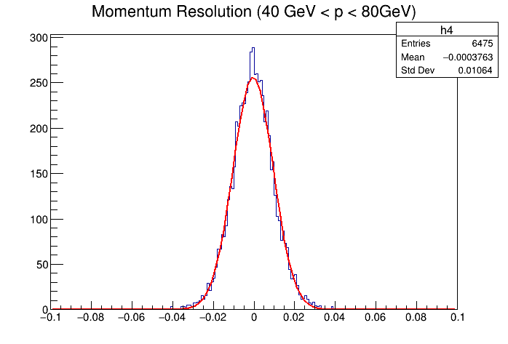
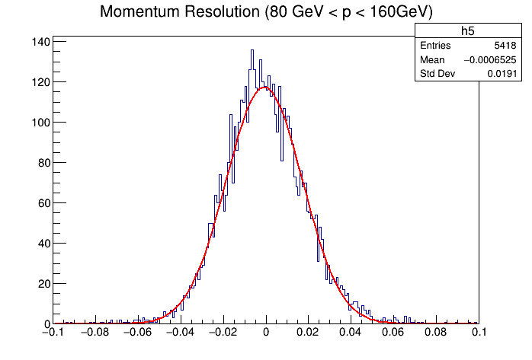
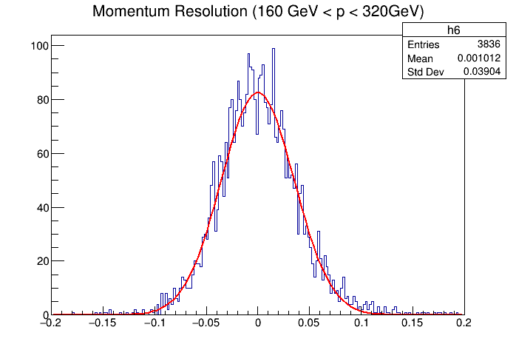
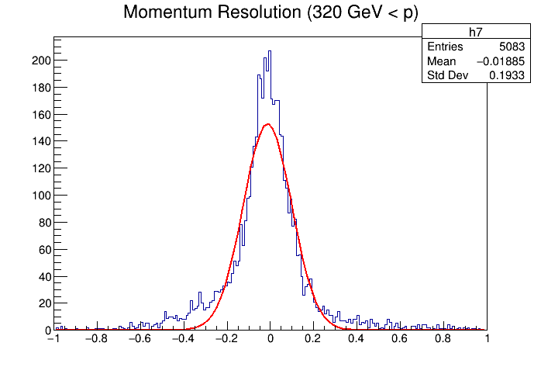


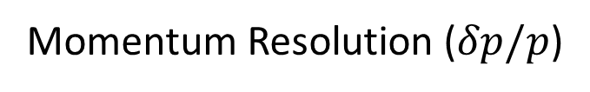





Momentum Resolution ($δp/p$)
$σ=0.0045$
$σ=0.0046$
$σ=0.0065$
includes beam
$σ=0.011$
$σ=0.019$
$σ=0.039$
$σ=0.193$
Using simulated Pythia events (MSEL=5)

Slide 11
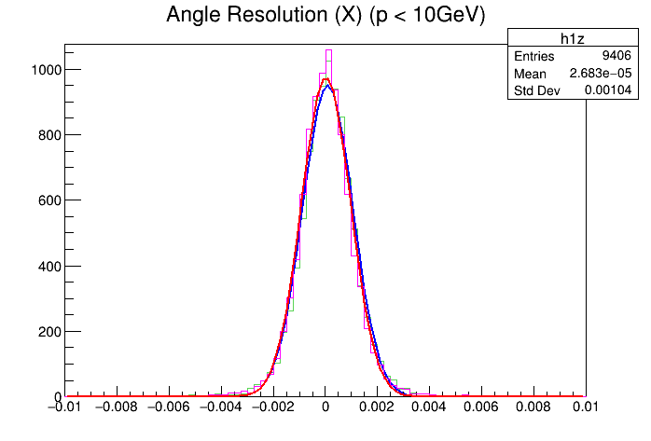
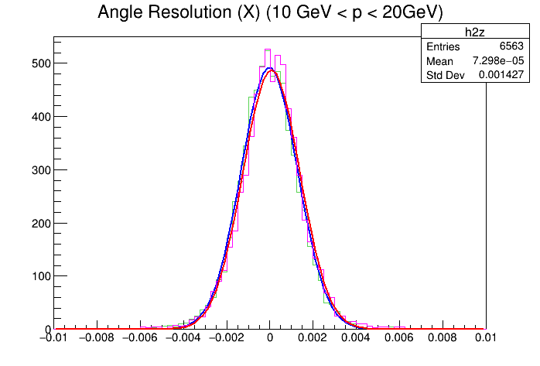
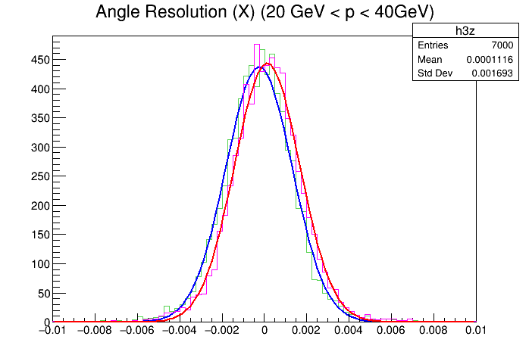
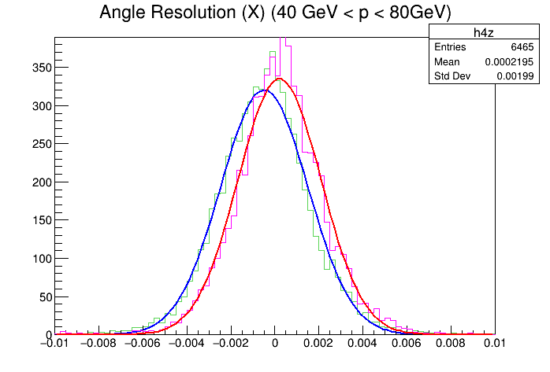
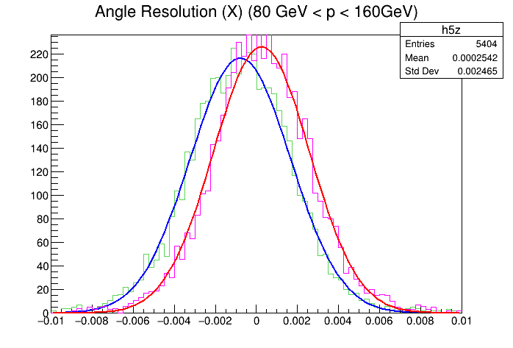
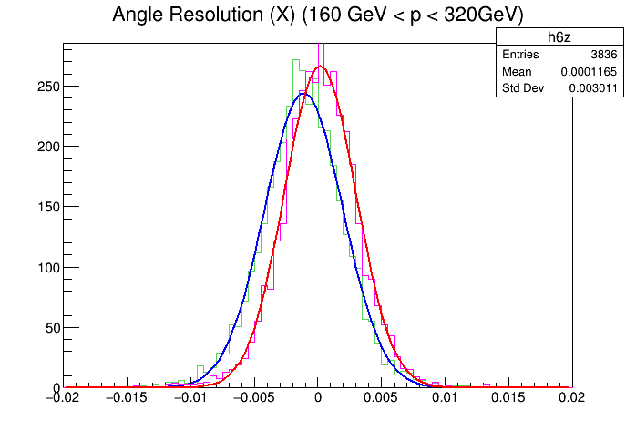
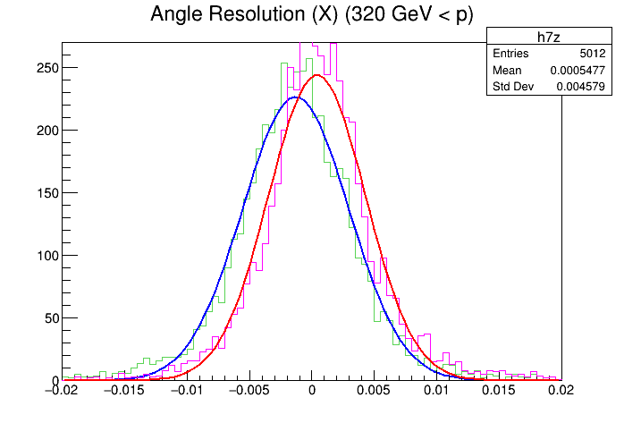





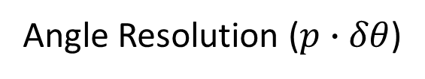


Angle Resolution ($p∙δθ$)
$σ_{x}=0.0011$
$σ_{z}=0.0010$
$σ_{x}=0.0014$
$σ_{z}=0.0014$
$σ_{x}=0.0017$
$σ_{z}=0.0017$
$σ_{x}=0.0021$
$σ_{z}=0.0020$
$σ_{x}=0.0026$
$σ_{z}=0.0025$
$σ_{x}=0.0033$
$σ_{z}=0.0030$
$σ_{x}=0.0049$
$σ_{z}=0.0046$
Using simulated Pythia events (MSEL=5)

Slide 12
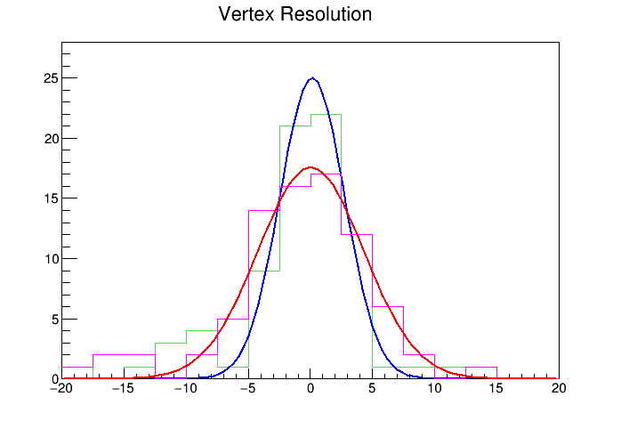
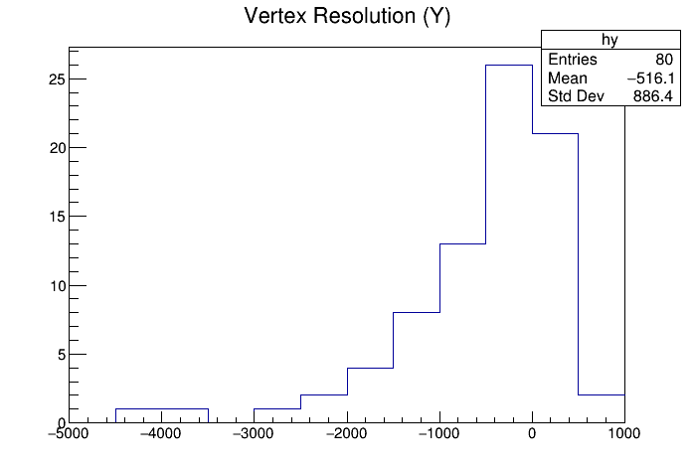


Vertex Resolution
B decay vertex (@ MSEL5 Single p-p Events, Total 100 Events each)
(X,Z)
$$σ_{x}=2.6 μm$$
$$σ_{z}=4.2 μm$$
($μm$)
($μm$)

Slide 13
Heavy flavor measurement

Slide 14
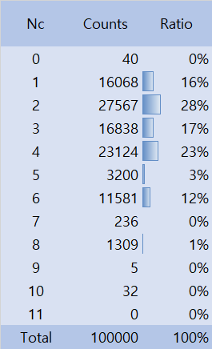

Main decay modes that counts charged particles from $Ξ_{cc}^{++}$
~50% ↑
We excluded neutral particles with strangeness from counting

Slide 15
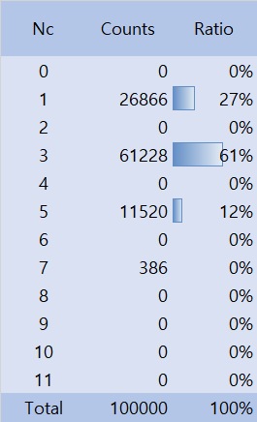
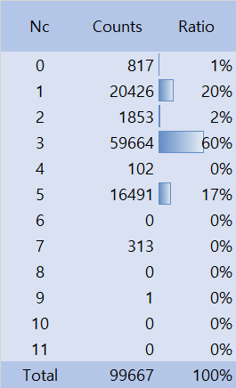


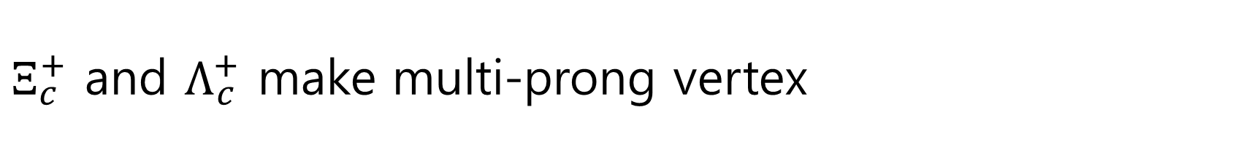
$Ξ_{c}^{+}$ and $Λ_{c}^{+}$ make multi-prong vertex
The number of charged particles Nc distribution
$$Ξ_{c}^{+}$$
$$Λ_{c}^{+}$$
Ignored uncategorized data fraction of 3%
~70% ↑
~70% ↑
We excluded neutral particles with strangeness from counting

Slide 16
Near future plan
Connected prong vertexes with charge carrying baryons
Prong vertexes with associated single hard lepton

Slide 17
e(μ) pair mass resolution

Slide 18
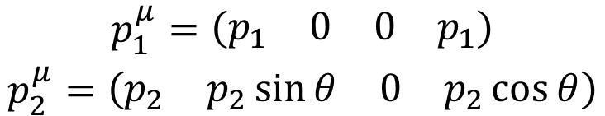
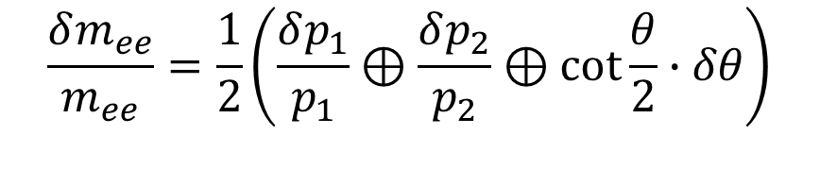
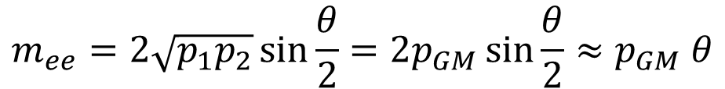

Simple formula for lepton pair mass
Assume and taking electron 1 direction as z,
$$m_{e}≪m_{ee}, p_{1},p_{2}$$
$$\begin{matrix}p_{1}^{μ}=\left(\begin{matrix}\begin{matrix}p_{1} & 0\end{matrix} & \begin{matrix}0 & p_{1}\end{matrix}\end{matrix}\right) \\ p_{2}^{μ}=\left(\begin{matrix}\begin{matrix}p_{2} & p_{2}\sin{θ}\end{matrix} & \begin{matrix}0 & p_{2}\cos{θ}\end{matrix}\end{matrix}\right)\end{matrix}$$
$$m_{ee}^{2}={\left({p_{1}+p}_{2}\right)}^{μ}{\left({p_{1}+p}_{2}\right)}_{μ}=2p_{1}^{μ}∙p_{2μ}=2p_{1}p_{2}\left(1−\cos{θ}\right)=4p_{1}p_{2}\sin^{2}\frac{θ}{2}$$
$$\frac{δm_{ee}}{m_{ee}}=\frac{1}{2}\left(\frac{δp_{1}}{p_{1}}⊕\frac{δp_{2}}{p_{2}}⊕cot\frac{θ}{2}∙δθ\right)$$
$$m_{ee}=2\sqrt{p_{1}p_{2}}\sin{\frac{θ}{2}}=2p_{GM}\sin{\frac{θ}{2}}≈p_{GM} θ$$
at zero mass limit

Slide 19

Possible limitation for mass resolution at zero limit
The 1st look at angular resolution
Kalman filter suppresses multiple scattering, but momentum dependence of angular resolution suggests multiple scattering is still the dominant contributor. If better resolution is needed,
  smaller pixel size will be effective linearly,
  and less material per unit distance will help if possible (!).
$$pδθ\sim {10}^{−3}(GeV)$$

Slide 20
Particle physics for the charmed and bottomed
Our strength
Acquired experience for large volume pixel detector.
Still away from industrial scale, but closest to the scale (new dimension in experience)

Slide 21
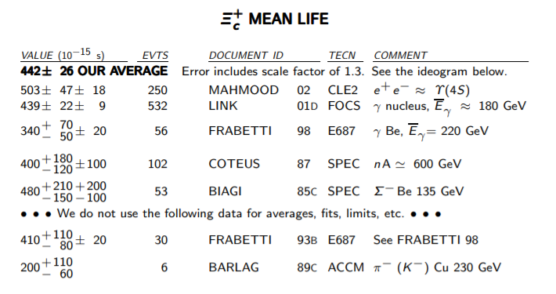

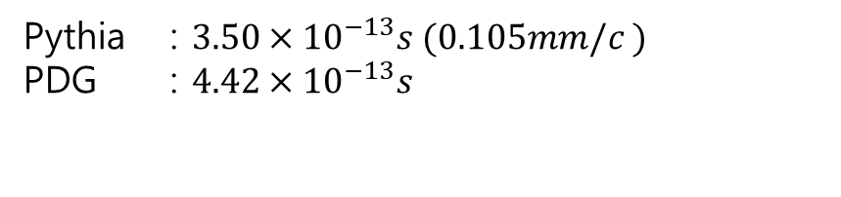
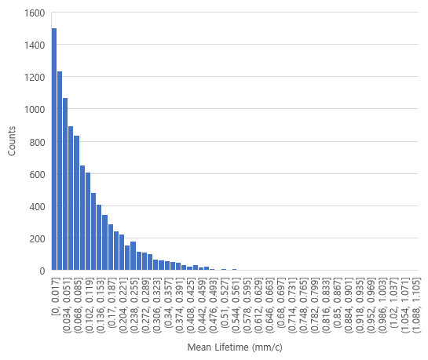
$Ξ_{c}^{+}$ Lifetime from Pythia vs PDG – reconstructed prong vertex?
Pythia : $3.50×{10}^{−13}s (0.105mm/c )$
PDG : $4.42×{10}^{−13}s$

Slide 22
Decay modes
Particle ID?
Some constraints for Leptonic modes?

