Slide 1
Studies on novel detector concepts
J. Kim (Yonsei Univ., Speaker), Prof. Y. Kwon (Yonsei Univ.), L. Musa (CERN)
12th ALICE ITS upgrade, MFT and O2 Asian Workshop – 2018, 21 Nov. 2018

Slide 2
Contents
  Kalman Tracking
    Tracking Algorithm
    Tracking Efficiency
    Momentum / Angle Resolution
    Limitations and Future Plan
  Vertex Reconstruction
    Efficiency for B / D meson
    Vertex Position Resolution
    Limitations and Future Plan

Slide 3
Kalman Tracking

Slide 4
Tracking Algorithm
Initial Helix Construction at TRAC
1. Make 3 "Helix Seed" (Tracklet) for 3 Pivot points.
Clustering hits inside of distance cut
(30, 75, 150 um for each X, 30 um for Z)
2. Divide "Multiple Hits Seed" into Single one.
Apply Track Slope Criteria
3. Construct Helix for all available combinations
Currently we assumed that Hit efficiency is 100%
→ Efficiency factor should be considered.
Seed 1
Seed 2
Seed 3
TRAC : 10 Layers

Slide 5
Tracking Algorithm
Verification step for Helix candidates
1. Check hit validity by using verification layer 1 and 2
Real helix can find hits at verification layers, within (distance cut) = 300 / 400 um for each.
2. Check linearity of 3 seeds for Z direction
(Parallel to B-field direction)
within (distance error) = 500 um
After confirmation, Do Kalman Filter for rest detectors (TRAC/TACT…)
Verification Layer 1/2
TRAC : 10 Layers

Slide 6
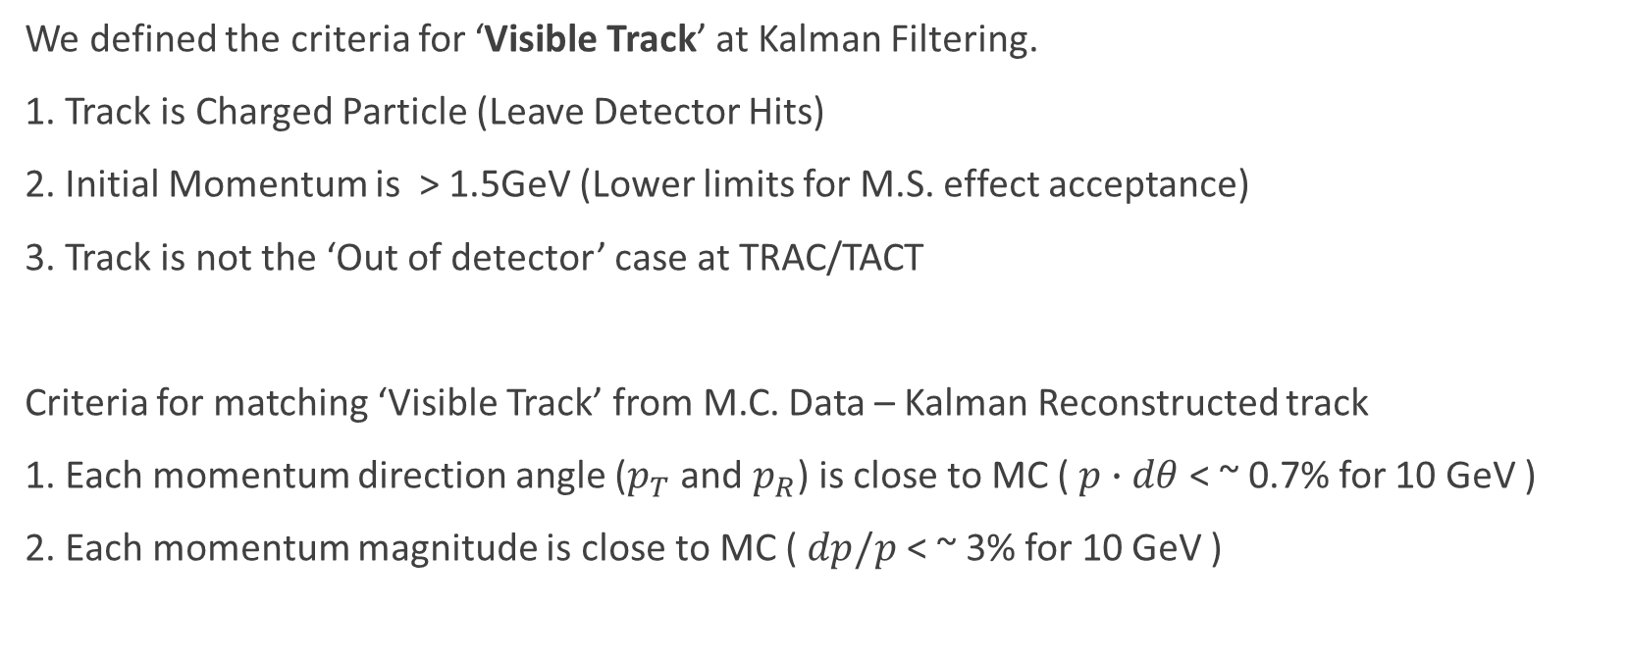
Kalman Tracking Efficiency
We defined the criteria for ‘Visible Track’ at Kalman Filtering.
1. Track is Charged Particle (Leave Detector Hits)
2. Initial Momentum is > 1.5GeV (Lower limits for M.S. effect acceptance)
3. Track is not the ‘Out of detector’ case at TRAC/TACT
Criteria for matching ‘Visible Track’ from M.C. Data – Kalman Reconstructed track
1. Each momentum direction angle ($p_{T}$ and $p_{R}$) is close to MC ( $p∙dθ$ < ~ 0.7% for 10 GeV )
2. Each momentum magnitude is close to MC ( $dp/p$ < ~ 3% for 10 GeV )

Slide 7
Kalman Tracking Efficiency
(@ MSEL5 Single p-p Events, Total 2000 Events)
We reconstructed 43785 tracks out of 45533 'Visible Tracks'. (~ 96%)

Slide 8
Kalman Tracking Efficiency – Failed Cases
Specific examples for Kalman tracking failed cases
1. Kink (Momentum Deflection) can cause Kalman failing at TACT.
  1400 cases ( ~ 3.1% of total found tracks)
ex) run002 Event#0 Track#21 : Delta ray Generation
run002 Event#1 Track#2 : Hadron Interaction
… …
2. Initial helix is not constructed.
  326 cases ( ~ 0.7 % of total found tracks)
→ Refine Helix construction criteria.

Slide 9
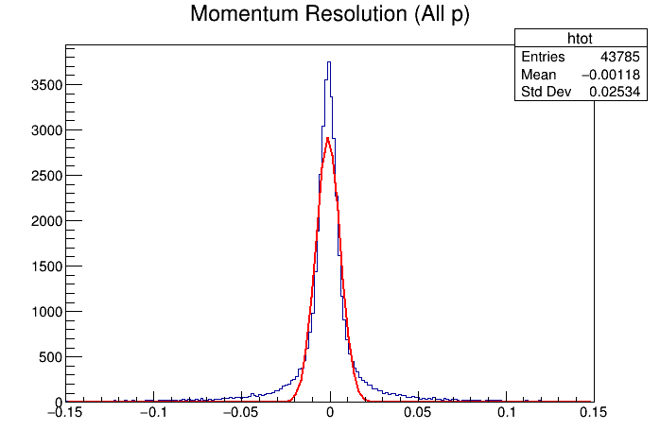
Kalman Tracking Resolution
(@ MSEL5 Single p-p Events, Total 2000 Events)
Momentum Resolution ($δp/p$): $σ=0.025$ (for All range of $p$)

Slide 10
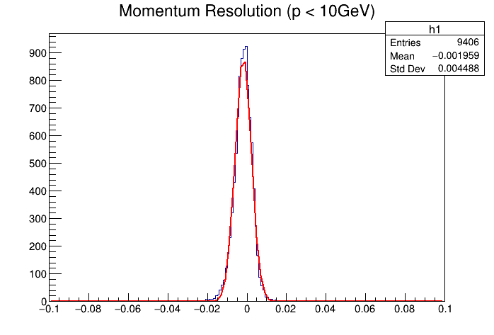
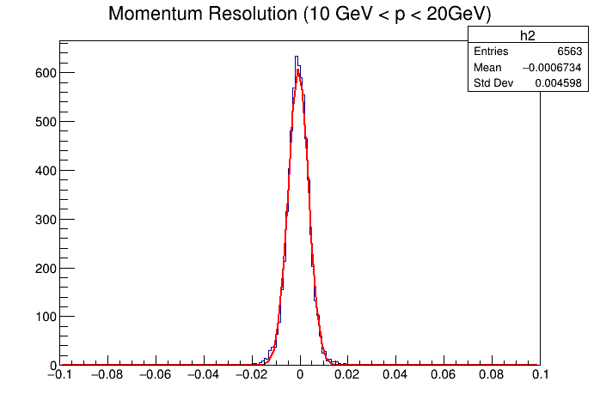
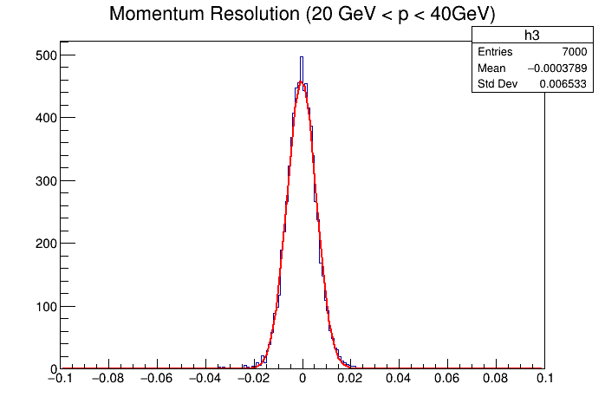
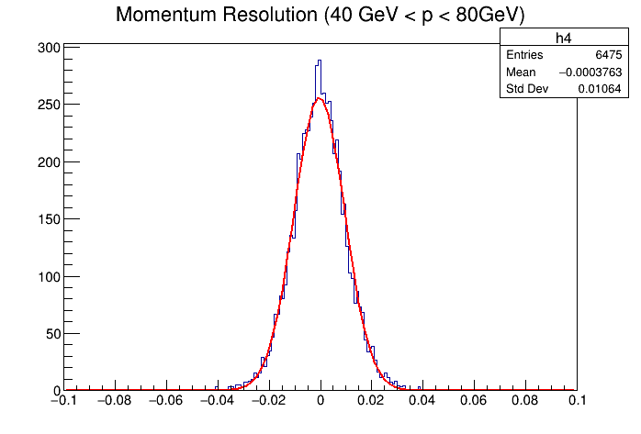
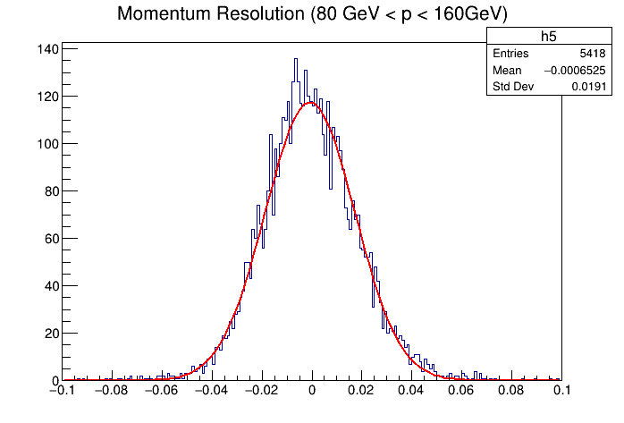
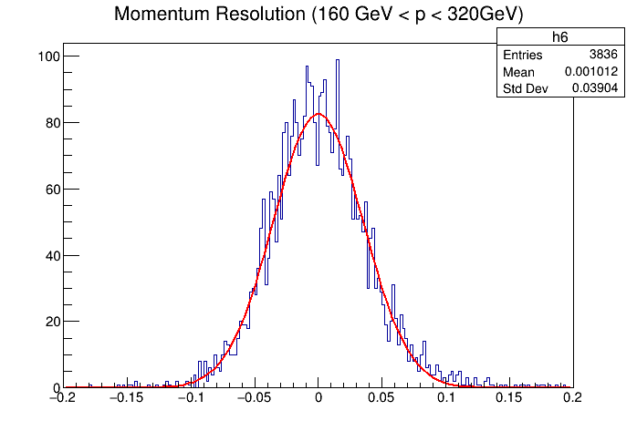
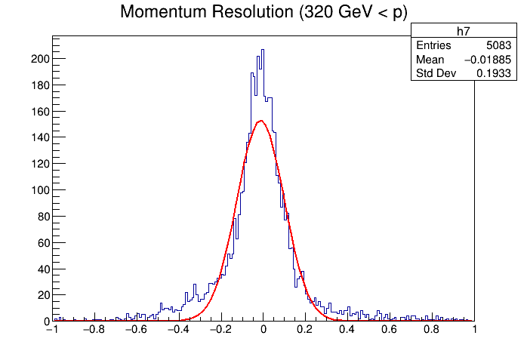


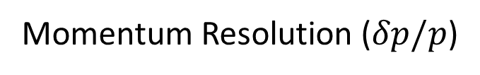





Momentum Resolution ($δp/p$)
$σ=0.0045$
$σ=0.0046$
$σ=0.0065$
$σ=0.011$
$σ=0.019$
$σ=0.039$
$σ=0.193$

Slide 11
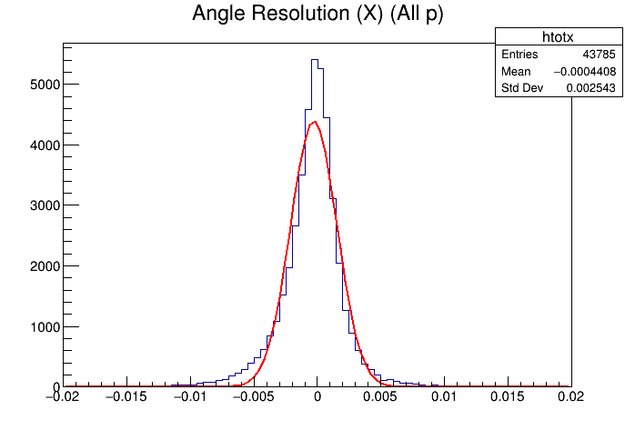
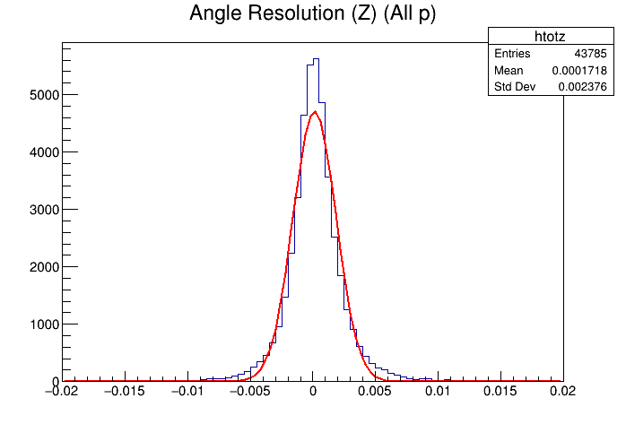


Kalman Tracking Resolution
Angle Resolution ($p∙δθ$) at Decay Vertex, All range of $p$ = 0.0025 ($rad∙GeV$, X direction)
(Beam Direction = Y) 0.0024 ($rad∙GeV$, Z direction)
$σ=0.0025$
$σ=0.0024$

Slide 12
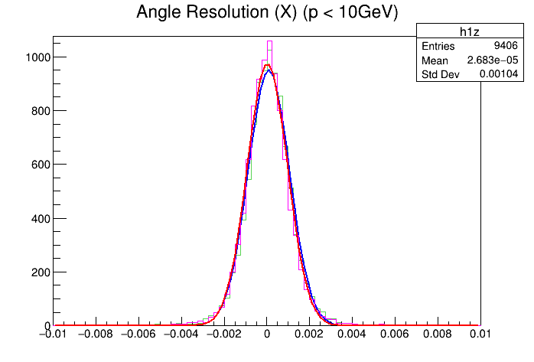
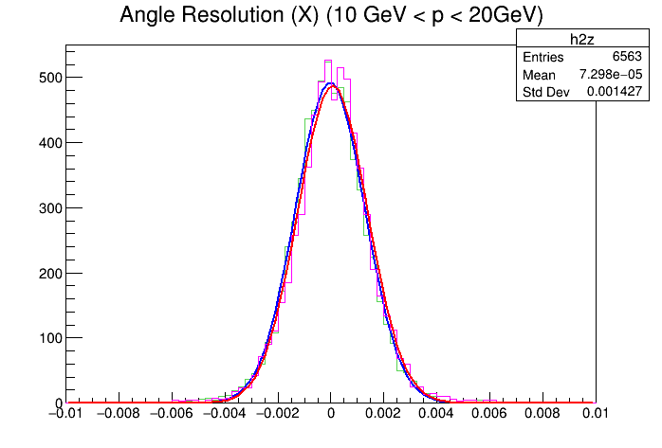
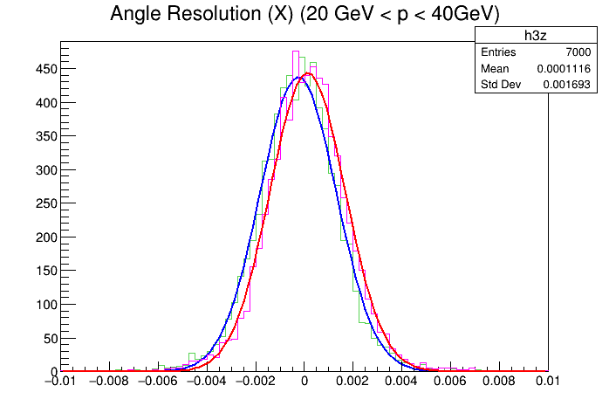
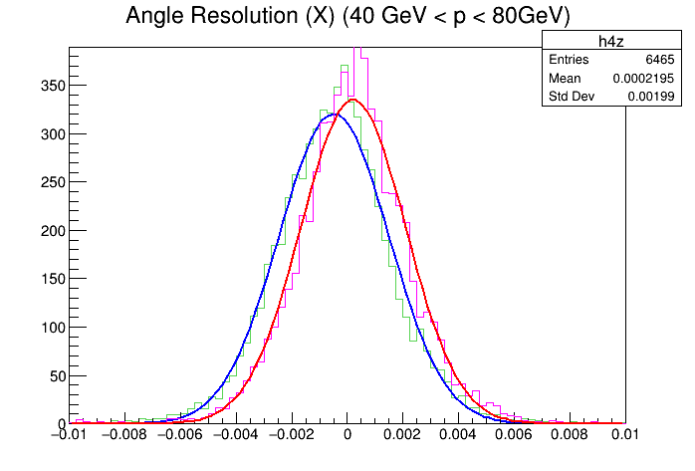
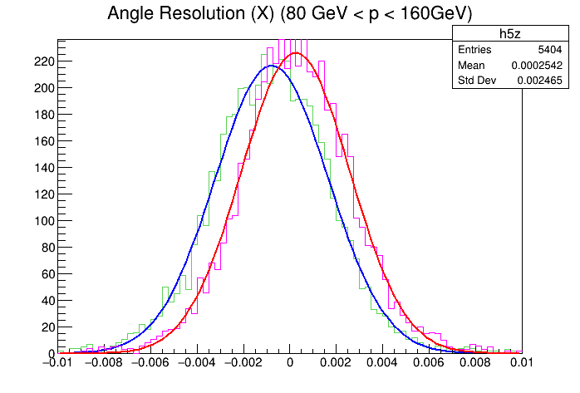
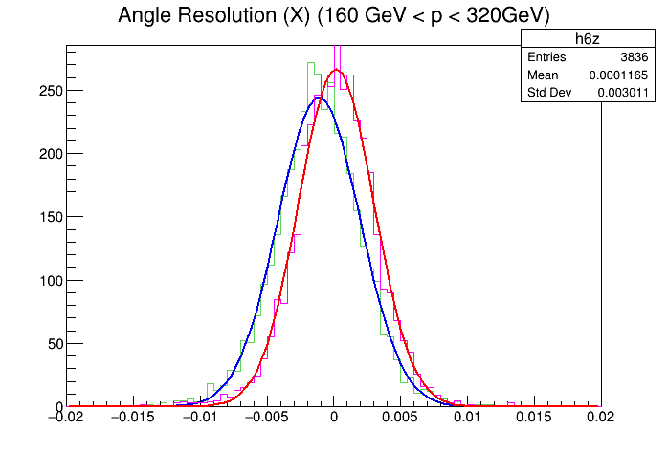
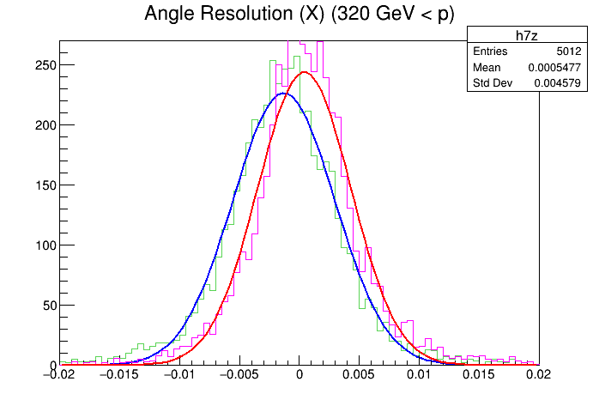





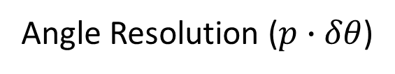


Angle Resolution ($p∙δθ$)
$σ_{x}=0.0011$
$σ_{z}=0.0010$
$σ_{x}=0.0014$
$σ_{z}=0.0014$
$σ_{x}=0.0017$
$σ_{z}=0.0017$
$σ_{x}=0.0021$
$σ_{z}=0.0020$
$σ_{x}=0.0026$
$σ_{z}=0.0025$
$σ_{x}=0.0033$
$σ_{z}=0.0030$
$σ_{x}=0.0049$
$σ_{z}=0.0046$

Slide 13
Kalman Tracking – Limitations&Way to Improvement
We got 96% Track finding efficiency, 0.025 momentum resolution, 0.0025 angle resolution.
We have following limitations for current algorithm.
1. We can find only tracks which passes all of TACT – TRAC detector.
2. We have some background (ghost) tracks problem, causing confusion when vertex finding
So, we plan to revise them.
1. Apply more precise cut for helix construction&verification to reject background tracks.
2. Apply searching windows when constructing initial 'helix seed'.

Slide 14
Decay Vertex Reconstruction
for D / B meson Vertices

Slide 15
Vertex Reconstruction Algorithm
We applied following vertex construction criteria :
1. For all Kalman-success tracks at TACT detector,
2. Scan for all TACT detector layer (with expolation between each layers for 500 um interval)
3. Make vertex suspects for approaching tracks each other (< 15 um latteral distance)
4. Delete duplicated vertices, if exist. (Save most upstream vertex)
and, compare to real vertex information what we have to find.

Slide 16
Vertex Reconstruction – D meson
D decay vertex (@ MSEL5 Single p-p Events, Total 100 Events)
Looking for “D ($D^{0}{\overline{D}}^{0}D^{+}D^{−}D_{s}^{+}…$) to Charged Particle” Decay Mode
# of Charged Tracks | (Quantity) | # of Trackable Tracks | (Quantity)
0 | 4 | 0 | 4
1 | 40 | 0 | 8
 |  | 1 | 32
2 | 102 | 0 | 4
 |  | 1 | 24
 |  | 2 | 74
3 | 48 | 0 | 0
 |  | 1 | 1
 |  | 2 | 16
 |  | 3 | 31
4+ | 21 | 0 | 0
 |  | 1 | 0
 |  | 2 | 1
 |  | 3 | 2
 |  | 4 | 18
Total Vertex | 215
0 Trackable Track | 12
1 Trackable Track | 57
2+ Trackable Track | 142
~ 67.0%

Slide 17
Vertex Reconstruction – D meson
Beam Direction = Y

Slide 18
Vertex Reconstruction – D meson

Slide 19
Vertex Reconstruction – B meson
B decay vertex (@ MSEL5 Single p-p Events, Total 100 Events)
Looking for “B ($B^{0}{\overline{B}}^{0}B^{+}B^{−}B_{s}^{0}…$) to Charged Particle” Decay Mode
# of Charged Tracks | (Quantity) | # of Trackable Tracks | (Quantity)
2 | 73 | 0 | 38
 |  | 1 | 35
 |  | 2 | 0
3 | 28 | 0 | 1
 |  | 1 | 13
 |  | 2 | 14
 |  | 3 | 0
4+ | 81 | 0 | 0
 |  | 1 | 2
 |  | 2 | 11
 |  | 3 | 30
 |  | 4 | 38
Total Vertex | 182
0 Trackable Track | 39
1 Trackable Track | 50
2+ Trackable Track | 93
~ 51.1%

Slide 20
Vertex Reconstruction – B meson
Beam Direction = Y

Slide 21
Vertex Reconstruction – B meson

Slide 22
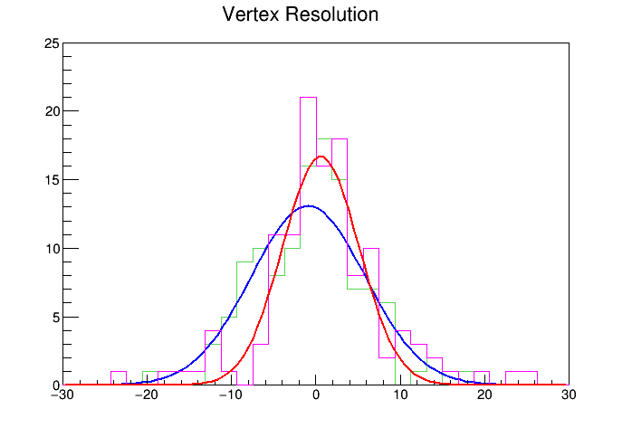
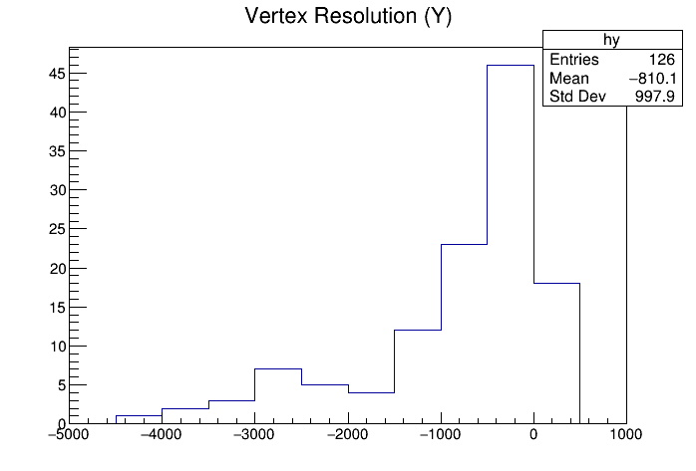


Vertex Resolution
D decay vertex (@ MSEL5 Single p-p Events, Total 100 Events each)
(X,Z)
$$σ_{x}=6.4 μm$$
$$σ_{z}=5.8 μm$$
($μm$)
($μm$)

Slide 23
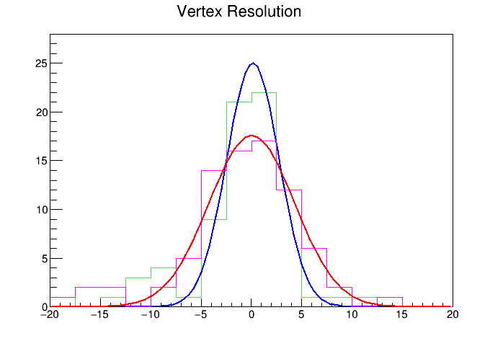
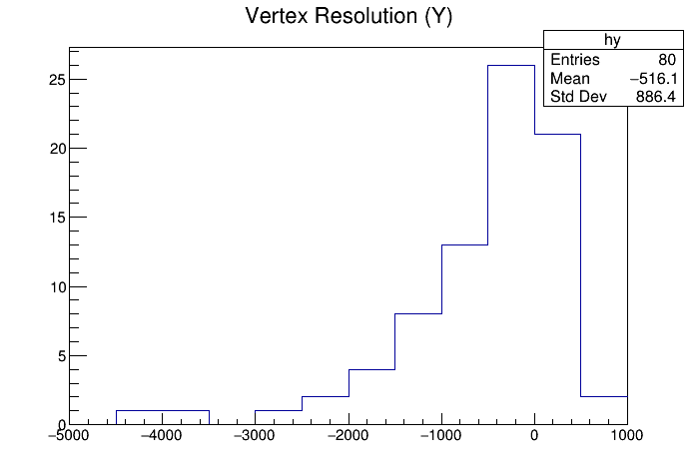

Vertex Resolution
B decay vertex (@ MSEL5 Single p-p Events, Total 100 Events each)
(X,Z)
$$σ_{x}=2.6 μm$$
$$σ_{z}=4.2 μm$$
($μm$)
($μm$)

Slide 24
Vertex Finding – Limitations&Way to Improvement
Current Limitations:
1. We cannot find single charged track vertex (1-prong vertex).
2. Lower finding efficiency as vertex latteral position becomes smaller.
3. Track confusion problem when finding vertex.
4. Huge Y position resolution for some bad cases, due to hit confusion at Kalman filter.
Improvement:
1. Advance Kalman algorithm to find vertex using track kink.
2. Advance Kalman algorithm to consider hit density at TACT upstream.
3. Investigate new detector configurations at TACT upstream.

