Slide 1


Update: September 10
William Heidorn
Iowa State University
ISU Weekly Meeting
September 10, 2018

Slide 2
Current Status
Finishing up Chiller Ctrl Code
  It currently runs decently… Ironing out the bugs…
  Doing tests on flow measurements
  Need to develop flow rate controls
    User would set flow rate instead of booster pump value
Getting finalized Yale work list together
  Everything seems to be coming together for this trip
On my list to do
  Compare Grahams +40C measurements of Stave 2 with our data
  Impedance comparisons and descriptive write up of the process
  reRead current H->J/Psi Gamma draft paper

Slide 3
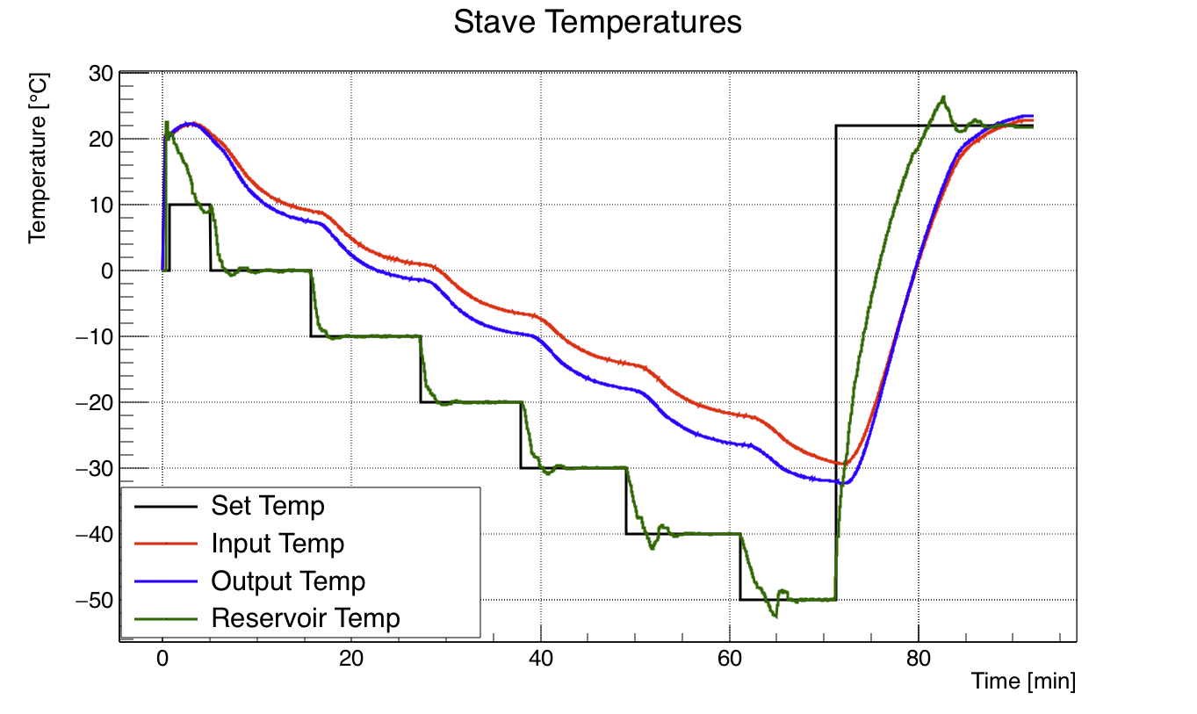
New ChillerCtrl Code Plots
Now measure chiller reservoir temp
  Shows how the chiller goes to set temps
Output Temp
Input Temp

Slide 4
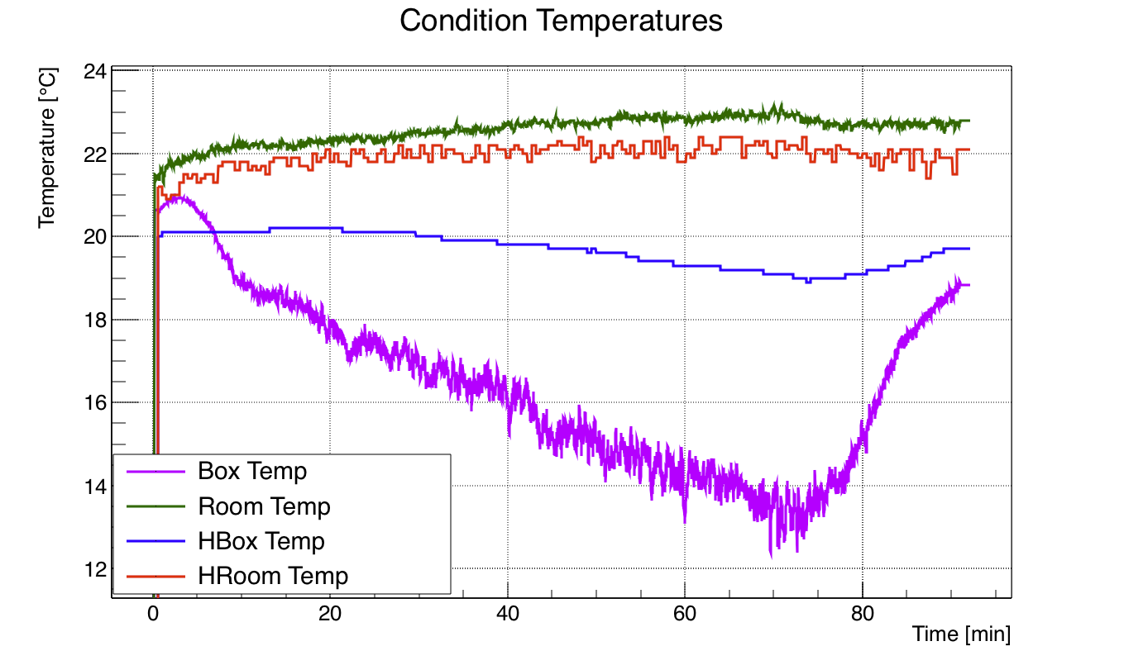
New ChillerCtrl Code Plots cont.
New Measurements of Hbox and Hroom!
  Hbox: Temperature at the humidity sensor in the enclosure
  Hroom: Temp probe in room also connected to humidity probe
The two box temperatures are very different
  BoxTemp has nitrogen convection cooling it!

Slide 5
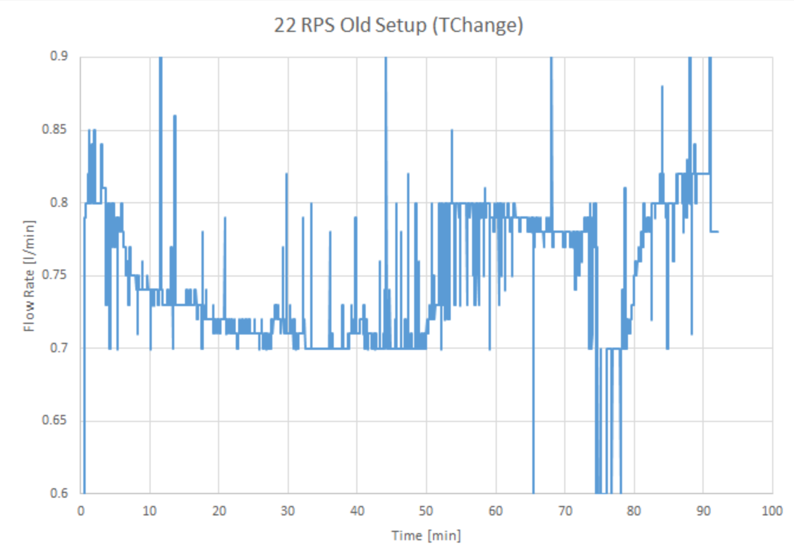
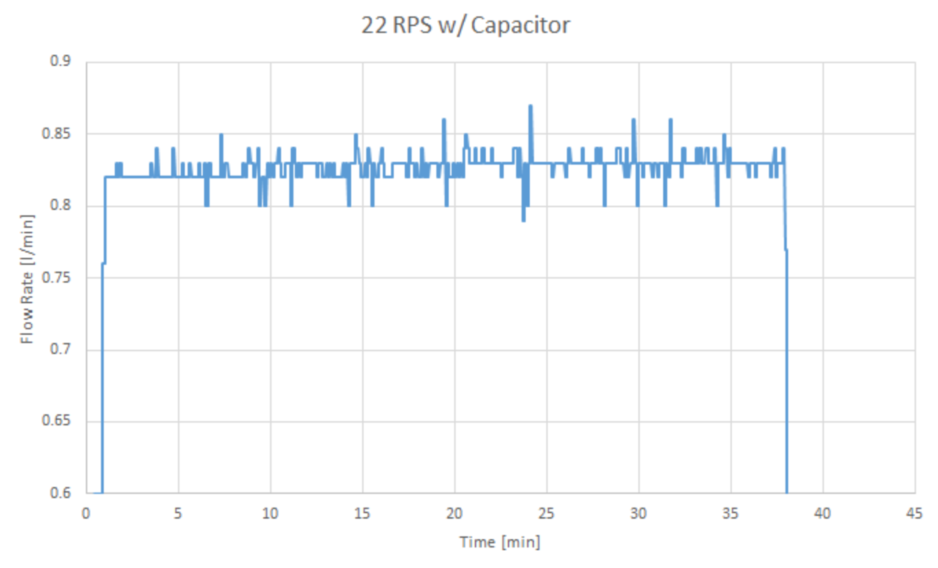
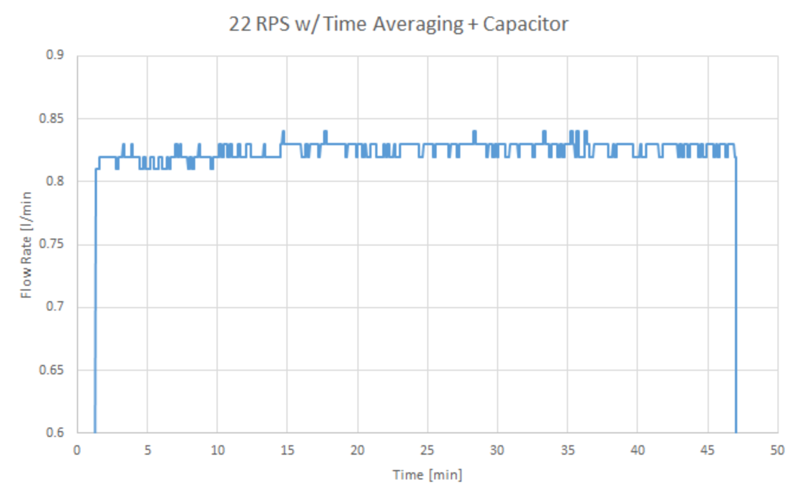
Flow Measurements
Found that there was noise in flow measurements
  Attempted to remove it all with a capacitor in parallel with the input signal
  Average is taken
    Measured every 2 seconds
    3 are average for each reported value

