Slide 1
Weekly Update
2018/09/10
Shuaiyan

Slide 2
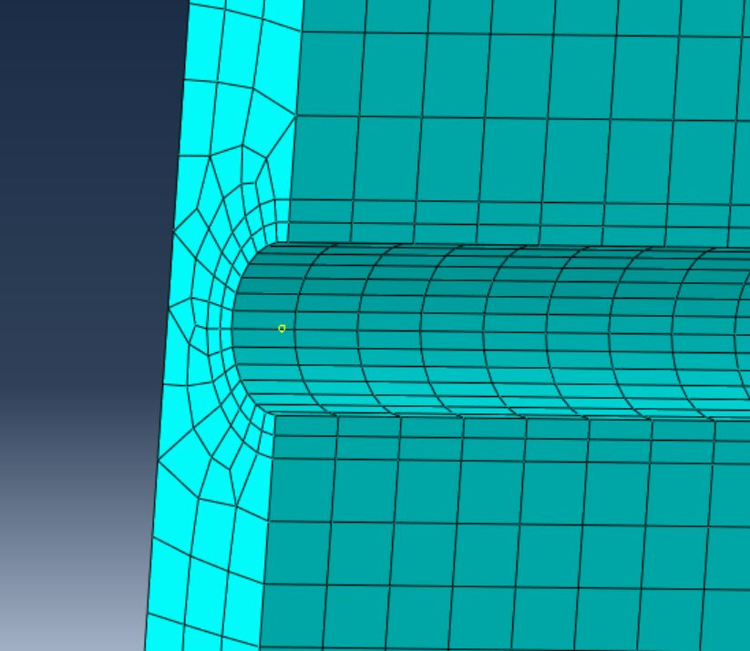
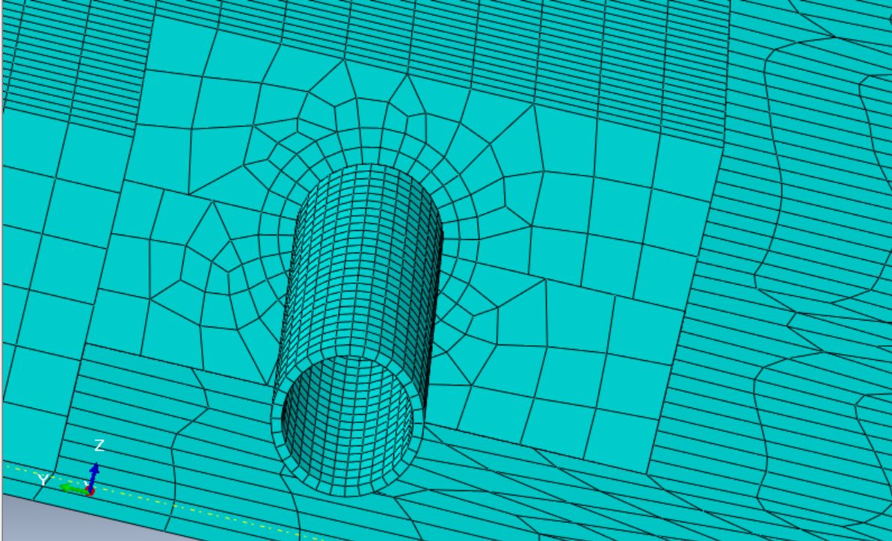
Qualification Task FEA Modeling
All the parts have been meshed. Fine elements were modeled around curves contacting the cooling pipe.
To do: model the stave PCB. Simulate the heat loads given by resistors.

