Slide 1
Efficient Energy Management for Particle Accelerators
Mike Seidel for WP4
PSI, CERN, CEA/Saclay, Univ.Uppsala, GSI, ESS

Slide 2
EEM: tasks
Task 1.1: Coordination (Mike Seidel, PSI)
Task 1.2: High Efficiency RF Power Sources (C.Marchand, P.Hamel, J.Plouin / CEA Saclay, R.Ruber / Univ.Uppsala)
Task 1.3: Energy efficient neutron production (Y.Charles, M.Wohlmuther, R.Bergmann / PSI, L.Zanini / ESS)
Task 1.4: High Efficiency SRF power conversion (A.Ivanov, F.Gerigk / CERN)
Task 1.5: Efficient operation of pulsed magnets (S.Haberer , P.Spiller / GSI)

Slide 3
Klystron - Principle
DC beam passes through input
  Electron beam is velocity modulated by RF gap voltage
Bunches of electrons are formed
Output cavity is excited by the bunches
Power is coupled out to load
RF input
RF output
Cathode
(DC Beam)
Collector
[C.Marchand, CEA]

Slide 4
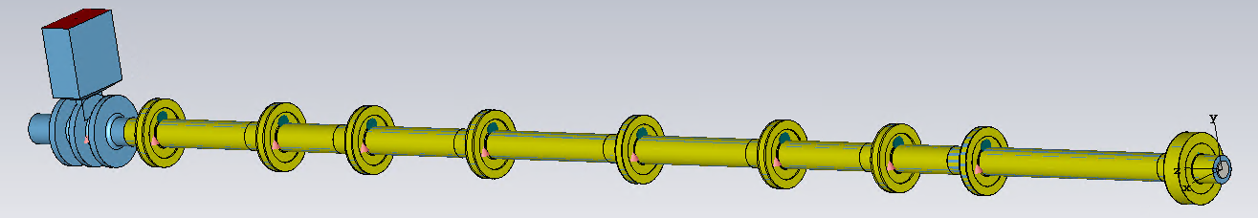
High Efficiency X-Band Klystron
CEA Saclay
Objectives:
  Provide a 3D RF design of a high efficiency klystron
Progress:
  Study has been focused on klystrons operating in the X band (12 GHz) (XFEL and CLIC RF-sources)
  Preliminary design has been optimized, based on a genetic algorithm. Efficiency of 70% has been reached so far.
  Results will be presented at IVEC 2019.
3 cells output cavity
Input cavity
INTERACTION LINE

Slide 5
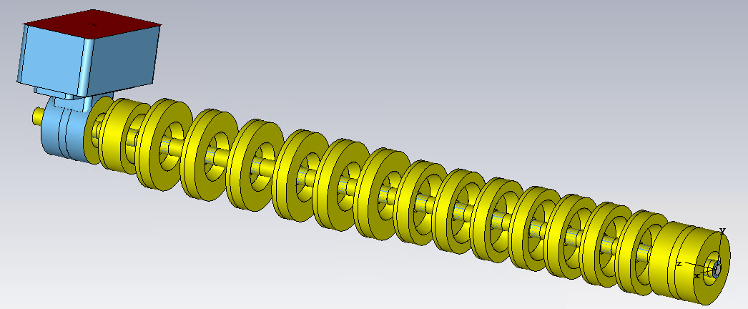
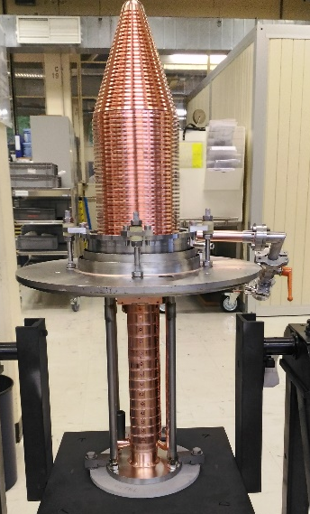
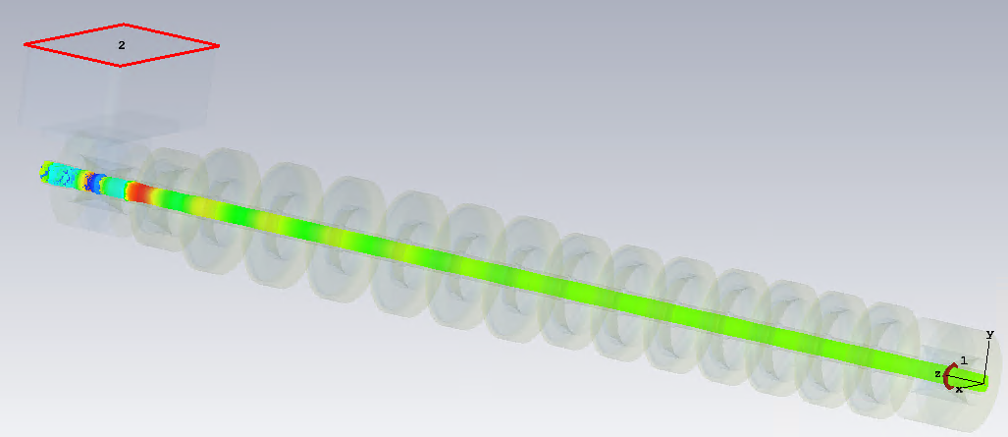
Klystron Design: Ongoing Work
Feedback from EUCARD²:
  During EUCARD², an efficient klystron for C-band (5 GHz) has been designed and manufactured.
  Tests: Because of spurious oscillations, the efficiency was lower than the expected one.
  Simulations are underway for understanding the cause of these oscillations:
  For the X-band klystron under design for ARIES, we will use advanced simulation tools to simulate properly theses oscillations and avoid them in the final design.

Slide 6



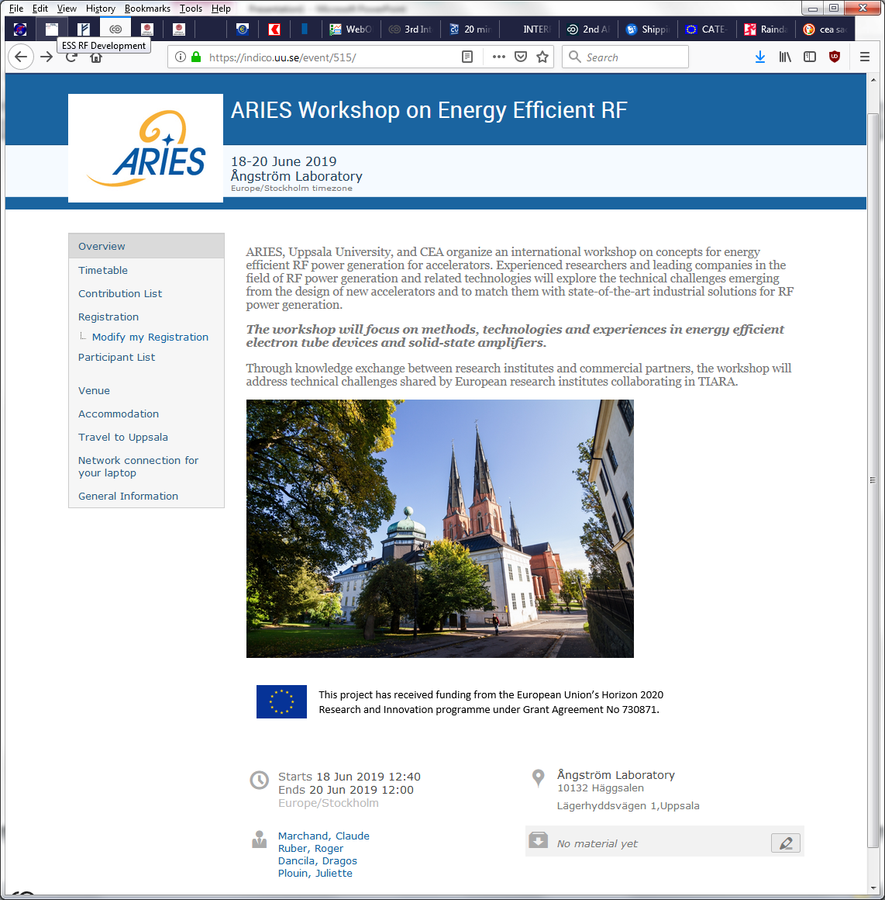
ARIES Workshop on Energy Efficient RF
Methods, technologies and experiences in energy efficient electron tube and solid-state RF amplifiers.
venue: Uppsala
dates: 18-20 June
registration deadline = 31 May
https://indico.uu.se/event/515

Slide 7
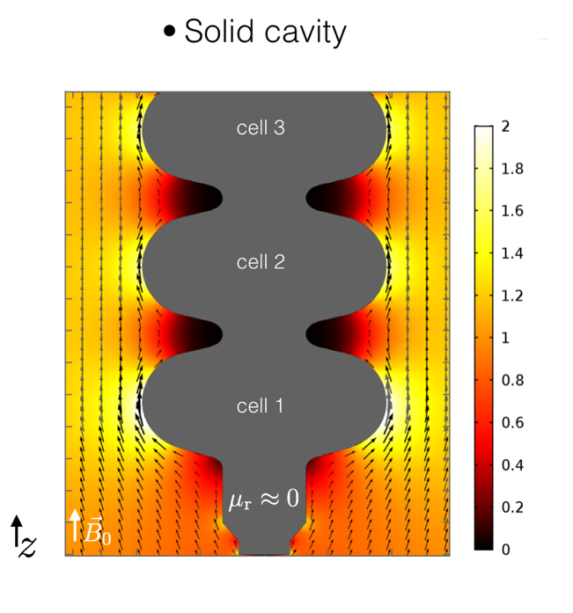
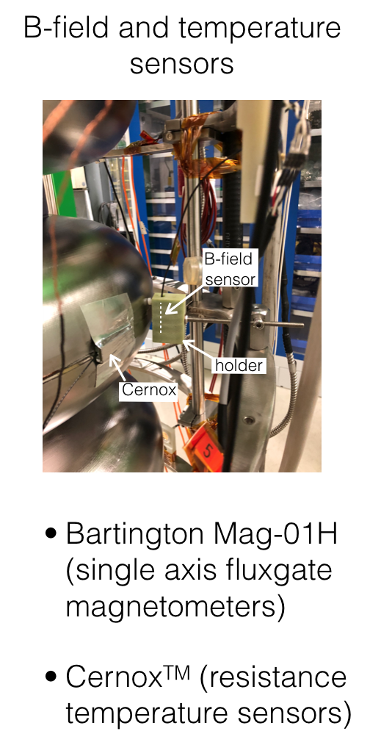
High Efficiency SRF Beam acceleration
May 2017 – Jan 2018: studies on improved magnetic shielding for an existing vacuum vessel with ARIES supported fellow. Measurement report: CERN-ACC-NOTE-2018-0045.
May 2018 – today: experimental and theoretical studies on flux trapping in superconducting cavities with ARIES supported fellow. See highlight talk by A. Ivanov.
Simulation of flux expulsion on multicell bulk Nb cavity
Experimental set-up to measure flux expulsion during cool-down.

Slide 8
Flux trapping workshop @ CERN, 8-9 Nov 2018
64 participants from the North America, Asia & Europe.
Supported by ARIES. Milestone: MS18, report
https://indico.cern.ch/event/741615/overview

Slide 9
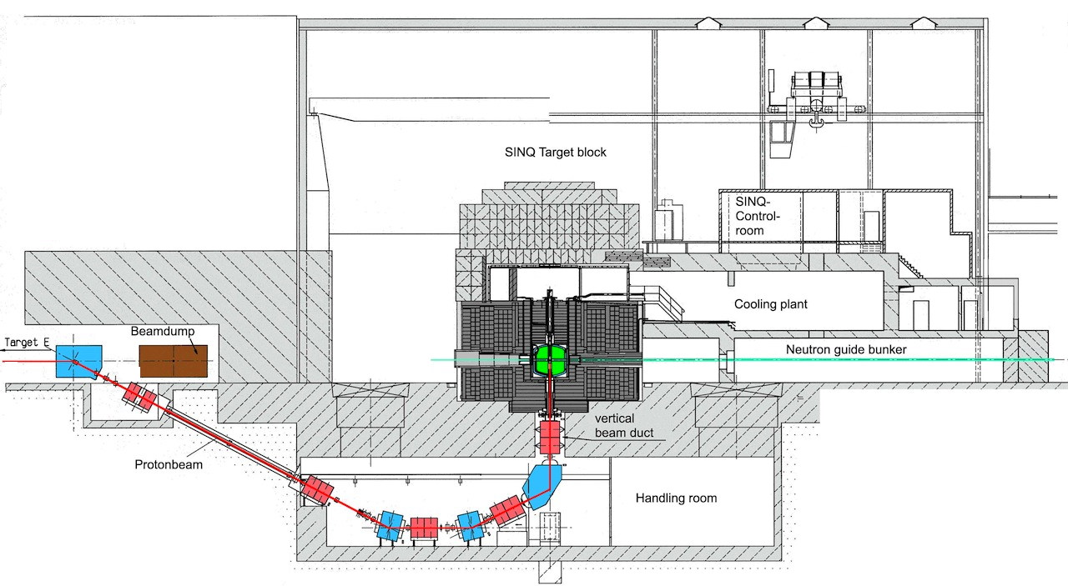
The Cold Neutron Source @ PSI
1 Megawatt
beam

Slide 10
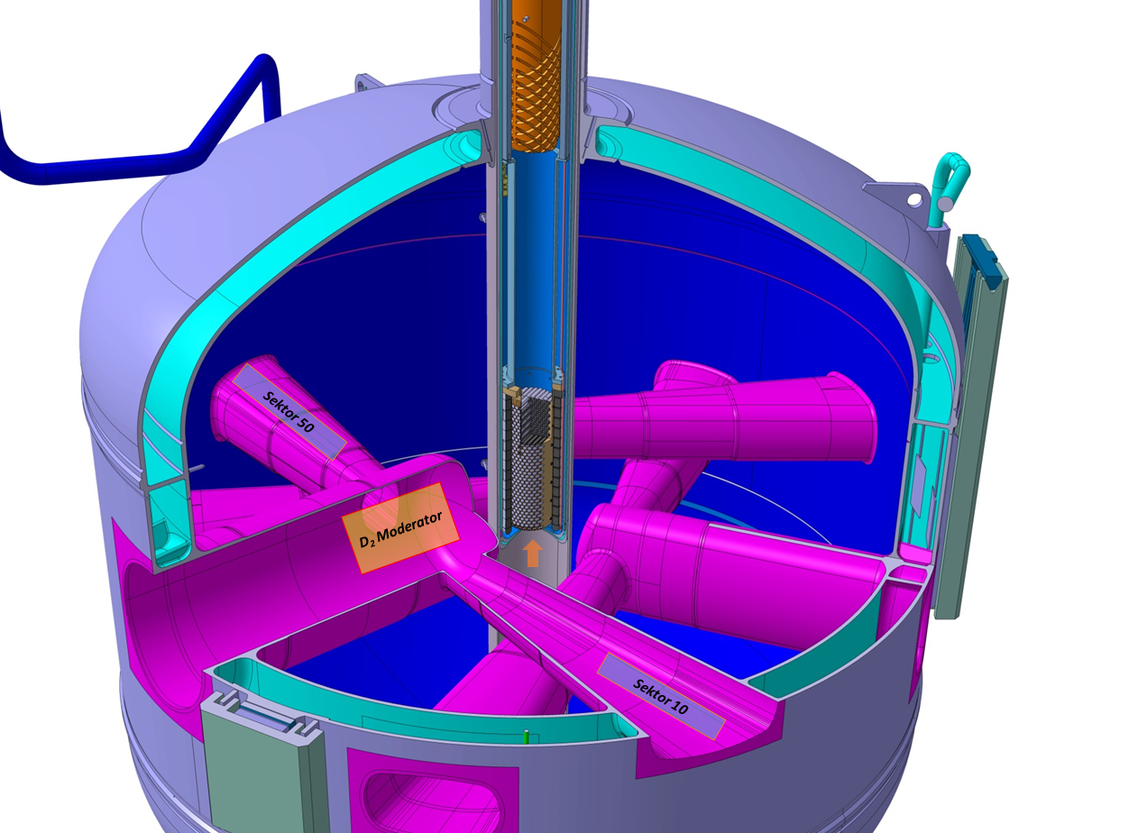
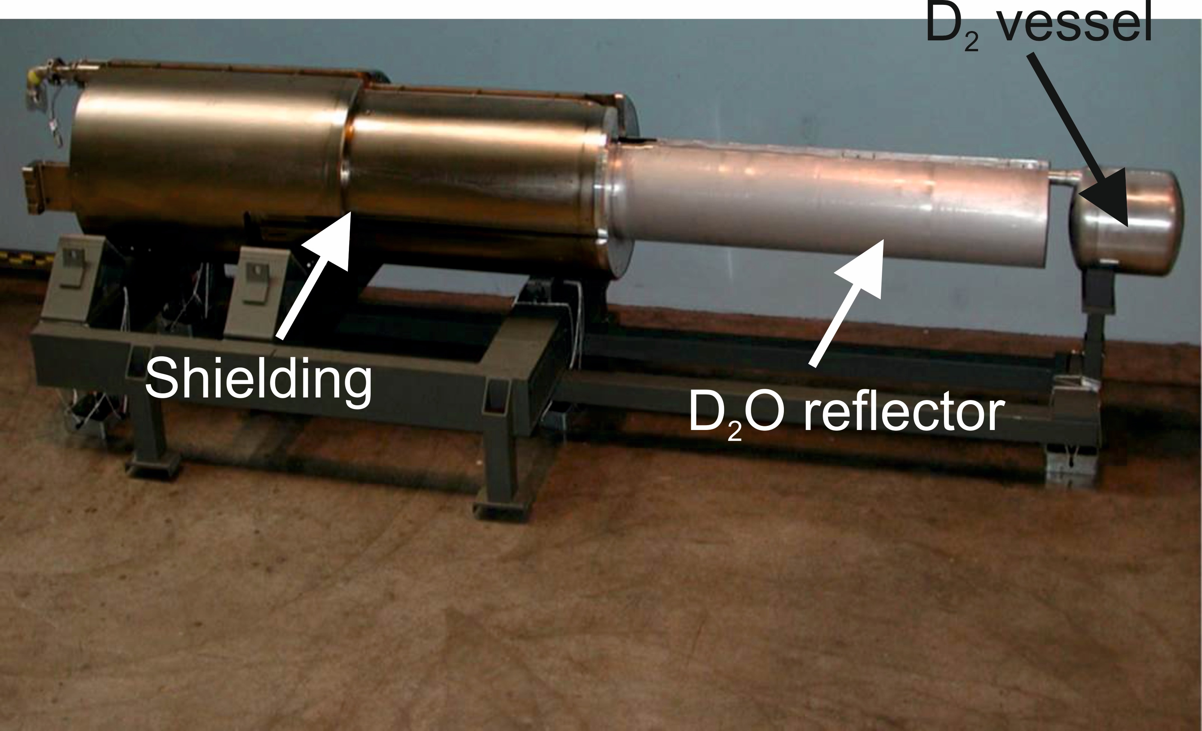
SINQ’s Cold Neutron Moderator
20 l of liquid D₂
T = 25 K
P =1.5 bars
Heat load ~1 kW
Improve the energy efficiency of the moderator

Slide 11
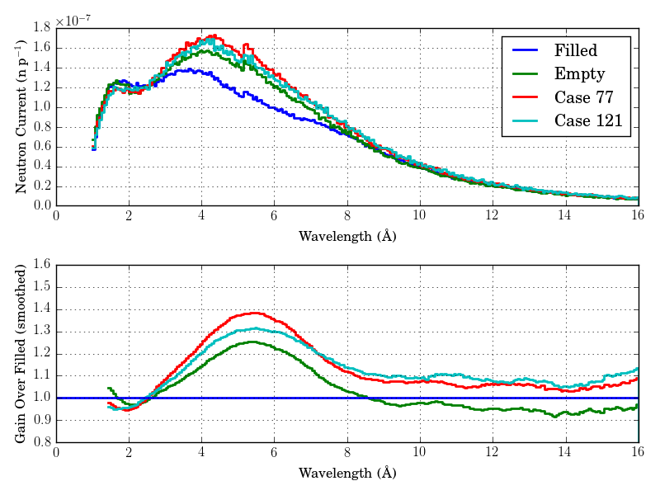
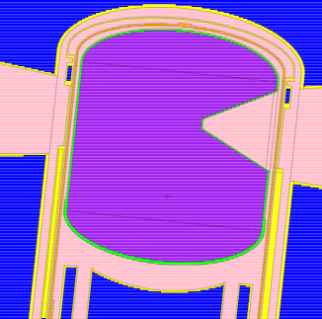
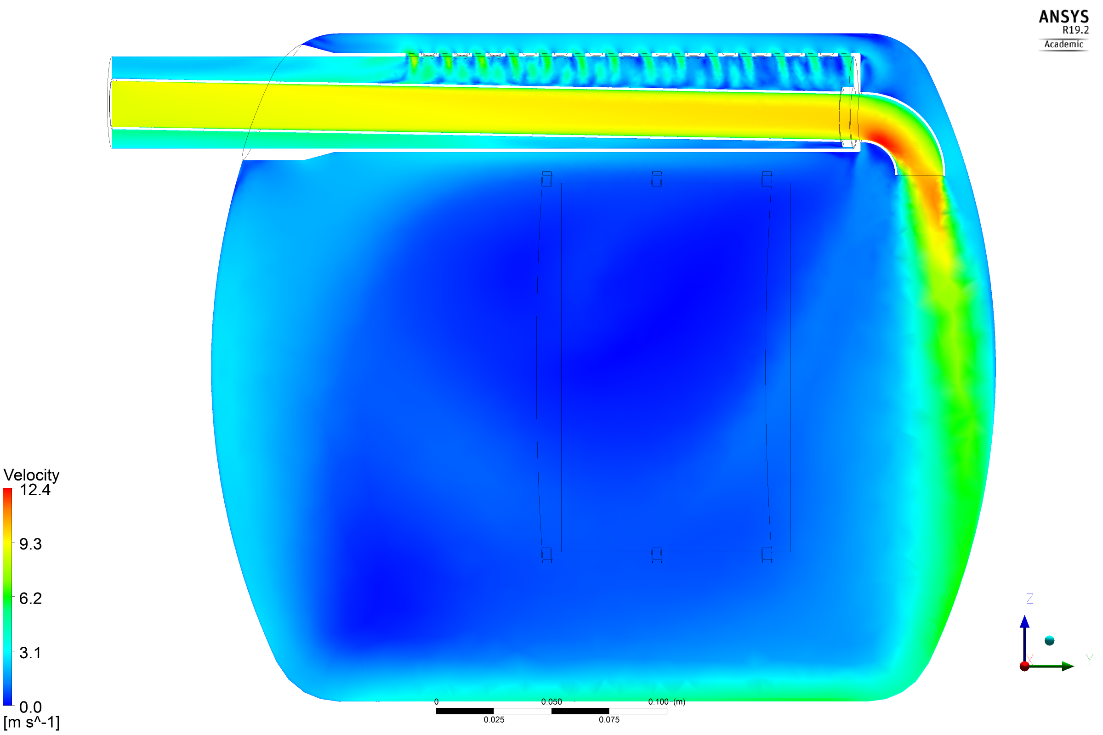
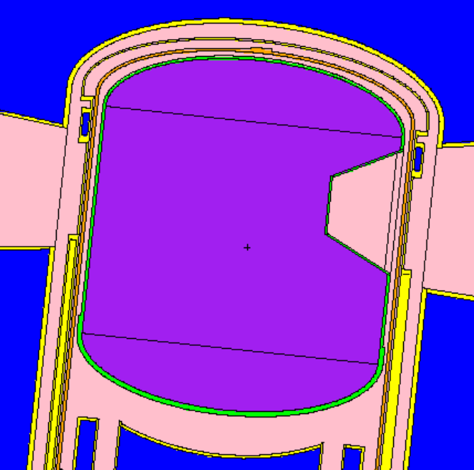
Moderator Optimization
Neutronics (R.M. Bergmann)
Thermomechanics (Y. Charles)
Case 77
Case 121
Neutron yield improvement from re-entrant cavity design
Single-phase flow of deuterium, heated by power deposition from SINQ target.
Adjust the re-entrant cavity
Predicted gain: 1.25 to 1.31 at medium wavelength
Current: single-phase with power deposition.
Next: two phases

Slide 12
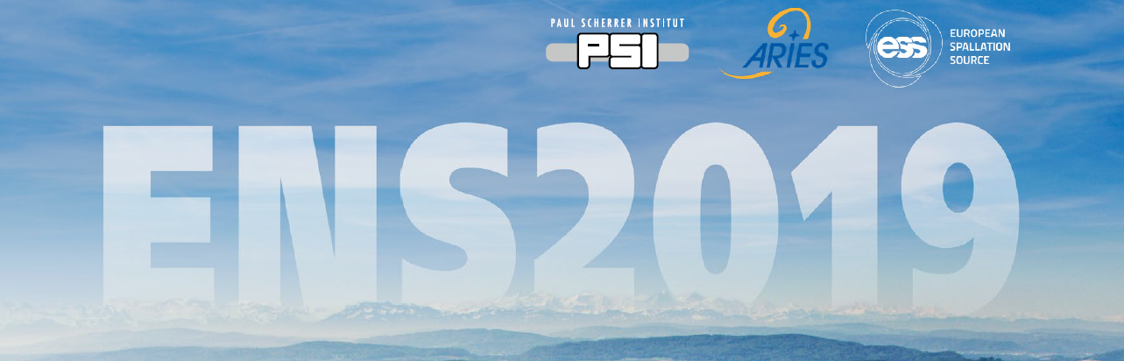

1st Workshop on Efficient Neutron Sources
Themes
Neutron Production
Moderators & Reflectors
Neutron Guides
Instruments & Detectors
September 2-5, 2019, Villigen, Switzerland
Registration until June 30
indico.psi.ch/e/ens2019
Scientific committee: L. Zanini (co-chair), M. Wohlmuther (co-chair), K. Andersen, D.V. Baxter, U. Filges, F.X. Gallmeier, M. Harada, S. Lilley, W. Lu, O. Zimmer.
Organizing committee: Y. Charles (chair), B. Ajmo, M. Anthony, D. Kiselev, M. Seidel, A. Takibayev, M. Wohlmuther, L. Zanini.

Slide 13
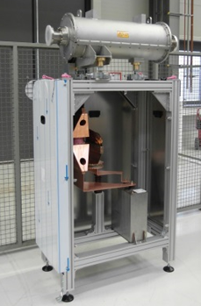
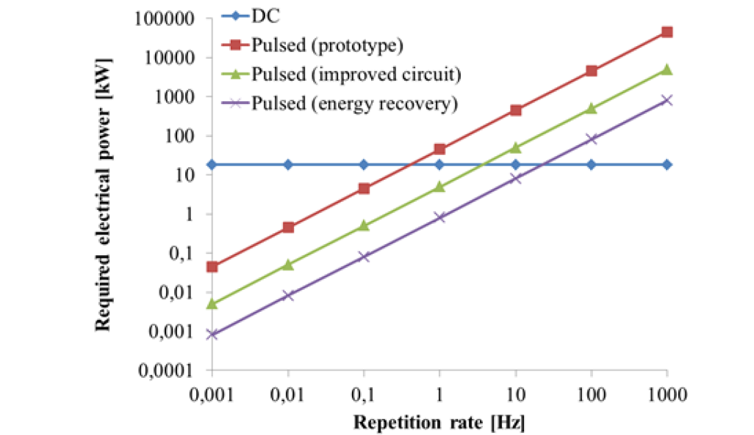
Pulsed Quadrupole [GSI]
Iron-free magnet
  Very high gradients similar to s.c. magnets
  Design parameter: up to 400 kA and 75 T/m
  Efficiency improvements possible
  Graph shows average power consumption depending on different circuit topologies and repetition rate
  Average power consumption highly dependent on repetition rate
Pulsed quadrupole
Pulsed power unit

Slide 14
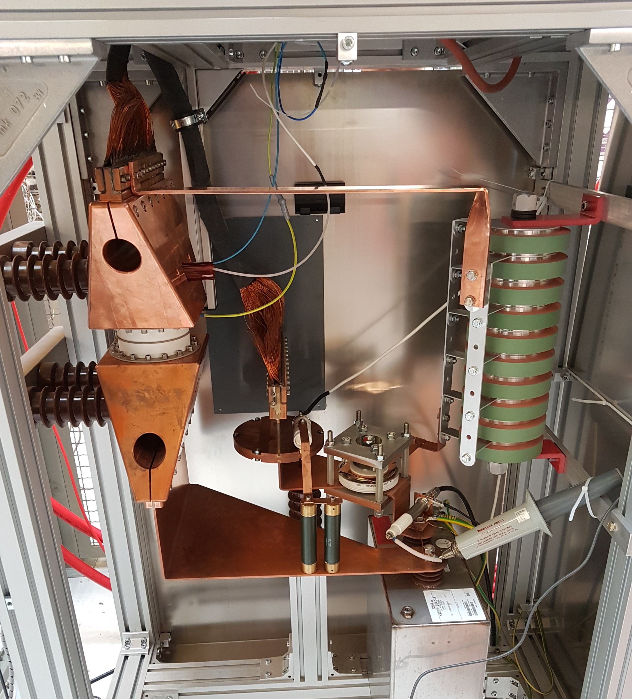
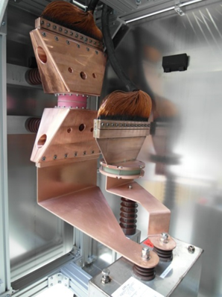
Assembly of components for improved circuit
assembly of HV-Diode, damping resistor, main switch and trigger unit, safety discharge circuit
Diode with clamping unit
Damping resistor
Improved Circuit
Quadrupole
Pulsed power unit
Prototype
Main Switch
Safety discharge circuit
Capacitor

Slide 15
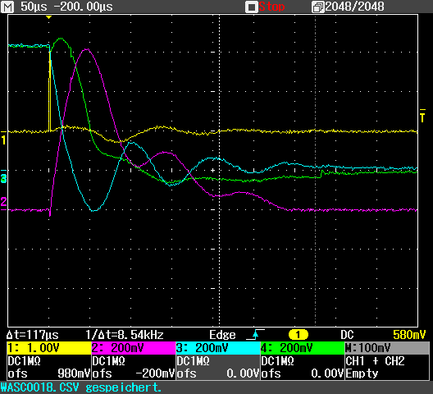
First Measurements
Quadrupole peak current:
  Prototype: 4.5 kA
  Improved Circuit: 8 kA
Diode Voltage
Quadrupol Current
Capacitor Voltage
Next Steps:
  Measurements and tests up to 30kA
  Parallelizing of diodes for higher currents
  Pulse capacitor replacement with a higher reverse voltage capability
  Further retrofitting of the circuit to an energy recovery circuit

Slide 16
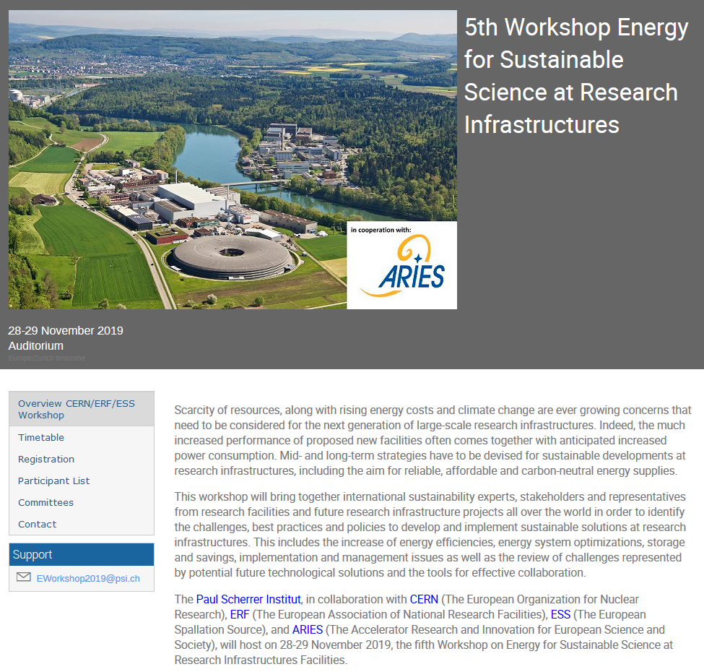
Upcoming Workshop
Program
General sustainability aspects (6)
Energy management at Research Infrastructures (8)
Energy efficient technologies (8)
Research on Sustainable Technologies using RI’s (4)
Cryogenic Systems and Conventional Cooling (4)
Organizing Committee
Carlo Bocchetta, ESS
Frederick Bordry, CERN
Florian Gliksohn, ERF
Joachim Grillenberger, PSI
Frank Lehner, DESY
Thomas Schmidt, PSI
Mike Seidel, PSI
Carlo Rizzuto, ELI
reserve the date: Paul Scherrer Institut, CH, November 28-29, 2019
https://indico.psi.ch/event/6754/

Slide 17
EEM: Workshops & Deliverables
Task | Workshops / Deliverables
#1: coordination | MS17: co-organize workshop on Energy for Sustainable Science, 2017, M7: done! + energy for sustainable science workshop, Nov 28/29 2019 at PSI
#2: efficient RF sources | MS19: workshop on simulations and prototyping of novel energy efficient RF sources, M13, Univ. Uppsala, CEA Saclay; 18 - 20 June 2019 D4.2: 3d design of efficient klystron, M41
#3: neutron production | MS20: 1st Workshop on Efficient Neutron Sources Sep 2-5, M31, ESS, PSI D4.4: report on the optimization procedure and technical layout of efficient moderator assemblies, M46
#4: high efficiency SRF power conversion | MS18: M19: workshop “Flux trapping & magnetic shielding” held: Nov 8/9, 2018, done! D4.1: report on magnetic shielding for high quality superconducting resonators, M35
#5: pulsed magnets | MS21: workshop on efficient magnets/beam transport, M37, GSI D4.3: Report on pulsed magnets, M43

