Slide 1
Reliability information databases and feasibility within accelerator community
Heinrich Humer (AIT Austrian Institute of Technology)
Alexander Preinerstorfer (AIT Austrian Institute of Technology)
Johannes Gutleber (CERN)
Arto Niemi (CERN)
Klaus Höppner (HIT Heidelberg)

Slide 2
Contents
Motivation
Current status on reliability data collection in accelerator facilities
Open Reliability information system for accelerators
Requirements for a prototype implementation
Roles and Use Cases
Data model – Information structure
Prototype implementation
Conclusion

Slide 3
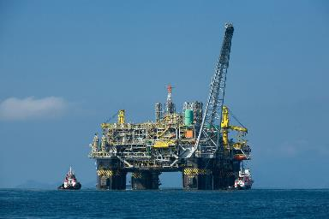
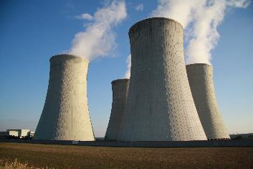

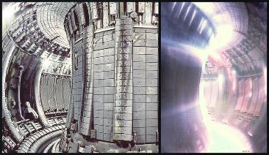
Motivation
Reliability and maintenance data are vital to analyse and improve system performance
Generating credible statistics is a long term activity
In various industries collected reliability data is shared to ease the burden
Could the same work in accelerator community?
Oil & Gas
Nuclear energy
OREDA & ISO 14224
Reliability data sharing standard
ISO 6527
Wind energy
Fusion power
Sparta (UK) & WInD-Pool (Germany)
ENEA Fusion component reliability DB

Slide 4
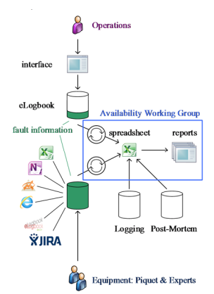
Situation today at CERN
Failure data is recorded in various data sources for various purposes
Generally: Not intended for reliability data sharing between organisations
Accelerator Fault
Tracking
Source | Intended to provide
Logbooks | Operational information for subsequent shifts
Excel spreadsheets | Specialized information for an individual data collector
Maintenance databases | Failure information for the unit that maintains the system
Accelerator fault tracking | High level statistics and failure information
AFT aims for high level, unified view by combining operation & expert system data

Slide 5
Open Reliability information system for accelerators
Based on ISO 14224 and ISO 6527 industry standards
Data users see:
  Own organisation’s uploaded data
  Generalized statistics of shared data
Data privacy & ownership never changes:
  Only anonymized statistics are shared
  Users can decide from which systems statistics are collected
Historical
records
Fault tracking,
Logbooks,
Observations,
Estimates
Handbooks,
Data initiatives
Information
System
PDF(characteristics, quality, conditions)
Model driven
Design and improvement

Slide 6
What anonymized sub-system statistics are?
Using the anonymized statistics requires
Coherent taxonomy to identify a sub-system
Measure of data credibility
Environmental conditions are important for accelerators:
Level of radiation
Is the equipment located indoors or outdoors
OREDA Example:
Taxonomy to identify the sub-system
Population size & length of the observation period
Failure modes
Failure rates & repair times
with confidence bounds

Slide 7
Requirements for a prototype implementation
An open infrastructure for Reliability data
Cloud-Solution
Support for many organisations (either in cooperation or in competition)
Privacy areas of equipment data, maintenance data and event data
Central administration of the taxonomy for equipment type
Distributed maintenance of organisations (users, rights) and installations
Common usage of statistical reports
Quality management for data

Slide 8
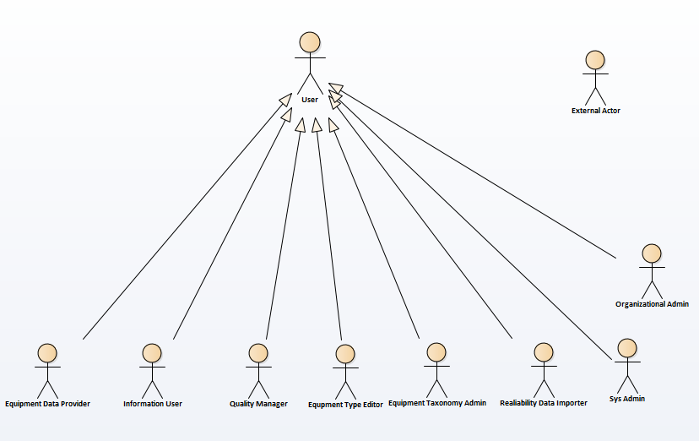
Roles or Actors
External User
Registered User
  Information user
  Equipment Data Provider
  Quality Manager
  Equipment Type Editor
  Equipment Taxonomy Editor
  Reliability Data importer
  Global Admin
  Organisational Admin

Slide 9
Equipment units versus Equipment group
Holder of statistics on „Objects of interest“
Equipment unit:
  specific equipment (instance) within an equipment class as defined by its boundary, identified by a serial number given by organisation
  Equipment units can exist as spare part or can be installed at a specific location.
Equipment group:
  Collection of equipment units with same properties descriped as group, not as single instances
  They exist without reference to an installation location.

Slide 10
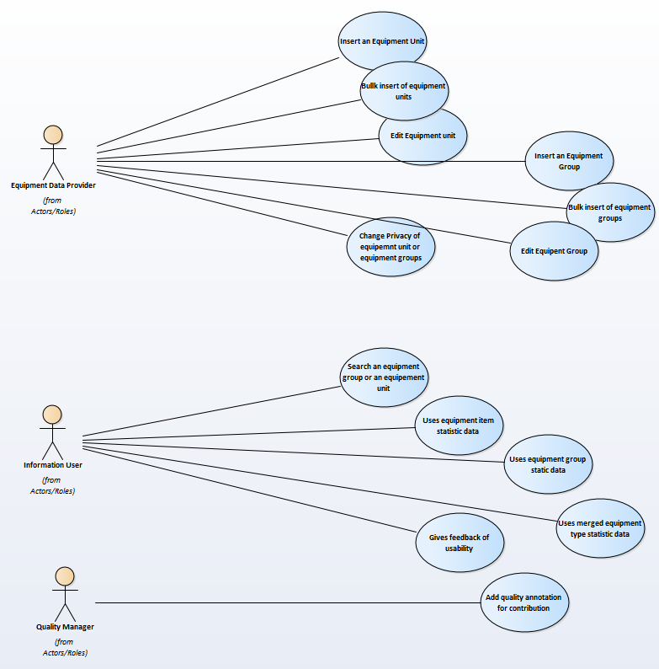
Use Cases for Equipment data provider
Equipment Data Provider
  Insert an equipment unit
  Bulk insert of eq.units
  Edit equipment unit
  Insert an equipment group
  Bulk insert of equipment groups
  Edit equipment group
  Change privacy of own euipment
  units/groups

Slide 11
Use Cases for Information user
Information user
  Search (Lookup) of equipment
  units or equipment groups
  Use statistic data on unit or group
  Use event data
  Uses merged equipment group
  statistic data
  Gives feedback of usability
Quality manager
  Add quality annotation for
  contribution

Slide 12
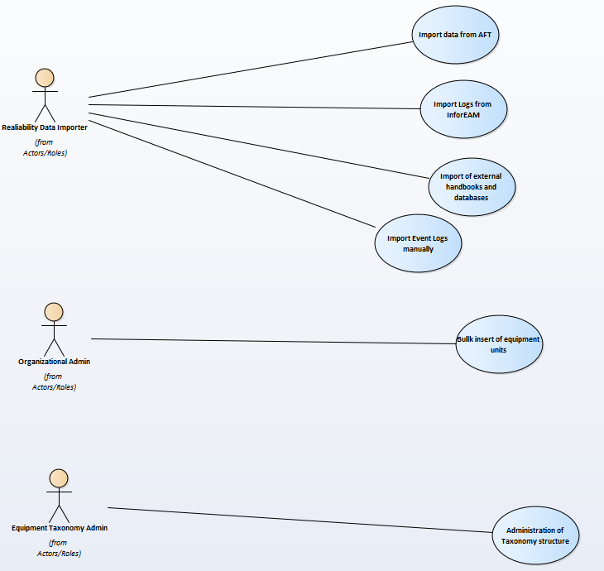
Use Cases for Admin Usages
User Administration Usage
  Classical administration of
  organisation, users and roles
  Global / Local administration
Taxonomy Admin
  Administration of taxonomy
  structure
Reliability Data importer
  Importer for external maintenance
  databases
  Importer for Event Logs

Slide 13
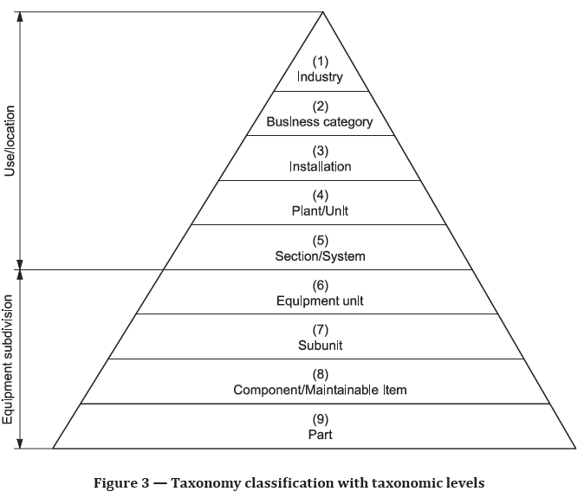
Classification Taxonomy modification
ISO 14224 - Petroleum, petrochemical and natural gas industries - Collection and exchange of reliability and maintenance data for equipment
Replaced by:
Organisation
  Installation
    Location/Sublocation
Alternative access by class hierarchy:
Equipment class
  Subclasses ….
    Equipment types
Part: Currently not used

Slide 14
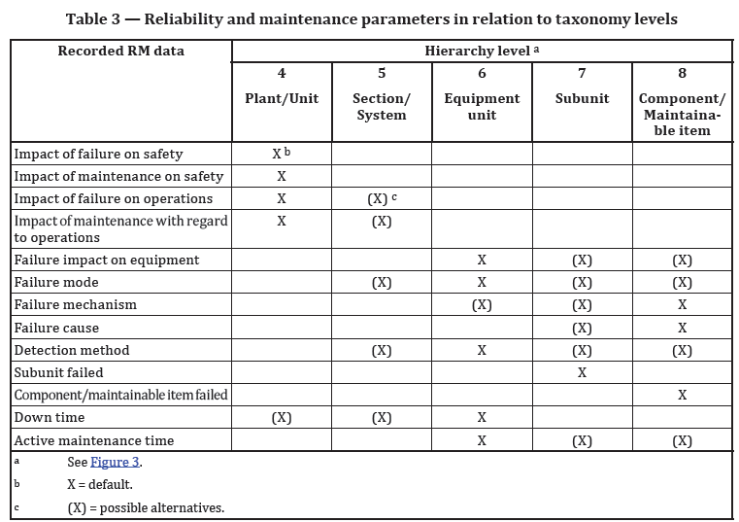
Information at which level
ISO 14224 - Petroleum, petrochemical and natural gas industries - Collection and exchange of reliability and maintenance data for equipment

Slide 15
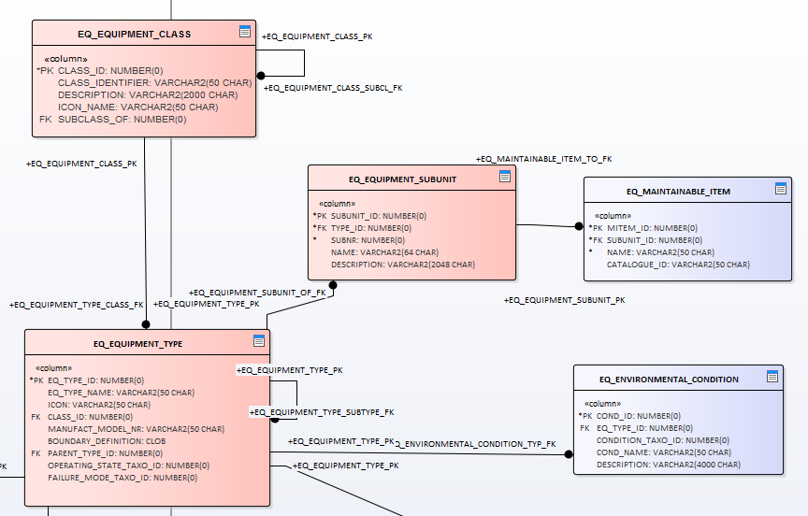
Data model – Information structure
Equipment class - class of similar type of equipment units (e.g. all pumps)
  Structure element to build up a hierarchy
  No Meta information
Equipment type - particular feature of the design which is significantly different from the other design(s) within the same equipment class
  Enables the construction of a type hierarchy for an equipment class
  Name, Description
  Boundery definition
  Operating states (def. Taxonomy)
  Failure modes (def. Taxonomy)
  Subunits
  Maintainable items

Slide 16
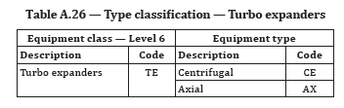
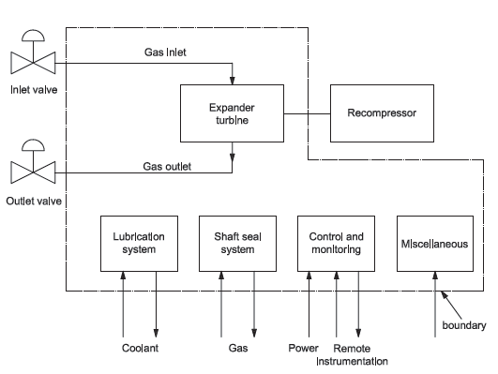
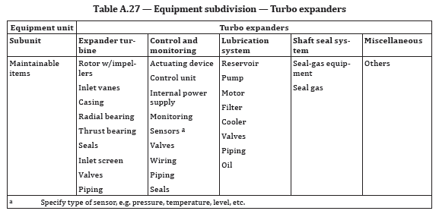
Example: 1:1 Translation of the OREDA concept
Example: „ISO-14224-2016.pdf“, p.77ff

Slide 17
Equipment type specific data

Slide 18
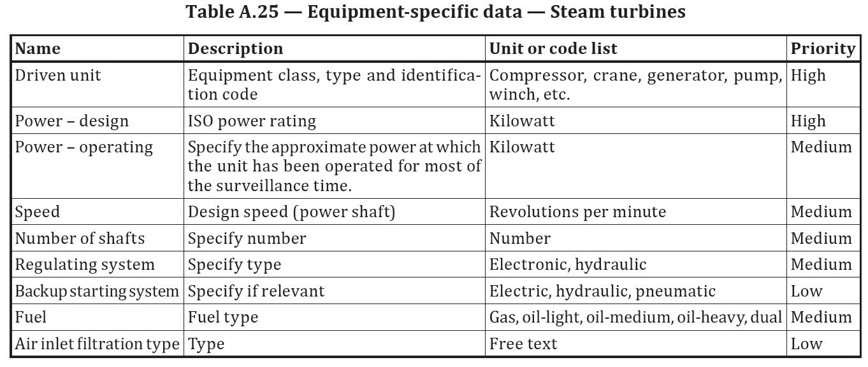
Example:

Slide 19
Equipment Units - Location
Organisation defines installation and location
structure
Each Equipment Unit can be associated
to one location of the organisation
„Spare parts“ are kept at the
„spare parts“ location.

Slide 20
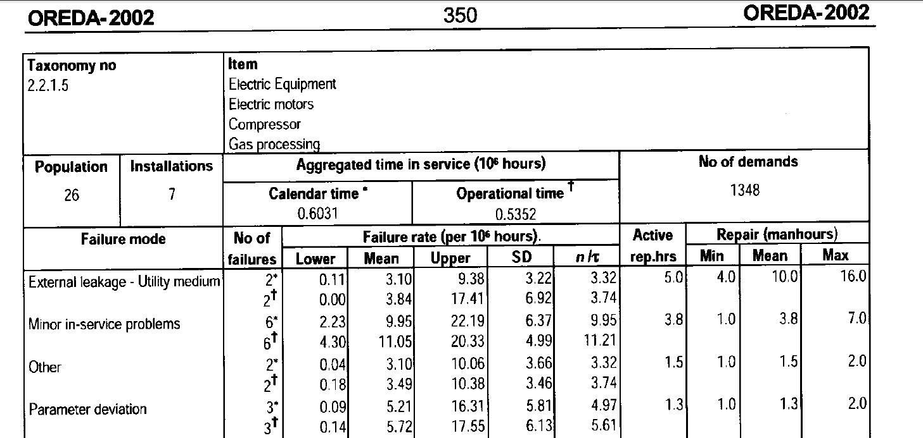
Reliability statistic data

Slide 21
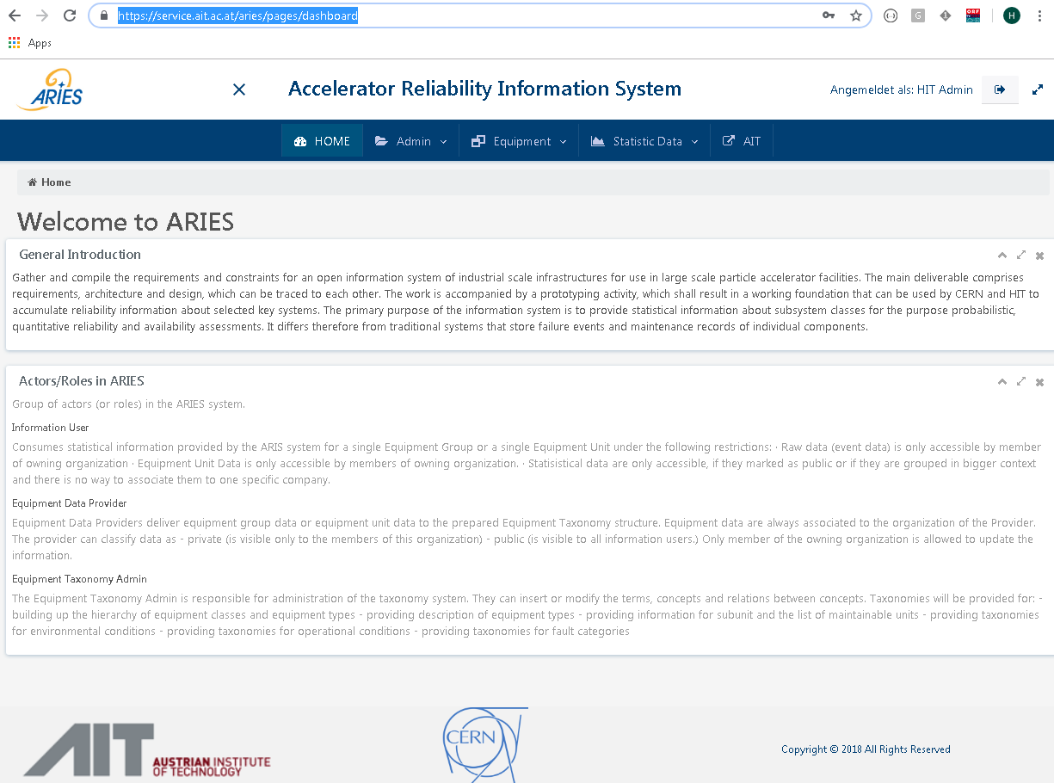
Implementation prototype
Cloud solution:
  Oracle database
  Tomcat-Service,
  REST-interface, Swagger
  Angular Client
    HTTP
    Typescript

Slide 22
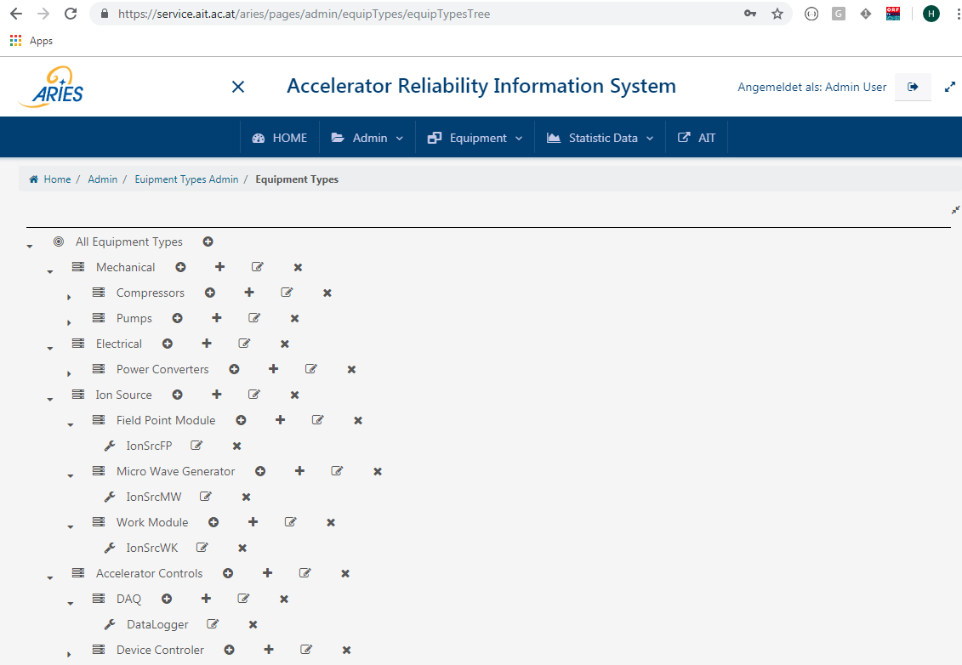
Evaluation site: HIT Heidelberg
Evaluation of the usability of the selected design
Feedback should improve the data model
Open problem:
Taxonomy of the Equipment class hierarchy MUST be INDEPENDENT of INSTALLATION
Improvements of usability are open
Missing functionalities:
Quality management processes
Calculation of group statistics

Slide 23
Conclusion
Reliability data sharing concept has worked & provided value in various industries
First prototype of an implementation has been built up, but currently not with full functionality
Implementation is not a technical challenge, real limiting factor are the personnel resources to collect the reliability data.

