Slide 1
Deposition and Characterisation of Superconducting thin films of NbN and Nb3Sn for SRF applications
Reza Valizadeh
on behalf of the team
2nd ARIES Annual Meeting , 8-12 April 2019, Budapest, Hungary

Slide 2
MOTIVATION
Bulk niobium (Nb) has been for the past three decades: the material of choice for SRF applications:
  It has the highest Tc (9.25K) for pure metal
  It has highest lower critical magnetic field H_{c1}
  Easy fabrication
But it has achieved the magnetic field limitation so further improvement of cavity RF performance dictate to turn to other superconducting materials. The material can be deposited as thin film either in:
  Single layer (new material on Cu or Nb)
  Double layer ( Nb/ new matrial on Cu)
  Superconductor/Insulator/new material SIS

Slide 3
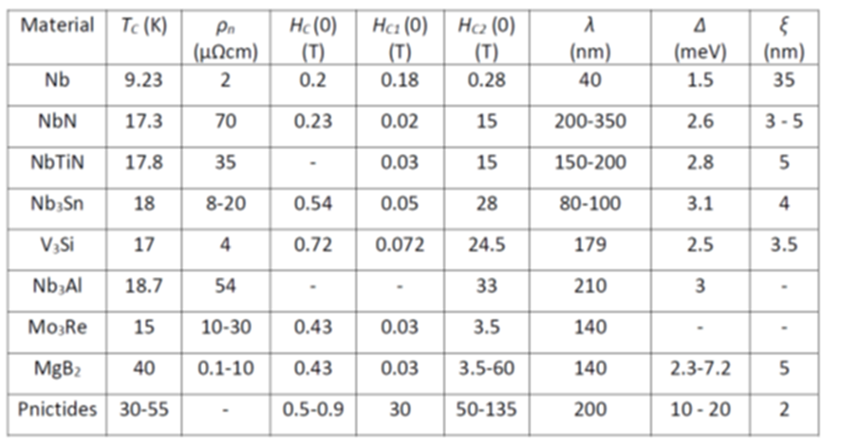
Desired SC properties
The desired SC material should have the following characteristic:
A large superheating field B_{sh} (large E_{acc})
Moderate ξ (not to be affected by small defects)
Large T_{c} (R_{BCS} ∝ e^{−Tc/T} and small normal resistivity ρ_{n})

Slide 4
SYSTEM 1
Nb3SN

Slide 5
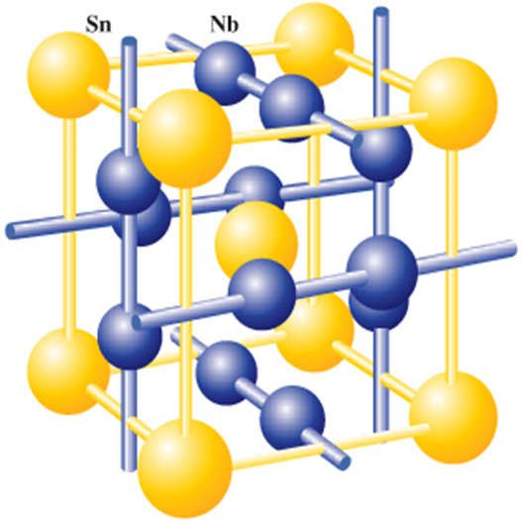
Nb3Sn unit cell Structure
The Sn atoms forms a bcc lattice and each cube face is bisected by orthogonal Nb chains.
In bcc Nb the shortest distance between the atoms is 0.286 nm starting from a lattice parameters of a = 0.330 nm
In Nb3SN the lattice parameters of about a = 0.529 nm for stoichiometric composition and the distance between the Nb atoms is 0.265 nm
The reduction of distance between the Nb chains is responsible for the high Tc in comparison to bcc Nb.
Sn deficiency may cause the Nb to occupy the site and effect the long range order

Slide 6
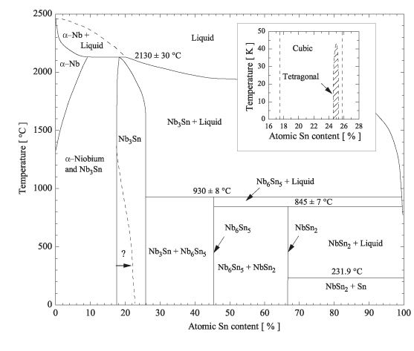
Nb3Sn binary phase diagram
Intermetallic niobium–tin is based on the superconductor Nb, which exists in a bcc Nb structure or a metastable Nb3Nb A15 structure
When alloyed with Sn and in thermodynamic equilibrium, it can form either Nb1−βSnβ (about 0.18≤β≤0.25) or the line compounds Nb6Sn5 and NbSn2.
Both the line compounds at β = 0.45 and 0.67 are superconducting, with
  Tc<2.8 K for Nb6Sn5
  Tc<2.68 K for NbSn2
Binary phase diagram of the Nb–Sn system after Charlesworth et al 1970 Chapman and Hall Ltd,

Slide 7
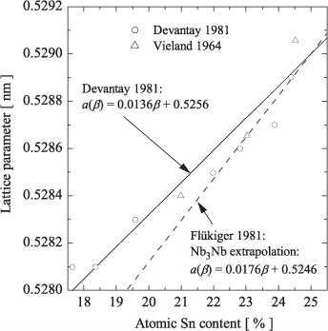
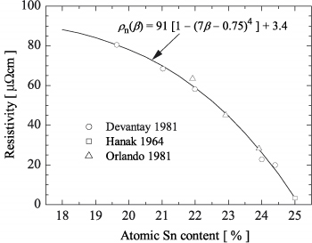
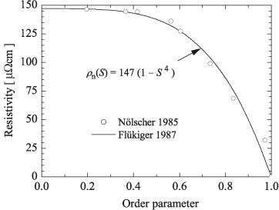
Variation in lattice properties
Variations in superconducting properties of the A15 phase are related to variations in the lattice properties through:
The lattice parameter (a)
Atomic Sn content (β)
The normal state resistivity just above Tc (ρn)
The long range order (LRO).

Slide 8
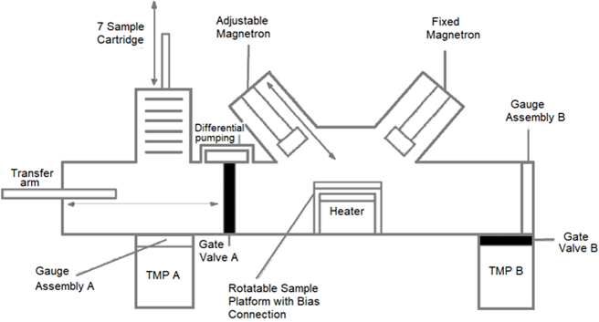
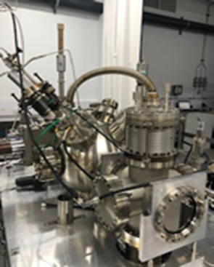
Nb3Sn deposition system and parameters
Magnetron sputtering from a RRR 300 Nb target
Substrate Temperature, Deposition Rate, Deposition Thickness, Substrate Bias, Concurrent Ion Bombardment can be varied independently.
Substrates are loaded into the load lock and system fully Baked.
Nb deposition:
400 W, 470v, 0.85A
4 hours deposition
Dc sputtering
Nb3Sn deposition:
200 W, 489 V, 0.41 A
2 Hours deposition
DC sputtering

Slide 9
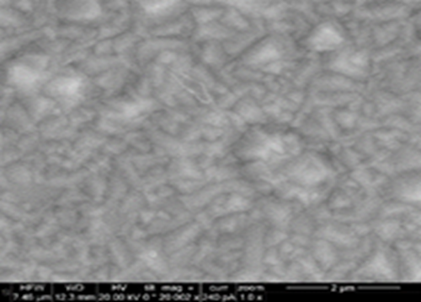
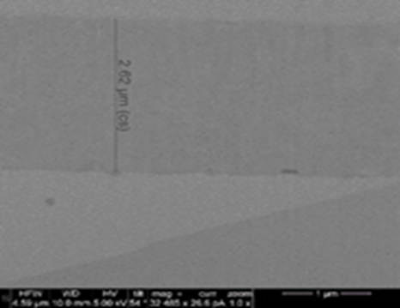
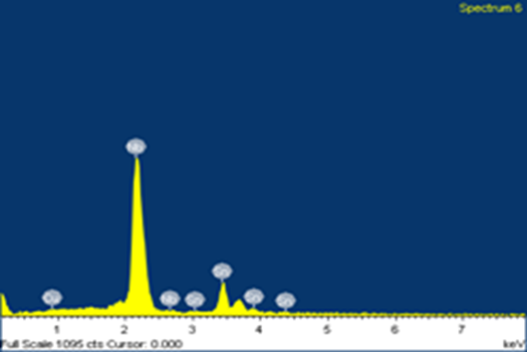
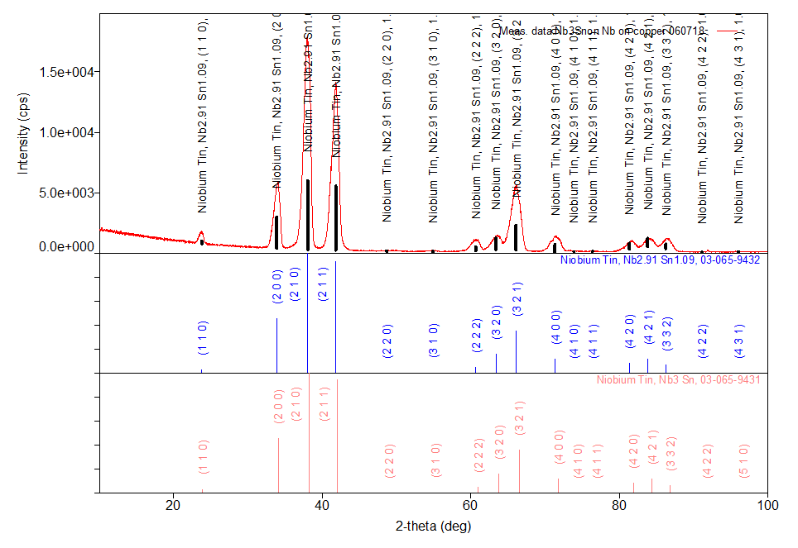
Cu/Nb₃Sn deposition (single layer)
element | atomic %
Cu L | 0.06
N L | 76.76
Sn L | 23.18
The lattice parameters is also been calculated to be 5.292 A.
The grain size calculated from the X-ray diffraction is in order of 8 to 10 nm (Twice coherent length of Nb3Sn which is reported to be 4.2 nm)

Slide 10
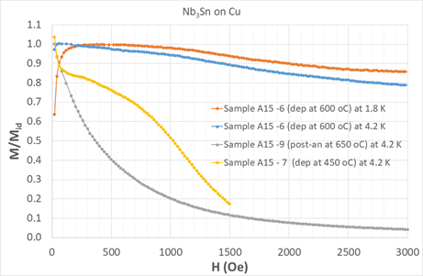
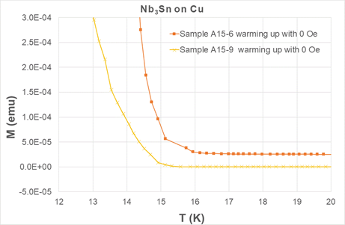
Normalized DC magnetic moment
Best performance in terms of superconducting properties is achieved by the film deposited at 650 °C (A15-6) where the film deviate slightly from the Meissner state even up to a field of 300 mT.
The film deposited at room temperature and then post annealed (A15-9) has the worst performance since M/Mi drop sharply at very low field of about 10 mT.
The film deposited at moderate temperature of 450 °C performs slightly better but its performance is much reduced.
This is also evident in the critical temperature of sample A15-7 where the Tc is estimated to be 14.6 K in comparison to the sample A15-6 which depicted to have Tc = 15.7.

Slide 11
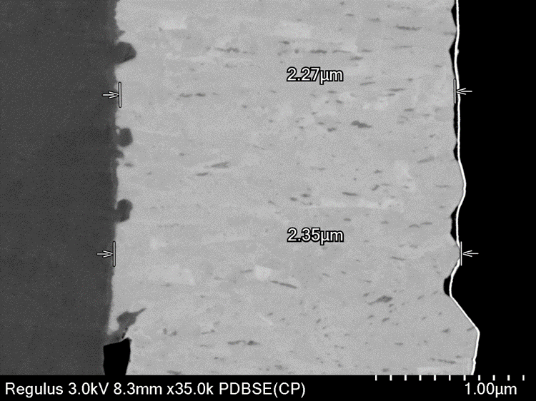
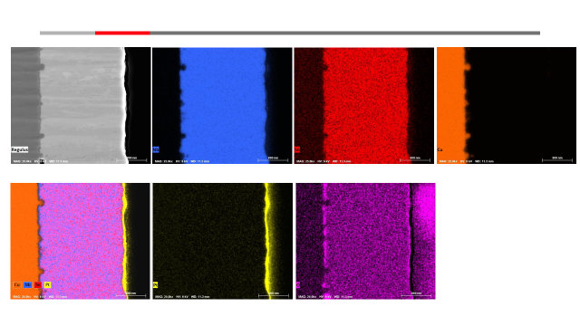
Cu (EP DL)/Nb₃Sn (single layer)
There is some diffusion of copper at the interface
There is a clear oxide layer at the interface despite high temperature treatment prior deposition
There are area that it is Sn deficient.

Slide 12
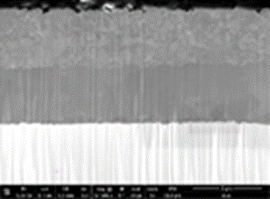
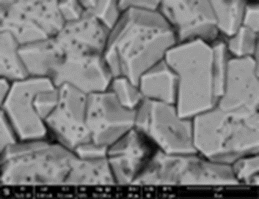
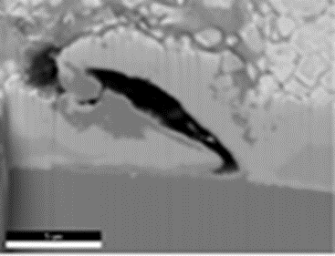
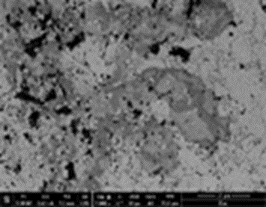
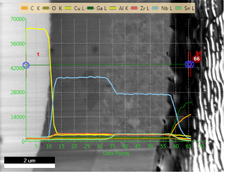
Cu/Nb/NB3Sn (double layer)
The Nb/Nb3Sn bilayer was deposited on copper in order to compare the performance of the thin film Nb3Sn as a superconducting material suitable for SRF cavity fabrication.
Two distinct area can be observed:
  Perfect area with sharp interface with correct stoichiometry for Nb3Sn layer
  Copper diffusion from the interface to top surface.

Slide 13
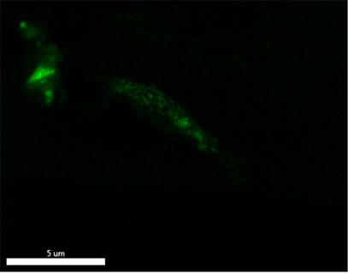
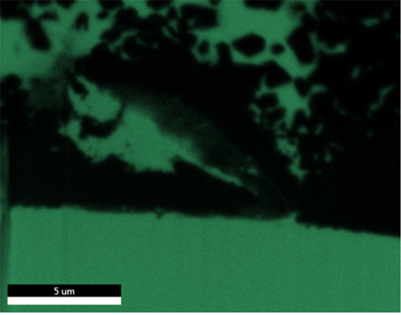
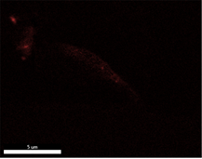



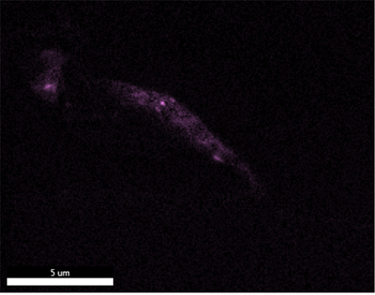
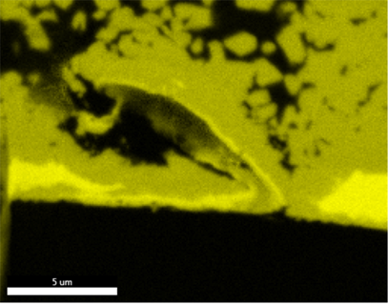
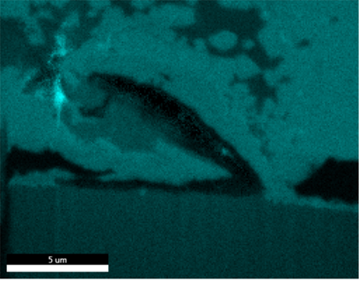



Cu/Nb/NB3Sn (double layer)
Nb and Nb₃Sn is completely intermixed and there is a substantial volume of copper substrate both in elemental and alloy form of copper-tin alloy is present throughout the depth of the layer and at the surface

Slide 14
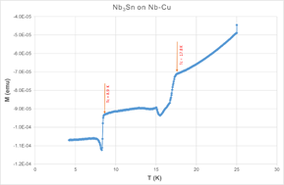
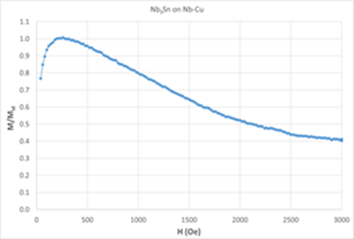
Normalized DC magnetic moment
In contrast with the single layer of Nb₃Sn deposited as single layer but in exactly the same condition the onset of the drop in magnetisation start much lower field of 50 mT.
The normalised magnetisation is the sum of the magnetisation of Nb layer and the Nb3Sn layer
The critical temperature of the Nb3Sn layer is found to be at 17.8 K.
The drop is gradual which is can be due to presence mixed phases or area of Sn deficient or some other type of defects.

Slide 15
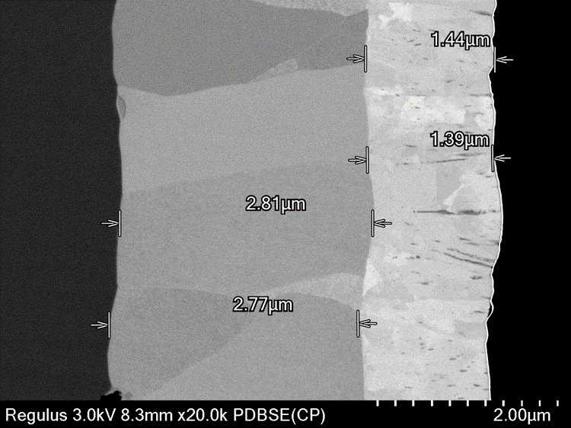
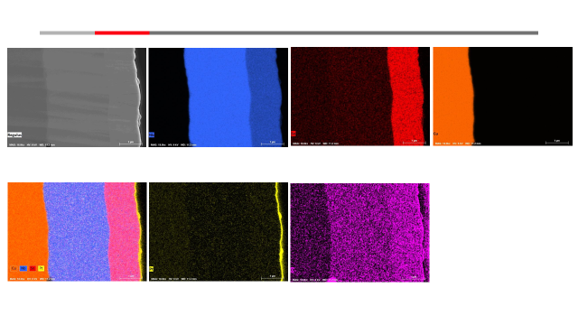
Cu/Nb/NB3Sn (double layer)
The interfaces both at Cu/Nb and Nb/Nb3Sn is well define
Nb layer is grown is large grain and in a perpendicular direction to the substrate surface
No intermixing of elements is observed
Some area of Sn deficiency and are of rich Sn in Nb3Sn layer can be observed.

Slide 16
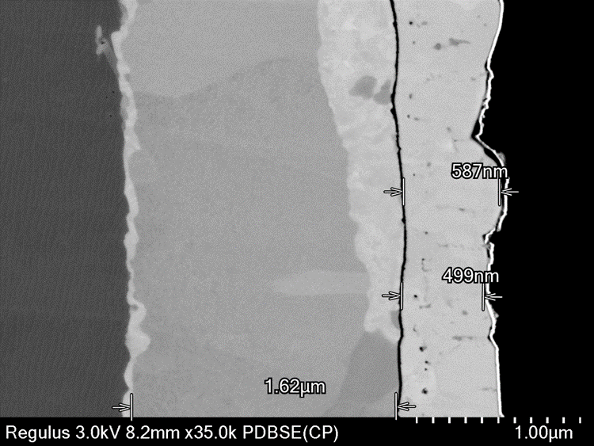
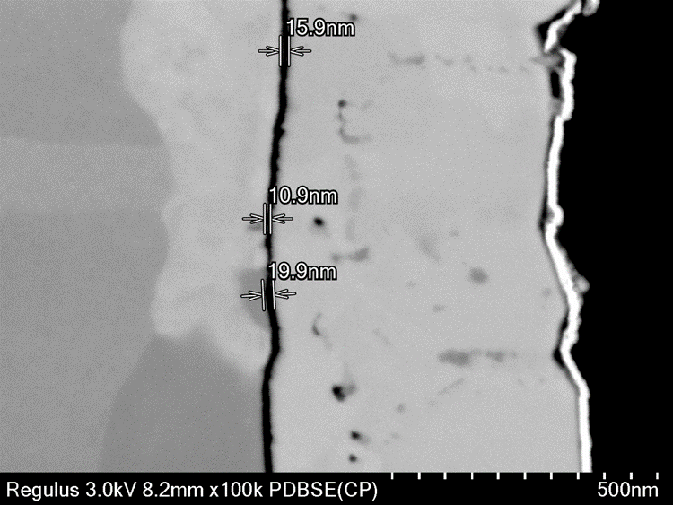
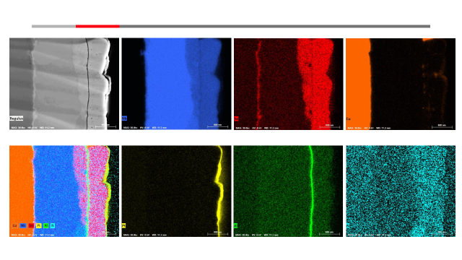
SIS Structure of Nb₃Sn/AlN/Nb multilayer on copper
Although the layers are well identified however there is again some degree of mixing can be observed.
Sn segregation at Cu/Nb interface
Nb3Sn into Nb layer
Copper diffusion on to the surface
Some level of Nitrogen diffusion into all the layers.

Slide 17
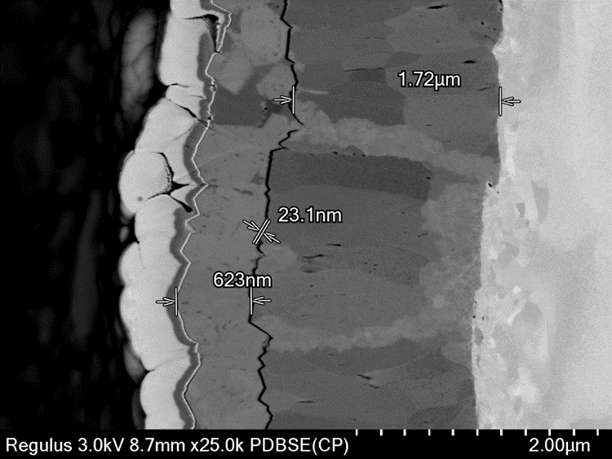
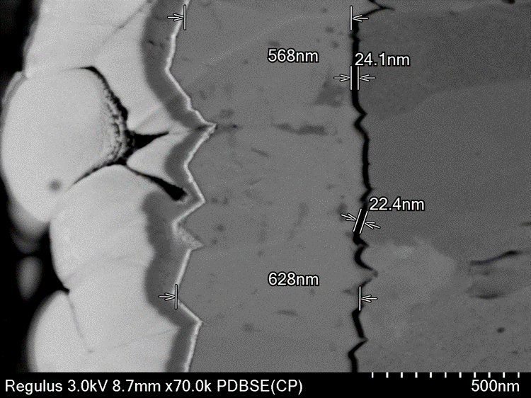
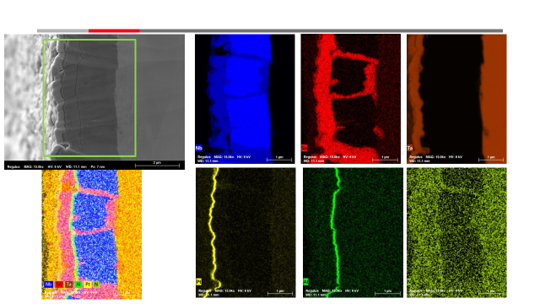
SIS Structure of Nb₃Sn/AlN/Nb multilayer on Ta
Although the layers are well identified however there is again some degree of mixing can be observed.
Sn segregation at Cu/Nb interface
Nb3Sn into Nb layer segregated at the grain boundary
Some level of Nitrogen diffusion into all the layers.

Slide 18
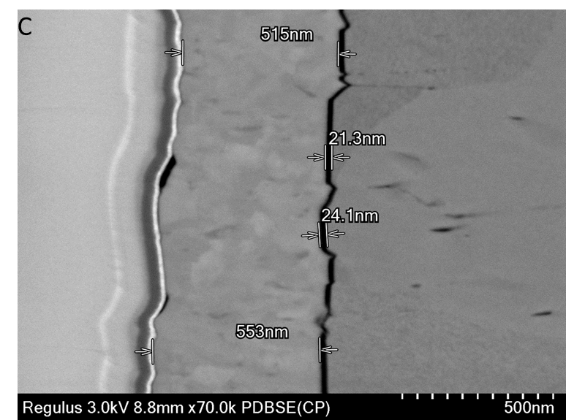
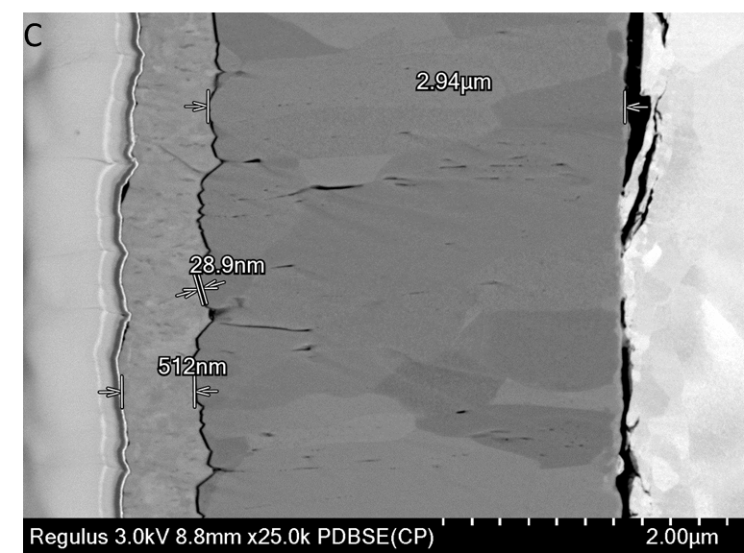
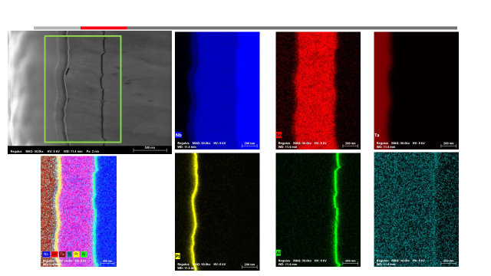
SIS Structure of Nb₃Sn/AlN/Nb multilayer on Ta
The layers are well identified and beside nitrogen no mixing can be observed.
No Sn segregation at Ta/Nb interface
Nb3Sn into Nb layer

Slide 19
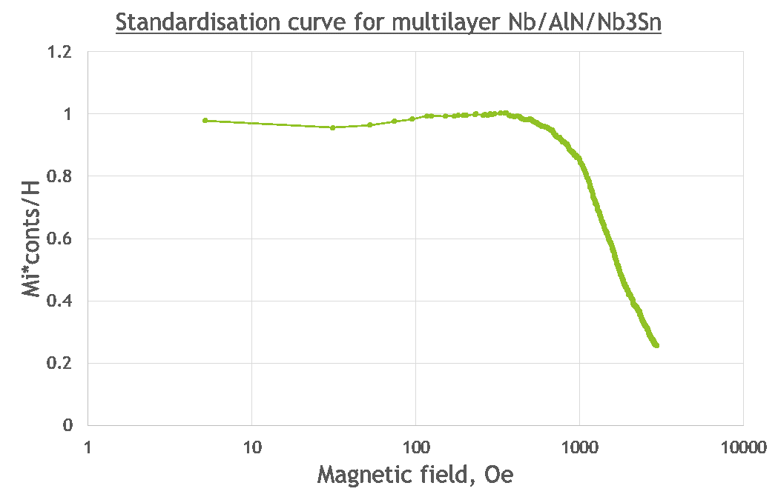
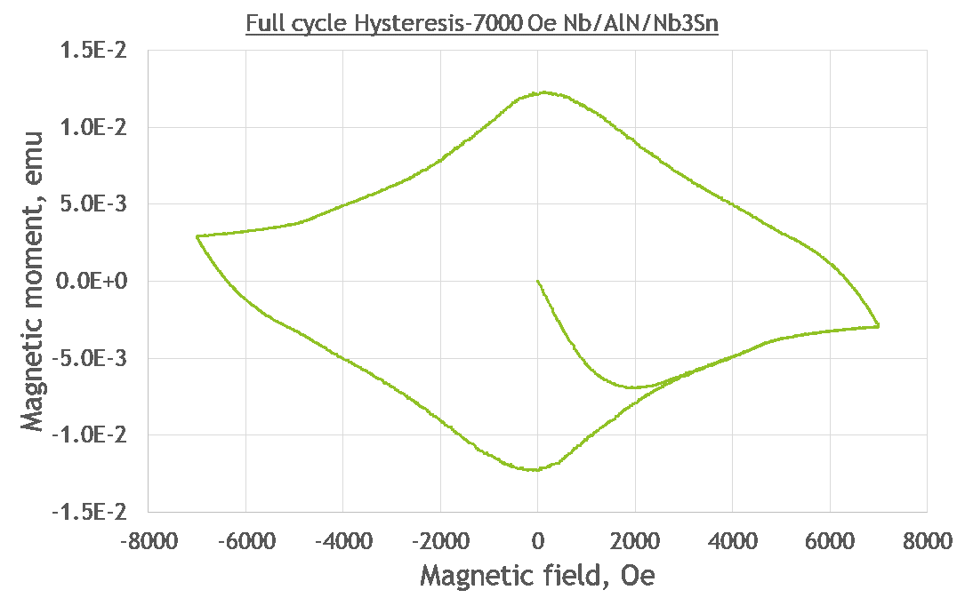
Normalized DC magnetic moment
the deviation from the Meissner state starts at applied external field of 80 mT which resembles to those of Nb single layer deposited on copper rather than Nb₃Sn observed above which the film stayed in Meissner state up to field of 300 mT.
The full cycle hysteresis loop shows a smooth curve over the full range of applied field which means that the film has stable flux pinning.

Slide 20
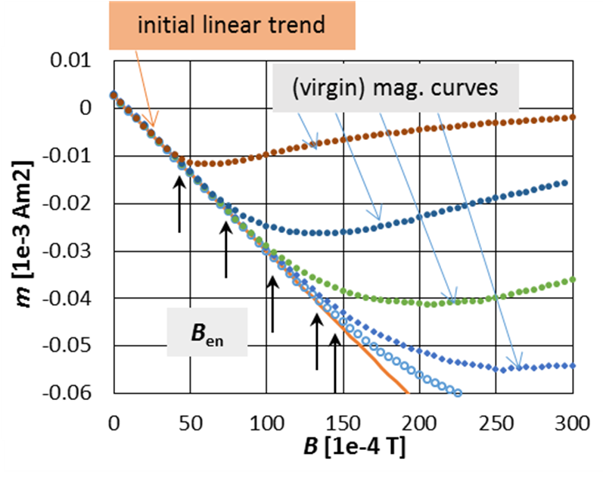
First flux entry B_{en} in Perpendicular Mag Filed for Nb3Sn
The first flux entry field B_{en}, determined applying the 2% relative difference criterion, at 4.22 K. Comparison of all Nb₃Sn samples deposited on different substrates (Cu, Sapphire, Ta). D – indicates the damaged samples on Ta substrate.

Slide 21
SYSTEM 2
NbN

Slide 22
NbN superconducting thin Film
B1 compounds have a NaCl-like structure where metallic atoms A form a face cantered cubic (fcc) lattice and non-metallic atoms B occupy all the octahedral interstices.
NbN has a very complex phase diagram, which makes it very challenging to achieve the superconducting δ phase.
ɣ-NbN Tc=15-17,3K
δ-NbN Tc=12-15K

Slide 23

NbN deposition parameters & subs prep
The NbN samples were synthesised in a randomized order developed through the use of a design of experiments function in Origin-Pro data analysis software
Mechanically polished to a roughness of Sq = 35 nm $±$18 nm.
Ultra sonic degrease in acetone – 15 mins
Ultra sonic degrease in ethanol – 15 mins
Chemical etch in HNO₃:H₂O (distilled) in a 3:2 ratio – 30 seconds
Rinsed with distilled water
Blow dry with N₂

Slide 24
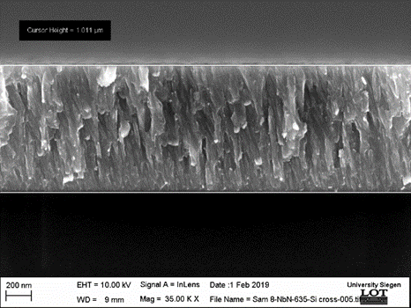
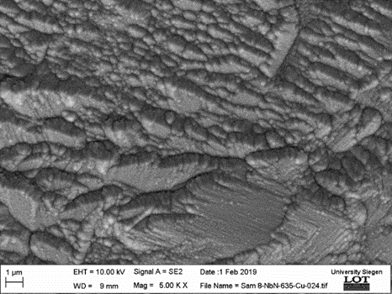
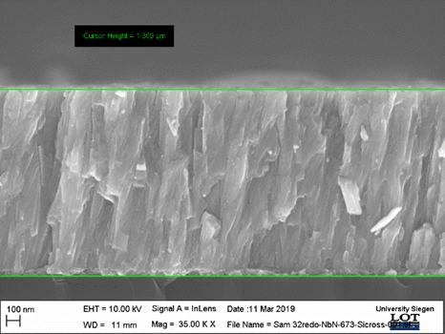
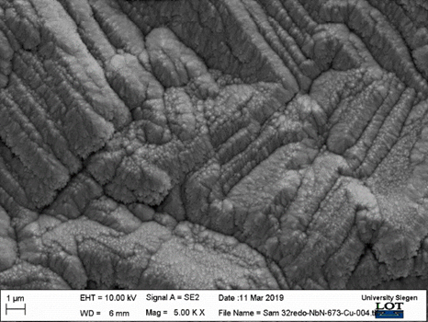

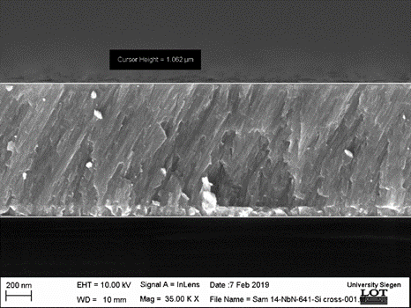
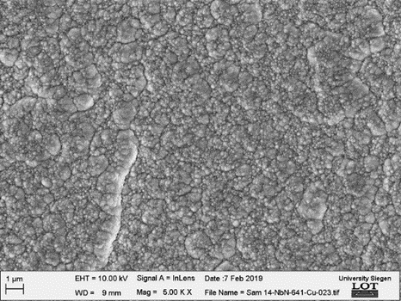
NbN film growth as function of dep parameters
The substitution of Ar with Kr did not change the growth mode.
Due to parameters interdependency no significant dependency of film growth with Ts was observed.
Film density can be controlled
Deposition temperature
working pressure
Deposition power
Sample bias
the high tendency of patterning of the coatings due to the different crystallographic orientation of the polycrystalline Cu substrate
(a)
(b)
columnar
(c)
(d)
(e)
(f)
Dense

Slide 25

B_{en} in Perpendicular Mag Filed for Nb, NbN, Nb3Sn
All NbN samples are considerably below the range of B_{en} values determined for the series of Nb
The Nb3Sn samples show a wide spread of B_{en} values
The highest Ben’s are comparable with the highest ones of the Nb samples while the lowest B_{en}’s are well below the range of Nb samples.

Slide 26
Summary
Nb3Sn can be successfully deposited from an alloy target and demonstrate good SC properties when it is deposited at high temperature (around 550-650 °C).
Complex defects can be formed in when Nb3Sn is deposited in a multilayer structure.
NbN can be produced from an Nb metal target by reactive sputtering in N2 rich atmosphere. The optimisation of the film’s structure is possible at well selected parameter settings. If NbN can compete with Nb or Nb3Sn in terms of SC properties, it will be shown in upcoming studies.
For SIS structures, the screening layer materials should be one containing nitrogen such as NbN and NbTiN, especially when the insulation layer is AlN.

Slide 27
Summary
DC magnetometry is an insufficient technique for multilayer characterisation of superconducting properties. The WP15 team should focus on development of:
3rd harmonics at CEA (operational) and IEE (presently under commissioning),
magnetic field penetration at STFC (presently under commissioning) and
RF measurements at CERN (operational), HZB (operational) and STFC (presently under commissioning).

Slide 28
Team Members
STFC
Adrain Hannah
Gavin Stenning
Daniel Turner
Yukari Dan (Hitachi)
Karl Dawson
Sepideh Aliasghari
Stuart Wilde
Oleg Malyshev
Tobias Junginger
Graeme Burt
Vinod Dannak
University of Siegen
Michael Vogel
Stewart Leith
Xin Jiang
Thorsten Staedler
IEE
Eugen Seiler
Rastislav Ries
INFN
Cristian Pira
Eduardo Chyhyrynets
Fabrisio Stivanello
Luca Zanotoo
Special thanks to all the team member

