Slide 1

The new Innovation Pilot project
Shaping our Future
Maurizio Vretenar, Roy Aleksan
2nd ARIES Annual Meeting, 11 April 2019
Notes:
Why do we need ARIES

Slide 2
Integrating Activities
ARIES is the 4th of a successful series of Integrating Activities for R&D on particle accelerators that have raised 43 M€ EC funding over 16 years (2.7 M€/yr).
CARE 01/2004 – 12/2008
5 years, 15.2 M€ EU contribution
Integrating Activities are originally intended to «integrate», i.e. to force scientific communities to collaborate across borders and to achieve a synergetic sharing of resources across Europe.
The structure of Integrating Activities (Networks, Transnational Access, Joint Research Activities) is functional to this goal.
FP6
EuCARD 04/2009 – 03/2013
4 years, 10.0 M€ EU contribution
FP7
EuCARD-2 05/2013 – 04/2017
4 years, 8.0 M€ EU contribution
“The aim of this action is to bring together, integrate on European scale, and open up key national and regional research infrastructures to all European researchers, from both academia and industry, ensuring their optimal use and joint development.”
H2020
ARIES 05/2017 – 04/2021
4 years, 10.0 M€ EU contribution
We have to acknowledge that after 16 years working together:
we are definitely a well integrated community, by all standards;
The rigid structure of Integrating Activities is increasingly less functional to our goals.

Slide 3
What after 4 Integrating Activities?
The Research Infrastructure Unit of DG/RTD is discussing since 2 years what should be the future of their 4 «super-advanced communities», having reached 3 or 4 successful IAs: accelerators, lasers, synchrotron light, detectors.
The first idea was to stop all support and leave them alone (they should become «sustainable»). We have a Task in ARIES on sustainability of accelerator research.
Luckily, another direction emerged from many discussions where we took part (ARIES and TIARA toghether with other communities), based on the creation of:
A separate new tools for communities centred on TNA (e.g. lasers);
A new tool centred on innovation that would boost the innovation potential (development of new technologies in partnership with industry) of other communities.
→ Birth of the Innovation Pilot
Pilot because this is an experimental programme, to test what the communities can invent and what they can produce inside such programmes.
If successful, the pilot could pave the way for a multi-million long term programme (flagship project) within the new Horizon Europe Framework Programme.

Slide 4
The Innovation Pilot in the RI Workprogramme
The Workprogramme for the last calls of H2020 – Research Infrastructures is in preparation since last September.
A final draft has been approved in January, and after some possible «minor technical modifications» the final version should be approved at the committee meeting of 7 May.
The programme contains the call:
«INFRAINNOV-04-2020: Innovation pilots» for 3 projects of 10 M€ each addressing innovation in 3 domains: light source technologies, detector technologies, accelerator technologies.
Non-competitive call, each community is expected to submit one project that will be approved if evaluated beyond an acceptance threshold.
TIMELINE:
Open call 28 November 2019
Deadline for submission 17 March 2020
Result of evaluation end of 2020
Possible project start May 2021
(end of ARIES on 30 April 2021!)
Unique opportunity of a flexible non-competitive project for the future of particle accelerators

Slide 5
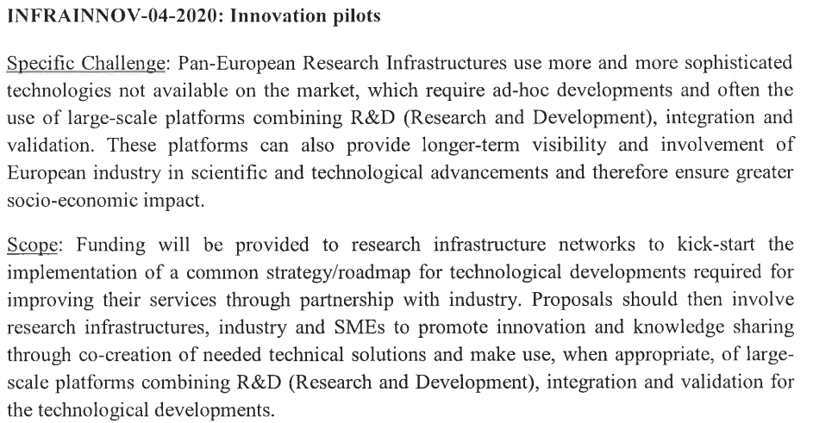
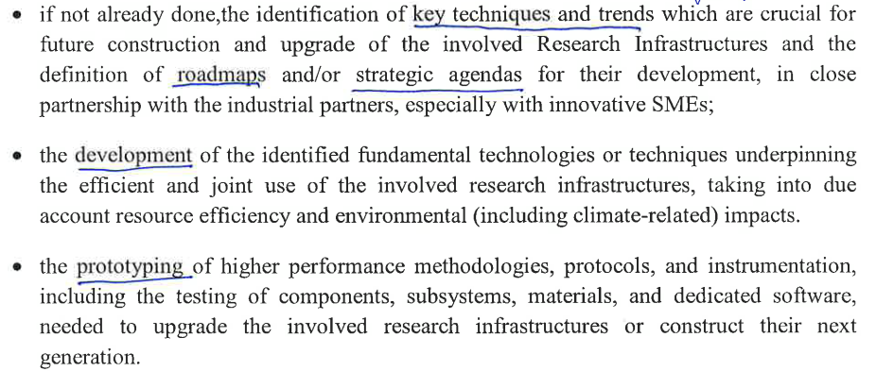
Contents of the new project (from workprogramme)
Key points:
RI Networks
Technological developments in partnership with industry
Use of large scale platforms
3 components:
Technological roadmaps in partnership with industry
«Development» of technologies.
«Prototyping» of technologies.

Slide 6
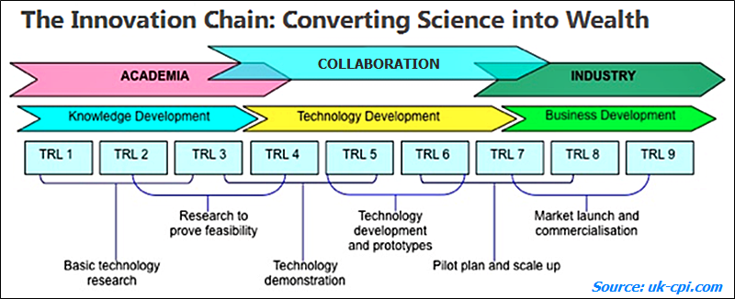
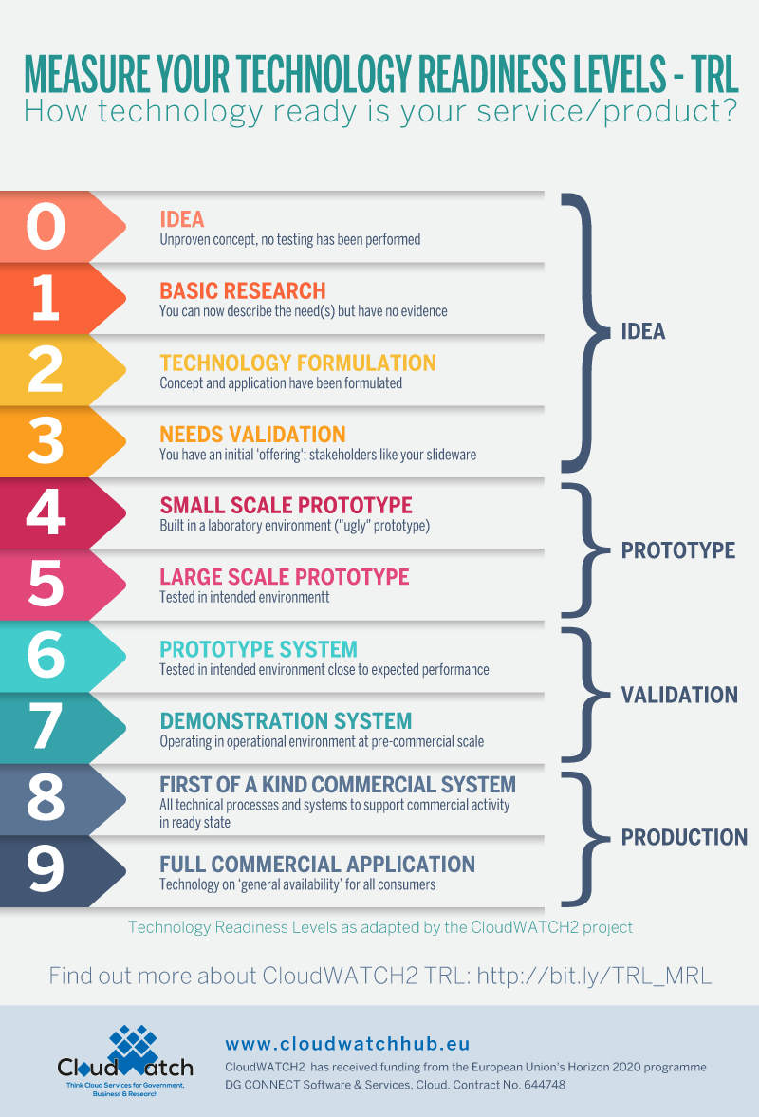
What does innovation mean in this context?
The Oslo Manual (OECD/Eurostat, 2005), defines innovation as “the implementation of a new or significantly improved product or process …”
- Improving the accelerator-based Research Infrastructures
- Bringing accelerator-based technologies to society
2.
Feasibility Study
3.
Demonstration,prototyping
1. Strategic roadmaps

Slide 7
The problem of societal applications
All good, but…
Reading the draft workprogramme, the innovations developed in the Innovation Pilot should aim exclusively at the RI’s themselves, to improve the delivery of services or to upgrade their infrastructure.
Innovations with a market outside of RI’s are in principle excluded. This includes all our medical, industrial and environmental applications of accelerators.
The reason is that the EC people wanted to clearly define a boundary between ATTRACT phase 2 (disruptive innovation in detectors with applications outside RI’s) and AIDA2 that shares the same Innovation Pilot text with ARIES2.
We lobbied against this serious blow to our traditions and to the potential of our technologies, and the Deputy Head of Unit promised to make some «minor technical modifications» to the final version of the text, to leave the door open to our societal applications.
We will know more in the next weeks. The communication with DG/RTD is difficult because of the ongoing restructuring.

Slide 8
Dimensions to retain from the present IA’s
In theory, we are free to do what we want with our Innovation Pilot if we respect the general rules. It might become an unstructured collection of mini-projects, originated in one single institute, with some additional industrial partners («à la ATTRACT»).
This is NOT what we want!
We must keep some important dimensions of our strategy for the development of accelerator that have emerged from our experience with Integrating Activities:
A project structured in well-identified and coordinated «themes».
European integration, in particular for smaller countries.
Connections and cross-fertilisation between laboratories, universities, industry.
Long-term time span of the R&D, beyond the needs of specific ongoing projects.
Co-funding, projects integrated in the work programme of our laboratories.
Partial two-stage submission as experienced with the ARIES proof-of-concept.

Slide 9
Proposed structure of the new Pilot
The Innovation Pilot contains «projects» of three types: strategies, developments, prototypes
Activity | TRL | Initial proposal (4 yrs.) |  |  | Second stage (3 yrs.)
 |  | Individual EC contribution | N. of projects | Total budget | Individual EC contribution | N. of projects | Total budget
Strategies |  | 200 k€ | 6 | 1.2 M€
Developments | 2 – 3 - 4 | 100 k€ | 15 | 1.5 M€ | 100 k€ | 15 | 1.5 M€
Prototypes | 4 – 5 - 6 | 500 k€ | 6 | 3.0 M€ | 500 k€ | 4 | 2.0 M€
TOTALS |  |  |  | 5.7 M€ |  |  | 3.5 M€
Example of possible distribution
Will be finalized depending on the proposals
The projects are organised in themes, with a theme (workpackage) coordinator. The ideal configuration would be having for each theme a strategy/roadmap and a number of projects at different TRL level.
Theme 1
Theme 2
Theme 3
Strategy
Strategy
Strategy
Development
Development
Development
Development
Development
…
Development
Prototype
Prototype
Prototype

Slide 10
What are we looking for
We are starting a bottom-up call for actions to become part of the new Innovation Pilot.
These actions may be:
Strategies (roadmaps), involving 5-10 partners including industry representatives, to identify a roadmap or a strategy to develop designs, technologies or applications. Possible examples: Frontier accelerators, Compact photon sources, Novel high-gradient accelerators, Low-emittance rings, Accelerators for medicine, Accelerators for industry and environment, Sustainability of technology infrastructure, Applications of superconducting magnets, High-gradient conventional RF, Future SC magnets, etc. Total budget about 200 k EC contribution, 50% co-funding for about 400 k total budget to be used for meetings, workshops, and to subcontract studies on perspectives and on possible markets.
Developments (feasibility studies) (100k) and prototypes (500k), involving minimum of 2-3 partners with possibly one from industry (mandatory for high TRL, optional for low TRL), to develop an idea, or a component, or a prototype for a new component, instrument, or application with wider long-term use beyond the needs of an individual project or laboratory. Examples: SC magnet, photocathode, electron lenses, advanced materials, components for new accelerators, etc.

Slide 11
Evaluation of projects – proposed selection criteria
The submitted projects will be evaluated with respect to some criteria.
The selection committe will define, before the selection, the weight to attribute to each criterion.
A first proposal for the evaluation could follow the criteria below:
  Scientific and technological excellence
  Impact on Research Infrastructures and/or on society
  Methodology
  Innovation content
  Transnationality and integration
  Co-funding rate
  Risk
  Cost vs. benefit
  Industry involvement
  Coherence with the priorities of the community

Slide 12
Proposed selection timeline and procedure
The members of the Innovation Evaluation Committee (IEC) should be nominated by the Directors of the 11 laboratories or consortia that signed the TIARA MoU [CEA, CERN, CNRS, CIEMAT, DESY, GSI, INFN, PSI, STFC, Uppsala University for the Nordic consortium, HN Institute of Nuclear Physics for the Polish consortium].
Each project will be submitted based on a standard form, and evaluated by the committee.
The requested EC contribution should correspond to the guidelines given for the three components, but different amounts can be asked in exceptional cases (to be evaluated by the committee).
Tentative Timeline:
1 May send letter and submission form to all institutes having participated in previous programmes
31 August submission deadline
30 September pre-analysis and classification of submissions completed.
31 October selection of projects completed.
30 November after a negotiation phase, structure of project complete and start editing.
The IEC will be nominated at the July TIARA meeting

Slide 13
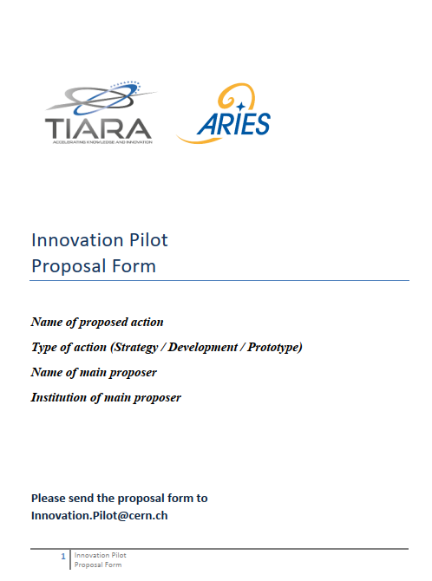
Proposal form
The submission form could be structured as follows:
Title and summary (0.5 p.)
Participants (0.5 p.)
Description (excellence) (1 p.)
Impact (0.5 p.)
Methodology and Organisation (0.5 p.)
Budget and indicative budget share with co-funding (0.5 p.)
Schedule, Deliverables and Milestones (0.5 p.)
Potential risks and mitigations (0.5 p.)
Proposed length about 5 pages

Slide 14

Ready for discussion…

