Slide 2
First year at CERN: working in the organisation and scheduling section
Antonio Grande
EN-ACE
UPM visit

Slide 3
General Overview
EN – ACE provides project coordination for the accelerator, support and expertise in matter of project & develops and supports CERN’s engineering
Projects implemented Long Shutdown 2 (LS2):
HI-LUMI - LHC (HIgh-LUMInosity LHC): upgrade of the LHC to achieve instantaneous luminosities a factor of five larger than the LHC nominal value
LIU - Injectors (LHC Injectors Upgrade): The LHC Injectors Upgrade should plan for delivering reliably to the LHC the beams required for reaching the goals of the HL-LHC
Consolidation of existing facilities
Management of the configuration relative to the machines (Space reservation, Engineering Change Request, Functional Specification, Engineering Specification, Installation Procedure, Tests Procedure etc…)
Update of the layout databases
Central information of the 3D models between all design office (services, mechanical etc…)
Identification of the interferences
Non-conformities of installation
Central information of the activities to schedule taking into account the logistic and operational safety aspects
Follow-up of the documentation (Space reservation, Engineering Change Request, Functional Specification, Engineering Specification, Installation Procedure, Tests Procedure etc…)
Follow-up of the Non-conformities of installation

Slide 4
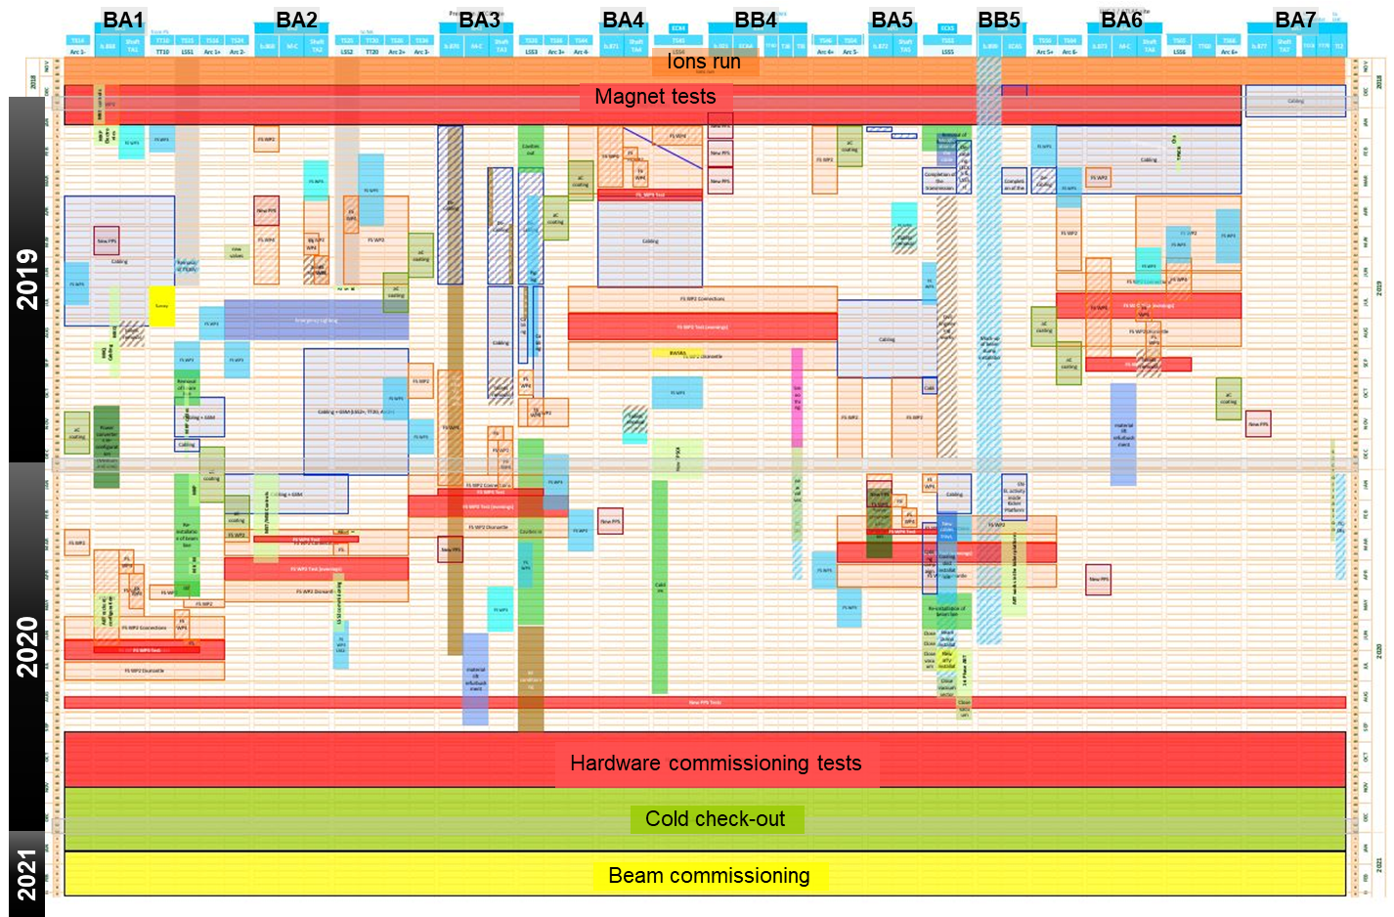
General Overview
EN-ACE-OSS, within the EN-ACE group, is in charge of the organisation and planning of the activities done in all the accelerators
ACE
Accelerator Coordination & engineering
ACE – OSA
(Operational Safety)
ACE – COS
(Coord. On Site)
ACE – ART
(Audits and
Technical Review)
ACE – EDM
(Eng. Data
Management)
ACE – OSS
ACE – CL
(Configuration
+ Layout)
ACE – CAE
(Computer
Aided Eng.)
ACE – INT
(Integration)
ACE – AMM
(Asset and
Maintenance Management)
Some of the tools developed by EN- ACE
LHC
Injectors
Layout Database
Layout Drawings
Planning (linear planning)
PLAN
Track It
Project server

Slide 5

General Overview
CERN has the necessity of coordinate the accelerators complex during the long shutdown
Main challenges
Workflow
Limited amount of time
Hundreds of activities involving different groups and departments
LS2
SPS Beam Dump project: More than 100 tasks involving +15 different groups
- TE-ABT
TE-EPC
EN-HE
…
2019
2020
!
Co-activities
Long Shutdown (LS2): 2 years
Technical stop(TS) : ~days
End of Year Technical Stop (EYETS): ~2 months
Different locations of works and links between them
Safety aspects
E. g. :
LHC: 27 km tunnel + surface
SPS: 7 km tunnel + surface
E. g. : There is a project to install fire safety equipment in the SPS tunnels during the LS2

Slide 6
Me at CERN
The complexity of an high technology organisation as CERN requires high qualified workers
Arrival
Today
Leaving
2017
Nov’17
2018
2019
2020
Nov’20
LS2
1
SPS beamline coordination
Manage and coordinate the time resources
Centralise all the activities which will be done in LS2
2
3
SPS coordination
SPS Schematic View
Define an schematic view of the SPS which will contain all the equipment as coordination tool
4
Vacuum resources coordination
Along with vacuum section, define and coordinate all the support tasks and personnel resources involved during LS2
1
2
3
De-cabling Project in all the injectors
Coordinate and organise the different information and the groups involved in the de cabling projects
Manage the online site (SharePoint) of the project
Help in the in-situ classification of the works
4
1
Decabling project
5
2
5
French
Courses offered by the organisation
The objective is to be able to lead meetings both English or French due to the general use of both languages
6
6

Slide 7
Me at CERN
SPS coordination: the main objective is to develop a planning for the LS2, as well as define the vacuum resources
SPS Beamline
Coordination
SPS Coordination
SPS Schematic View
Official holidays
Start & end of LS2
Limit of personnel available
Personnel needed
Vacuum resources
coordination
Personnel
Duration of the LS2 (months)

Slide 8
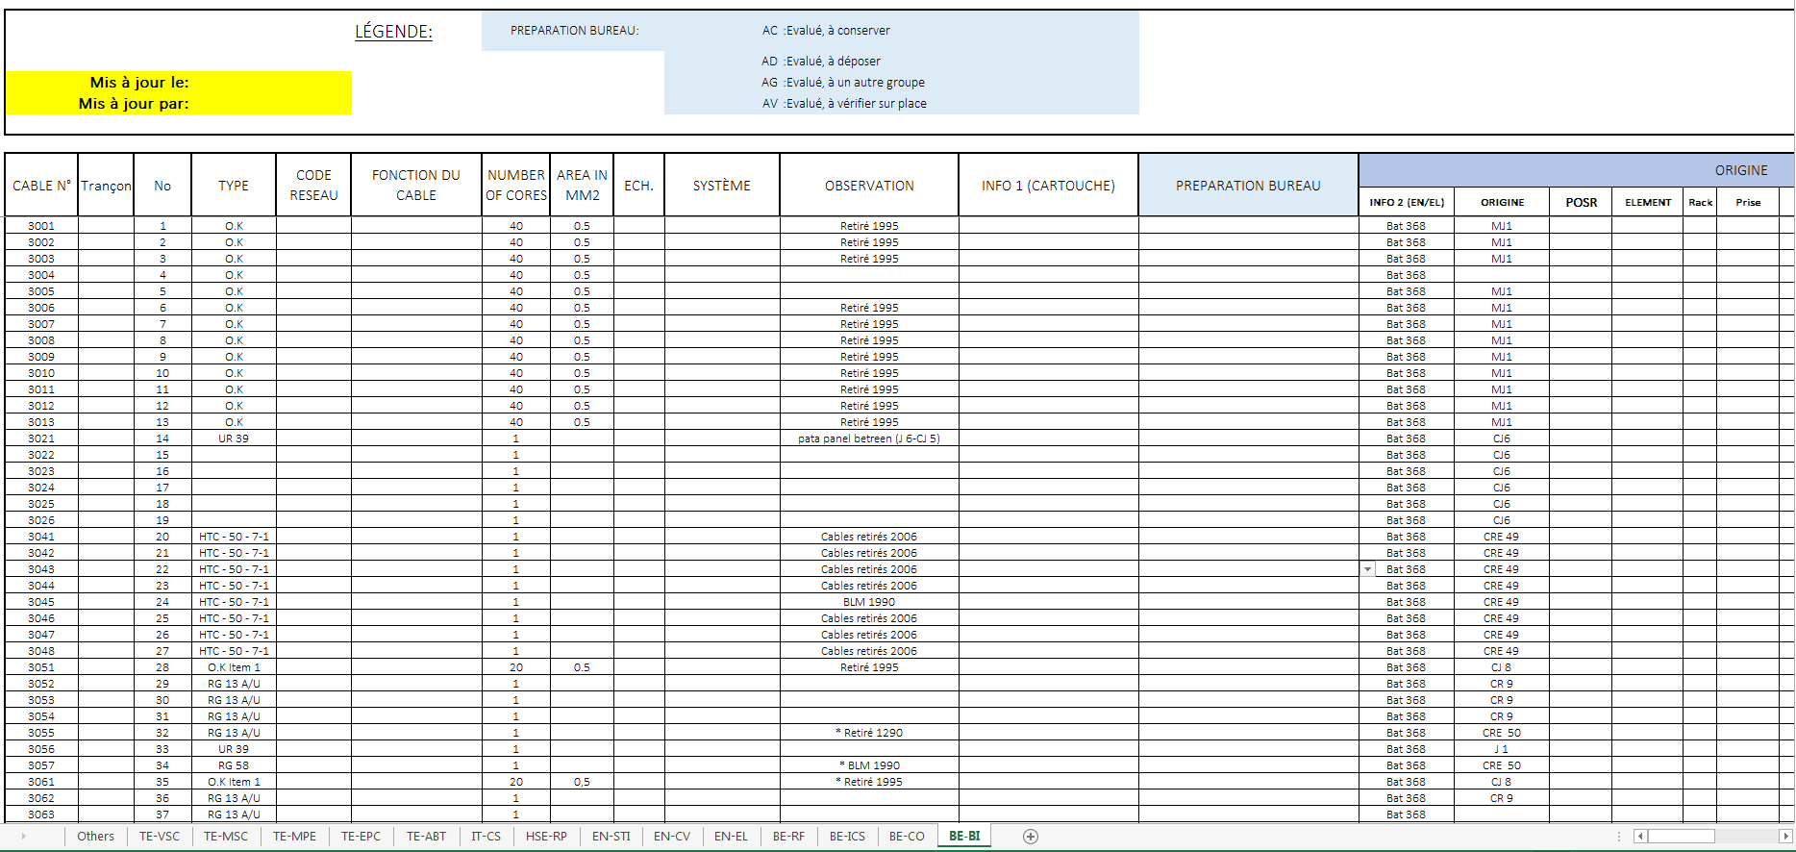
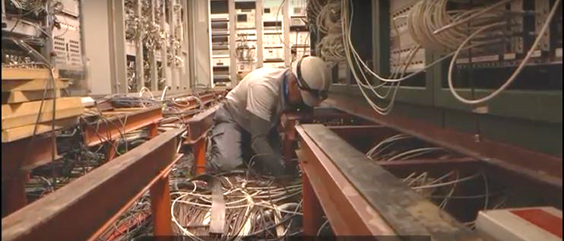
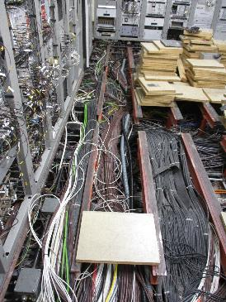
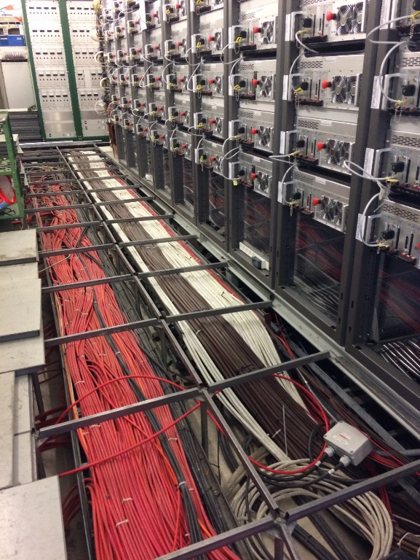
Me at CERN
De-cabling: the removal of obsolete cables is necessary in order to make space enough for the LIU installation
The main objective of the project are:
Space: the removal of the cables is a key step prior to install the upgrades of the LIU project
Safety: regarding this field, the removal of the obsolete cables leads to improve safety, because the less cables on site, the less fire risk, electrical issues…
Typical workflow
Working in the office
+
Online platform
Work in situ
Extra Identifications by EN/EL
CES (in service)
SPS3
APPROVAL
DEC’s
DOV (To be removed)
Identifications by Groups
Already removed
PT (not found)

Slide 9
Me at CERN
Conclusion: working at CERN is making me learn in technical areas and improving my personal background
Technical background
Organise the work of a high complexity facility
Manage of high amount of information
Use of computer tools as SharePoint or MS Project
Liaise and organise stakeholders
French
Personal background
Working at CERN is allowing me to understand a big organisation, working in a more practical way and applying the theoretical concepts learned at the university
The international environment is giving me a different approach in developing projects
I have the possibilities of getting in touch with different fields which let me improve my knowledge in different areas

