Slide 1

WMS and Computing Resources
A.Tsaregorodtsev,
CPPM-IN2P3-CNRS, Marseille,
9th DIRAC User Workshop,
14 May 2019 London

Slide 2
Outline
General WMS architecture
Computing resources
Interfaces
Conclusions

Slide 3
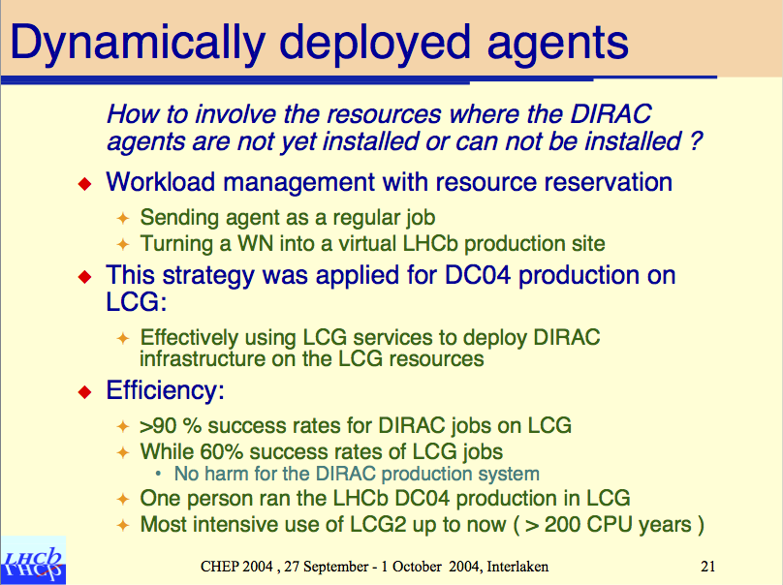
WMS with pilot jobs
First demonstration
in 2004 in the LHCb
Data Challenge
Natural evolution
of the PULL
scheduling
paradigm (as
opposed to PUSH
scheduling)

Slide 4



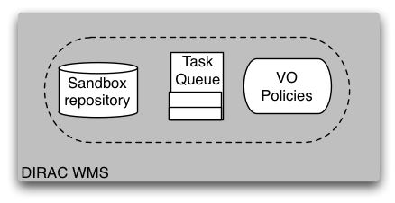





Physicist
User
Production
Manager
Matcher
Service
EGI/WLCG
Grid
NDG
Grid
Amazon
EC2 Cloud
CREAM
CE
EGI
Pilot
Director
NDG
Pilot
Director
Amazon
Pilot
Director
CREAM
Pilot
Director

Slide 5
Pilot based WMS
One evident advantage is that the users’ payload is starting in an already verified environment
  In early days of the grid and even now users saw an important decreasing of their jobs failure rate
The environment checks can be tailored for specific needs of a particular community by customizing the pilot operations

Slide 6
Pilot based WMS
Site resources providers does not need to distinguish individual users
  One user identity represents the whole community to the sites
  Simplifies site management but needs special trust relation between the site and the community
Sites does not need to organize local resources to meet the community requirements
  E.g. special queues per community groups with special fair sharing
Adding new sites to the pool of DIRAC managed resources is considerably simpler
  DIRAC does not require special services to be deployed on sites
    There are exceptions (see the HPC case below)

Slide 7
Pilot based WMS
User jobs submitted to the system are not passed immediately to a selected site but wait in the central repository – Task Queue
Possibility to apply community policies by dynamically adjusting the job priorities
  Similar mechanism to batch systems fair sharing mechanism
  Job priorities can be adjusted using community specific plugins
  Standard plugins include static group shares
  Job priorities of users in the same group are dynamically adjusted based on the recent history of the consumed resources as provided by the Accounting service

Slide 8
Computing resources: grid
DIRAC was trying to exploit all the possibilities to reserve computing resources
  Using both grid job orchestration services (Resource Brokers, gLite WMS) and direct submission to Computing Elements
    Wise decision: all the middleware brokers/WMS are now the story of the past
  Need for dealing with different types of Computing Elements:
    Computing Element abstraction with multiple implementations for different CE types
  Currently supported Computing Elements types
    Globus GRAM (is it used ?)
    CREAM
    HTCondorCE
    ARC
    SSH

Slide 9
CREAM CE
CREAM will be retired soon
Good service with a complete functionality:
  CE status query
  Job submission, status monitoring, logging, output retrieval
  User proxy renewal
No need to keep traces of the jobs locally
  Different DIRAC services and agents can interact with the same CREAM CE service

Slide 10
ARC
ARC
  No a real service interface
    Rumors are that a REST interface is in the works (ARC6)
  Can not interrogate detailed CE status
    Ldap service, not always up to date (not directly from the batch system)
  Problems retrieving pilot output on demand to WMSAdministrator
  Not using ARC data management

Slide 11
HTCondorCE
HTCondorCE
  Not very convenient to use
    using command line
    relying on locally stored information
  Can not interrogate CE status
    relying on PilotAgentsDB
  Problem retrieving pilot output on demand to WMSAdministrator

Slide 12
How to cope with ?
CE status evaluation by monitoring submitted pilots
  Pilots after the start are proactively reporting their status to the DIRAC central service
  No need to interrogate Ces
  Aborted pilots can be detected with a long delay
Pilot output retrieval is rather complicated
  Need for a generic mechanism to upload pilot output to the DIRAC central service (dedicated SE)
  Pilot logging using MQ protocol is a step in this direction

Slide 13
No CE resources
Computing resources with no special service for remote access
Abstraction of a Batch System with implementations for:
  GE, Condor, Torque, LSF, SLURM, OAR
  Host
The BatchSystem objects are used by special ComputingElements
  LocalComputingElement
    Submits and manage jobs in the local batch system
    Can be used by on-site Pilot Directors
  SSHComputingElement
    See below

Slide 14
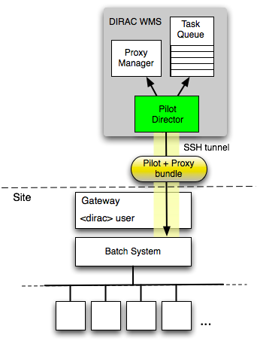
Standalone computing clusters
Off-site Pilot Director
  Site delegates control to the central service
  Site must only define a dedicated local user account
  The payload submission through an SSH/GSISSH tunnel
The site can be:
  a single computer or several computers without any batch system
  a computing cluster with a batch system
    LSF, BQS, SGE, PBS/Torque, Condor
      Commodity computer farms
    OAR, SLURM
      HPC centers
The user payload is executed with the owner credentials
  No security compromises with respect to external services

Slide 15
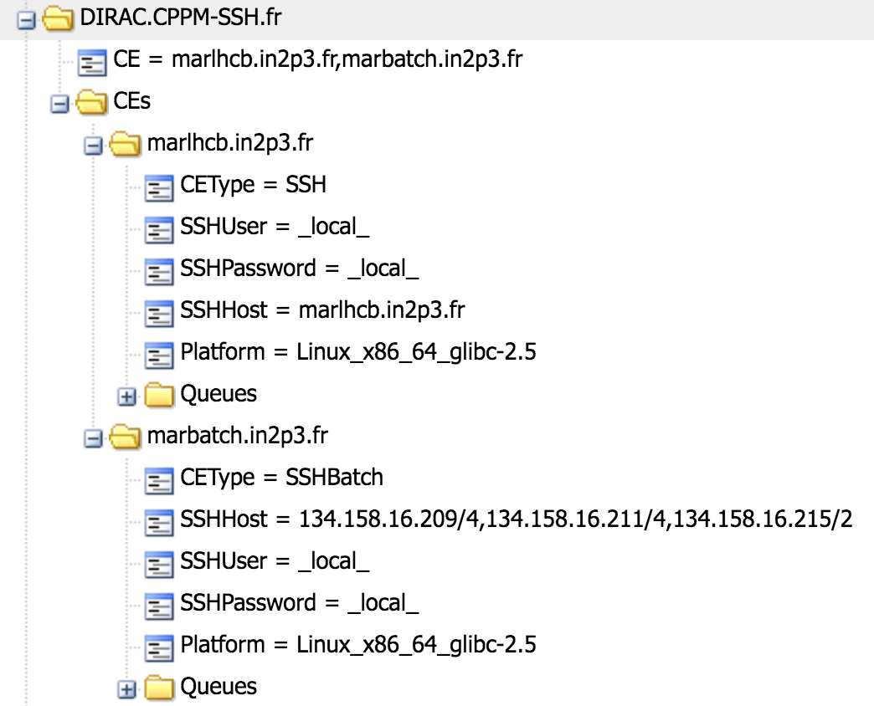
SSH CE: simplest case
SSH CE simplest case:
  One host CE with one job slot
SSHBatch CE
  Several hosts form a CE
    Same SSH login details
    Number of job slots per host can be specified
Pilots are sent as an executable self-extracting archive with the pilot proxy bundled in

Slide 16
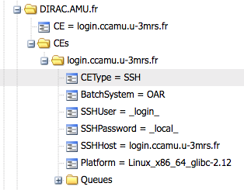
SSH CE with a batch system
SSH login to the cluster interactive host
  Copy several tools, e.g. BatchSystem plugin at the first
  time
Submit pilots to the local cluster using a relevant BatchSystem plugin

Slide 17
HPC Centers
The number of accessible HPC centers is growing
They are typically not part of any grid infrastructure
  Define own rules for accessing, outbound connectivity, software distribution, etc
Under certain circumstances the use is trivial
  SSH access allowed
  Outbound connectivity from WNs
  CVMFS available
Otherwise special setup is needed for each center
  See example below

Slide 18
HPC access possible setup
Computing site
Login
DIRAC Server installation
Worker Node
DIRAC services
Gateway
Job
Job
pilot wrapper
Site Director
pilot
Job
Job
Job
DIRAC SE proxy (?)
RequestExecutingAgent
ReqManager
DIRAC SE
SE
SE
18

Slide 19

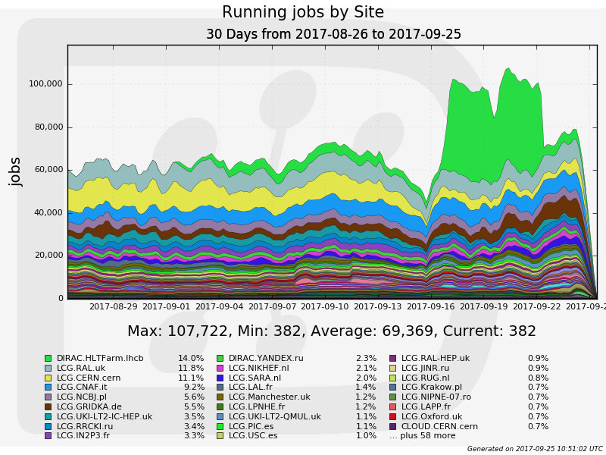
LHCb Collaboration
More than 100K concurrent jobs in ~120 distinct sites
  Limited by available resources, not by the system capacity
Further optimizations to increase the capacity are possible
  Hardware, database optimizations, service load balancing, etc

Slide 20
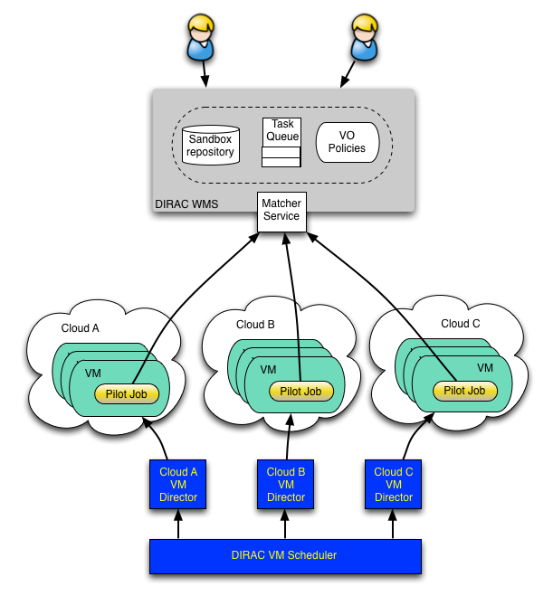
Clouds
Clouds can provide flexibly computing resources
  The amount of HTC suitable resources remains small
VM scheduler
  Dynamic VM spawning taking Task Queue state into account
  Discarding VMs automatically when no more needed
The DIRAC VM scheduler by means of dedicated VM Directors is interfaced to different cloud provider services

Slide 21
VMDIRAC
Currently supported cloud connectors
  Legacy cloud endpoint connectors
    Apache-libcloud
    Rocci command line
    OCCI REST
  Amazon EC2
    Using boto2 python binding
  Using directly cloud services
    Openstack REST interface
    OpenNebula XML-RPC interface

Slide 22
Openstack cloud
Openstack is the most popular cloud endpoint
  Most of the EGI FedCloud sites
Keystone v2 & v3 is supported
  Login/password
  VOMS proxies
Openstack dashboards support SSO login
  Not yet used in the service APIs

Slide 23
VMs
VM contextualization
  Starting from standard images (SL6 or CC7 or …)
    No need to maintain special DIRAC images
    Specific images can be needed to access special resources, e.g. GPUs
  The necessary software environment is prepared during the VM bootstrapping
    CVMFS, Docker, Singularity, etc
    More elements can be added

Slide 24
VM Pilots
Pilots are started as the last step of the VM contextualization process
  Still use VMDIRAC specific pilot deployment
  Pilot 3 integration is necessary
Single pilot is started on one VM
  Exploiting all the VM CPU cores
  No one pilot per CPU core

Slide 25
VM Pilots
VM pilots use PoolComputingElement to manage local resources
  On-WN batch system
  Flexible strategy with prioritized job requests to the Matcher, e.g.:
    First, ask for jobs requiring WholeNode tag
    If none, ask for jobs requesting as many cores as available
    If none, ask for jobs with MultiProcessor requirement
    If none, ask for single-core jobs
  The goal is to fill the VMs with payloads fully exploiting there multi-core capacity
    Other job request strategies can be added

Slide 26
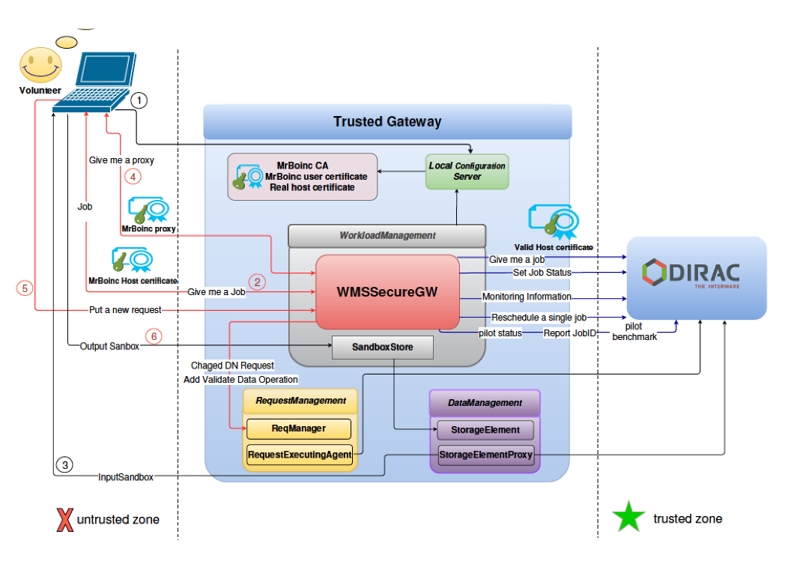
Volunteer grids
LHCb solution
Trust problem: separate trusted and untrusted worlds
  Put a gateway in between to ensure communication
    Use temporary certificates in the untrusted machines, communicate with a real host certificate to DIRAC service
    Validate any output of the jobs before uploading to the final destination
BoincDIRAC extension created
  Waiting for an interested developer to make it a generic solution

Slide 27
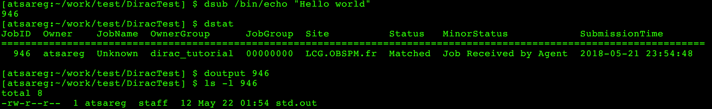
User interfaces
For the users all the internal WMS/pilots machinery is completely hidden. They see all the DIRAC operated computing resources as single large batch system
  Presented in the Basic DIRAC Tutorial tomorrow
  Command line
  DIRAC API
  Web Portal

Slide 28
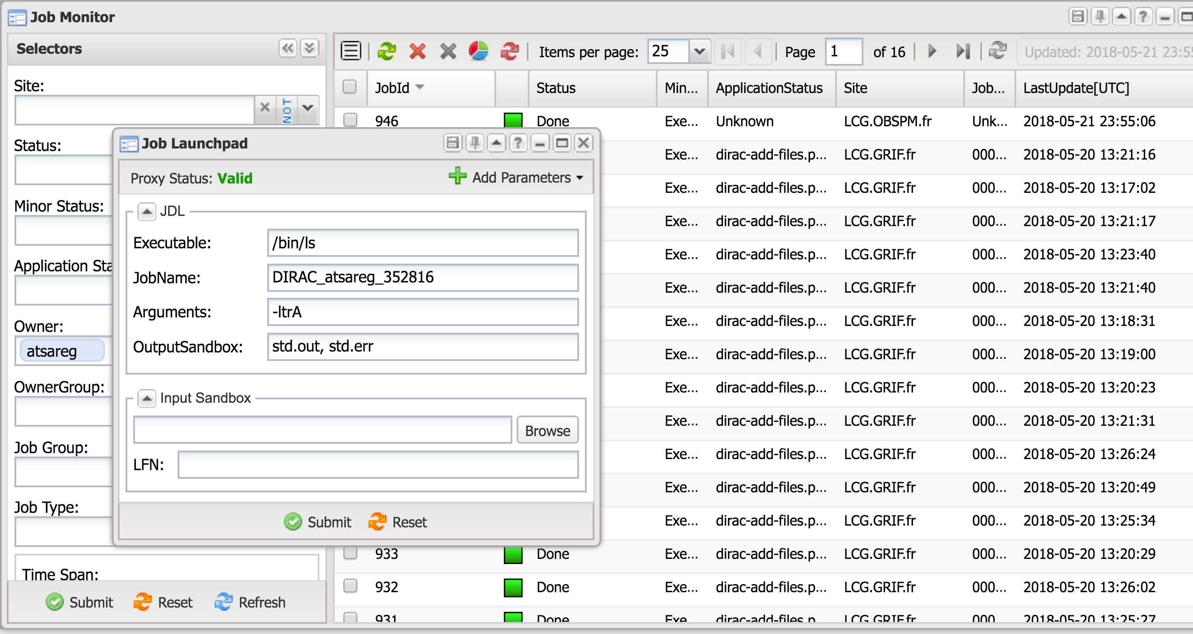
Jobs in the Web Portal

Slide 29
Conclusions
Pilot based WMS proven to be efficient in the HEP experiments is now available for the users of dedicated and multi-VO DIRAC services
A large variety of heterogeneous computing resources can be federated due to the pilot job mechanism
Ongoing effort to make new non-grid resources conveniently available (HPC, Cloud)
Keeping uniform resource access interfaces for the users – single DIRAC computer

