Slide 1
TE-VSC activities and status
Jose A. Ferreira Somoza

Slide 2
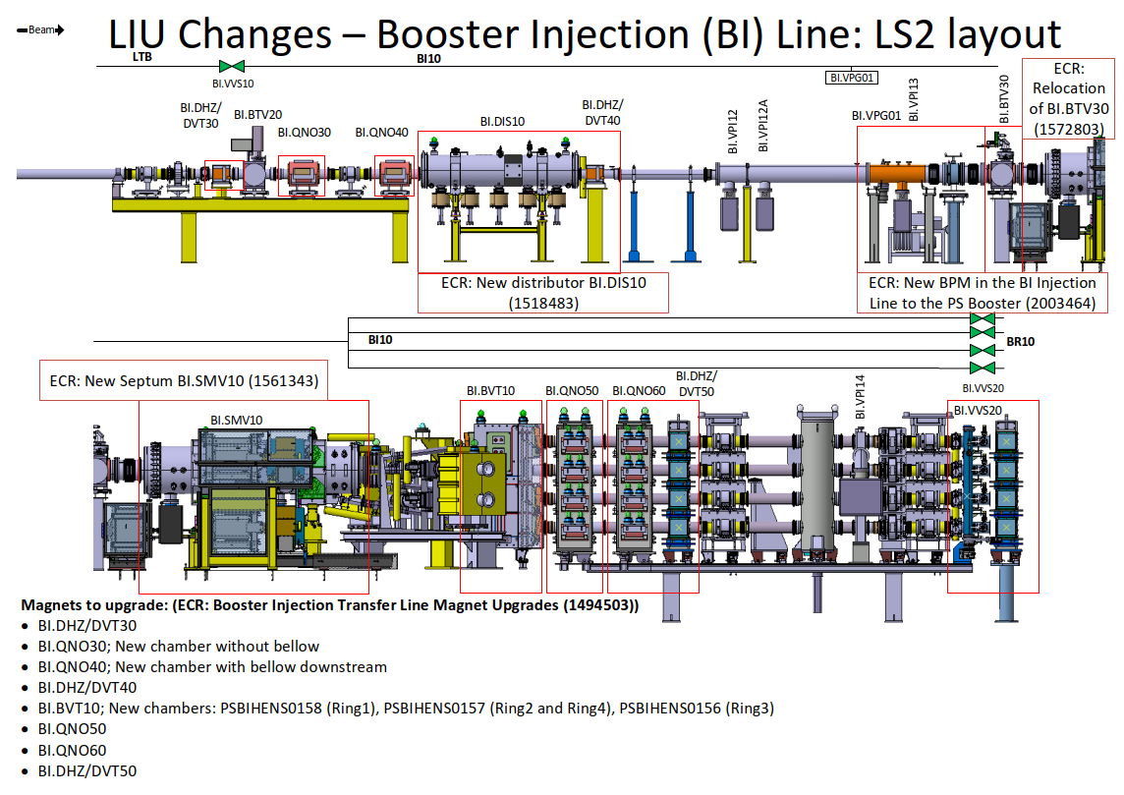
BI line
New vacuum chamber. Ready for C2 and start production
In stock
New vacuum chamber. Job open waiting design
In stock
In stock

Slide 3
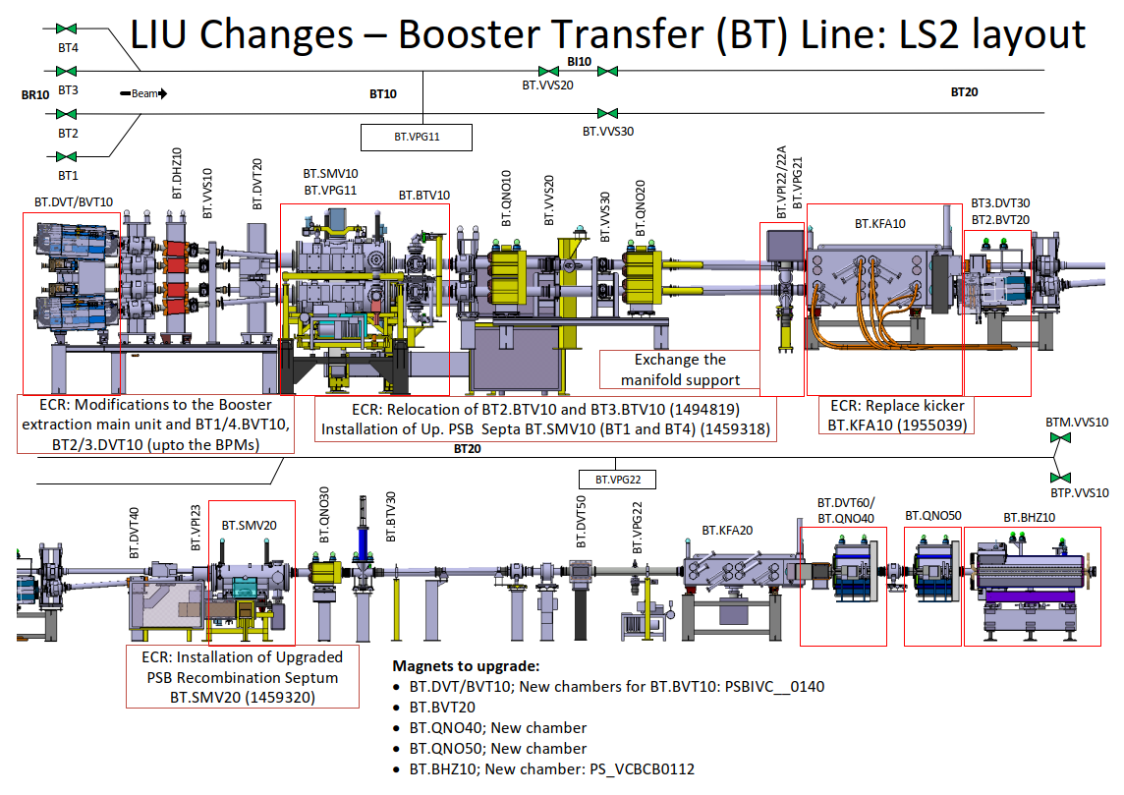
BT line
In production
BE-BI (reminder)
In stock
In stock
In production

Slide 4
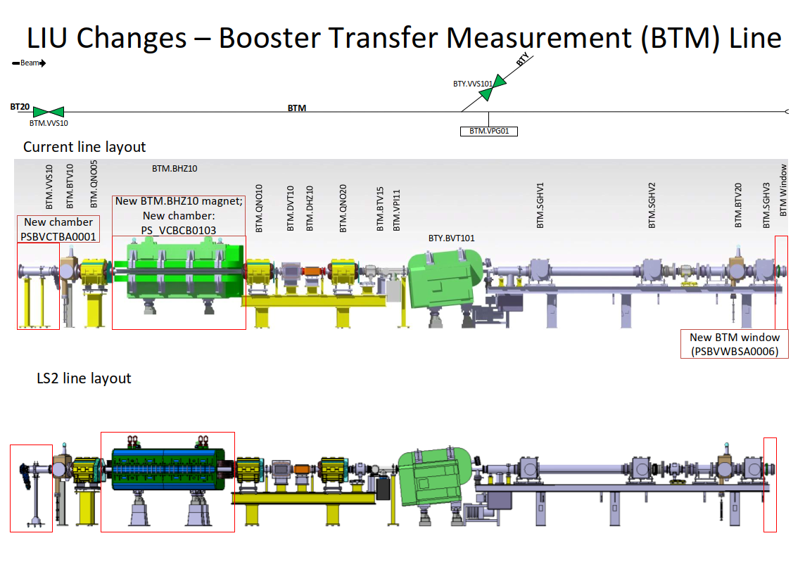
BTM line
In stock
In stock
In stock

Slide 5
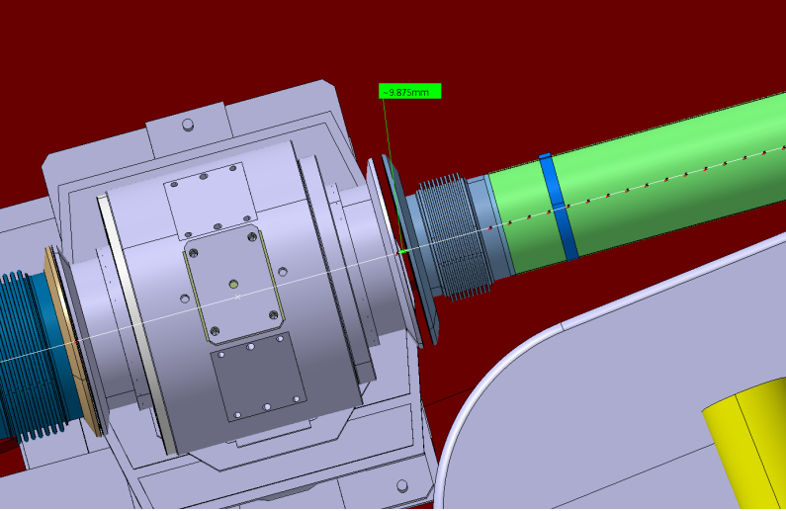
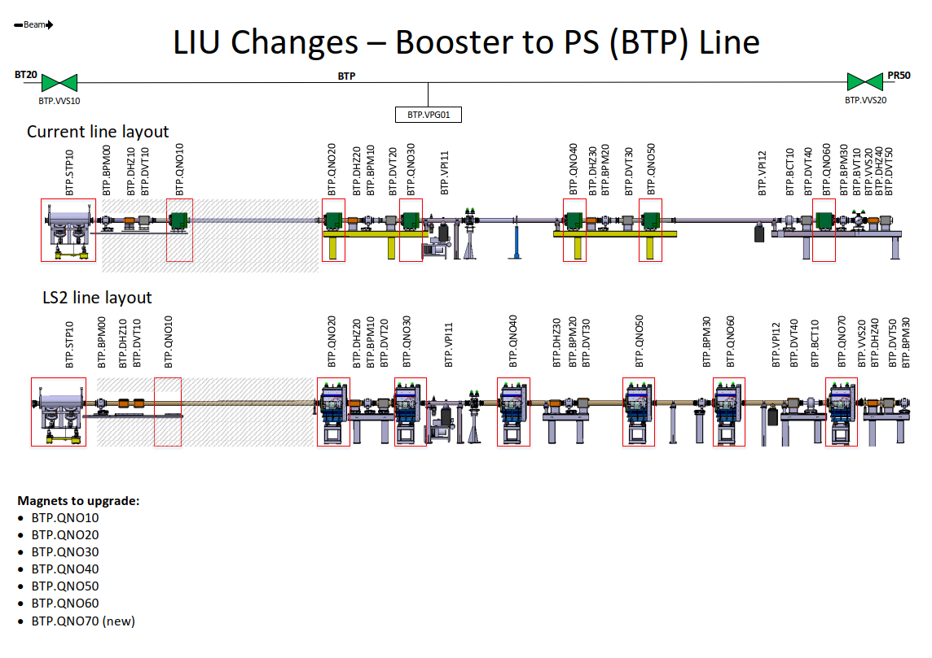
BTP line
Possible gap between PU and next chamber
In production

Slide 6
Summary of transfer lines
Stock of bellows and flanges. 316LN sheet ordered in May but not yet received. Bellows arriving in November
BI line. All chambers in stock except:
  Last modification to add a new pick-up
  Two modifications to decouple alignment of quads and BI.DIS (not strictly required)
BT line. All chambers in stock except:
  BT.BVT10 (modification of BHZ151)
  Chambers for new quads
BTM line. Everything in stock
BTP line. Everything under production. Some issues linked to integration to be followed. ECR?

Slide 7
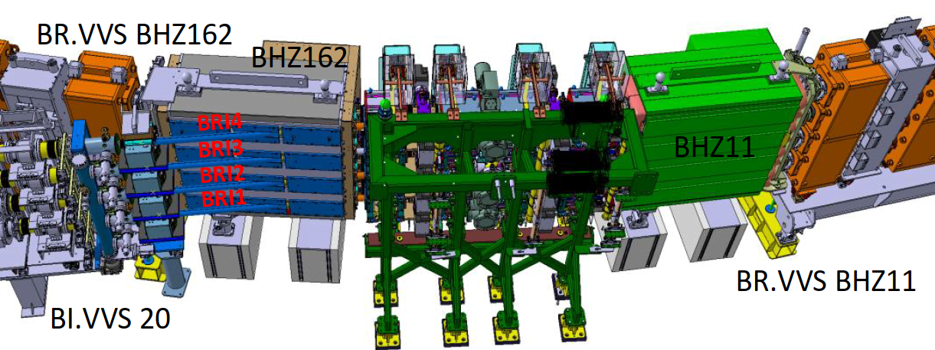
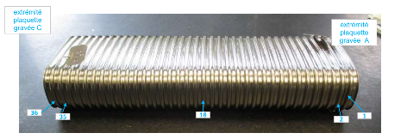
PSB ring
Injection area: Everything in stock
Extraction area (BHZ151). ECR sent for approval. In production, corrugated chambers already in metrology
FWS vacuum chambers for layout modification in production
Finemet cavities: Some chambers under production (flange non conformity). One missing support under production
Replacement chambers for period 6 and 10 under production

Slide 8
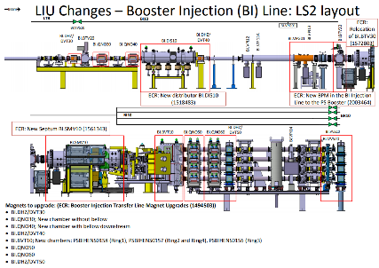
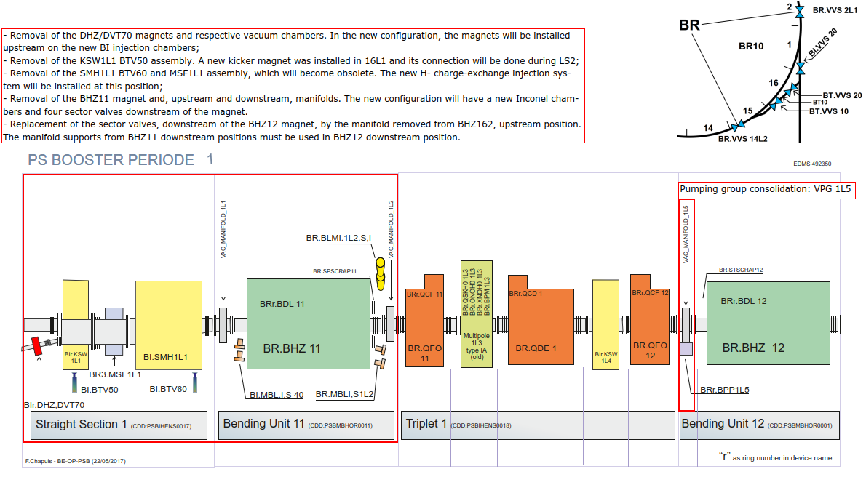
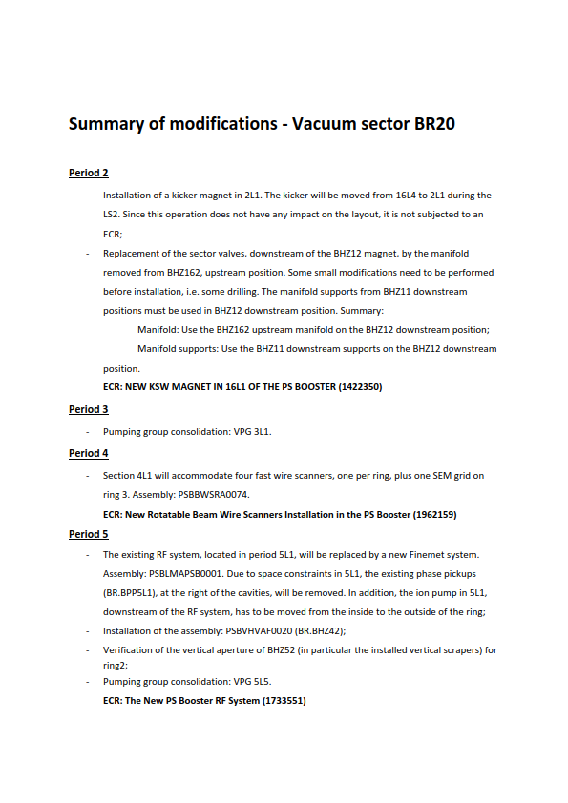
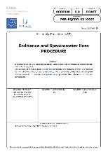
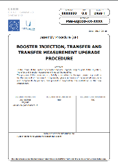
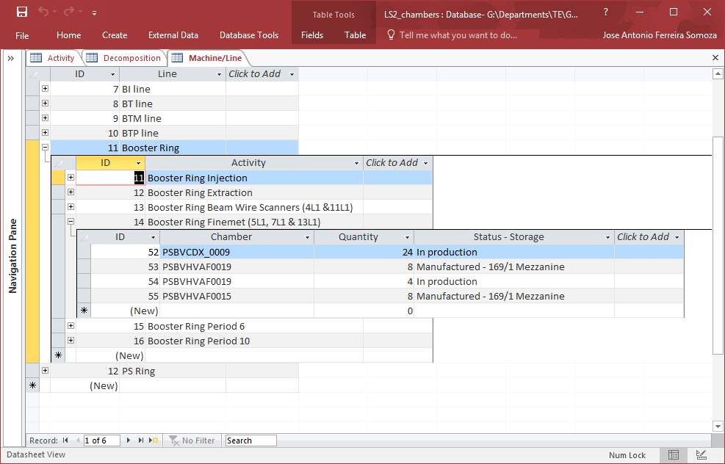
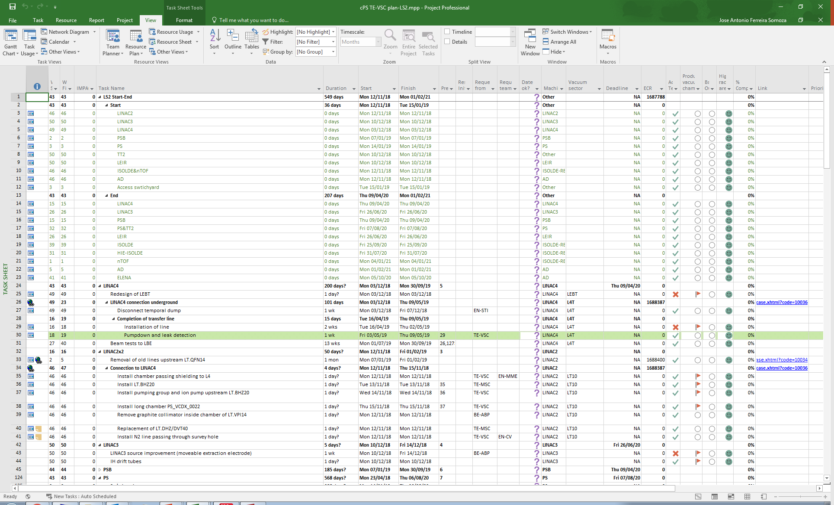
Preparation
Schematic layouts with TE-VSC involvement
Inventories
Procedures
Planning

Slide 9
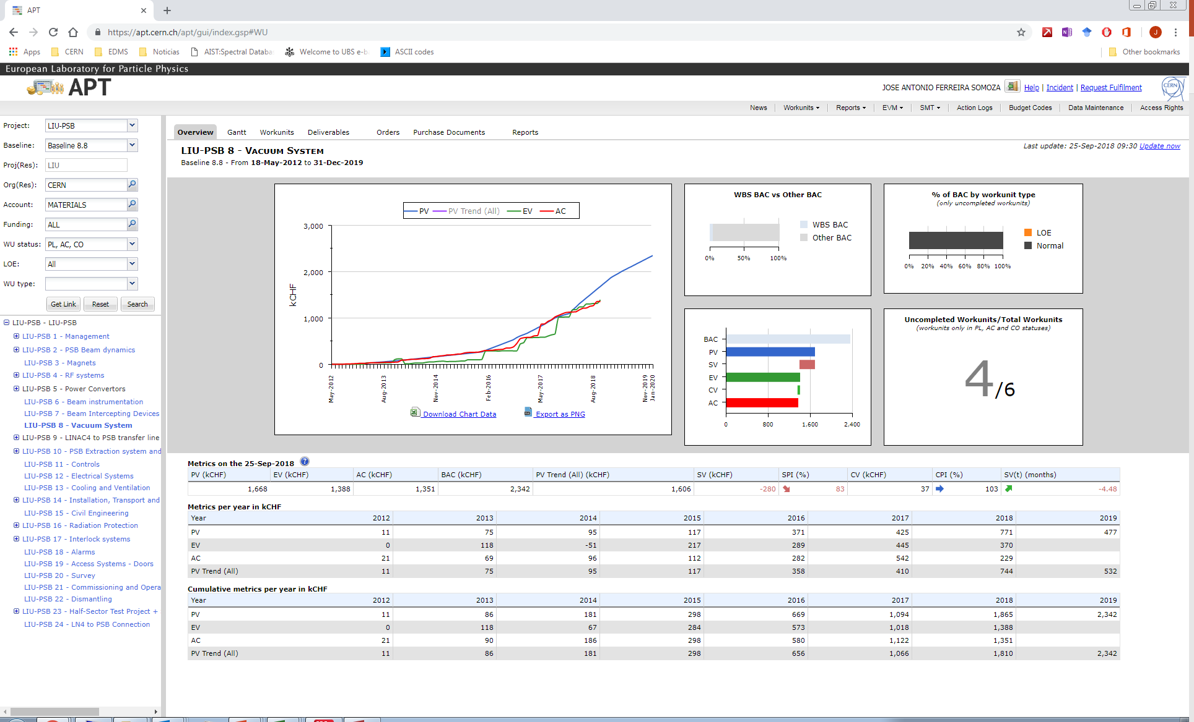
EVM
Review this Thursday
Budget dominated by EN-MME jobs

Slide 10
Conclusion
No showstoppers detected (yet)
Some difficulties with the integration of different lines
Mechanical assembly drawings → Budget allocated might be short. TE-VSC will continue producing these drawings (while budget available). No clear responsibility for the production of 3D models of old lines

