Slide 1
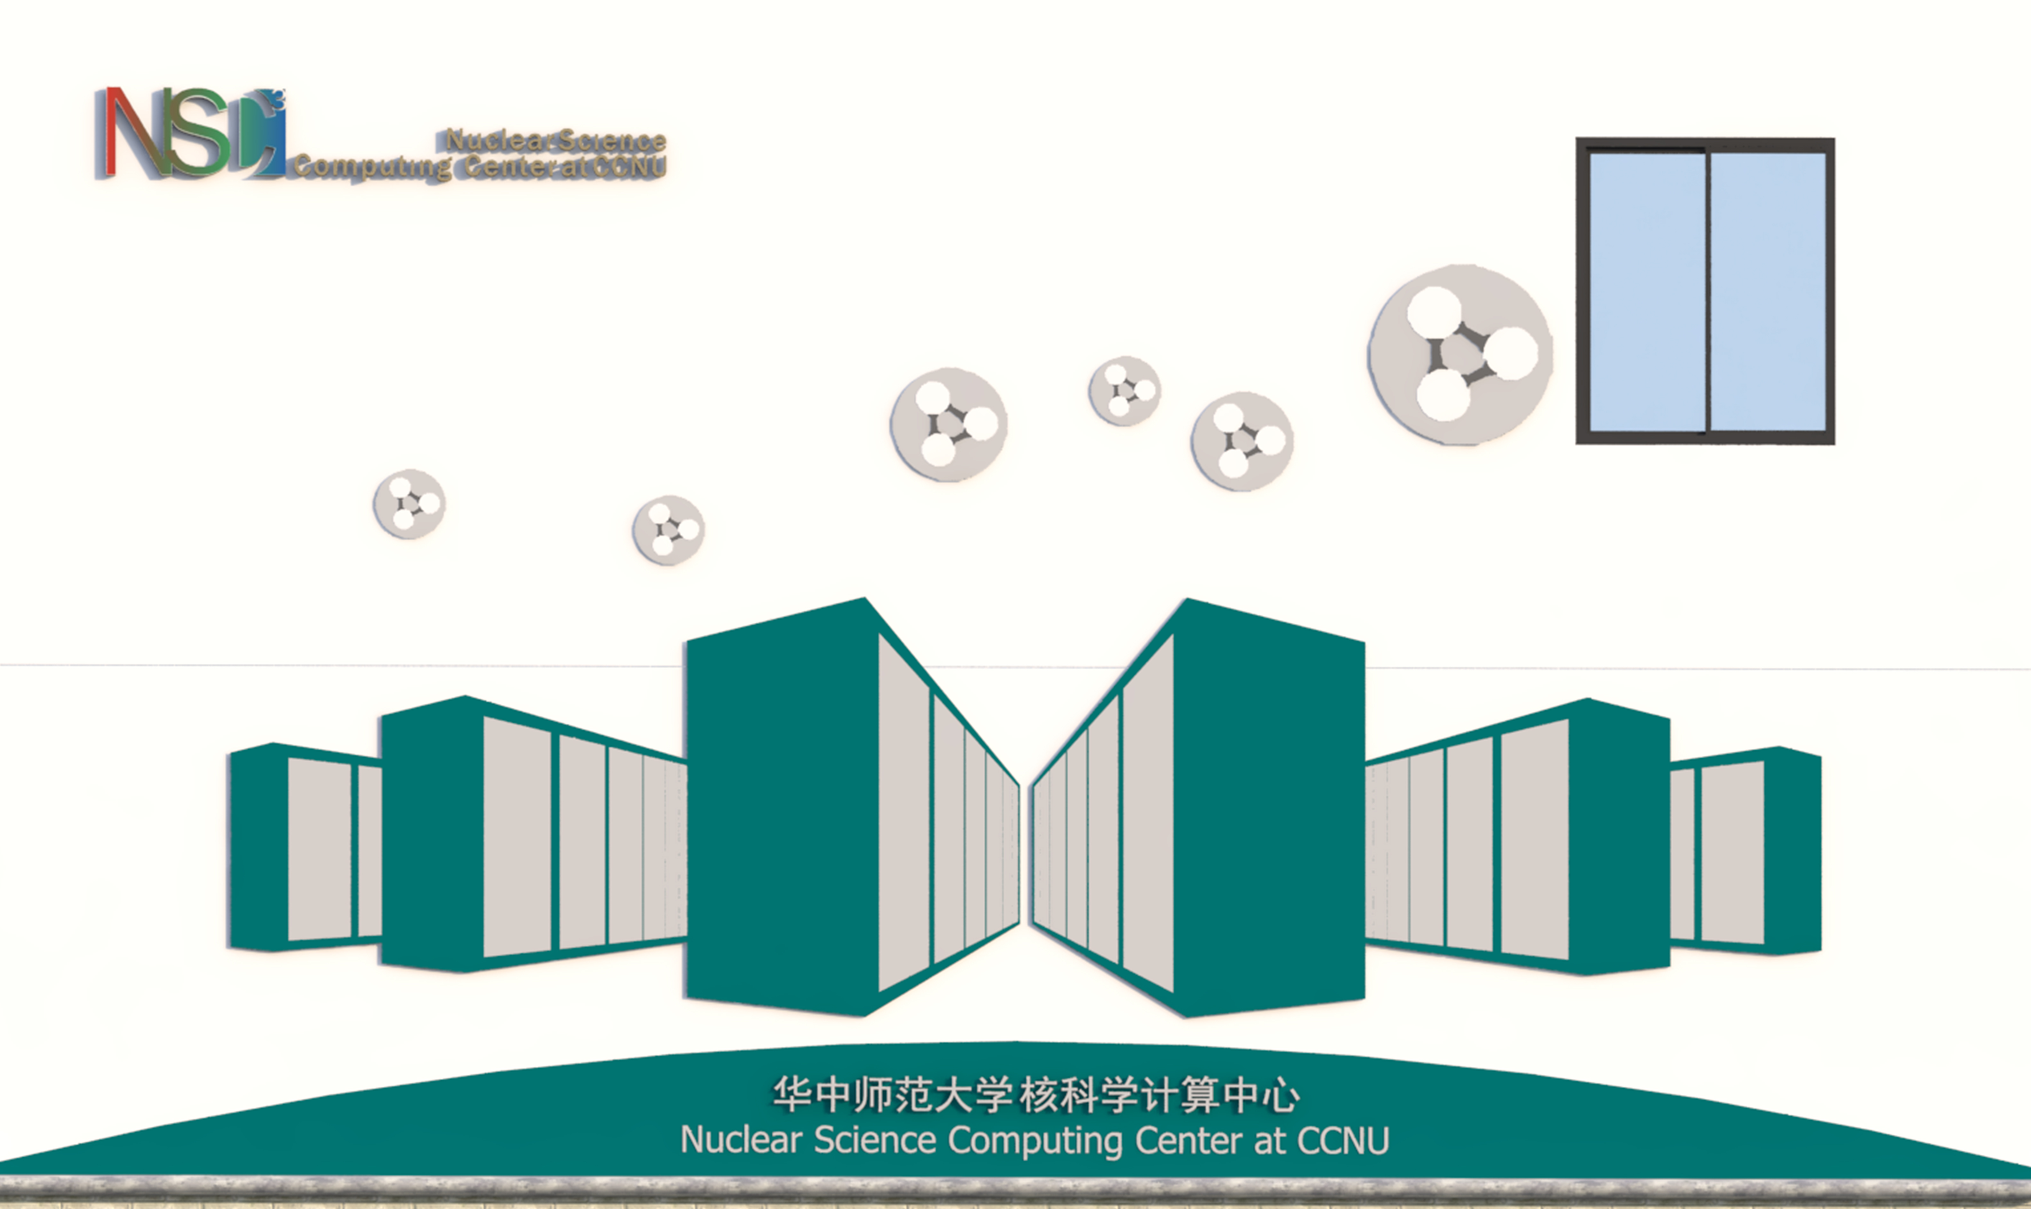
Introduction to NSC³
High Performance Computing in High Energy Physics
Sep. 19- 21, 2018 @ CCNU, Wuhan

Slide 2


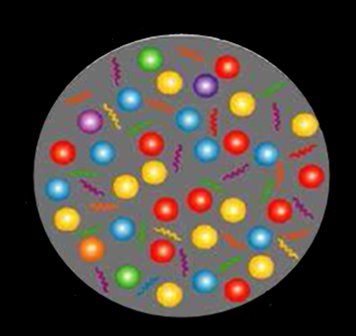
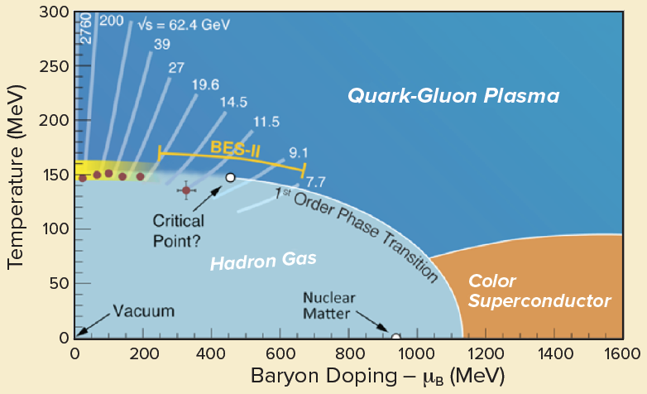

华中师范大学
核科学计算中心
计算平台至关重要
Phenomenology
Experiments
Lattice QCD(hep-lat)
HIC(nucl-th,hep-ph)
Detector simulation (nucl-exp)
Experimental Data analyses (nucl-exp)
……
Theory
Lattice QCD
pQCD

Slide 3
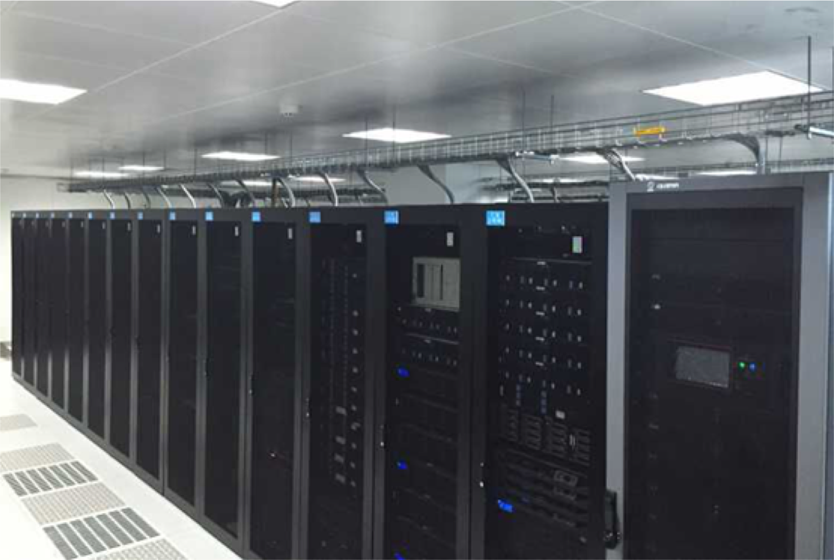
Computing resources not sufficient
for
Research
Old PC cluster（1216 cores, storage 480TB）
Peak performance： 0.044 PFlops/s
计算平台性能参数如下：
第一期(2008年)含双路服务器10台，每台含2块Intel至强E5-2620(2.0GHz，6核)CPU, 内存48GB；
第二期（2011年）含双路服务器32台，其中10台每台含2块Intel至强E5620(2.4GHz，4核)CPU,内存24GB；另外22台每台含2块Intel 至强X5650(2.66GHz，6核)CPU,内存16GB；
第三期（2012年）含双路服务器共55台，其中42台每台含2块Intel至强E5-2620(2.0GHz，6核)CPU, 内存48GB；另外13台每台含2块Intel至强E5410(2.33GHz，4核)CPU,内存16GB；
第四期（2014年）含双路服务器共12台，每台含2块Intel至强E5-2640(2.50GHz，6核)CPU, 内存48GB。

Slide 4

N:
Nuclear
S: Science
C³: Color 3 -> QCD
计算决定未来！
“道生一，一生二，二生三，三生万物” —- 《道德经》老子 600 BC
High Performance, Low Power Consumption
~100% utilized

Slide 5
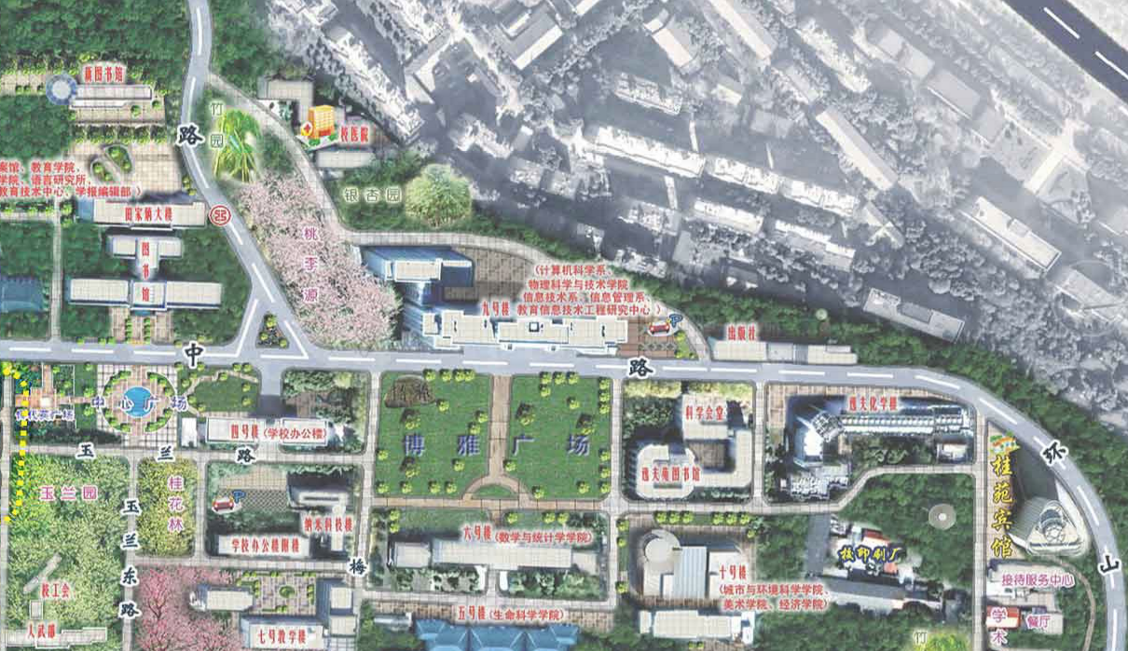
Location of NSC³
North
NSC³

Slide 6
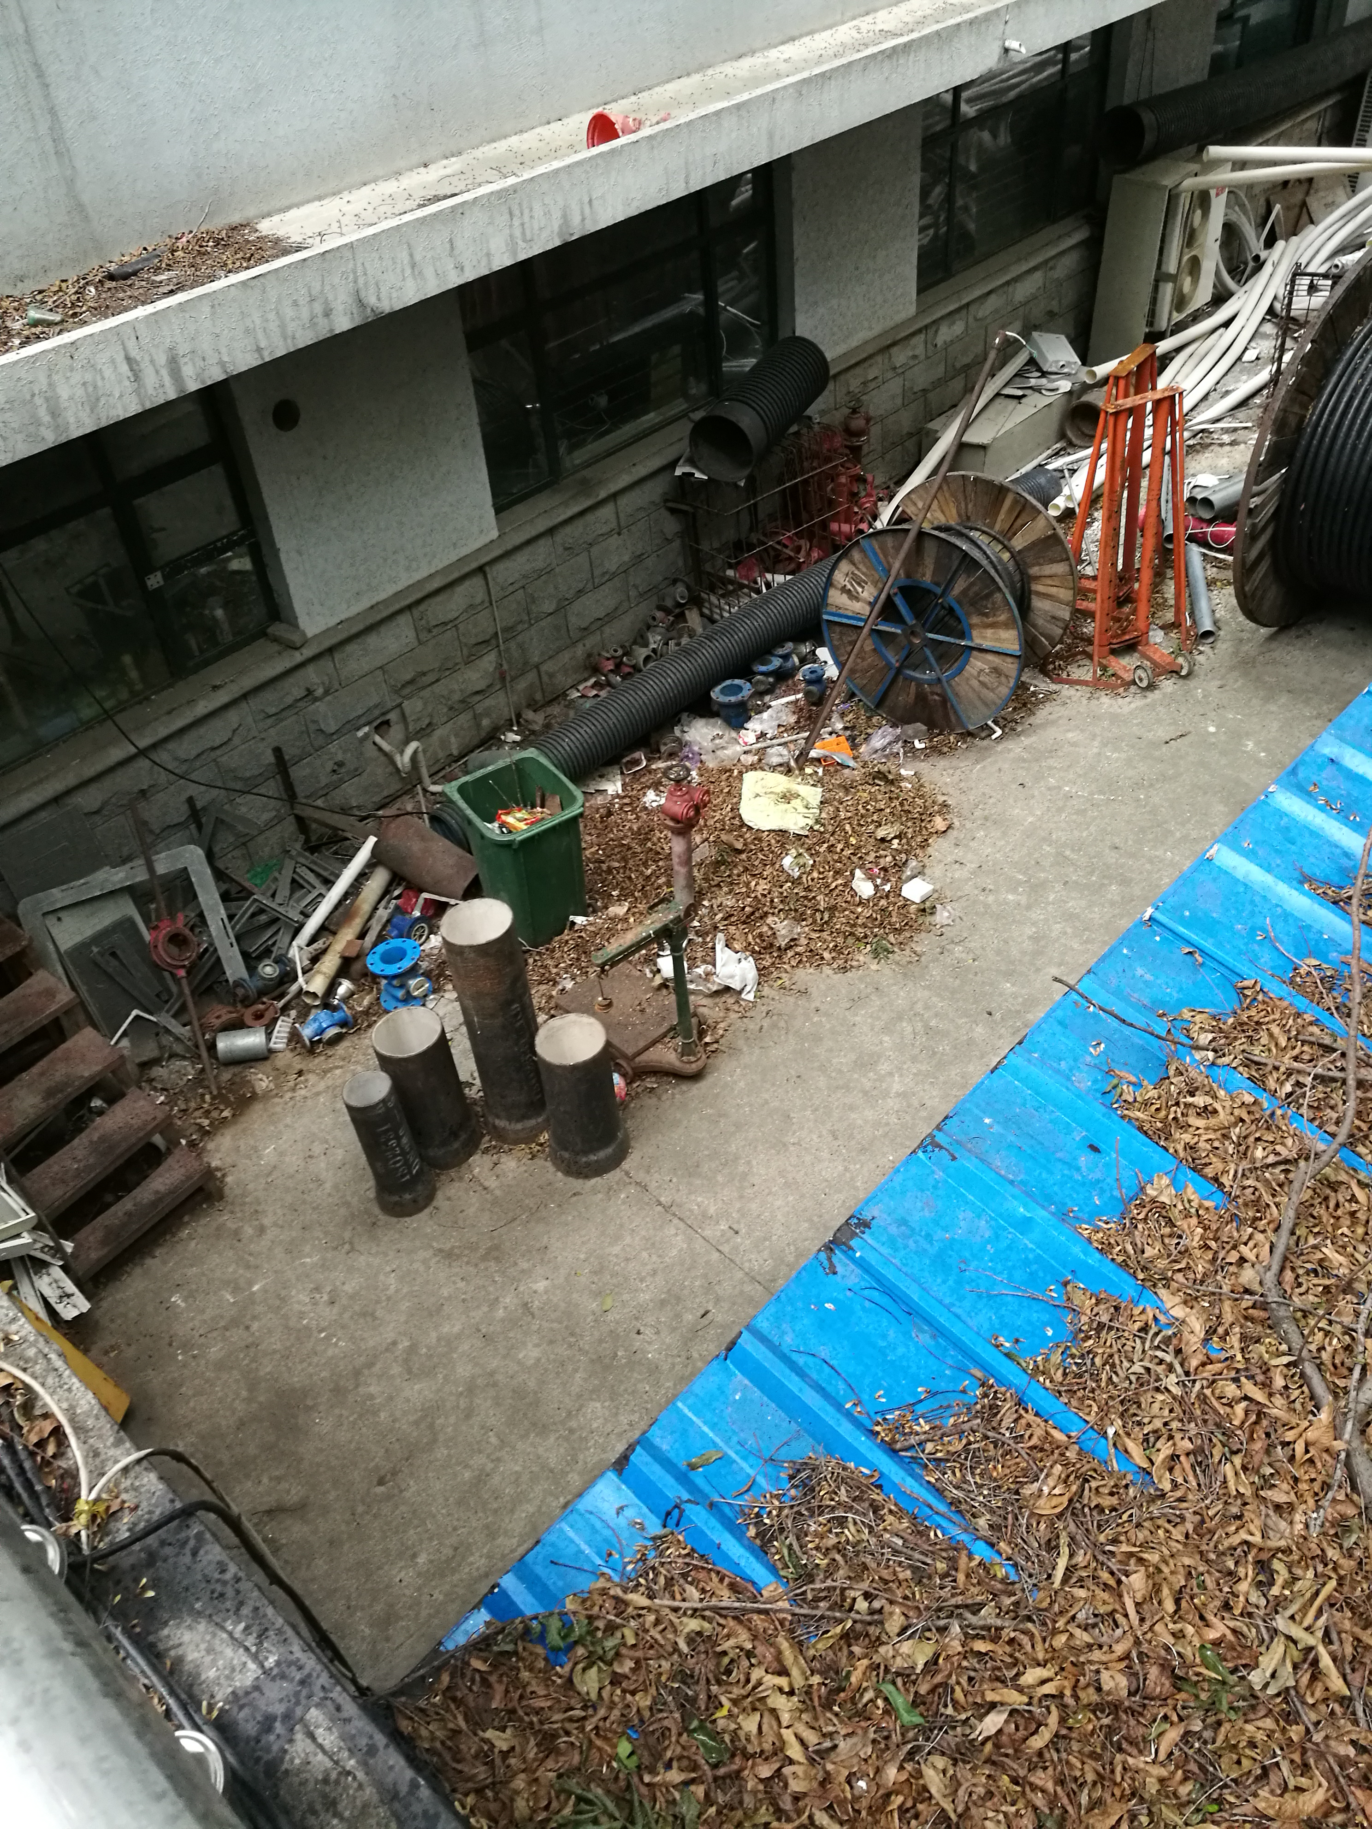
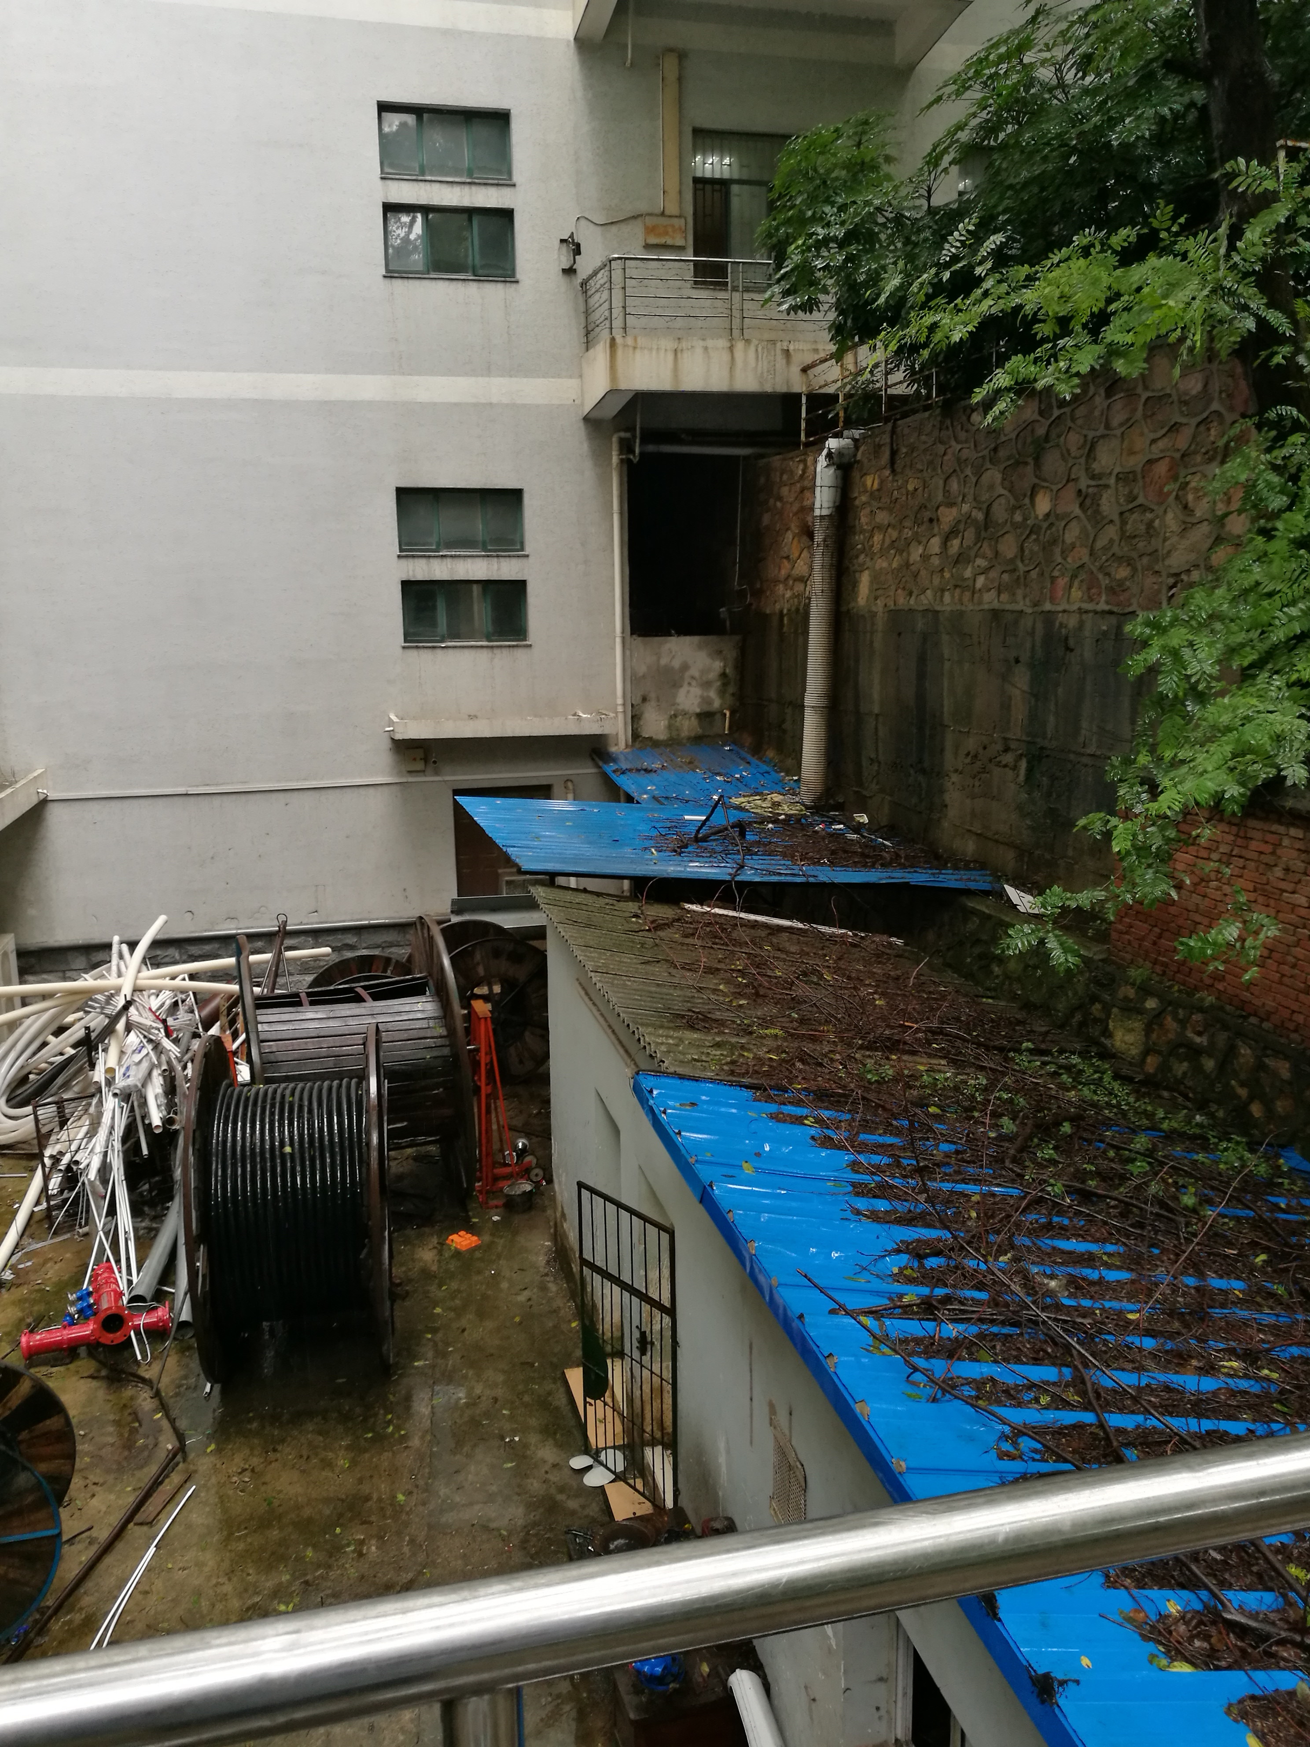
Scenes back in 2014

Slide 7



Support from CCNU

Slide 8
computing room
机房外部

Slide 9
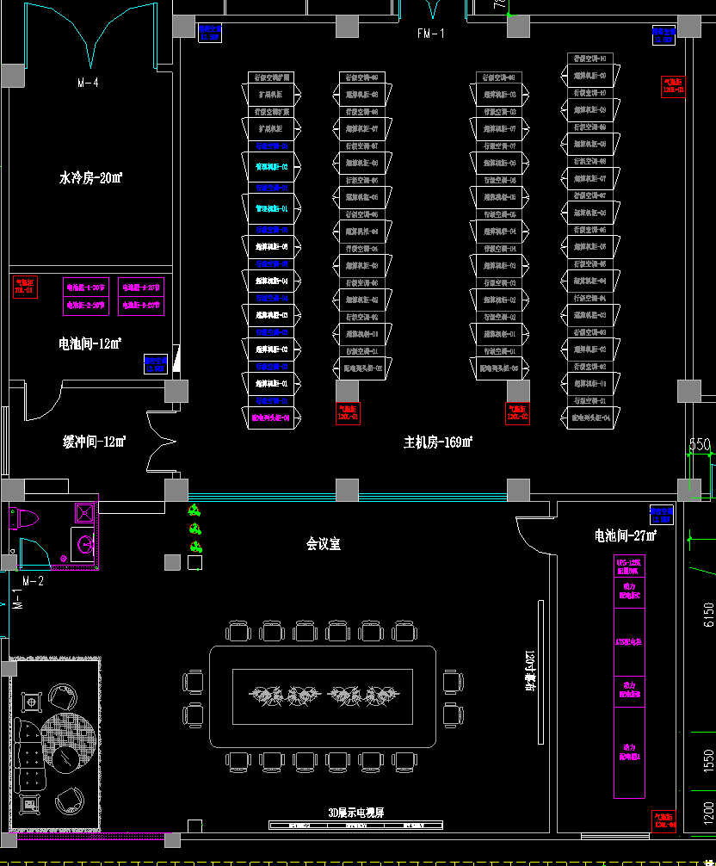
layout of NSC³
Cooling pipes
& water filters
~ 32m²
Computer room
~160m²
North
Battery room
~ 32m²
Total area
~360 m²
Exhibition area ~160m²
Low Voltage
Distribution
Room
~ 27 m²
Can be extended to install more racks

Slide 10
Layout of the computing room
Capacity of 36 Racks
2018：7 racks installed
Liquid Cooling Package
Electricity rack
Fire extinguisher
^{可作为计算放置扩展区域}

Slide 11
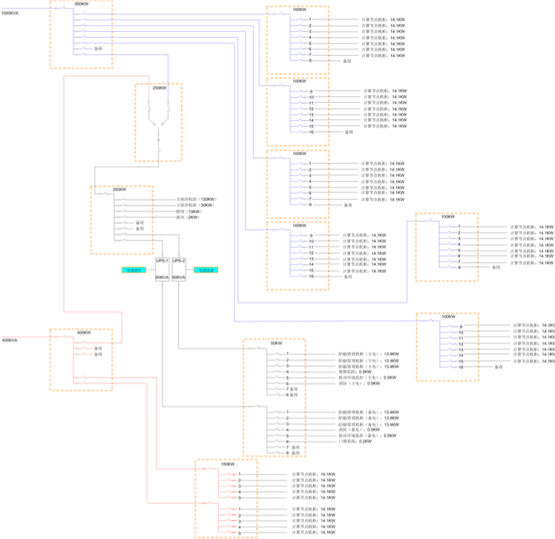
Two circles of
electricity power
1000kVA
A new
transformer
Computing Nodes: 7/24 on
UPS: file server and login nodes
computing
nodes
400kVA
UPS
file servers & login nodes

Slide 12
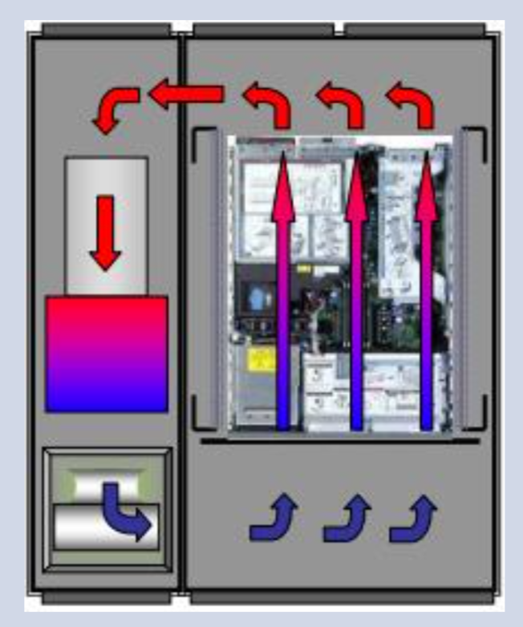
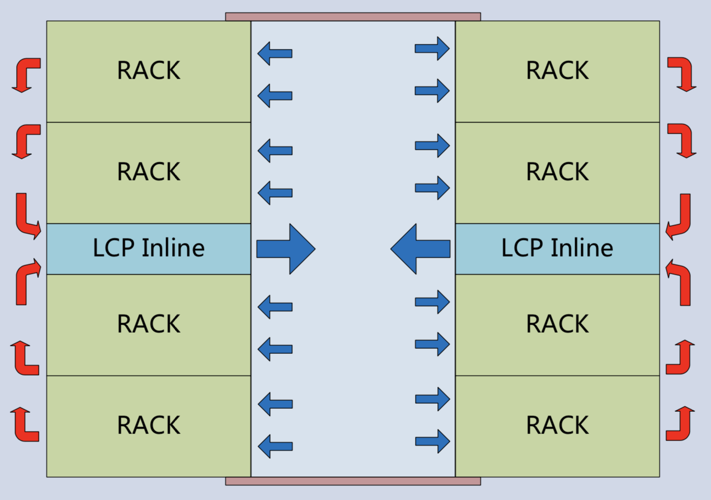
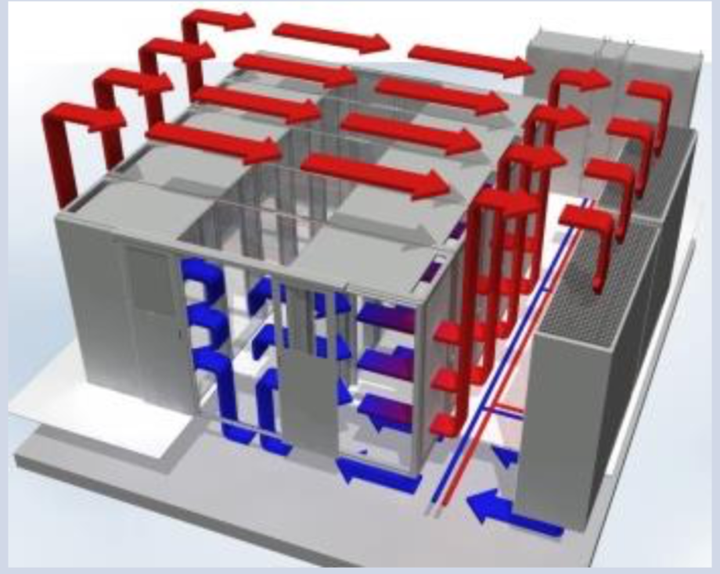
Cooling strategies
Strategies of cooling | Cool each rack | Cool each two rows of racks | Cool the room
Layout
Cooling target | IT devices within a rack | IT devices with 1 or 2 rows of racks | whole computer room
Blow distance | 0.1~0.8m | 1.2~3m | 3~15m
Cooling efficiency | High | Medium | Low
Application | High Performance, Green computing | Cloud computing, mixed | Traditional computing room

Slide 13
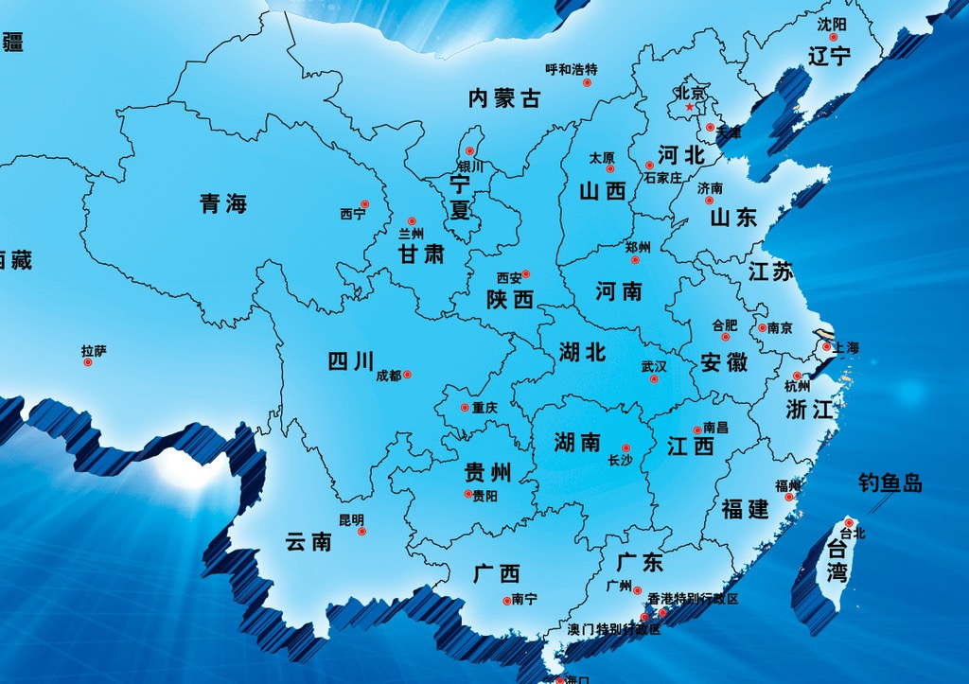
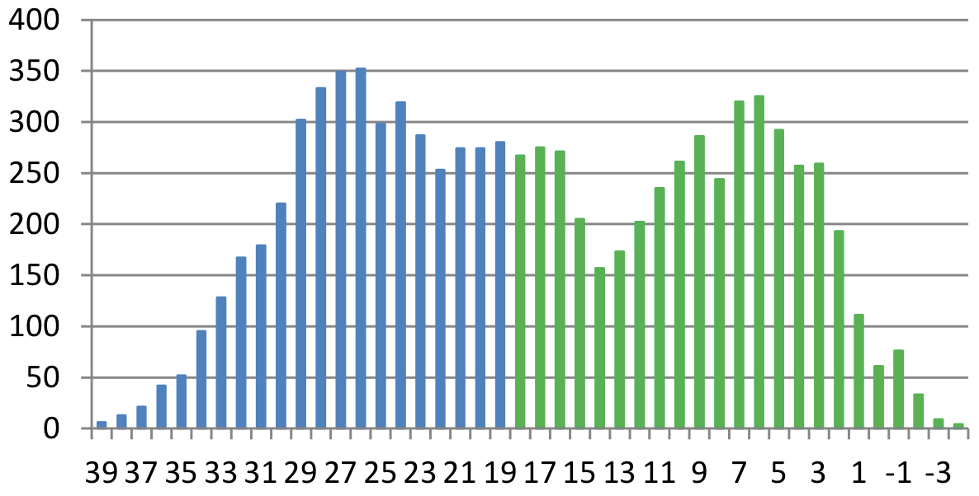
Temperature distribution
in a typical year of Wuhan
hours
Dry bulb temperature
There are 4516 hours yearly in Wuhan that T < 18℃
51% of the year free cooling is available

Slide 14

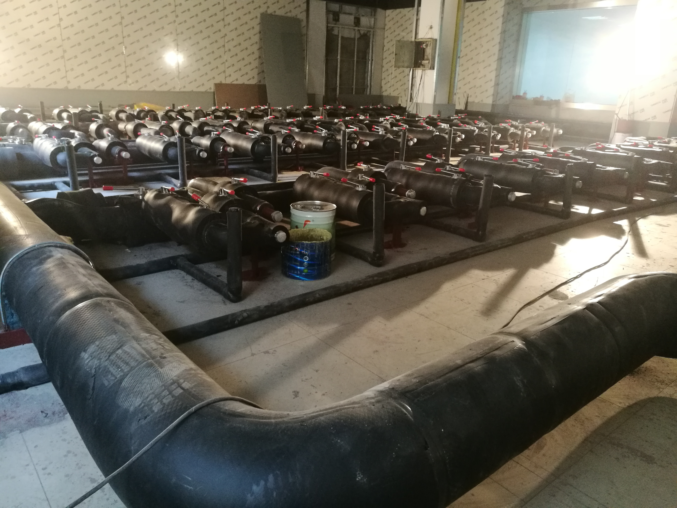

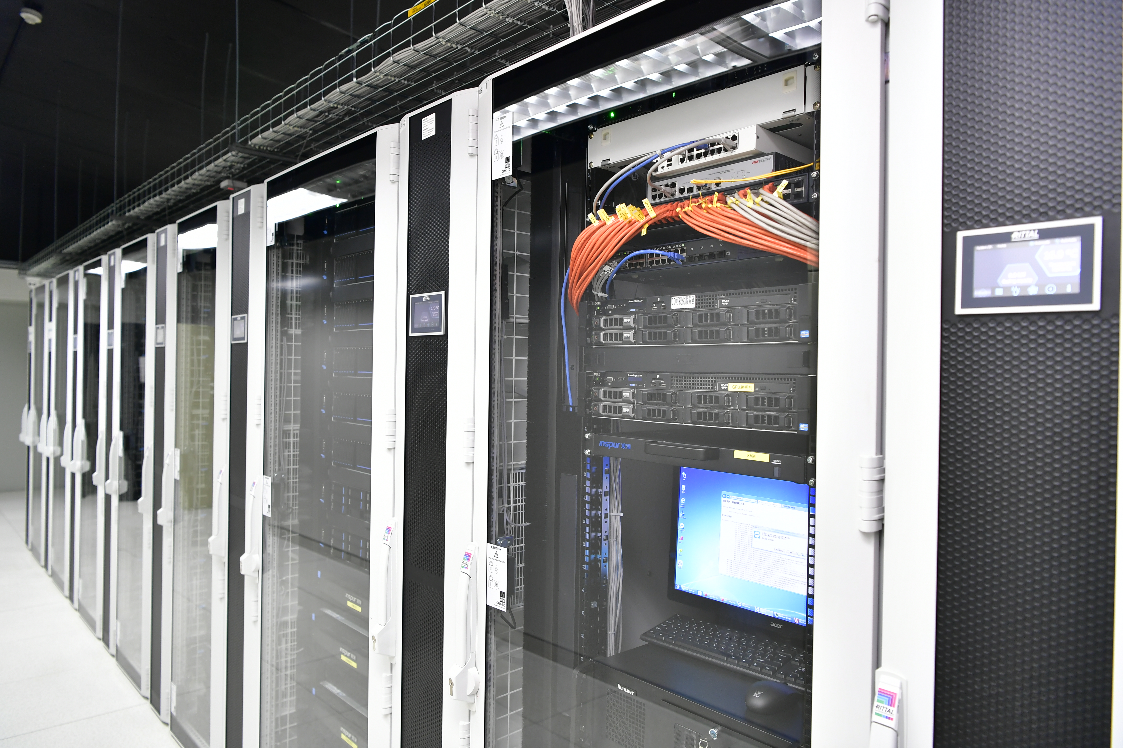

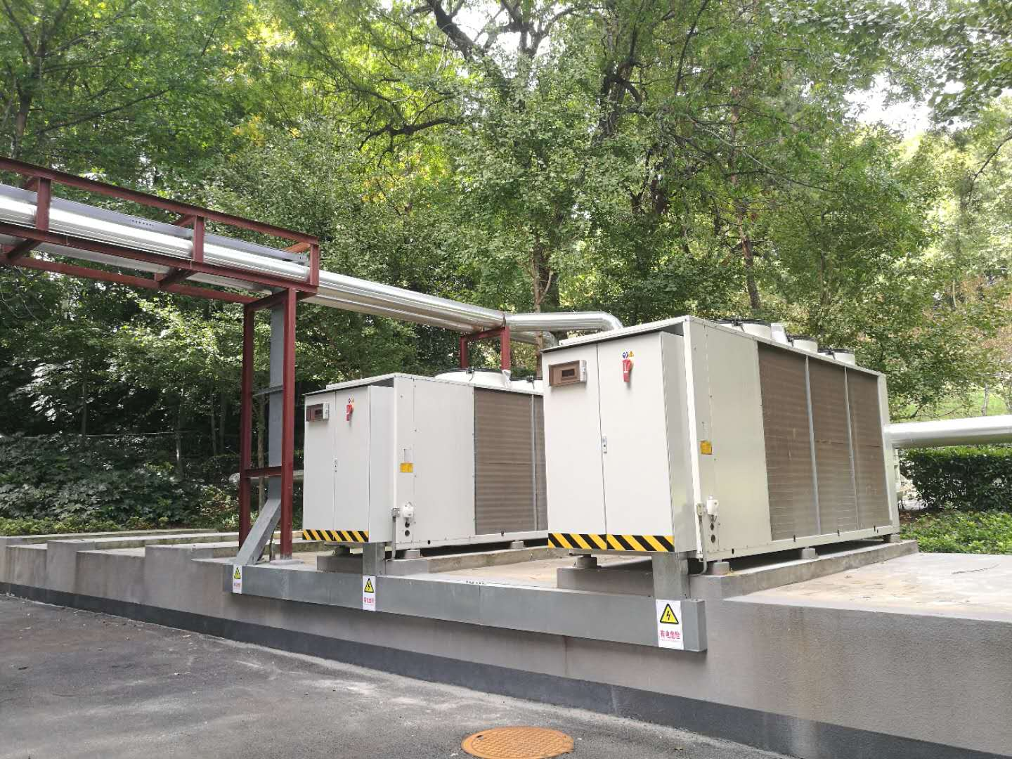
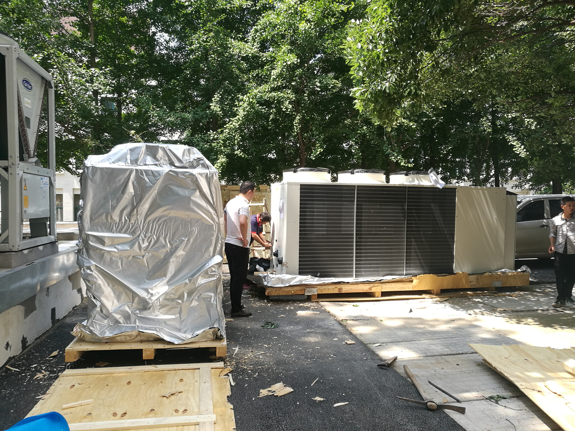
Water Cooling

Slide 15

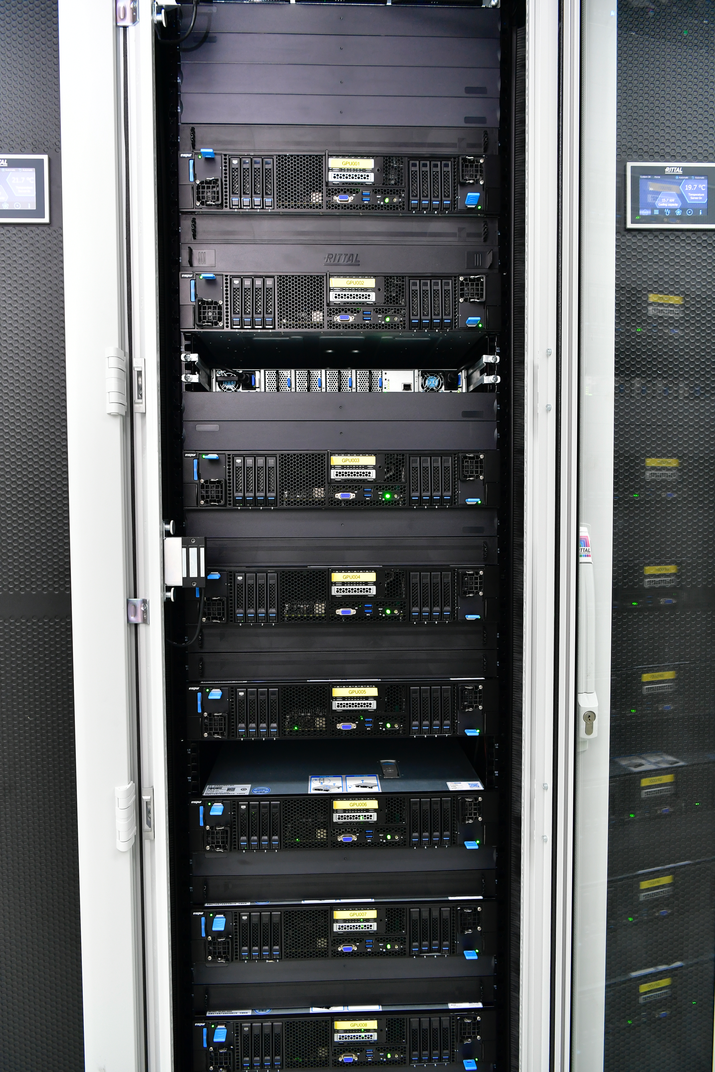
Configurations of the GPU cluster
18 GPU nodes,
Maximally 8 nodes per rack
In one GPU node:
8 Volta 100 GPU cards
2 skylake-SP (12 cores)
256 GB DDR memory
2 HBA cards
GPU node interconnected
via EDR Infiniband
In total:
144 GPUs
432(288) CPU cores
500 + 500 TB storage

Slide 16
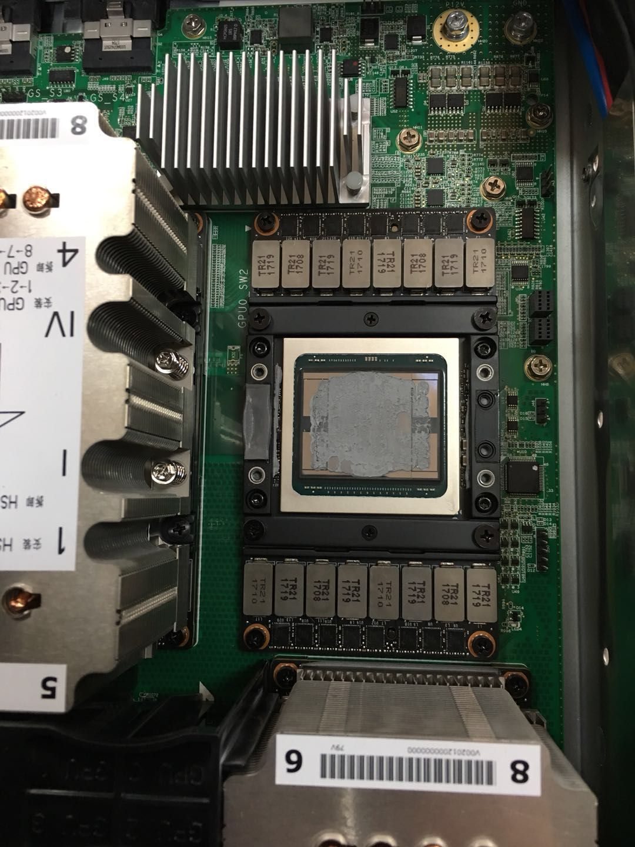
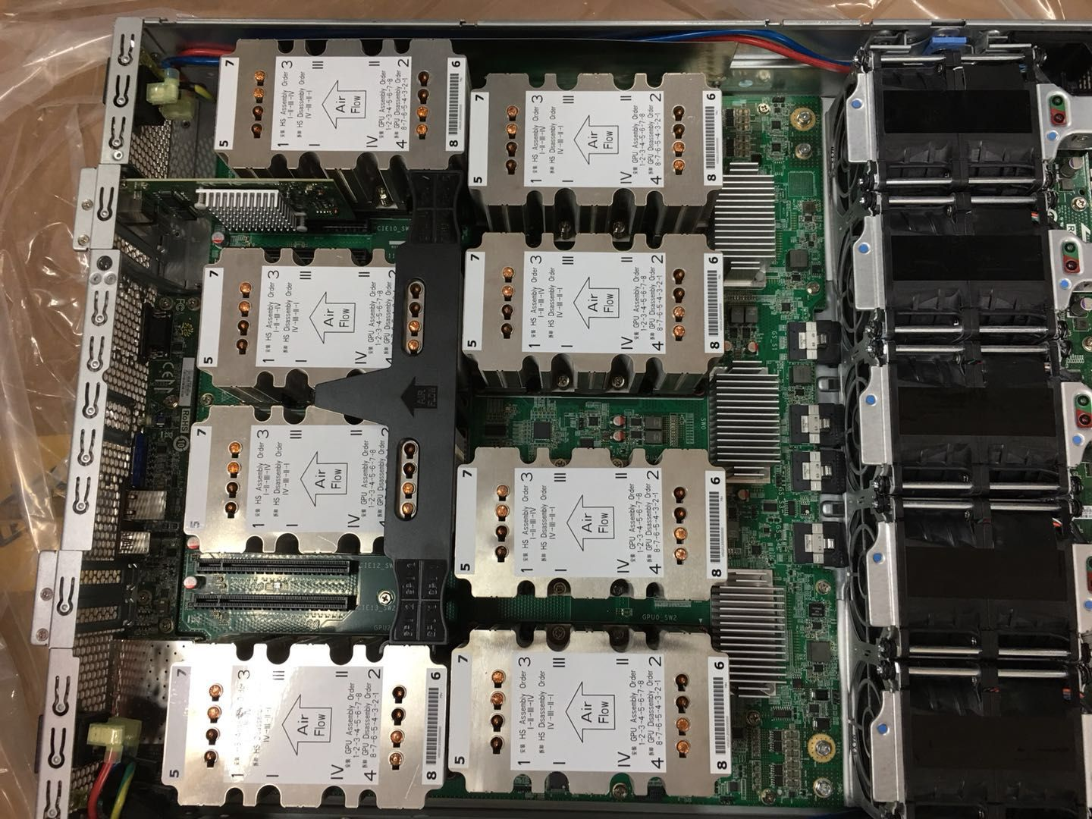
8 Volta 100 NVLINK in one node

Slide 17
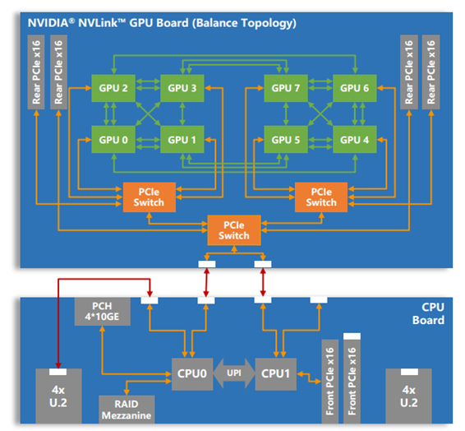
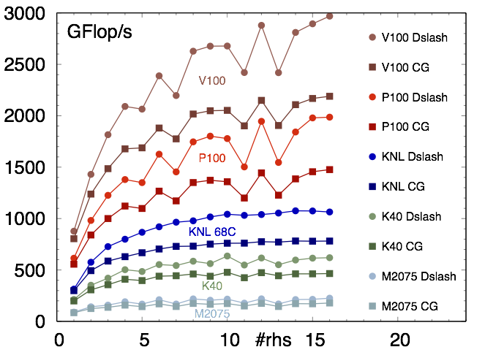
LQCD Benchmarks
HISQ, 48³x12

Slide 18

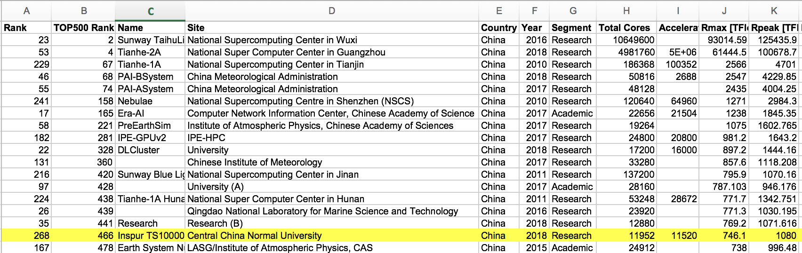
June, 2018
NSC³
ranks 466 in Top500 list
and 268 in Green500 list
“Research” & “Academic” Institutes in China listed in Top 500
https://www.top500.org/list/2018/06/?page=5
https://www.top500.org/files/green500/green500_top_201806.xls

Slide 19
Plans for the near future
LQCD: QCD phase structure, Transport coefficients…
Hydro simulations
STAR/ALICE/LHCb data analyses
…
Programs to be determined by a committee
Domestic and international collaborations are welcome

Slide 20
Thanks!

