Slide 1
Status of LHCb and its upgrade
Collaboration matters
LHCb 2018 run status
Physics output and selected physics results
The LHCb upgrade
LHCb future upgrades
Conclusions and outlook
G. Passaleva
INFN – Florence and CERN
On behalf of the LHCb collaboration
RRB – 31/10/2018

Slide 2
Collaboration matters
New physics coordinator elected in May: Mat Charles (LPNHE, Sorbonne Université, Paris)
LHCb collaboration still growing
  Three new groups:
    Constantine University, Algeria,
    Institute Of High Energy Physics (IHEP), Beijing, China,
    South China Normal University (SCNU), Guangzhou, China.
  Two additional groups were upgraded from associate to full members,
    UCAS (Beijing), CCNU (Wuhan), China
  first Technical Associate group
    Jozef Stefan Institute, Ljubljana, Slovenia, joined the collaboration to work on R&D for Upgrade II

Slide 3
2018 LHCb run status
LHCb operations and performance

Slide 4
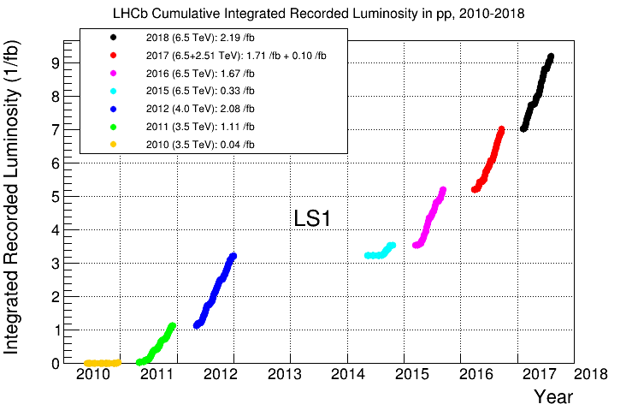
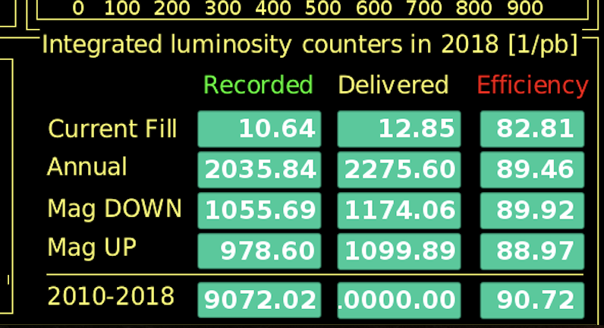
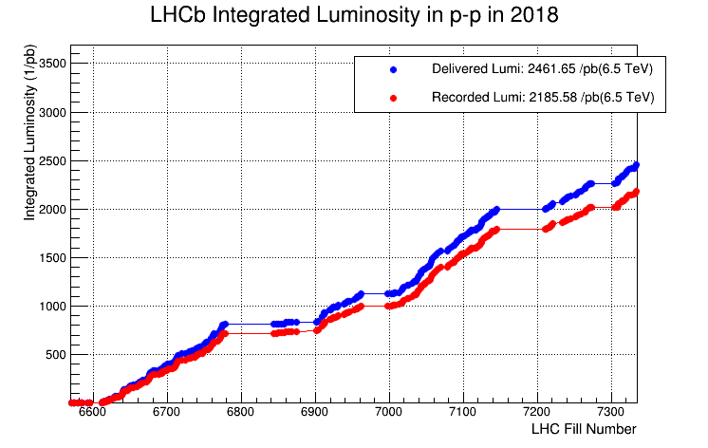
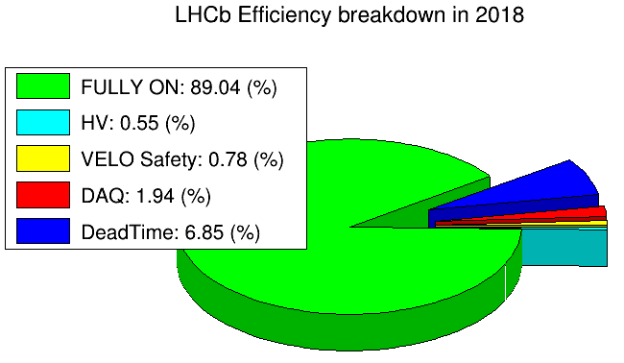
Detector operations in 2018
End of Run 2 pp physics !
Broke record after record
  > 10 fb⁻¹ delivered Run1+ Run2
  > 9 fb⁻¹ recorded
  Highest yearly integrated lumi
  ~2.5 fb⁻¹ delivered 2018
  ~2.2 fb⁻¹ collected 2018
Now closing with heavy ions!
1.9 fb⁻¹
Superb performance of LHC
THANK YOU!
All this clearly exceeded our expectations…!
Excellent DAQ efficiency despite >10 years of age

Slide 5
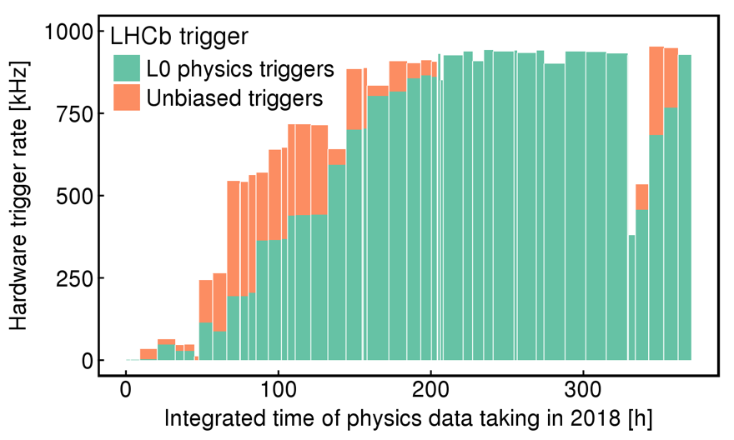
Detector operations in 2018
Aim at maximum recorded luminosity
  ☞ stability!
  ☞ efficiency!
HLT farm availabe
Squeeze every drop of physics in every machine conditions: saturated trigger BW during LHC intensity ramps
Optimal use of computing resources

Slide 6
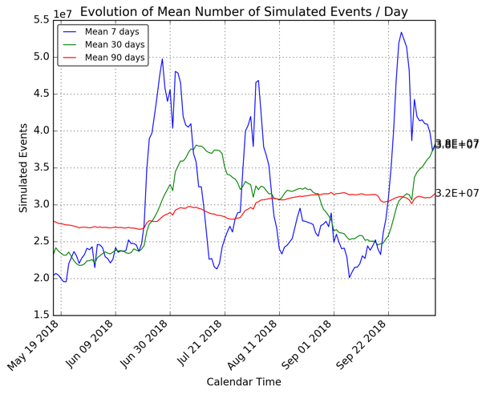
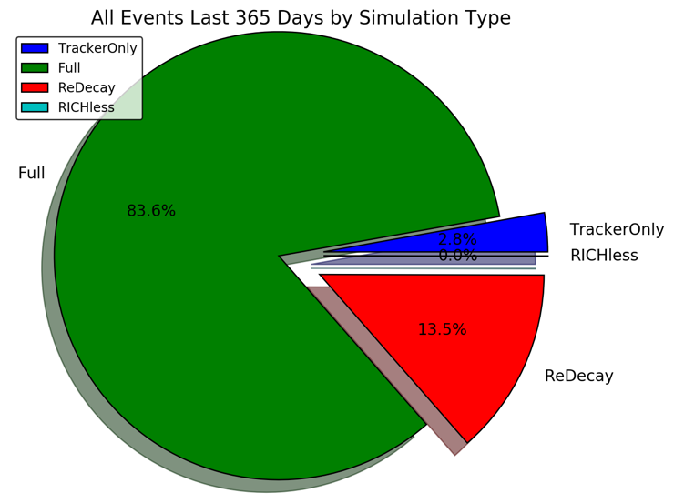
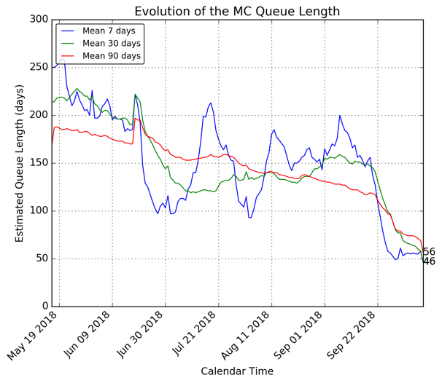
Computing resource usage
Trigger farm used
CPU resource usage dominated by Monte Carlo production
Optimal usage of the trigger farm helps to reduce the backlog in MC production
Use of new fast simulation techniques is also encouraged
  Techniques like reusing many times the same underlying event or simulating only the tracking detectors are already in use with large reduction factors in CPU time

Slide 7
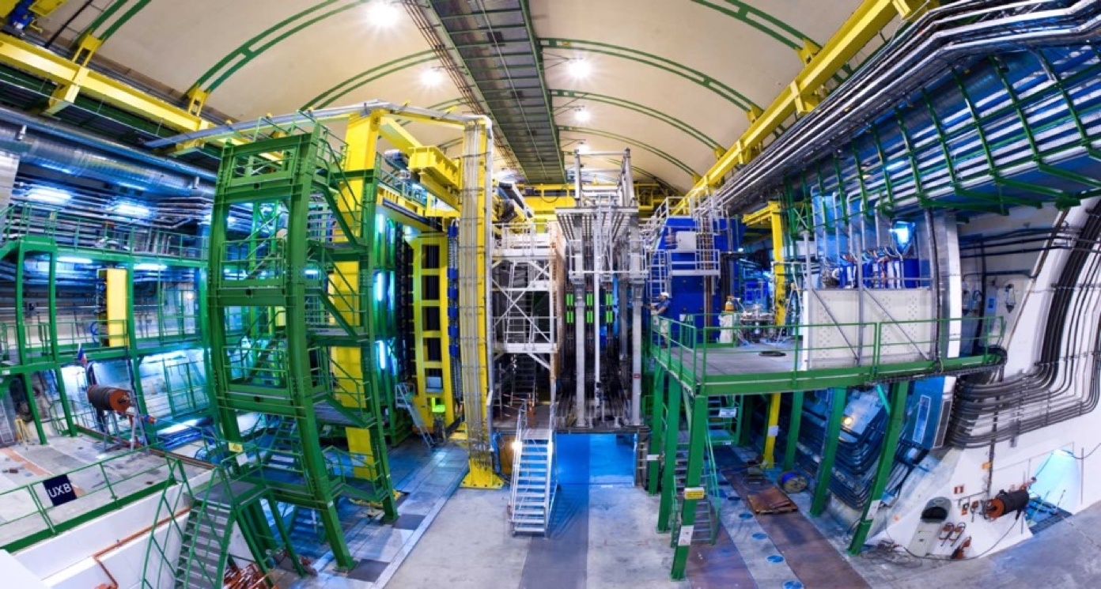

2018 the last year for LHCb… as we know it now!...
…Going to install a major upgrade in a few months…
Grazie e… arrivederci!

Slide 8
Physics output and selected physics results
Paper production

Slide 9
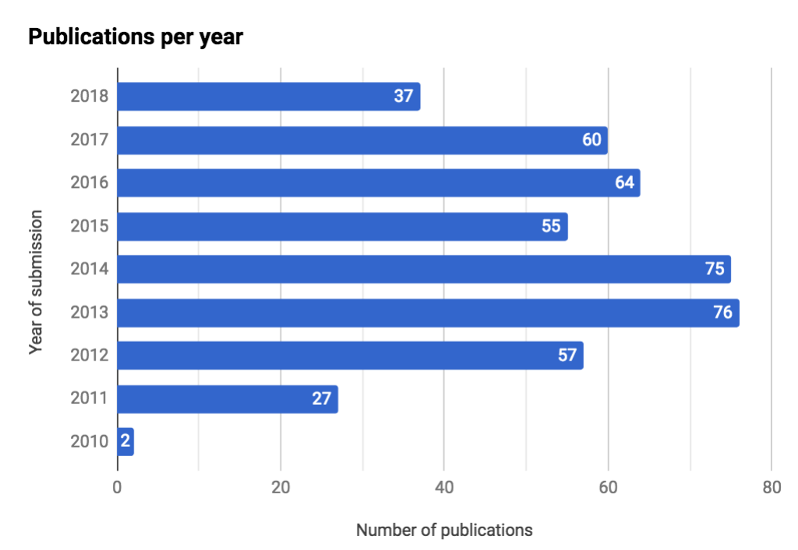
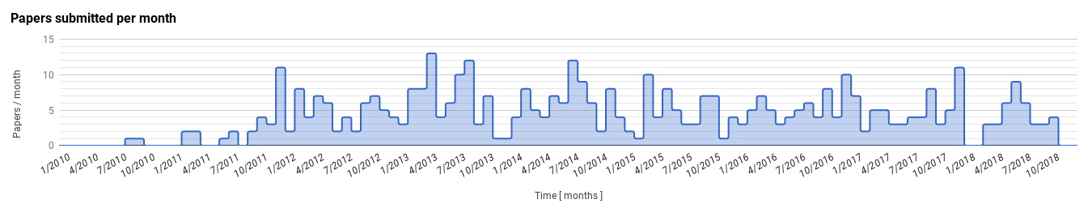
Physics: paper production
451 papers submitted (29 since Apr ‘18 RRB)
  37 in 2018
  9 other papers being processed within the Editorial Board
28 further analyses under review
2010
2011
2012
2013
2014
2015
2016
2017
2018

Slide 10
Sharpening the CKM picture
Measurement of CP asymmetry in B⁰_{(s)}→ h⁺h⁻ decays
A precise measurement of CKM angle γ
Combination of LHCb measurements of γ

Slide 11
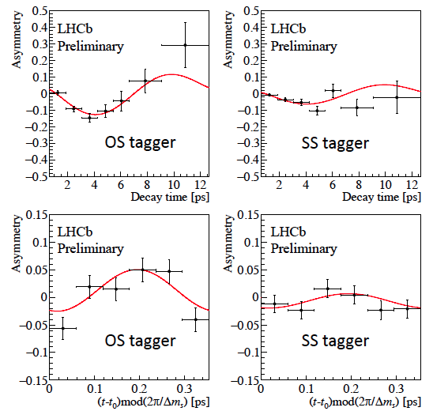
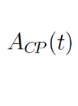
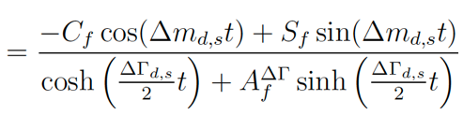
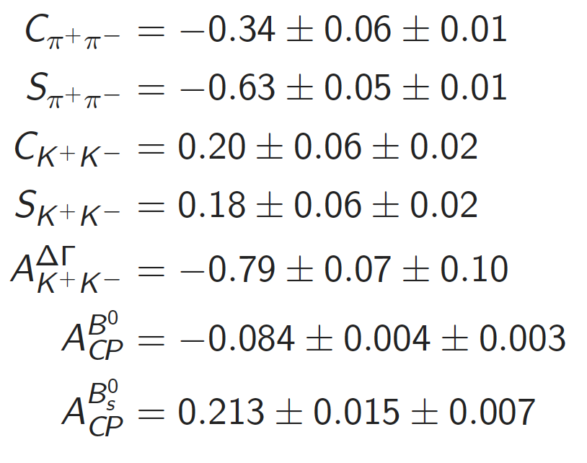
CP violation in B⁰_{(s)} →h⁺h⁻ − h = K, π
[Phys. Rev. D 98, 032004 (2018) Run 1, 3 fb⁻¹]
Combined analysis of the branching fractions and CP
asymmetries in B⁰_{(s)} →h⁺h⁻ allows to constrain γ
Sensitive to direct CPV in decay through C_{f}
π⁺π⁻
Measure 4.0σ deviation of (C_{KK}, S_{KK}, A^{ΔΓ}_{KK}) from (0, 0,−1) no-CPV expectation;
Strongest evidence for time-dependent CP violation in the Bs system to date
1st determination of A^{ΔΓ}_{KK}
K⁺K⁻

Slide 12
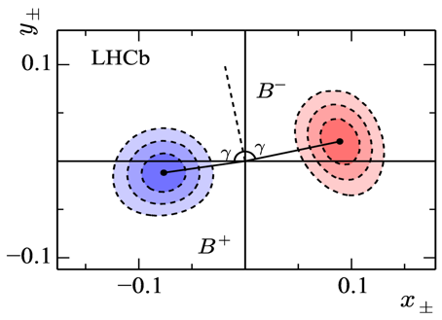
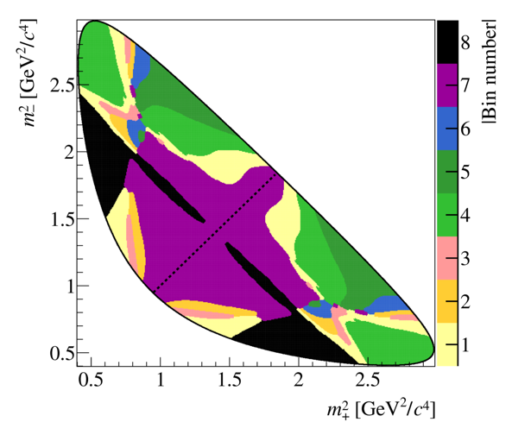
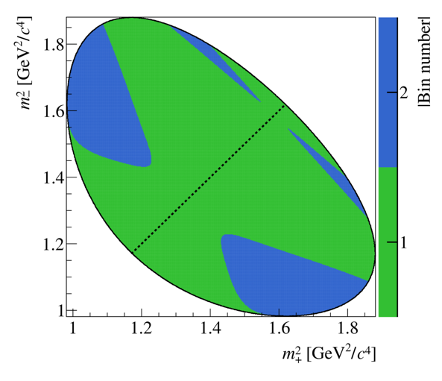
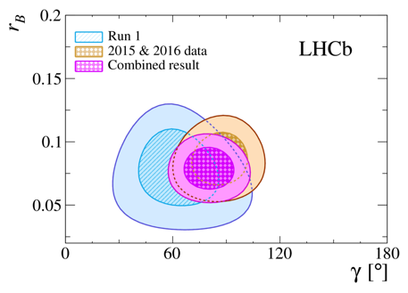
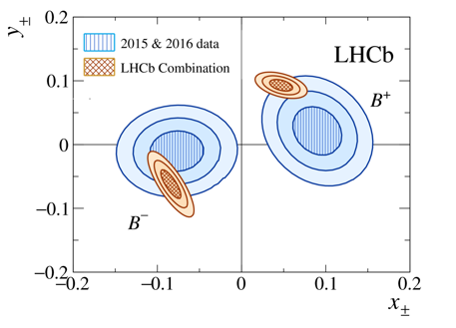
Measurement of γ using B⁺→DK⁺ with D → K_{S}h⁺h⁻ decays
[J. High Energ. Phys. (2018) 2018: 176 Run 2, 2fb⁻¹]
Same B± →(D⁰ → K⁰_{S} h⁻h⁺)K± final state accessible with D⁰ and D⁰
Divide up the Dalitz space into symmetric bins chosen to optimise sensitivity to γ
Fit Dalitz plot to determine x± and y±
Inputs from Cleo-c for the model, (looking forward to fruitfully involve BES-III !)
Combining with Run 1 determines γ = (80⁺¹⁰₋₉)°
Most precise determination of γ from a single channel!
Run 2, 2fb⁻¹
K_{S}π⁺π⁻
K_{S}K⁺K⁻
x± = r_{B} cos(δ_{B} ± γ)
y± = r_{B} sin(δ_{B} ± γ)

Slide 13
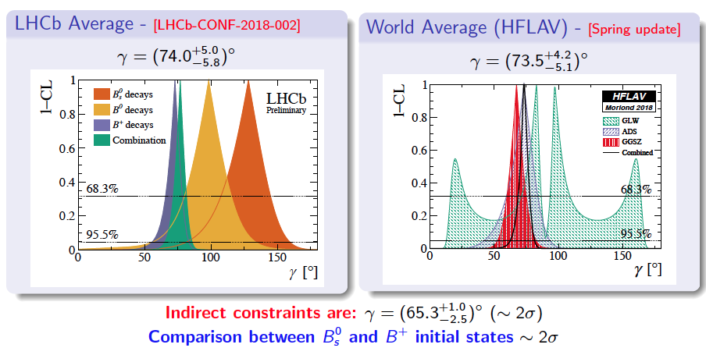
Combination of LHCb measurements of γ
[LHCb-CONF-2018-002]
Slight tensions to be monitored as the precision on γ improves

Slide 14
Adding charm to the picture
Mixing and CP violation in charm: y_{CP}

Slide 15
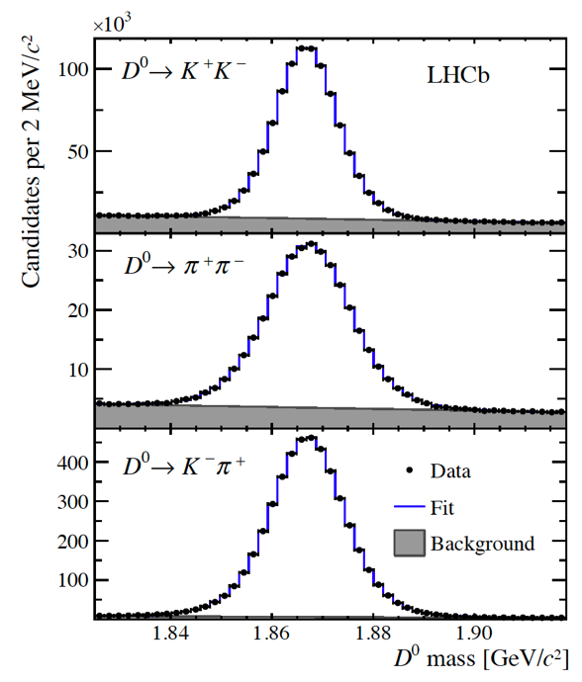
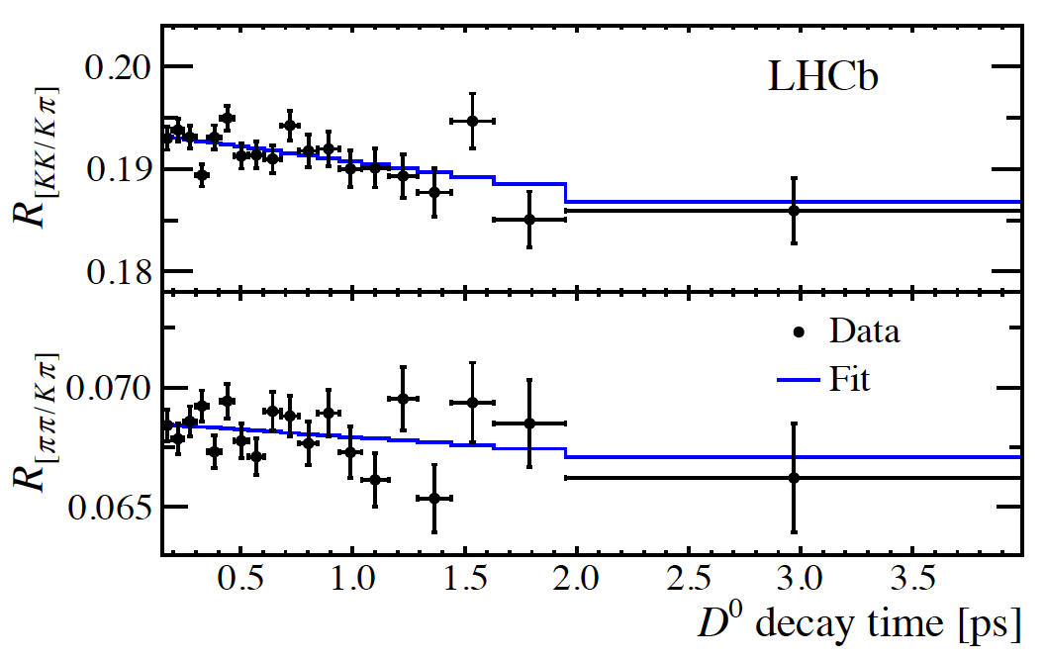
Measurement of the charm-mixing parameter y_{CP}
Effective D⁰ lifetime to CP-even eigenstates (e.g. π⁺π⁻ or K⁺K⁻) is different from lifetime to flavour-specific states like K⁻π⁺
y_{CP} = Γ_{hh}/Γ_{kπ} – 1 is equal to the mixing parameter y if no CPV is present
Measured using time-dependent ratio between D⁰→ π⁺π⁻ (K⁺K⁻) and
D⁰→ K⁻π⁺ yields, using semileptonic tag B → D⁰ μ⁻νX where B ≡ B⁰ or B⁻
Result: y_{CP} = (0.57 ± 0.13 ± 0.09)%
compatible with current world average (0.84 ± 0.16)% and as precise
arXiv:1810.06874. RUN1 3fb⁻¹
Compatible with the HFLAV value of charm mixing parameter
y = (0.62 ± 0.07)%
(arXiv:1612.07233)
no evidence for CP violation in D⁰ - D⁰ mixing.

Slide 16
Rare decays, a window on new physics
D⁰→h⁺h⁻μ⁺μ⁻ decays

Slide 17
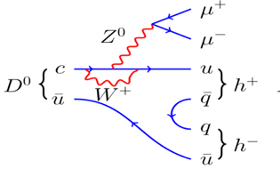
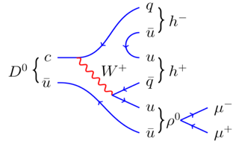
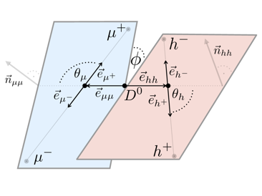
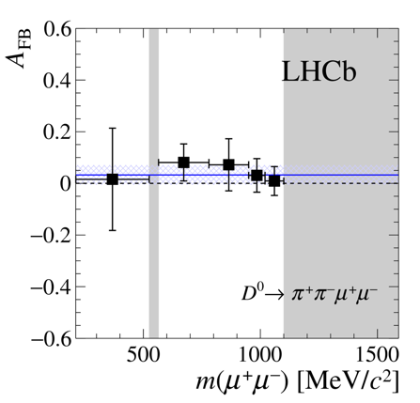
D⁰→h⁺h⁻μ⁺μ⁻ decays
[Phys. Rev. Lett. 121, 091801 (2018)Run1+2 5 fb⁻¹ ]
Rare charm decays very sensitive to new physics contributions
  Unique laboratory to probe FCNCs in the up-type quark sector
Rarest charm decay ever observed, BR ~O(10⁻⁷- 10⁻⁶)
Now looking for CP asymmetries!
[PRL 119 (2017) 181805]
All measured asymmetries compatible with zero
D⁰
D⁰

Slide 18
Is Nature blind to lepton flavour?
Recap on tests of lepton flavour universality in B decays
Controlling the systematics: D⁰/D^{0*}/D^{0**} relative fractions in B →Dlν

Slide 19
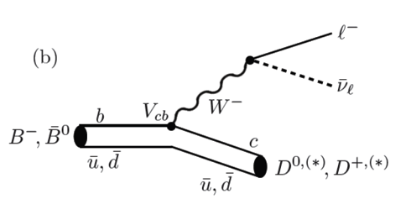

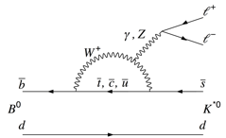
Tests of lepton flavour universality
Lepton flavour universality can be checked in several B meson decays involving leptons in the final state
Two main classes of decays have been studied:
  Semileptonic B⁰→D^{(∗)−} l⁺ν - tree level decay
  b→sl⁺l⁻ decays e.g. B⁰→K^{(∗)0}l⁺l⁻ - FCNC decays
Observables:
Theoretically clean!
R(K^{(*)}) = BF(B→K^{(*)}μ⁺μ⁻)/BF(B→K^{(*)}e⁺e⁻) ~ 1
SM

Slide 20
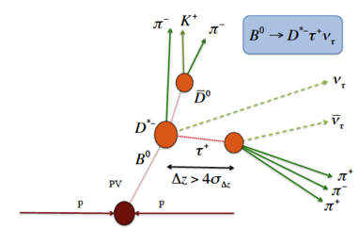
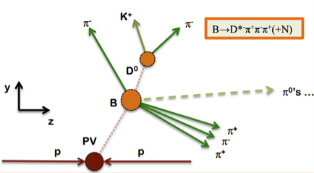
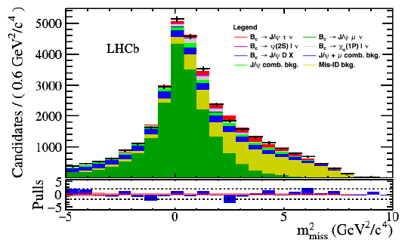
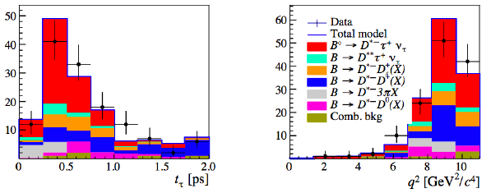
Tests of lepton universality: semitauonic decays - R(D*)
[PRD 97(2018)072013, PRL 120(2018)121801 Run1, 3 fb⁻¹]
Latest measurement from LHCb look at final states τ→π⁺π⁻π⁺ ν…
…and also to the B_{c} sector: R(J/ψ) = BF(B_{c}→J/ψτν)/BF(B_{c}→J/ψμν)
World-average R_{D}, R_{D*} deviate from SM by ~4σ
(http://www.slac.stanford.edu/xorg/hflav/semi/fpcp17/RDRDs.html)
New combined R_{D} and R_{D*} measurement well under way
Great potential at LHCb to study other modes with B_{s}, B_{c}, Λ_{b} decays
τ→π⁺π⁻π⁺ ν
B_{c}→J/ψτν

Slide 21
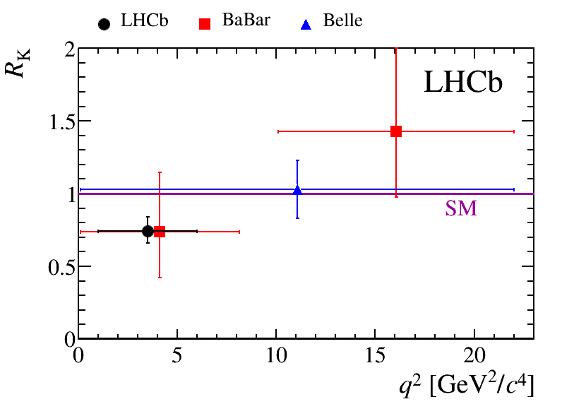
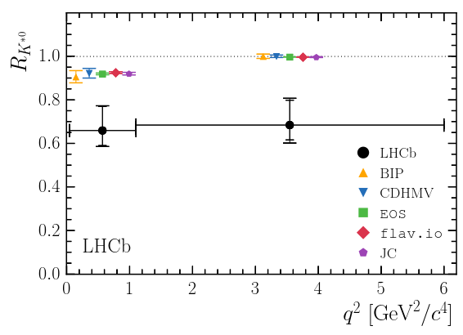
Tests of lepton universality: R(K) and R(K*)
[Phys. Rev. Lett. 113 (2014) 151601, JHEP 08 (2017) 055 Run1 3 fb⁻¹]
Test the LFU in electroweak penguin decays (e.g. the class of FCNC decays b→sl⁺l⁻)
Results for R(K) and R(K*):
Updates for R_{K} and R_{K*} being worked out
New unexplored channels will be also measured, like
B_{s}→φl⁺l⁻ (R_{φ}) and others
Upcoming updates based on Run 1 + ~2 fb⁻¹ Run 2
[Phys. Rev. Lett. 113 (2014) 151601]
[JHEP 08 (2017) 055]
~2-2.5 σ away from SM

Slide 22
A benchmark for QCD: spectroscopy
Measurement of Ω_{c}⁰ lifetime
Observation of two resonances in Λ_{b}⁰ π± and precise measurement of Σ_{b}± and Σ∗_{b}± properties
New exotic states

Slide 23
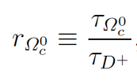
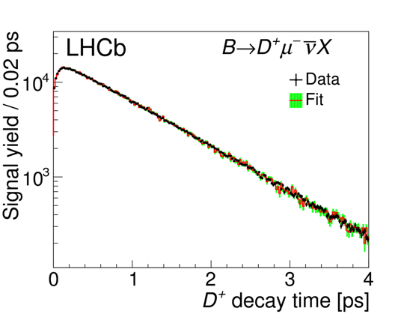


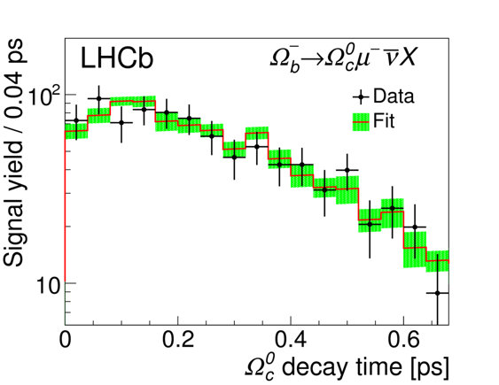
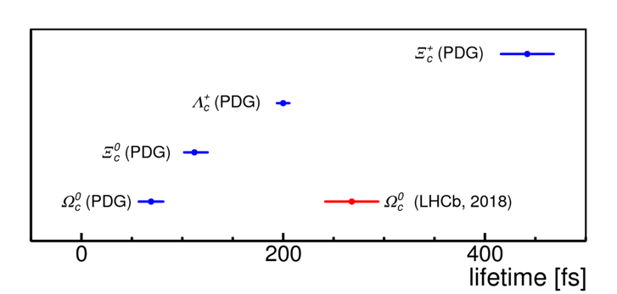
New results from charmed baryons: Lifetime of Ω⁰_{c}
Fit the ratio
from decay time distributions of D⁺ and Ω⁰_{c} and obtain τ(Ω⁰_{c}) from the well known τ(D⁺)
Use a sample of Ω⁰_{b} → Ω⁰_{c} (→ pK⁻K⁻π⁺) μνX; B → D+ (→ K⁻π⁺π⁺)μνX
Results
The measured lifetime is ~4 times larger and inconsistent with the PDG average 69± 12 fs (Chin. Phys.294 C40 (2016) 100001)
This measurement places the Ω⁰_{c} baryon as having the second largest lifetime of charmed baryons
Phys. Rev. Lett. 121, 092003 (2018), Run1 3 fb⁻¹
3 fb⁻¹
(stat) (sys) (D⁺)
Numerous crosschecks, incl.:
  (Bkg-sub signal) vs simulation
  sPlot → sideband subtraction
  Measure Lc+ lifetime
  Measure D0 lifetime
  Check in 13 TeV data
  Vary selection cuts
Vs theory: unexpected but not shocking
  Tricky calculation; depends on cancellation of amplitudes
3 fb⁻¹

Slide 24
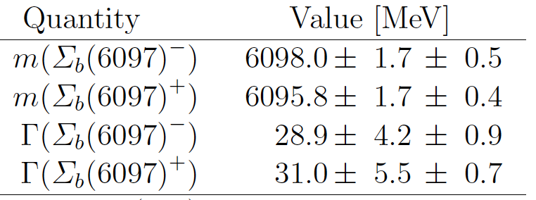
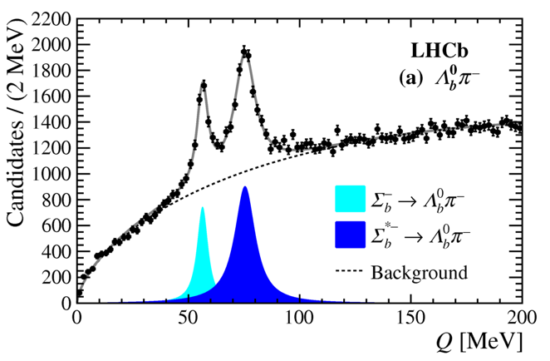
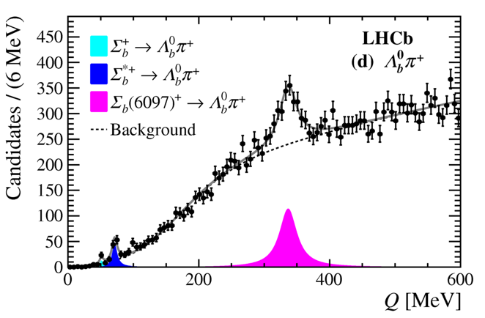
Observation of two resonances in Λ_{b}⁰ π± and precise measurement of Σ_{b}± and Σ∗_{b}± properties
[arXiv:1809.07752, Run1 3.0 fb⁻¹]
Study of Λ_{b}⁰ π⁺ and Λ_{b}⁰ π⁻ systems
  Λ_{b}⁰ → Λ_{c}⁺ π⁻, Λ_{c}⁺ → p K⁻ π⁺
Isodoublets of Σ_{b}±(buu/bdd) resonances:
  Two previously known from CDF (1/2+, 3/2+) – seen also by LHCb [Phys. Rev. Lett. 115 (2015) 241801]
  ... and a third discovered at higher mass
Structures behave like an iso-doublet of individual resonances, but more complex interpretations can't be excluded, e.g. two (or more) near-degenerate states.
Low mass resonances confirmed,
Mass and width precisely measured
New resonances Σ_{b}±(6097)
in extended mass region,

Slide 25
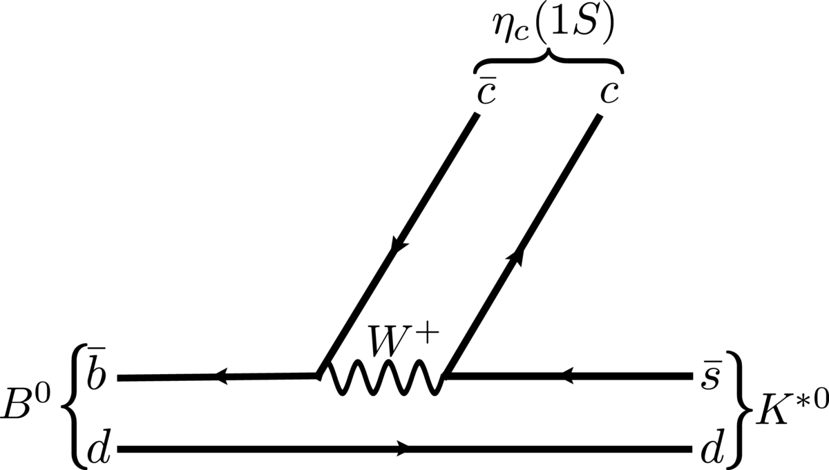
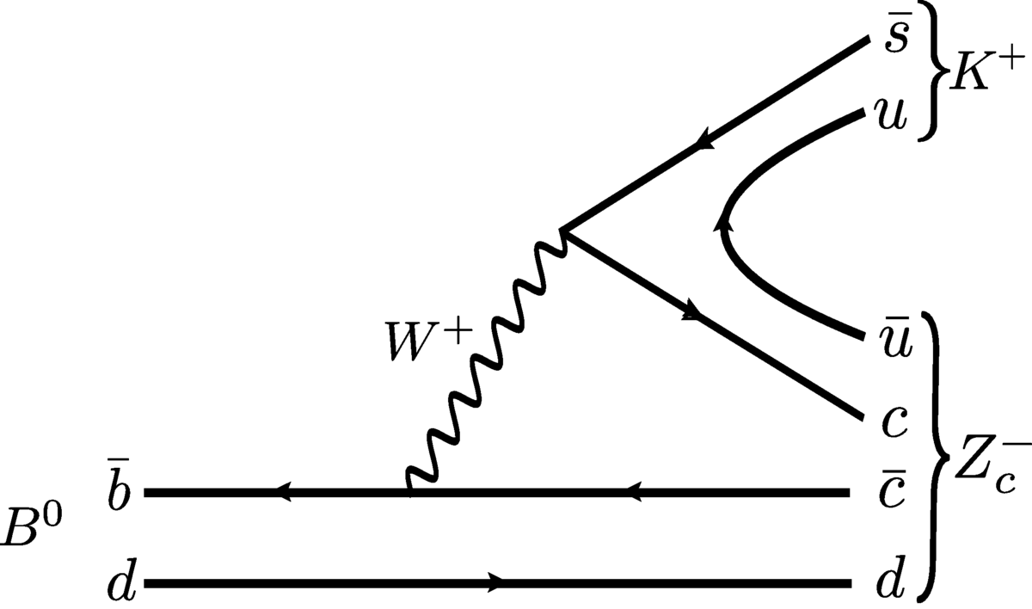
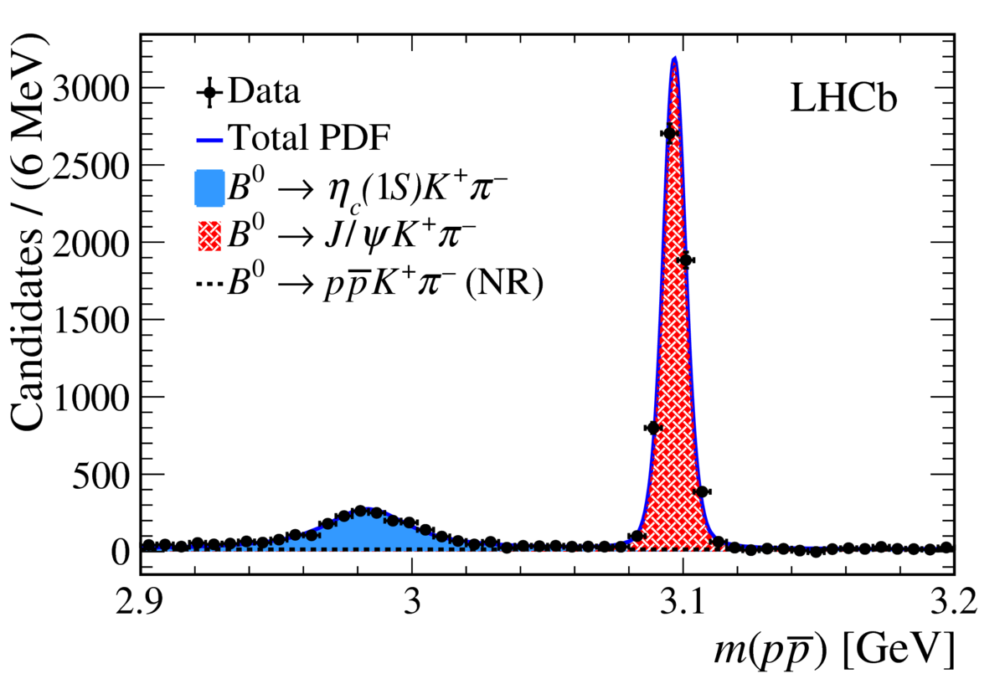
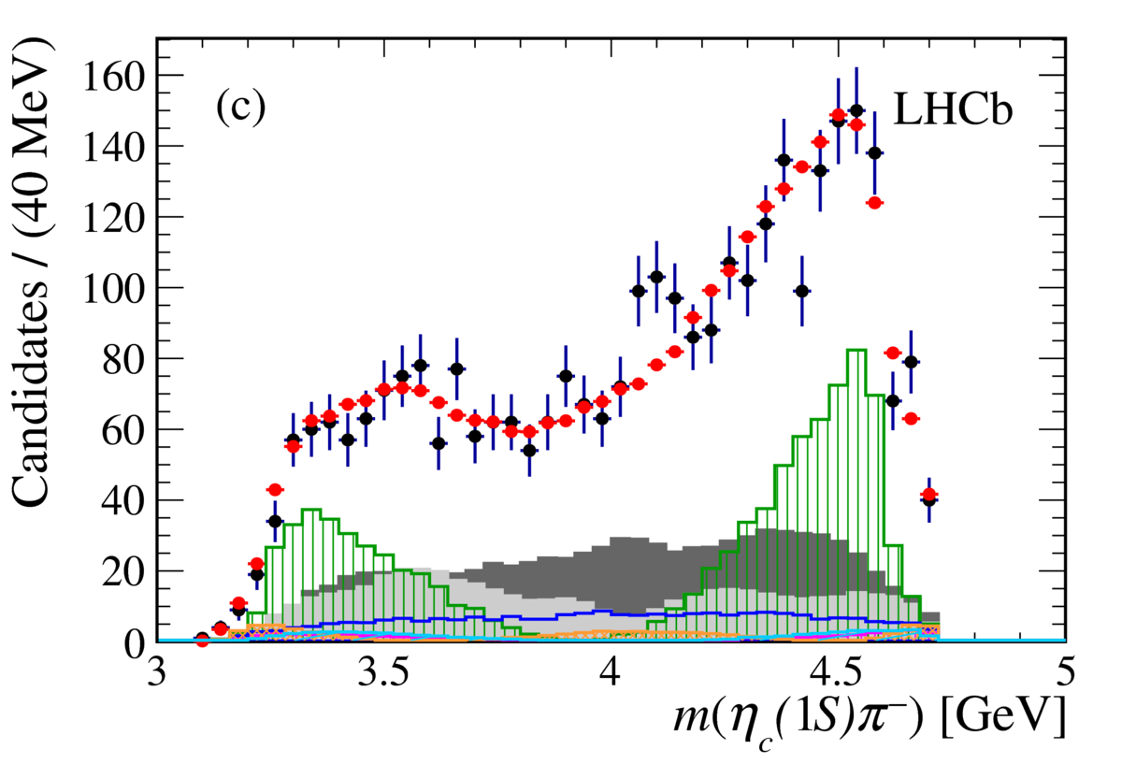
New exotic states
[arXiv:1809.07416 Run1+2 4.7 fb⁻¹ ]
Dalitz plot analysis of B⁰ → η_{c}(1S) K⁺π⁻
Seen evidence for an exotic resonance in η_{c}(1S)π⁻ system
Can be interpreted as a Z_{c}(4100)⁻ exotic state
More data will be required to conclusively determine the nature of the Z_{c}(4100)⁻ candidate

Slide 26
Not only flavour
Measurement of antiproton production in p-He collisions at
√s_{NN} = 110 GeV

Slide 27
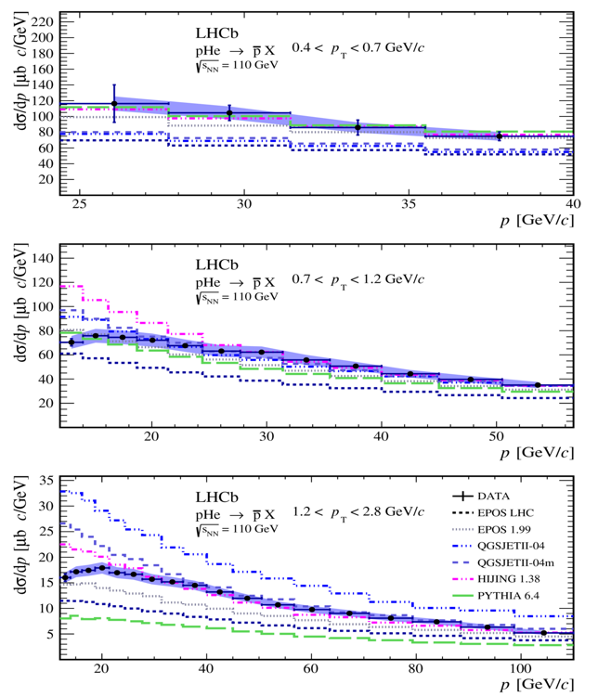
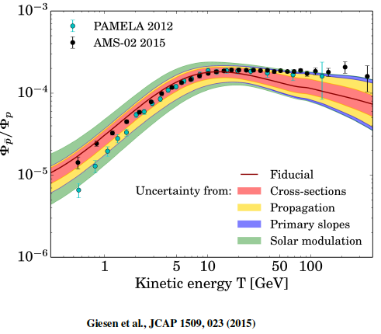
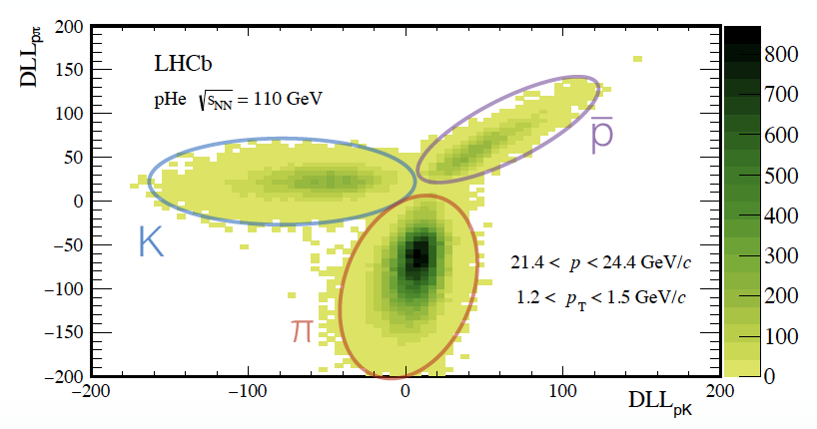
Measurement of antiproton production in pHe collisions at √s_{NN} = 110 GeV
Antiproton fraction in cosmic rays sensitive indirect probe of exotic astrophysical sources of antimatter
  Precision measurements of antiproton-proton flux ratio from PAMELA, AMS
  Uncertainties in 10-100 GeV antiproton energy range dominated by uncertainty on production cross-section – no data available until now!
First measurement of prompt antiproton production in pHe collisions
  Use proton beam of 6.5 TeV on helium gas target
  Luminosity from pe⁻ elastic scattering – dominant systematic <~10%
  PID from RICH detector response
[arXiv:1808.06127 Run2 0.5 nb⁻¹]
Antiproton production cross section
(integrated over different kinematic regions)
<10% uncertainty in most bins
Interpretation ongoing, expected to improve the precision of secondary antiproton cosmic ray flux predictions
Will include secondary antiproton production from hyperons in future paper

Slide 28
A look to the future
The LHCb upgrades

Slide 29
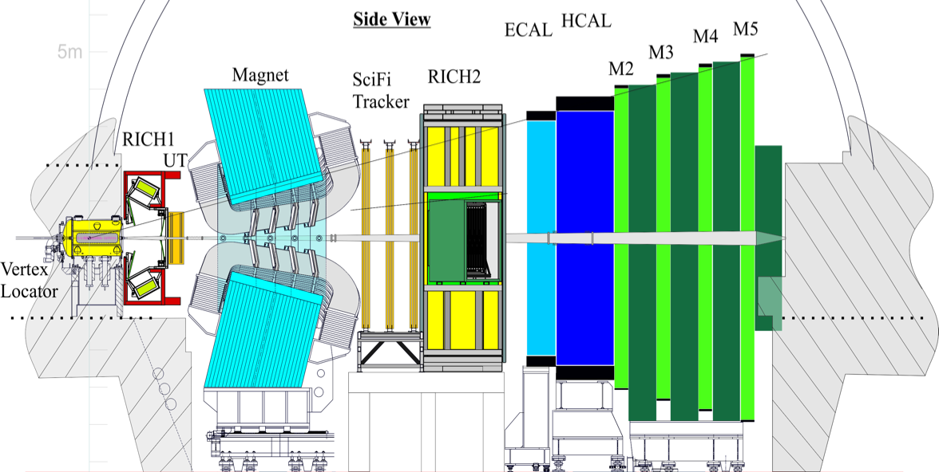
The LHCb Upgrade I in a snapshot
[CERN-LHCC-2012-007]
All sub-detectors read out at 40 MHz for a fully software trigger
Upgraded detector
New scintillating fibre tracker (SciFi)
New silicon upstream tracker (UT)
New PIXEL vertex detector
(VELO)
New RICH optics and photodetectors
New electronics for muon and calorimeter systems

Slide 30

LHCb Upgrade in snapshot
UT sensor

Slide 31


LHCb upgrade: VELO
VELO project progressing very well
Sensors: all are at the tile manufacturer
Velopix: ~500 tested, full order going out.
Tiles: ~30% produced/tested.
µchannel substrates being produced, graded and connectorized
Modules: PRR passed on July 10.
Module production complete by Jul 2019.
  2 production sites
  52 modules needed. Can produce 1-2/week/site
Detector halves to be ready by Feb 2020.
Full VELO module
VELO sensor tiles testing device
Substrate connectorisation
Substrate connectorisation ongoing

Slide 32





LHCb upgrade: VELO
Mechanics:
Module bases completed, metrology shows impressive precision
Detector hoods: first one completed
Isolation vacuum in production
RF foils: 1 ready, 2nd one in production
Module base
the isolation vacuum assembly
RF foil
Detector hood at the workshop
Vacuum feedthrough assembly

Slide 33

LHCb upgrade: UT
Type-A sensor under QA test
Sensors: received 25+80 A (finish Feb 2019), B,C,D pre-series ordered.
Readout electronics: PRR passed, ready for production
Flex cables ordered, pre-series available, test stands ready, glueing to staves starting soon
Bare staves: >90% have been produced
Integration infrastructure at progressing full speed
Bare stave detail
Data concentrator board
Prototype stave shipped at CERN
Prototype C-Frame

Slide 34

LHCb upgrade: UT
Hybrids: prototypes available, waiting for final SALT to conclude design.
Test stands developed.
SALT front-end chip is still an issue and represents a major concern
  Identified problems in the analog front-end in the latest version
  Design review with external experts in July
  Several issues identified and corrected
  Continuous pre-submission review and support by external experts in the last months
  New version submitted last week
Critical !
Hybrid prototype
Bonding lab
Test of UT module assembly

Slide 35




LHCb upgrade: SciFi
mats from 10000 km fibres: about finished
Modules: >95% produced
A large pile stacked at CERN.
Electronics: entered mass production
PACIFIC: produced and tested
SiPM+flex: assemblies in production, first batch delivered for cold assembly production
Cold bar production started
C-frame construction underway
128 modules needed
Preparation of flex cables and SiPM array assemblies
Precision machine for cold bar production
Prototype C-frame in construction at P8

Slide 36






RICH
To be produced for RICH1+2: 22+24 = 46 columns (+spares)
  MaPMTs: all 3500 tested
  CLARO: full prod received, 100k, QA
  Electronics and mechanics mostly under production, now focus on detector assembly, services and integration at CERN
  Digital readout board (PDMDB): PRR passed, EDMS 1989419, ready for production, baseline is Kintex
Mirrors and Qz window ordered
No more PRRs…
Test module installed in the current RICH
PDMDB
Photon detection module

Slide 37





Muon+CALO
To be produced: electronics boards + shielding plugs
  All electronics in production or tendering, all PRRs passed
  ASICs:
    ICECAL chips in hand and tested
    nSYNC production starting
Plan:
  FEB: firm being chosen, produce in batches (8+16+rest)
  CB: start producing in Sep
  HV/Calib/Moni: ready for production
  nODE: expect (pre-) full production finished by (Apr) Sep 2019
  nSB & nPDM: full prod by Apr 2019
New shielding plug, 3 parts, design finalized, parts being ordered
CALO FEB
278 needed
+21 CB
+144 HV/Calib/Moni
Muon nODE
148 needed
+120 nSB
+8 nPDM

Slide 38





LHCb upgrade: Online and computing
Containers for Event Filter Farm and Evt Builder:
  First 2 EFF modules in Oct 2018
  2+2 more Mar & Nov 2019
Event Builder:
  simulation of traffic is now working for 500 nodes and gives confidence in scalability of system.
Vertical Slice Test will allow checking simulation results at a scale of 20% of the final system.
Decide on Event Builder technology after a review in Apr 2019
First PCIe40 ready at contractor
Installation of the HLT farm power module
Vertical slice test rack

Slide 39
LHCb upgrade: software & computing TDR
TDR on upgrade software and computing released
  Summarizes core software solutions to enable HLT implementation
  All aspects of data processing (Simulation, offline, distributed computing,…) are discussed
a Computing Model TDR where offline computing resources will be discussed is about to be released to the LHCC

Slide 40
Upgrade II
LHCb Upgrade II: the ultimate exploitation of LHC for flavour physics

Slide 41

LHCb Upgrade II
[arXiV:1808.08865]
Aim to fully exploit HL-LHC for flavour physics and other opportunities in the forward direction
Aim to collect > 300 fb⁻¹ at L = 2x10³⁴, x10 with respect to Upgrade I
Consolidate in LS3, Major upgrade in LS4
Expression of Interest issued in 2017
Feasibility study performed by LHC experts
Physics case document released
Green light from LHCC to proceed to TDRs (expected ~late 2020)
[CERN-ACC-NOTE-2018-0038]

Slide 42


Physics Case – CKM unitarity triangle evolution
now
Upgrade II, 300 fb⁻¹
LHCb only
300 fb⁻¹

Slide 43
Conclusions and outlook

Slide 44

Conclusions and outlook
2018 run going very well
  Collected record luminosity in proton-proton
  We were delivered 10 fb⁻¹ which was the goal in our Technical Proposal in 1998 !
LHCb continues to provide a wealth of excellent physics results
The march towards the upgrade I is continuing
  All subsystems progressing - installation starts in a few months!
  Schedule is tight, working hard to be ready for LHC Run 3!
Looking into the far future:
  Expression of Interest for future upgrades submitted
  Physics case document released
  Green light from LHCC to proceed to TDRs
  A lot of opportunities !
See you in Run III with the upgraded LHCB!

Slide 45

Thank you !

Slide 46
BACKUP SLIDES

Slide 47




Controlling the systematics: D⁰/D^{*0}/D^{**0} relative fractions in B →Dlν
[arXiv:1807.10722 RUN1 3.0 fb⁻¹]
B →DXlν represent major background for R(D), R(D*) measurements
  Exclusive/inclusive BRs do not match
Infer the D⁰/D^{*0}/D^{**0} relative fractions measuring the missing mass in
B →DXlν
  Clever trick: use decay of excited state B_{s2}^{*0} → B⁻K⁺ to constrain B⁻ kinematics
  Use same-sign BK combinations to constrain the background
  Use MC templates to fit data
Fit projection to bckg sub. data
Same-sign K
Roughly:
1/4 directly to D⁰ μν
1/2 directly to D^{*0} μν
1/4 via higher D resonances

Slide 48




New results from charmed baryons: Ξ_{cc}⁺⁺
Discovered by LHCb in the channel Ξ_{cc}⁺⁺ →Λ_{c}⁺K⁻π⁺π⁺ [PRL 119 (2017) 112001]
Consistent with a weakly decaying object, but lifetime left for later study
Revisit 1.7 fb⁻¹ sample of Run 2 data, using Λ⁰_{b}→Λ_{c}⁺K⁻π⁺π⁻ control mode to measure the Ξ_{cc}⁺⁺ lifetime with respect to that of Λ_{b}⁰
Lifetime result:
Confirms that Ξ_{cc}⁺⁺ is a weakly decaying baryon.
Also, Ξ_{cc}⁺⁺ “rediscovered” in another decay channel : Ξ_{cc}⁺⁺ → Ξ_{c}⁺π⁺
Measured mass is:
m(Ξ_{cc}⁺⁺ ) = 3620 ±1.5 (stat) ± 0.4 (syst) ± 0.3(Ξ_{c}⁺) MeV/c²
[Phys. Rev. Lett. 121, 052002 (2018), Run 2, 1.7 fb⁻¹]
+
Invariant mass of candidates used for lifetime measurement
Lifetime fit
[Phys. Rev. Lett. 121, 162002 (2018), Run 2, 1.7 fb⁻¹]

