Slide 1


Update: Pump Control, Yale
William Heidorn
Iowa State University
ISU Weekly Meeting
September 12, 2018

Slide 2
Since last time…
Yale thermal setup
Found issues with CRC-16 (modbus) generation
  The cyclic redundancy check (CRC) is to make certain that the commands that have been sent are not corrupted in transmission.
  If the CRC is not correct it causes the command to fail… causing the system to shutdown instead of change to the correct pump value.
  The CRC generation has been found not to work for pump settings of 12.8-15.9 and 38.4 and greater.
    This is probably good, because these will be locations where the flowmeter will not usually go for 1l/min flow rates
Comparing pump setting to flow and voltage measurements
  Noticing problems with low temperature conversions

Slide 3
Yale Thermal Setup Requirements
Finish Setup
  Install Arduino software
  Install computer control software
  Make certain all parts are together(pipes, alignment, etc)
Flow Meter Calibration
Vignetting measurements
Stave measurements with Yale Setup
  #2R and #8
T-probe test? Use one of our short pipes?

Slide 4
Booster Pump Commands
In Hexadecimal
  0106002cRRRRyyyy
  = Set booster pump RPS to RRRR/10
  where yyyy is CRC code generated from 0106002cRRRR
  Our current CRC generator has issues from 12.8-15.9 or 0080-009F in hex
  Why? I do not know. Roy’s looking into it.

Slide 5
Pump Check
Measurements of the flow rate from the arduino were taken with varying pump settings from around 10 rps to 38 rps
Compared with direct flow rate measurements that were used to make the voltage conversion formula
FlowRate = A*Volt+ B + C*Temp+ D*Temp²
  Volt: Voltage from flow meter
  Temp: Used Tres value (this is a problem at low temperatures)

Slide 6
Room Temp
Flow comparison between early direct flow measurements and flow rates measured from the voltage, using the formula
Both are within uncertainty

Slide 7
Hot Temp
Flow comparison between early direct flow measurements and flow rates measured from the voltage, using the formula
Again both are within uncertainty

Slide 8
Cold Temps
The flow rate that was measured using the formula was much lower than what was measured directly
Direct measurement did not have the fluid flow through long enough to cool off the stave.
Fluid in the Arduino measurements was much colder than the direct measurements.
  Problem: No logger was used during these measurements… so no temperature data was recorded
  Could redo measurements using similar technique and see what kind of results we end up with

Slide 9
Voltage Comparison
This is a comparison between all of the voltage measurements from the arduino and the direct measurement at -40C.
The direct at -40C had a different fluid temperature than the other low temperature measurements

Slide 10
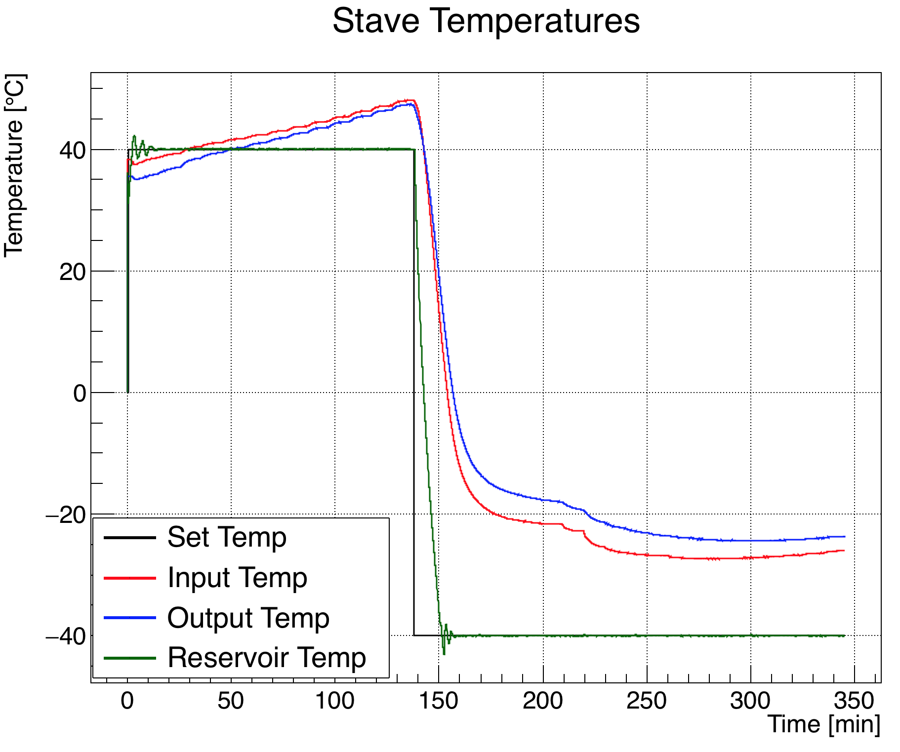
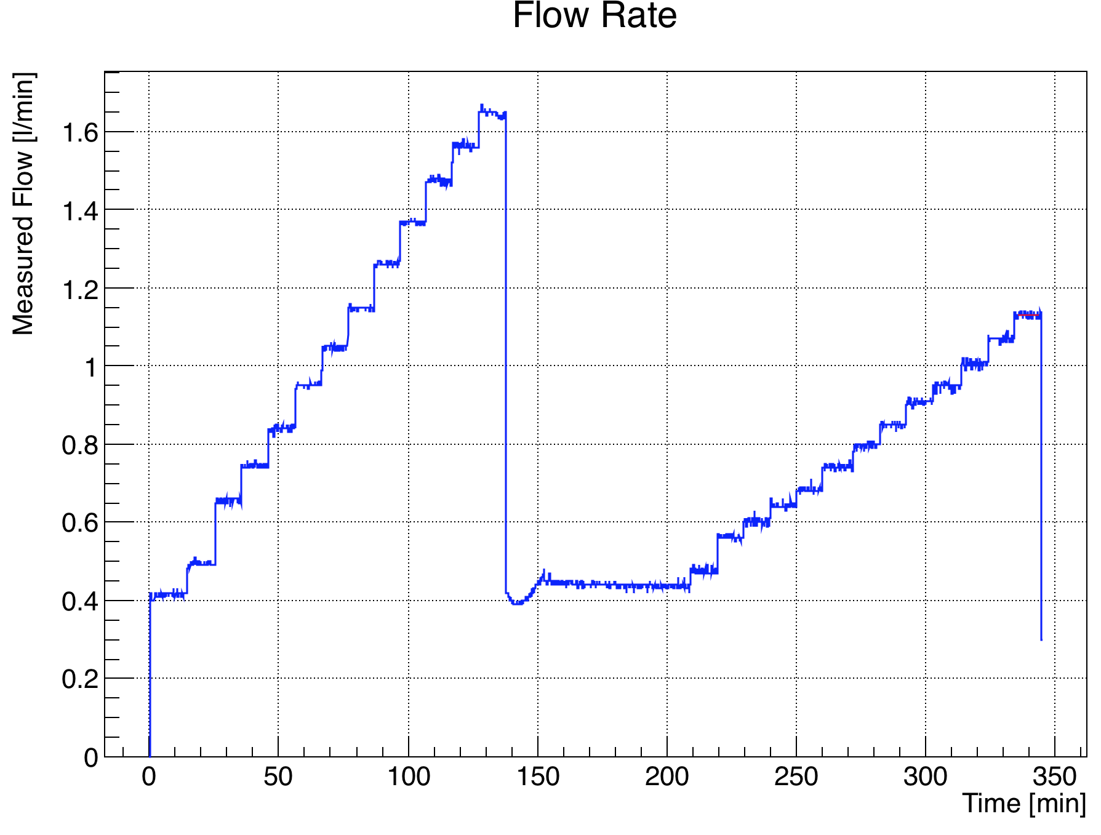
Some Plots

Slide 11
Backup Slides

