Slide 1


Yale Update: Oct 11th
William Heidorn
Iowa State University
ISU Weekly Stave qc Meeting
October 11, 2018

Slide 2
Where we are…
Thermal-
  All hardware and computer communication are working.
  Most calibration tests have been done
    Vignetting
    Flow rate
  Remaining Issues and tests
    Box size… Looking at the test stave I found that the pixel size was smaller(2mm/pixel instead of 2.2mm/pixel)… I found that the big box is a few inches shorter than what is mentioned in the setup guide (not certain if it was a typo on the drawings)
  Stave 8 and 2R measurements
Laser-
  Camera issue- Biggest problem is that the camera purchased was not the same… causing headaches due to different data format and intensity.

Slide 3
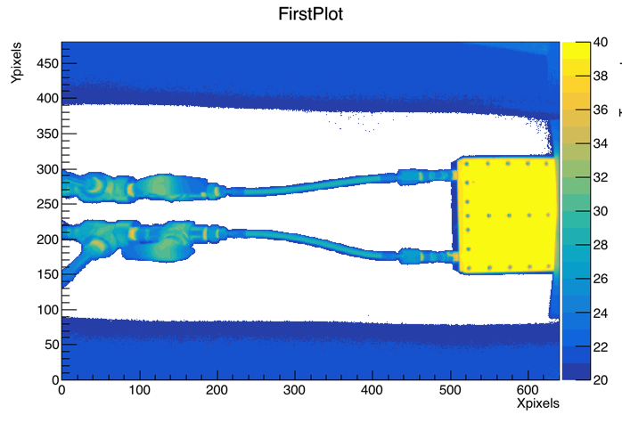
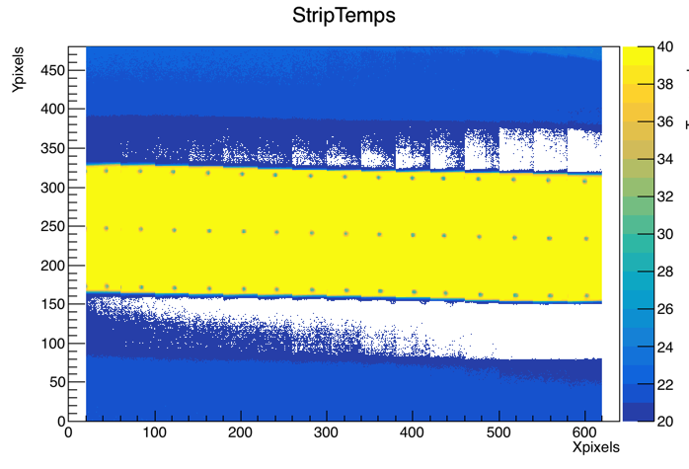
Vignetting
The metal block was cooled/ heated to a stable temperature.
The camera was focused and observed the plate 15 times. Each time, the same plate portion was observed with a different section of pixels of the camera.
Before each image measurement the camera was recalibrated between each image using the NUC (non-uniformity compensation) feature of the camera.
Images were taken with 100 frames over 4 seconds and averaged assuming an emissivity of 0.95

Slide 4
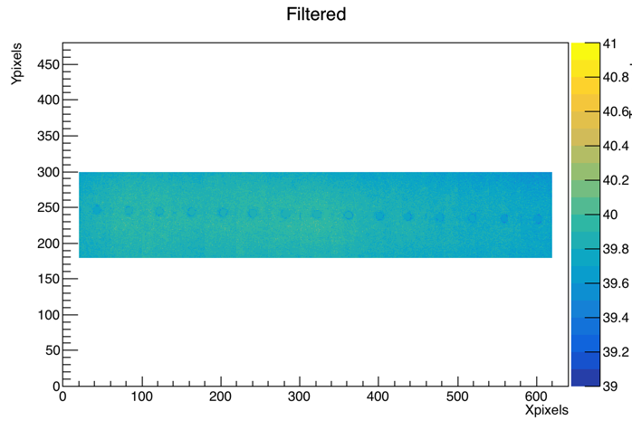
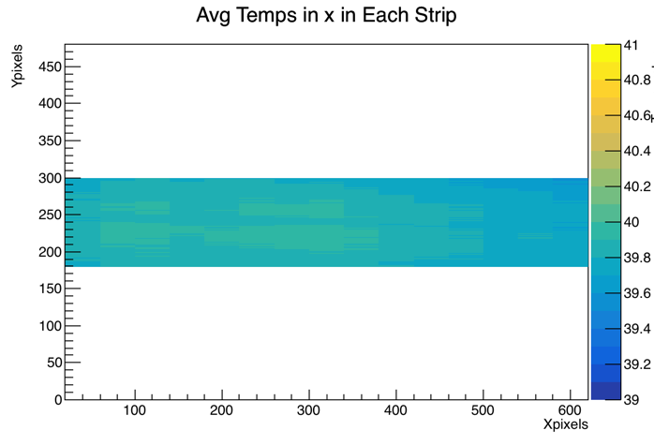
Vignetting cont.
The image is smoothed within the region in which the stave will reside in measurements
  Find average throughout the strip area and remove any temperatures outside one standard deviation and replace them with the average
The temperature is next averaged along the x direction in each strip
Finally the central strip is subtracted from the rest to give the vignetting

Slide 5
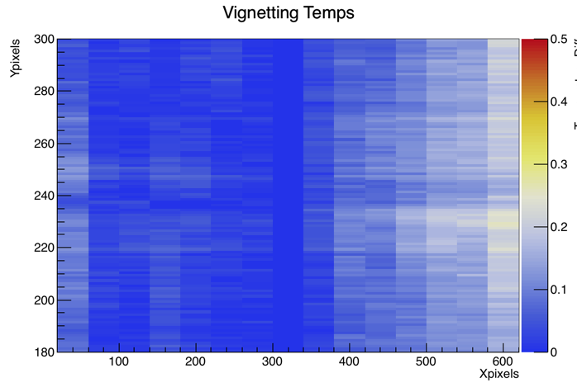
Vignetting +40C Block
To the right you see the vignetting map
  Max Vignetting: 0.26 C
  Avg Vignetting: 0.07 C
This is quite impressive given that the measurement is taken over a 10 min period
Absolute Vignetting [C]

Slide 6
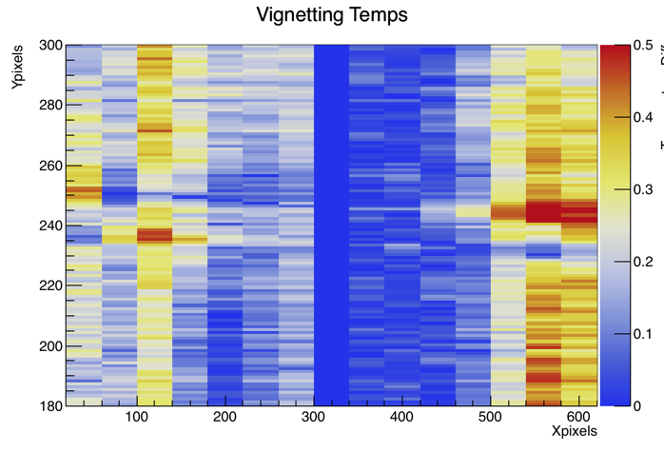
Vignetting -40C Block
To the right you see the vignetting map
  Max Vignetting: 0.63 C
  Avg Vignetting: 0.17 C
This is quite impressive given that…
  The measurement is taken over a 10 min period
  Alignment of metal was not right for one line
Absolute Vignetting [C]

Slide 7
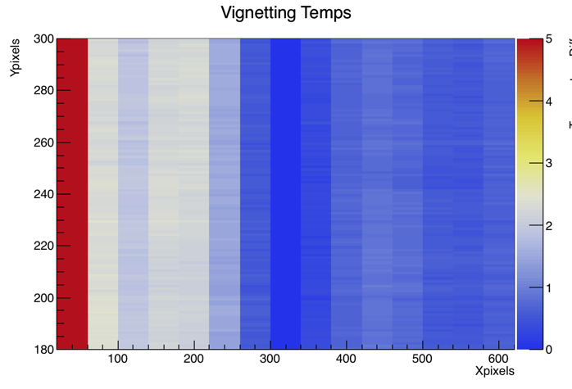
First Yale Trip -40C Block
No NUC utilized during this run
Similar to what we saw at ISU (~3 max)
Vignetting worsens over time(orange arrow)
Error in the last row
Absolute Vignetting [C]

Slide 8
Cold Temperature Fluctuations during Vignetting
For the cold measurement, fluctuations of the temperature are at most 0.2 C
Orange arrows display direction of taken data
Vignetting [C]

Slide 9
Vignetting Conclusions
The actual vignetting of the thermal camera’s are much smaller than we had earlier measured.
Using the NUC, the camera’s maximum vignetting is below 1 C!
  +40C Block: Avg Vignetting 0.07C, Max Vignetting 0.27C
  - 40C Block: Avg Vignetting 0.17C, Max Vignetting 0.63C
These fluctuations may mainly be due to the fluctuation of the temperature of the block during the measurement

Slide 10
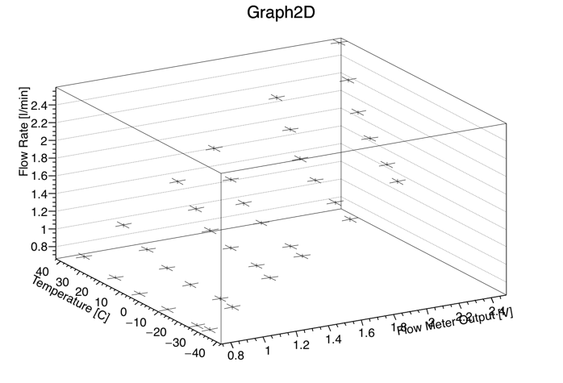
Flow Rate Calibration initial plots
Novec 7100 fluid was passed through the flow meter with the metal calibration plate in line.
The bypass was opened and the fluid was pumped into the 1l graduated cylinder while the time was measured with a stop watch
The temperature of the chiller and booster pump were set to varying values
Initial plot of the data is shown at the right…
I will have nicer plots in the future

Slide 11
Backup Slides

