Slide 1


Novec HFE 7100 affect on Titanium pipe study.
R. McKay
Iowa State University
ISU Weekly Meeting
18-Oct-2018

Slide 2
Titanium tube samples.
Three titanium tubes of 2mm ID by 8cm length were provided for long term exposure to find what, if any, effects the 3M Novec HFE-7100 fluid would do to the titanium tubes.
One tube was set aside for a baseline sample. It was not exposed to the HFE fluid.
A second tube was exposed for 770 hours with +40 °C HFE fluid, pumped around 1 liter/minute. The 3rd tube was exposed for 774 hours with -40 °C HFE fluid pumped at the same 1 liter/minute.
At the conclusion of each run, the tubes were sent to Ames Lab metallurgy division for micrographic examination.

Slide 3
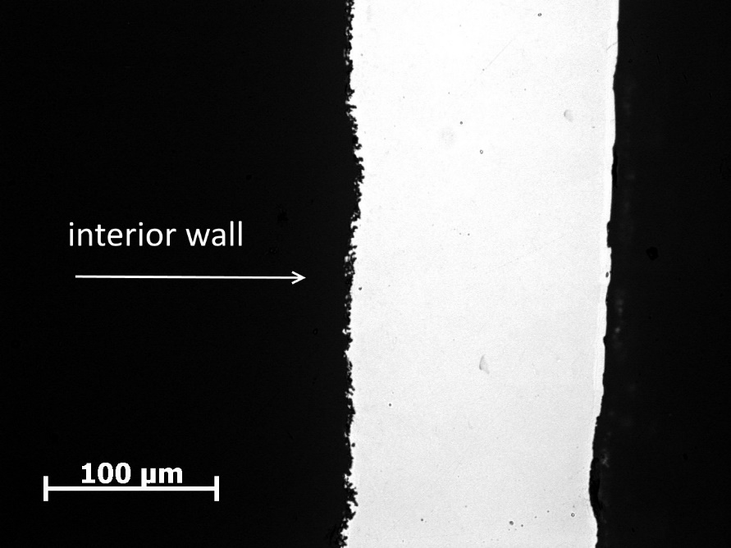
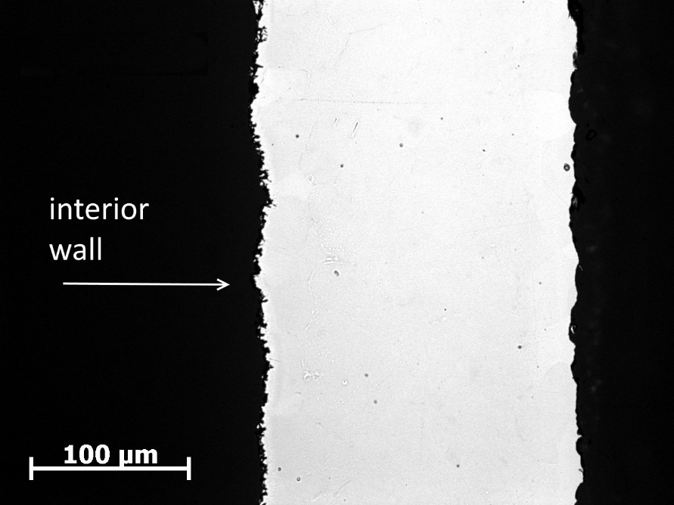
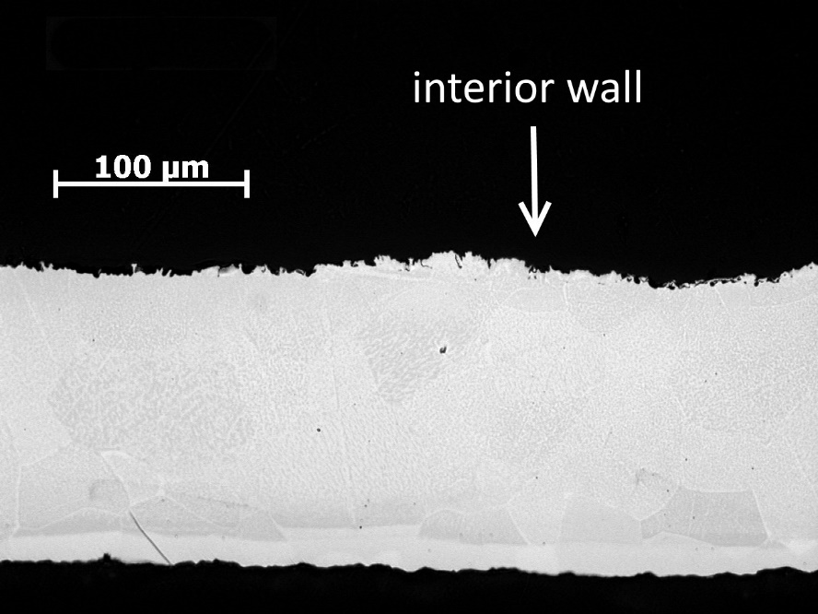
Quiz: Which photo is: baseline, +40 °C, - 40 °C
A
B
C
Baseline
-40°C
+ 40°C

Slide 4
Conclusion
Difficult to tell the difference.
An X-ray fluorescence scan on the samples did not find any contaminants on the inner walls of the tubes.
The 3M Novec HFE-7100 fluid appears not to harm the Titanium pipes.

