Slide 1
Laser Scan Setup at Yale
Shuaiyan
2018/10/18

Slide 2
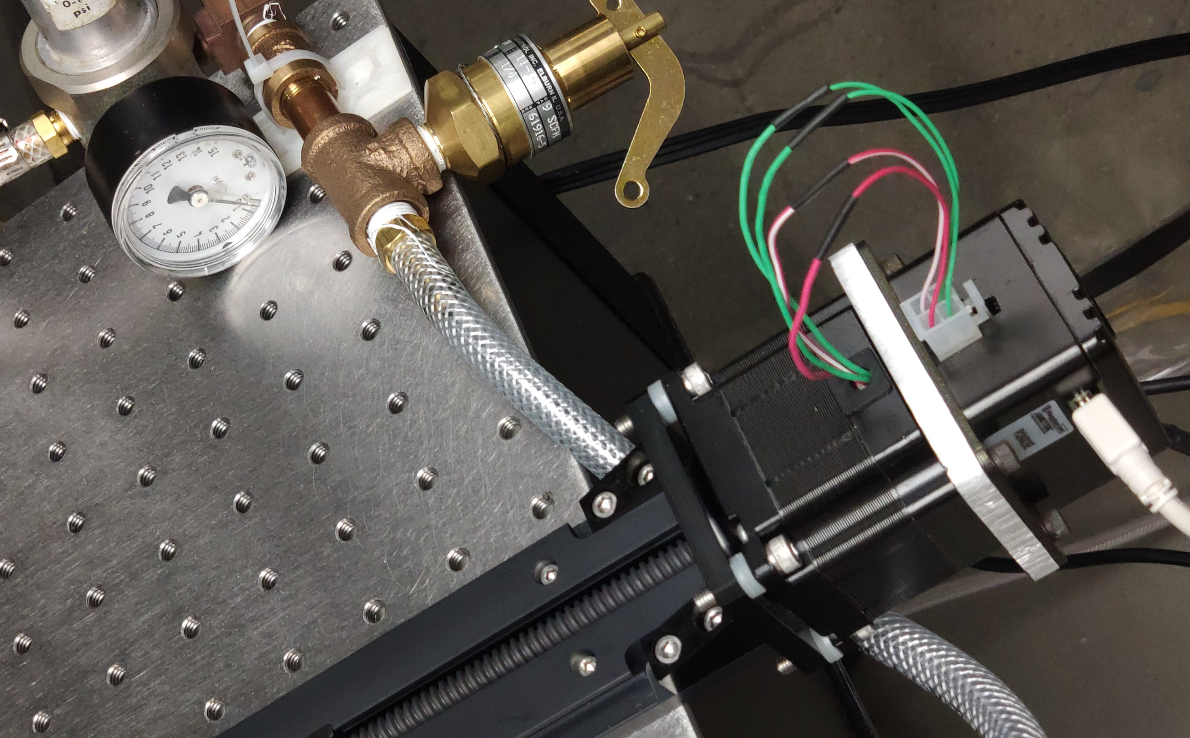
So far
Linear stage thermal expansion has been fixed. The motor was pulled so it doesn’t contact with linear stage.
New camera received Tuesday afternoon. The only difference is the ethernet connection interface. The camera configuration was pretty much the same as ours except some options changed/removed because of new firmware.

Slide 3
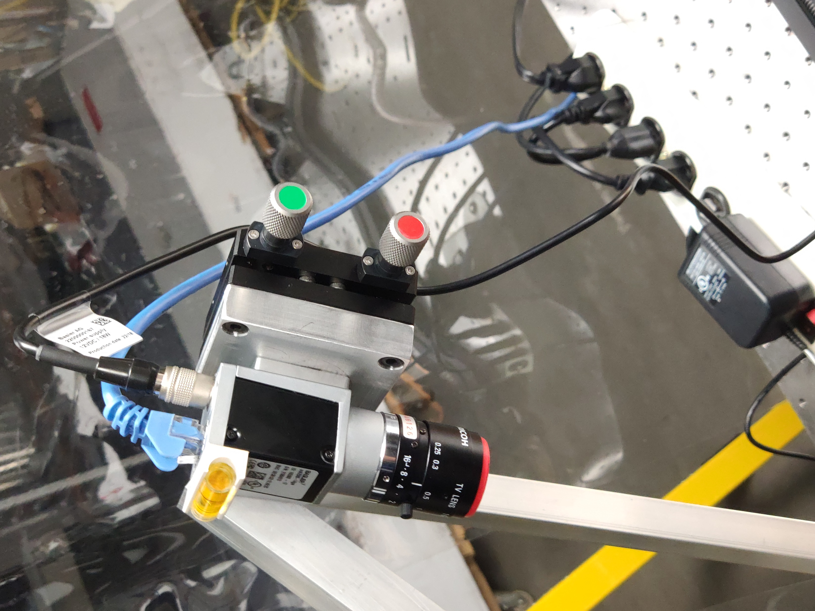
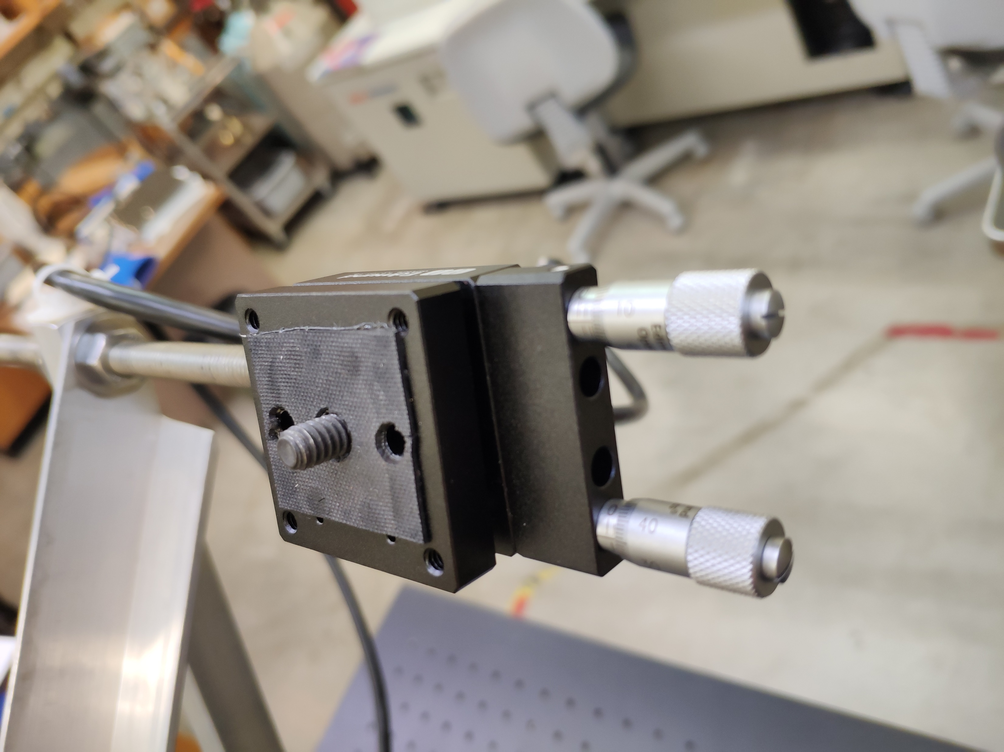

The height scale factor is about 133$μm/$pixel, ours is 78. So for image fluctuation, the height jump will be bigger resulting in large RMS.
This is caused by different view angle. The camera base here is thicker than ours. Looks like they added an additional aluminum base between camera and adjusting plate.
The scale factor was lowered to about 126 by aligning the vertical index (190, about 1/10 of entire length) with laser instead of camera center (792). So the object can have a maximum of 2.5cm higher than base (pixel index decreases when object higher).

Slide 4
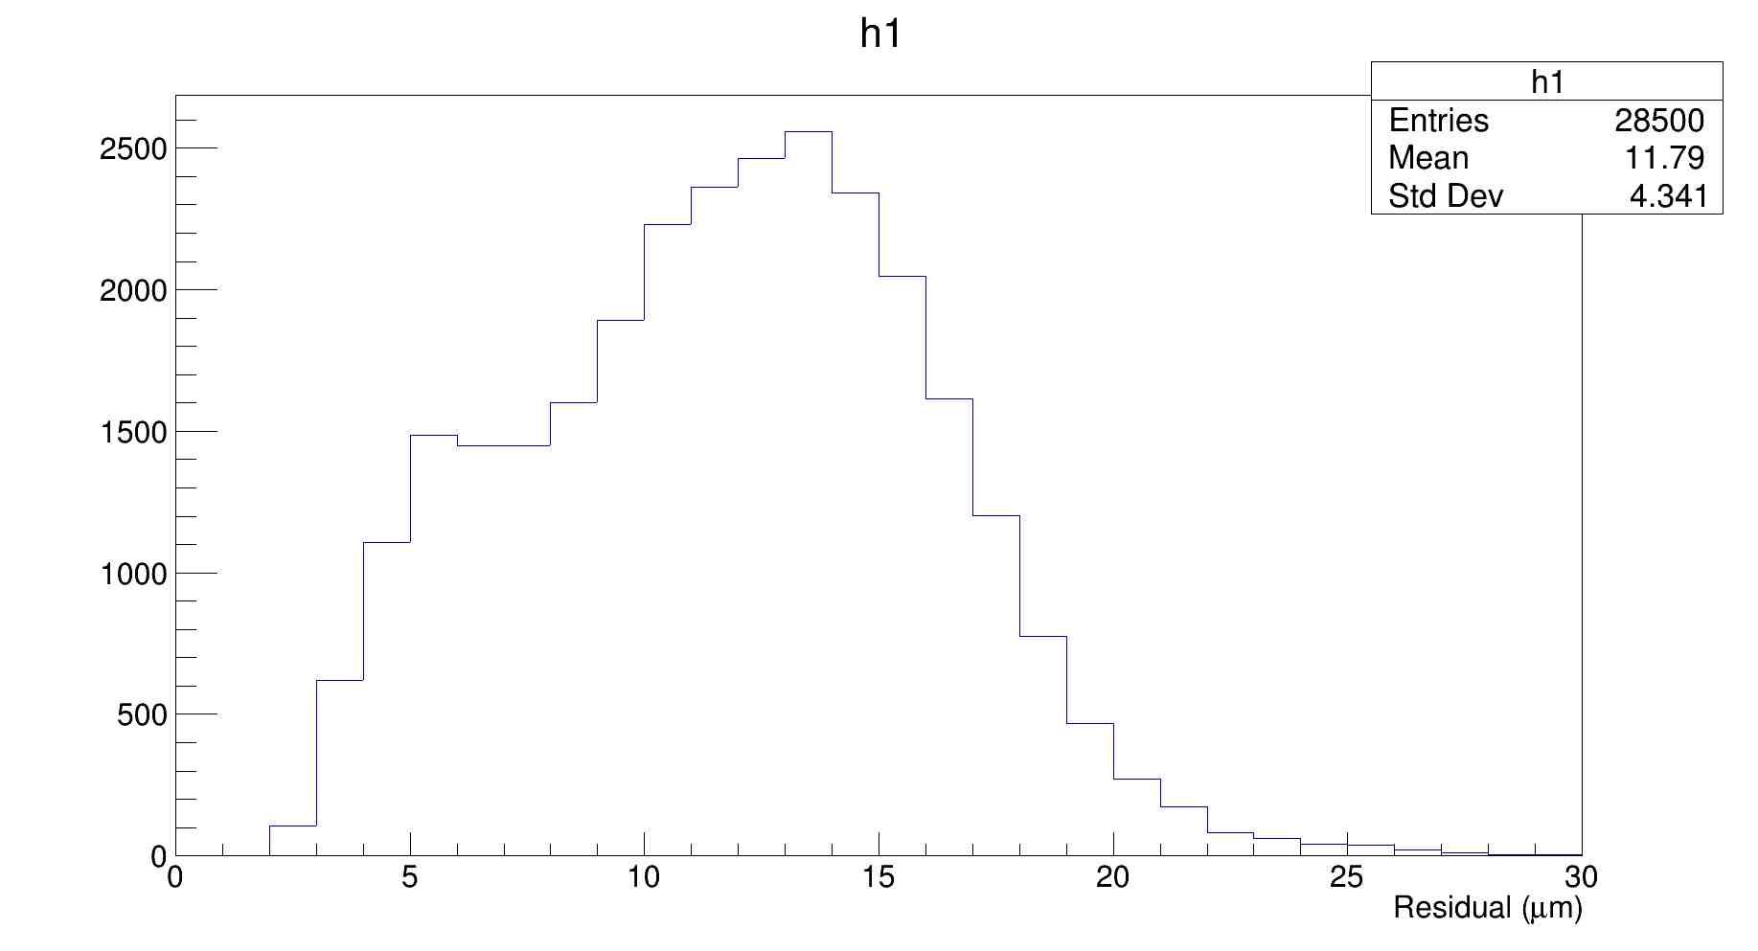
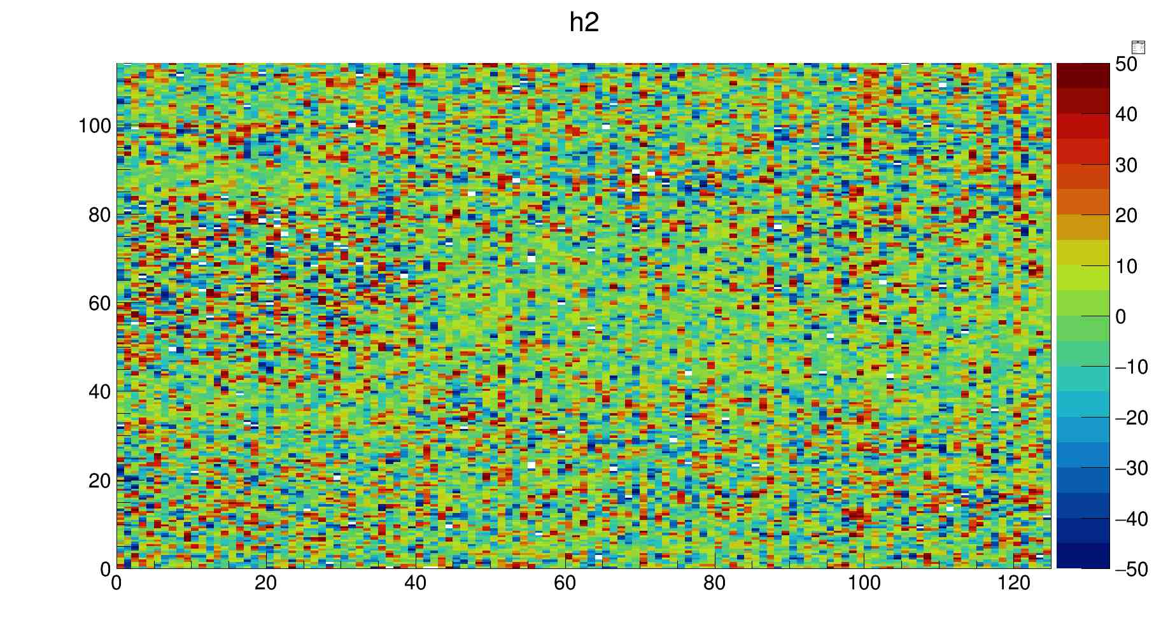
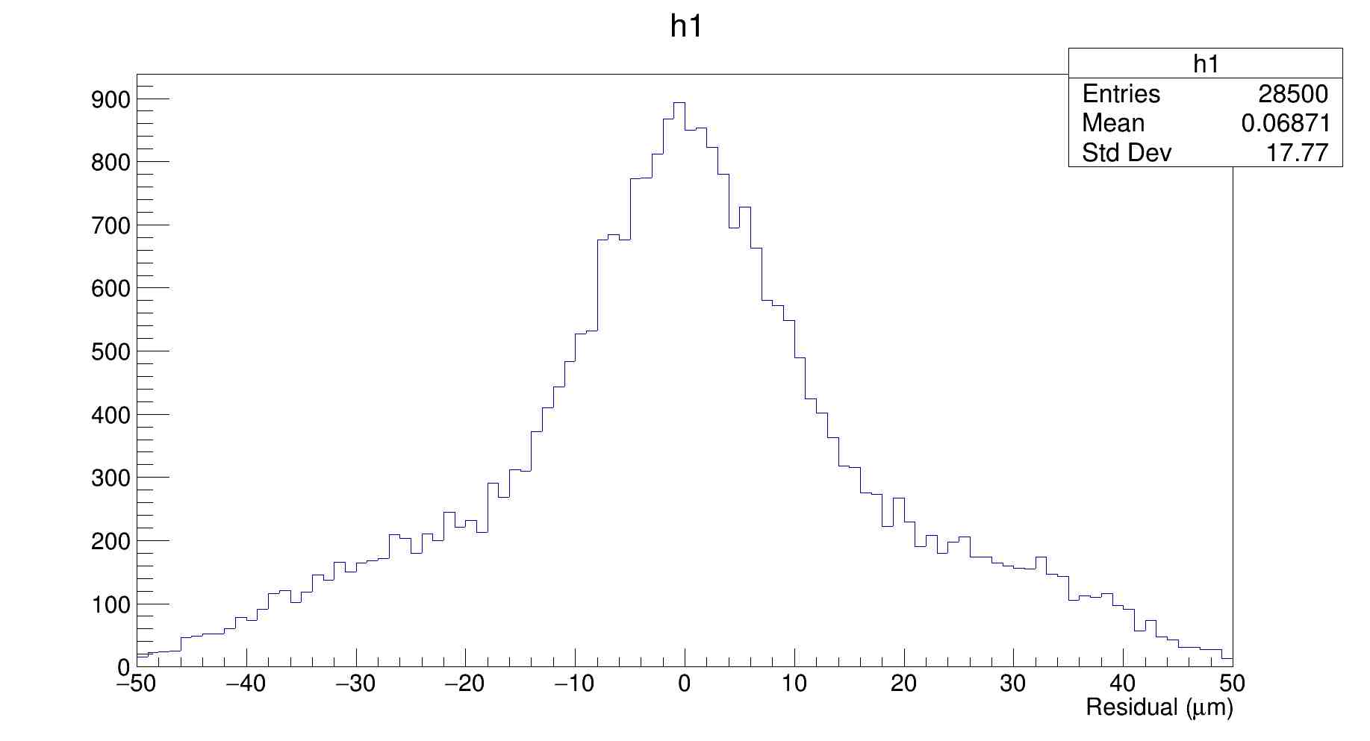
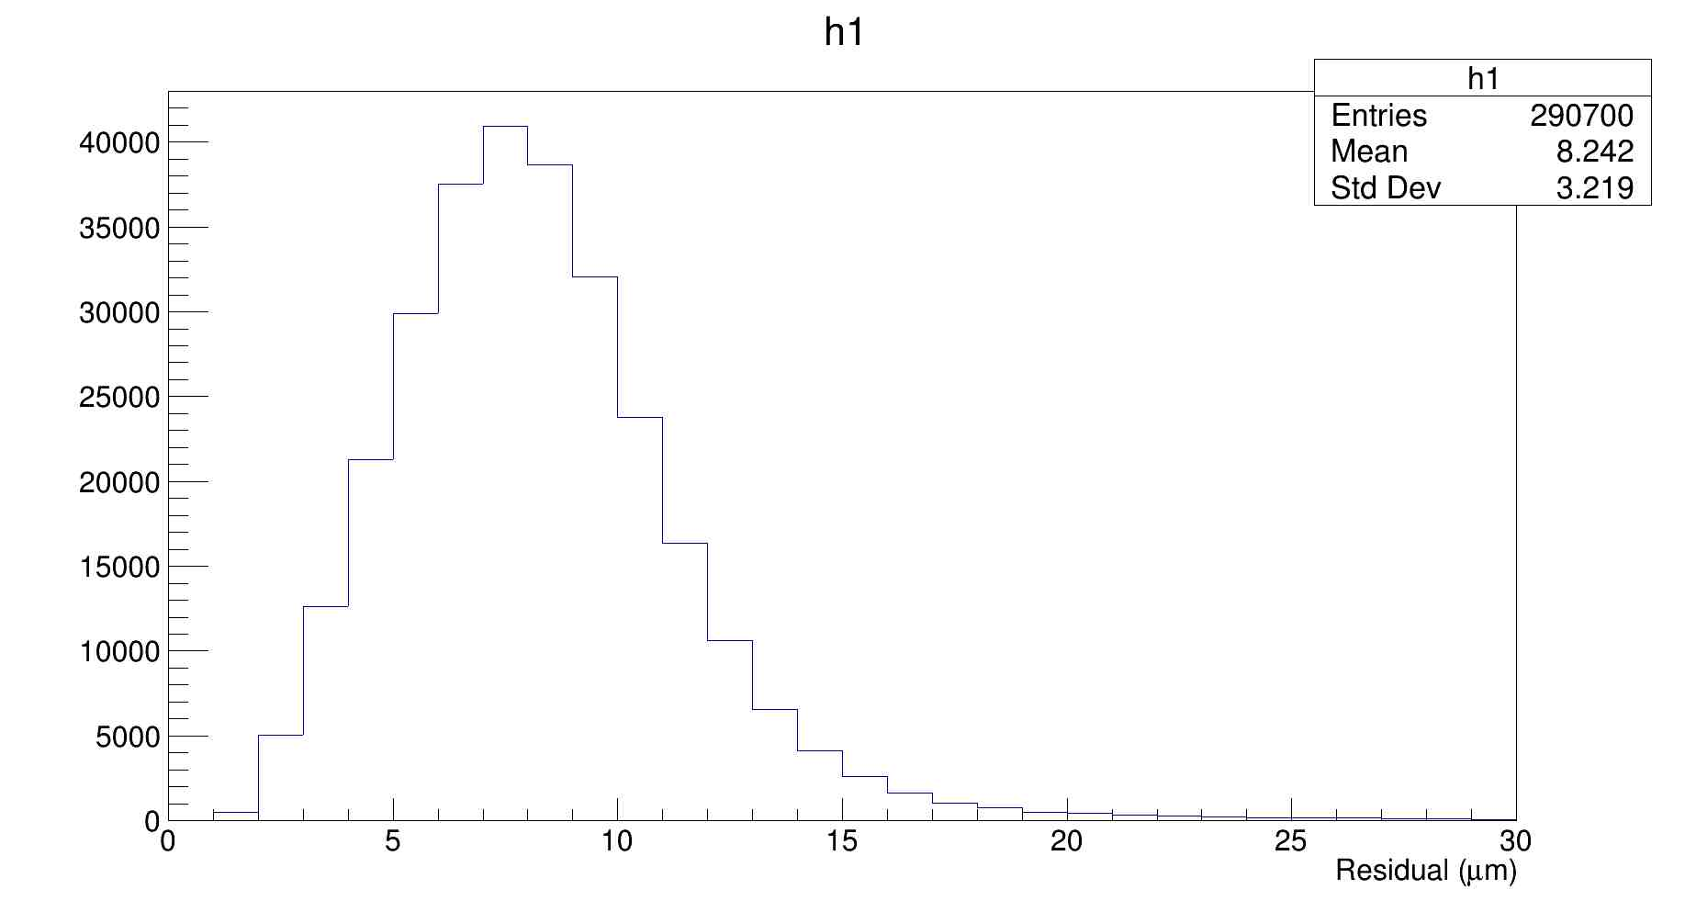
Latest scan
Scan area: 125mm. Stave 2R 0 psi
RMS for last 15 scans
Residue of two plots
Our data
Residue plot

