Slide 1
Thermal FEA Update
2018/11/08
Shuaiyan

Slide 2
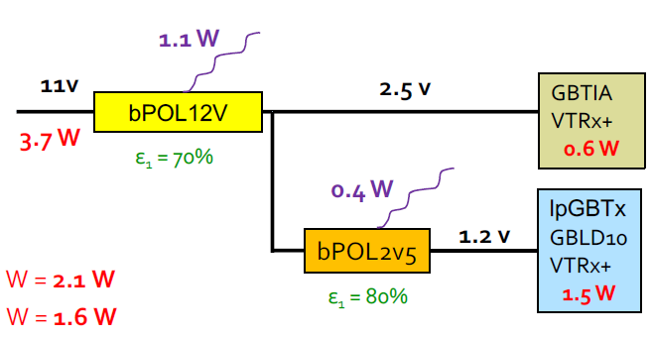
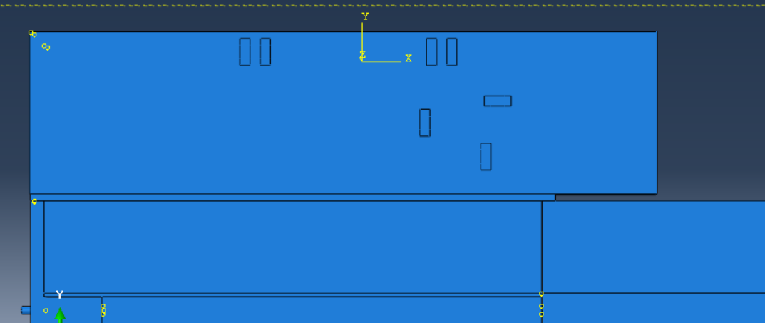
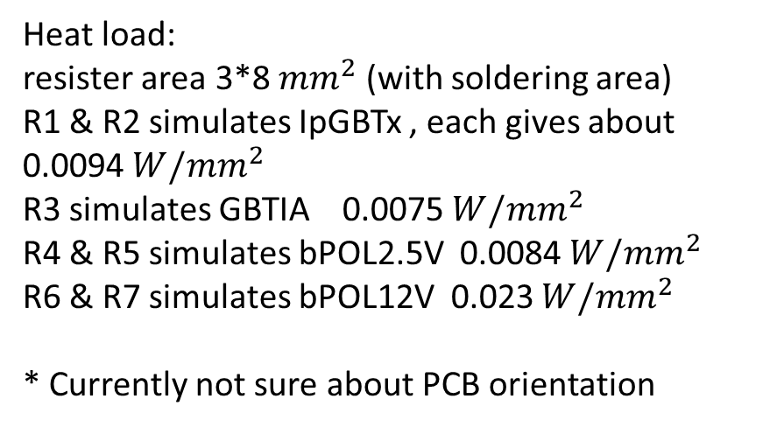
Resistor heat dissipation
Heat dissipation:
bPOL12V 1.1 W, bPOL2.5V 0.4W
GBTIA 0.18W, IpGBTx 0.45W
(with 70% estimated efficiency)
PCB power distribution diagram made by Mogens Dam
Heat load:
resister area 3*8 ${mm}^{2}$ (with soldering area)
R1 & R2 simulates IpGBTx , each gives about 0.0094 ${W/mm}^{2}$
R3 simulates GBTIA 0.0075 ${W/mm}^{2}$
R4 & R5 simulates bPOL2.5V 0.0084 ${W/mm}^{2}$
R6 & R7 simulates bPOL12V 0.023 ${W/mm}^{2}$
* Currently not sure about PCB orientation
4
5
6
7
3
2
1
Dummy PCB model

Slide 3
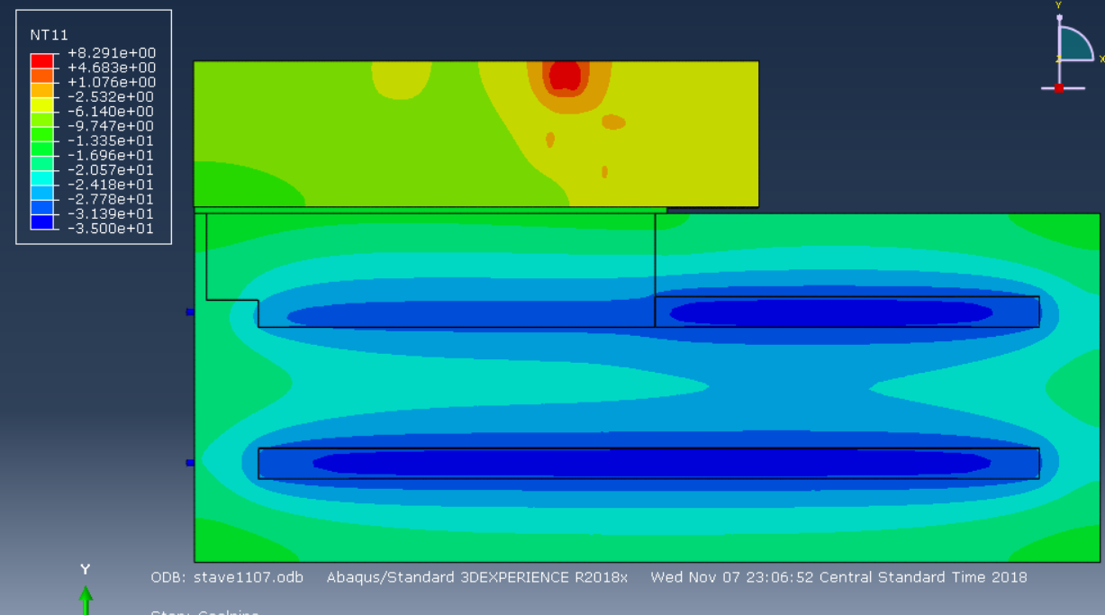
Stave temperature distrubation

Slide 4
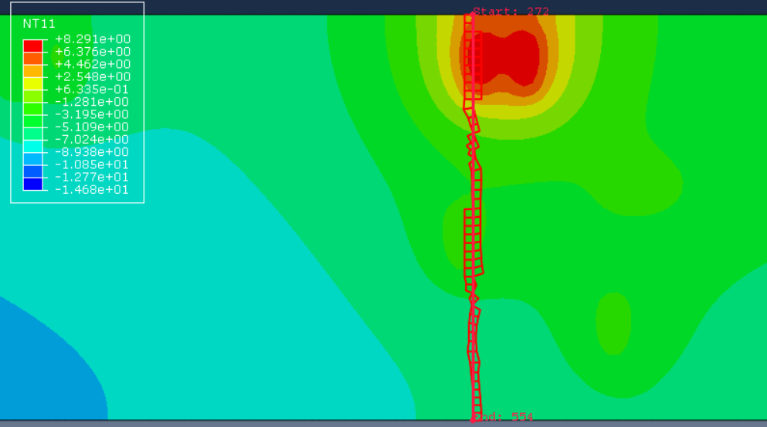
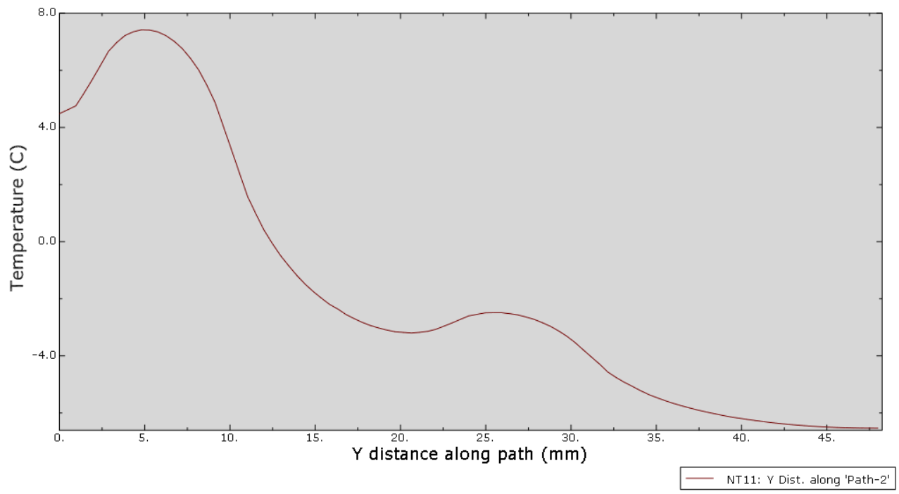
Temperature distribution across PCB
Y
Path across PCB
Temperature across PCB

Slide 5
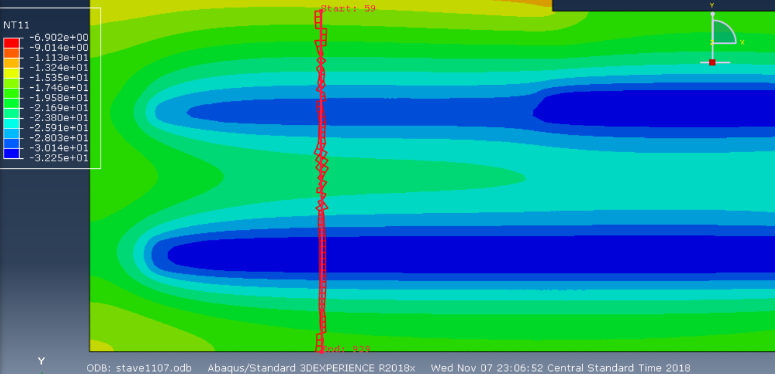
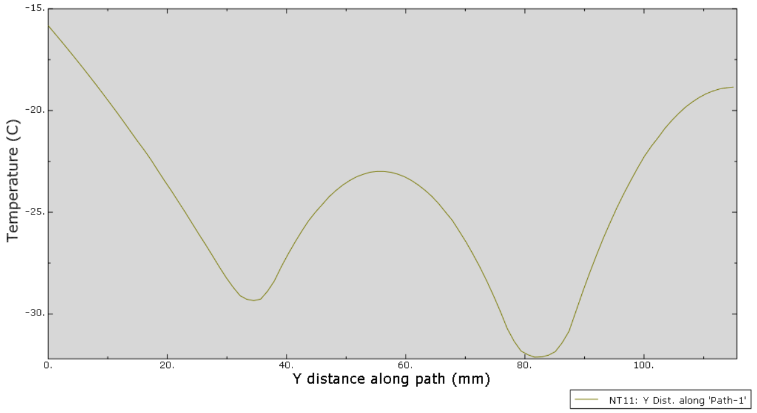
Temperature distribution across stave
Y
Path across stave
Temperature across stave

