Slide 1
FEA Update
Shuaiyan
2018/12/20

Slide 2
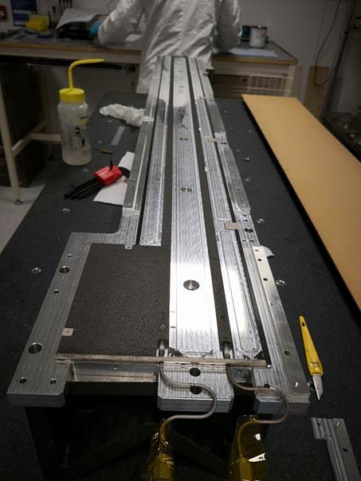
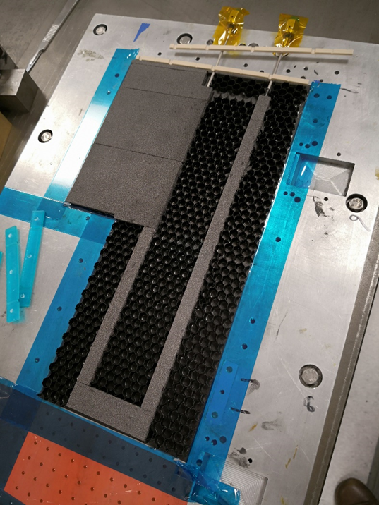
Mini stave EOS foam
Mini stave EOS foam was cut into three pieces. However, for 14 module stave production, the foam will be a whole part.
Pipe U bend part is covered by two 60*20*2.5 mm foams.
Picture from Stephanie Yang

Slide 3
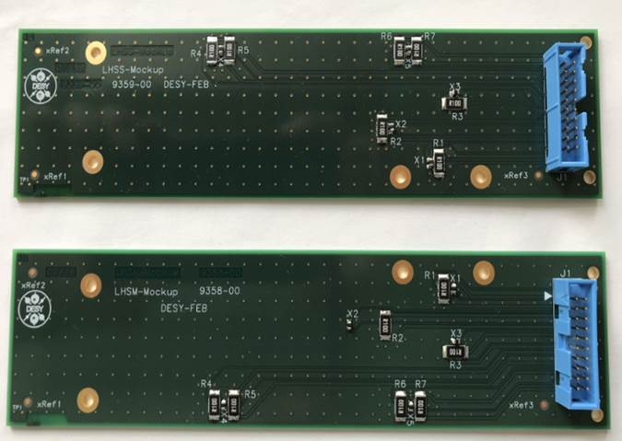
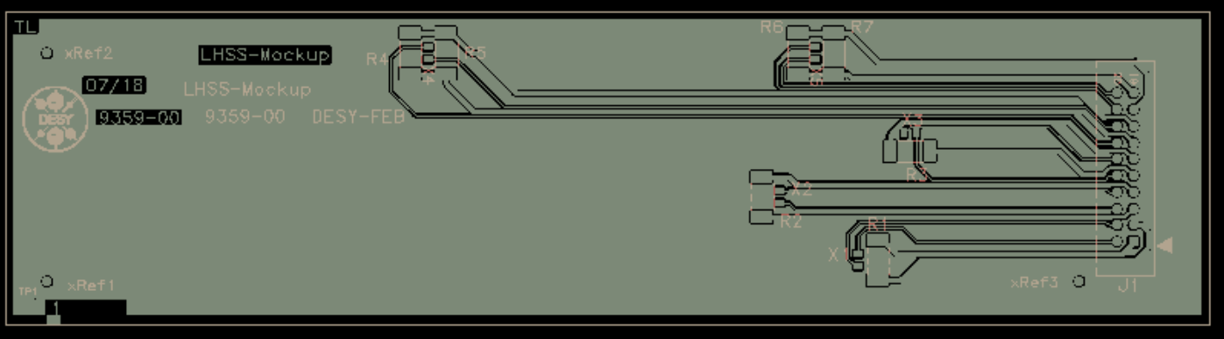
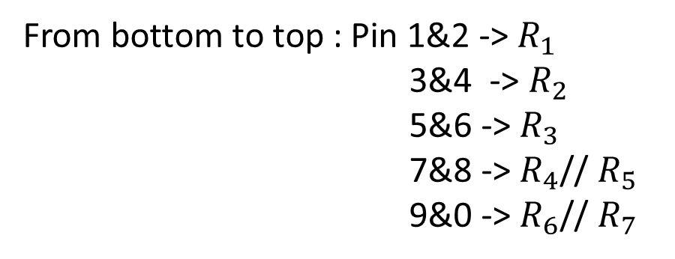
EOS Dummy PCB
From bottom to top : Pin 1&2 -> $R_{1}$
3&4 -> $R_{2}$
5&6 -> $R_{3}$
7&8 -> $R_{4}$// $R_{5}$
9&0 -> $R_{6}$// $R_{7}$
1234567890
This column powers capacitors , we don’t use
PCB circuit drawing from DESY

Slide 4
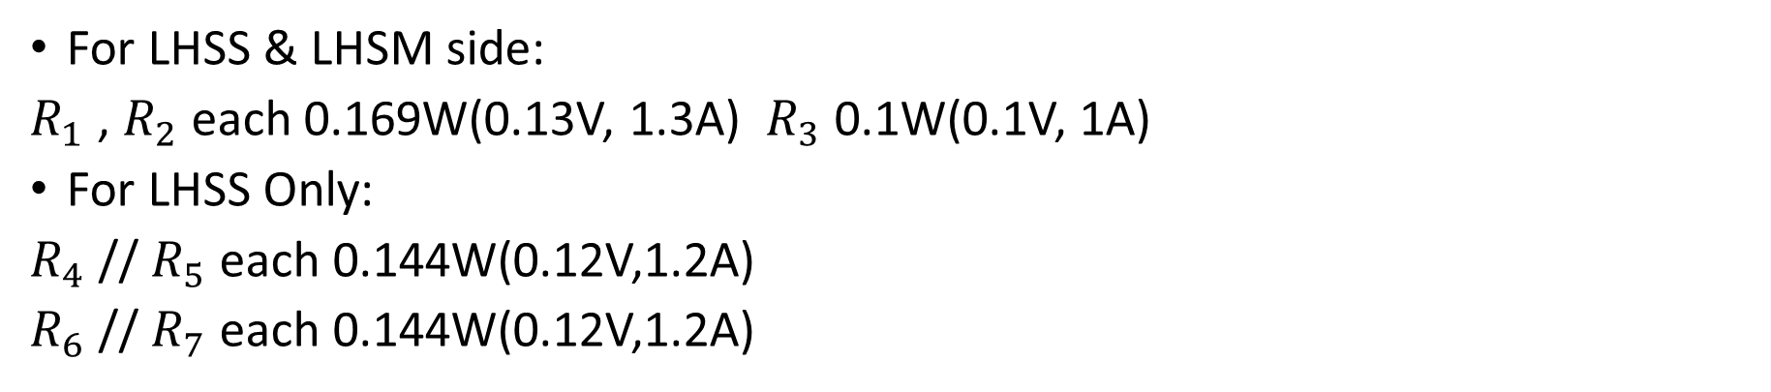
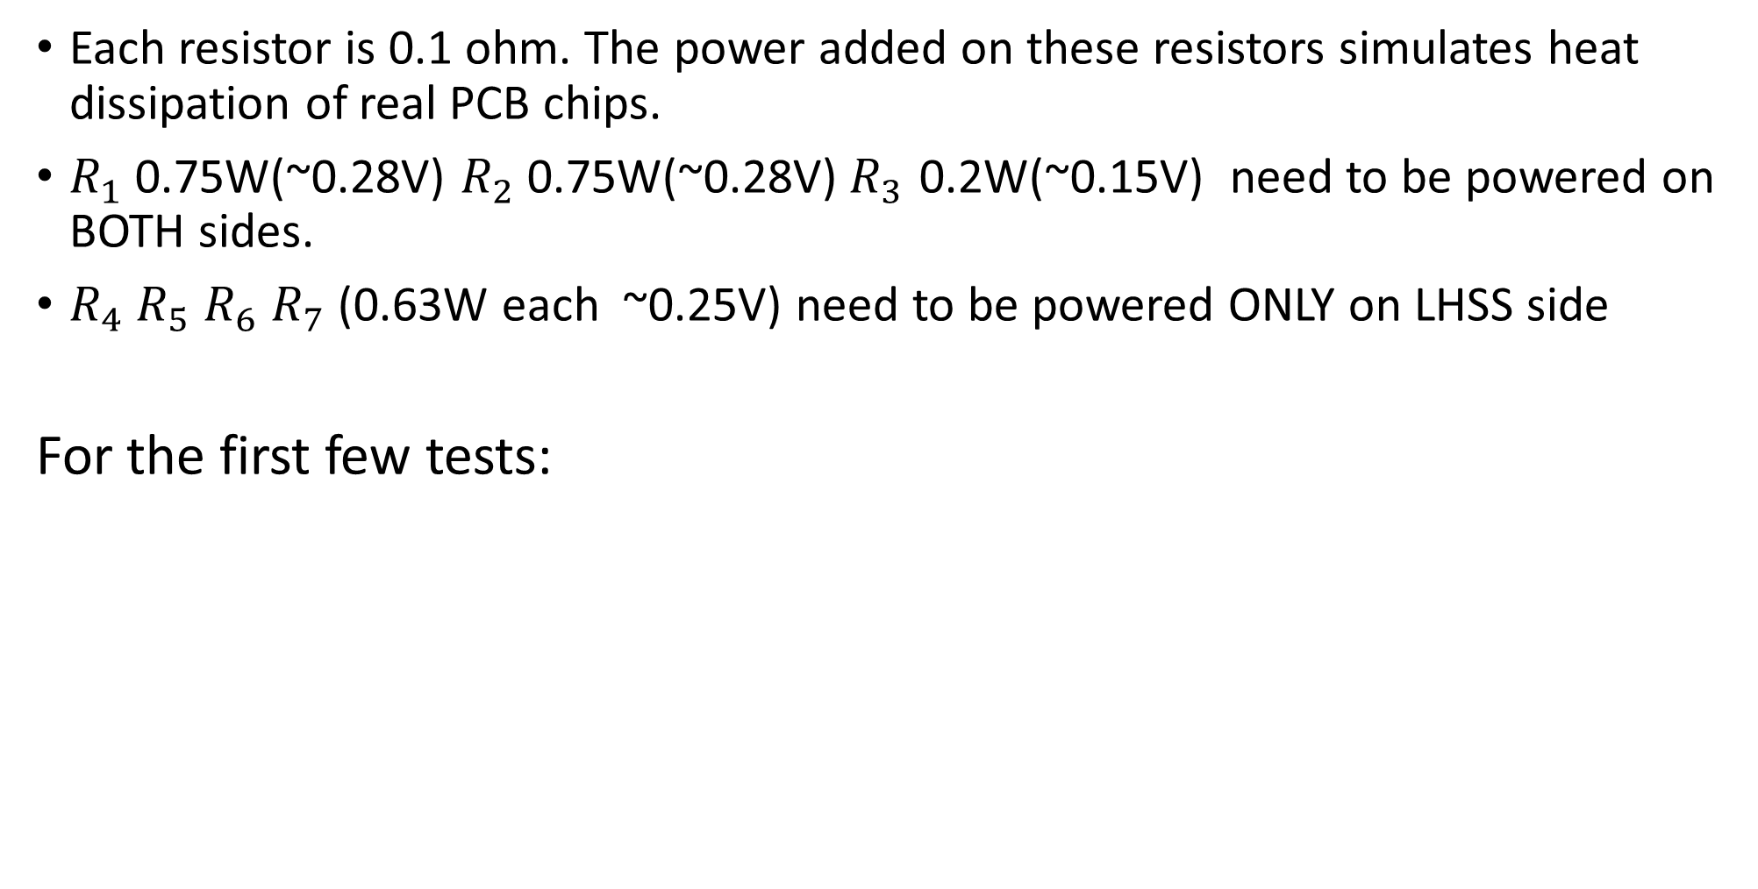
Power need For Resistors
Each resistor is 0.1 ohm. The power added on these resistors simulates heat dissipation of real PCB chips.
$R_{1}$ 0.75W(~0.28V) $R_{2}$ 0.75W(~0.28V)${ R}_{3}$ 0.2W(~0.15V) need to be powered on BOTH sides.
$R_{4}{ R}_{5}$ $R_{6}$ $R_{7}$ (0.63W each ~0.25V) need to be powered ONLY on LHSS side
For the first few tests:
For LHSS & LHSM side:
$R_{1}$ , $R_{2}$each 0.169W(0.13V, 1.3A) ${ R}_{3}$ 0.1W(0.1V, 1A)
For LHSS Only:
$R_{4}$ // $R_{5}$ each 0.144W(0.12V,1.2A)
$R_{6}$ // $R_{7}$ each 0.144W(0.12V,1.2A)

