Slide 1

Mini stave Thermal Finite Element Analysis
Boping Chen, Chunhui Chen, William Heidorn, Shuaiyan Kang, Soeren Prell, Roy Mckay, Jie Yu
JAN 18, 2019

Slide 2
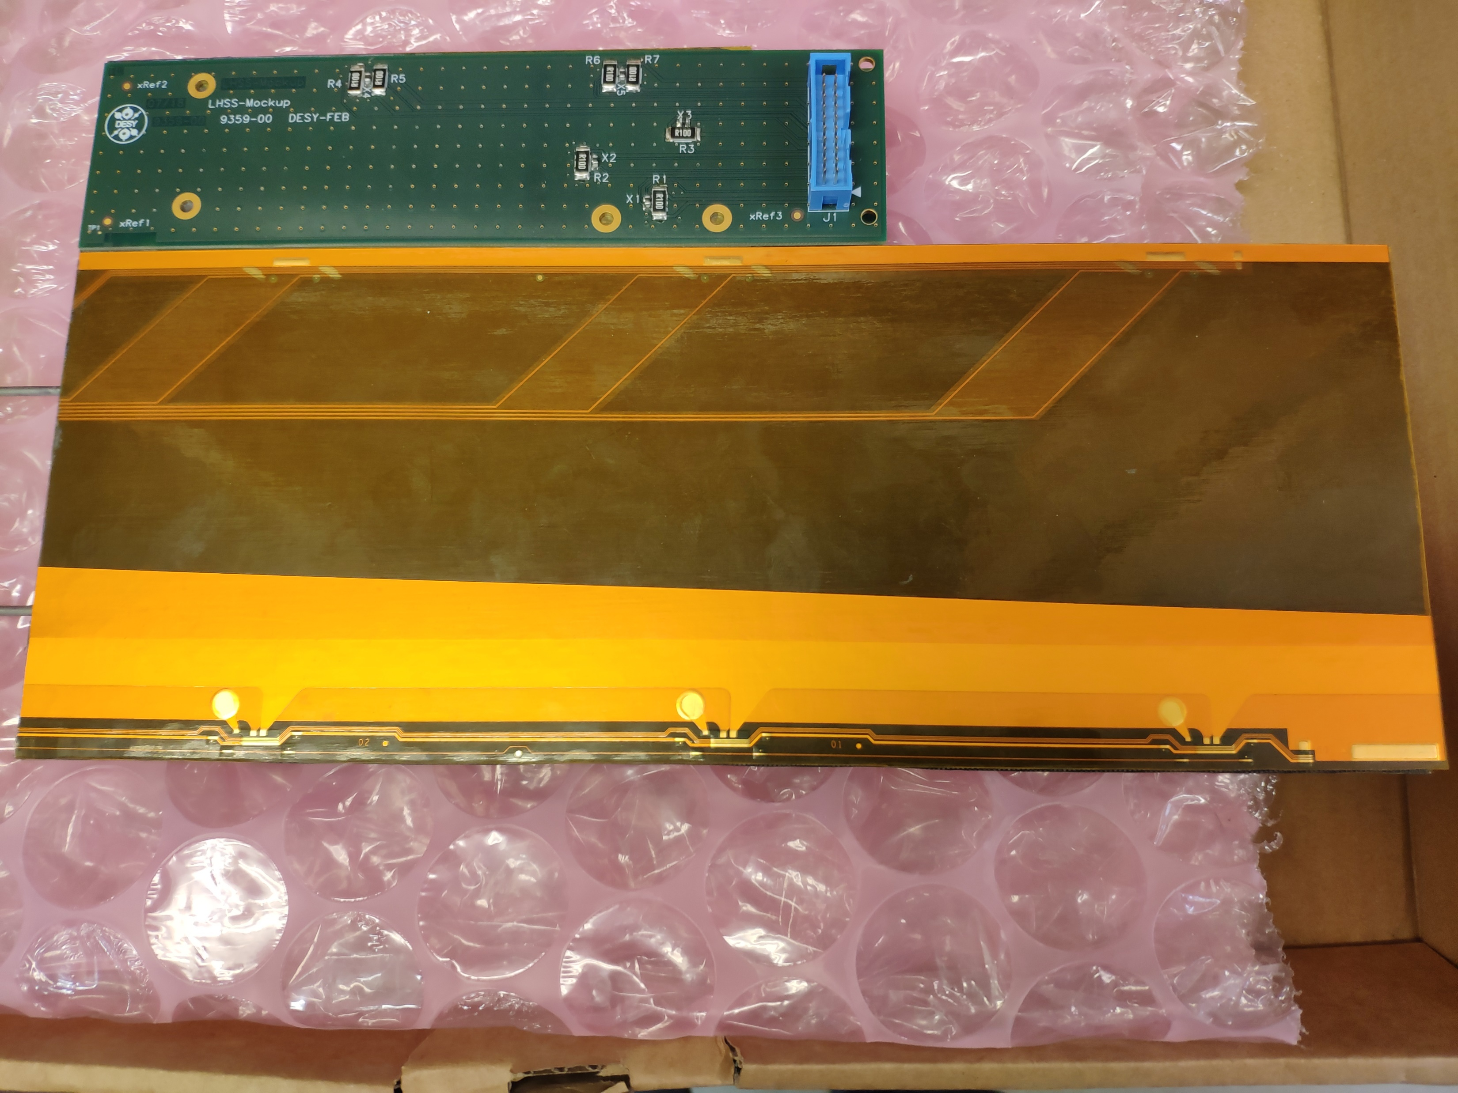
Mini stave with dummy PCB
Features: A 3-module long stave ~300 mm, design is similar to the normal 14-module stave
Two dummy PCBs glued on EOS card region
Seven resistors ( ~0.1 ohm) and five thermistors on each PCB
Resistors are used for simulating heat dissipation from chips on PCB
Objective: Do measurements using IR imaging and compare with FEA simulation

Slide 3
What is Finite Element Analysis (FEA)?
FEA is a simulation method first developed in 19th century which is now widely used in civil engineering and aerospace. FEA gives the prediction of how a part behaves under given conditions. For example, it offers numerical approach to heat diffusion problems governed by complicated partial differential equations.
Mesh, consisting of minions of fine elements, is the fundamental of FEA simulation. Each element is calculated separately and then combined together to give final result of a model.

Slide 4
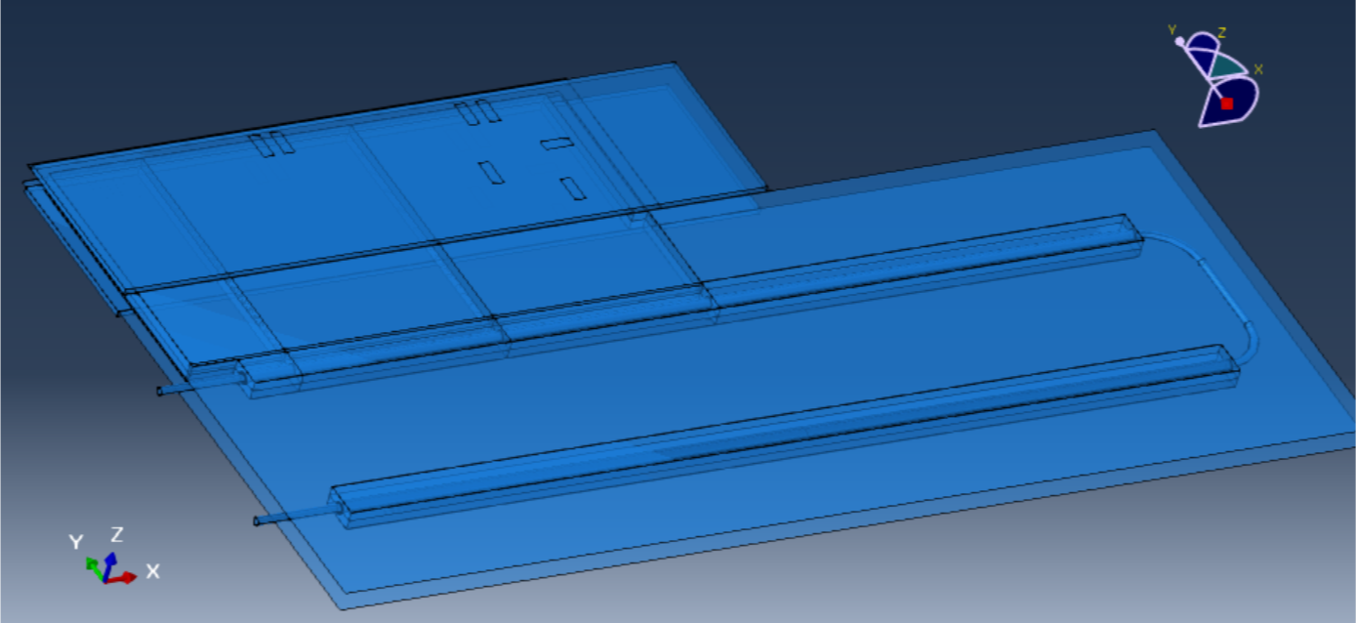
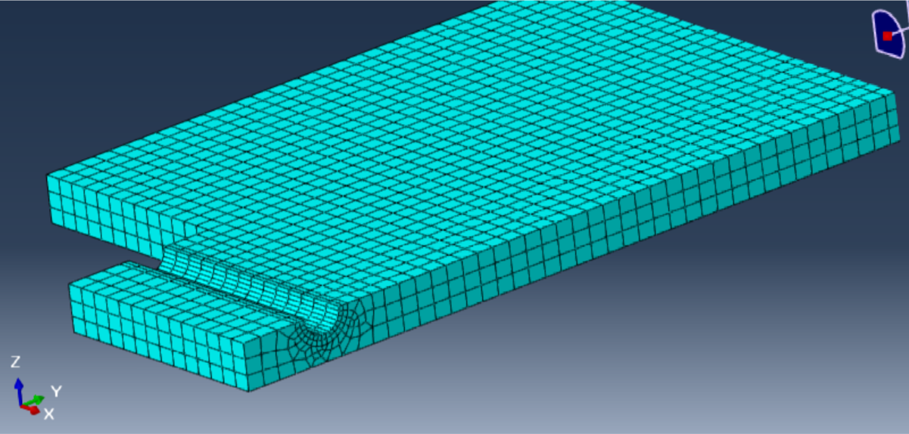
Mini stave Model
U-bend foam and bus tape currently are not included
One “meshed” EOS foam
Element size ~1mm³

Slide 5
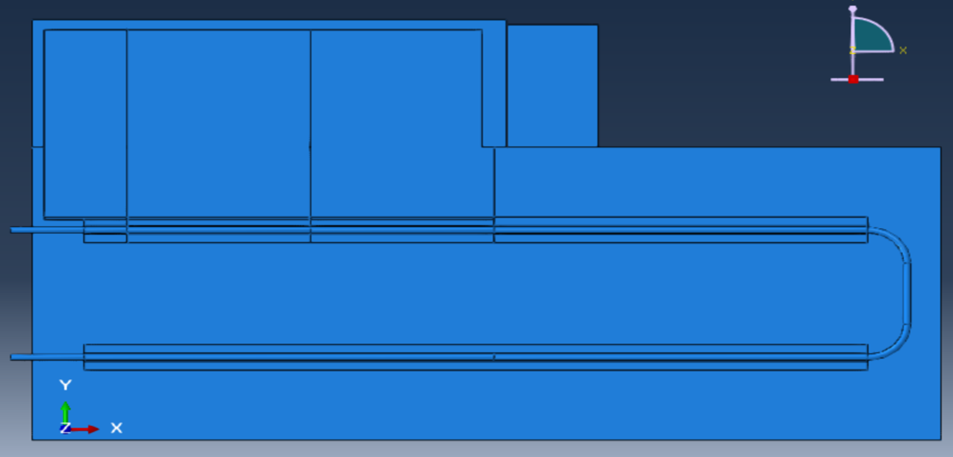
Mini stave Model
Parts are modeled individually then assembled together
EOS foam
Polyimide surface
PCB
L facing shell
Cooling pipe
Pipe foam
X-Y view of the mini stave model (upper parts not shown)

Slide 6
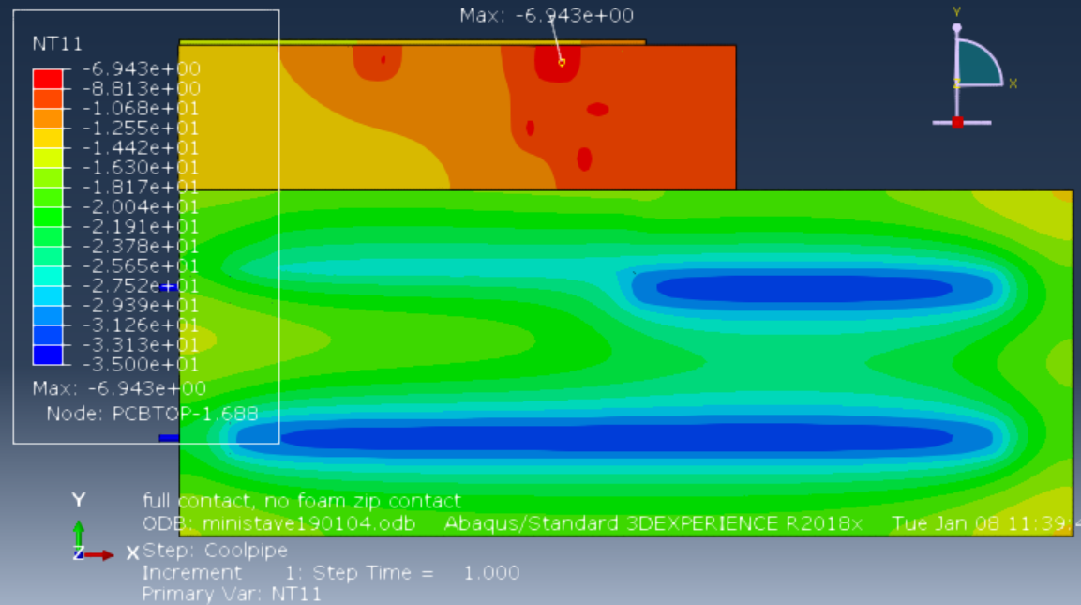
Mini stave surface temperature (master)
Ambient T at + 20C; surface to surface conductivity ${10}^{−5} W/(K∙mm2)$;
pipe inner surface T at -35C; load on PCB resistors (in backup);

Slide 7
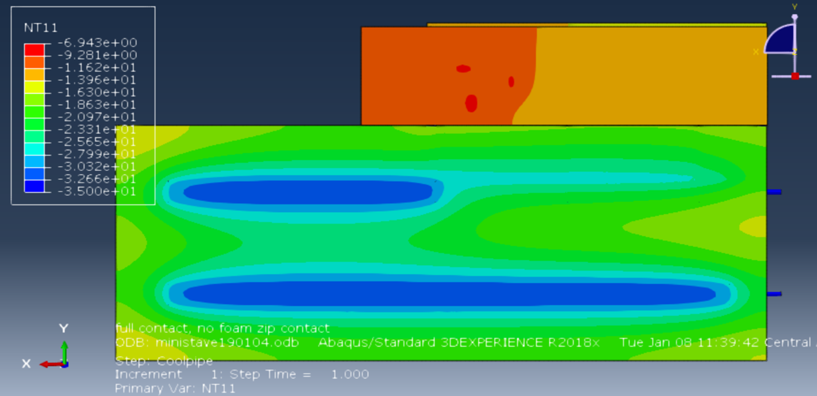
Mini stave surface temperature (slave)

Slide 8
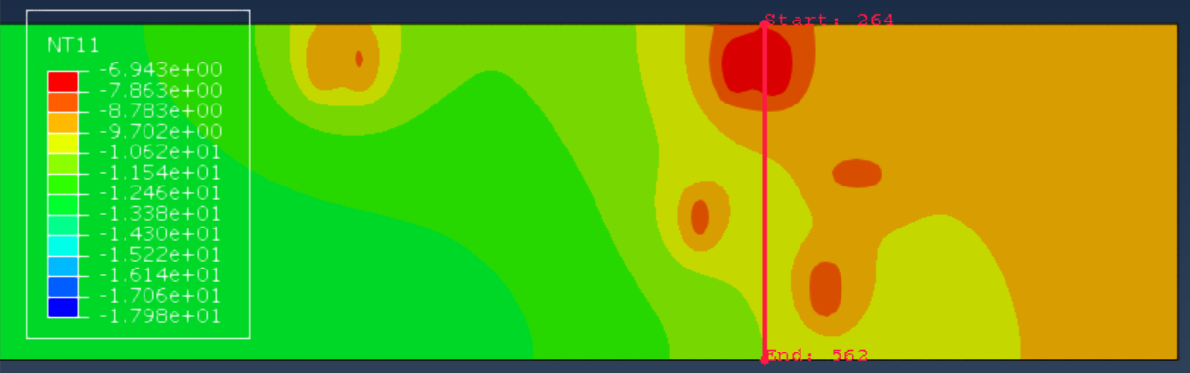
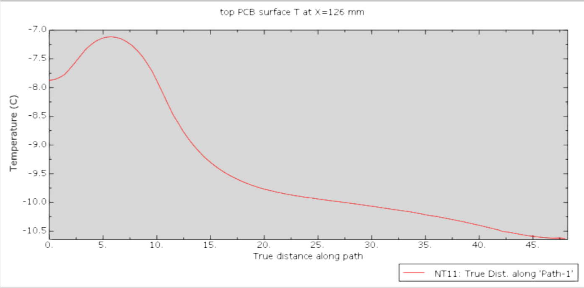
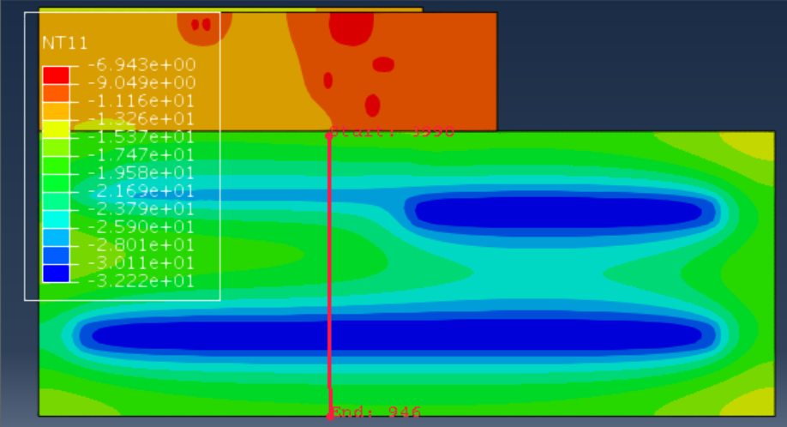
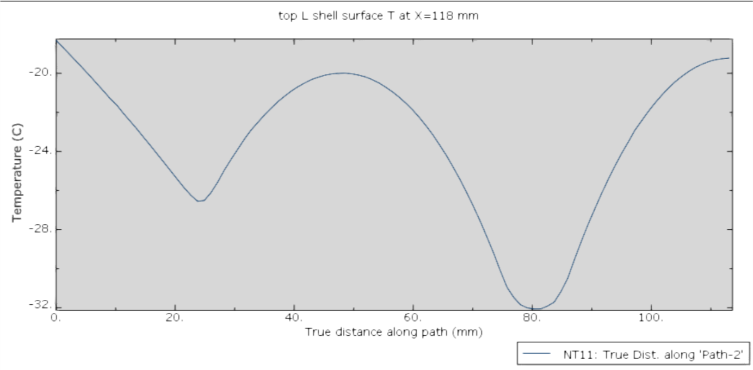
Surface temperature across stave
Top PCB surface T
Top L shell surface T

Slide 9
Next:
Compare the FEA simulation results with mini stave temperature measurement.

Slide 10

Back up : Load for PCB resistors
For LHSS & LHSM side:
$R_{1}$ , $R_{2}$each 0.169W(0.13V, 1.3A) ${ R}_{3}$ 0.1W(0.1V, 1A)
For LHSS Only:
$R_{4}$ // $R_{5}$ ; $R_{6}$ // $R_{7}$ each 0.144W(0.12V,1.2A)

