Slide 1
QT Mini stave PCB FEA
2019/02/28
Shuaiyan

Slide 2
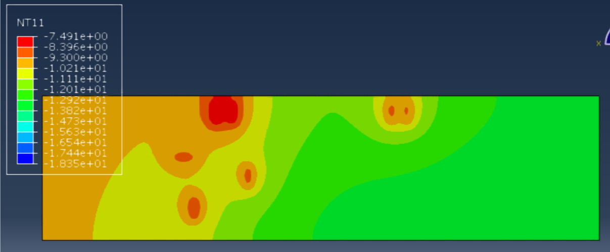
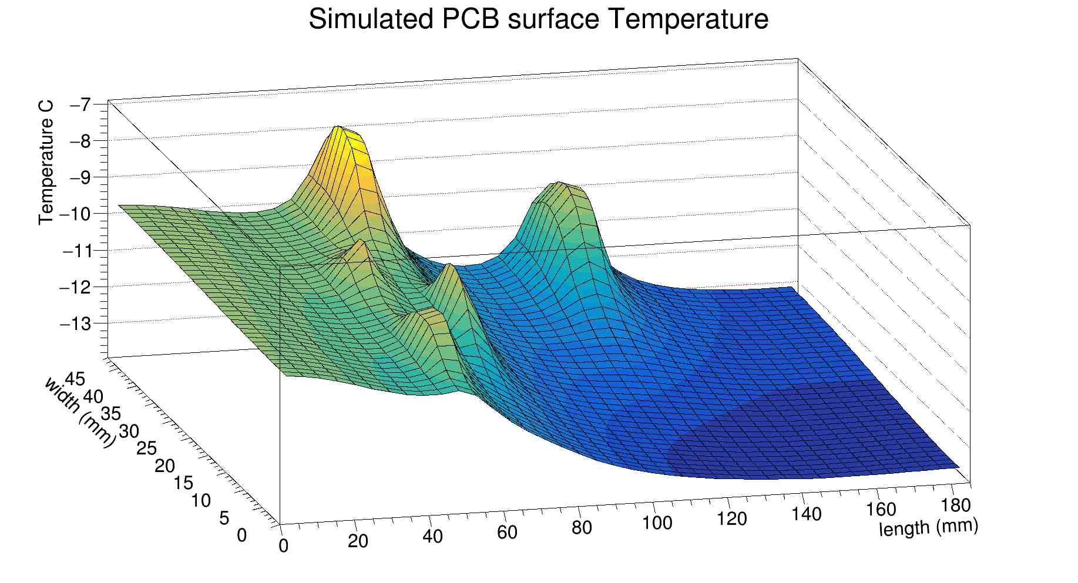
Plot FEA PCB surface Temperature
Plot in ROOT using data from Simulation

Slide 3
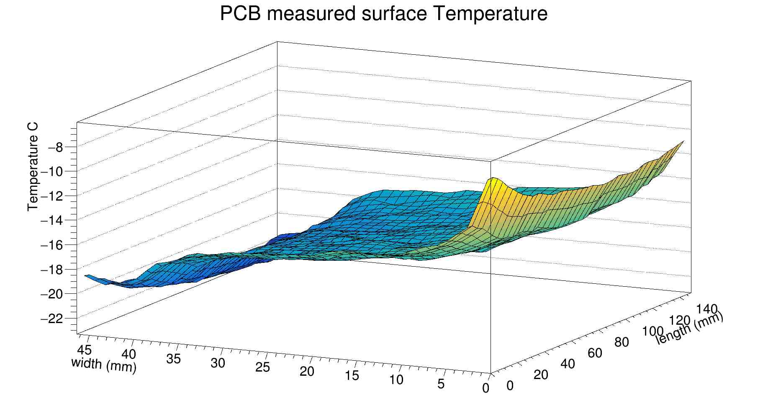
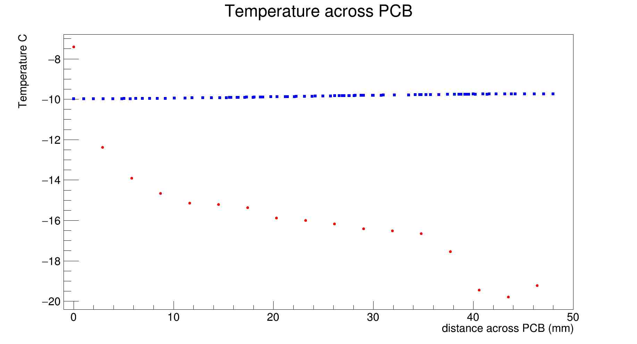
Pixel Length:
Simulation: ~1mm
Measured: ~2.5mm length ~3.5mm width
Stave 6 EOS region surface T from previous measurement

Slide 4
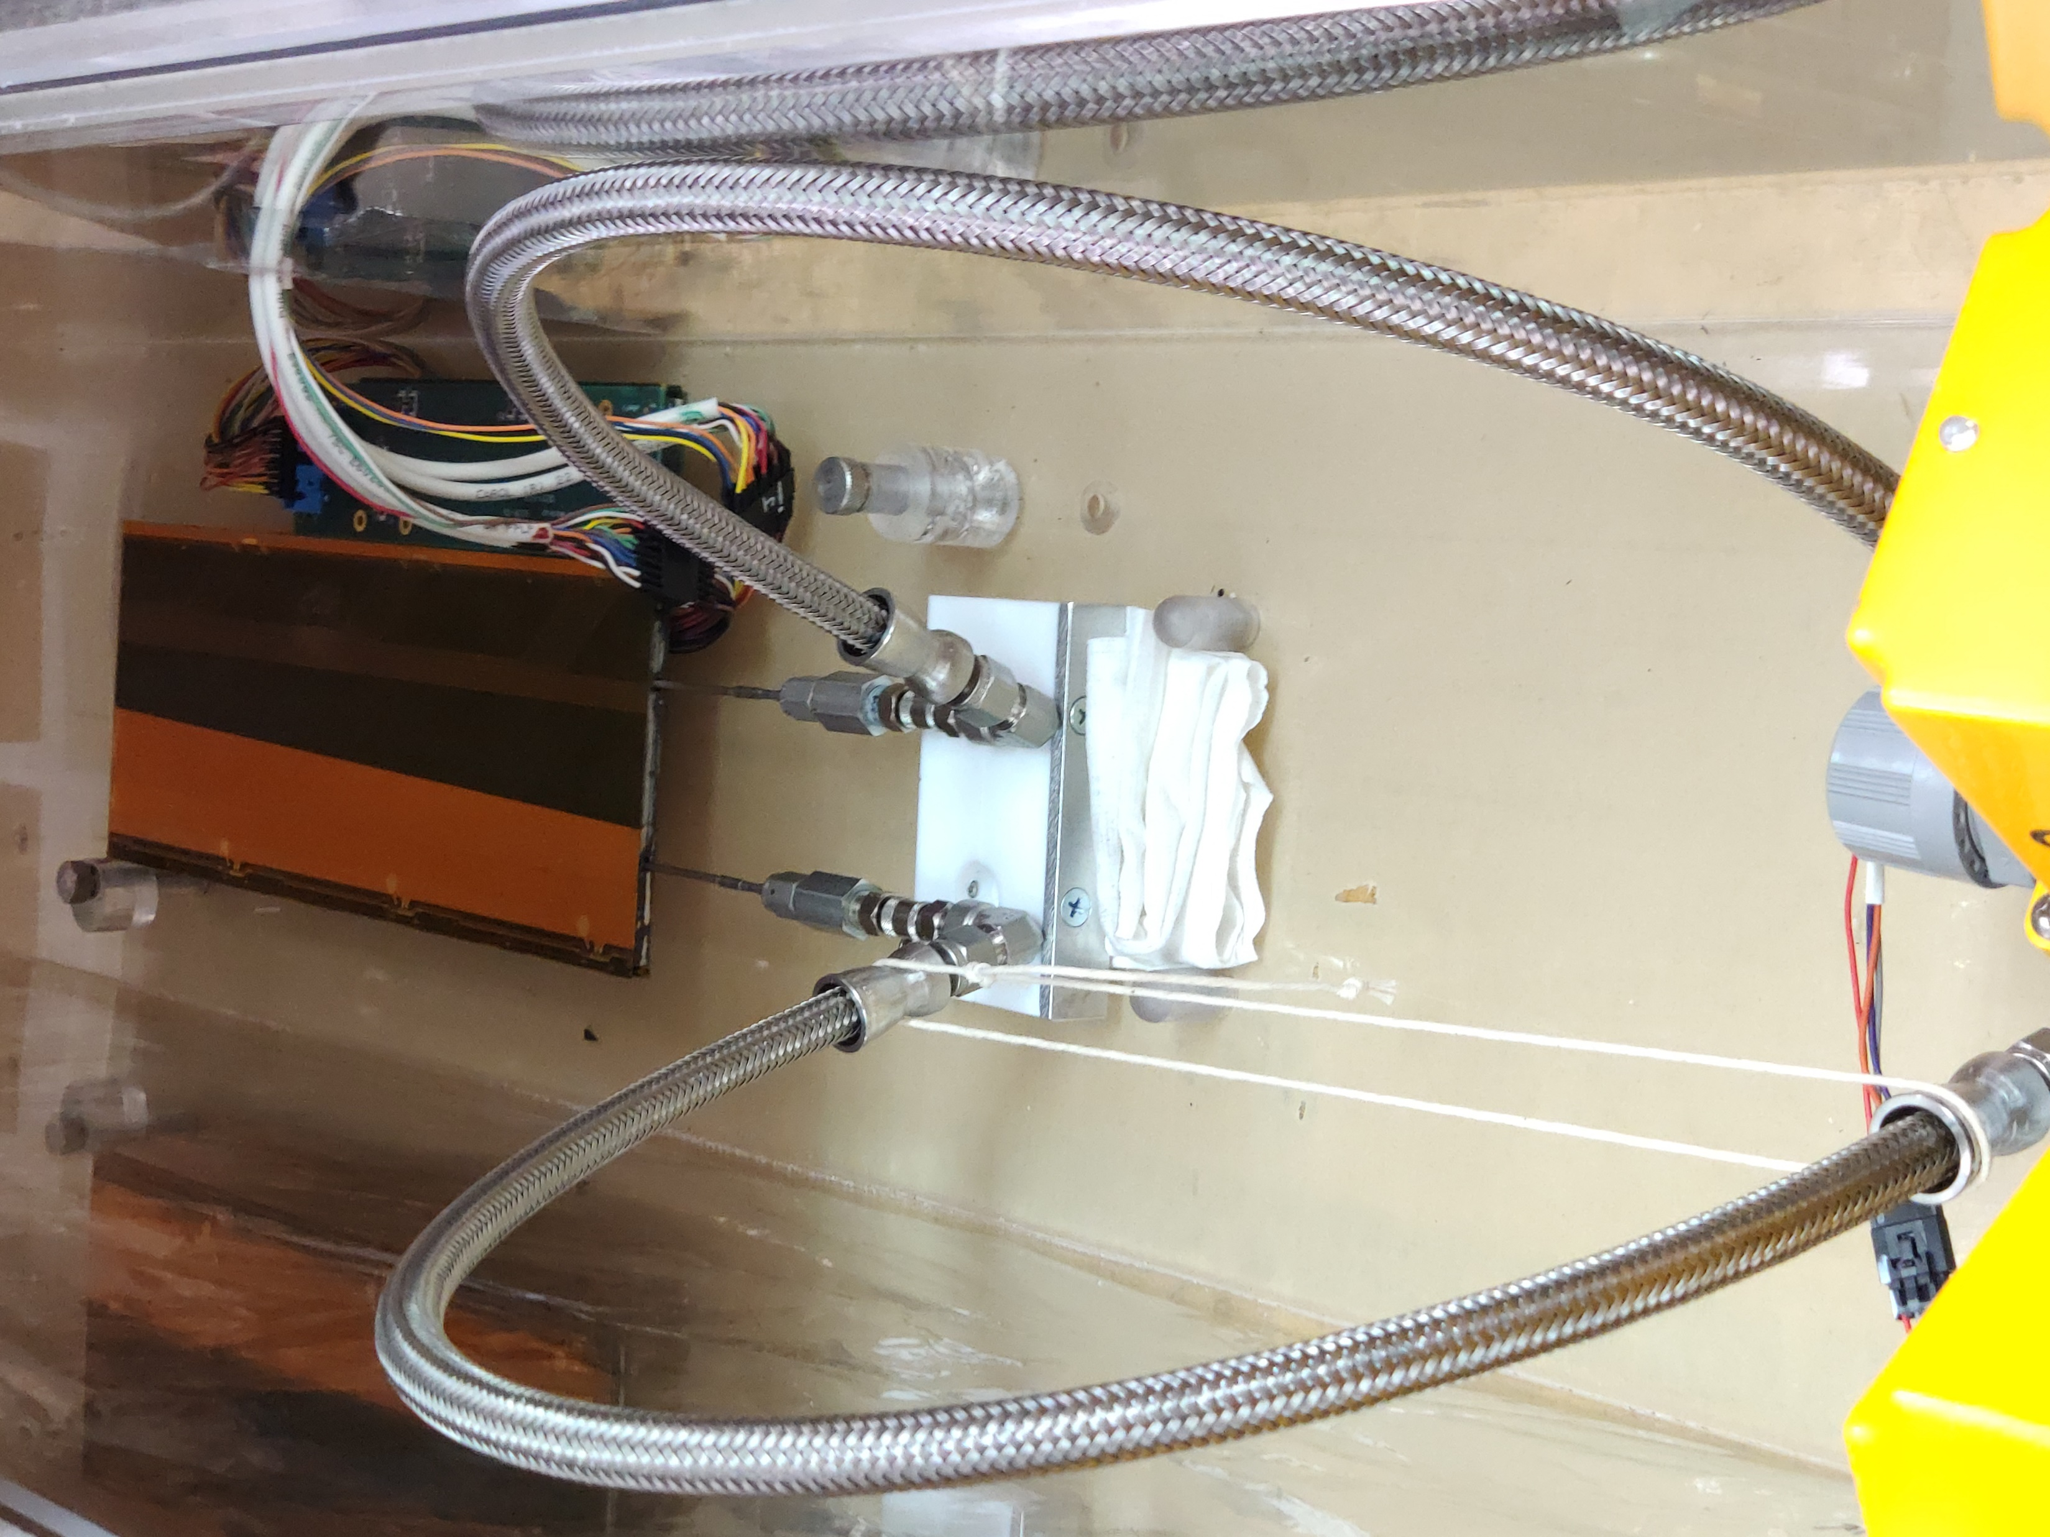
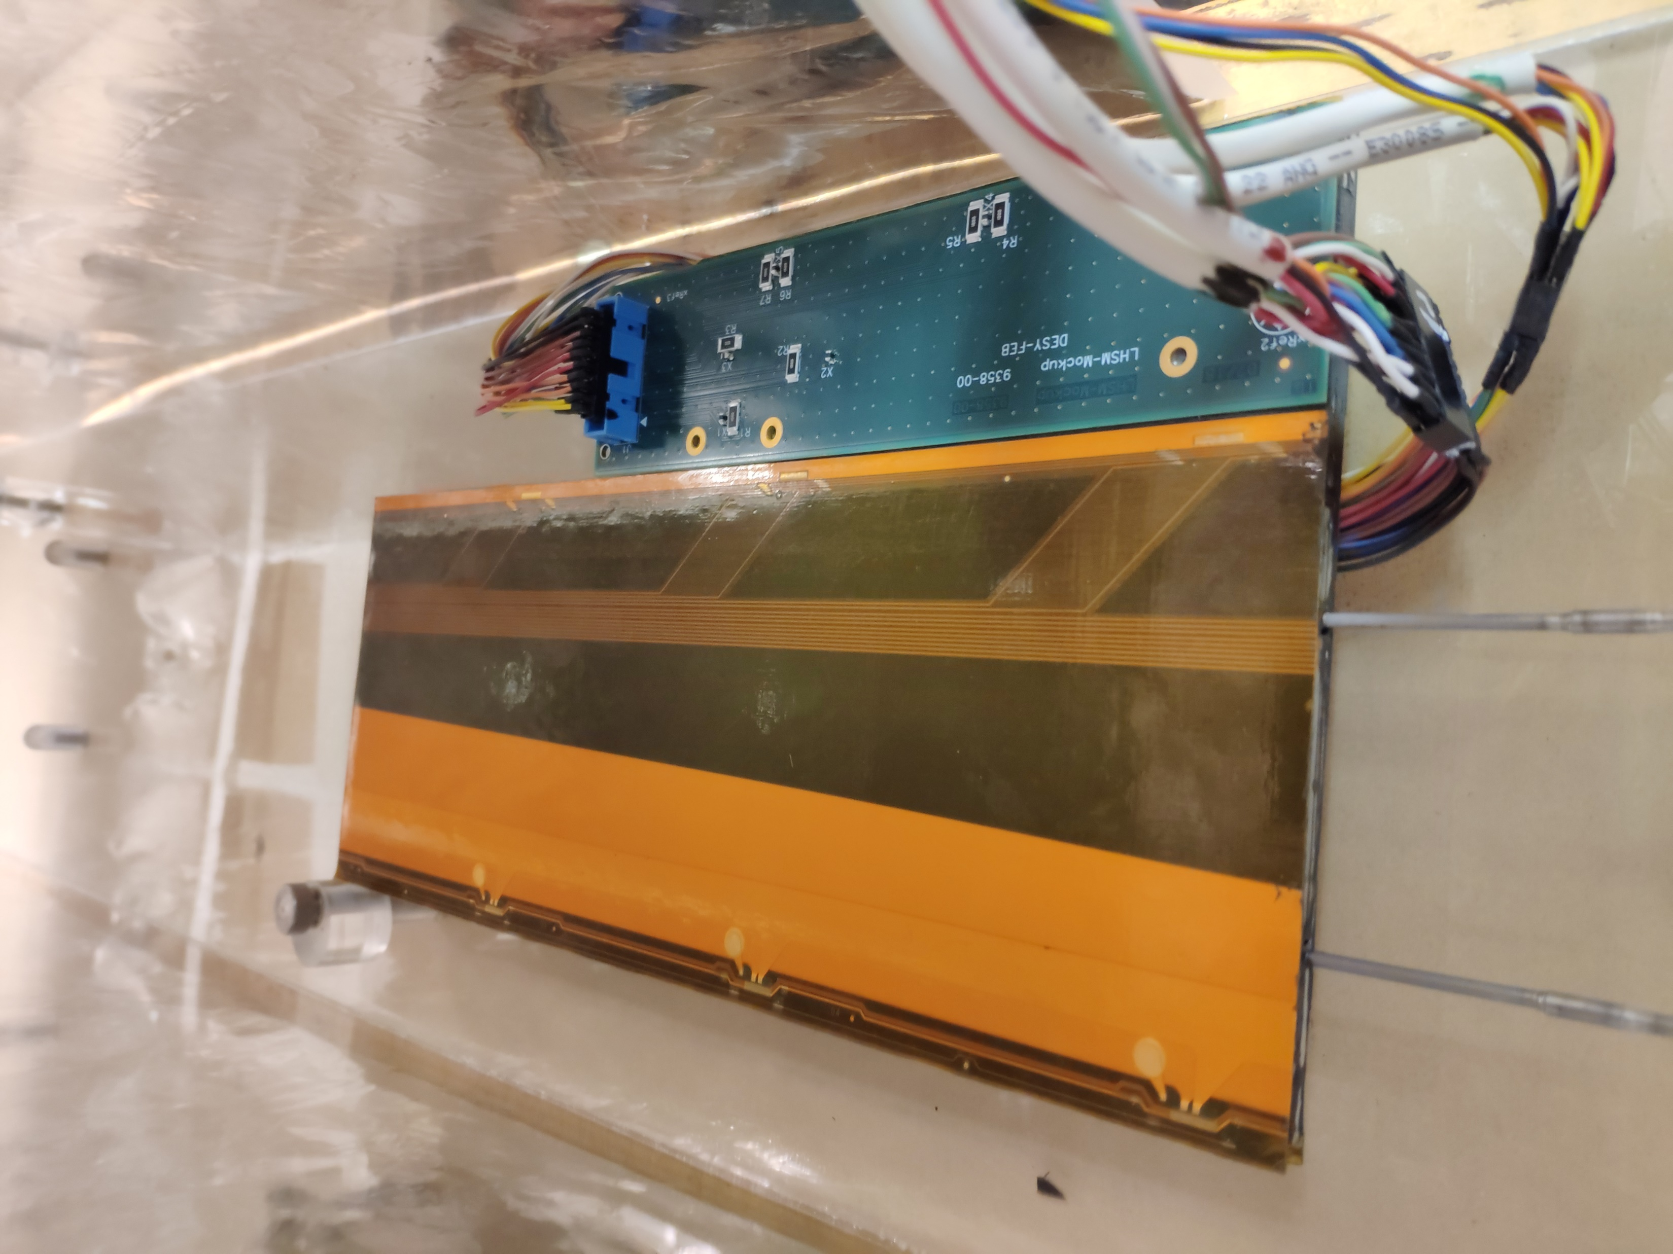
Current Setup
String is used for keeping stave horizontal

