Slide 1
Mini stave FEA
Shuaiyan
2019/03/14

Slide 2
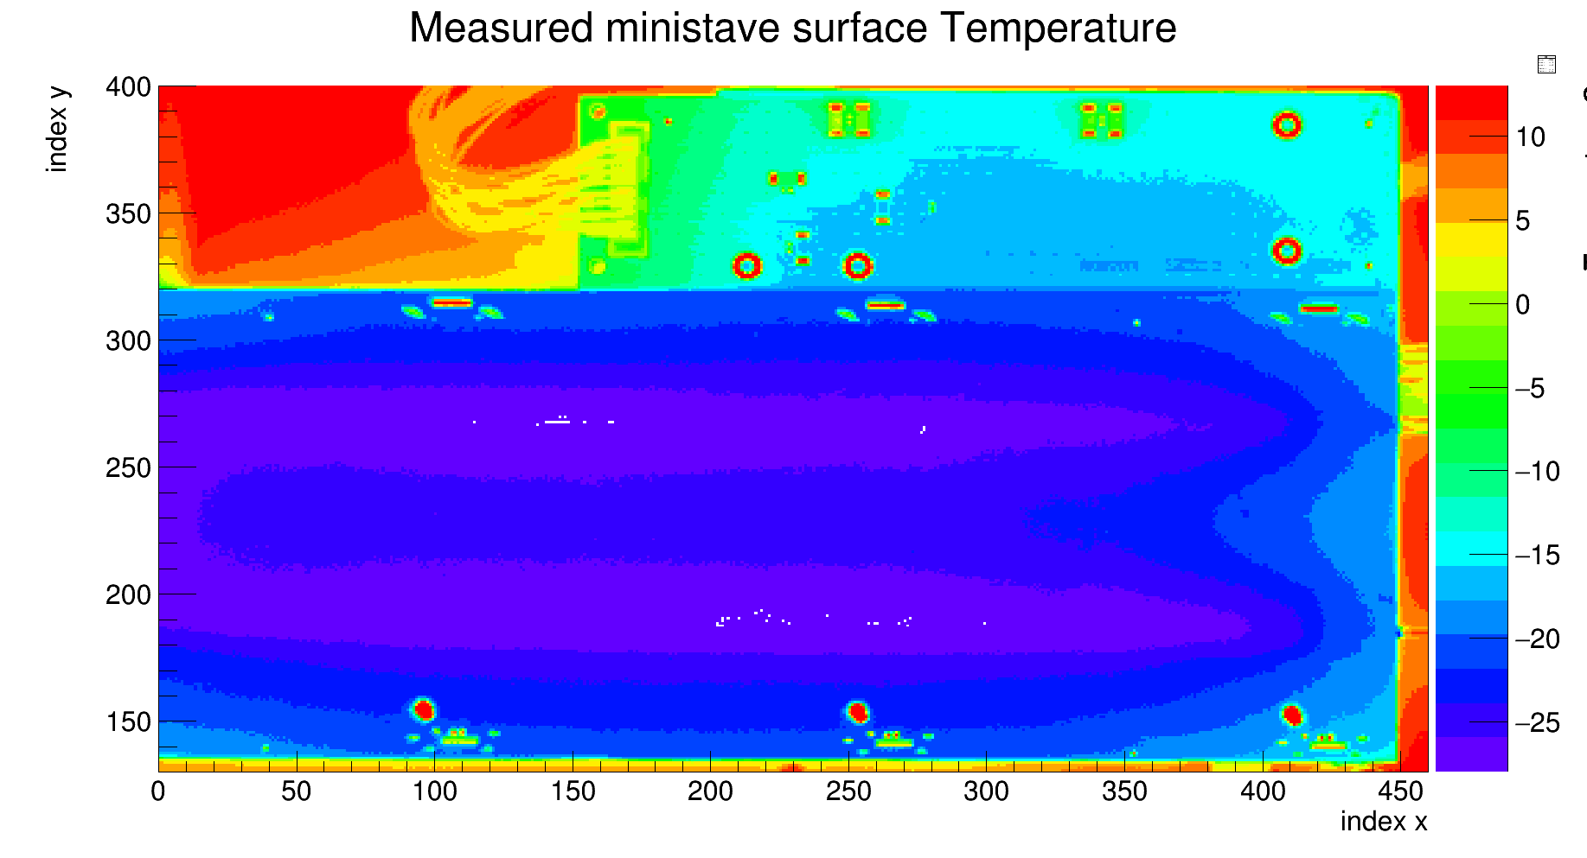
Update
Take measurement using small angle lens, pixel length~0.6 mm
Chiller set Temperature -40 C, bypass inlet -33.3 C, outlet -31.0 C
Powered resisters: LHSM R4//R5 , R6//R7 : ~0.333W each ; R3: ~0.171W
Add holes on PCB in FEA model, element size~0.6 mm
Data taken with little air flow
Small dots in plot correspond to tiny PCB holes, diameter~0.3 mm

Slide 3
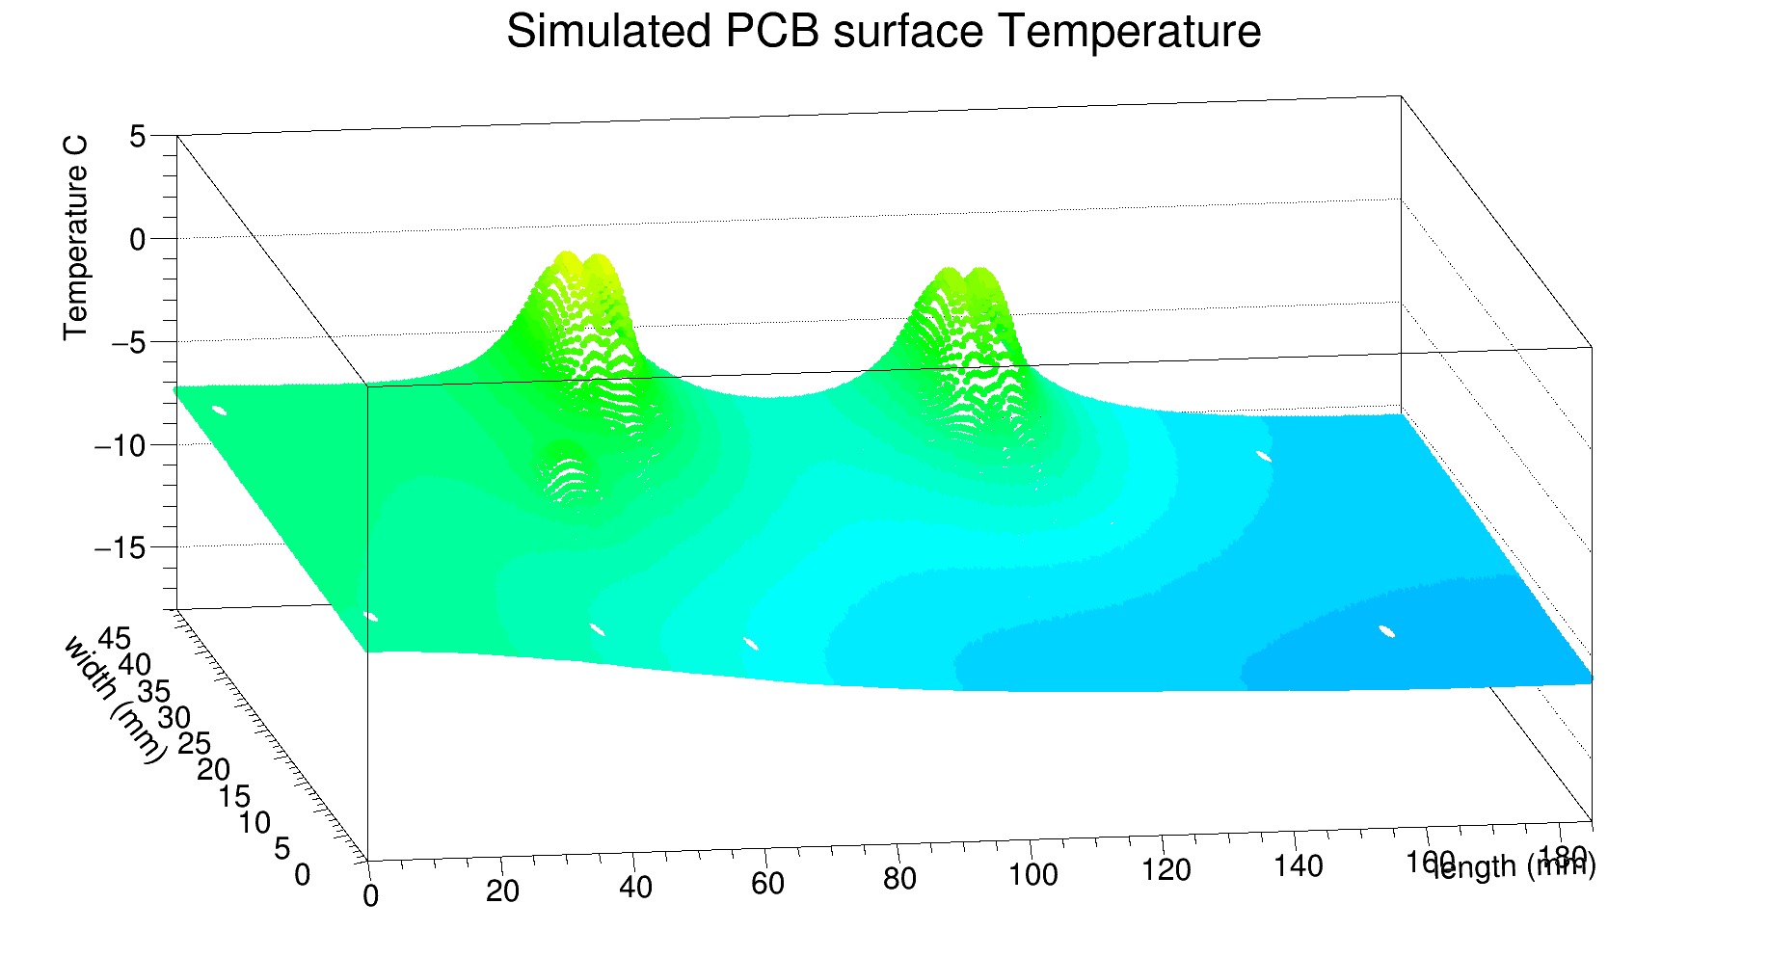
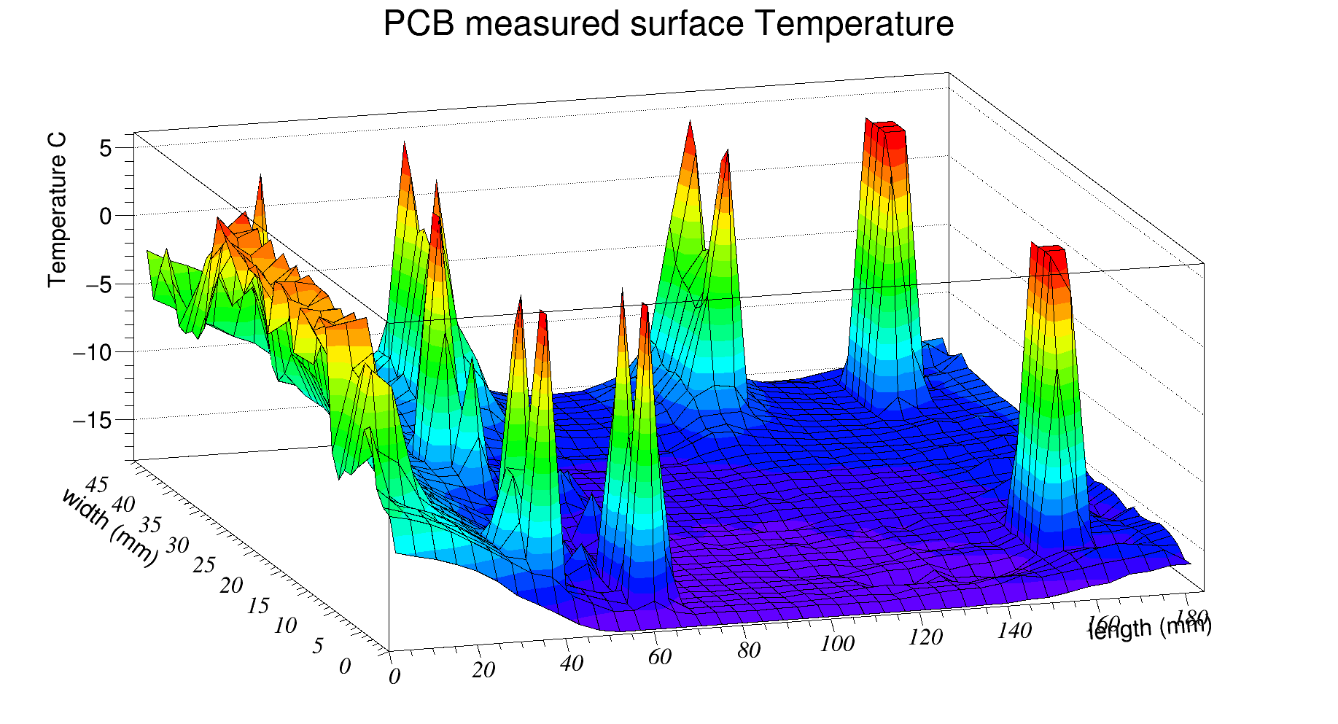
PCB region
Model set PCB all glued to EOS
Some peaks due to low emissivity of PCB holes and soldering points
PCB is partially glued to EOS

Slide 4
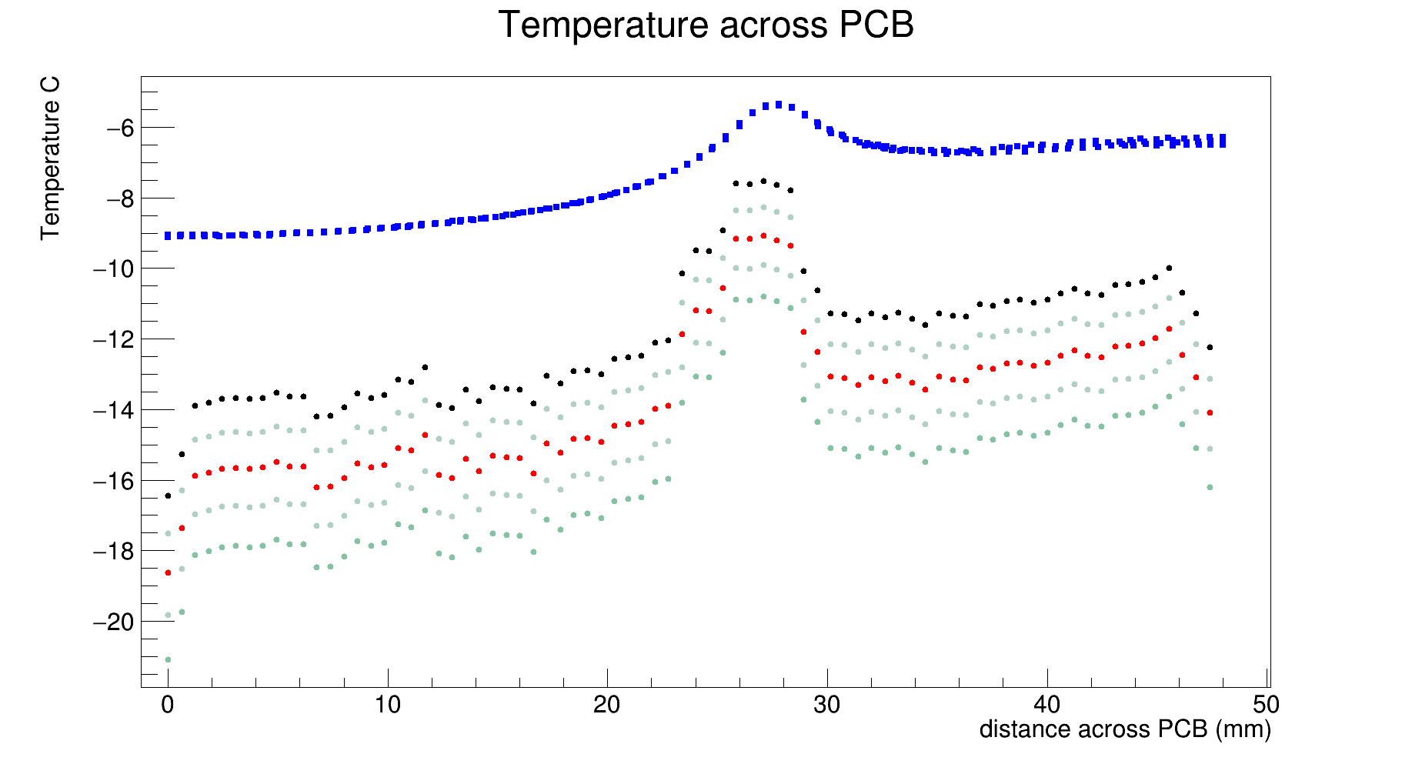
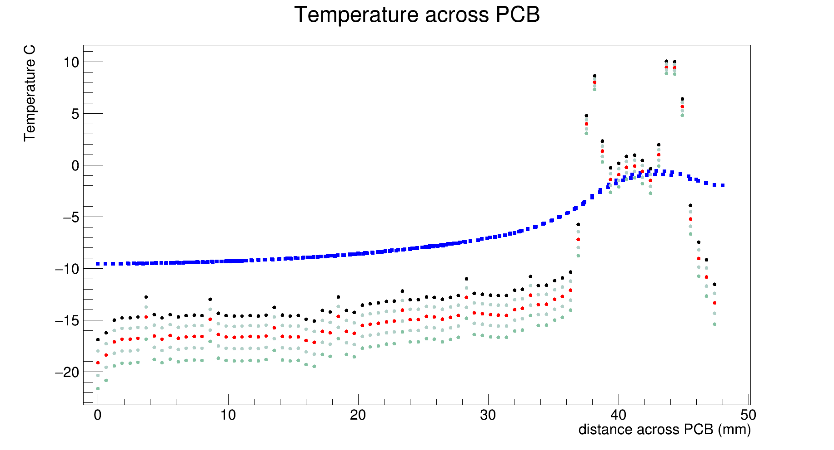
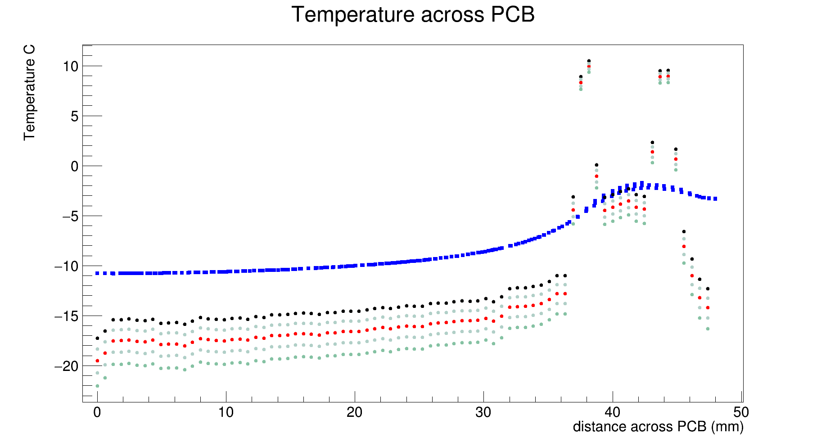
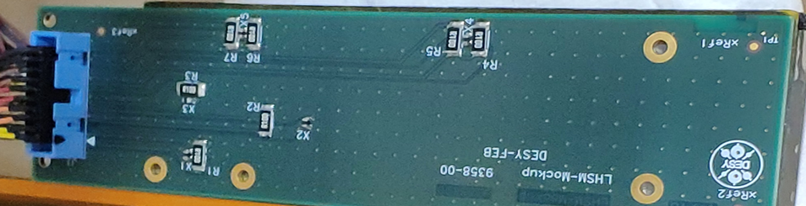
Temperature across PCB for different emissivity
Emissivity: black curve 0.96; red 0.92; deep green 0.88.
FEA simulation: blue curve
At length~46mm, passes R3
At length~57mm, passes R7
At length~115mm, passes R5
Stave ambient contact may not be modeled accurately

Slide 5
Next:
Modify model contact regions
Power resistors on both sides
Test with different cooling temperature

