Slide 1




V. Gadelshin¹, V. Barozier², B. Marsh², V. Fedosseev²
MELISSA:
MEDICIS Laser Ion Source Setup
¹Institute of Physics, University of Mainz, Germany
²EN department, CERN, Geneva, Switzerland

Slide 2
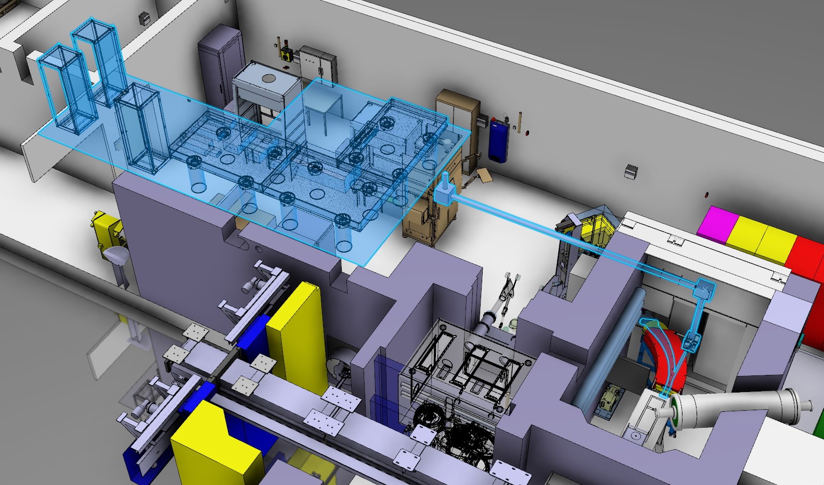
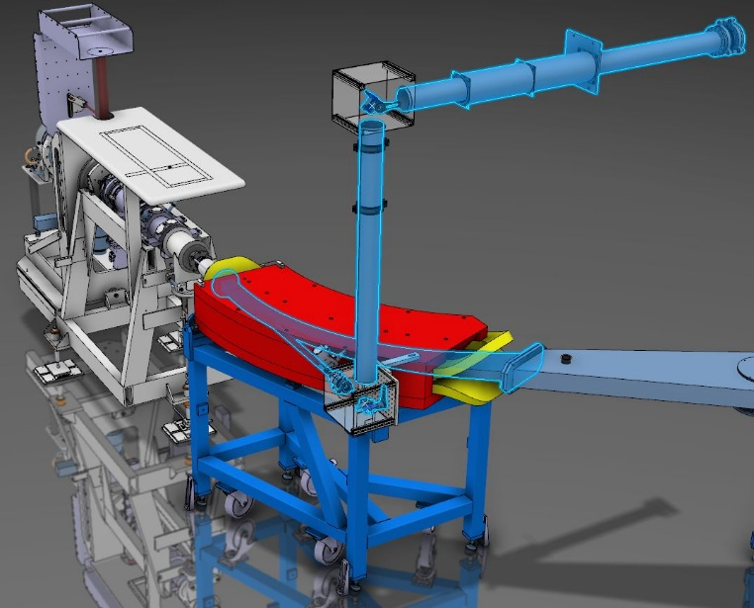


MEDICIS Laser Ion Source: What? Where? How?
Laser Lab
1st floor
Radiochemical Lab
Ground floor
Front-end
Electromagnet
Off-line Mass Separator
V.M. Gadelshin | 2nd MEDICIS Collaboration Meeting, CERN (03.10.2018)

Slide 3
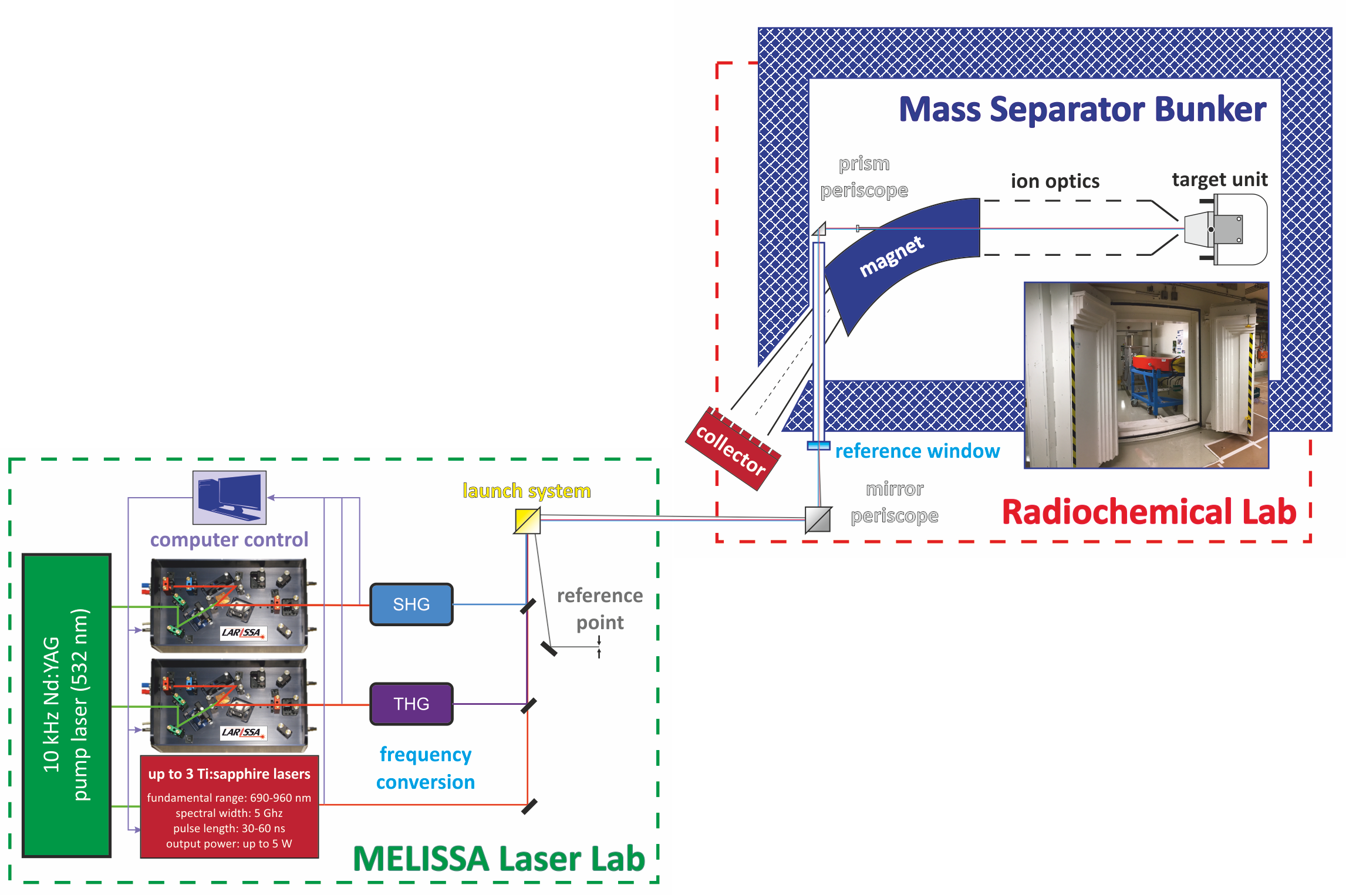
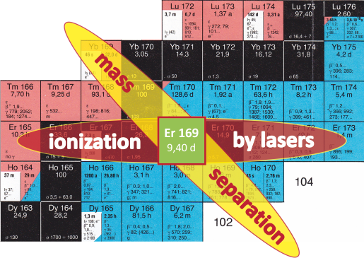
Mass Separation & Laser Ionization
  Merits of the use of the Laser Ion Source:
  Element selective ionization – excellent ion beam purity;
  Highly efficient ionization process – faster extraction of the desired radioisotopes;
  Decrease of the production time – no need to wait till the decay of contaminants;
  Lower work temperature of the ion source – less contaminations in a final product;
  High specific activity products;
  Unique set of radionuclides: Tb, Er, Ac, Sc, Lu…
auto-ionizing state
ionization potential
2nd excited state
1st excited state
ground state

Slide 4
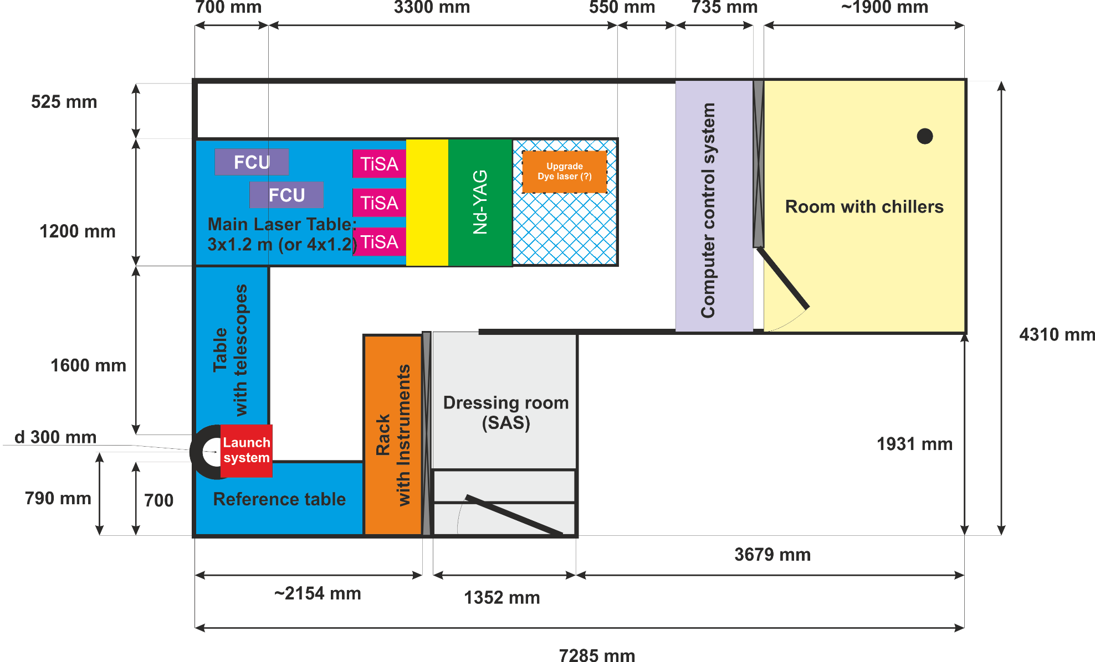
Laser Lab – Design Sketch
V.M. Gadelshin | 2nd MEDICIS Collaboration Meeting, CERN (03.10.2018)

Slide 5
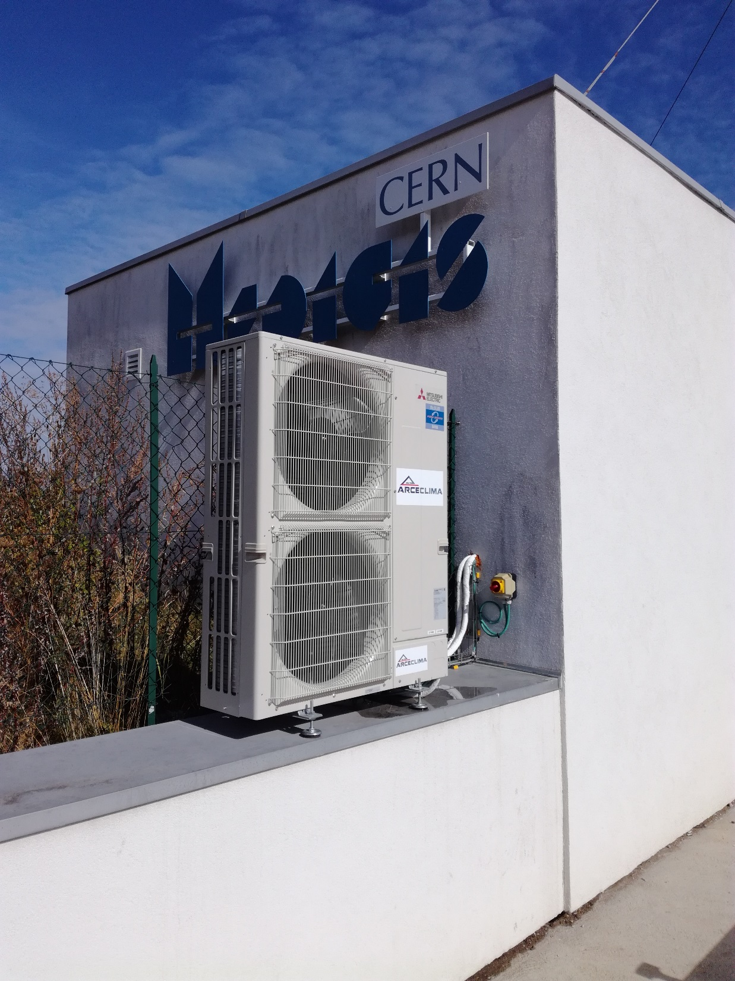
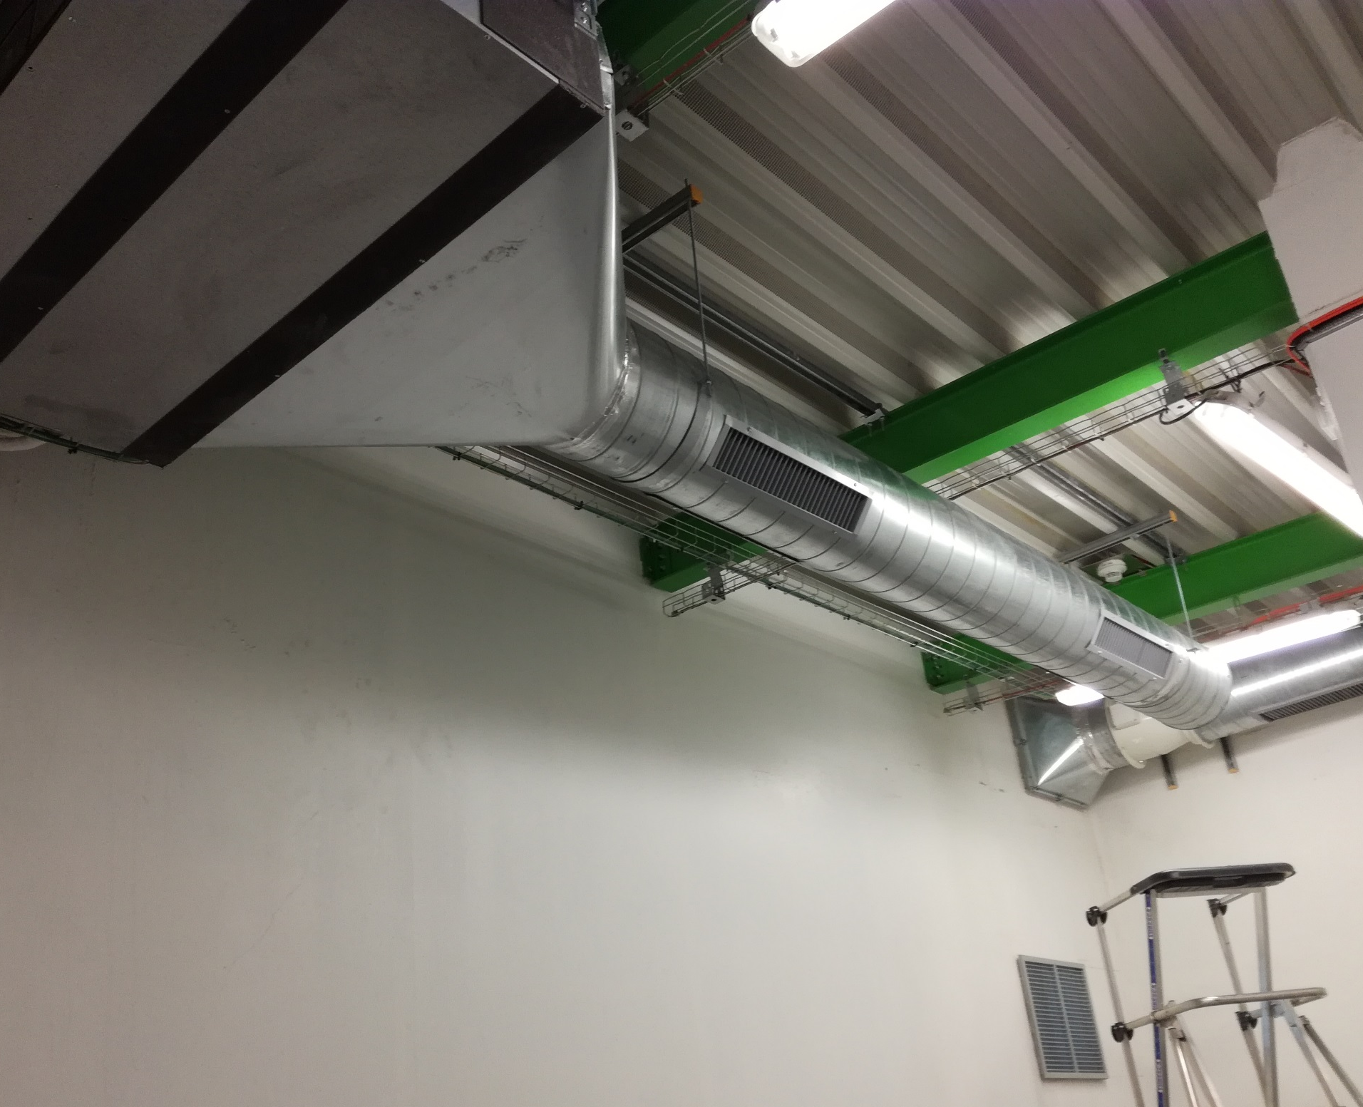
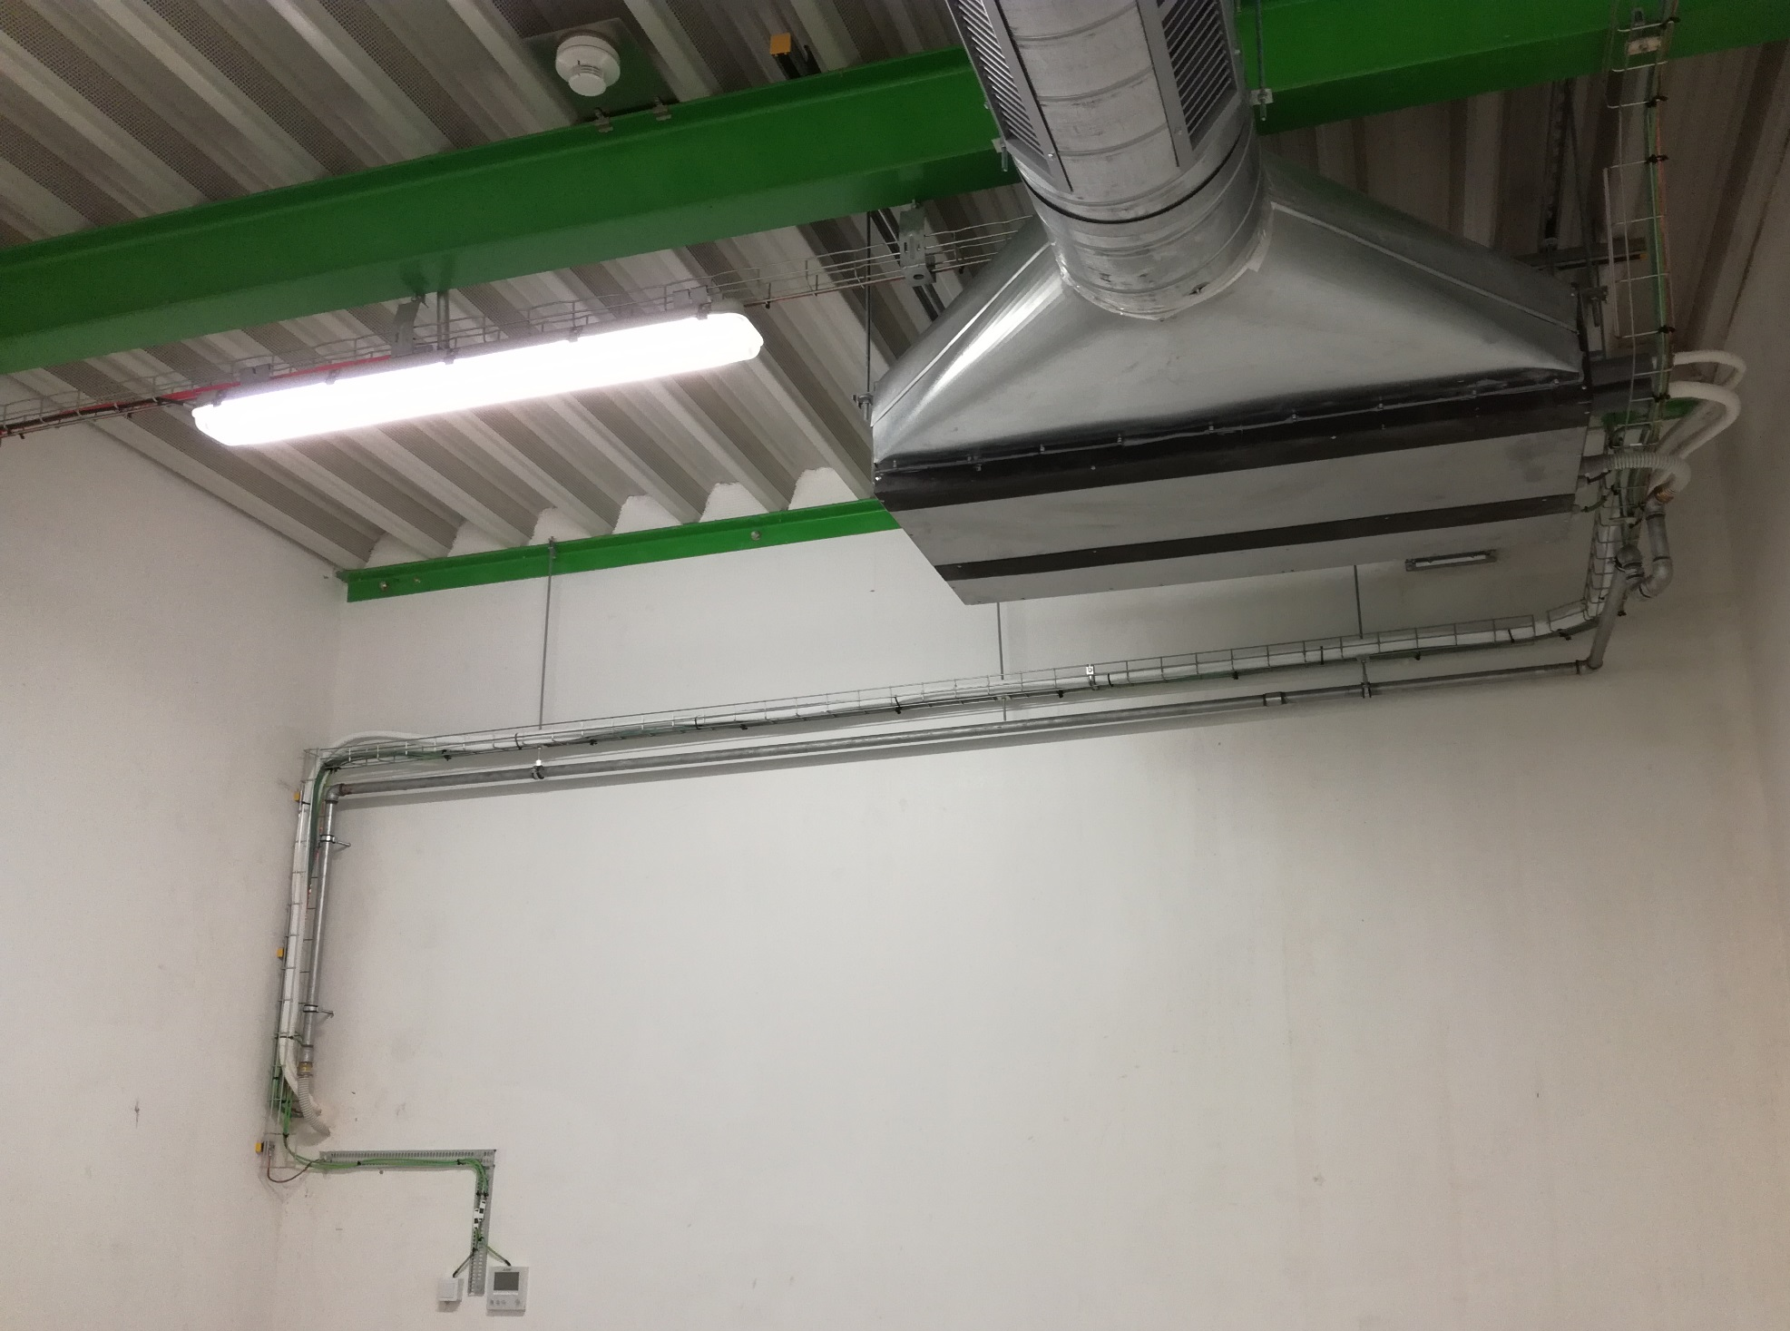
MELISSA: Laser Lab Status
Air conditioning and ventilation
Installed in June-July 2018
V.M. Gadelshin | 2nd MEDICIS Collaboration Meeting, CERN (03.10.2018)

Slide 6
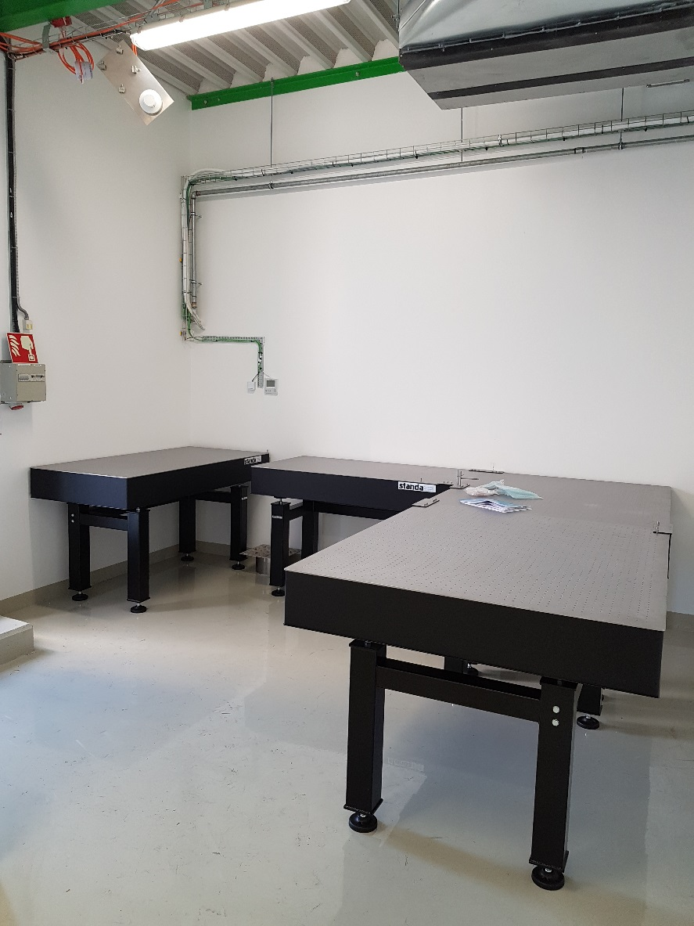
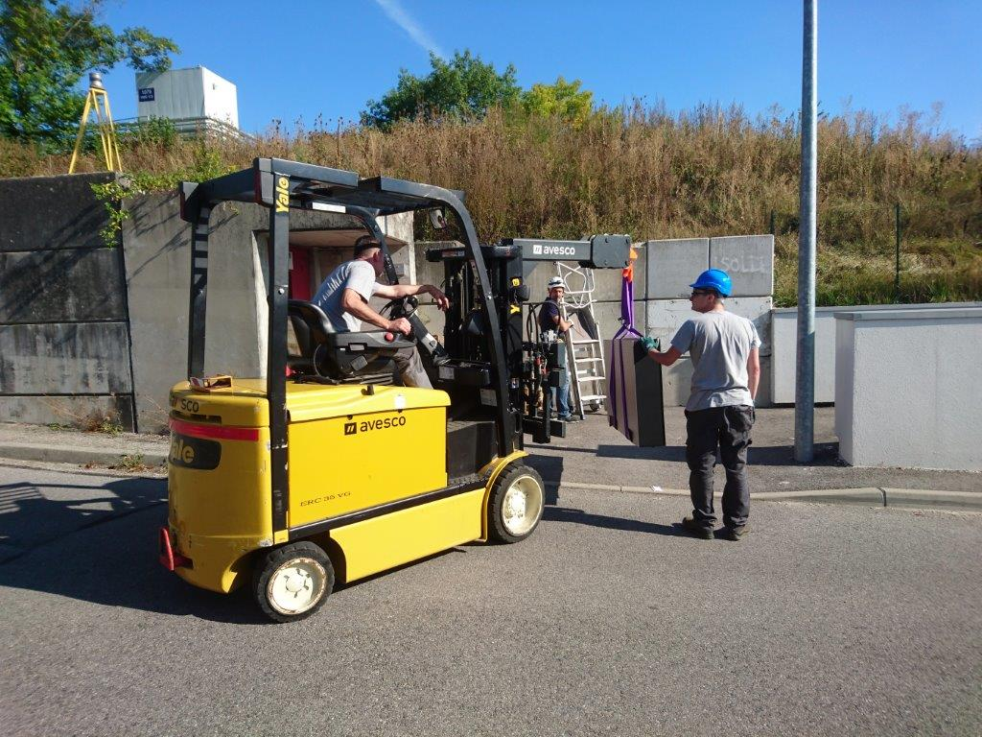
MELISSA: Laser Lab Status
Optical Tables
Refurbishing of walls and floor in August
Delivered to CERN in August
Installed in September
V.M. Gadelshin | 2nd MEDICIS Collaboration Meeting, CERN (03.10.2018)

Slide 7
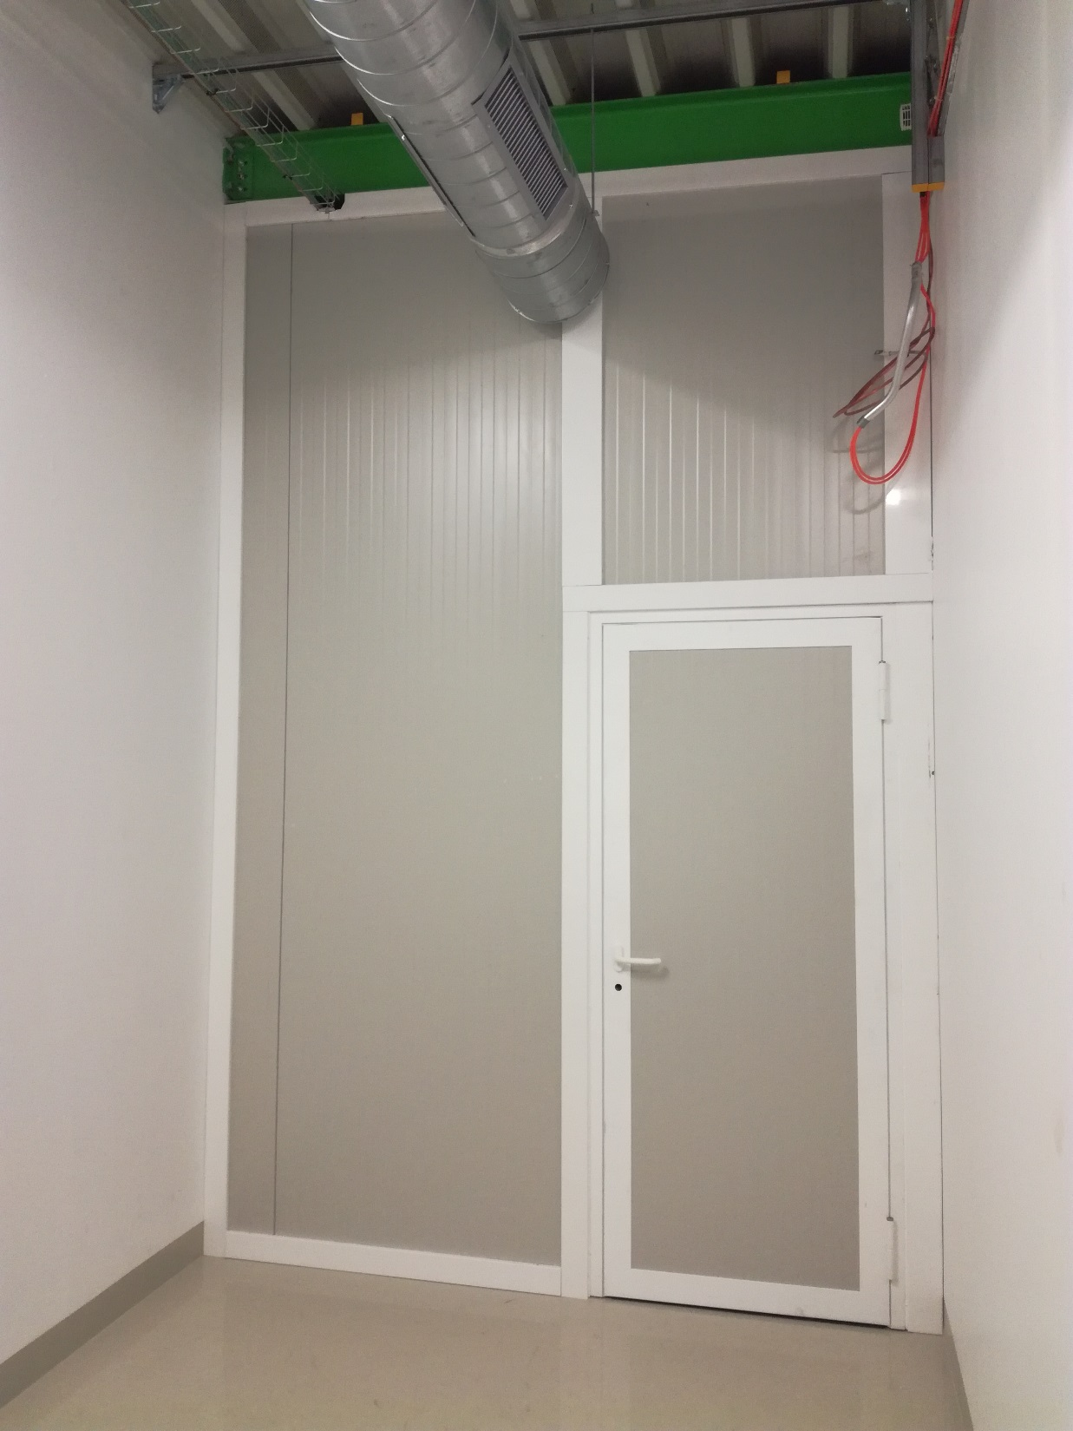
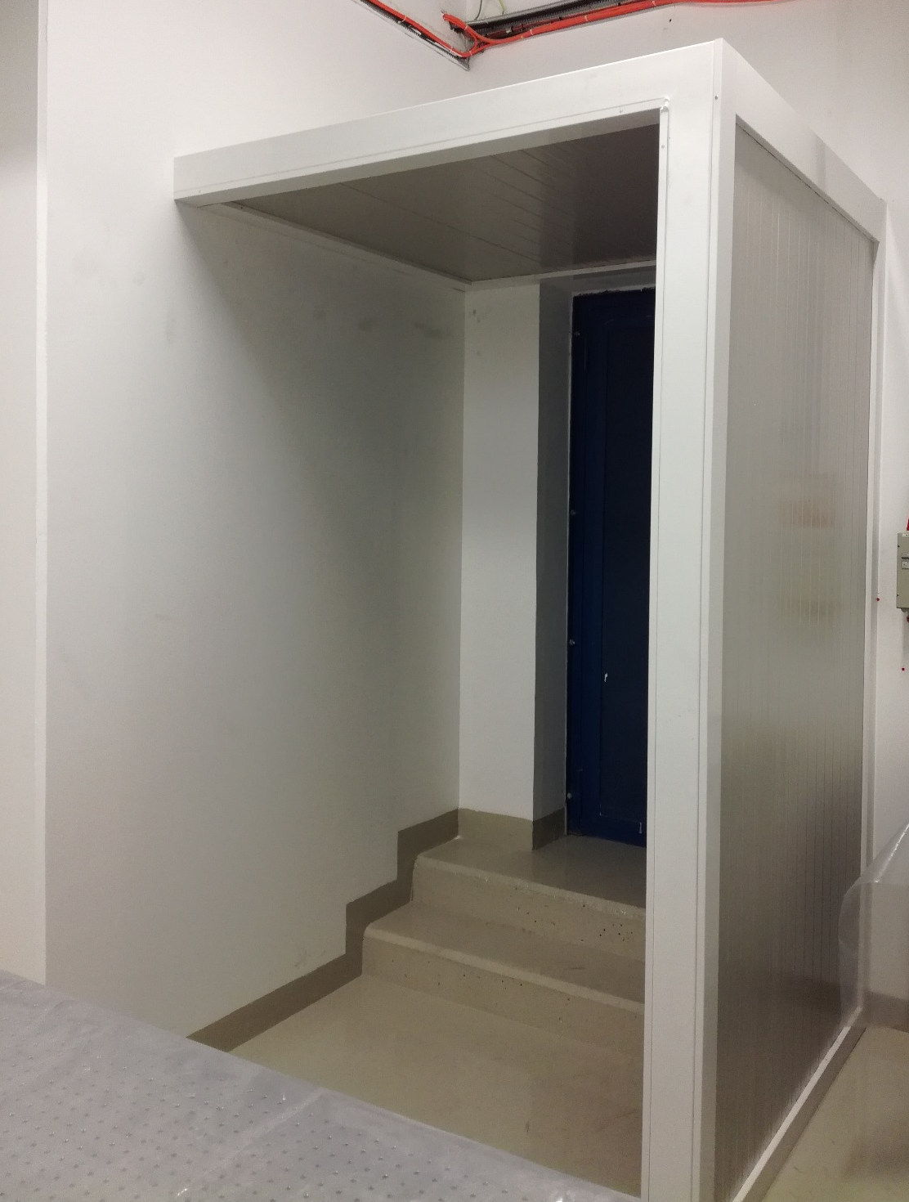
MELISSA: Laser Lab Status
Chiller room and SAS
Constructed in September
V.M. Gadelshin | 2nd MEDICIS Collaboration Meeting, CERN (03.10.2018)

Slide 8
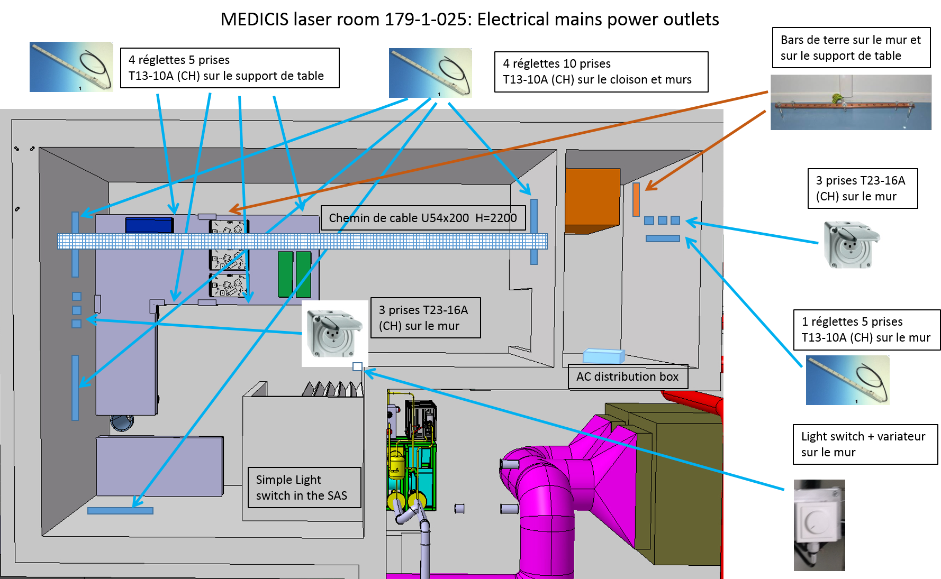
MELISSA: Laser Lab Status
Electrical network, grounding
V.M. Gadelshin | 2nd MEDICIS Collaboration Meeting, CERN (03.10.2018)

Slide 9
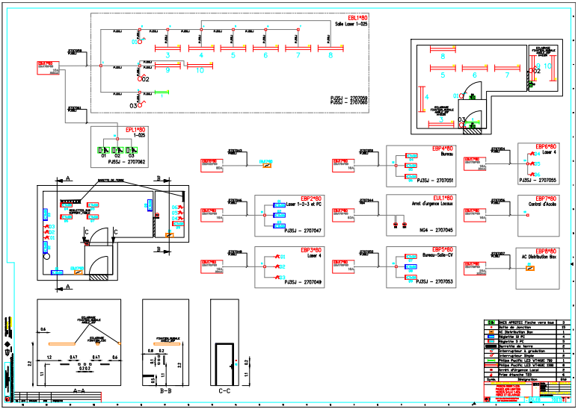
MELISSA: Laser Lab Status
Electrical network, grounding
Work started today
To be finished in October
V.M. Gadelshin | 2nd MEDICIS Collaboration Meeting, CERN (03.10.2018)

Slide 10
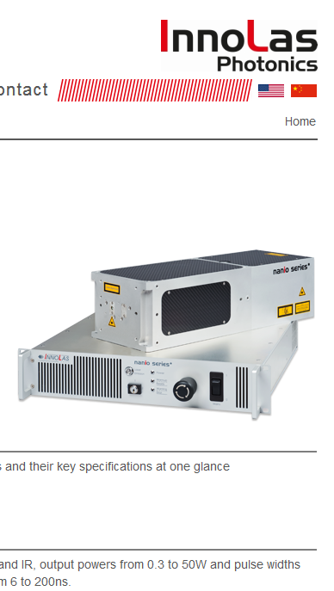
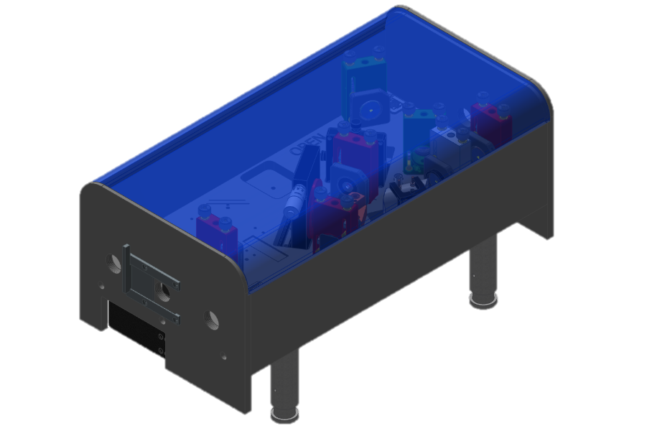
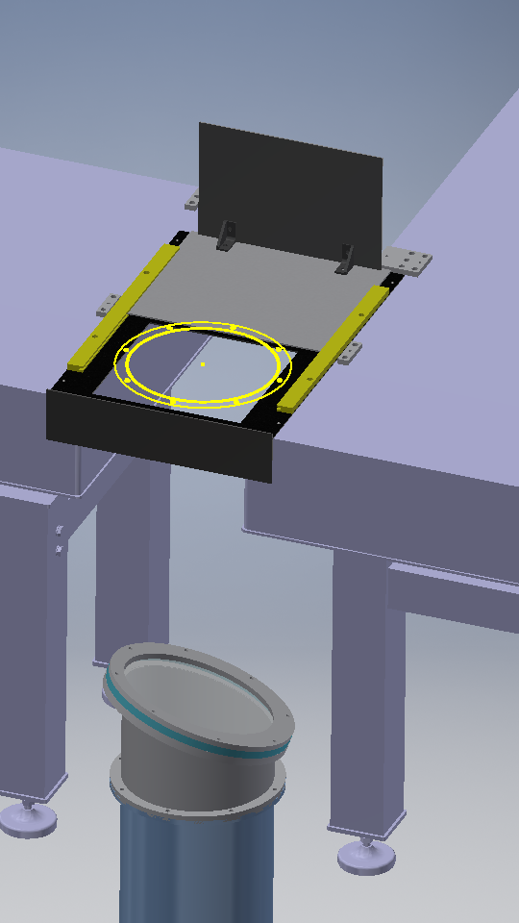
MELISSA: Laser System Status
Pump Lasers: ready to ship
Ti:Sa Lasers: done, painting
Interlock system: in design
V.M. Gadelshin | 2nd MEDICIS Collaboration Meeting, CERN (03.10.2018)

Slide 11
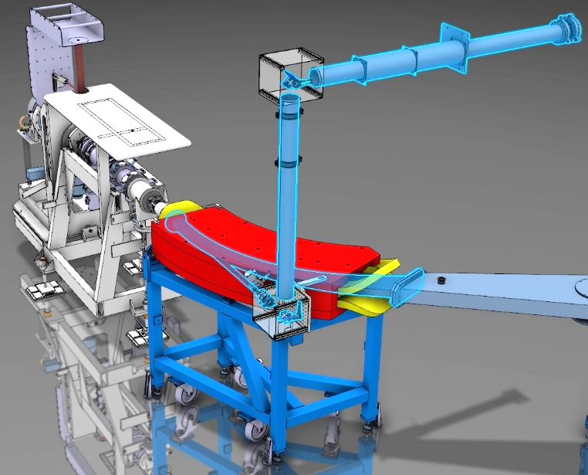
Laser Beam Transport System
Radiochemical Lab
Laser Lab
Point V
Point IV
Point II
Front-end
Point III
Electromagnet
Off-line Mass Separator
Point I
V.M. Gadelshin | 2nd MEDICIS Collaboration Meeting, CERN (03.10.2018)

Slide 12
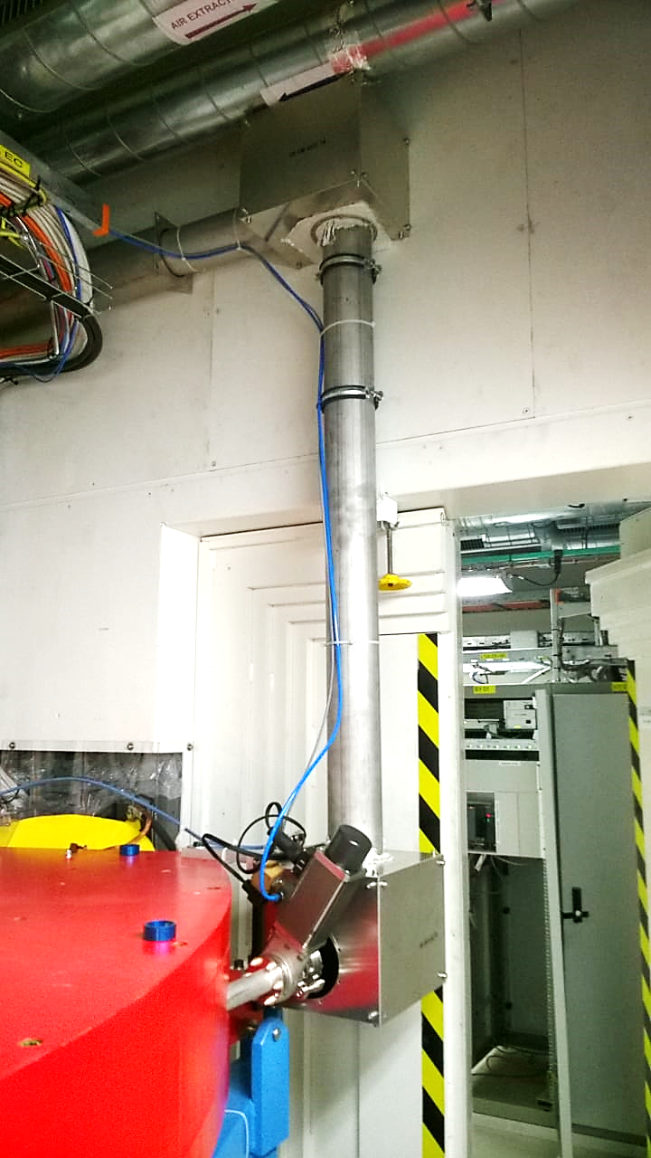
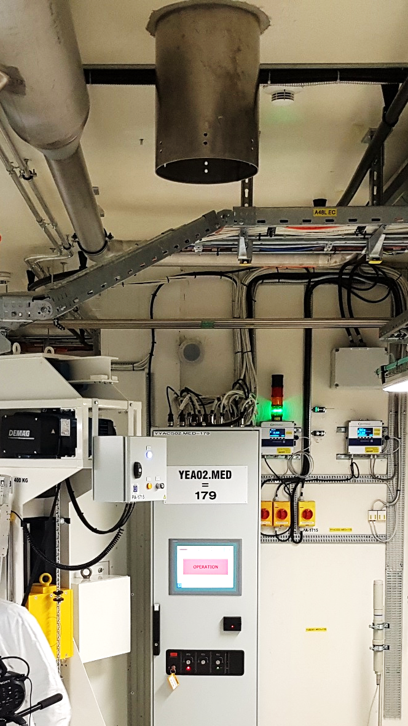
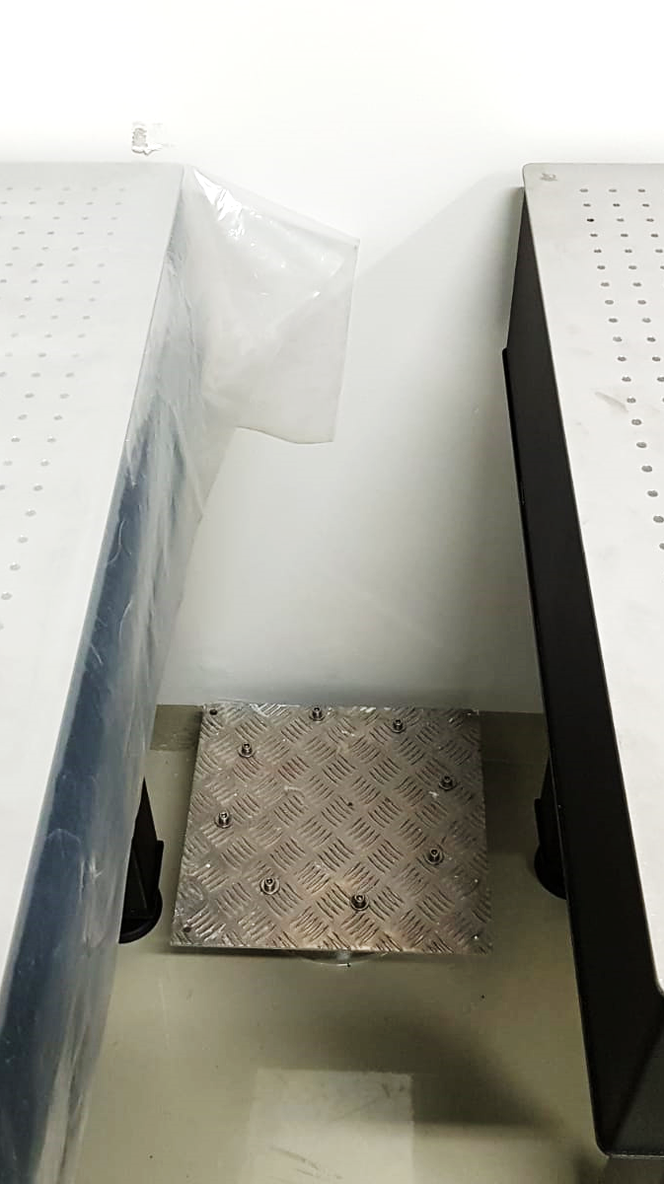
Laser Beam Transport System
Point 1-2: Completed
Point 3-4: Finalization
Point 5: In workshop
V.M. Gadelshin | 2nd MEDICIS Collaboration Meeting, CERN (03.10.2018)

Slide 13
Summary and roadmap
Task | Activities | Status
1. AC and Ventilation system | Split of cold laser room and for hot chiller room Search for economic solution Cutting the concrete wall for air channels Installation by ARCECLIMA and commissioning | Done
2. Cosmetic repair | - Walls painting - Resin floor cover | Done
3. Optical Tables | - Definition of optimal layout - Procurement and installtion | Done
4. Additional building works | - Installation of additional walls for the chiller room and SAS | Done
5. Electricity | - Definition of power requirements and network layout - Installation work | In process -> October
6. Laser Safety Measures | Definition of requirements for the interlock system Installation by BE/ICS | In progress -> November
7. Lasers and optics | Procurement Installation | In progress -> December.
V.M. Gadelshin | 2nd MEDICIS Collaboration Meeting, CERN (03.10.2018)

