Slide 1
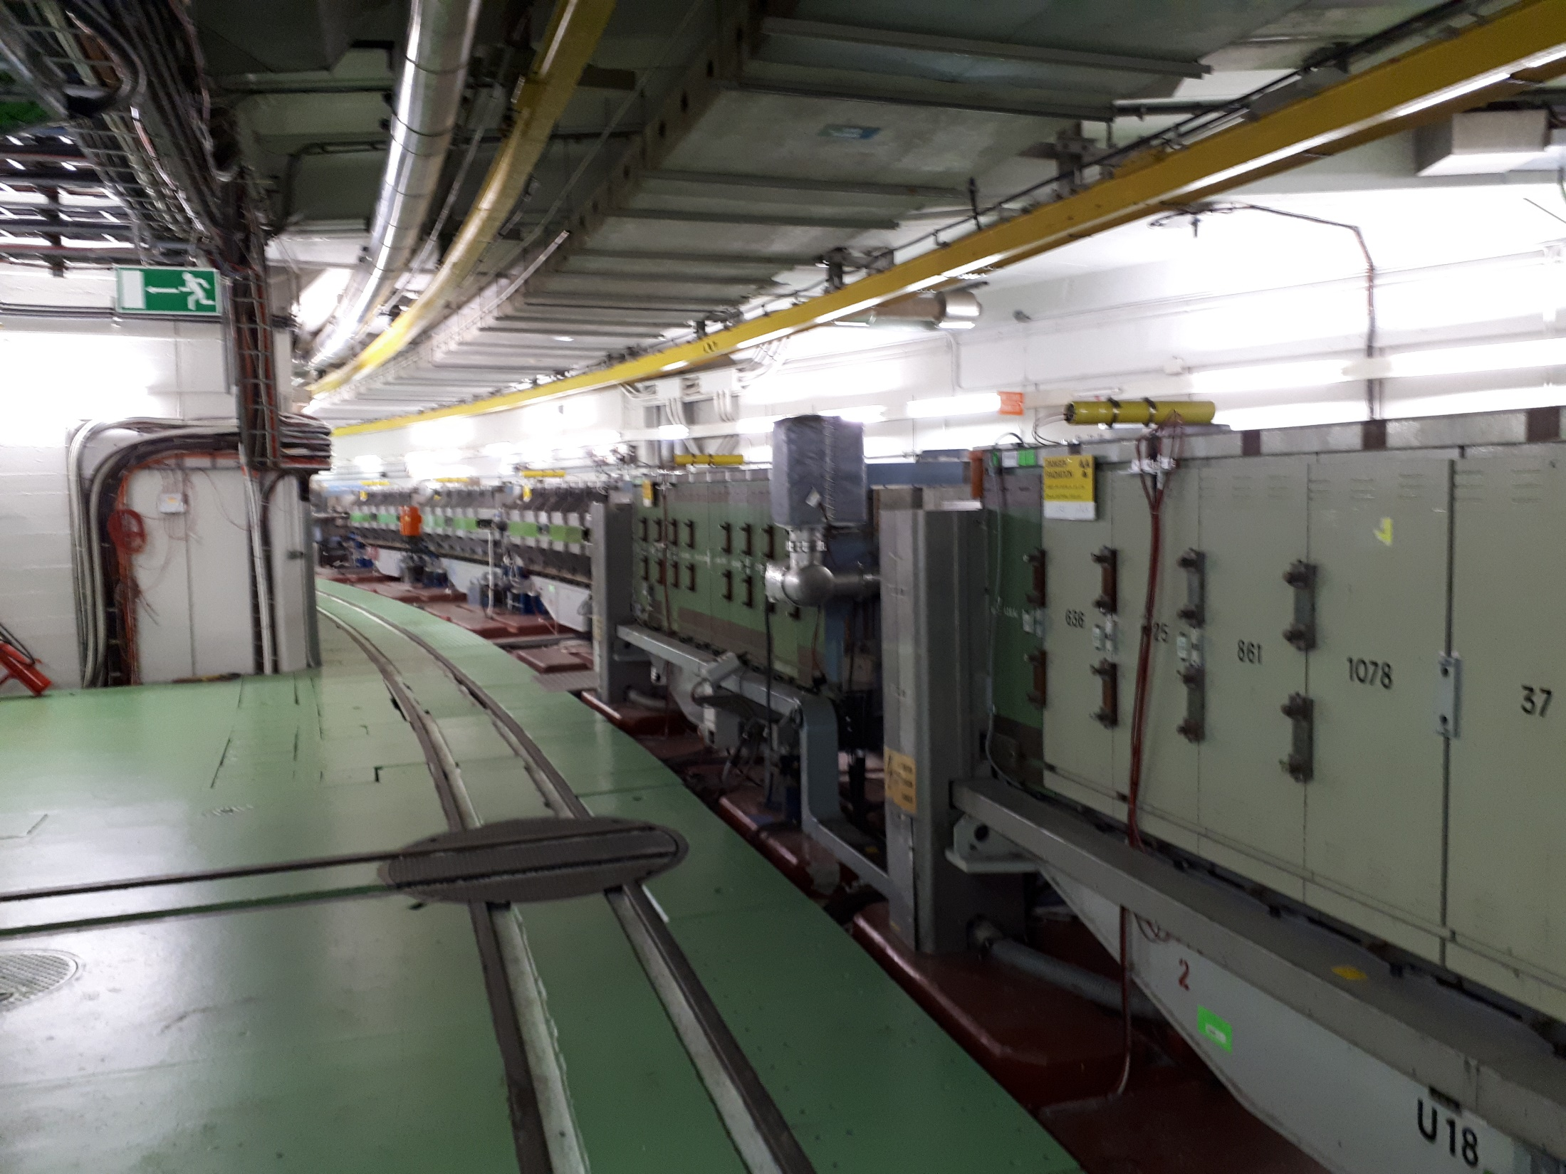
A Beam Quality Monitor for the PS
K Hanke - BCWG 21-09-18

Slide 2
Conceptual Overview
System similar to SPS BQM
In a first phase longitudinal beam parameters only
Measurement done by a Wall Current Monitor WCM
Comparison with pre-defined criterea for LHC type beams (presumably 25 ns and BCMS)
HW identical to SPS – discussions with G. Papotti
Problem: Longitudinal beam parameters of the beams in the PS are only defined during the very last turns! Too late to dump in the PS. We would only “flag” the beam and dump it in the SPS
KH

Slide 3
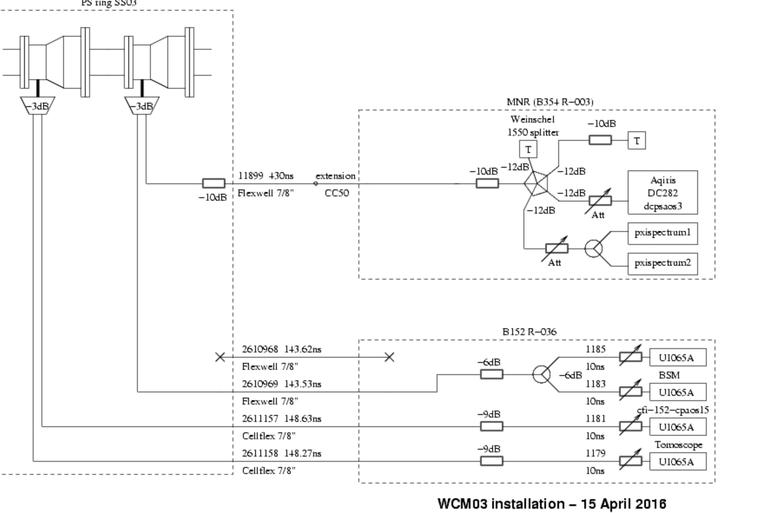
Crucial Ingredient: WCM
Presently two WCMs are installed in section 3. They are used for the tomoscope and BSM, and also for the dp/p measurement which is then fed into the transverse emittance measurement. There is a 3rd WCM used exclusively by RF
KH

Slide 4
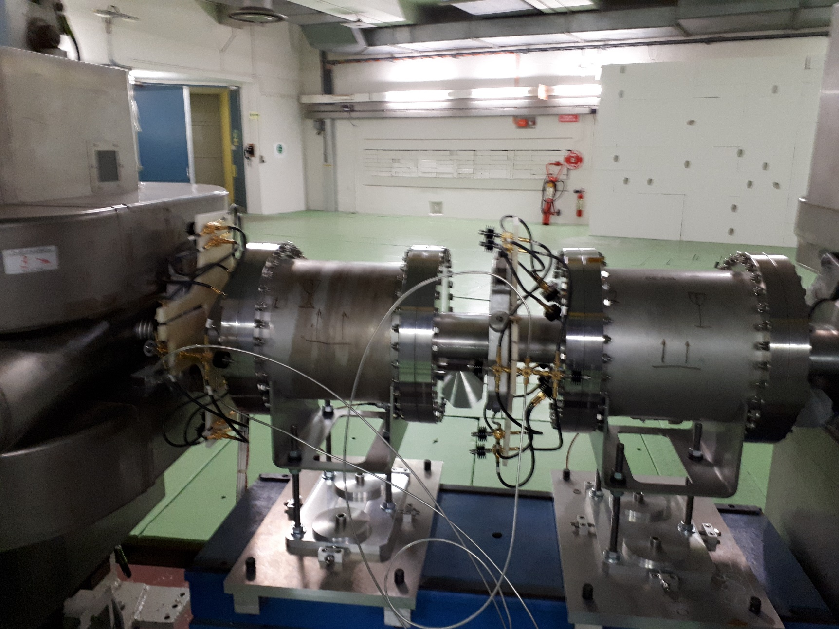
Present WCMs
KH

Slide 5
Towards an additional WCM
There is already now an issue (reflections) with measuring at the same time high-intensity and low-intensity beams, so there is anyway the request to build and install an additional WCM
The BQM would definitely call for an additional WCM
Triggered again a series of discussions with BI; we are converging to build a Chinese copy of the existing WCM (J. Belleman, M. Wendt).
Budget: This is not in LIU or CONS… a special budget in BE has been identified (cost of the order of 100 k); we got verbal approval for this
Time lines: BI and in particular the workshops are overloaded during LS2; towards the end of LS2 capacities would become available; target installation date could be a YETS after LS2
KH

Slide 6
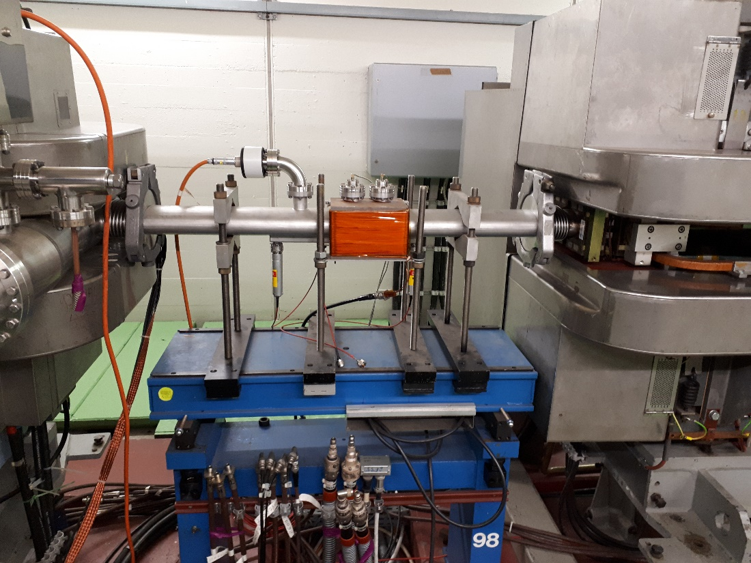
Toward s an additional WCM
Location, cabling, vacuum compatibility, …
Access 18 Sep to look for a possible place in the PS
98 is preferred location (in terms of cable length, and cables are possibly available; there are other possible locations; an old e-cloud device could probably be removed; there is a pending SRR for the Landau cavity for this place
KH

Slide 7
Next Steps
I am presently drafting a proposal
Continue to work with BI towards construction of the WCM
Iterate with G. Papotti on the rest of the installation
GUI
…
KH

