Slide 1
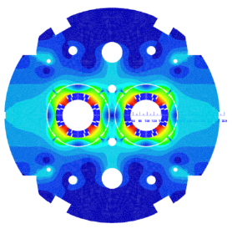

MQYYM magnetic MEASUREMENT
MQYYM
INSTRUMENTATION
TECHNICAL REVIEW
Damien Simon for the MQYYM team
CEA: H. Felice, D. Simon, M. Segreti, J.M. Rifflet, S. Somsom, R. Machado-Correia, R. Godon
CERN: M. Guinchard, P. Grosclaude, J.C. Perez, N. Bourcey, A Foussat, E. Todesco

Slide 2
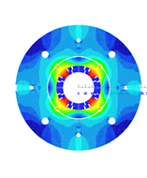
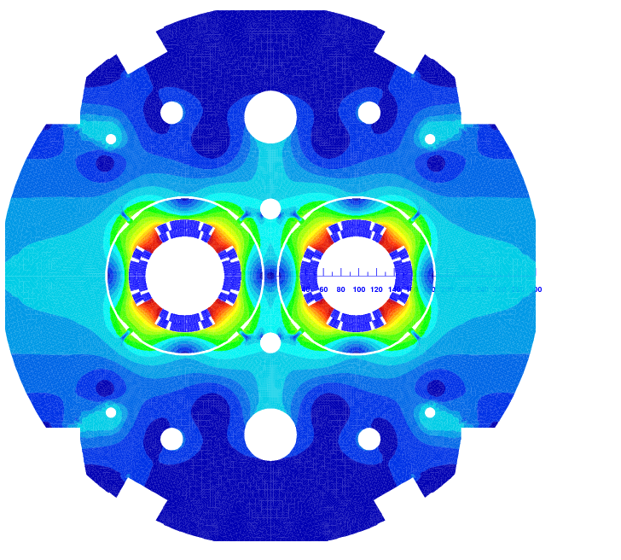
INtroduction
The MQYY project:
  Collaboration CERN-CEA for the HL-LHC
  Design of the MQYY a double aperture cos(2θ) Nb-Ti matching section magnet
  Fabrication and test of the MQYYM single aperture magnet short model of the MQYY magnet
  Fabrication of the MQYYM coils at CEA
  Assembly, instrumentation and warm magnetic measurements at CERN
  Cold magnetic measurements at CEA
The MQYY
The MQYYM

Slide 3
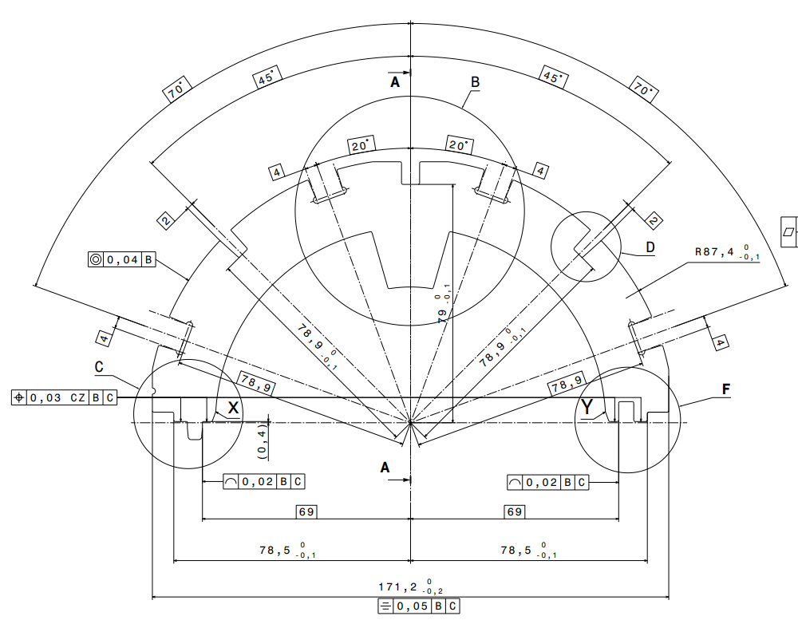
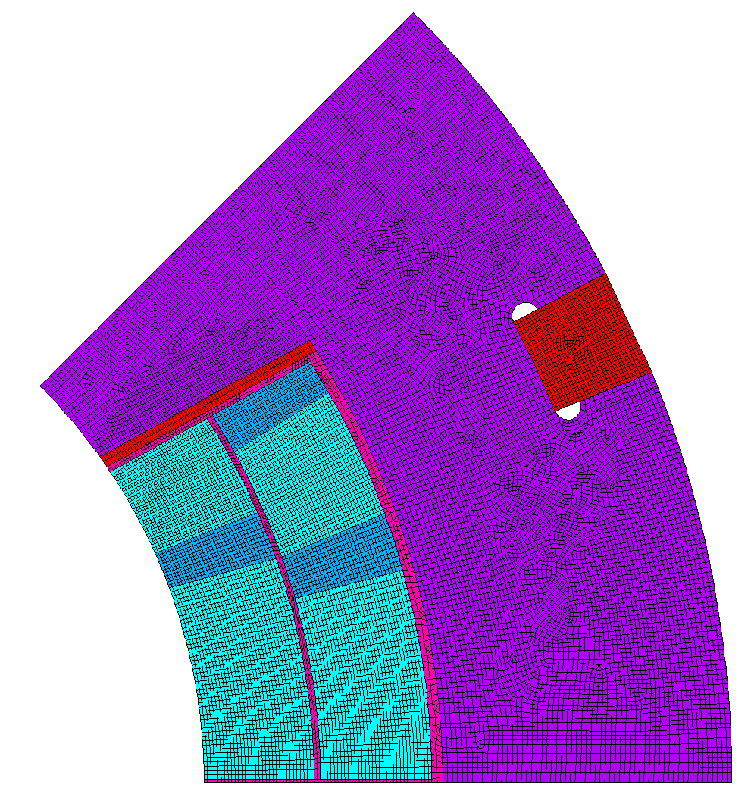
Strain gauges position
Collars instrumentation:
Strain gages

Slide 4
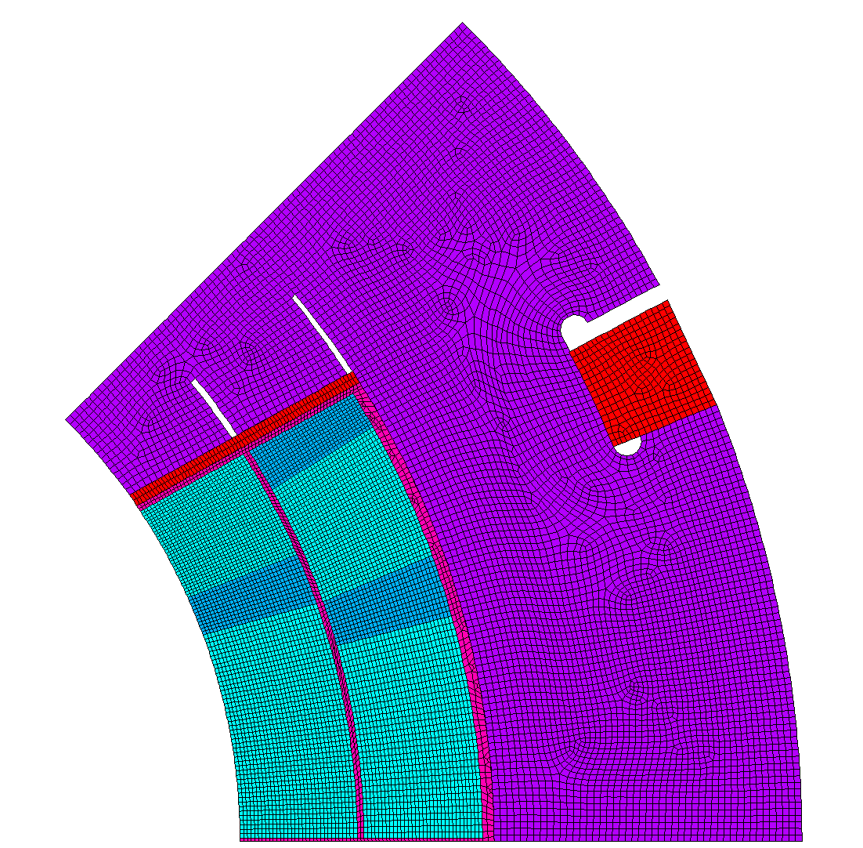
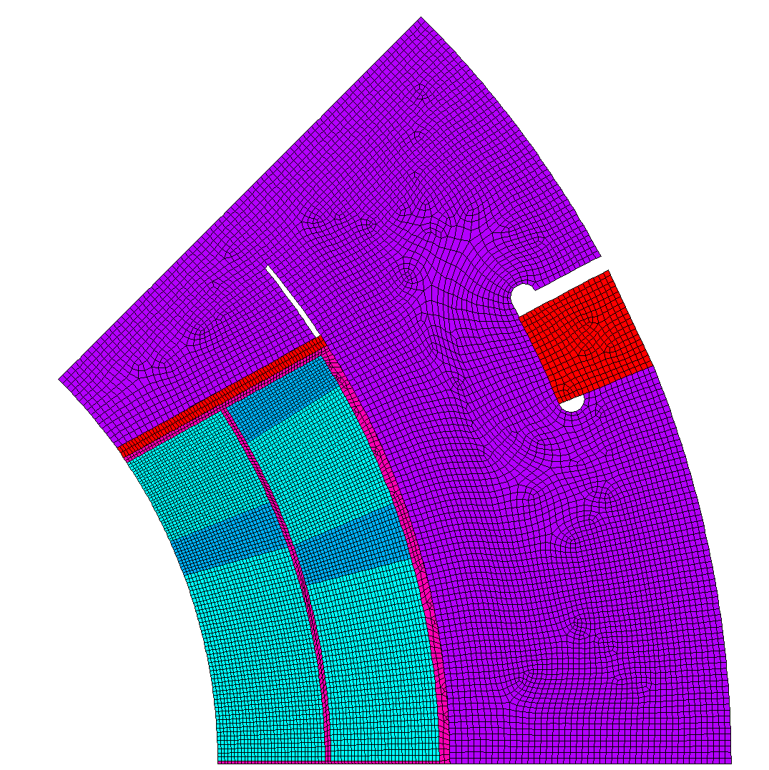

ScenariI
Collars instrumentation:
  The goal is to measure the azimtal stress on the pole
  The radial stress should be low to measure only the azimutal stress
  3 possibilities:
    0 cut
    1 cut
    2 cuts
Strain gages

Slide 5
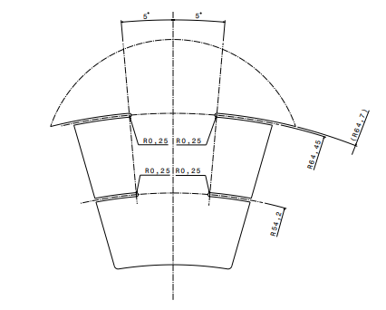
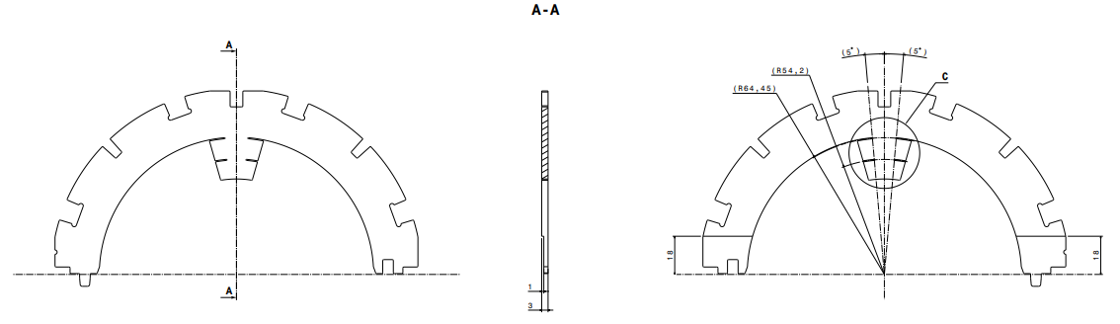
Drawings
Collars instrumentation:
  The goal is to measure the azimtal stress on the pole

Slide 6
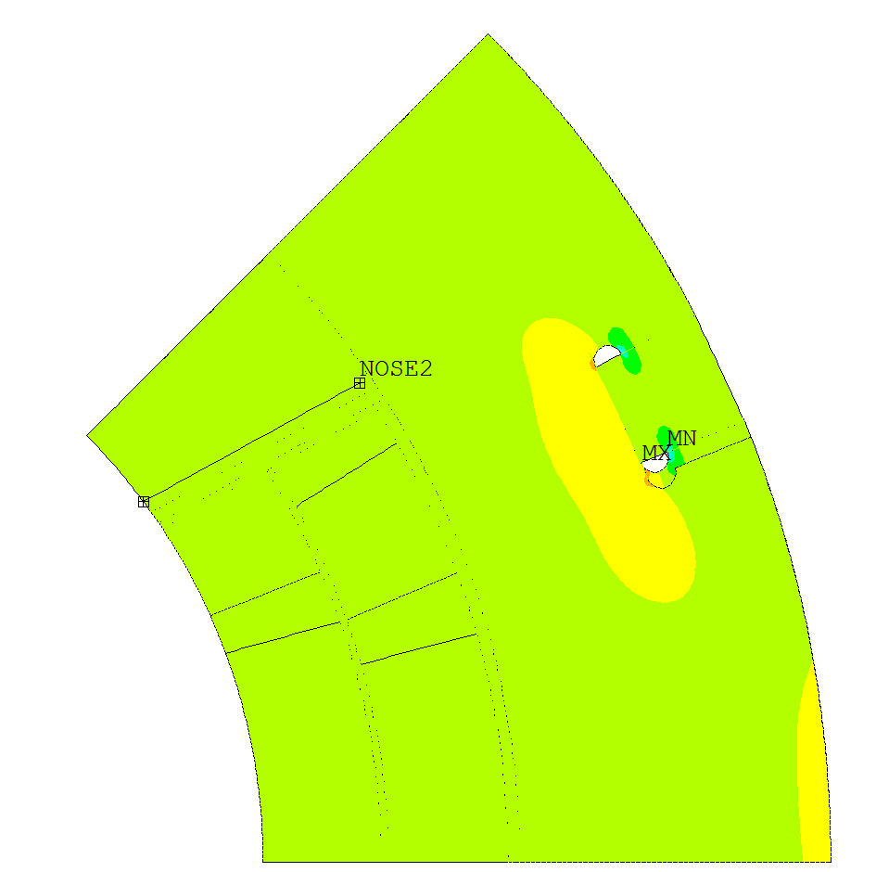
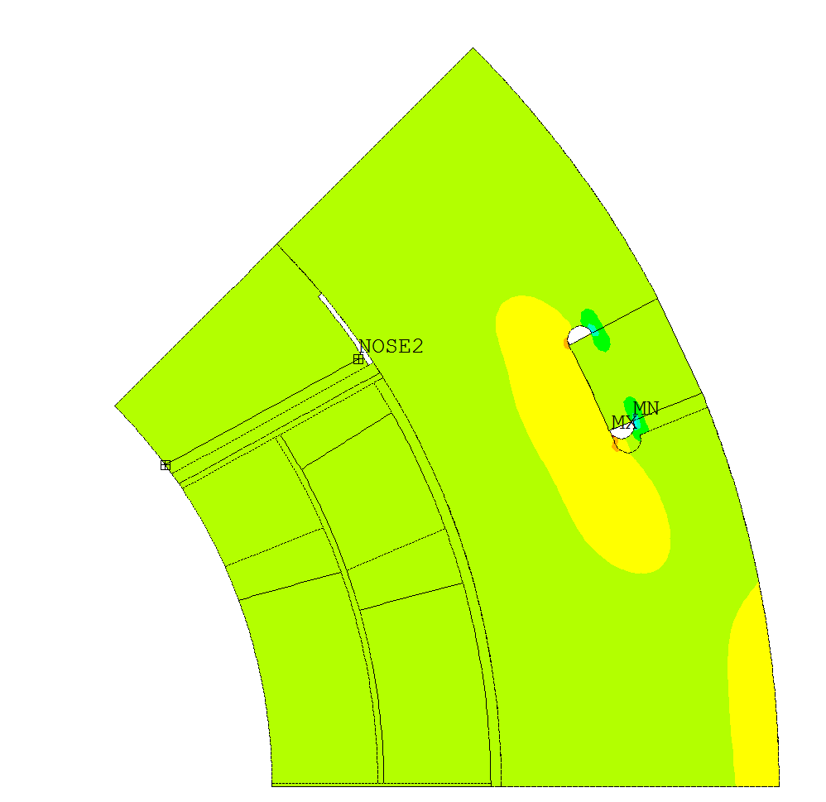
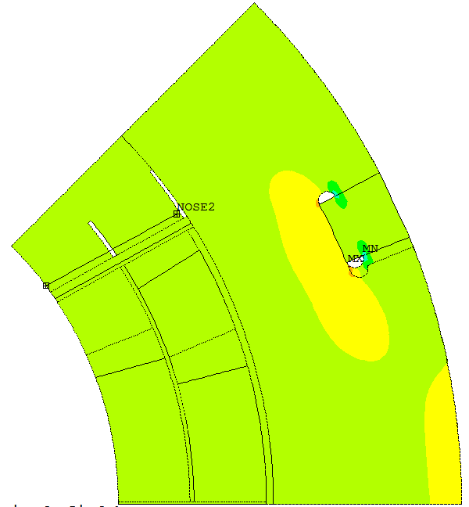
Introduction to the simulation
Collars instrumentation:
  PATH: 1 path
    NOSE2
  Notation: e(x/y)StepYZCuts
    X Radial strain & Y azimuthal strain
    Y number of the load step (1 collaring, 2 cooling, 3 enregization)
    Z number of cuts (0 cut, 1 cut, 2 cuts)

Slide 7
Introduction to the simulation
Collars instrumentation:
  The idea is to canceled the azimuthal stress
  The poisson ratio of the stainless steel is 0,3
  To canceled the azimuthal stress we need a ratio between the radial strain and the azimuthal strain of -0,3.

Slide 8
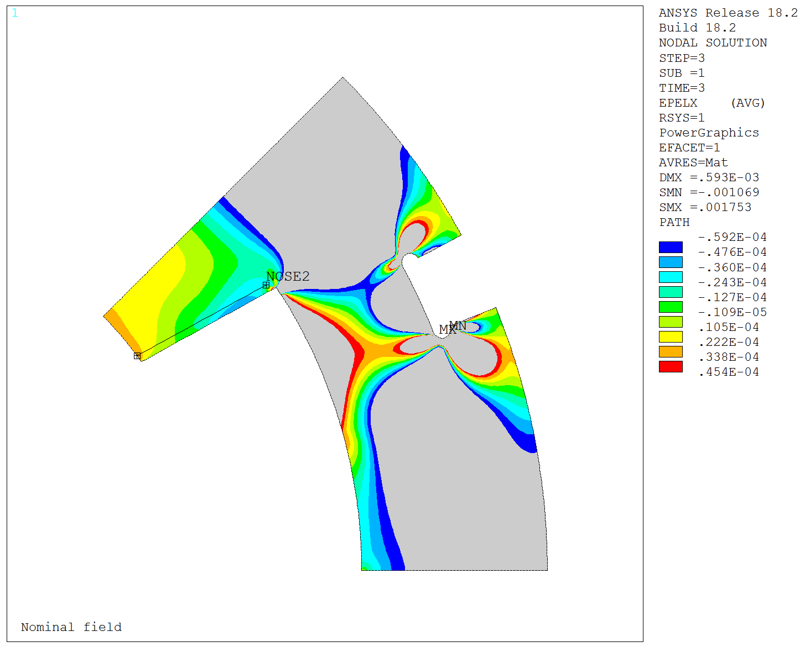
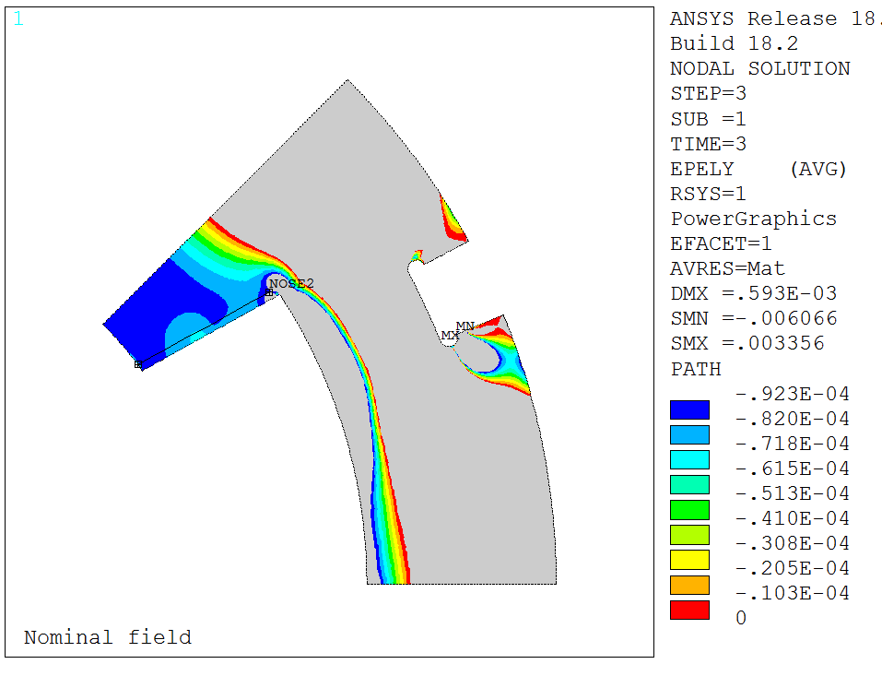
RESULTS 0 Cut
Radial strain
Radial and azimuthal strain in the collar nose for 0 cut
(Step 3)
azimuthal strain

Slide 9
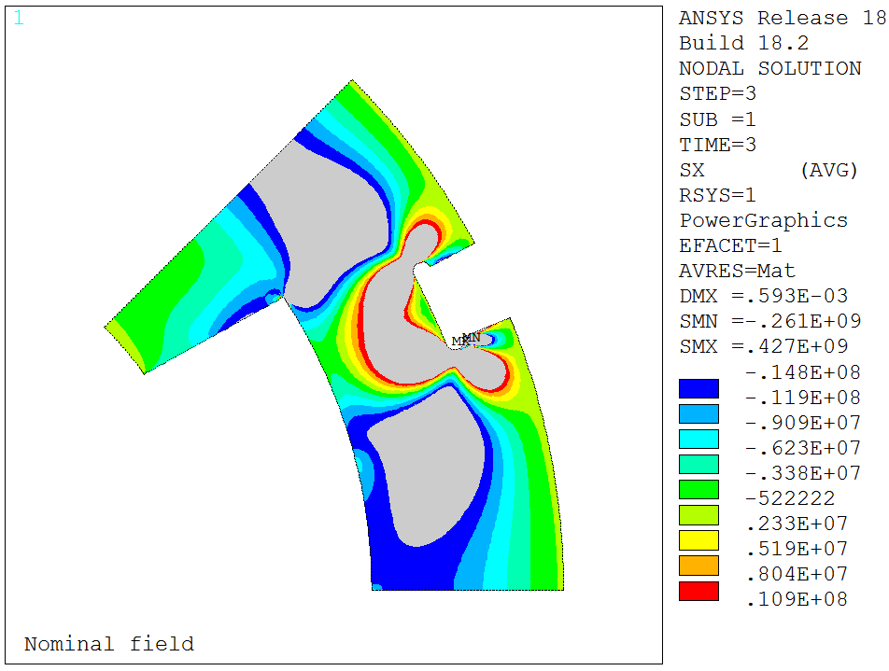
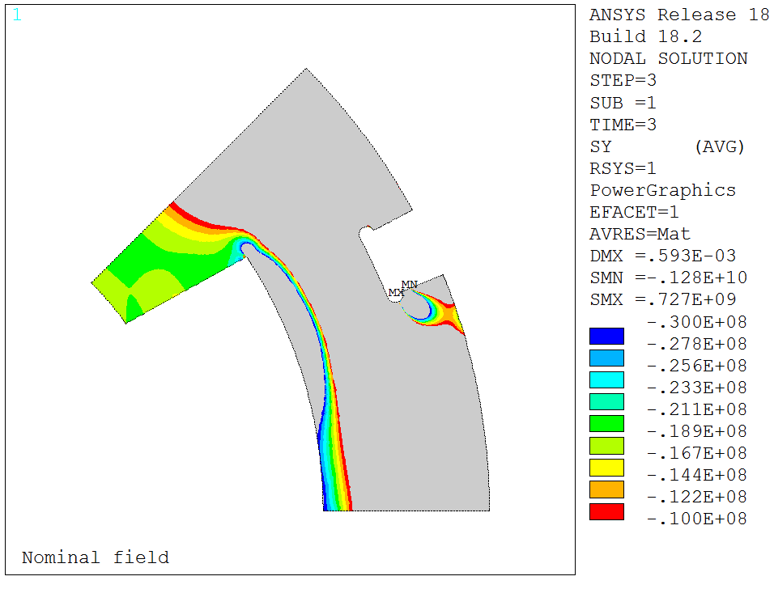
RESULTS 0 Cut
Radial stress
Radial and azimuthal stress in the collar nose for 0 cut
(Step 3)
azimuthal stress

Slide 10
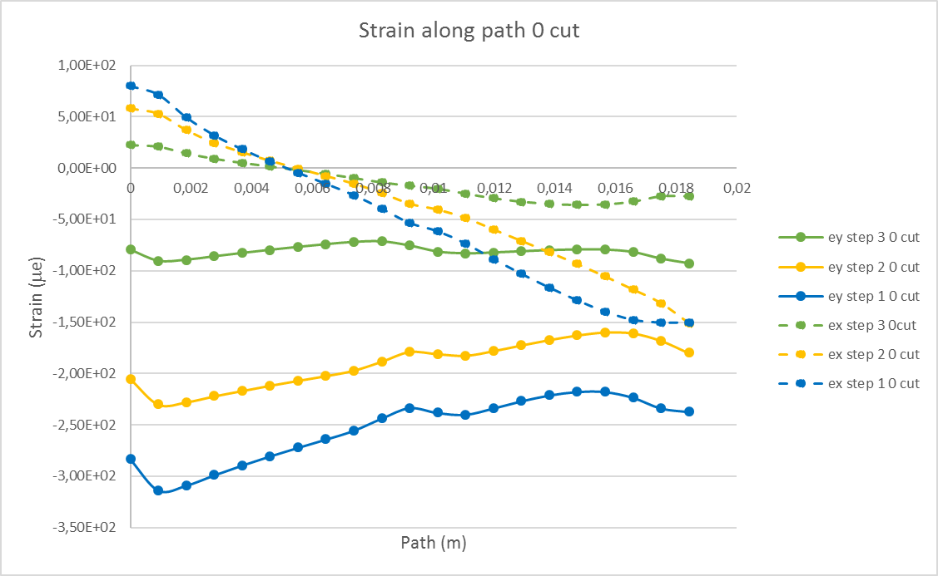
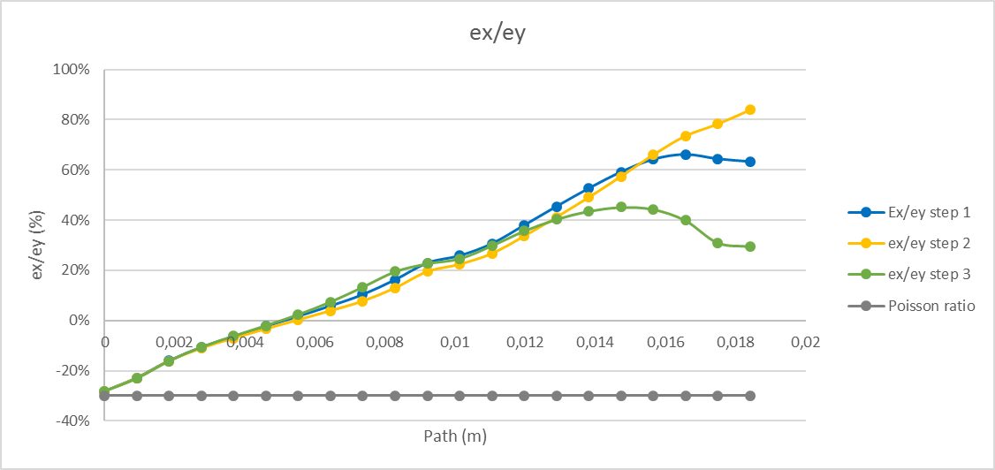
RESULTS 0 Cut
The radial strain along the « nose 2 » path is huge and not constant especialy at the end of the nose (x = 18 mm)
The radial stress is not canceled
0 mm
18 mm

Slide 11
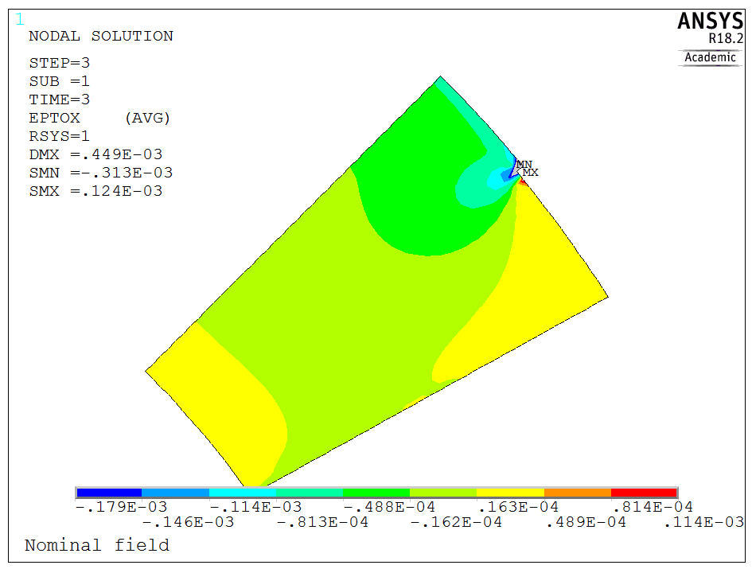
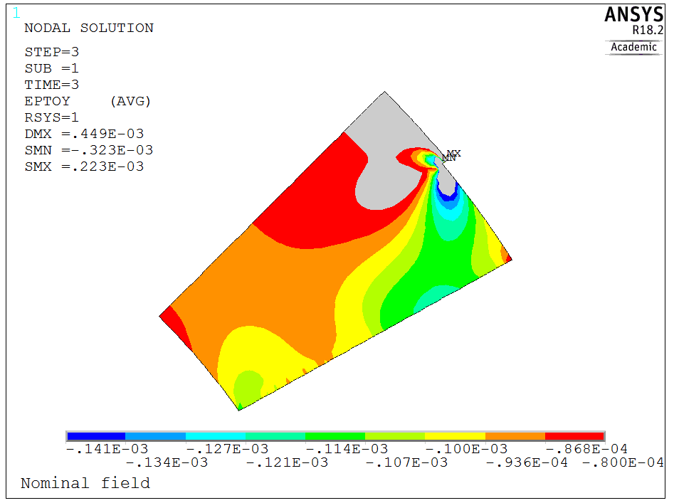
RESULTS 1 Cut
Radial strain
Radial and azimuthal strain in the collar nose for 1 cut
(Step 3)
azimuthal strain

Slide 12
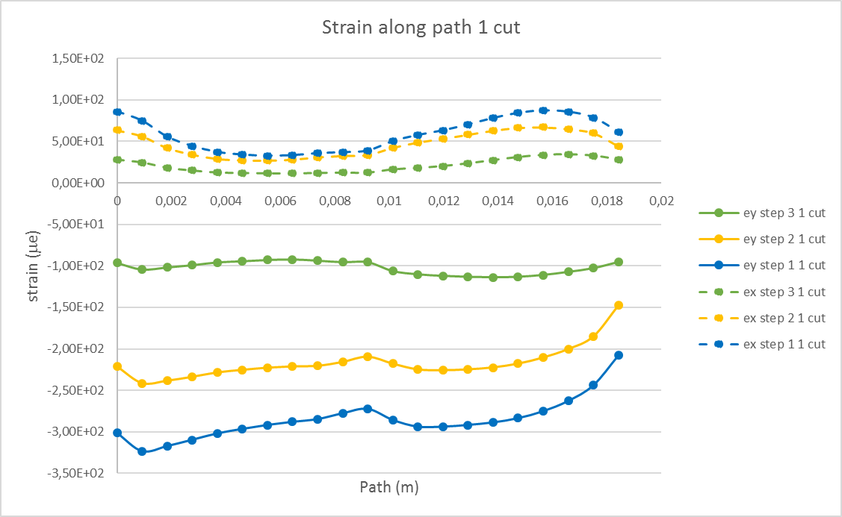
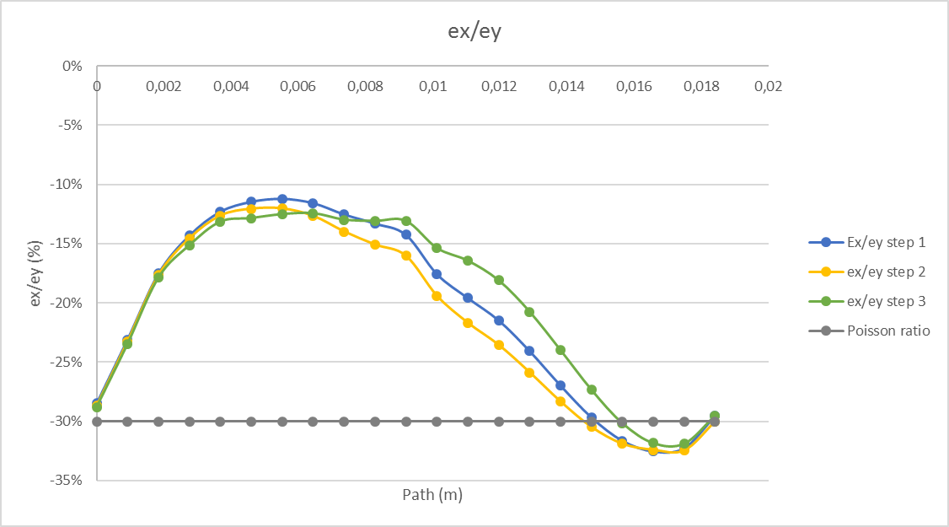
RESULTS 1 Cut
The radial and azimuthal strain along the « nose 2 » path is almost contant.
The radial stress is not canceled at the middle of the path.

Slide 13
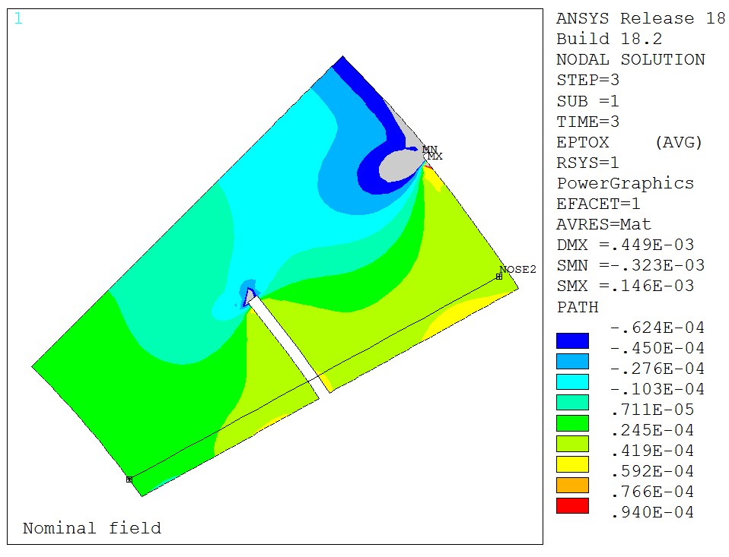
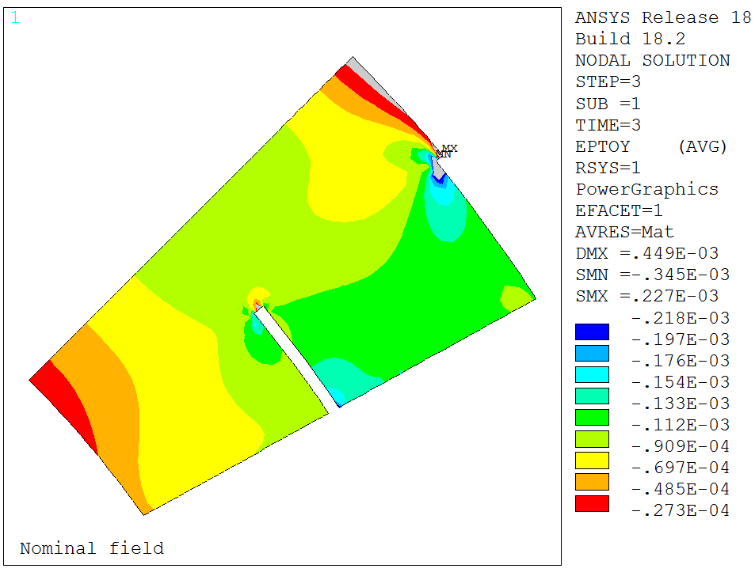
RESULTS 2 Cuts
Radial strain
Radial and azimuthal strain in the collar nose for 2 cut
(Step 3)
azimuthal strain

Slide 14
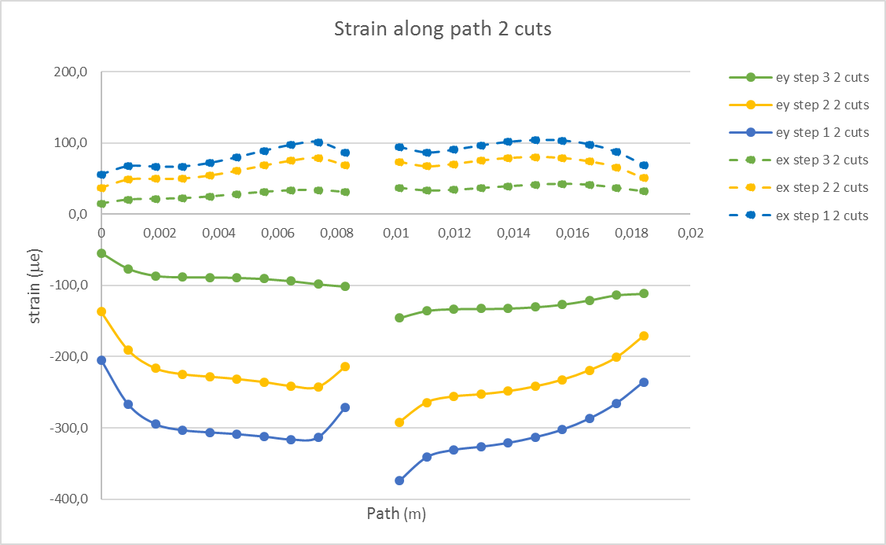
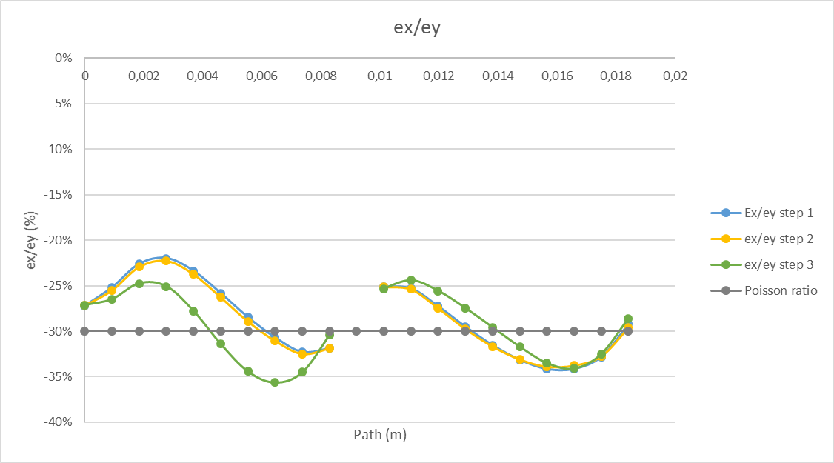
RESULTS 2 Cuts
The radial and azimuthal strain along the « nose 2 » path is almost contant.
The radial stress is almost canceled all along the path
2 CUTS: BEST OPTION

Slide 15
RESULTS 2 Cuts
Strain
Stress
Path (m) | Step 1 |  |  | Step 2 |  |  | Step 3
 | ey (με) | ex (με) | ex/ey | ey (με) | ex (με) | ex/ey | ey (με) | ex (με) | ex/ey
0 | -204,6 | 55,7 | -27% | -137,0 | 37,2 | -27% | -54,4 | 14,8 | -27%
9,21E-04 | -266,9 | 67,2 | -25% | -190,8 | 48,7 | -26% | -76,5 | 20,3 | -26%
1,84E-03 | -294,5 | 66,6 | -23% | -216,3 | 49,6 | -23% | -86,4 | 21,4 | -25%
2,76E-03 | -303,1 | 66,6 | -22% | -224,6 | 50,0 | -22% | -88,4 | 22,2 | -25%
3,68E-03 | -306,2 | 71,6 | -23% | -228,1 | 54,2 | -24% | -88,6 | 24,6 | -28%
4,60E-03 | -308,6 | 79,7 | -26% | -231,3 | 60,8 | -26% | -89,1 | 28,0 | -31%
5,52E-03 | -312,0 | 88,8 | -28% | -235,6 | 68,2 | -29% | -90,8 | 31,2 | -34%
6,45E-03 | -316,1 | 97,0 | -31% | -241,2 | 74,9 | -31% | -93,7 | 33,4 | -36%
7,37E-03 | -313,2 | 101,1 | -32% | -242,5 | 78,9 | -33% | -98,1 | 33,9 | -35%
8,29E-03 | -271,3 | 86,4 | -32% | -214,1 | 68,2 | -32% | -101,5 | 30,9 | -30%
9,21E-03
1,01E-02 | -374,3 | 94,1 | -25% | -291,9 | 73,4 | -25% | -145,4 | 36,9 | -25%
1,10E-02 | -341,1 | 86,4 | -25% | -264,1 | 67,1 | -25% | -135,5 | 33,1 | -24%
1,20E-02 | -330,8 | 90,2 | -27% | -255,8 | 70,3 | -27% | -132,9 | 34,0 | -26%
1,29E-02 | -326,3 | 96,3 | -30% | -252,7 | 75,2 | -30% | -132,7 | 36,4 | -27%
1,38E-02 | -321,0 | 101,3 | -32% | -248,5 | 78,7 | -32% | -132,1 | 39,1 | -30%
1,47E-02 | -313,0 | 103,8 | -33% | -241,8 | 80,1 | -33% | -130,3 | 41,3 | -32%
1,57E-02 | -302,4 | 103,3 | -34% | -232,4 | 78,8 | -34% | -126,7 | 42,5 | -34%
1,66E-02 | -286,8 | 97,9 | -34% | -219,0 | 74,0 | -34% | -120,7 | 41,2 | -34%
1,75E-02 | -265,3 | 87,1 | -33% | -200,9 | 65,8 | -33% | -113,7 | 36,9 | -32%
1,84E-02 | -235,4 | 68,8 | -29% | -170,7 | 50,6 | -30% | -111,5 | 31,9 | -29%
 | -299,6 | 85,5 | -29% | -227,0 | 65,2 | -29% | -107,4 | 31,7 | -30%
Path (m) | Step 1 |  |  | Step 2 |  |  | Step 3
 | sy (MPa) | sx (MPa) | sx/sy | sy (MPa) | sx (MPa) | sx/sy | sy (MPa) | sx (MPa) | sx/sy
0 | -41,9 | -1,3 | 3% | -28,1 | -0,9 | 3% | -11,1 | -0,3 | 3%
9,21E-04 | -55,0 | -2,9 | 5% | -39,3 | -1,9 | 5% | -15,7 | -0,6 | 4%
1,84E-03 | -61,2 | -4,9 | 8% | -44,9 | -3,4 | 8% | -17,8 | -1,0 | 6%
2,76E-03 | -63,2 | -5,4 | 9% | -46,8 | -3,9 | 8% | -18,2 | -1,0 | 5%
3,68E-03 | -63,5 | -4,5 | 7% | -47,3 | -3,2 | 7% | -18,1 | -0,4 | 2%
4,60E-03 | -63,5 | -2,9 | 5% | -47,5 | -1,9 | 4% | -18,0 | 0,3 | -2%
5,52E-03 | -63,7 | -1,1 | 2% | -48,0 | -0,6 | 1% | -18,2 | 0,9 | -5%
6,45E-03 | -64,0 | 0,5 | -1% | -48,8 | 0,6 | -1% | -18,7 | 1,2 | -6%
7,37E-03 | -63,1 | 1,6 | -3% | -48,8 | 1,4 | -3% | -19,6 | 1,0 | -5%
8,29E-03 | -54,7 | 1,1 | -2% | -43,2 | 0,9 | -2% | -20,6 | 0,1 | 0%
9,21E-03
1,01E-02 | -77,2 | -4,1 | 5% | -60,2 | -3,2 | 5% | -30,0 | -1,5 | 5%
1,10E-02 | -70,3 | -3,6 | 5% | -54,4 | -2,7 | 5% | -28,0 | -1,7 | 6%
1,20E-02 | -67,8 | -2,0 | 3% | -52,4 | -1,4 | 3% | -27,4 | -1,3 | 5%
1,29E-02 | -66,3 | -0,4 | 1% | -51,3 | -0,1 | 0% | -27,2 | -0,7 | 3%
1,38E-02 | -64,8 | 1,1 | -2% | -50,2 | 0,9 | -2% | -26,8 | -0,1 | 0%
1,47E-02 | -62,9 | 2,2 | -3% | -48,6 | 1,7 | -3% | -26,3 | 0,5 | -2%
1,57E-02 | -60,5 | 2,8 | -5% | -46,6 | 2,0 | -4% | -25,4 | 1,0 | -4%
1,66E-02 | -57,4 | 2,7 | -5% | -43,9 | 1,9 | -4% | -24,2 | 1,1 | -5%
1,75E-02 | -53,4 | 1,7 | -3% | -40,4 | 1,2 | -3% | -22,9 | 0,6 | -3%
1,84E-02 | -47,9 | -0,4 | 1% | -34,7 | -0,1 | 0% | -22,7 | -0,4 | 2%
 | -61,1 | -1,0 | 1% | -46,3 | -0,6 | 1% | -21,8 | -0,1 | 0%
σx=(E/(1-ν²))*(ε_{x}+νε_{y})
E | 2,03E+11
ν | 0,3

Slide 16
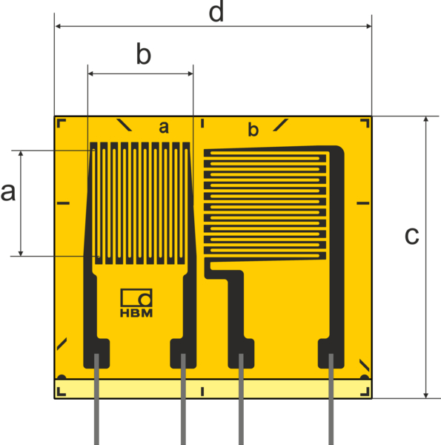
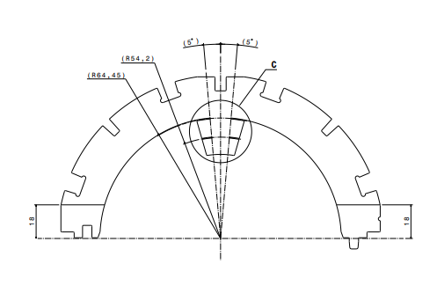
Strain Gages
Orientation of the gages:
Orientation 1
a | b | c
1,5 mm | 1,5 mm | 6 mm
Orientation 2
1-XC11-1.5/350

Slide 17
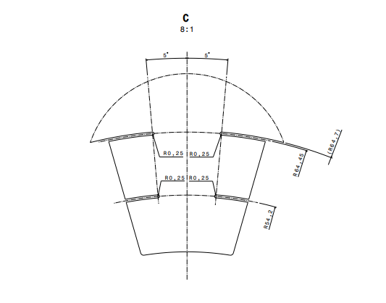
Strain Gages Orientation
1-XC11-1.5/350
Orientation 1
a | b | c
1,5 mm | 1,5 mm | 6 mm
Orientation 2

Slide 18
Strain Gages orientation
Strain Gages parallel to the pole

Slide 19
Strain Gages orientation
Strain Gages perpendicular to the pole

Slide 20
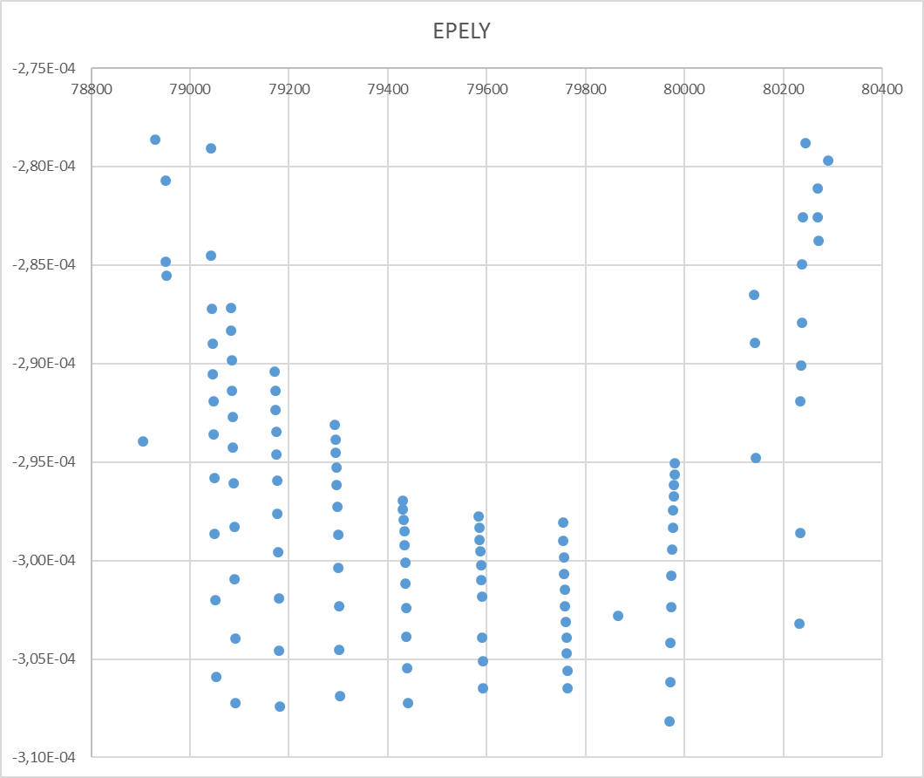
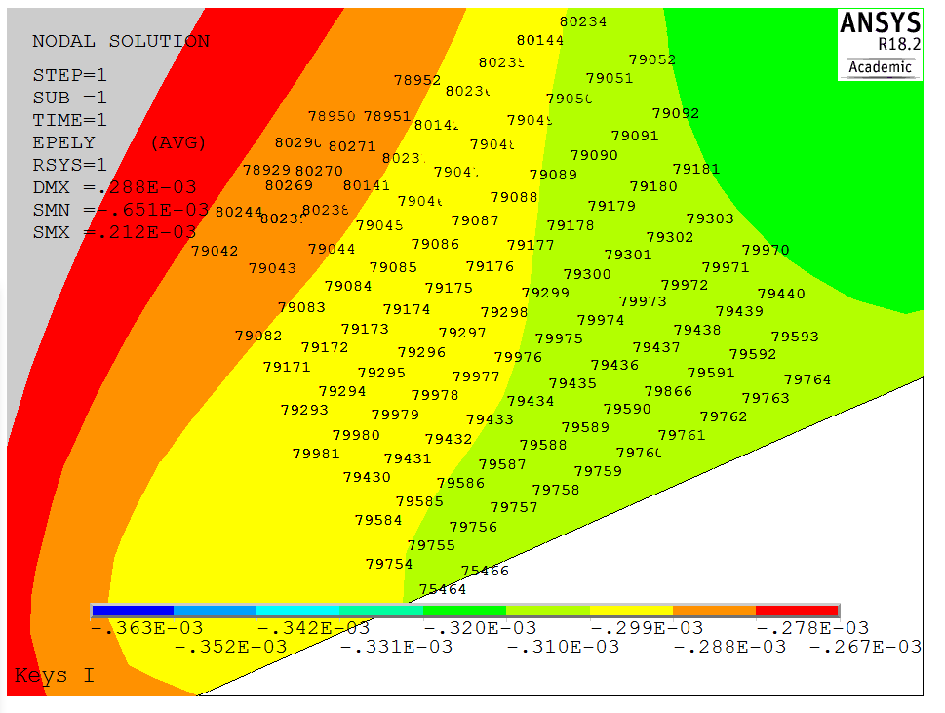
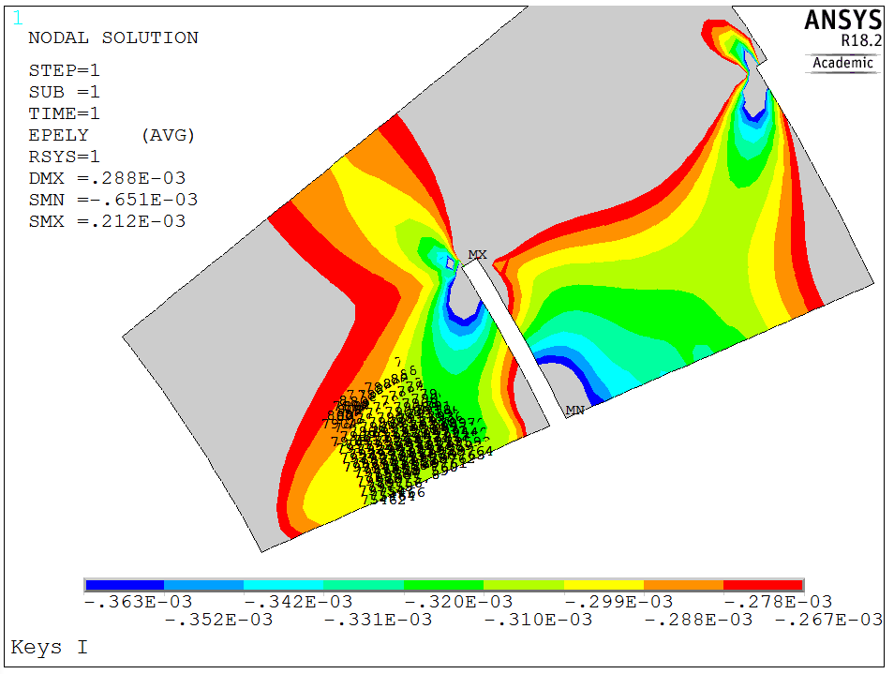
Strain Gages orientation
Time 1 (layer 1)
Nodes
Strain max: - 297 με
Strain min: - 307 με
Strain mean: - 302 με

Slide 21
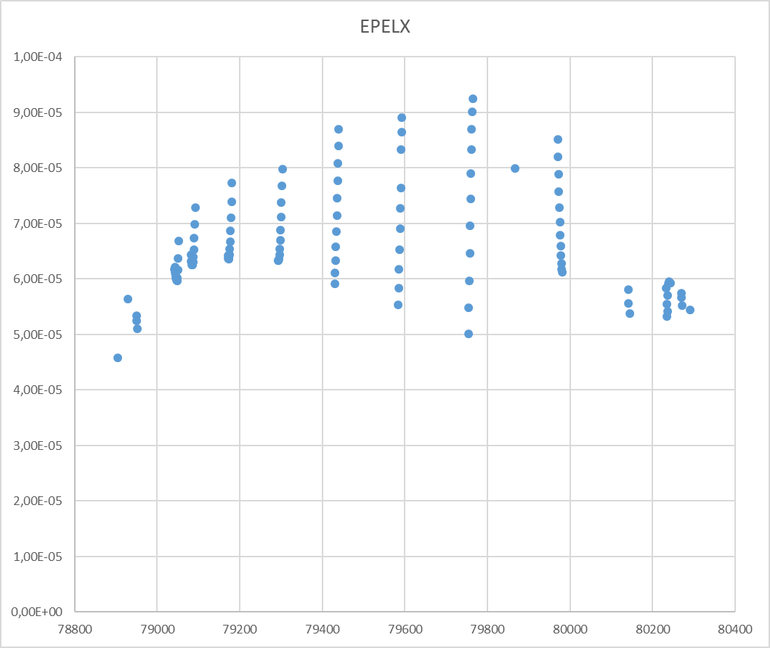
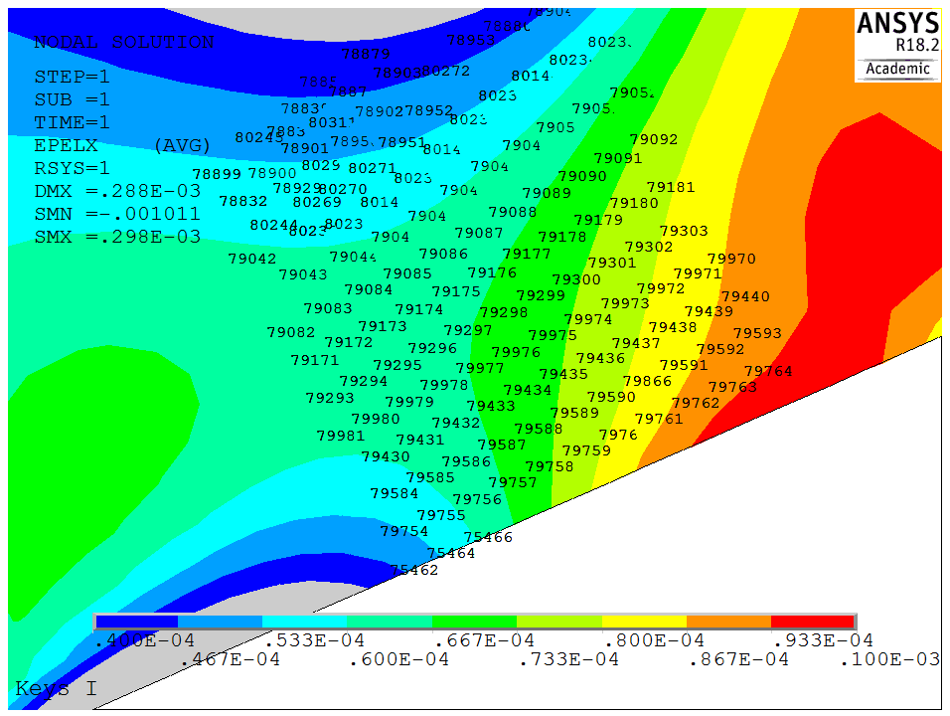
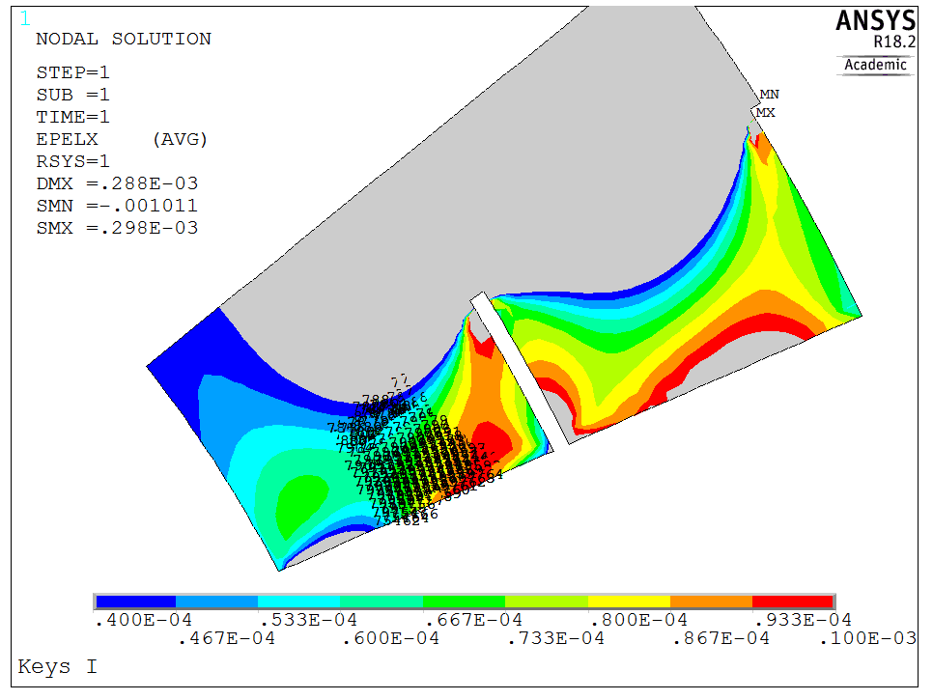
Strain Gages orientation
Time 1 (layer 1)
Strain max: 92 με
Strain min: 48 με
Strain mean: 70 με
Nodes

Slide 22
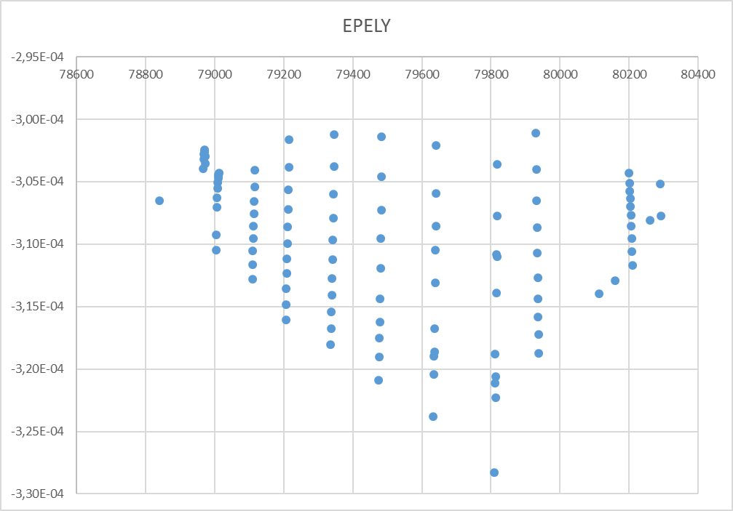
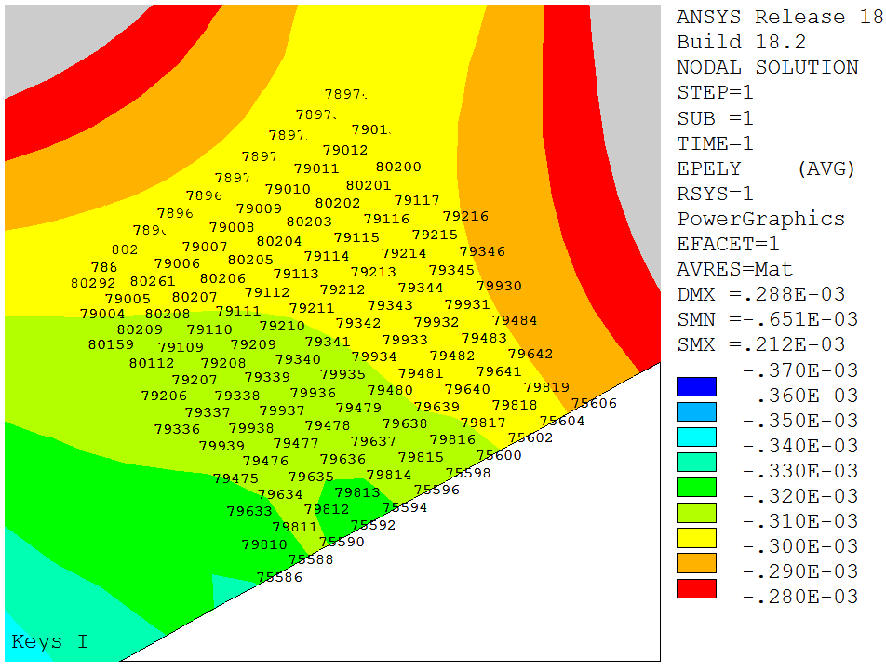
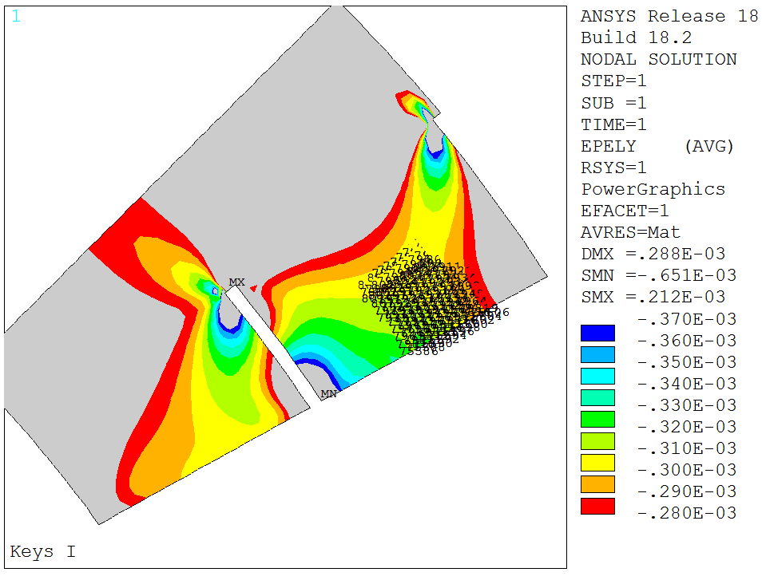
Strain Gages orientation
Time 1 (layer 2)
Nodes
Strain max: - 300 με
Strain min: - 320 με
Strain mean: - 310 με

Slide 23
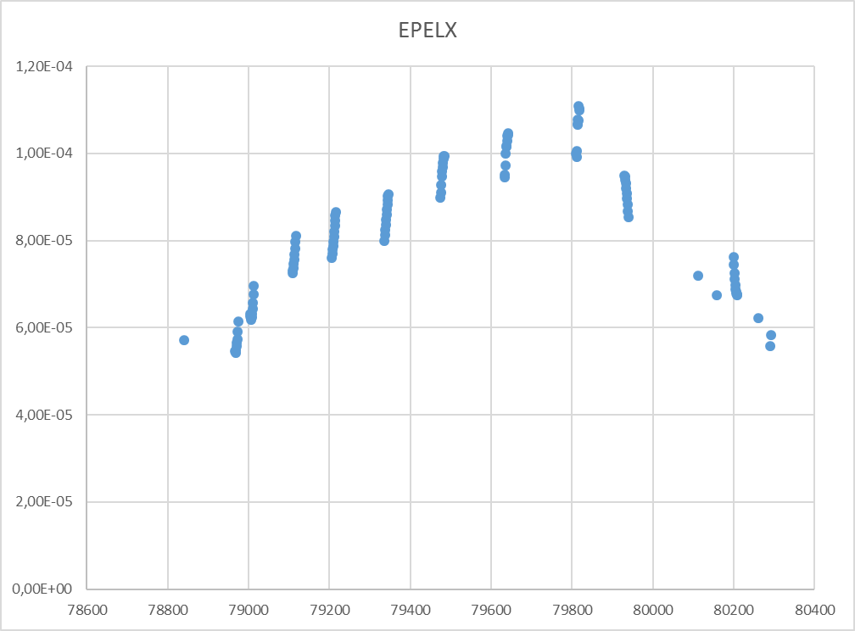
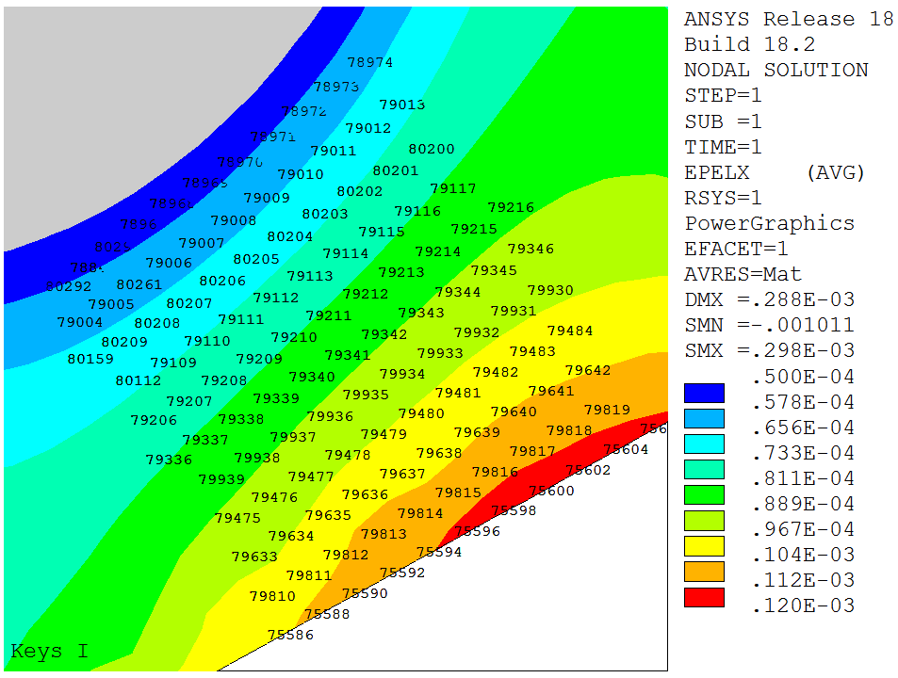
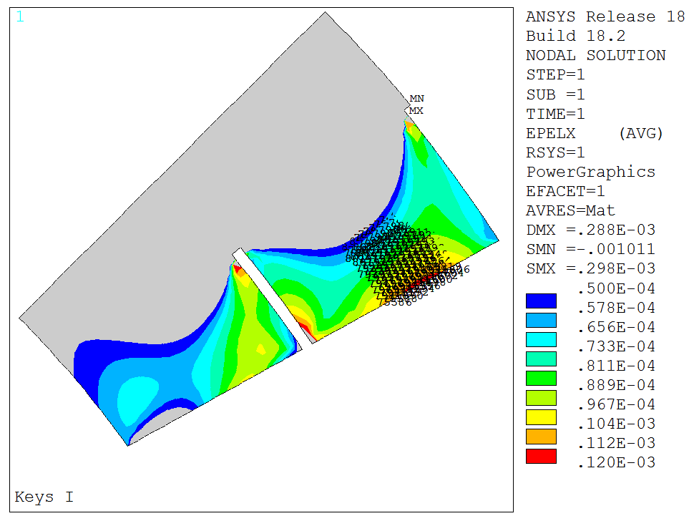
Strain Gages orientation
Time 1 (layer 2)
Strain max: 105 με
Strain min: 80 με
Strain mean: 92 με
Nodes

Slide 24
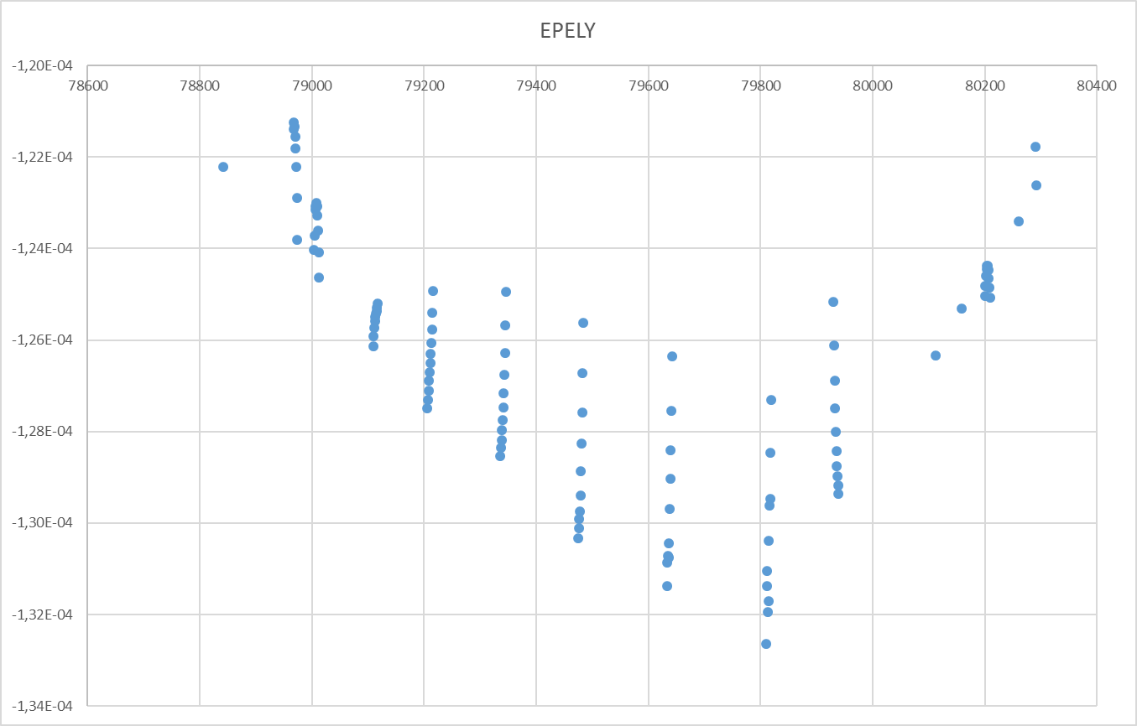
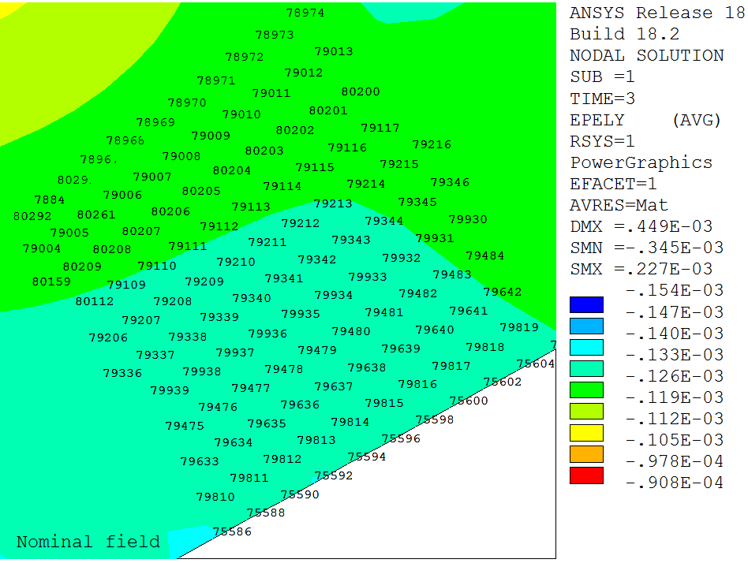
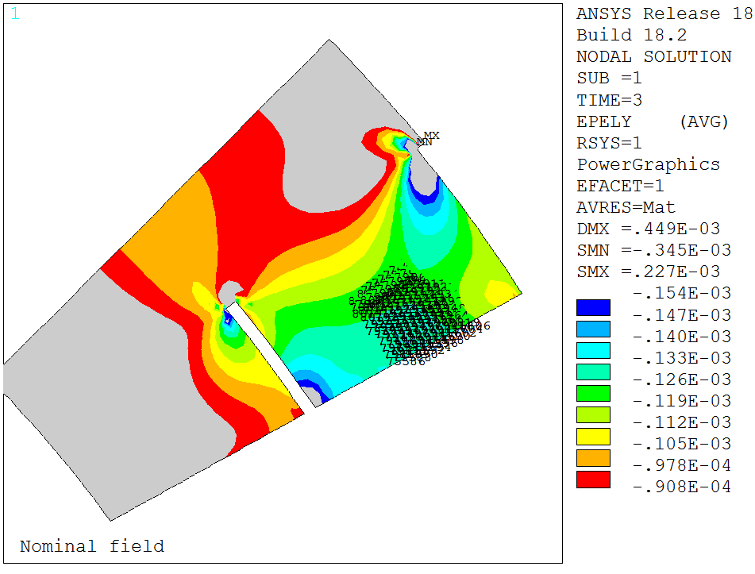
Strain Gages orientation
Time 3 (layer 2)
Nodes
Strain max: - 125 με
Strain min: - 133 με
Strain mean: - 129 με

Slide 25
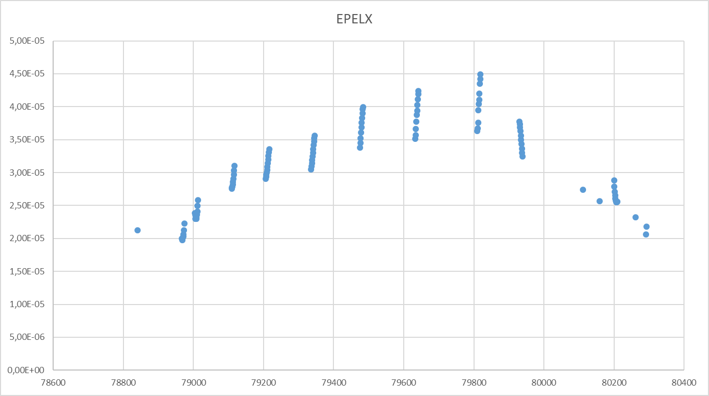
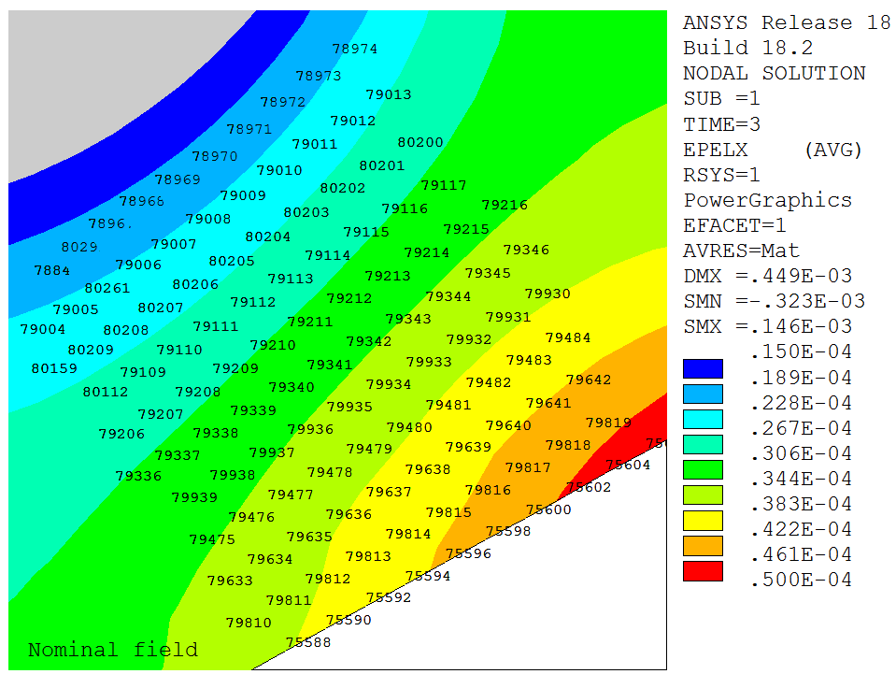
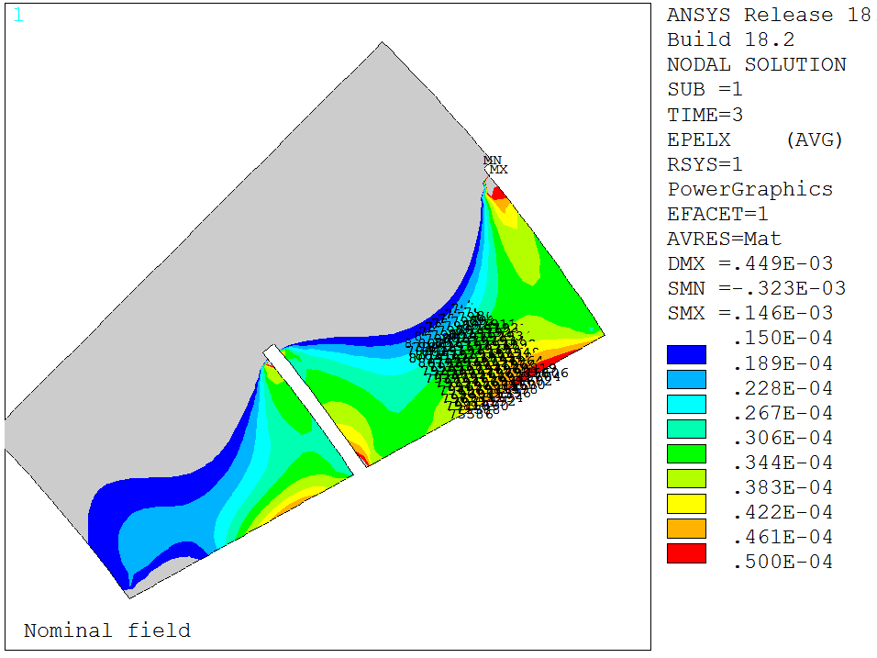
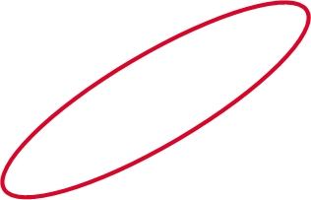
Strain Gages orientation
Time 3 (layer 2)
Strain max: 45 με
Strain min: 35 με
Strain mean: 40 με
Nodes

Slide 26
Strain Gages orientation
BEST SOLUTION: Solution 1

Slide 27
Strain Gages orientation
Time 3
(layer 2)
30%

