Slide 2
Retirement Seminar
DEPARTURE FORMALITIES
Laetitia Luberda et Maria Quintas

Slide 3
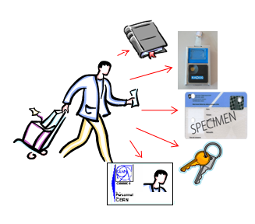
DEPARTURE FORMALITIES
Information communicated to Staff Members
Brochure from Social Services: “When you leave CERN”
2. Departure formalities
Departure letter circulated in EDH
Access to your computing account
After leaving CERN
Further advice and assistance

Slide 4
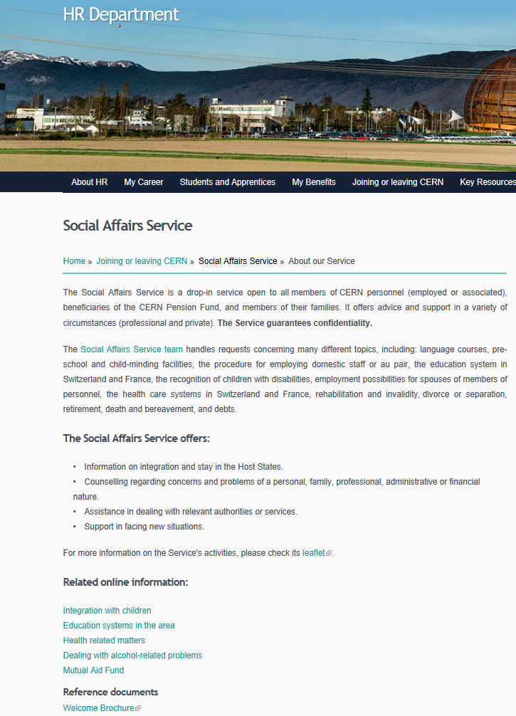

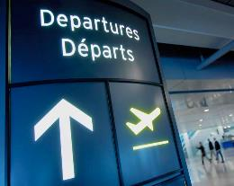
WHEN YOU LEAVE CERN BROCHURE
CONTENT
Administrative matters – Termination Sheet, Final Payments, Pension Fund, Health Insurance etc.
Personal matters – Links with CERN , Pensioners, Vehicles, Termination of Leases, Public Utilities, Insurance Policies, Bank Accounts, Taxes, Social Security.
Notes:
http://cds.cern.ch/record/1995621/files/WYLC.pdf

Slide 5
DEPARTURE FORMALITIES (1)
PERSONALIZED DEPARTURE FORMALITIES
Departure Email: received 3 months before the end of the contract or earlier if the staff member has lot of leave to take.
Departure Formalities Letter: you can find this via the link received in your inbox, tailored according to your personal situation in order to facilitate your departure.
Termination Sheet: personalized EDH document indicating the procedures you need to follow before leaving CERN (returning official cards, books, keys etc.).

Slide 6
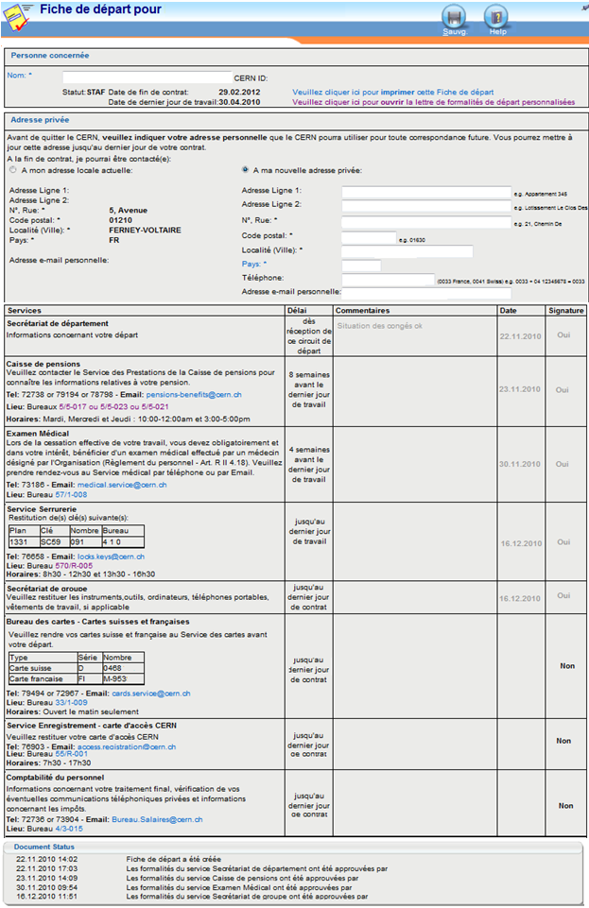
DEPARTURE FORMALITIES (2)
PERSONALIZED DEPARTURE FORMALITIES
Important: CLICK on the link provided in your departure email to generate the EDH Termination Sheet
….also important:
announce your private address in your EDH Termination Sheet
follow the indicated steps within the foreseen delay
your last stop - Salary Office

Slide 7
Access to your Computing Account
You computing account is accessible until 2 months after the end of the contract.
After this date, the account is automatically deactivated
6 months after the end of the contract, your account is automatically deleted.
After the end of your contract:
enter your private email address in the account management portal via Manage my Accounts page (https://account.cern.ch/account/Management/MyAccounts.aspx )
2 months after the end of the contract an external account is automatically created (follow the instructions received in your external email address to create the external account).
Note: When the annual internal taxation attestation is generated (every March) an email will be sent to your private email address to allow you to access it.
Notes:
https://account.cern.ch/account/Management/MyAccounts.aspx

Slide 8
Services to contact: advice and assistance
Departmental Secretariat (DAO) Admin e-guide | General Questions http://admin-eguide.web.cern.ch/procedure/formalites-de-depart
Social Services Email: social.affairs@cern.ch | Brochure ‘When you leave CERN’
Records Office Email: records.office@cern.ch | Communication of departure formalities
IT support Email: service-desk@cern.ch | Computing accounts
Staff Association | https://home.cern/cern-people/staff-association

Slide 9


