Slide 2
2017 Personnel Statistics
Anna Cook, HR Department
TREF, 8th May 2018

Slide 3
2017 Context
First full year after implementation of the five-yearly’s new career structure and diversity measures, and after introduction of Benchmark Jobs.
Recruitment of ~ 80 additional LD staff posts.
New Associate Member States joining in 2017:
  16th January: India (Associate Member State).
  4th July: Slovenia (Associate Member in the pre-stage to Membership of CERN for a minimum period of 24 months).
Improvements:
  Additional details and improved readability of the document.
  Confidence intervals added to the presentation on certain topics.
  No more Flash animation in presentation.
  New Personnel Statistics «Dashboard» available online.

Slide 4
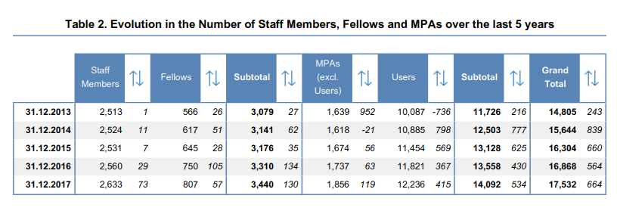
Members of Personnel
Cf. table 2, page 3

Slide 5
Members of Personnel
Total MP : 17,532

Slide 6
Personnel evolution
Cf. table 2, page 3

Slide 7
Members of Personnel
Cf. table 2, page 3
Staff members 2633 in "headcount" - 2556.4 FTEs
Fellow numbers overtook 800 for the 1st time in 2017 (807)
  79 on TTE programme
  122 Marie Curie fellows
Continued increase in number of users (now over 12,200) and in
ratio of MPA to staff

Slide 8
Category evolution
Cf. Page 8
Proportion of Cat 2. increase (80 additional posts): now over 43% total.
Increase in proportion of Cat. 5 (NB: also result of “mapping” to BMJ in 2016).
Slight decrease in Cat. 3 Technical & Cat. 4 Manual work.

Slide 9
Gender
Cf. figure 3, page 6
Staff member female percentage stable (cca. 20%)

Slide 10
Gender (2)
Cf. figure 3, page 6
Significant increase between 2013 and 2016/2017.

Slide 11
Gender (3)
Cf. figure 3, page 6
Significant increase between 2013 and 2014-2017.
Significant increase between 2013/2014 and 2016/2017.
Over the past 5 years, increase in % female students & trainees, and % of female Fellows

Slide 12
Cf. table 25, page 22
Age & Seniority
56-65 age bracket still low = low numbers of departures due to retirement foreseen in coming years
  41 retirements in 2016 vs 44 in 2017
Steady but stable rise in average age and seniority since 2012
  Avg age increase 2013 44.1 to 44.9 in 2017
  Avg seniority increase 2013 11.9 to 12.5 yrs in 2017

Slide 13
Cf. figure 9, page 22
Age & Seniority

Slide 14
Cf. figure 7, page 13 and
table 26, page 23
Age & Seniority

Slide 15
Arrivals and Departures
Cf. table 30, page 27
4.71% turnover (was 5.76% in 2014, 5.74% in 2015, 4.01% In 2016 (contract extensions))
190 arrivals vs 122 departures
80 posts impact categories 2, 3 and 5

Slide 16
Arrivals and Departures
Cf. table 29, page 26
SK: 1 person selected, but refused offer)

Slide 17
LD and IC contracts
Cf. figure 8, page 15
Slight increase in LD-IC ratio 32.6 : 67.4 (impact of additional 80 posts)
Continued monitoring of succession planning: skills retention remain a challenge
Contract extensions advantage for LS2 skill retention (2012 ‘flexibility posts’ and 2017 80 posts)
2017:
  44 Retirements vs 42 IC awards
  49 LD contract expirations

Slide 18
LD and IC contracts
Cf. table 18, page 15

Slide 19
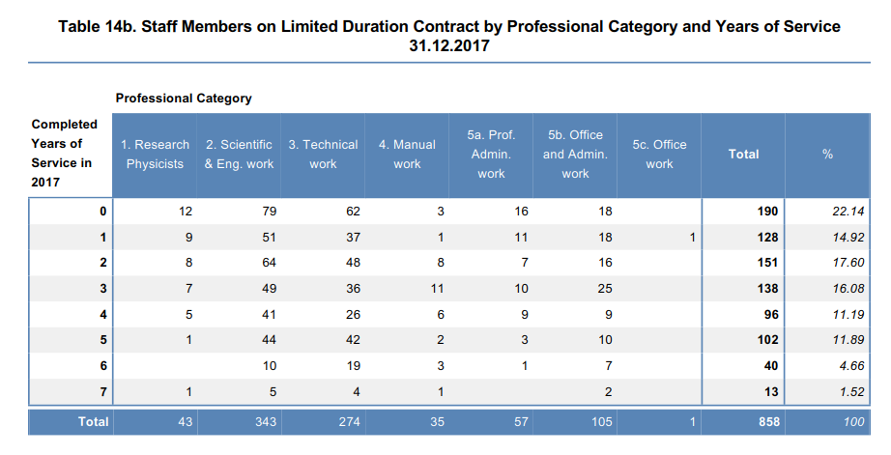
Cf. table 14b, page 12 and
table 43, page 42
LD contract extensions
Contract policy 2015
Standard contract duration is 5 years, extensions up to max 8 years
Clear predominance in categories 2 and 3
Notes:
AC 2 Extension of a limited-duration contract
a. Procedure and criteria
47. In determining whether the extension of a limited-duration contract is in the interests of the Organization, the respective Head of Department shall hold a discussion with representatives of: the staff member’s hierarchy, the department in question, and the Human Resources Department, to consider the following: 47.1 The nature of the activities, in particular: i) ongoing need for the functions; ii) availability of budget resources in the short to medium term; iii) required team competencies; and iv) duration and complexity of training required for a new staff member to the position, and
47.2 Elements relating to the staff member, in particular: i) their overall proven performance record; ii) their professional potential and versatility.

Slide 20
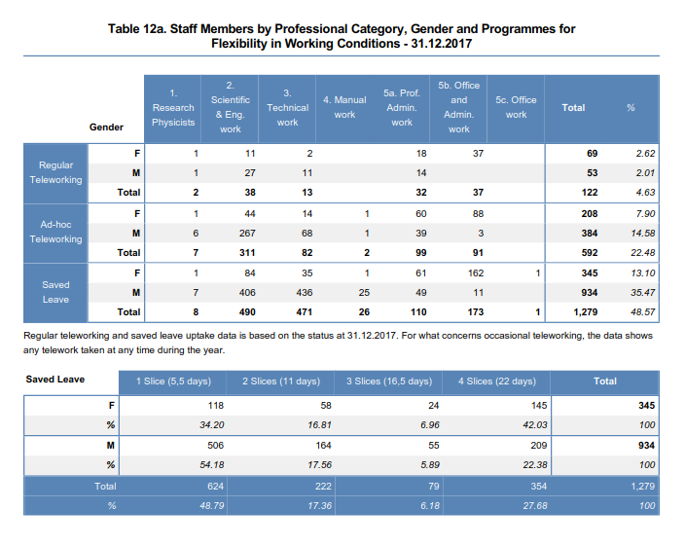
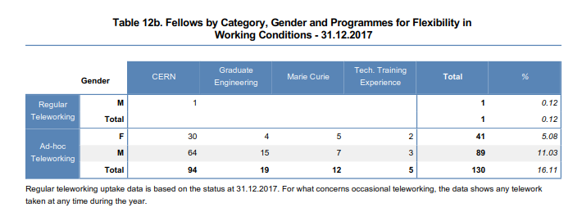
Telework and saved leave
Cf. tables 12a and b,
Page 10
122 Staff members on regular telework
  592 ad hoc (up from resp. 97 and 461 2016)
Saved leave taken by 48.6% of staff members (44% M and 63% F)
Fellows’ uptake of ad hoc telework cca 16%

Slide 21
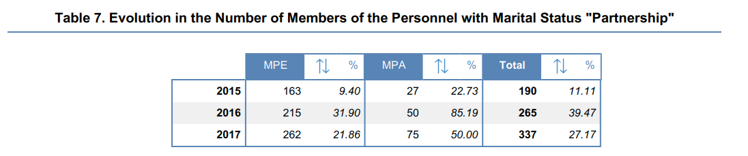
5-YR: Partnerships
Cf. table 7, page 6
2016: Full recognition of registered Partnerships
  Equal benefits for married and partnered couples during employment or association contract.
  Equal provisions regarding pension benefits, including survivor’s pension, for employed members of personnel.

Slide 22
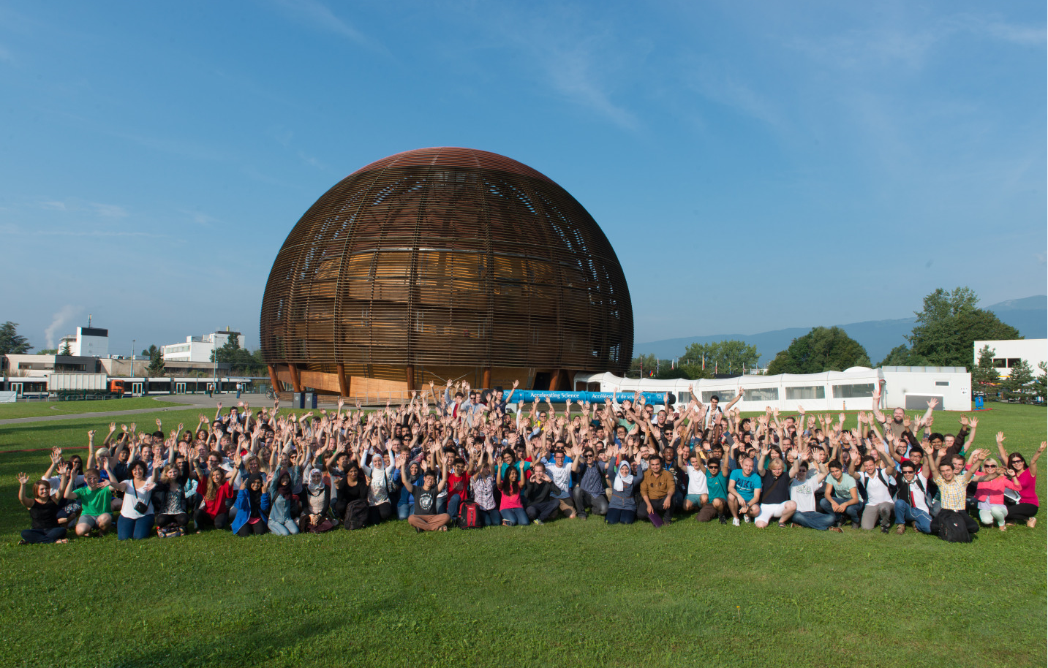
Investing in future generations
Status | Typical stay
Doctoral students | 3 years
Technical students | 1 year
Admin students | 1 year
Apprentices | 4 years
Trainees | 5 months to 2 years
Fellows | 2 to 3 years
Summer students | 8 – 13 weeks

Slide 23
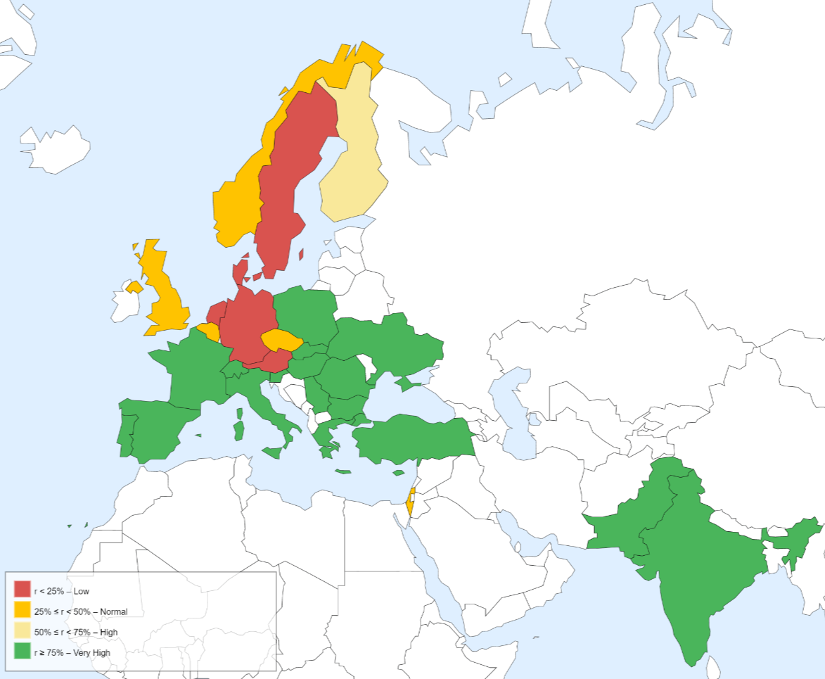
Staff recruitment
Pages: 37 - 43
Average age of a new recruit stable at cca. 34
Country and domain specific challenges persist (RF, electricity, electronics …)
  11 republications owing to sourcing challenges (out of 184 vacancies)
  No selections for CZ, DK and IL: require specific action (outreach, targeted publicity)
32 not attended interview/738 invited (4.3%) vs 2.7% in 2016 and 5.3% in 2015)
6.2% refused offer rate (was 6% in 2016, 5% in 2015, 11% in 2014)
Staff Return on Applicants by Nationality

Slide 24
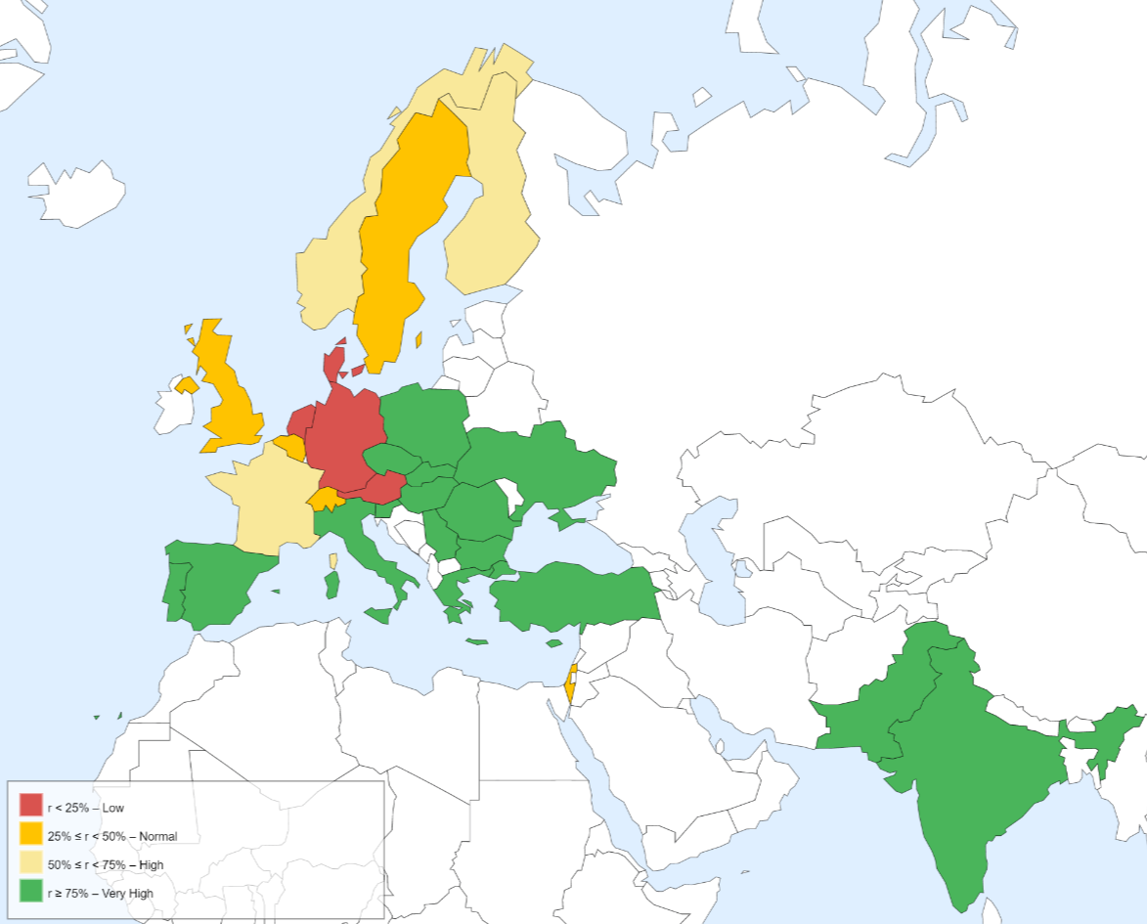
Pages: 44 - 47
Fellows & Students recruitment
Fellows
  Applications highest from IT, GR, ES and FR.
  High applications from IN and PK
  Selections highest for IT (incl. 19 females), ES, FR and PL, Further increase in e.g. NO with 14 fellows selected (3 females - only 6 selections in 2016)
Students:
  TECH & DOCT:
    Continued Improvements seen for Scandinavia (NO & FI)
    Positive selection rate for DE (44%)
Continuous efforts to attract fellows & students from under-represented countries:
  Career fairs, university visits, advertising
Fellows return on Applicants by Nationality

Slide 25
Conclusions
Stable staff resources (small increase); increase in fellows & MPAs.
  80 additional LD staff posts reflected predominantly in staff cats 2,3 and some 5.
Workforce planning is key (succession, extensions, LS2 around the corner).
Aim to maintain a stable LD:IC ratio.
Continued take up of new diversity measures observed.
Dedicated focused outreach in under-represented MS for Staff, Fellow and Student programmes.

Slide 26
Personnel Statistics Dashboard
https://aistools-prod.cern.ch/docs/display/TPRDOC/HR+Dashboards

Slide 28
Back up slides
TREF 8th May 2018

Slide 29

Methodology
SAMPLE
CENSUS
Personnel Statistics is based on a census
No error based on the fact that the data collected may not be representative of the whole population
Notes:
Personnel Statistics document is based on a census (recensement) and not on a sample, i.e. there is no error based on the fact that the data collected may not be representative of the whole population (we are considering the whole population).

Slide 30


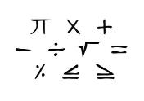
Methodology (2)
?
MP by gender and year
proportion of women over n years
proportion is higher/lower than previous year
TEST OF PROPORTION
Notes:
One tool often used in statistics for human and social sciences is called “tests of hypothesis”. This allows to check the statistical significance of an observation.
In the context of PS, we had computed proportions over n years and wanted to make sure that the observed evolution was significant.

Slide 31

Methodology (3)
Population A
= ?
Population B
34 %
36 %
CERN MP
= ?
19 %
0.00 % … 50.00% … 100.00 %
Notes:
We implemented two slightly different approach and finally choose the one that seems the more relevant in our context. It is based on the test of proportion, that is used to compare proportions in two different populations, taking into account not only the proportions themselves, but also the average proportion and the size of the populations.
What we did here is to compare the observed proportions with all possible proportions that could have been observed. Then we draw a confidence interval on the graph, showing that inside this interval, if we accept 5% of error, there is no statistical difference.

Slide 32


Methodology (4)
CONFIDENCE INTERVAL
19.23 %
19.00 %
18.95 %
Size of interval depends on …
%

Slide 33
80 additional staff LD posts
80 additional staff on limited-duration contracts.
Presented in a Green Paper to Council in December 2016.
Overall increase in staff complement of 3%.
Visible in the personnel statistics in terms of the LD:IC ratio impact and Staff Members by professional category
Notes:
To ensure:
the successful implementation of CERN’s scientific programme
including the reliable and effective operation of the LHC,
the timely completion of the LHC upgrade
the continuation of a moderate but compelling scientific diversity programme
the preparation of the future through R&D efforts and design studies,
continuous engagement in other strategic goals (e.g. education and training)
a modest increase of 80 FTE (~ 3%) in the number of staff on LD contracts is required.
This additional staff will be assigned to key technical areas where crucial needs have been identified following a comprehensive resources analysis, conducted in the second half of 2016.
The posts in question will be financed, within the existing Budget, by reallocating 2% of the materials budget to the personnel budget, without any additional contributions from the Member and Associate Member States or any increase in the peak cumulative budget deficit.

Slide 34
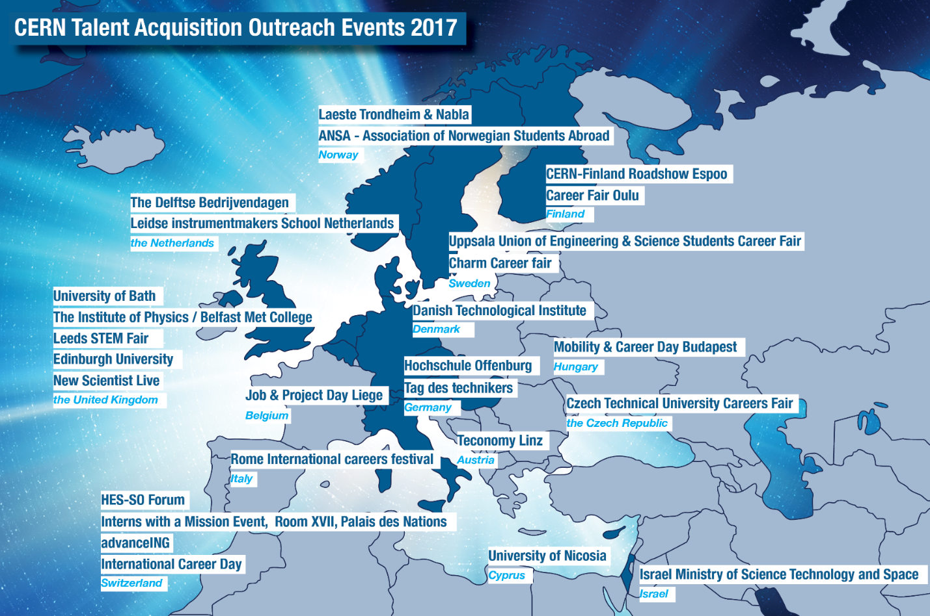

Slide 35
2017 outreach
Title | Country | City
Teconomy Linz / IAESTE / Johannes Kepler University | Austria | Linz
Danish Technological Institute Danes@cern | Denmark | Taastrup
Career Fair Oulu | Finland | Oulu
Finland | Finland | Helsinki/Espoo
Tag des Technikers | Germany | Erlangen
Rome International careers festival | Italy | Rome-Skype
Iaeste Trondheim & Nabla | Norway | Trondheim
ANSA - Association of Norwegian Students Abroad | Norway | OSLO
Charm Career fair | Sweden | Goteborg
HES-SO Forum Montreux | Switzerland | Montreux
International Career Day in Bern | Switzerland | BERN
Czech Technical University Careers Fair / IAESTE | the Czech Republic | Prague
The Delftse Bedrijvendagen | the Netherlands | Delftse
‘Return Day’ at ‘Tool makers School’ / Leidse instrumentmakers School Netherlands - http://www.lis.nl/ | the Netherlands | Leiden
ROC ICT and Technical education / ROC Leiden (Regional Education Centre) - https://www.rocleiden.nl/opleidingen/mbo-opleidingen/techniek/ | the Netherlands | Leiden
University of Bath | the United Kingdom | Bath

Slide 36
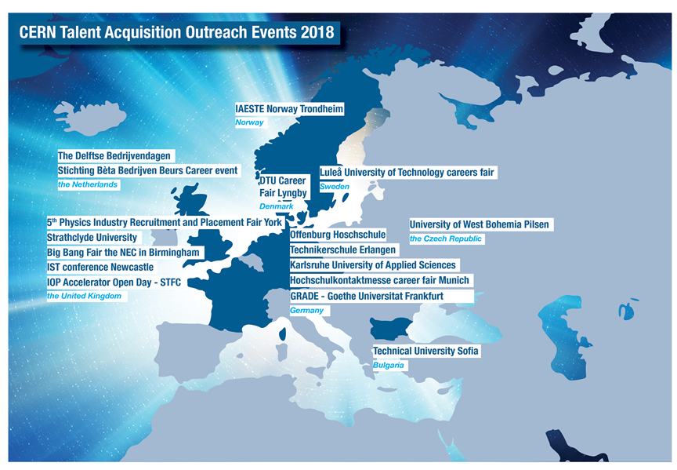

Slide 37
2018 outreach
Title | Country | City
Lyngby Fair | Denmark | Lyngby
5th Physics Industry Recruitment and Placement Fair | the United Kingdom | York
Luleå University of Technology’s careers fair | Sweden | lulea
The Delftse Bedrijvendagen | the Netherlands | Delft
IAESTE Norway trondheim | Norway | trondheim
offenburg ? | Germany | Offenburg
Strathclyde University | the United Kingdom | Glasgow
Technikerschule Erlangen | Germany | Erlangen
Universite de Haute Alsace, Mulhouse / presentation | France | Mulhouse
Karlsruhe | Germany | Karlsruhe
Big Bang Fair the NEC in Birmingham | the United Kingdom | Birmingham
BBB careereventbeurs | the Netherlands | Nijmegen
HOCHSCHULKONTAKTMESSE career fair Munich | Germany | Munich
Center "Career and Alumni" - Technical University - Sofia | Bulgaria | Sofia
IST conference Newcastle | the United Kingdom | newcastle
Jobfair of University of West Bohemia Pilsen CZ | the Czech Republic | Pilsen
IOP Accelerator Open Day/STFC - material only provided | the United Kingdom | Warrington

Slide 38

EU Charter
As part of our collaboration with the European Commission, CERN subscribes to the principles of the European Commission’s European Charter of Researchers and Code of Conduct for the Recruitment of Researchers (EU C&C)
Principles = best practice guidelines, to promote equal rights and obligations for individual researchers throughout Europe by specifying the roles, responsibilities and entitlements of researchers, as well as those of funders and/or employers of researchers.
They promote attractive research careers and boost employment and working conditions for European researchers
Introduced in 2010
  410 organisations have received the Award

Slide 39
EU C&C:
CERN’s Application
CERN’s application for the award comprises a gap analysis of the 40 points of the EU C&C, as well as an associated action plan on 20 of these.
Regarding Diversity, the following points will be addressed:
  Working conditions:
    Exchange of information between CERN and the EC relevant to gender in science and research.
    Offer internship opportunities to STEM students with disabilities/special needs with a view to increasing their inclusion in the High-Energy Physics and related fields.
  Gender balance:
    Further study the leaky pipeline of early career researchers to increase the pool of women candidates to Staff member positions.
    Set up a dedicated communication channel between CERN LGBTQ Informal Network and the Diversity Office to ensure inclusive practices for trans-gender people.

Slide 40
5-YR: Telework (formerly WFH)
Exceptional second day of teleworking under certain conditions (health condition, family circumstances).
Introduction of teleworking for fellows.
Possibility of occasional teleworking if approved by the hierarchy.
Possibility of teleworking from another location than home.
Notes:
Registered throughout the year – increased visibility of the programme
Saved leave: cost reduction
Increase in 2-3 slices

Slide 41
LD and IC contracts (2)

Slide 42

Stress Management @ CERN
Project objectives
Identify and act on causes of stress
Increase people’s coping abilities
Provide structured and holistic support systems
PHASE 1.
Understand what exists outside CERN and analyse what exists at CERN
PHASE 2.
Define the scope and methodology for diagnosis
Raise awareness
Launch Survey and Focus groups
PHASE 3.
Design stress prevention programme
Analyse diagnosis results
Propose interventions
PHASE 4.
Implementation (roles and responsibilities matrix)
Define monitoring measures / KPIs
PHASE 5.
Project closure
End of 2018
End of 2018
TODAY
June – October 2018
January – May 2018
September December 2017
42

Slide 43



Proposed scope to prevent stress
Comprehensive Stress Prevention & Management Programme
Reducing workplace stressors & reinforcing moderators
Helping individuals to identify stress symptoms & improve their coping skills
Assisting individuals experiencing on-going difficulties in the workplace
Interventions at the individual, teams and organisational levels
Stress reduction
Stress management
Remedial assistance
Causes
Effect
Primary
Secondary
Tertiary
43

