Slide 1

Norway WG
Knowledge Transfer Overview for

Slide 2
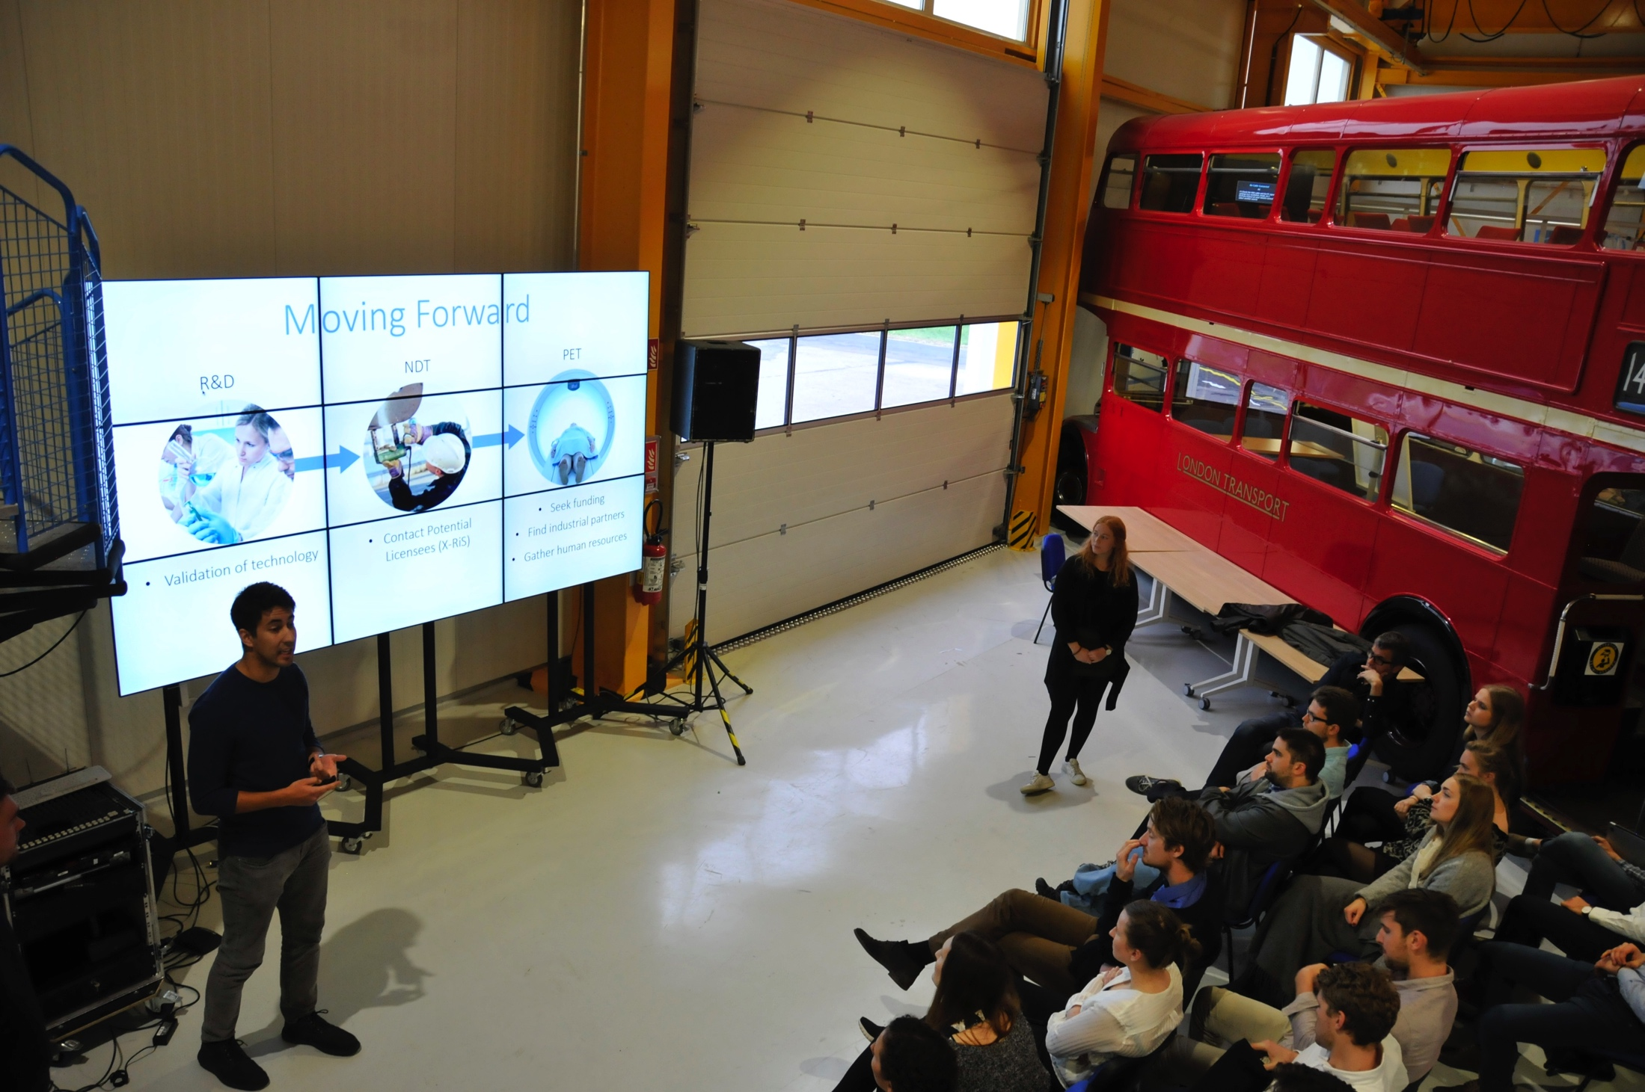
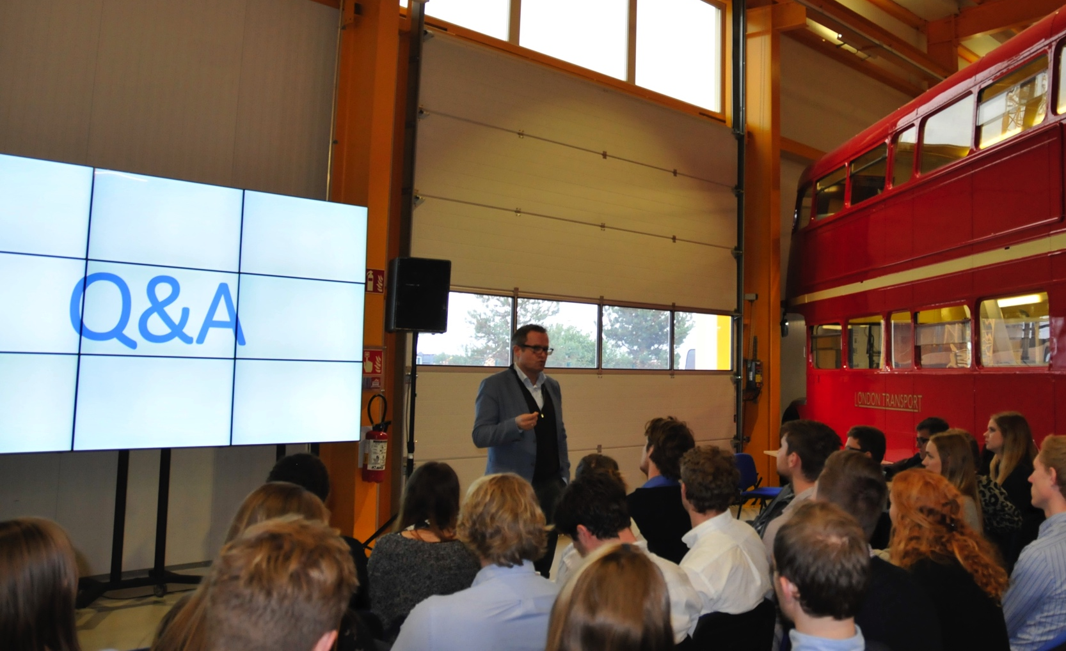
CERN – NTNU Screening Week
10 sessions until now in total
41 technologies screened
About 270 students visited and worked with the KT Group
Providing a large exposure of CERN Technologies to Norwegian Industry
Next edition: October 2018

Slide 3
BIC in Norway
Contract signed in 2014 expires in October
Little impact obtained with the present setting
Need to review the situation and possibly select another partner
CERN is committed to continue this endeavour but we need to work together to make it a success

