Slide 1


Electronics setup and configuration
ECS WORKSHOP

Slide 2
Documentation
Control system manual:
  https://gitlab.cern.ch/lhcb-readout40/readout40-docs/raw/master/WinCC_panels/Control_System_for_the_MiniDAQ.pdf?inline=false
ECS guidelines:
  http://lhcb-online.web.cern.ch/lhcb-online/ecs/default.htm
Creating Device Units and Control Units
  http://lhcb-online.web.cern.ch/lhcb-online/ecs/fw/FSMConfig.pdf
JCOP guidelines:
  https://edms.cern.ch/ui/file/1100577/1.3/jcopFrameworkGuidelines.pdf
FwHw Documentation:
  http://lhcb-online.web.cern.ch/lhcb-online/ecs/fwhw/default.html

Slide 3
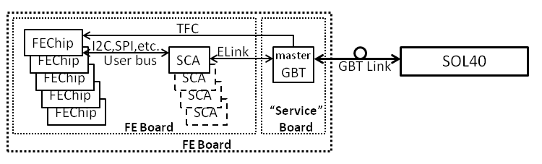
Front End control architecture
Gbt Client
HwTool
Run Control
GbtClient
  Direct access to the front-end registers through an full address
Hardware Tool
  Access FE registers by name
  Monitoring controlled by the GbtServ
  Hardware models in dpe structures
Run Control
  Implementing Device FSMs on top of HwTool
  Configuration of FEs through recipes upon “CONFIGURE”
WinCC-OA
Control PC
MiniDAQ or PCIe40
Firmware
GbtServ
DIMServer
PCIe Library P
FPGA
PCIe driver P
SOL40
PCIe
SOL40
Host PC

Slide 4
HwTool – Creating your models/devices
Create you Hardware types with XML files
  Build modular models, separate by geography or function.
  Bear in mind that WinCC has a limit of Datapoint Elements under the same Datapoint structure.
  Default values of settings are useful, they will be the same for all the instances.
  2 parameters common to all registers:
    “poll” for the monitoring period in seconds
    “onchange” for updating the datapoint only when the reading changes
  Import into WinCC and you’re ready to instantiate devices!
Instantiate your devices with fwHw_create
  Apply other settings with fwHw_setCommonSettings
Subscribe your devices with fwHw_subscribe (whole device)
  This configures the GbtServer to map these devices to their physical address and connect datapoints via DIM
Come to us for a case-by-case Study

Slide 5
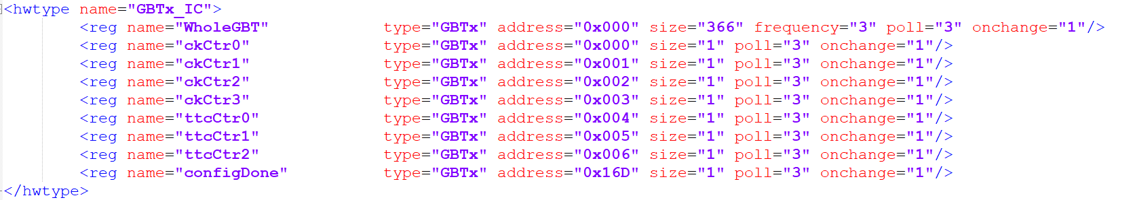
HwTool – Model guidelines
  Define the physical model
  The bigger the registers for configuration, the better.
  Can have overlapping definitions if it helps!

Slide 6
HwTool – Devices FSM
After instantiating your devices…
Necessary for controlling FEEs from Run Control (recipes).
The leaf nodes of the FSM tree (device units) should:
  Represent the smallest part of the detector you want to disable/enable
  Most natural: 1 device unit per hardware device
  Implement other enable/disable functionalities in user panel (store in datapoints)

Slide 7
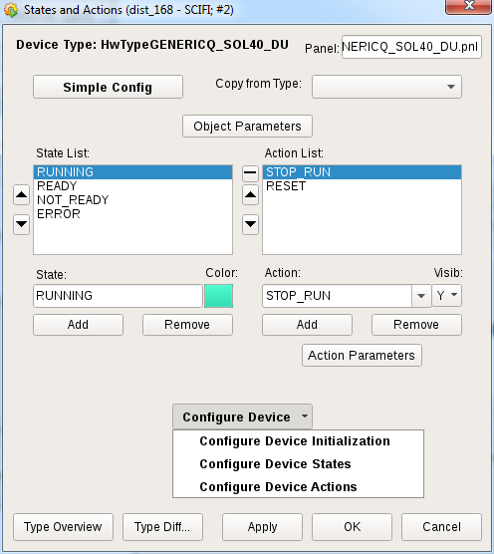
Defining your Device FSM actions
<DeviceType>_DU_initialize()
  Called at FSM Startup: clear alarms for example
  <DeviceType>_valueChanged()
    Result of a dpConnect of important device parameters, return new STATE|
  <DeviceType>_doCommand()
    Command execution (Configure/Start/Stop/etc…)
Configure_deviceType
  Config_GBTx()
  Config_SCA()
  Set_GPIOs()
  fwHw_applyRecipe() -> http://lhcb-online.web.cern.ch/lhcb-online/ecs/fwhw/default.html
  post recipe configurations
  can startMonitoring()
  Important: define functions in libraries

Slide 8
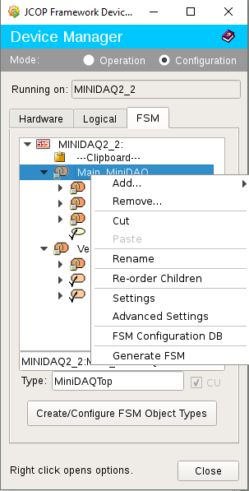
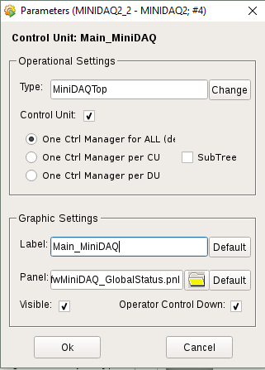
HwTool – Devices FSM
User panel for devices units and control units
  Set with fwFsmTree_setNodePanel or through Device Manager
Use the JCOP colors only (avoids confusion)
Colors must indicate a status, not actions (colors on buttons are unadvised)
Default $parameters ($1 -> domain, $2 -> device)

Slide 9
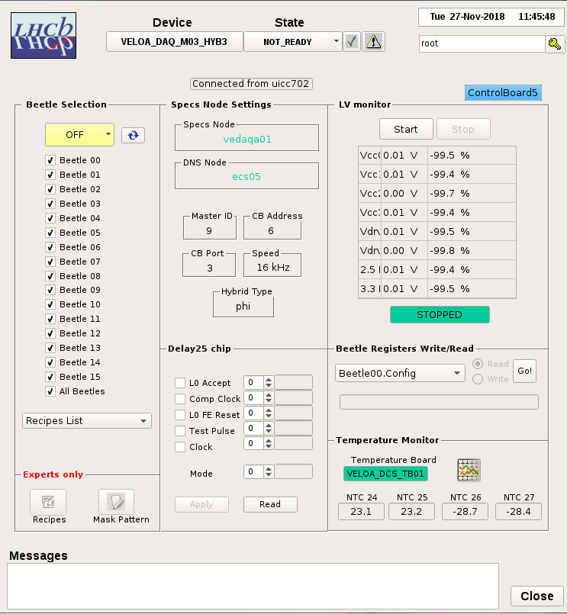
Example device panel
FwStateOkPhysics |  | Okay and physics data taking
FwStateOkNotPhysics |  | Okay but not physics data taking
FwStateAttention1 |  | Not good, needs attention
FwStateAttention2 |  | Further away from Physics
FwStateAttention3 |  | There is a real problem here!
RUNNING
READY
NOT READY
UNKNOWN
ERROR

Slide 10
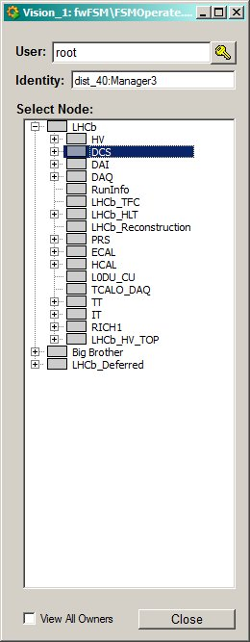
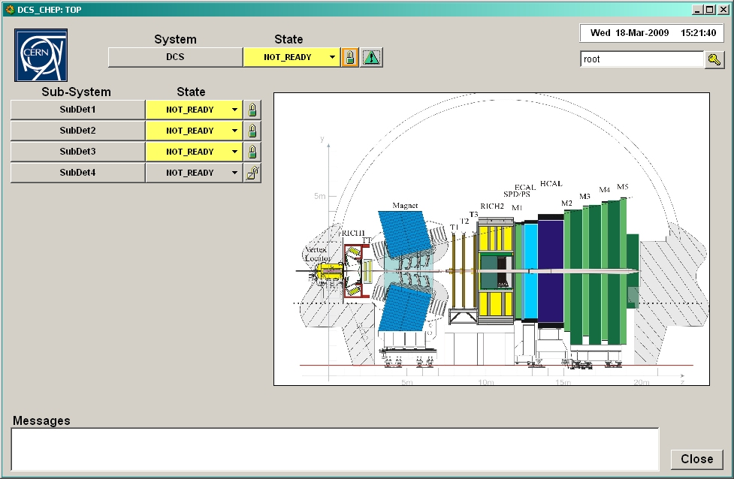
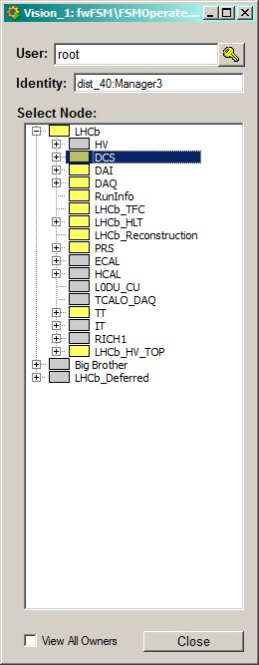
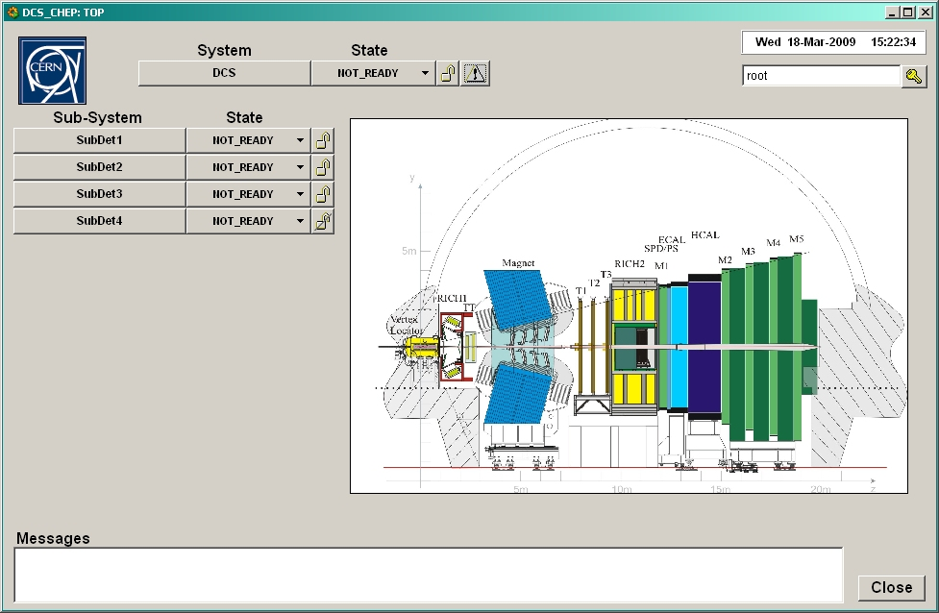

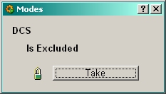
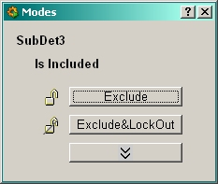
Generic user interface
“Embedded” partitioning rules:
  Take
  Include
  Exclude
  Ignore
  Etc.

Slide 11
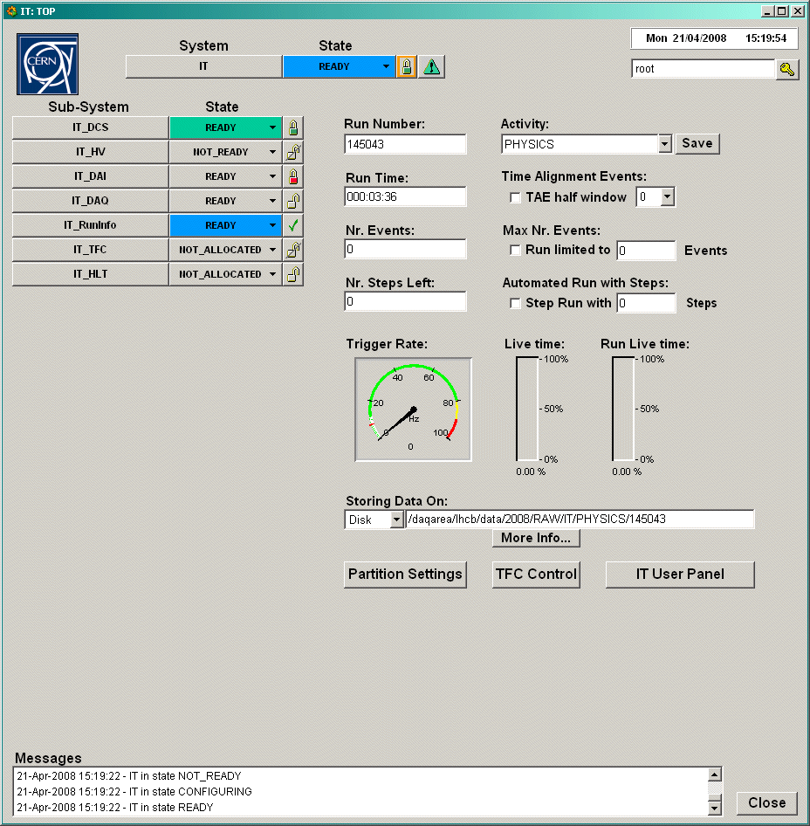
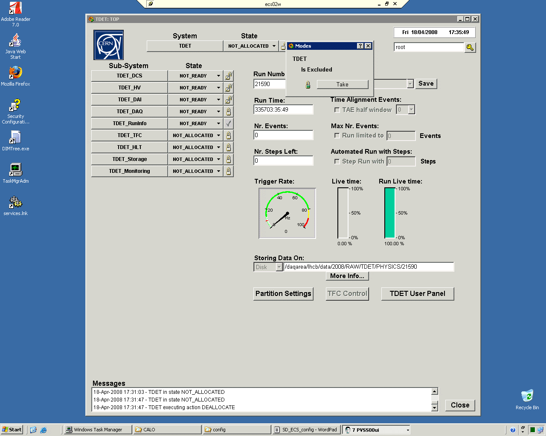
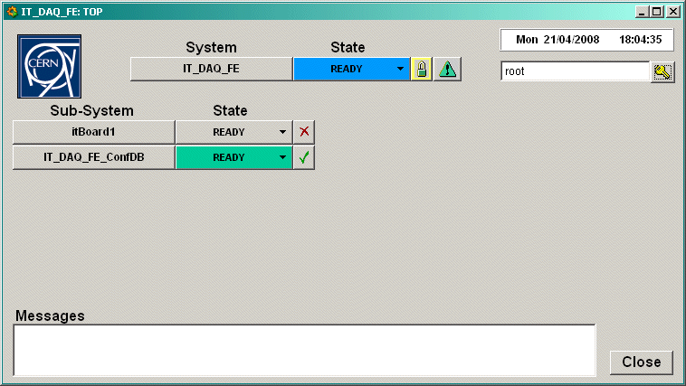
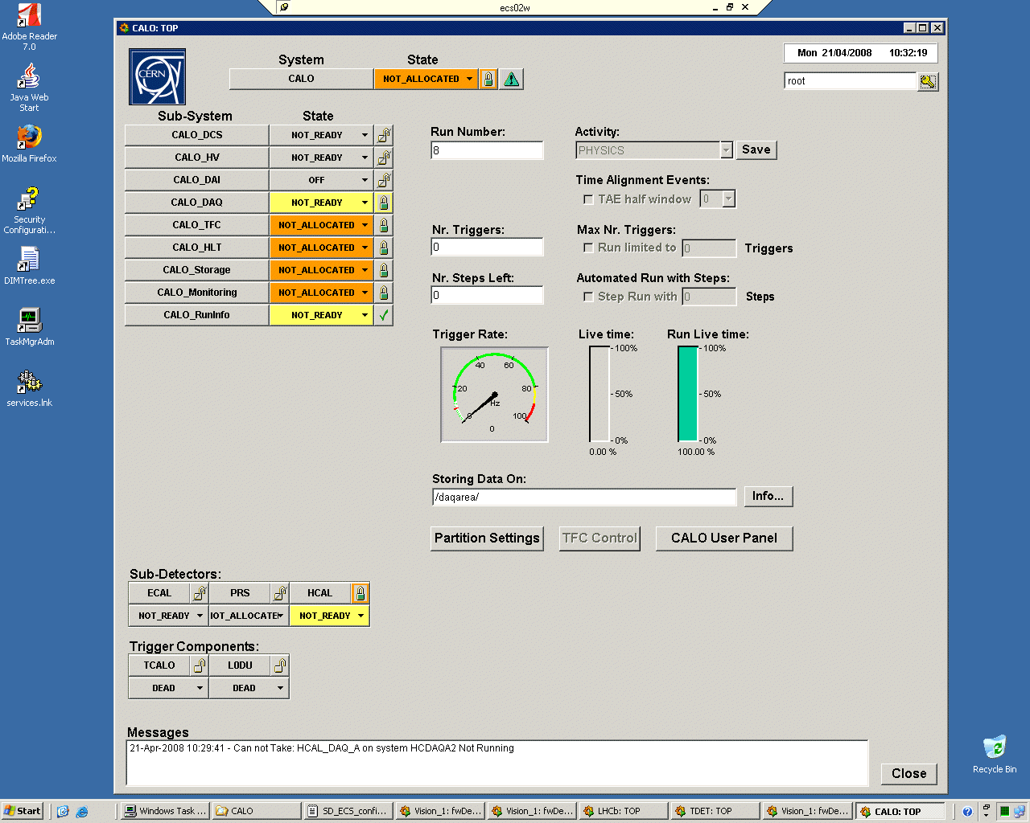
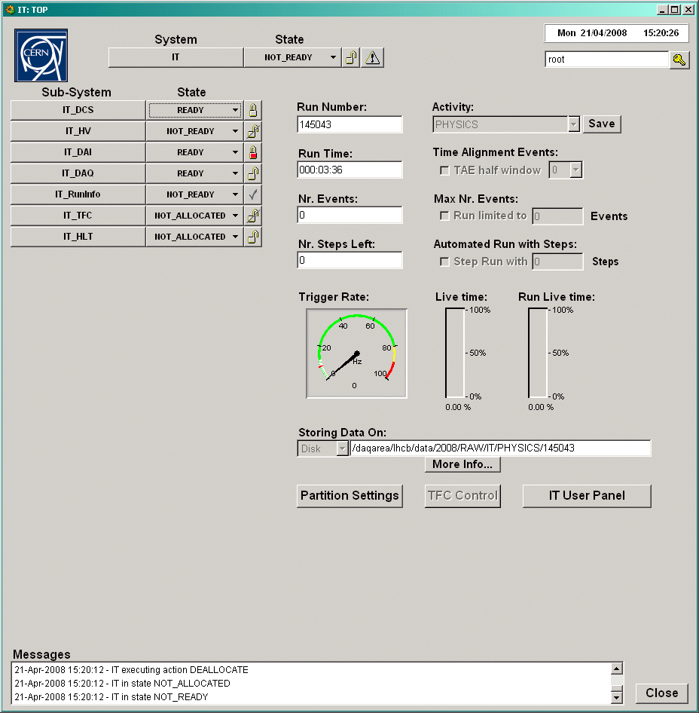
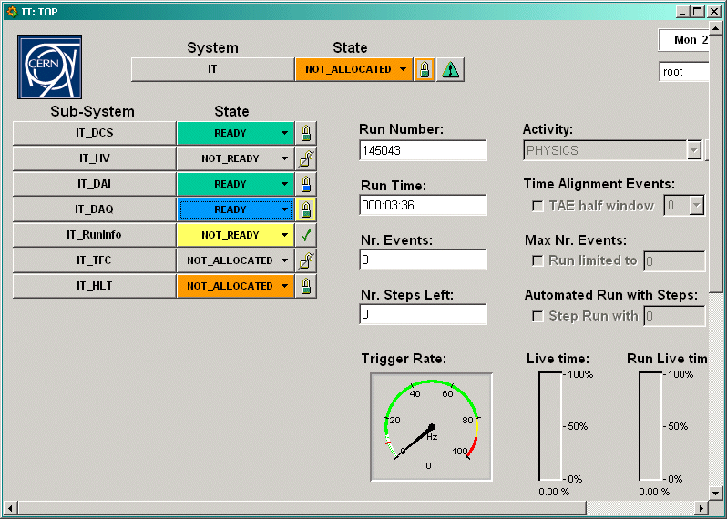
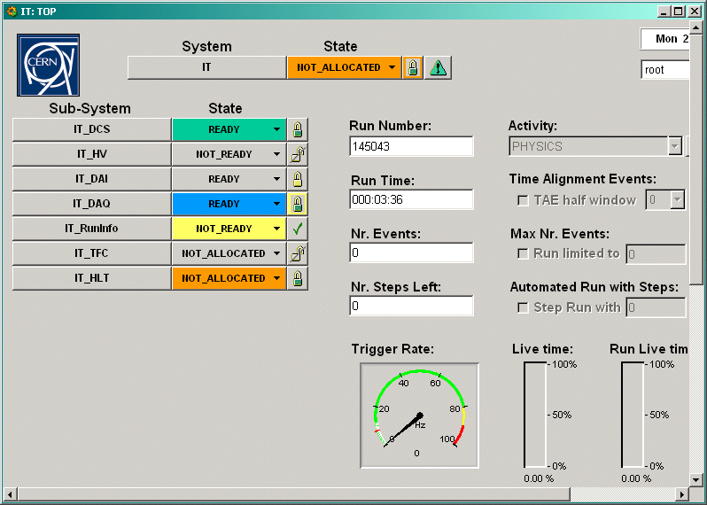
Generic interface symbols
Control Units (CU)
Excluded
Complete Tree below
Excluded & LockedOut
Device(s) disabled below
CU(s) excluded below
Included / No Owner
FSM Dead below
Included / You are the Owner / Exclusive
Device Units (DU)
Included / You are the Owner / Shared
Included / Owned by someone else / Exclusive
Enabled
Included / Owned by someone else / Shared
Disabled

Slide 12
Questions?

Slide 13
Why a need for a new SOL40_SCA?
Resource Usage
  Right now we cannot fit 48 links of SOL40
  Need more sharing between the SCAs and several links
  Transfer some ALMs usage to memory usage
Release CPU of some painfull tasks
  Avoid or reduce SCA protocol micromanaging
  Bit swapping and alikes
  Avoid memory copies
  Ideally GbtServer does not touch the data between getting it from DIM and sending it to the SOL40.
In general speed up the configuration and monitoring process
Notes:
-LHC experiments will enter the LS 2
-LHCb will use this LS 2 to upgrade the detector together with ALICE
-For Run 3 LHCb will perform 30MHz readout without hardware trigger
-All detector electronics are going to be refurbished to handle the new readout rate
-For readout, TFC and slow control ECS the detector electronics will be connected through optical links to the off detector electronics

Slide 14
What changes for the SOL40
  SOL40_SCA:
    One core per for all the links (resource usage scales with link number and SCAs per link still)
  GBT Internal Control Manager:
    One SC_IC core for all the links
  SOL40_link_core
    Gets the data from the SOl40_SCA elinks and maps it according to every subdetector mapping
Notes:
In the SOL40 firmware we try to have as little firmware replicated as we can (not always easy)
Avalon slave interfaces the user logic with the PCIe interface.
The SOL40_SCA is the block that decodes ECS commands (meant for the GBT-SCA) into actual SCA commands. There is only one block for all the links and the block is configurable to serve as many SCAs as needed.
Same goes for the GBT Internal Control Manager (configuring the GBTx throught the IC field in the fiber).
These two blocks will output a serialized pair of bits (elinks) that will be routed to the actual physical elink through the mapping implemented in the SOL40_link_cores.
Inside these cores the necessary delays are applied to the TFC commands and mixed with the GBT-SCA commands to then be sent through a GBT word to the GBT-FPGA core later on.

Slide 15
What changes in the SOL40_SCA
2 memories per link
  One tx data
  One rx data
1 command FIFO per link
1 Reply FIFO for all the links
Ideally 1 SCA agent per SCA
1 Protocol decoder for all the links
Commands are uniquely identified
GBT-SC (EP-ESE) used for hdlc encoding
Command data size now depends on the memory sizes, no longer restricted to 128 bit per command
Command word 0 | Gbt Link [31:24] | SCA elink index [23:16] | SCA channel number [15:8] | Cmd code [7:0]
Command word 1 | Protocol specific word [31:0]
Command word 2 | Data Address [31:16] |  | Data length [15:0]
Command word 3 | Command Identifier [31:0]
Notes:
SOL40_SCA is responsible for decoding the commands sent by the GBTserver units through the driver and unfold these into as many GBT-SCA commands necessary to do the task.
SOL40_SCA firmware core was designed to be able to operate the SCAs in parallel and to accept ECS commands that send many bytes to the SCA
It does so by having memories in the buffer layer that hold the data to be sent to the front-ends while the SCA agents go through that data and send the necessary micro commands to the chips through the GBT-SC
There are also several FIFOs instantiated with the command specifications that are picked up by the SCA agents. The fact that there are several fifo units prevents clogging of the stream of commands if a GBT-SCA suddenly goes unresponsive.
Once the SCA agent is active with an ECS command, it will unroll as many SCA commands as necessary to fulfill the ECS request, by configuring all the register necessary and fetching the data words from memory to be sent to the GBT-SCA
The SCA agent is the one handling the send-wait cycle of the micro commands to the GBT-Sca and summarizes the result of these operations to the GbtServer through the ECS reply FIFO (which can be only one for all the SCAs)
GBT-SC is responsible for the encoding of these commands in the serialized pair of bits of the elink.
This module is shared between all the links and is configurable in the sense that the memories can be bigger if there is memory to eb used in the FPGA. Some parts like the SCA agent and the GBT-SC will scale linearly with the number of SCAs served by the block. However others like the protocol driver or the buffers layers will rather scale with the number of GBT links.

Slide 16
What changes in the GbtServer
DIM Services/Commands
GbtServ of today
HW Tool
Monit.
GBT/SCA
Low level lib
pcie40_ecs
driver
HW Tool
Srvcs and Cmds
BAR registers
GbtClient
Srvcs and Cmds

Slide 17
What changes in the GbtServer
DIM Services/Commands
GbtServ of for SOL40_SCA_V2
HW Tool
Monit.
GBT/SCA
Low level lib
pcie40_ecs
driver
HW Tool
Srvcs and Cmds
BAR registers
1 thread per SCA
GbtClient
Srvcs and Cmds

