Slide 1
Experiment Control System
…A Brief History
And the path to Operations…

Slide 2
The JCOP Project
Joint COntrols Project
  Between the 4 LHC Experiments and a CERN Support Group: IT -> EN -> BE
  Created in December 1997
  First tasks
    Gather Requirements from Experiments
    In-depth Technological Survey
      SCADA – Supervisory Control and Data Acquisition
      (commercial and “home-made”)
    WinCC-OA (PVSS at the time) chosen
    Define the Architecture, Develop the Framework

Slide 3
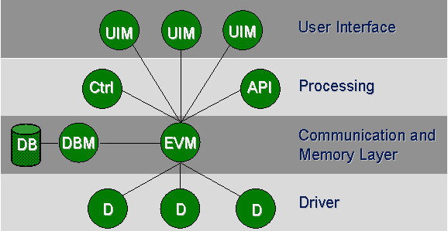
The SCADA tool
Why WinCC-OA?
  Technical (& Financial) Reasons
    Windows & Linux (not so common)
    Distributed & Open Architecture
      Could scale to very large distributed systems
      Could integrate external tools (FSM, etc.)
    Many tools and interfaces:
      Graphic Editor, Archiving, Alarm Handling, Drivers, etc.
    Many man-years of development for a small price
  “Sociological” reasons
    Standard Interfaces: The same concepts everywhere
    (The datapoint mechanism, the scripting language, Gedi, etc.)
      Can share resources within and outside the experiment.
      Not perfect at everything, but a coherent and integrated set of tools

Slide 4
The JCOP Project
Today:
  Still extremely active
    Meetings (almost) every week
    Several FW components being revised and improved:
      Archiving, Alarm handling, Device access, etc.
    Provide Support & Training
JCOP Tools Usage:
  LHCb use the JCOP Concepts throughout ECS
    DAQ/RunControl, DCS/BigBrother, etc.
  While the other LHC Experiments only for DCS
    NA62 and ProtoDUNE more like LHCb
  Other CERN domains also use it:
    Magnets, Cryogenics, Electricity, Cooling, Vacuum, etc.

Slide 5
LHCb Upgrade ECS
Same Architecture & Concepts as current system
Selected Concepts:
  Integration & Homogeneity
  Partitioning & Automation
  Promote HW Standardization
    Same board (PCIE40) for:
      DAQ R/O (TELL40)
      TFC + ECS (SOL40)
    CAEN, Wiener, Iseg, ELMBs…
  Separate Data/Control paths
  Promote SW Uniformity
    Guidelines, FW Components, FSM Templates
  Small number of Operators
    1 Operator +1 Data Manager
ECS
INF
DCS
TFC
DAQ
HLT
LHC
Commands
…
…
Status & Alarms
SubDet1
DCS
SubDet2
DCS
SubDetN
DCS
SubDet1
DAQ
SubDet2
DAQ
SubDetN
DAQ
SubDet1
LV
SubDet1
TEMP
SubDet1
GAS
SubDet1
FEE
SubDet1
RO
Legend:
Control
Unit
LV
Dev1
LV
Dev2
…
LV
DevN
FEE
Dev1
FEE
Dev2
…
FEE
DevN
Device
Unit

Slide 6
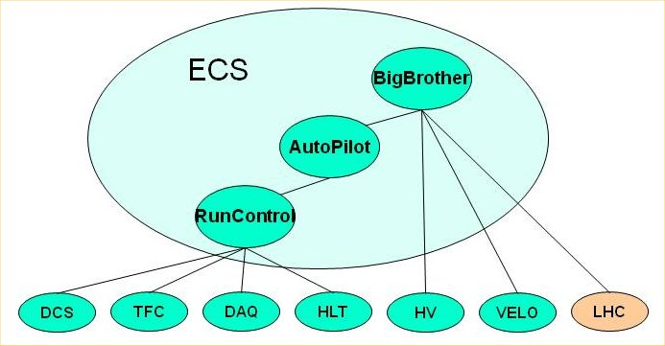
LHCb Operations
Main Tools:
  RunControl
    Handles the DAQ & Dataflow
    Allows to:
      Configure the system
      Start & Stop runs
  AutoPilot
    Knows how to start and keep a run going from any state.
  BigBrother
    Based on the LHC state:
      Controls SD Voltages
      VELO Closure
      RunControl

Slide 7
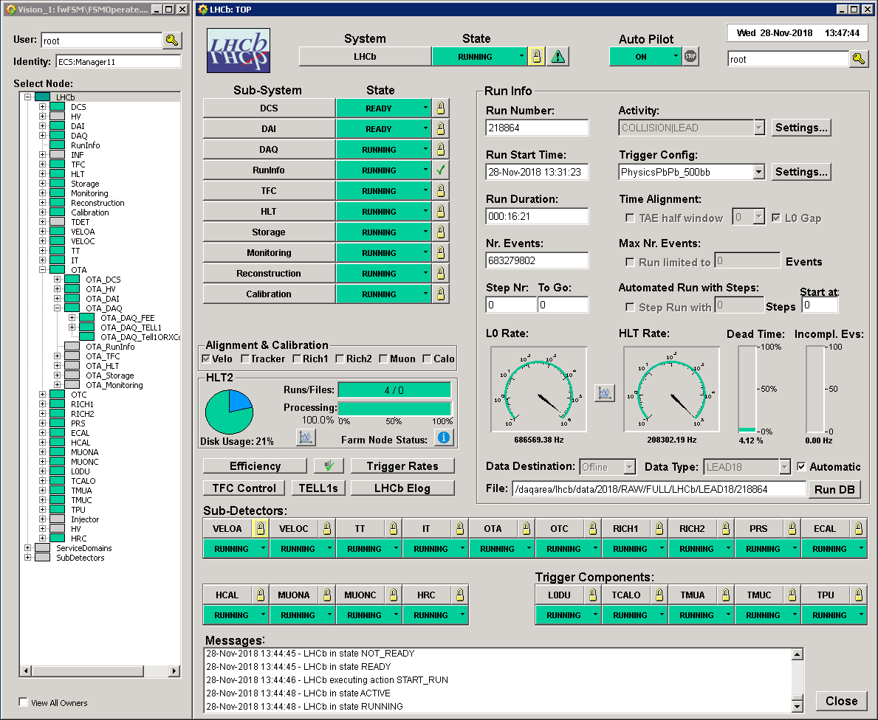
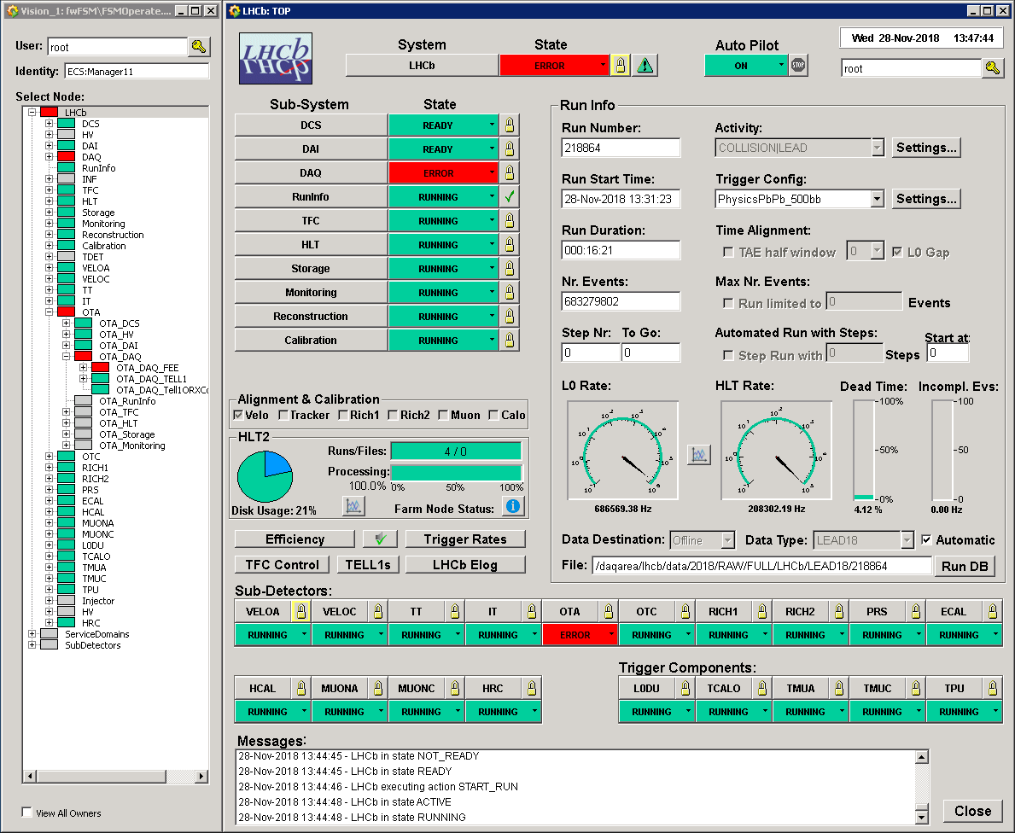
Run Control
Matrix
Domain
x
Sub-detector

Slide 8
DAQ Partitioning
Partition:
  Part of the system that can run independently and concurrently with the others (LHCb, VELO, RICH1, etc.)
Some resources
are shared:
  TFC
  HLT
  Storage
  Monitoring
  Reconstruction
Need to “Allocate”
  In order to define the resources needed by a partition:
  For example the number of HLT sub-farms
X
Detector
L0
VELO
ST
OT
RICH
ECal
HCal
Muon
Trigger
L0 trigger
FE
FE
FE
FE
FE
FE
FE
LHC clock
TFC
Electronics
Electronics
Electronics
Electronics
Electronics
Electronics
Electronics
System
Readout
Readout
Readout
Readout
Readout
Readout
Readout
Board
Board
Board
Board
Board
Board
Board
Front
-
End
Experiment Control System (ECS)
MEP Request
READOUT NETWORK
Event building
SWITCH
SWITCH
SWITCH
SWITCH
SWITCH
SWITCH
SWITCH
SWITCH
C
C
C
C
C
C
C
C
C
C
C
C
C
C
C
C
C
C
C
C
C
C
C
C
C
C
C
C
P
P
P
P
P
P
P
P
P
P
P
P
P
P
P
P
P
P
P
P
P
P
P
P
P
P
P
P
U
U
U
U
U
U
U
U
U
U
U
U
U
U
U
U
U
U
U
U
U
U
U
U
U
U
U
U
HLT farm
MON farm
Event data
Timing and Fast Control Signals
Control and Monitoring data

Slide 9
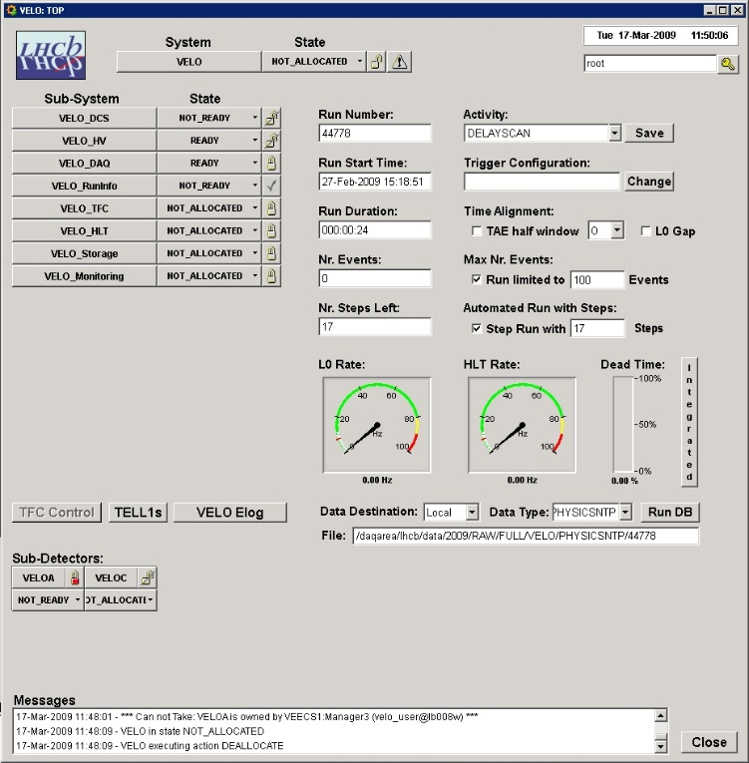
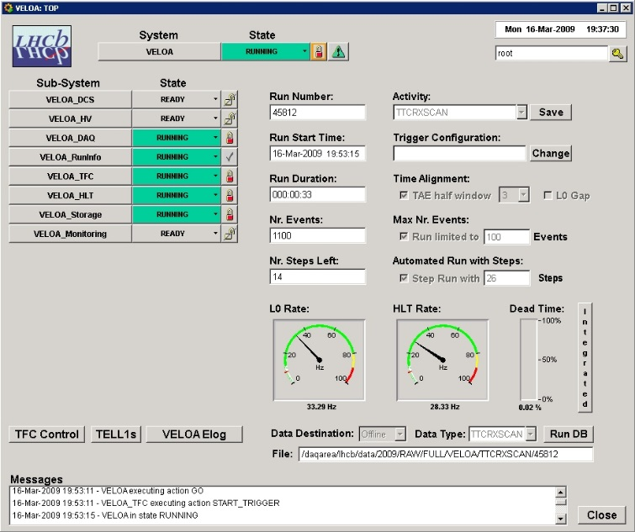
Sub-Detector Integration
ECS
INF
DCS
HV
DAI
DAQ
TFC
HLT
LHC
VELO
X
X
X
X
VELOA
VELOC
VELOA
DCS
VELOA
HV
VELOA
DAI
VELOA
DAQ
VELOA
COOLING
VELOA
LV
VELOA
TEMP
VELOA
CRATES
VELOA
FEE
VELOA
TELL40

Slide 10
Run Control FSM
NOT_ALLOCATED
Steps:
  Allocate resources
  Configure Sub-systems:
  Apply Electronics settings
  prepare DAQ/HLT jobs
  Start:
  Prepare to acquire data
  Start Trigger:
  TFC only
Allocate
ALLOCATING
Deallocate
ERROR
Recover
NOT_READY
UNKNOWN
Configure
CONFIGURING
Reset
READY
Start
Stop
ACTIVE
Go
Stop_Trigger
RUNNING

Slide 11
Run Control
Matrix
Domain
x
Sub-detector
Activity
Driven

Slide 12
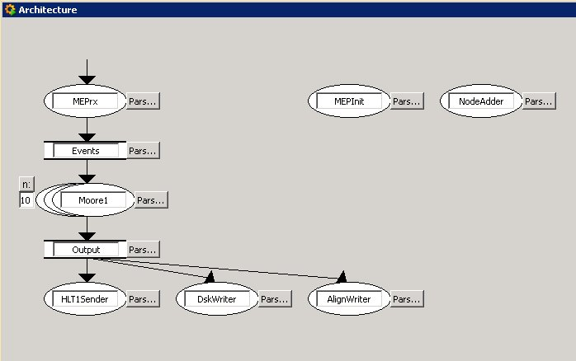
Run Control Activities
Activity
  “Activity” defines the “recipe” which will be applied by all sub-systems on CONFIGURE
    Ex.: PHYSICS|LEAD
    Will try to apply “PHYSICS|LEAD” everywhere, if not existing will try “PHYSICS”, if not existing “DEFAULT”
  “Activity” also contains the global run settings:
    Architecture for farm nodes ->
    Nr. Sub-farms
    Trigger Config. (TCK)
    Data Type & Destination:
      Local, Castor, Offline
    Calibration “Step Runs”
      TAE flag, nr. events, nr. steps

Slide 13
Sub-detector Configuration
ECS
1
INF
DCS
HV
DAI
DAQ
TFC
HLT
LHC
1
VELOA
DCS
VELOA
HV
VELOA
DAI
VELOA
DAQ
2
Conf.
1
1
DB
2
VELOA
DCS_1
VELOA
DCS_2
VELOA
DAQ_1
VELOA
DAQ_2
VELOA
Dev1
3
Configure/mode=“PHYSICS|LEAD”
Check… Ex: Get “PHYSICS” Settings
Apply Settings
VELOA
Dev1
1
VELOA
Dev1
VELOA
DevN
2
3

Slide 14
ECS Databases
WinCC-OA (Project) Data Base Context
Conf.
DB
if Needed for next
run settings
(Pedestal Followers)
Configuration settings
for a running mode
“Recipes”
Experimental Equipment
WinCC
OA
PVSS
Archive
Monitoring data
(at regular intervals)
if Archive On
DB
if Passes Conditions filter
.
.
Cond.
To Offline
To Offline
DB

Slide 15
LHCb Operations
Main Tools:
  RunControl
    Handles the DAQ & Dataflow
    Allows to:
      Configure the system
      Start & Stop runs
  AutoPilot
    Knows how to start and keep a run going from any state.
  BigBrother
    Based on the LHC state:
      Controls SD Voltages
      VELO Closure
      RunControl

Slide 16
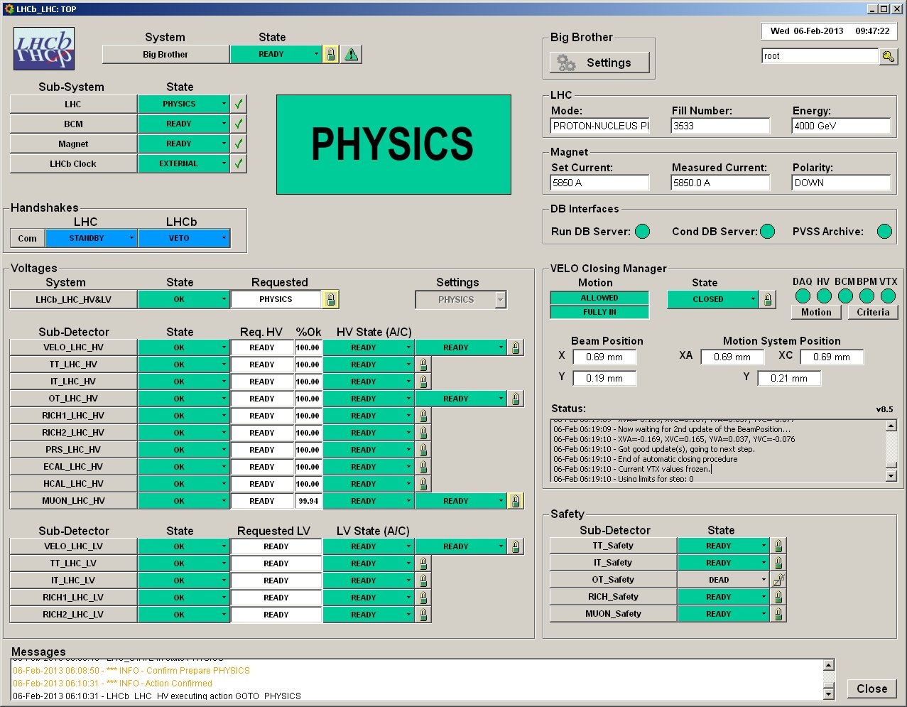
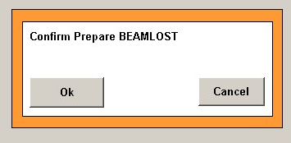
Big Brother
Based on LHC state, controls:
  Voltages
  VELO Closure
  Run Control
Can sequence activities, ex.:
  End-of-fill Calibration
Handshake
Confirmation
Voice Messages

Slide 17
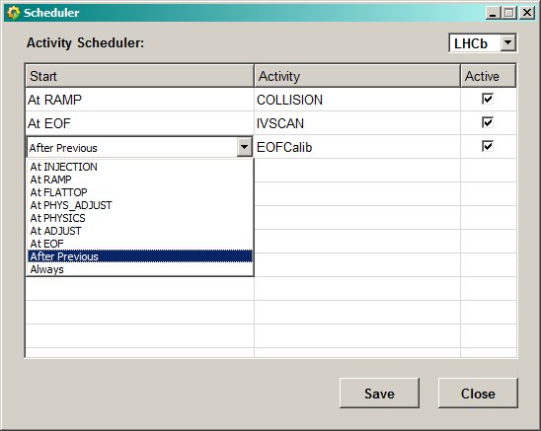
Big Brother Scheduler
Scheduler:
Provides complete
Run Control Automation

Slide 18
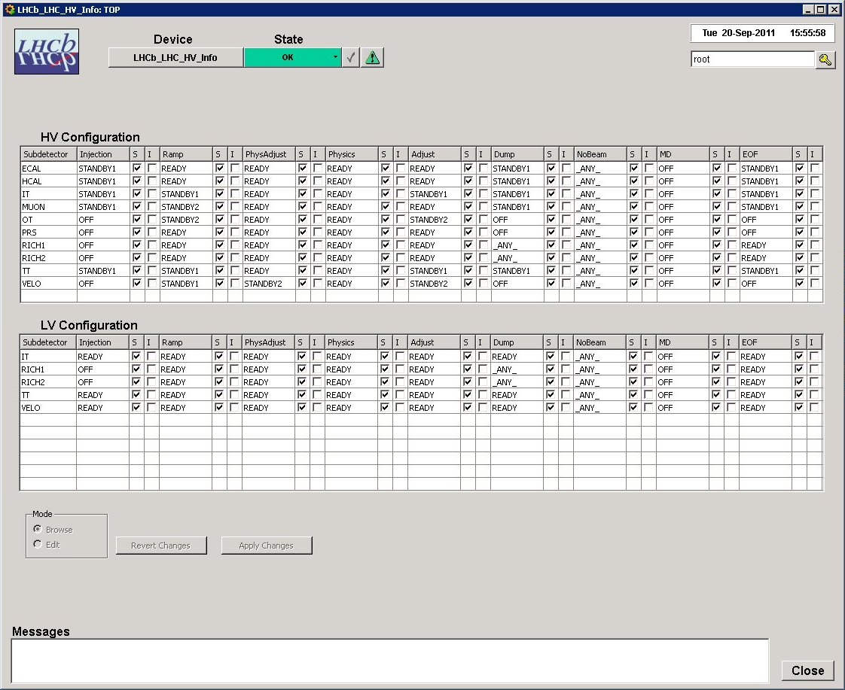
Big Brother Voltage Table
Matrix
Sub-detector
X
LHC State

Slide 19
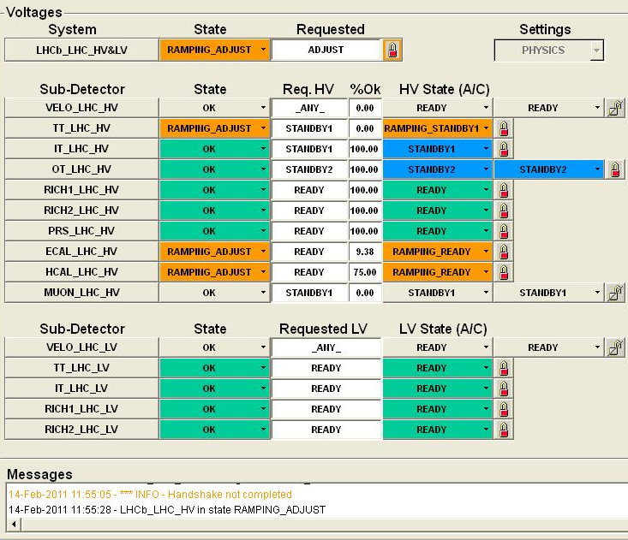
Voltage Control
State column
(Current SD state regard. LHC state)
Requested
(SD target state)
%Ok
HV/LV State
(SD Current state)

Slide 20
Safety Tree(s)
Sub-detectors can have a “parallel” Safety tree
  Does not replace HW/DSS interlocks
ERROR
Recover
Switch_OFF
NOT_READY
OFF
VELOA
Switch_ON
Switch_OFF
READY
Clear_Emergency
EMERGENCY_OFF
Do_Emergency_OFF
From any state
VELOA
DCS
VELOA
HV
VELOA
DAI
VELOA
DAQ
DCS FSM
(HV FSM Equivalent)
VELOA
COOLING
VELOA
LV
VELOA
TEMP
VELOA
HV
VELOA
CRATES
VELOA
FEE
VELOA
TELL40
VELOA
Safety

Slide 21
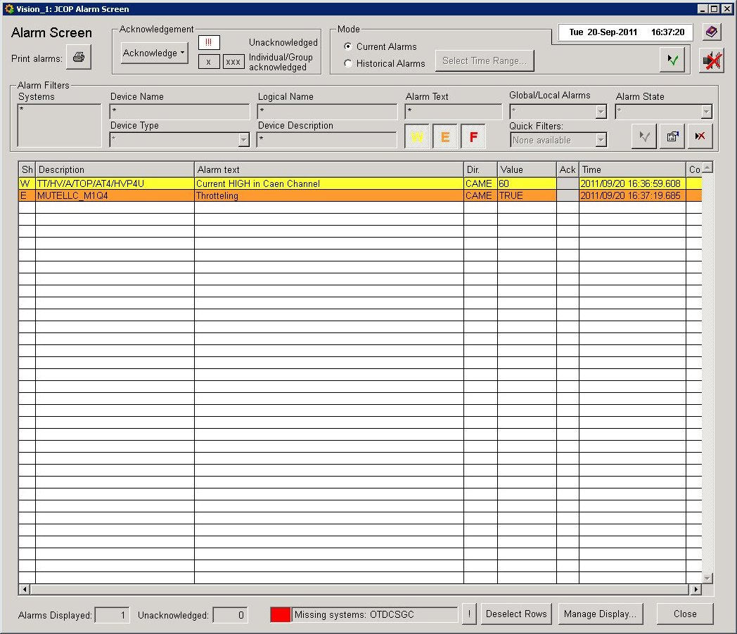
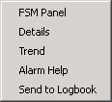
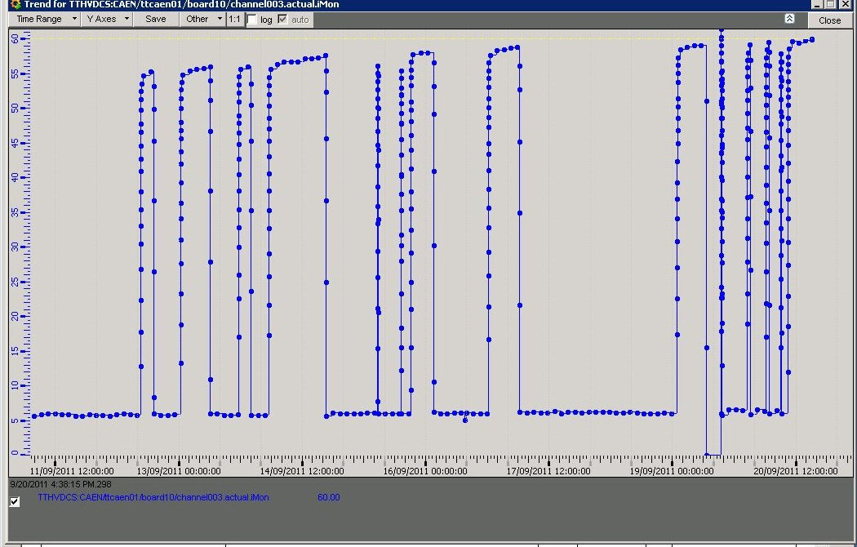
Alarm Screen
Normally empty
Every alarm should be followed up
May also provide complementary information to FSM Errors
Severities:
  Warning
  Error
  Fatal

Slide 22
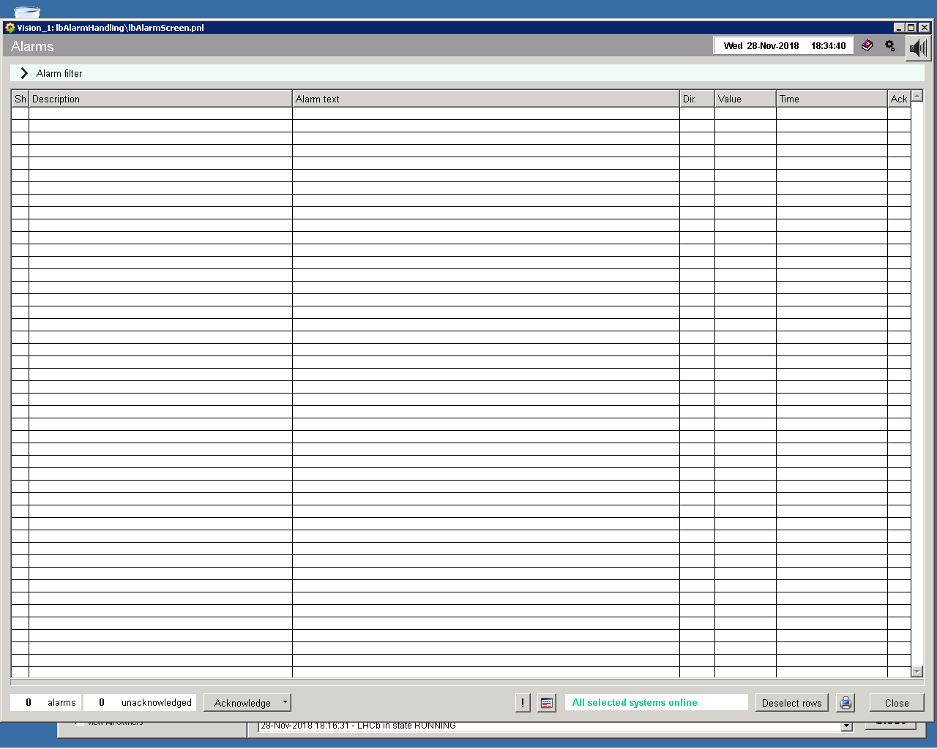
Alarm Screen (Yesterday)

Slide 23
Slide from Nov. 2006
 | VELO | ST |  | OT | RICH |  | CALO |  |  | MUON
 |  | IT | TT |  | RICH1 | RICH2 | ECAL | HCAL | PRS/SPD
DAQ
FE | SPECS | SPECS | SPECS | SPECS | SPECS/J | SPECS/J | SPECS | SPECS | SPECS | ELMB
TELL1/UKL1 | CC-PC | CC-PC | CC-PC | CC-PC | CC-PC | CC-PC | CC-PC | CC-PC | CC-PC | CC-PC
DCS
LV | CAEN E | Wiener M | Wiener M | Wiener M | Wiener M | Wiener M | Wiener M | Wiener M | Wiener M | Wiener M
Environ. | ELMB | SPECS | SPECS | SPECS | ELMB | ELMB |  |  | ELMB | ELMB
Cooling | Nikhef | 2 TC/CV | 2 TC/CV | TC/CV | TC/CV | TC/CV | TC/CV | TC/CV | TC/CV | TC/CV
Gas |  |  |  | GasWG | GasWG | GasWG |  |  |  | GasWG
HV
HV | ISEG | CAEN | CAEN | CAEN | CC-PC | CC-PC | SPECS | SPECS | SPECS | C | FL
DAI
crates | CERN | CERN | CERN | CERN | CERN | CERN | CERN | CERN | CERN | CERN
Legend:
Not yet started
Development started
(Tools identified)
Under development
Almost Ready
(Prototype exists)
Ready
 | VELO | ST |  | OT | RICH |  | CALO |  |  | MUON
 |  | IT | TT |  | RICH1 | RICH2 | ECAL | HCAL | PRS/SPD
Other
VELO Posit. | PLC
VELO Vacuum | PLC
VELO Interlock | ELMB
ST BP pos. |  | SPECS | SPECS
IT RadMon |  | VME
OT Pos. Mon
OT RASNIK Al |  |  |  | PCI
RICH Si. bias |  |  |  |  | CAEN | CAEN
RICH Magfield |  |  |  |  | ? | ?
RICH Laser Al
RICH MagDist
Calo LED |  |  |  |  |  |  | SPECS | SPECS | SPECS
Calo source |  |  |  |  |  |  | CAN | CAN | CAN

Slide 24
Conclusion
ECS “Readiness”
  Tools are better than in 2016, but:
    Very short time
    A lot to be done
    (In 2008 we had an extra year…)
Don’t hesitate to talk to us…

