Slide 1
Linac4 Towards Operation
B. Mikulec on behalf of the Linac4 Supervisors and PSB operation

Slide 2
Outline
Schedule
Linac4 HW commissioning
Linac4 beam commissioning milestones
Operational improvements / open points
Reliability run planning

Slide 3
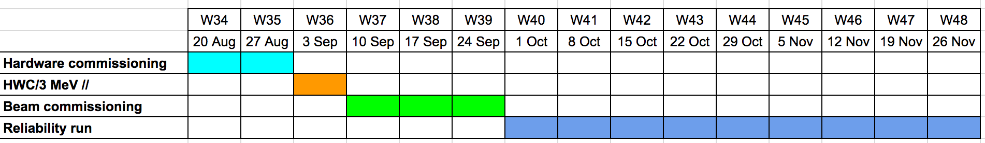
Schedule and Organisation
W34-35 managed by OP; dry runs with equipment experts
W36-39 managed by ABP in close collaboration with OP and equipment groups
From W40 managed by OP in close collaboration with ABP and equipment groups
Wednesday 9-10am weekly meetings chaired by M. Lamont
  Very beneficial and reinforces collaboration

Slide 4
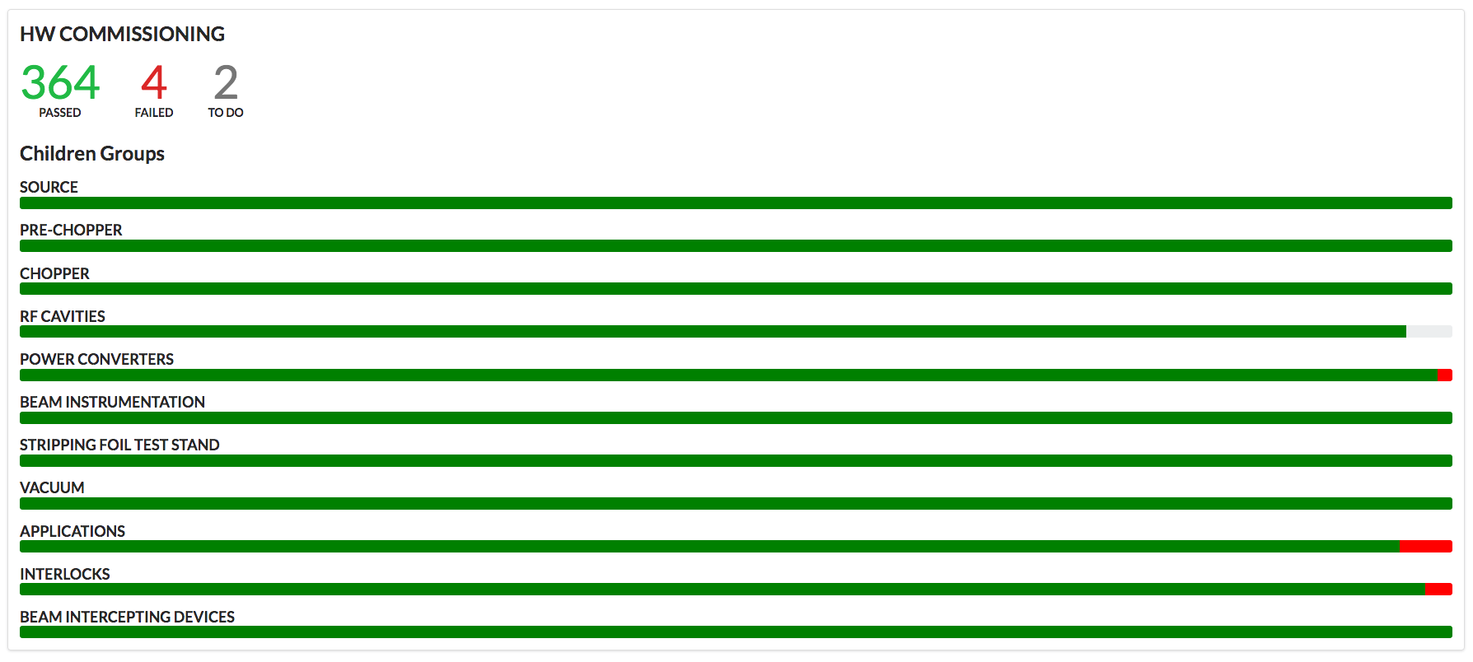
Linac4 HW Commissioning
Checklist prepared and tests carried out by CPS operators
Planning through standard ASM tool with link to checklist (BCWG)
Completed on time (0.5 weeks pre-requisites, 2 weeks HW comm.)
  52 pre-requisite tests + 364 HW tests successfully performed
  Debuncher commissioning outstanding
  4 failed tests (Autopilot – to be followed up with ABP, in-depth RF BIS commissioning still to be scheduled)

Slide 5
Linac4 Beam Commissioning Milestones
Commission the RF changes deployed during the summer stop | DONE
Evaluate functionality of all beam instrumentation to be ready for reliability run → support from BI for repairs/calibrations/corrections | ~90% completed
Autopilot running with min. functionality to avoid steady manual tuning of source and low-energy line | Still open; Autopilot only surveying/restarting source HV supplies and source RF
Source caesiation by OP from ccc if needed | Done by source specialists, as Autopilot not available for caesiation
Assure OP participation for RF phasing in to learn procedure | OK (operators partially trained)

Slide 6
Linac4 Beam Commissioning Milestones – Beam Quality
As defined during the June workshop
~25mA beam current at the end of the linac
600 μs beam pulse length with ~5% flatness at the end of the linac
180 μs beam pulse length with ~2% flatness at the end of the linac
Pulse-to-pulse stability
Nominal chopping scheme (~64% chopping factor) with <1% extinction factor
Nominal beam requirements defined in EDMS 1898179

Slide 7
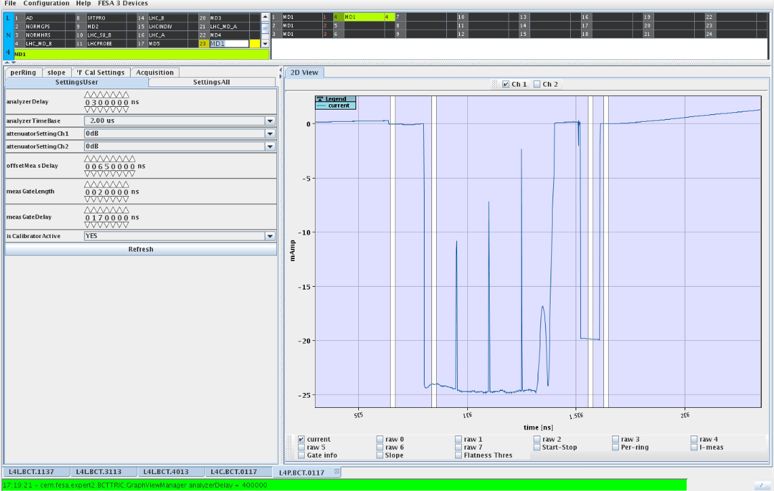
Beam in PIMS
25 mA at the end of the linac
  Discovered after TS that the flat top of the quadrupoles has to be extended for a 600 us long beam (doing this for the low-energy quads removed the ‘dip’ in R1) and EPC still needs to check correct synchronization of the FGCs with beam.

Slide 8
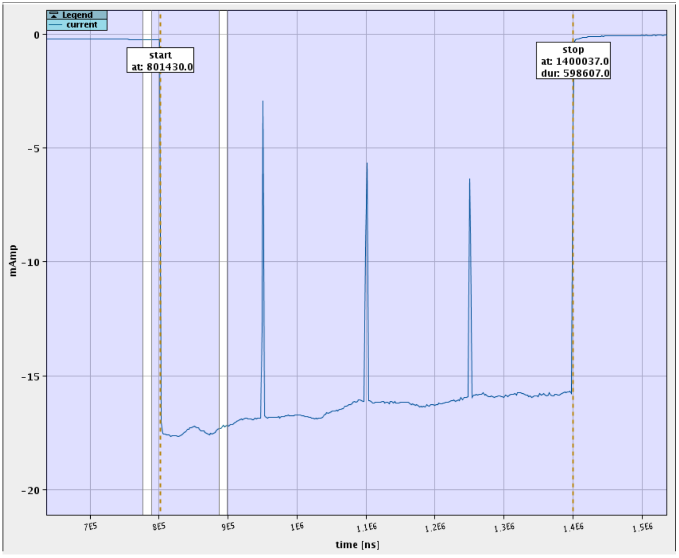
600 us long beam pulse at end of linac
Chopper upgraded during summer for longer beam pulse
  Had to remove 150 us in addition of beam head with chopper for stable pulse start
L4Z.BCT.0273 (02/10/2018)
600 us

Slide 9
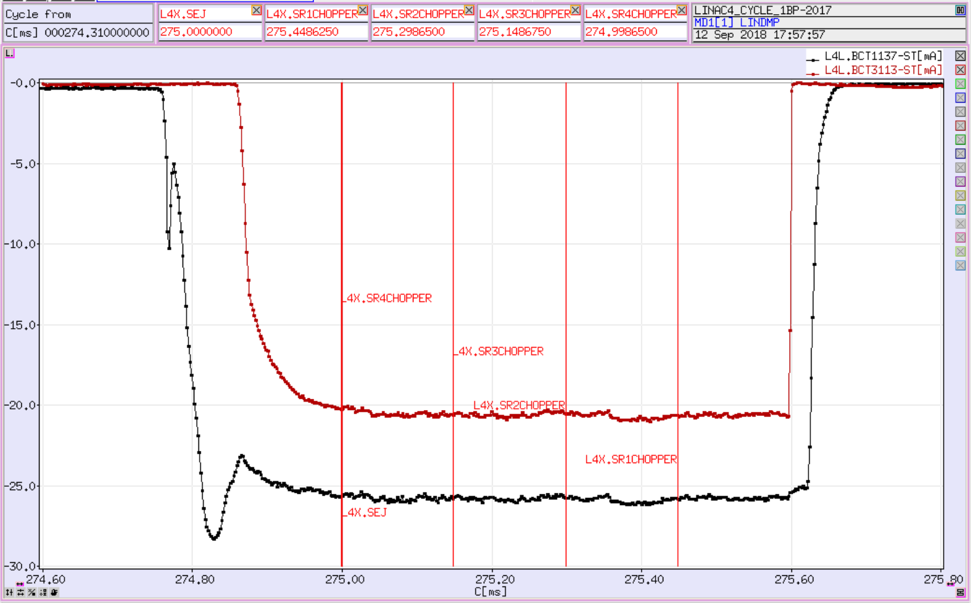
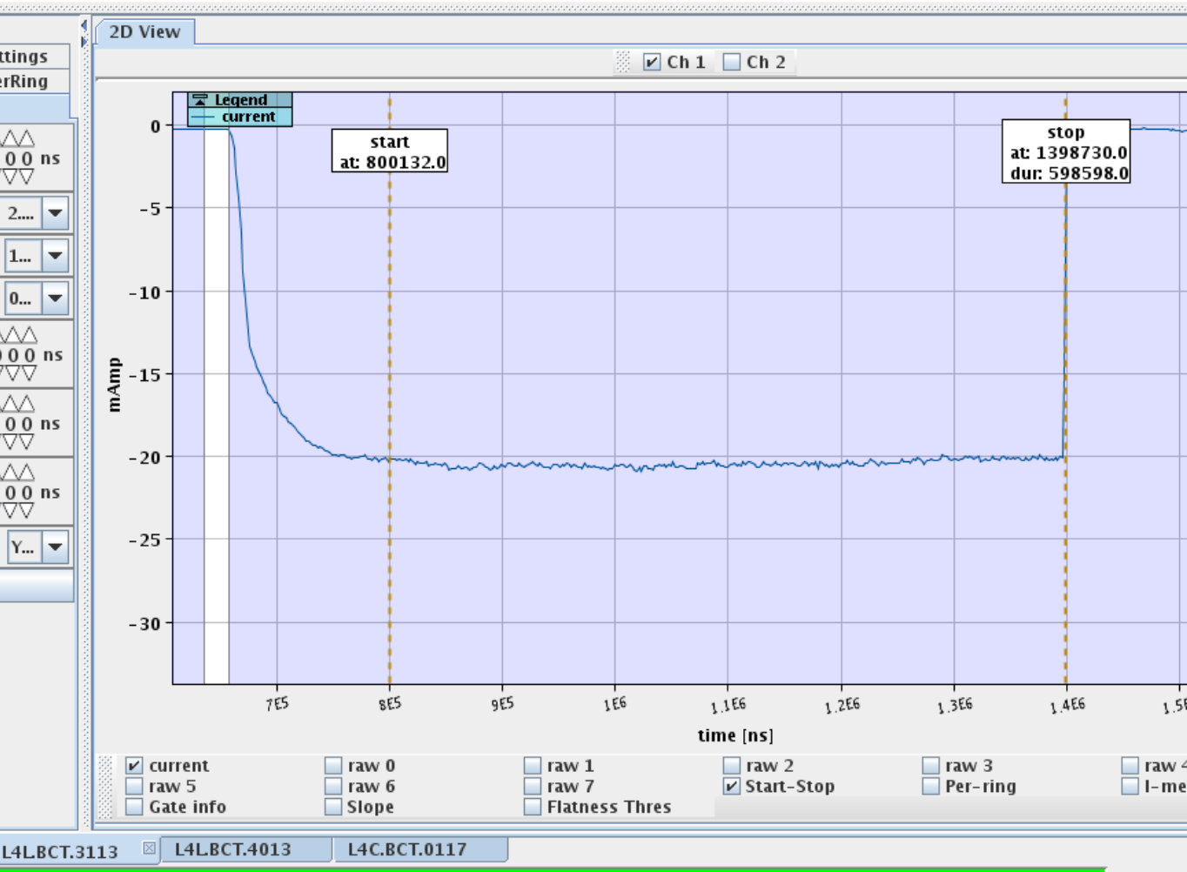
Pulse Flatness
Can achieve now flat pulse once source + LEBT are tuned, but requires retuning every ~8-12h --> need automatic tuning procedure (Autopilot)
after RFQ (before chopper)

Slide 10
Pulse-to-Pulse Stability
40 kW – 6h30m tuned 24 hours before the stats
  Current stability measured after RFQ (orange points) follows pulse-to-pulse variations from the source (blue points)

Slide 11
Pulse-to-Pulse Stability
48 kW – 5h20m – tuned 2 hours before stats
  Increasing the source RF power helps improving the pulse-to-pulse stability after the RFQ (~same current out of RFQ)

Slide 12
Pulse-to-Pulse Stability
BCT1137
Mean | -34.8707
Standard Error | 0.004292
Median | -34.804
Mode | -34.735
Standard Deviation | 0.525633 | -0.01507
Sample Variance | 0.27629
Kurtosis | 0.909436
Skewness | -0.67696
Range | 5.079
Minimum | -38.167
Maximum | -33.088
Sum | -523026
Count | 14999
BCT3113
Mean | -25.0861
Standard Error | 0.001207
Median | -25.107
Mode | -25.205
Standard Deviation | 0.147871 | -0.00589
Sample Variance | 0.021866
Kurtosis | 1.077557
Skewness | 0.813988
Range | 1.743
Minimum | -25.414
Maximum | -23.671
Sum | -376267
Count | 14999
48 kW source
RF power
Source stability seems to be linked to the RF power stability
Test on a load have been done during a dedicated beam stop
BE-RF will address the issue during LS2
Until LS2 we continue running with 48 kW source RF power
Notes:
Instability of RF power ~1% as tested on load

Slide 13
Nominal Chopping Pattern
Tried yesterday; chopper works, but still need to analyse chopping efficiency etc. in more detail

Slide 14
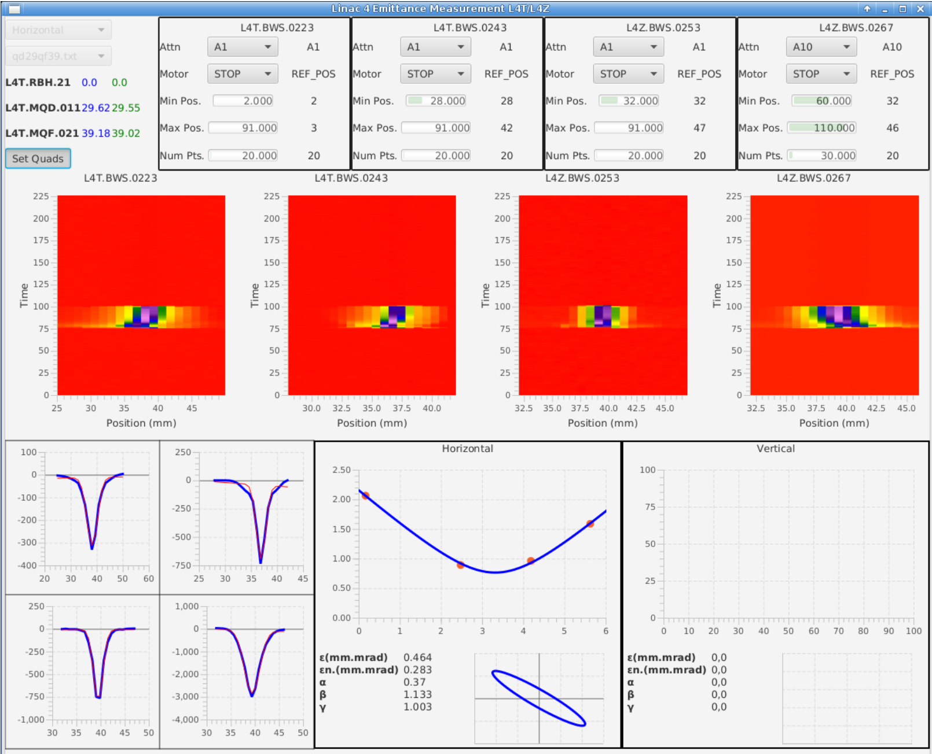
Applications
New: Emittance measurement application (with WS)
𝝴_{n}~0.283

Slide 15
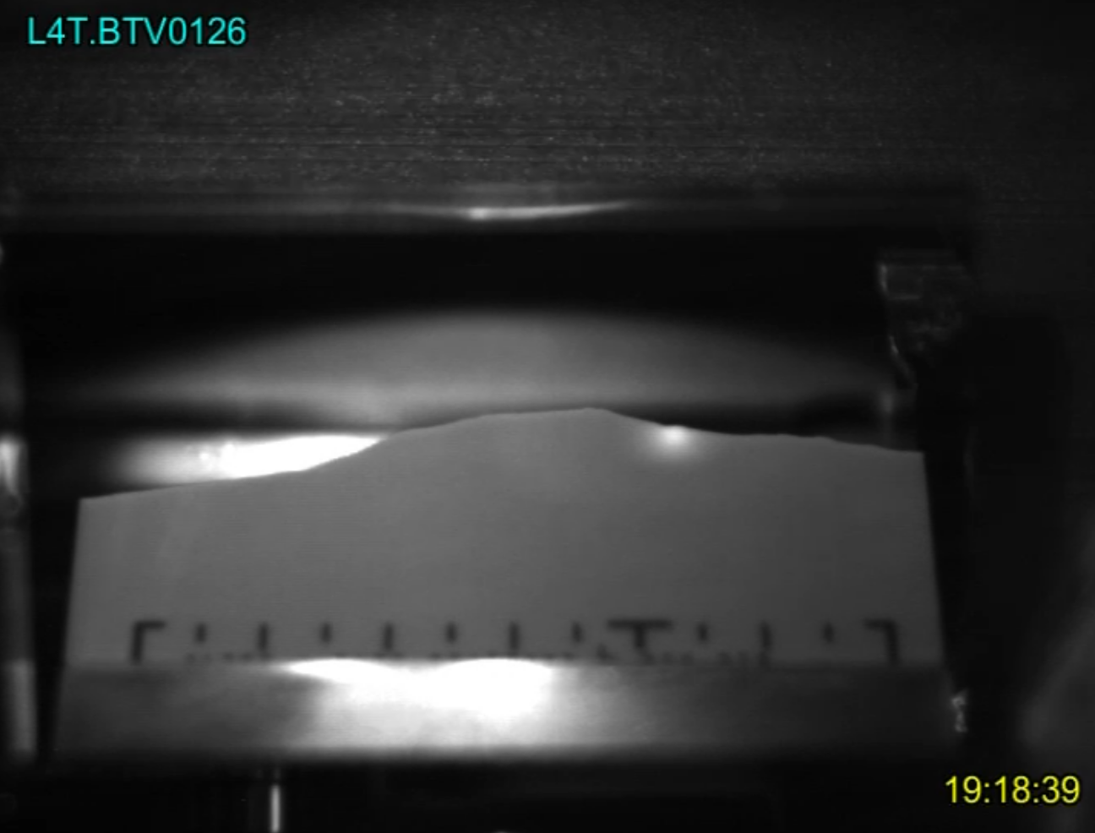
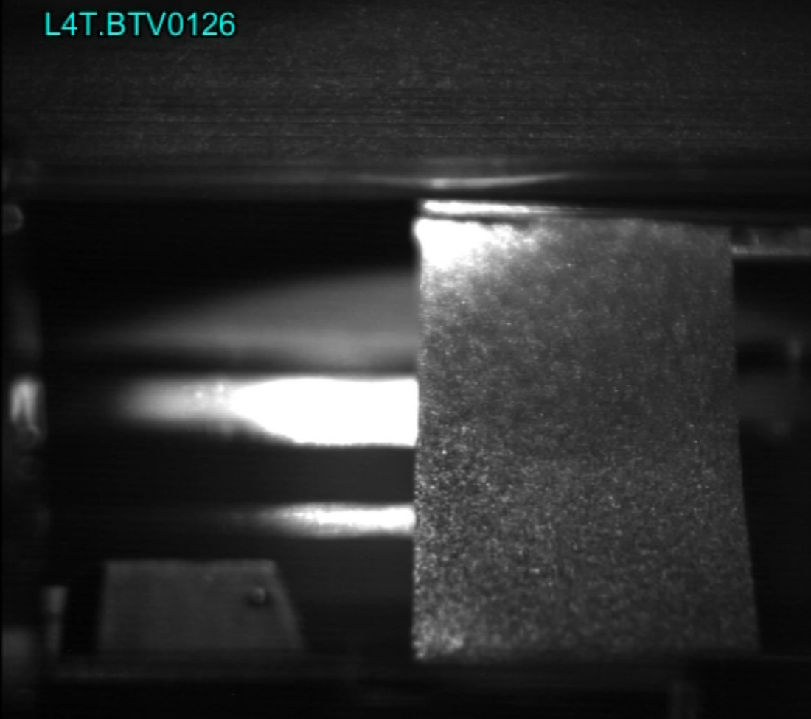
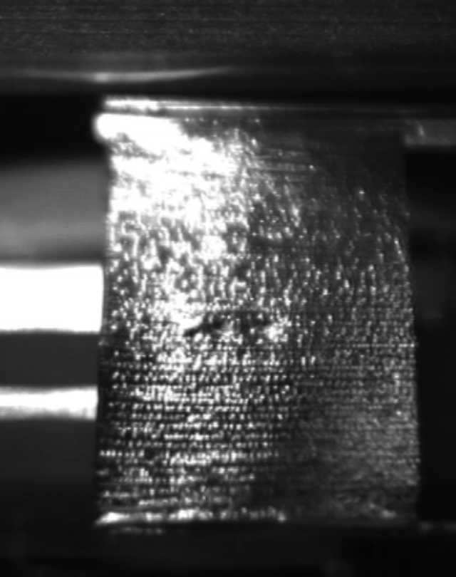
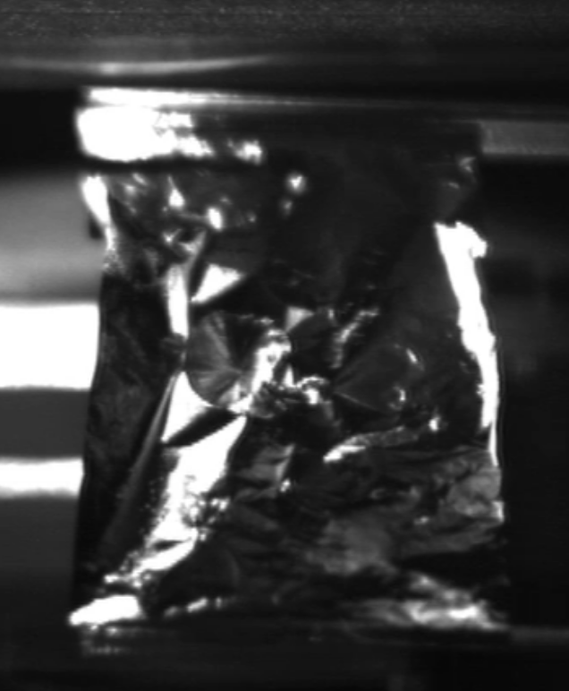
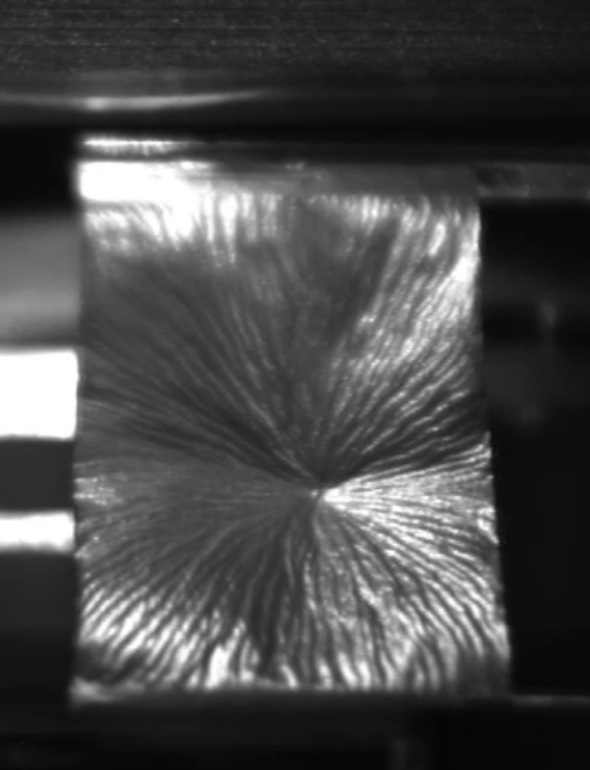
Stripping Foil Tests
BTV broken (26/09/2018)…
After first beam
impact!
Kaneka foil
XCF-200 carbon
Micromatter DLC
GIS foil

Slide 16
Reliability Run
Start today with 3 days delay (issues after TS)
1 week needed for preparations
  Ppm copy of machine settings to virgin cycle (today) as follow-up of first trial on Tuesday
  Source caesiation Friday
  Preparation of different ‘operational’ cycles beginning of next week
Start AFT Monday 8/10
Regular beam quality measurements by operators from middle of next week
MD blocks inserted into reliability operation

Slide 17
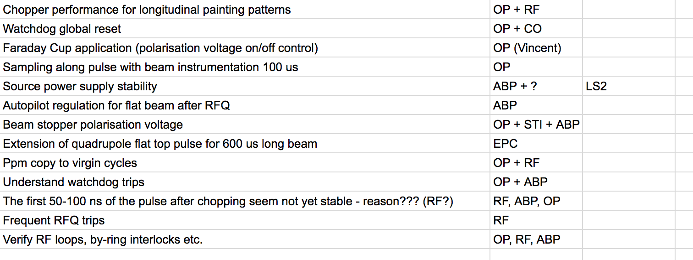
Points to follow up (list available online)

Slide 18
Organisation and Planning
Daily meetings with core group representatives
Weekly meetings chaired by Mike to report on progress and discuss issues in wider community
Up-to-date daily online planning available

Slide 19
Conclusions
A lot of progress after 1st month with beam since summer stop and interventions
  RF team put a lot of effort in upgrading HW, SW and controls
Starting to discover several issues related to multi-user operation - these will require close follow-up
Improvements in work organisation (checklists, productive meetings etc.) and planning; good collaboration between teams
Planning and open issues available here

