Slide 1
Study of rare B-meson decays at ATLAS
Marek Biroš
IPNP CUNI

Slide 2
Content
Motivation
Detector ATLAS
Decay’s channels
Distribution of invariant mass K*
Distribution of invariant mass B
Distribution of decay’s angles

Slide 3

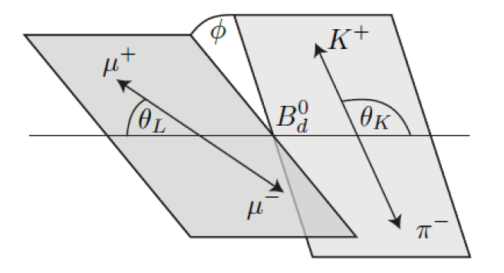
Motivation

Slide 4
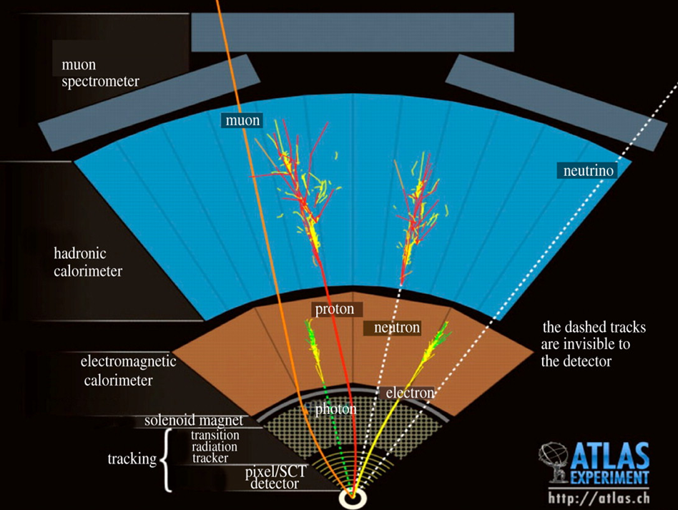
Detector ATLAS

Slide 5






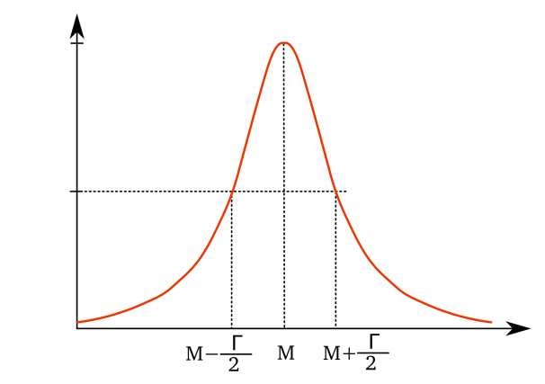
Decay channels
Signal decay
Background
  similar decays
  misinterpretation of K π
  out and okey
    closer than
  combinatoric background

Slide 6

Gaussian
Distribution of invariant mass B

Slide 7
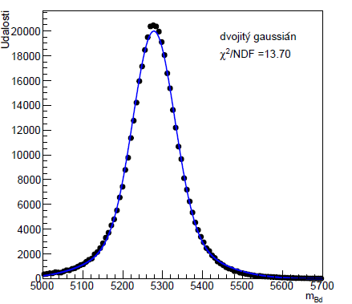

Double gaussian
Distribution of invariant mass B

Slide 8
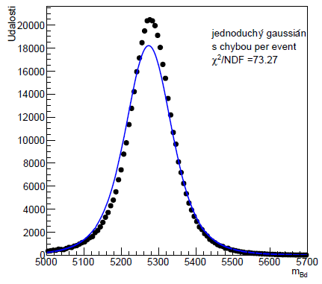

Per-event gaussian
Distribution of invariant mass B

Slide 9
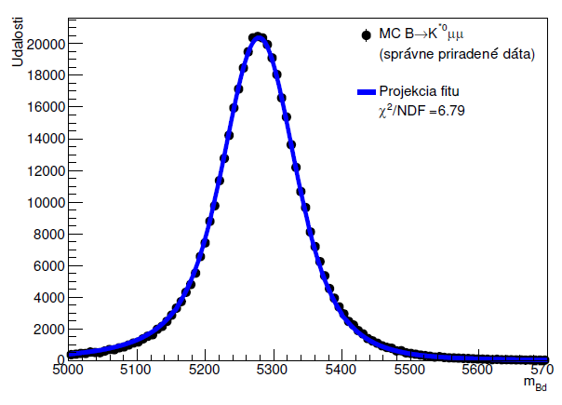

Double per-event gaussian
Distribution of invariant mass B
00

Slide 10
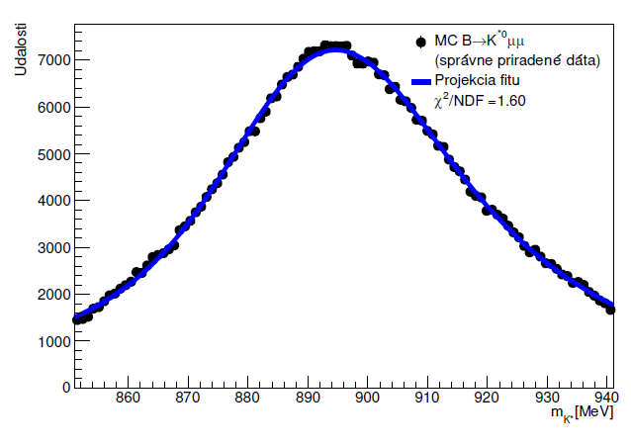

Breit-Wiegner * gaussian
Distribution of invariant mass K*

Slide 11
1D polynomial fits
Decay’s angles distribution

Slide 12
2D projections of final 3D polynom
Decay’s angles distribution

Slide 13


Spherical harmonics expansion
Decay’s angles distribution
rozpadu

Slide 14
2D projections of final function
Decay’s angles distribution

Slide 15
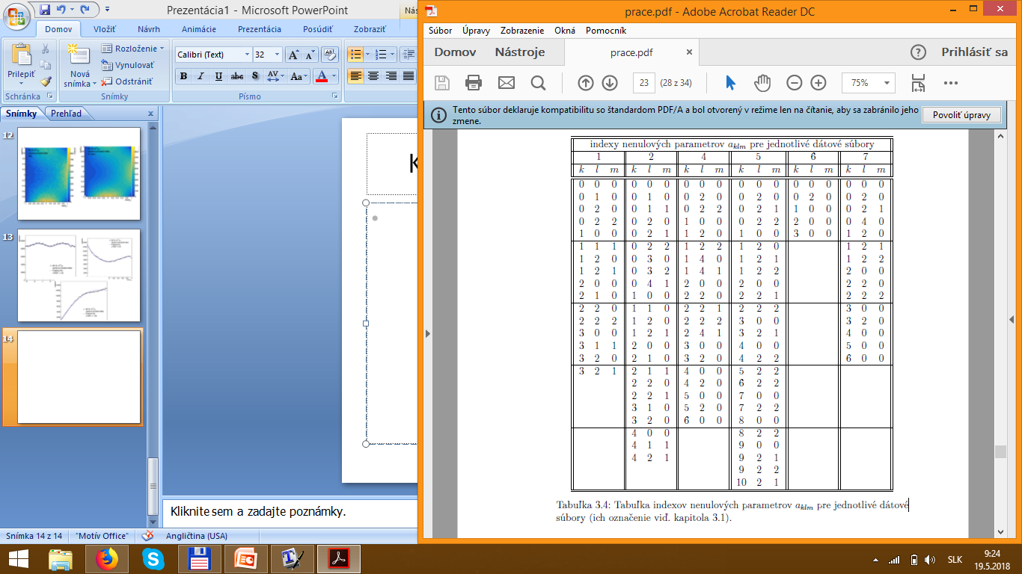
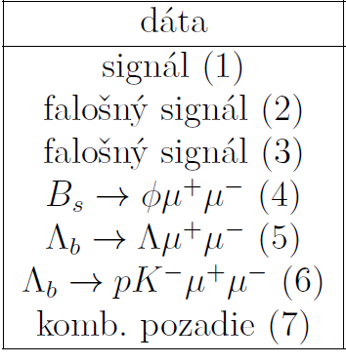
Dvojrozmerné projekcie fitovacej funkcie
Decay’s angles distribution
Indices of non-zero parameters for each data sample
data
1 | sgnl
2 | fake sgnl
3 | fake sgnl
4
5
6
7 | comb. bckg

Slide 16
Conclusion
Description of signal and background distributions
  invariant mass of K*
  invariant mass of B meson
  decay‘s angles
Ready to use in RUN 2 analyssis

Slide 17
Thank you for attention
Any questions???

Slide 18
1D projections of fit function
Appendix - Decay’s angles distribution

Slide 19

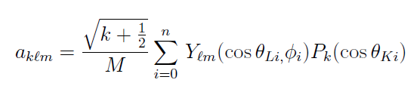
Spherical harmonics expansion
Appendix - Decay’s angles distribution

Slide 20
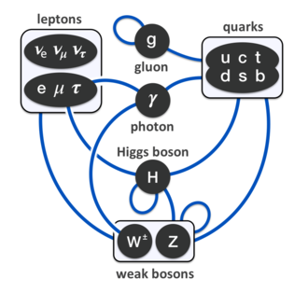
Standard Model

