Slide 1
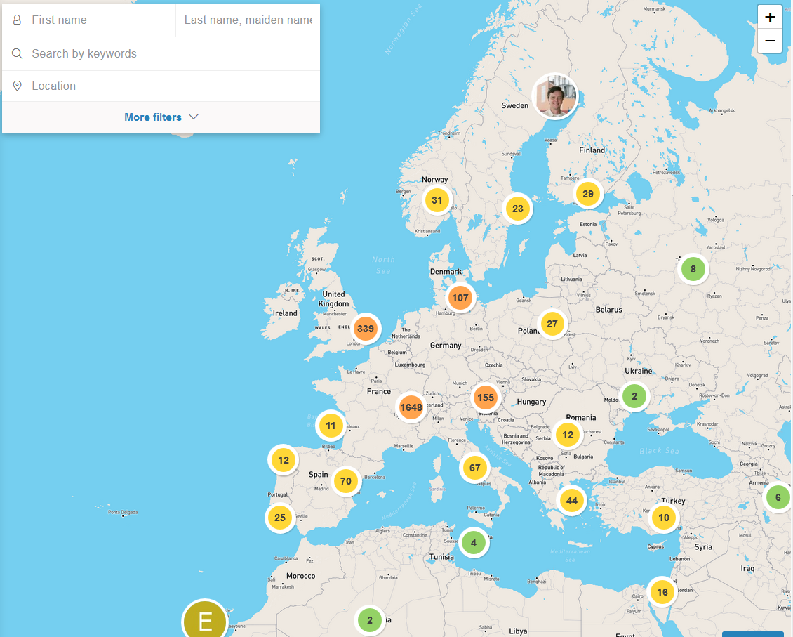
The CERN Alumni Network
Is for you!
http://alumni.cern
Alumni.relations@cern.ch

Slide 2
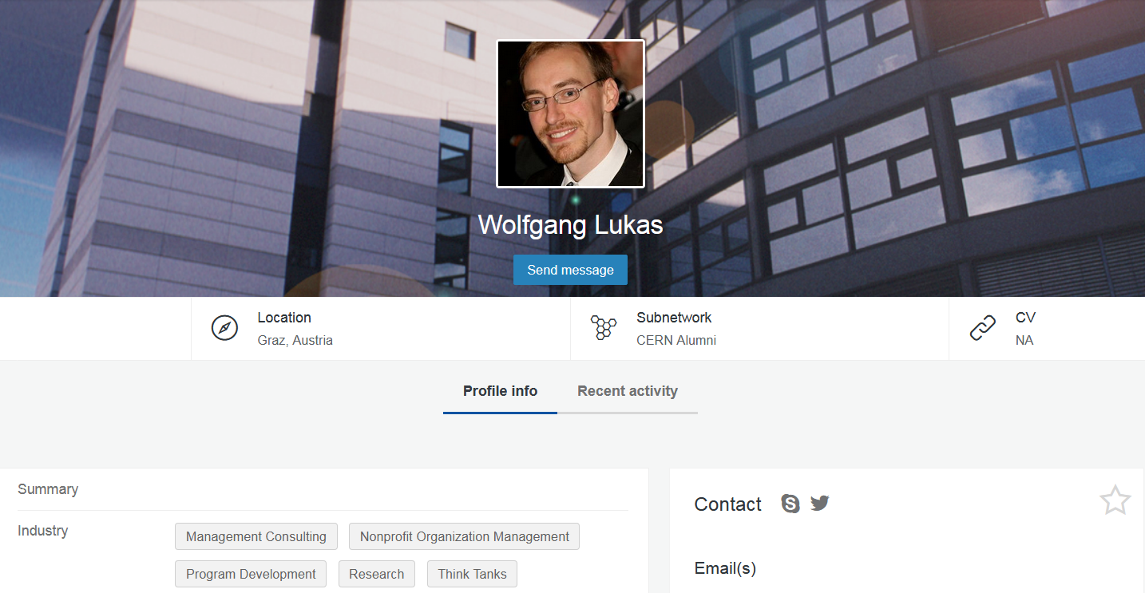
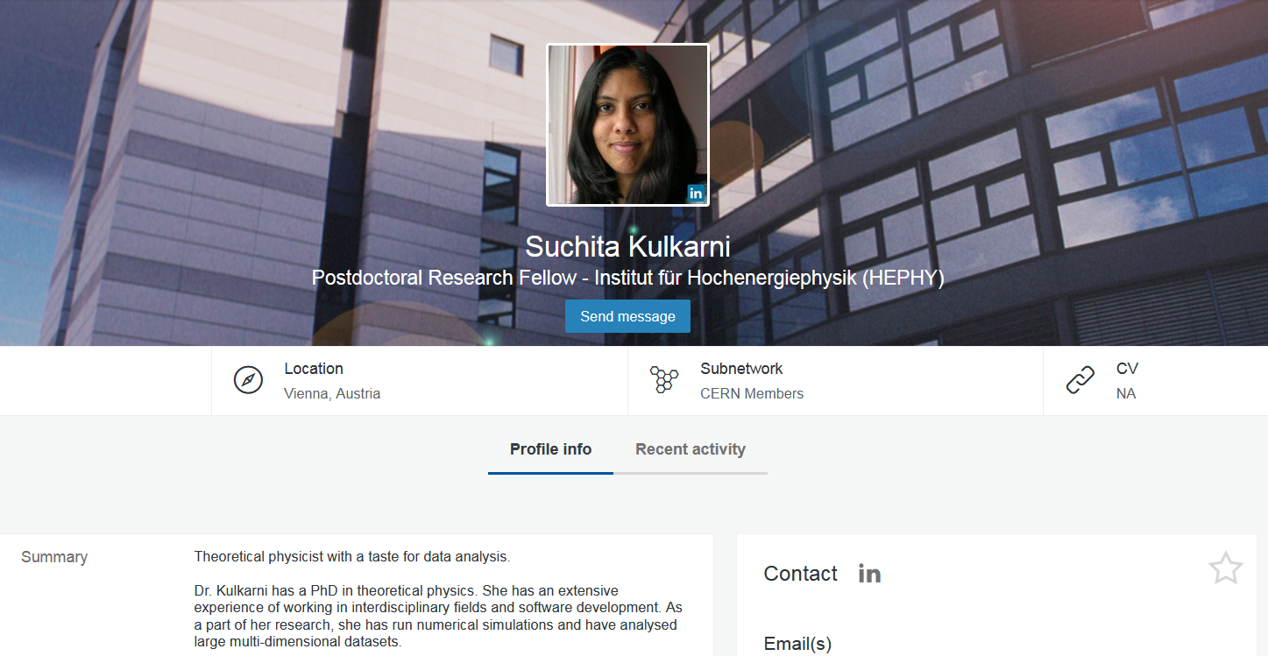
Access to a vast Network
Over 3800 active members
70% MPA (43% Users)
82 % alumni or soon to be alumni

Slide 3
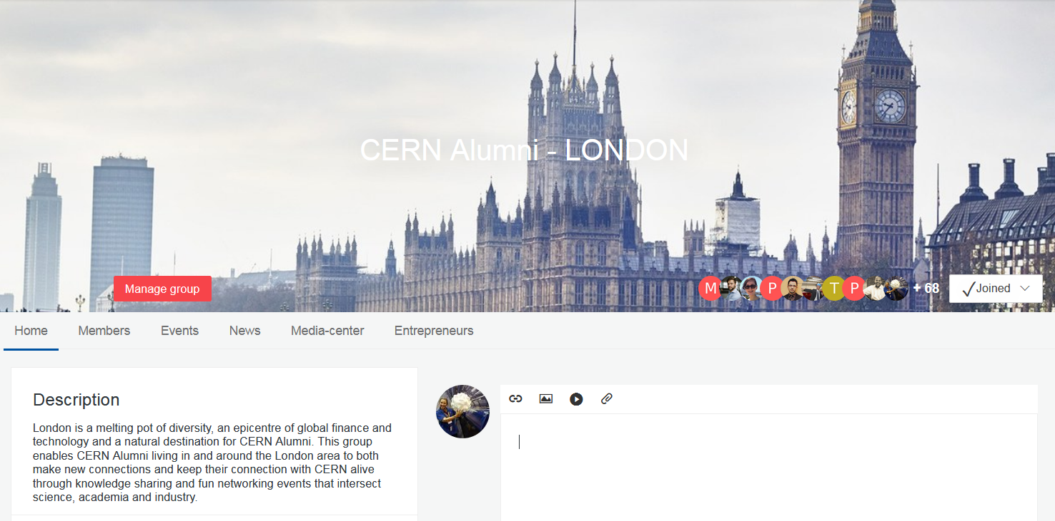
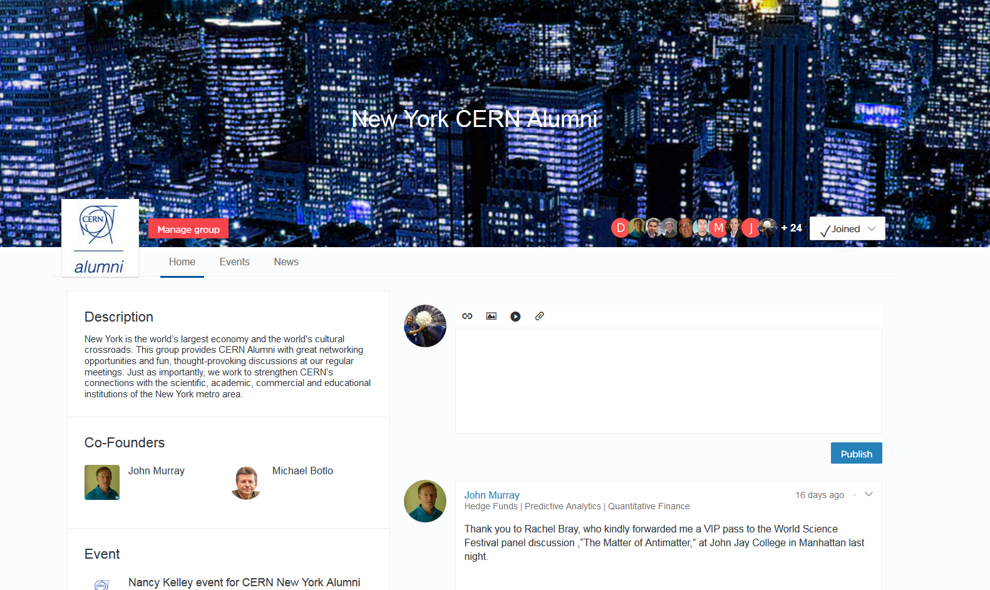
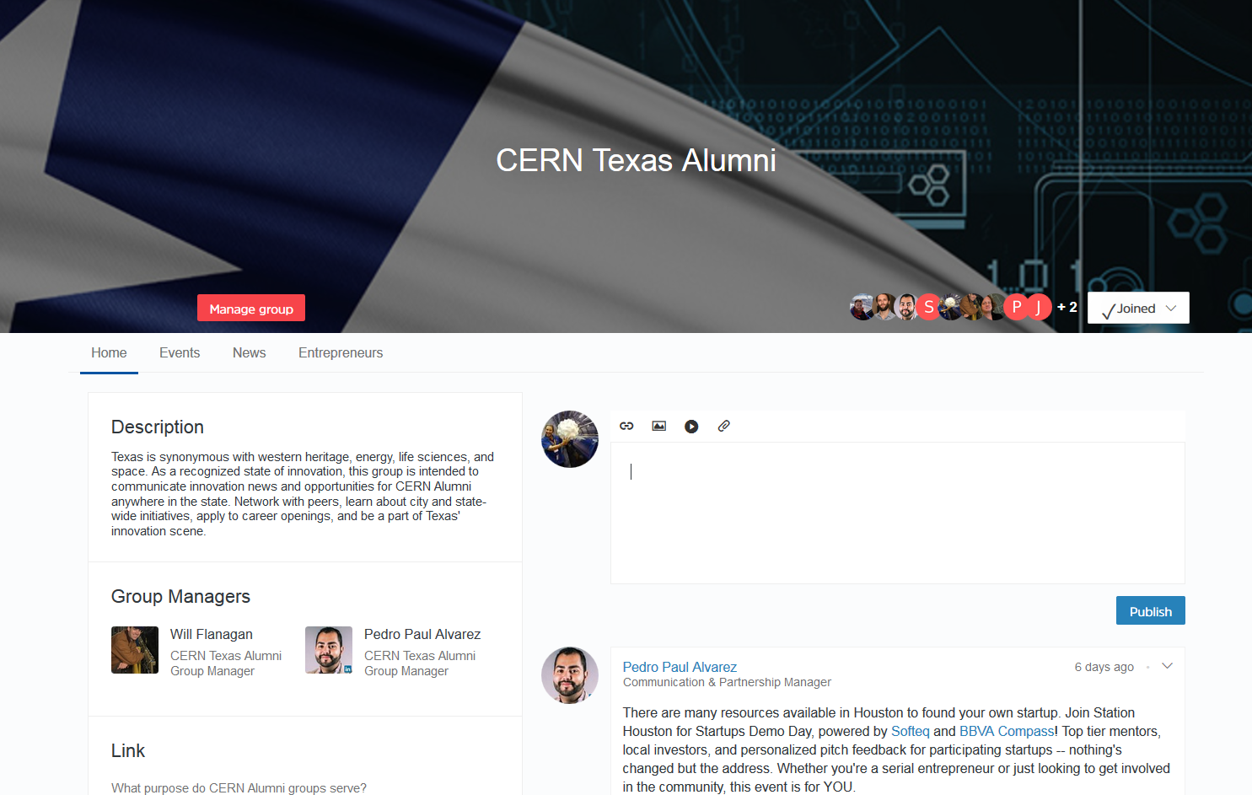
Stay Connected to the Organization
Local groups
  Athens
  Boston
  Vienna
  in the pipeline

Slide 4
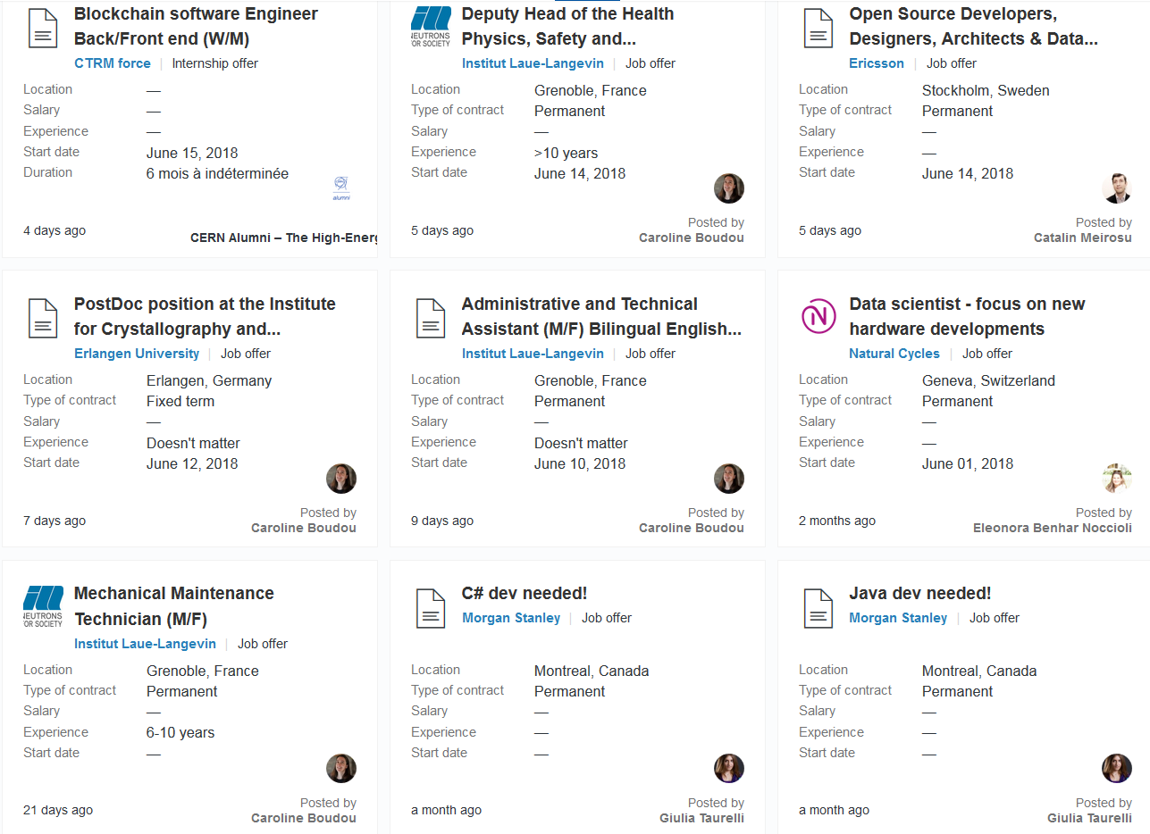
Post & Find Job Opportunities
220 career opportunities
posted by 67 companies

Slide 5
Impactful events to reunite and network
First Collisions! Feb 2018
New series of “Moving out of Academia To …”
  Moving out of Academia to The Financial Sector
  Moving out of Academia to Big Data
  Moving out of Academia to Mechanical & Industrial Engineering
“Remote CERN Alumni Collisions”
  First ever CERN Alumni Event in the UK, July 2018
    hosted in the Physics Pavilion at WOMAD 2018 (Malmesbury)
Tickets for Ars Electronica + more!

Slide 6
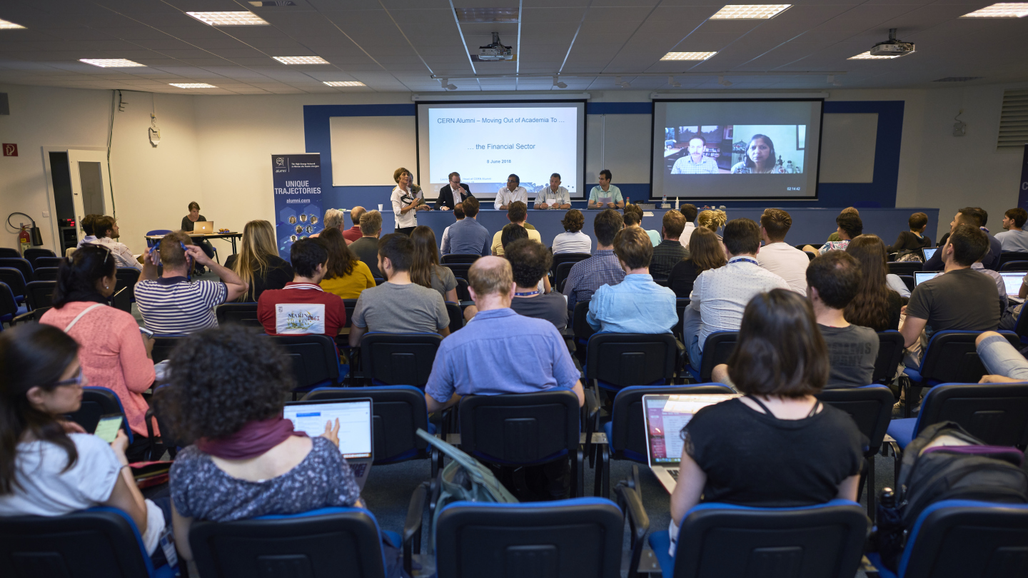
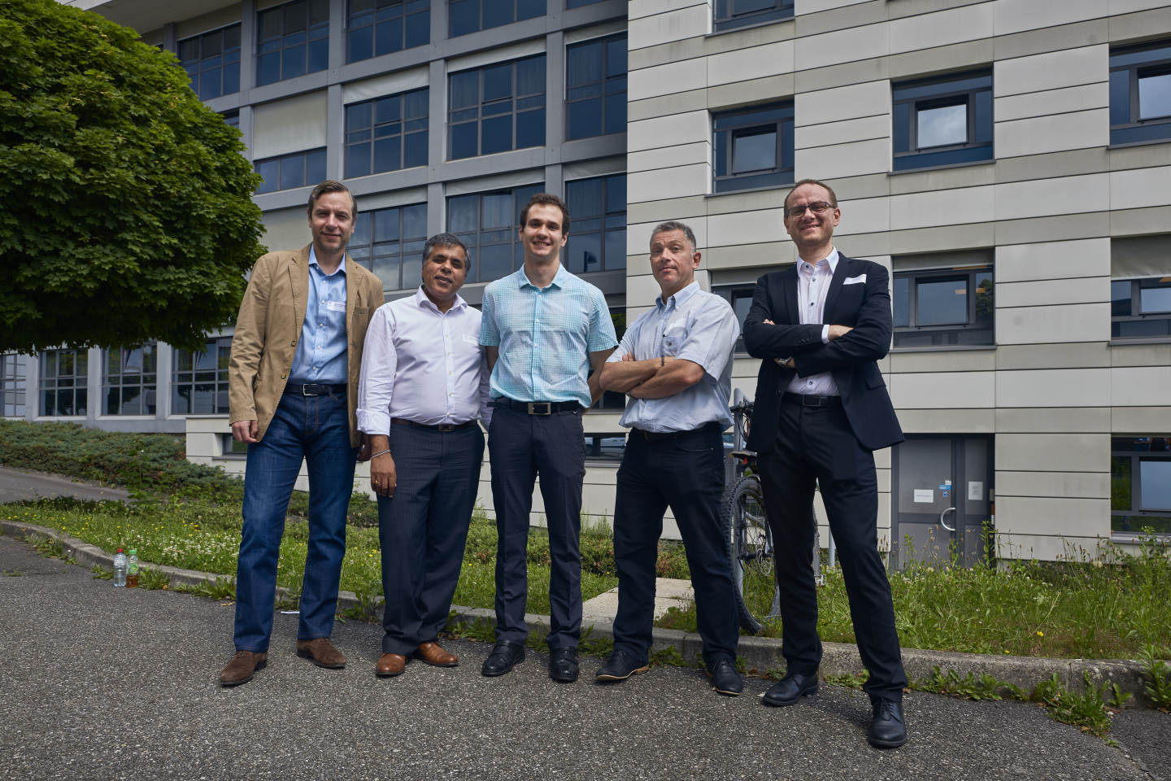
Amazing engagement and readiness to help from
CERN alumni with a career
A real need for support from early career alumni

Slide 7
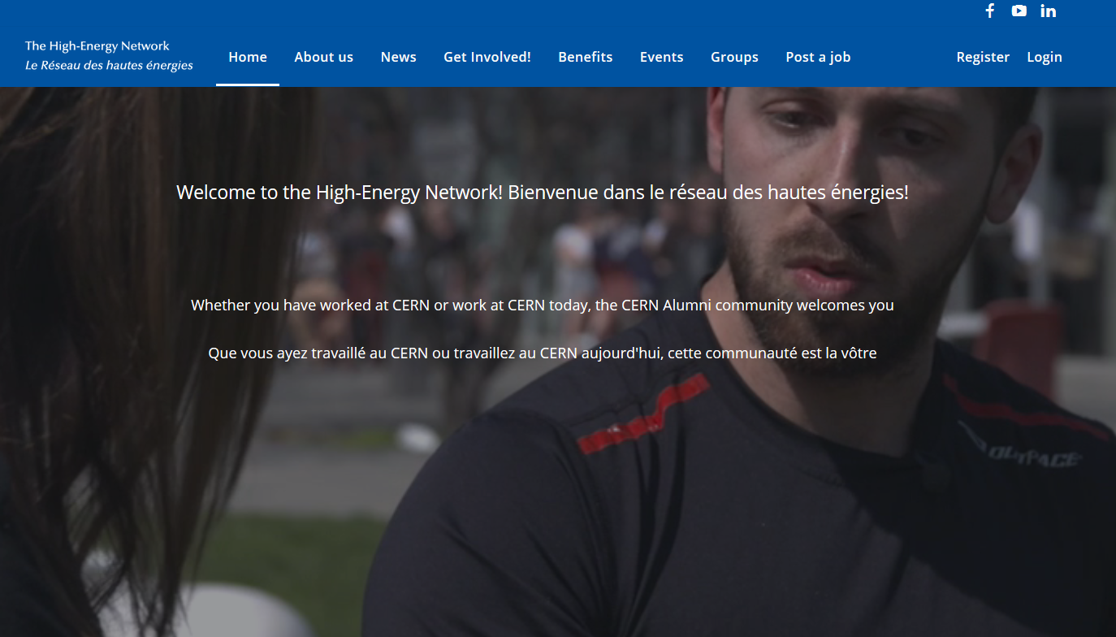
Join the CERN Alumni Network

