Slide 1


Direct Vlasov solvers – part II
Nicolas Mounet, CERN/BE-ABP-HSC
Acknowledgements: Sergey Arsenyev, Xavier Buffat, Giovanni Iadarola, Kevin Li, Elias Métral, Adrian Oeftiger, Giovanni Rumolo

Slide 2
Direct Vlasov solvers
Part I
Introduction: collective effects
Motivation for Vlasov solvers
Vlasov equation historically, and in the context of accelerators
Transverse impedance and instabilities
Building of a simple Vlasov solver for impedance instabilities
Part II
Compact way to present the theory: Hamiltonians & Poisson brackets
Upgrade of part I theory to obtain Sacherer integral equation
Solving Sacherer equation – convergence
Benchmarks & examples of application of Vlasov solvers

Slide 3
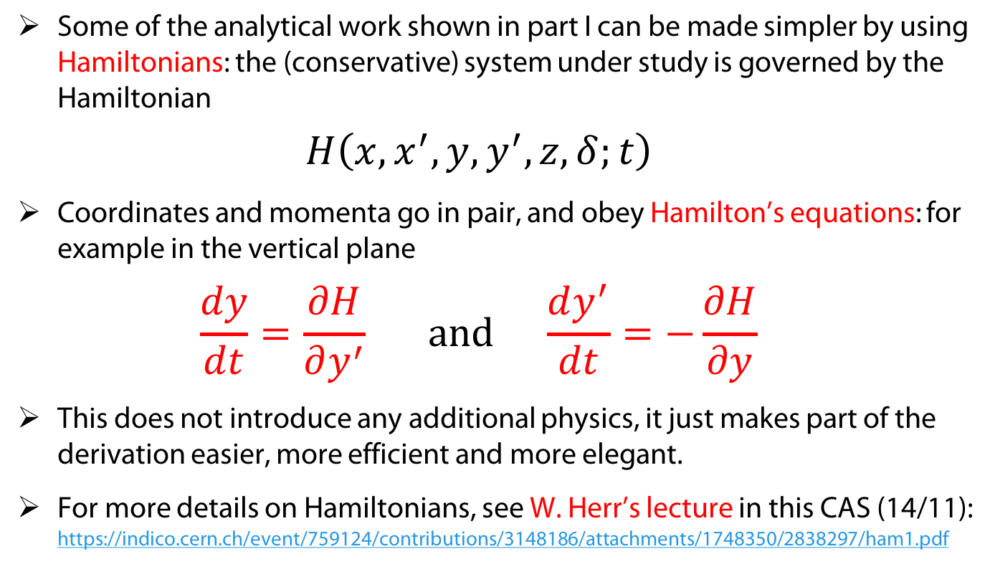
Introducing Hamiltonians
Some of the analytical work shown in part I can be made simpler by using Hamiltonians: the (conservative) system under study is governed by the Hamiltonian
$\begin{aligned}H\left(x,x^{′},y,y^{′},z,δ;t\right)\end{aligned}$
Coordinates and momenta go in pair, and obey Hamilton’s equations: for example in the vertical plane
$\frac{dy}{dt}=\frac{∂H}{∂y^{′}} \text{and} \frac{dy^{′}}{dt}=−\frac{∂H}{∂y}$
This does not introduce any additional physics, it just makes part of the derivation easier, more efficient and more elegant.
For more details on Hamiltonians, see W. Herr’s lecture in this CAS (14/11): https://indico.cern.ch/event/759124/contributions/3148186/attachments/1748350/2838297/ham1.pdf

Slide 4

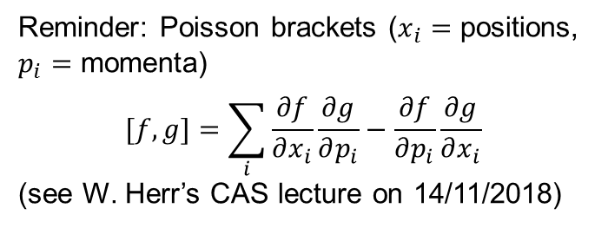


Vlasov equation with Hamiltonians
Going back to our simple Vlasov solver in 2D:
$\begin{aligned}\frac{dψ}{dt}&=\frac{∂ψ}{∂t}+\frac{∂ψ}{∂y}\frac{dy}{dt} + \frac{∂ψ}{∂y^{′}}\frac{dy^{′}}{dt} \\ &=\frac{∂ψ}{∂t}+\frac{∂ψ}{∂y}\frac{∂H}{∂y^{′}}−\frac{∂ψ}{∂y^{′}}\frac{∂H}{∂y}\end{aligned}$
Vlasov equation $\frac{dψ}{dt}=0$then becomes
$\frac{∂ψ}{∂t}+\left[ψ,H\right]=0$
… and this is completely general.
Going back to our simple Vlasov solver in 2D:
$\begin{aligned}\frac{dψ}{dt}&=\frac{∂ψ}{∂t}+\frac{∂ψ}{∂y}\frac{dy}{dt} + \frac{∂ψ}{∂y^{′}}\frac{dy^{′}}{dt} \\ &=\frac{∂ψ}{∂t}+\frac{∂ψ}{∂y}\frac{∂H}{∂y^{′}}−\frac{∂ψ}{∂y^{′}}\frac{∂H}{∂y}\end{aligned}$
Vlasov equation $\frac{dψ}{dt}=0$then becomes
$\frac{∂ψ}{∂t}+\left[ψ,H\right]=0$
… and this is completely general.
Reminder: Poisson brackets ($x_{i}=$ positions, $p_{i}=$ momenta)
$$[f,g]=\sum_{i}{\frac{∂f}{∂x_{i}}\frac{∂g}{∂p_{i}}−\frac{∂f}{∂p_{i}}\frac{∂g}{∂x_{i}}}$$
(see W. Herr’s CAS lecture on 14/11/2018)
This is simply $\left[ψ,H\right]$!

Slide 5
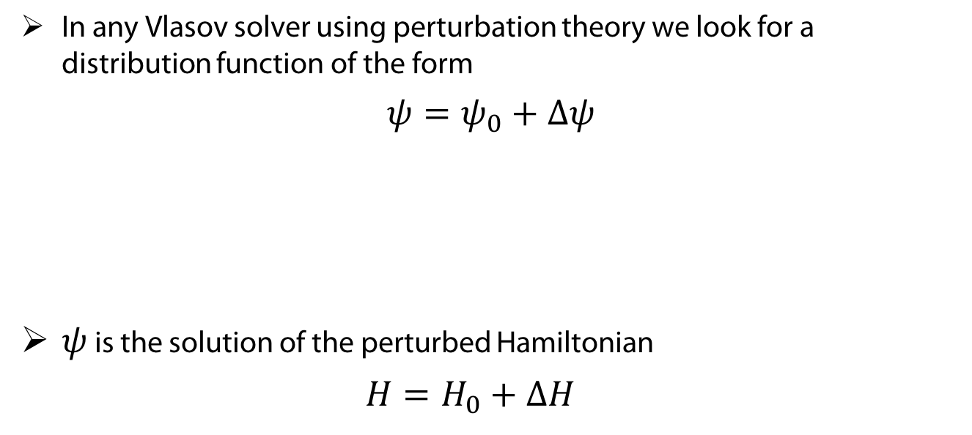
Perturbation
In any Vlasov solver using perturbation theory we look for a distribution function of the form
$$ψ=ψ_{0}+Δψ$$
$ψ$ is the solution of the perturbed Hamiltonian
$H=H_{0}+ΔH$
Stationary distribution for the Hamiltonian without impedance.
Perturbation of the stationary distribution, of first order
Unperturbed Hamiltonian
First order perturbation of the Hamiltonian, here from impedance.

Slide 6
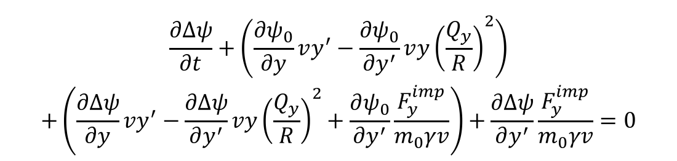

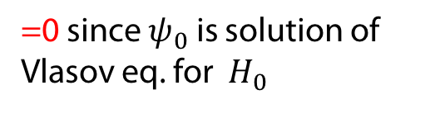



Linearized Vlasov equation using Poisson brackets
$$\begin{aligned}&\frac{∂ψ}{∂t}+\left[ψ,H\right]=0 \\ ⇔&\frac{∂{(ψ}_{0}+Δψ)}{∂t}+\left[ψ_{0}+Δψ,H_{0}+ΔH\right]=0 \\ ⇔&\frac{∂ψ_{0}}{∂t}+\left[ψ_{0},H_{0}\right]+\frac{∂Δψ}{∂t}+\left[Δψ,H_{0}\right]+\left[ψ_{0},ΔH\right]+\left[Δψ,ΔH\right]=0\end{aligned}$$
$$\begin{aligned}&\frac{∂ψ}{∂t}+\left[ψ,H\right]=0 \\ ⇔&\frac{∂{(ψ}_{0}+Δψ)}{∂t}+\left[ψ_{0}+Δψ,H_{0}+ΔH\right]=0 \\ ⇔&\frac{∂ψ_{0}}{∂t}+\left[ψ_{0},H_{0}\right]+\frac{∂Δψ}{∂t}+\left[Δψ,H_{0}\right]+\left[ψ_{0},ΔH\right]+\left[Δψ,ΔH\right]=0\end{aligned}$$
$$\begin{aligned}&\frac{∂ψ}{∂t}+\left[ψ,H\right]=0 \\ ⇔&\frac{∂{(ψ}_{0}+Δψ)}{∂t}+\left[ψ_{0}+Δψ,H_{0}+ΔH\right]=0 \\ ⇔&\frac{∂ψ_{0}}{∂t}+\left[ψ_{0},H_{0}\right]+\frac{∂Δψ}{∂t}+\left[Δψ,H_{0}\right]+\left[ψ_{0},ΔH\right]+\left[Δψ,ΔH\right]=0\end{aligned}$$
$$\begin{aligned}& \frac{∂Δψ}{∂t}+\frac{∂ψ}{∂y}\frac{dy}{dt}\text{+}\frac{∂ψ}{∂y^{′}}\frac{dy^{′}}{dt}=0 \\ &⇔\frac{∂Δψ}{∂t}+\frac{∂ψ}{∂y}vy^{′}\text{+}\frac{∂ψ}{∂y^{′}}\left(\frac{F_{y}^{impedance}}{m_{0}γv}−vy{\left(\frac{Q_{y}}{R}\right)}^{2}\right)=0 \\ \begin{aligned}&⇔\frac{∂Δψ}{∂t}+\left(\frac{∂ψ_{0}}{∂y}+\frac{∂Δψ}{∂y}\right)vy^{′}+\left(\frac{∂ψ_{0}}{∂y^{′}}+\frac{∂Δψ}{∂y^{′}}\right)\left(\frac{F_{y}^{imp}}{m_{0}γv}−vy{\left(\frac{Q_{y}}{R}\right)}^{2}\right)&=0 \\ \\ \end{aligned}\end{aligned}$$
=0 since $ψ_{0}$ is solution of Vlasov eq. for $H_{0}$
Only remaining terms
Second order
Isn’t that exactly what we did – somewhat more painfully – during part I?
$$\begin{aligned}& \\ \begin{aligned}&\frac{∂Δψ}{∂t}+\left(\frac{∂ψ_{0}}{∂y}vy^{′}−\frac{∂ψ_{0}}{∂y^{′}}v{y\left(\frac{Q_{y}}{R}\right)}^{2}\right) \\ +\left(\frac{∂Δψ}{∂y}vy^{′}−\frac{∂Δψ}{∂y^{′}}vy{\left(\frac{Q_{y}}{R}\right)}^{2}+\frac{∂ψ_{0}}{∂y^{′}}\frac{F_{y}^{imp}}{m_{0}γv}\right)+\frac{∂Δψ}{∂y^{′}}\frac{F_{y}^{imp}}{m_{0}γv}=0\end{aligned}\end{aligned}$$

Slide 7
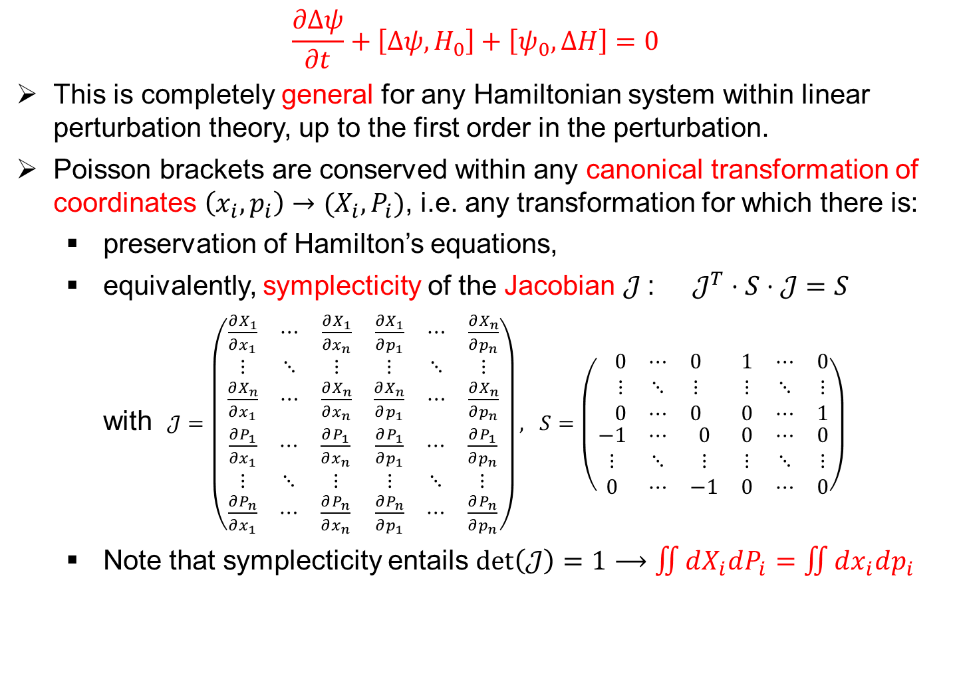
Linearized Vlasov equation using Poisson brackets
$$\frac{∂Δψ}{∂t}+\left[Δψ,H_{0}\right]+\left[ψ_{0},ΔH\right]=0$$
This is completely general for any Hamiltonian system within linear perturbation theory, up to the first order in the perturbation.
Poisson brackets are conserved within any canonical transformation of coordinates $\left(x_{i},p_{i}\right)→(X_{i},P_{i})$, i.e. any transformation for which there is:
  preservation of Hamilton’s equations,
  equivalently, symplecticity of the Jacobian $𝒥$: $𝒥^{T}⋅S⋅𝒥=S$
  with$𝒥=\left(\begin{matrix}\begin{matrix}\frac{∂X_{1}}{∂x_{1}} & ⋯ & \frac{∂X_{1}}{∂x_{n}} \\ ⋮ & ⋱ & ⋮ \\ \frac{∂X_{n}}{∂x_{1}} & ⋯ & \frac{∂X_{n}}{∂x_{n}}\end{matrix} & \begin{matrix}\frac{∂X_{1}}{∂p_{1}} & ⋯ & \frac{∂X_{n}}{∂p_{n}} \\ ⋮ & ⋱ & ⋮ \\ \frac{∂X_{n}}{∂p_{1}} & ⋯ & \frac{∂X_{n}}{∂p_{n}}\end{matrix} \\ \begin{matrix}\frac{∂P_{1}}{∂x_{1}} & ⋯ & \frac{∂P_{1}}{∂x_{n}} \\ ⋮ & ⋱ & ⋮ \\ \frac{∂P_{n}}{∂x_{1}} & ⋯ & \frac{∂P_{n}}{∂x_{n}}\end{matrix} & \begin{matrix}\frac{∂P_{1}}{∂p_{1}} & ⋯ & \frac{∂P_{1}}{∂p_{n}} \\ ⋮ & ⋱ & ⋮ \\ \frac{∂P_{n}}{∂p_{1}} & ⋯ & \frac{∂P_{n}}{∂p_{n}}\end{matrix}\end{matrix}\right), S=\left(\begin{matrix}\left.\begin{matrix}0 & ⋯ & 0 \\ ⋮ & ⋱ & ⋮ \\ 0 & ⋯ & 0\end{matrix}\right. & \left.\begin{matrix}1 & ⋯ & 0 \\ ⋮ & ⋱ & ⋮ \\ 0 & ⋯ & 1\end{matrix}\right. \\ \left.\begin{matrix}−1 & ⋯ & 0 \\ ⋮ & ⋱ & ⋮ \\ 0 & ⋯ & −1\end{matrix}\right. & \begin{matrix}0 & ⋯ & 0 \\ ⋮ & ⋱ & ⋮ \\ 0 & ⋯ & 0\end{matrix}\end{matrix}\right)$
  Note that symplecticity entails $\det\left(𝒥\right)=1⟶\iint{dX_{i}dP_{i}}=\iint{dx_{i}dp_{i}}$

Slide 8
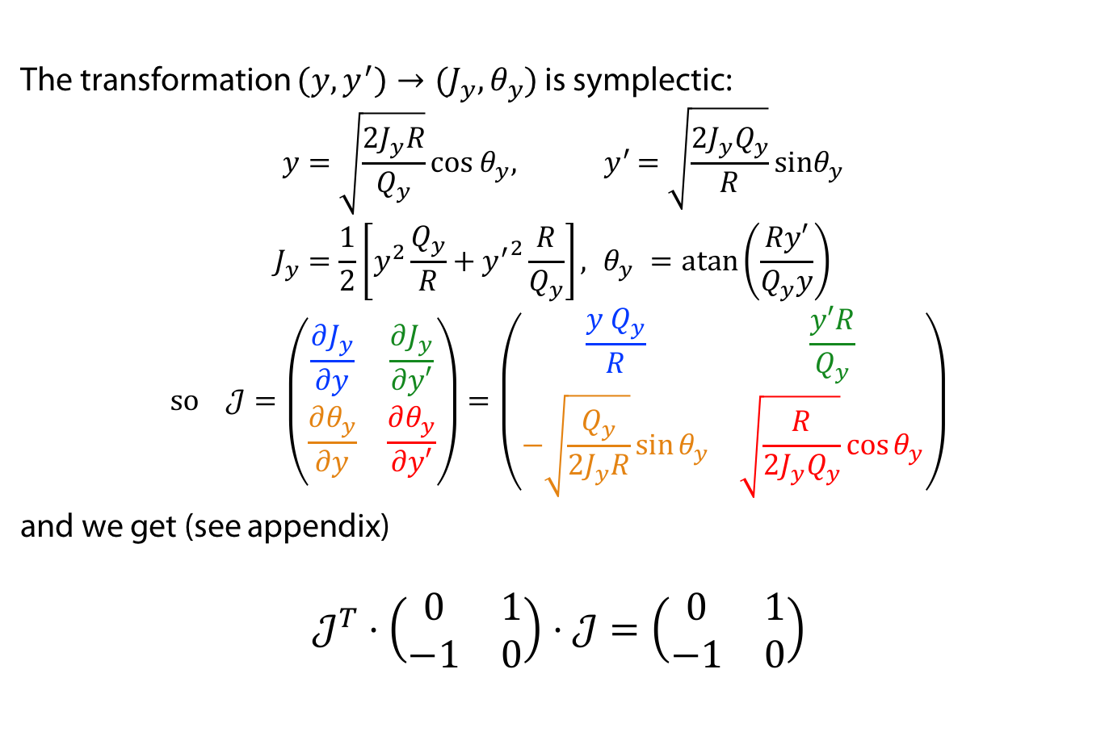
Application to the derivation of part I
The transformation $(y,y^{′})→(J_{y},θ_{y})$is symplectic:
$$\begin{aligned}y&=\sqrt{\frac{2J_{y}R}{Q_{y}}}cos θ_{y}{, y}^{′}&=\sqrt{\frac{2J_{y}Q_{y}}{R}}sinθ_{y} \\ J_{y}&=\frac{1}{2}\left[y^{2}\frac{Q_{y}}{R}+{y^{′}}^{2}\frac{R}{Q_{y}}\right],{ θ}_{y}&=\operatorname{atan}\left(\frac{Ry′}{Q_{y}y}\right)\end{aligned}$$
$$\text{so} 𝒥=\left(\begin{matrix}\frac{∂J_{y}}{∂y} & \frac{∂J_{y}}{∂y′} \\ \frac{∂θ_{y}}{∂y} & \frac{∂θ_{y}}{∂y′}\end{matrix}\right)=\left(\begin{matrix}\frac{y Q_{y}}{R} & \frac{y′R}{Q_{y}} \\ −\sqrt{\frac{Q_{y}}{2J_{y}R}}\sin{θ_{y}} & \sqrt{\frac{R}{2J_{y}Q_{y}}}\cos{θ_{y}}\end{matrix}\right)$$
and we get (see appendix)
$$𝒥^{T}⋅\left(\begin{matrix}0 & 1 \\ −1 & 0\end{matrix}\right)⋅𝒥=\left(\begin{matrix}0 & 1 \\ −1 & 0\end{matrix}\right)$$

Slide 9


Hamiltonian of our simple Vlasov solver (part I)
For our simple Vlasov equation in part I we had
$$\begin{aligned}\frac{∂H}{∂y^{′}}&=\frac{dy}{dt}&&=v{⋅y}^{′} \\ −\frac{∂H}{∂y}&=\frac{dy^{′}}{dt}&&=\frac{F_{y}^{imp}}{m_{0} γv}{−vy\left(\frac{Q_{y}}{R}\right)}^{2}\end{aligned}$$
which corresponds to the Hamiltonian
$$\begin{aligned}H=H_{0}+ΔH&=\frac{v}{2}\left[y’^{2}+y^{2}{\left(\frac{Q_{y}}{R}\right)}^{2}\right]−\frac{y}{m_{0}γv}F_{y}^{imp} \\ &=\frac{vQ_{y}}{R}J_{y}−\sqrt{\frac{2J_{y}R}{Q_{y}}}\cos{θ_{y}}\frac{F_{y}^{imp}}{m_{0}γv}\end{aligned}$$
For our simple Vlasov equation in part I we had
$$\begin{aligned}\frac{∂H}{∂y^{′}}&=\frac{dy}{dt}&&=v{⋅y}^{′} \\ −\frac{∂H}{∂y}&=\frac{dy^{′}}{dt}&&=\frac{F_{y}^{imp}}{m_{0} γv}{−vy\left(\frac{Q_{y}}{R}\right)}^{2}\end{aligned}$$
which corresponds to the Hamiltonian
$$\begin{aligned}H=H_{0}+ΔH&=\frac{v}{2}\left[y’^{2}+y^{2}{\left(\frac{Q_{y}}{R}\right)}^{2}\right]−\frac{y}{m_{0}γv}F_{y}^{imp} \\ &=\frac{vQ_{y}}{R}J_{y}−\sqrt{\frac{2J_{y}R}{Q_{y}}}\cos{θ_{y}}\frac{F_{y}^{imp}}{m_{0}γv}\end{aligned}$$

Slide 10
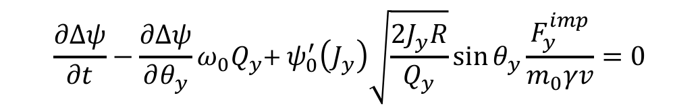



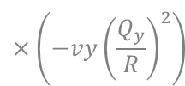


Application to our simple Vlasov solver (part I)
$$\begin{aligned}H_{0}&=ω_{0}Q_{y}J_{y} \\ ΔH&=−\sqrt{\frac{2J_{y}R}{Q_{y}}}\cos{θ_{y}}\frac{F_{y}^{imp}}{m_{0}γv} \\ ψ&=ψ_{0}+Δψ\end{aligned}$$
In $(J_{y},θ_{y})$ coordinates, the linearized Vlasov equation
$$\frac{∂Δψ}{∂t}+\left[Δψ,H_{0}\right]+\left[ψ_{0},ΔH\right]=0$$
gives immediately
$$ω_{0}=\frac{v}{R}$$
It’s slightly easier, and less prone to error, than what we did in Part I:
$$\begin{aligned}\frac{∂Δψ}{∂y}=\frac{∂Δψ}{∂J_{y}}⋅\frac{∂J_{y}}{∂y}+\frac{∂Δψ}{∂θ_{y}}⋅\frac{∂θ_{y}}{∂y}&=\frac{∂Δψ}{∂J_{y}}⋅\frac{y Q_{y}}{R}&+\frac{∂Δψ}{∂θ_{y}}⋅\left(−\sqrt{\frac{Q_{y}}{2J_{y}R}}\sin{θ_{y}}\right) \\ \frac{∂Δψ}{∂y^{′}}=\frac{∂Δψ}{∂J_{y}}⋅\frac{∂J_{y}}{∂y^{′}}+\frac{∂Δψ}{∂θ_{y}}⋅\frac{∂θ_{y}}{∂y^{′}}&=\frac{∂Δψ}{∂J_{y}}⋅\frac{y^{′}R}{Q_{y}}&+\frac{∂Δψ}{∂θ_{y}}⋅\left(\sqrt{\frac{R}{2J_{y}Q_{y}}}\cos{θ_{y}}\right)\end{aligned}$$
$$×vy^{′}$$
$$×\left(−vy{\left(\frac{Q_{y}}{R}\right)}^{2}\right)$$
Reminder: $[f,g]=\frac{∂f}{∂J_{y}}\frac{∂g}{∂θ_{y}}−\frac{∂f}{∂θ_{y}}\frac{∂g}{∂J_{y}}$
$$\frac{∂Δψ}{∂t}−\frac{∂Δψ}{∂θ_{y}}{ω_{0}Q}_{y}\text{+} ψ_{0}^{′}\left(J_{y}\right)\sqrt{\frac{2J_{y}R}{Q_{y}}}\sin{θ_{y}}\frac{F_{y}^{imp}}{m_{0}γv}=0$$

Slide 11
Building a Vlasov solver: method outline
Write Hamiltonian
Choose coordinates
Write stationary distribution
Introduce perturbation
Use equations of motion
Simplify and linearize Vlasov equation
Transform coordinates
Decompose perturbation
Reduce number of variables
Write impedance force
Final equation
Write stationary distribution
Introduce perturbation
Use equations of motion
Simplify and linearize Vlasov equation
Transform coordinates
Decompose perturbation
Reduce number of variables
Write impedance force
Final equation
Write stationary distribution
Introduce perturbation
Use equations of motion
Simplify and linearize Vlasov equation
Transform coordinates
Decompose perturbation
Reduce number of variables
Write impedance force
Final equation
Write Hamiltonian
Choose coordinates
Write stationary distribution
Write linearized Vlasov equation
Decompose perturbation
Reduce number of variables
Write impedance force
Final equation
New outline
Outline of part I

Slide 12


A more elaborate Vlasov solver
Let’s try to relieve some assumptions of the Vlasov solver of part I:
  Impedance $Z_{y}(ω)$ is the only source of instability considered, and gives the EM force arising from the interaction of the beam with the resistive or geometric elements around it,
  only vertical plane, with position and “momentum” $\left(y,y^{′}=\frac{dy}{ds}\right)$ (using for convenience $y′$ rather than $p_{y}$)
  purely linear, uncoupled optics in transverse, within
  smooth approximation,
  no longitudinal motion, i.e. essentially rigid bunches in z,
  chromaticity $Q_{y}^{′}=\frac{dQ_{y}}{dδ}=0$,
  Phase space distribution function is then
  $ψ= ψ\left(y,y^{′},z,δ≡\frac{p_{z}}{m_{0}γv};t\right)$
Let’s try to relieve some assumptions of the Vlasov solver of part I:
  Impedance $Z_{y}(ω)$ is the only source of instability considered, and gives the EM force arising from the interaction of the beam with the resistive or geometric elements around it,
  only vertical plane, with position and “momentum” $\left(y,y^{′}=\frac{dy}{ds}\right)$ (using for convenience $y′$ rather than $p_{y}$)
  purely linear, uncoupled optics in transverse, within
  smooth approximation,
  no longitudinal motion, i.e. essentially rigid bunches in z,
  chromaticity $Q_{y}^{′}=\frac{dQ_{y}}{dδ}=0$,
  Phase space distribution function is then
  $ψ= ψ\left(y,y^{′};t\right)$
But we still neglect any effect from the transverse plane on the longitudinal motion.

Slide 13
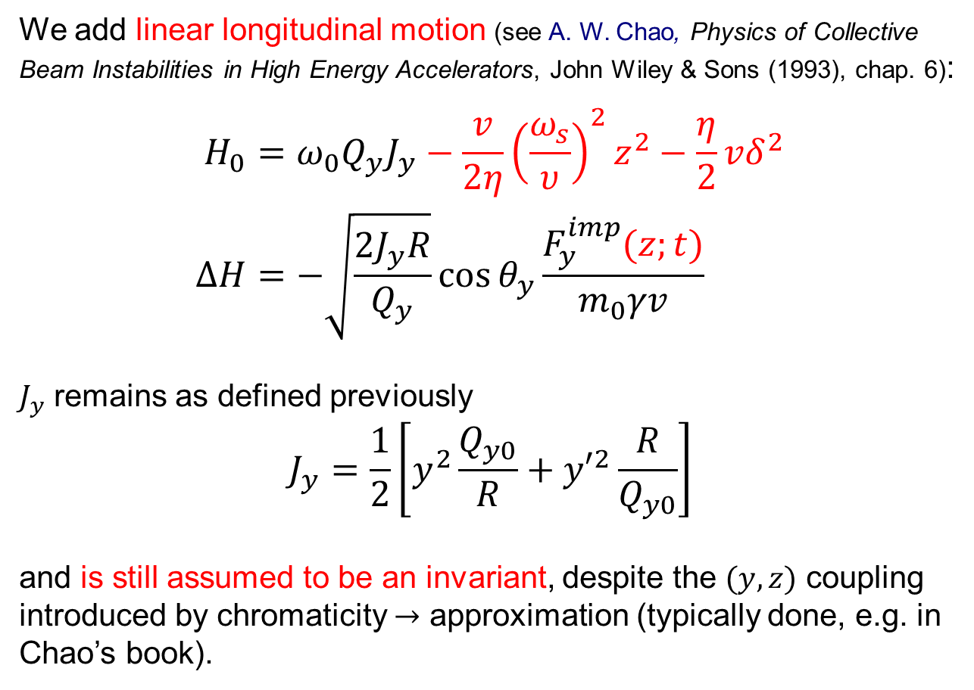

Hamiltonian
Hamiltonian
We add linear longitudinal motion (see A. W. Chao, Physics of Collective Beam Instabilities in High Energy Accelerators, John Wiley & Sons (1993), chap. 6):
$$\begin{aligned}H_{0}&=ω_{0}Q_{y}J_{y}−\frac{v}{2η}{\left(\frac{ω_{s}}{υ}\right)}^{2}z^{2}−\frac{η}{2}vδ^{2} \\ ΔH&=−\sqrt{\frac{2J_{y}R}{Q_{y}}}\cos{θ_{y}}\frac{F_{y}^{imp}(z;t)}{m_{0}γv}\end{aligned}$$
$J_{y}$ remains as defined previously
$$J_{y}=\frac{1}{2}\left[y^{2}\frac{Q_{y0}}{R}+{y′}^{2}\frac{R}{Q_{y0}}\right]$$
and is still assumed to be an invariant, despite the $(y,z)$ coupling introduced by chromaticity $→$ approximation (typically done, e.g. in Chao’s book).
Slippage factor
$$Q_{y}=Q_{y0}+Q_{y}^{′}δ$$
Synchrotron angular frequency

Slide 14
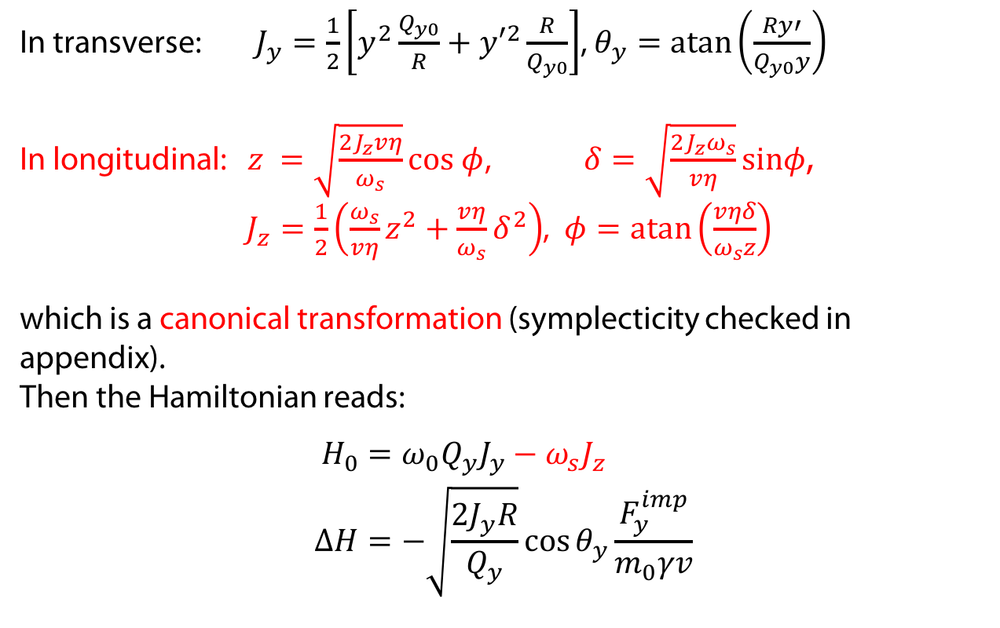
Transformation of coordinates
Hamiltonian
In transverse: $J_{y}=\frac{1}{2}\left[y^{2}\frac{Q_{y0}}{R}+{y′}^{2}\frac{R}{Q_{y0}}\right]$, $θ_{y}=\operatorname{atan}\left(\frac{Ry′}{Q_{y0}y}\right)$
In longitudinal: $z =\sqrt{\frac{2J_{z}vη}{ω_{s}}}cos φ$, $δ=\sqrt{\frac{{2J_{z}ω}_{s}}{vη}}sinφ$,
$J_{z}=\frac{1}{2}\left({\frac{ω_{s}}{vη}z}^{2}+{\frac{vη}{ω_{s}}δ}^{2}\right)$, $φ=\operatorname{atan}\left(\frac{vηδ}{ω_{s}z}\right)$
which is a canonical transformation (symplecticity checked in appendix).
Then the Hamiltonian reads:
$$\begin{aligned}H_{0}&=ω_{0}Q_{y}J_{y}−ω_{s}J_{z} \\ ΔH&=−\sqrt{\frac{2J_{y}R}{Q_{y}}}\cos{θ_{y}}\frac{F_{y}^{imp}}{m_{0}γv}\end{aligned}$$
Coordinates

Slide 15
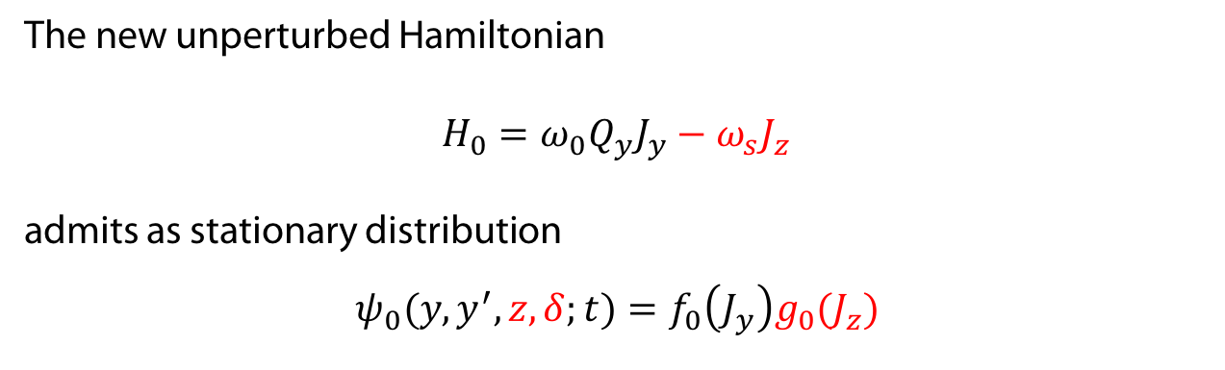
Stationary distribution
Hamiltonian
The new unperturbed Hamiltonian
$H_{0}=ω_{0}Q_{y}J_{y}−ω_{s}J_{z}$
admits as stationary distribution
$$ψ_{0}(y,y^{′},z,δ;t)=f_{0}\left(J_{y}\right)g_{0}(J_{z})$$
Coordinates
Stationary distribution

Slide 16





Linearized Vlasov equation
Hamiltonian
$$\frac{∂Δψ}{∂t}+\left[Δψ,H_{0}\right]+\left[ψ_{0},ΔH\right]=0$$
with
We get:
$$\frac{∂Δψ}{∂t}−\frac{∂Δψ}{∂θ_{y}}{ω_{0}Q}_{y}\text{+}\frac{∂Δψ}{∂φ}ω_{s}{+f}_{0}^{′}\left(J_{y}\right)g_{0}\left(J_{z}\right)\sqrt{\frac{2J_{y}R}{Q_{y}}}\sin{θ_{y}}\frac{F_{y}^{imp}}{m_{0}γv}=0$$
Note: from our initial assumption that the transverse plane does not affect the longitudinal one, we have neglected $\frac{∂ΔH}{∂z}$, as in Chao’s book.
Coordinates
$$\begin{aligned}H_{0}&=ω_{0}Q_{y}J_{y}−ω_{s}J_{z} \\ ΔH&=−\sqrt{\frac{2J_{y}R}{Q_{y}}}\cos{θ_{y}}\frac{F_{y}^{imp}\left(z;t\right)}{m_{0}γv}\end{aligned}$$
$$ψ_{0}(y,y^{′},z,δ;t)=f_{0}\left(J_{y}\right)g_{0}(J_{z})$$
Stationary distribution
Linearized Vlasov eq.
$$f_{0}’=\frac{df_{0}}{dJ_{y}}$$
Reminder: $\left[f,g\right]=\frac{∂f}{∂J_{y}}\frac{∂g}{∂θ_{y}}−\frac{∂f}{∂θ_{y}}\frac{∂g}{∂J_{y}}+\frac{∂f}{∂r}\frac{∂g}{∂φ}−\frac{∂f}{∂φ}\frac{∂g}{∂r}$

Slide 17
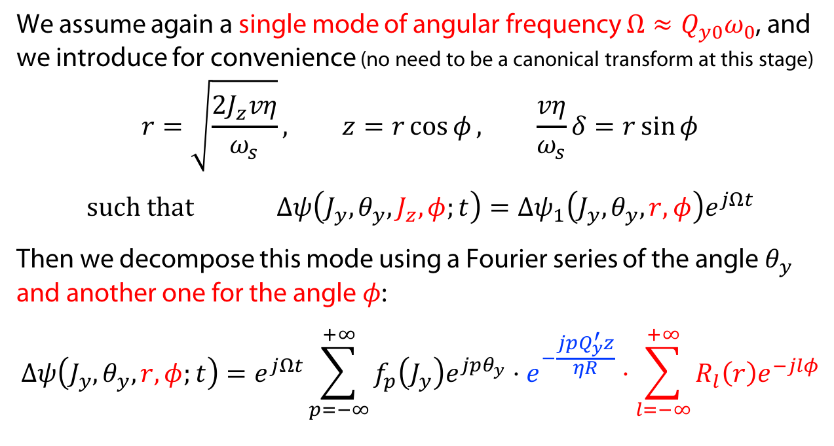
Writing the perturbation
Hamiltonian
We assume again a single mode of angular frequency $Ω≈Q_{y0}ω_{0}$, and we introduce for convenience (no need to be a canonical transform at this stage)
$$r=\sqrt{\frac{2J_{z}vη}{ω_{s}}}, z=r\cos{φ}, \frac{vη}{ω_{s}}δ=r\sin{φ}$$
$$such that Δψ\left(J_{y},θ_{y},J_{z},φ;t\right)=Δψ_{1}\left(J_{y},θ_{y},r,φ\right)e^{jΩt}$$
Then we decompose this mode using a Fourier series of the angle $θ_{y}$ and another one for the angle $φ$:
$$Δψ\left(J_{y},θ_{y},r,φ;t\right)=e^{jΩt}\sum_{p=−∞}^{+∞}{f_{p}\left(J_{y}\right)e^{jpθ_{y}}}⋅e^{−\frac{j{pQ}_{y}^{′}z}{ηR}}⋅\sum_{l=−∞}^{+∞}{R_{l}\left(r\right)e^{−jlφ}}$$
Coordinates
Stationary distribution
Linearized Vlasov eq.
Perturbation decomp.
Additional phase factor (that we are allowed to put here without loss of generality) – will appear later to be very convenient
→ headtail phase factor

Slide 18

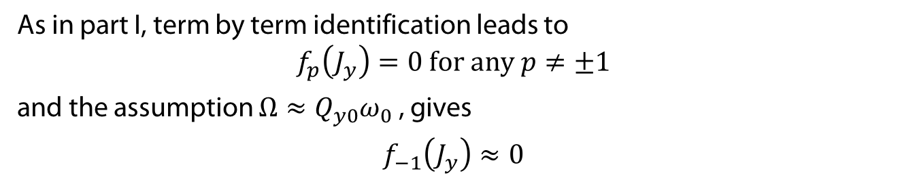

Reducing the number of variables
Hamiltonian
Injecting the perturbation into Vlasov equation, we can simplify it even more:
$$\begin{aligned}\frac{∂Δψ}{∂t}−\frac{∂Δψ}{∂θ_{y}}Q_{y}+\frac{∂Δψ}{∂φ}ω_{s}+ f_{0}^{′}\left(J_{y}\right)g_{0}\left(r\right)\sqrt{\frac{2J_{y}R}{Q_{y}}}\sin{θ_{y}}\frac{F_{y}^{imp}}{m_{0}γv}=0 \\ ⇔e^{jΩt}\sum_{p=−∞}^{+∞}{f_{p}\left(J_{y}\right)e^{jpθ_{y}}e^{−\frac{jpQ_{y}^{′}z}{ηR}}\sum_{l=−∞}^{+∞}{R_{l}\left(r\right)e^{−jlφ}}\left(jΩ−jpQ_{y0}ω_{0}−jlω_{s}\right)=} \\ {−f}_{0}^{′}\left(J_{y}\right)g_{0}\left(r\right)\sqrt{\frac{2J_{y}R}{Q_{y}}}\frac{e^{jθ_{y}}−e^{−jθ_{y}}}{2j}\frac{F_{y}^{imp}}{m_{0}γv} \\ & \\ &\end{aligned}$$
Injecting the perturbation into Vlasov equation, we can simplify it even more:
$$\begin{aligned}\frac{∂Δψ}{∂t}−\frac{∂Δψ}{∂θ_{y}}Q_{y}+\frac{∂Δψ}{∂φ}ω_{s}+ f_{0}^{′}\left(J_{y}\right)g_{0}\left(r\right)\sqrt{\frac{2J_{y}R}{Q_{y}}}\sin{θ_{y}}\frac{F_{y}^{imp}}{m_{0}γv}=0 \\ ⇔e^{jΩt}\sum_{p=−∞}^{+∞}{f_{p}\left(J_{y}\right)e^{jpθ_{y}}e^{−\frac{jpQ_{y}^{′}z}{ηR}}\sum_{l=−∞}^{+∞}{R_{l}\left(r\right)e^{−jlφ}}\left(jΩ−jpQ_{y0}ω_{0}−jlω_{s}\right)=} \\ {−f}_{0}^{′}\left(J_{y}\right)g_{0}\left(r\right)\sqrt{\frac{2J_{y}R}{Q_{y}}}\frac{e^{jθ_{y}}−e^{−jθ_{y}}}{2j}\frac{F_{y}^{imp}}{m_{0}γv} \\ & \\ &\end{aligned}$$
Coordinates
Stationary distribution
Linearized Vlasov eq.
Perturbation decomp.
This is where we use this factor to simplify the term in brackets.
Reduction variables
As in part I, term by term identification leads to
$$f_{p}\left(J_{y}\right)=0 \text{for} \text{any} p≠±1$$
and the assumption $Ω≈Q_{y0}ω_{0}$ , gives
$$f_{−1}\left(J_{y}\right)≈0$$

Slide 19
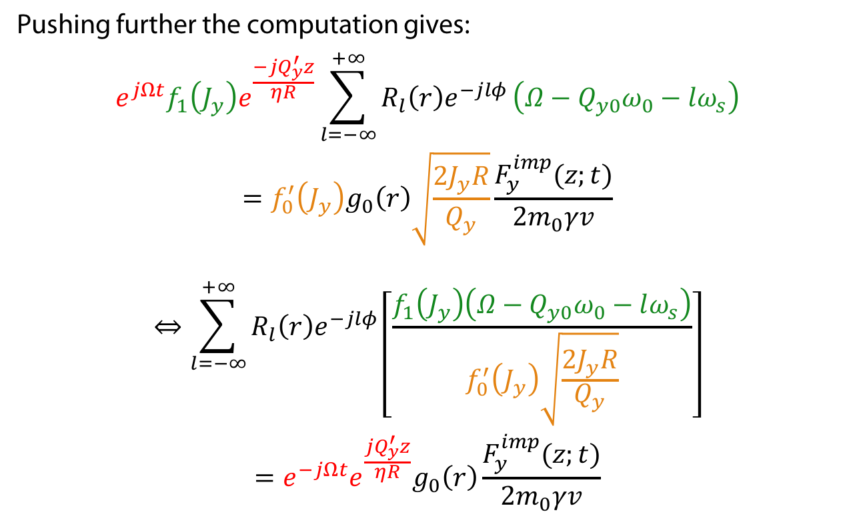
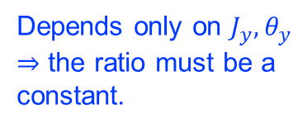
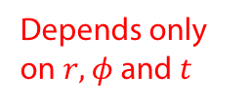
Reducing the number of variables
Hamiltonian
Pushing further the computation gives:
$$\begin{aligned}{e^{jΩt}f}_{1}\left(J_{y}\right)e^{\frac{−jQ_{y}^{′}z}{ηR}}\sum_{l=−∞}^{+∞}{R_{l}\left(r\right)e^{−jlφ}}\left(Ω−Q_{y0}ω_{0}−lω_{s}\right) \\ =f_{0}^{′}\left(J_{y}\right)g_{0}\left(r\right)\sqrt{\frac{2J_{y}R}{Q_{y}}}\frac{F_{y}^{imp}(z;t)}{{2m}_{0}γv}\end{aligned}$$
$$\begin{aligned}⇔\sum_{l=−∞}^{+∞}{R_{l}\left(r\right)e^{−jlφ}}\left[\frac{f_{1}\left(J_{y}\right)\left(Ω−Q_{y0}ω_{0}−lω_{s}\right)}{f_{0}^{′}\left(J_{y}\right)\sqrt{\frac{2J_{y}R}{Q_{y}}}}\right] \\ ={e^{−jΩt}e^{\frac{jQ_{y}^{′}z}{ηR}}g}_{0}\left(r\right)\frac{F_{y}^{imp}(z;t)}{{2m}_{0}γv}\end{aligned}$$
Coordinates
Stationary distribution
Depends only on $J_{y}, θ_{y}$
$⇒$ the ratio must be a constant.
Linearized Vlasov eq.
Perturbation decomp.
Reduction variables
Depends only on $r, φ$ and $t$

Slide 20
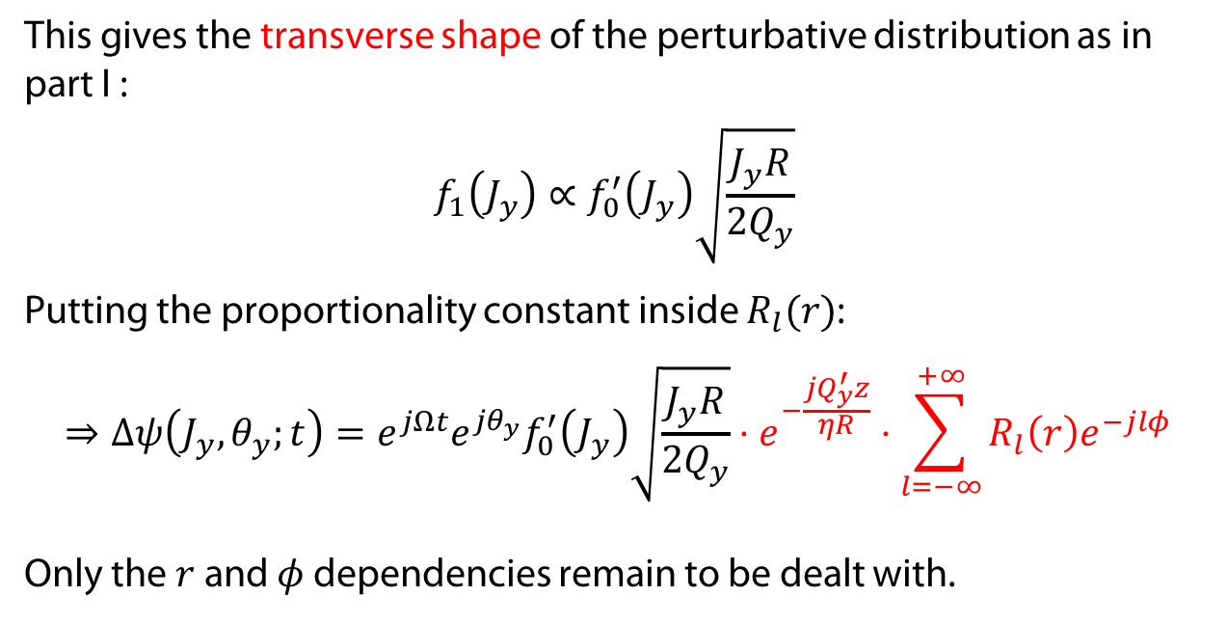
Reducing the number of variables
Hamiltonian
This gives the transverse shape of the perturbative distribution as in part I :
$$f_{1}\left(J_{y}\right)∝f_{0}^{′}\left(J_{y}\right)\sqrt{\frac{J_{y}R}{2Q_{y}}}$$
Putting the proportionality constant inside $R_{l}(r)$:
$$⇒Δψ\left(J_{y},θ_{y};t\right)=e^{jΩt}{e^{jθ_{y}}f}_{0}^{′}\left(J_{y}\right)\sqrt{\frac{J_{y}R}{{2Q}_{y}}}⋅e^{−\frac{jQ_{y}^{′}z}{ηR}}⋅\sum_{l=−∞}^{+∞}{R_{l}\left(r\right)e^{−jlφ}}$$
Only the $r$ and $φ$ dependencies remain to be dealt with.
Coordinates
Stationary distribution
Linearized Vlasov eq.
Perturbation decomp.
Reduction variables

Slide 21
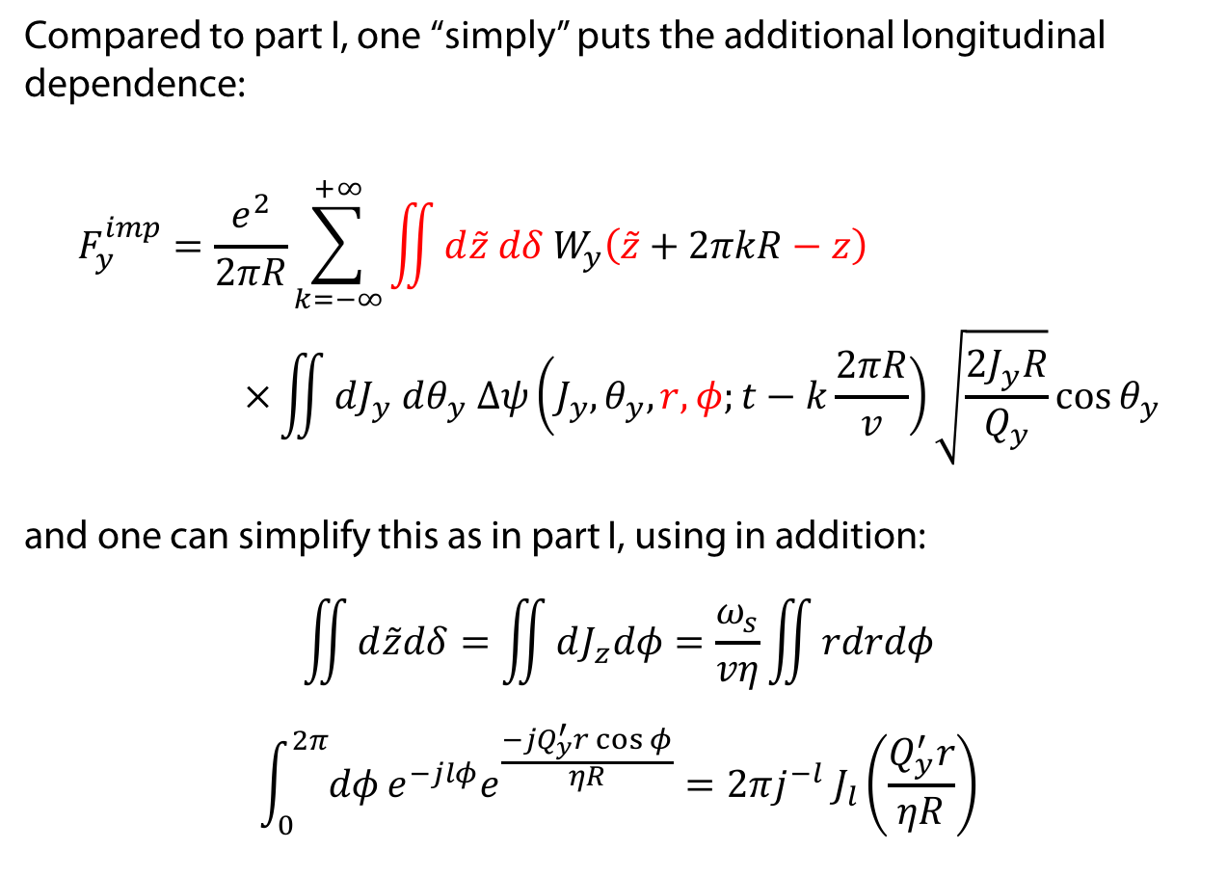
Force from impedance
Hamiltonian
Compared to part I, one “simply” puts the additional longitudinal dependence:
$$\begin{aligned}F_{y}^{imp}&=\frac{e^{2}}{2πR}\sum_{k=−∞}^{+∞}{\iint{{d\tilde{z} dδ W}_{y}\left(\tilde{z}+2πkR−z\right)}} \\ & ×\iint{dJ_{y} dθ_{y} Δψ\left(J_{y},θ_{y},r,φ;t−k\frac{2πR}{v}\right)\sqrt{\frac{2J_{y}R}{Q_{y}}}\cos{θ_{y}}}\end{aligned}$$
and one can simplify this as in part I, using in addition:
$$\begin{aligned}\iint{d\tilde{z}dδ=\iint{dJ_{z}dφ}=\frac{ω_{s}}{vη}\iint{rdrdφ}} \\ &\int_{0}^{2π}{dφ}e^{−jlφ}e^{\frac{{−jQ}_{y}^{′}r\cos{φ}}{ηR}}=2πj^{−l} J_{l}\left(\frac{Q_{y}^{′}r}{ηR}\right)\end{aligned}$$
Coordinates
Stationary distribution
Linearized Vlasov eq.
Perturbation decomp.
Reduction variables
Impedance force
Bessel function

Slide 22
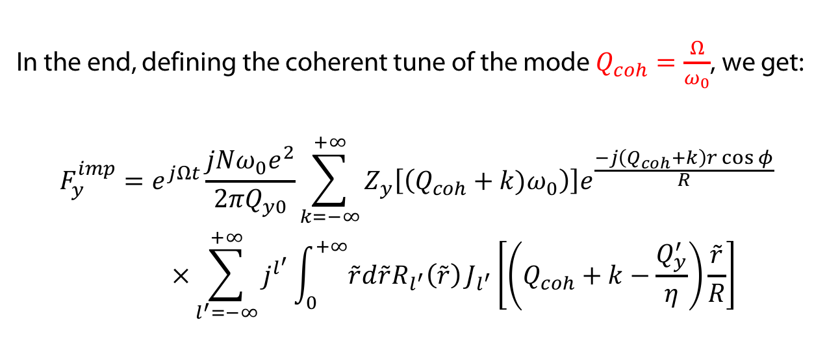
Force from impedance
Hamiltonian
In the end, defining the coherent tune of the mode $Q_{coh}=\frac{Ω}{ω_{0}}$, we get:
$$\begin{aligned}F_{y}^{imp}&=e^{jΩt}\frac{{jNω_{0}e}^{2}}{2πQ_{y0}}\sum_{k=−∞}^{+∞}{Z_{y}\left[\left(Q_{coh}+k)ω_{0}\right)\right]e^{\frac{−j\left(Q_{coh}+k\right)r\cos{φ}}{R}}} \\ & ×\sum_{l^{′}=−∞}^{+∞}{j^{l^{′}}}\int_{0}^{+∞}{\tilde{r}d\tilde{r}R_{l^{′}}\left(\tilde{r}\right)}J_{l^{′}}\left[\left(Q_{coh}+k−\frac{Q_{y}^{′}}{η}\right)\frac{\tilde{r}}{R}\right]\end{aligned}$$
Coordinates
Stationary distribution
Linearized Vlasov eq.
Perturbation decomp.
Reduction variables
Impedance force

Slide 23
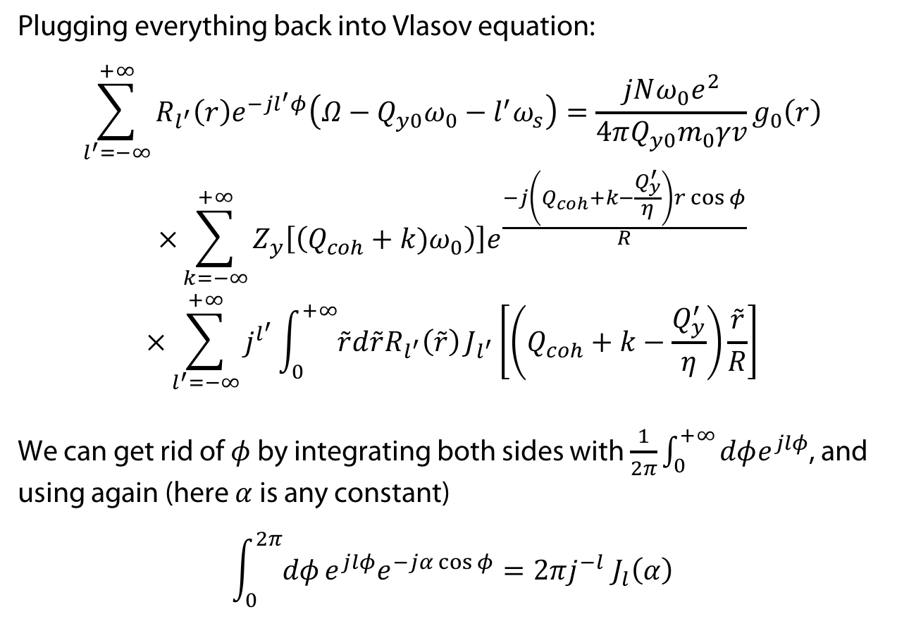
Sacherer integral equation
Hamiltonian
Plugging everything back into Vlasov equation:
$$\begin{aligned}\sum_{l^{′}=−∞}^{+∞}{R_{l^{′}}\left(r\right)e^{−jl^{′}φ}\left(Ω−Q_{y0}ω_{0}−l^{′}ω_{s}\right)}={\frac{{jNω_{0}e}^{2}}{4πQ_{y0}m_{0}γv}g}_{0}\left(r\right) \\ ×\sum_{k=−∞}^{+∞}{Z_{y}\left[\left(Q_{coh}+k)ω_{0}\right)\right]e^{\frac{−j\left(Q_{coh}+k−\frac{Q_{y}^{′}}{η}\right)r\cos{φ}}{R}}} \\ ×\sum_{l^{′}=−∞}^{+∞}{j^{l^{′}}}\int_{0}^{+∞}{\tilde{r}d\tilde{r}R_{l^{′}}\left(\tilde{r}\right)}J_{l^{′}}\left[\left(Q_{coh}+k−\frac{Q_{y}^{′}}{η}\right)\frac{\tilde{r}}{R}\right]\end{aligned}$$
We can get rid of $φ$ by integrating both sides with $\frac{1}{2π}\int_{0}^{+∞}{dφe^{jlφ}}$, and using again (here $α$ is any constant)
$$\int_{0}^{2π}{dφ}e^{jlφ}e^{−jα\cos{φ}}=2πj^{−l} J_{l}\left(α\right)$$
Coordinates
Stationary distribution
Linearized Vlasov eq.
Perturbation decomp.
Reduction variables
Impedance force
Final equation

Slide 24
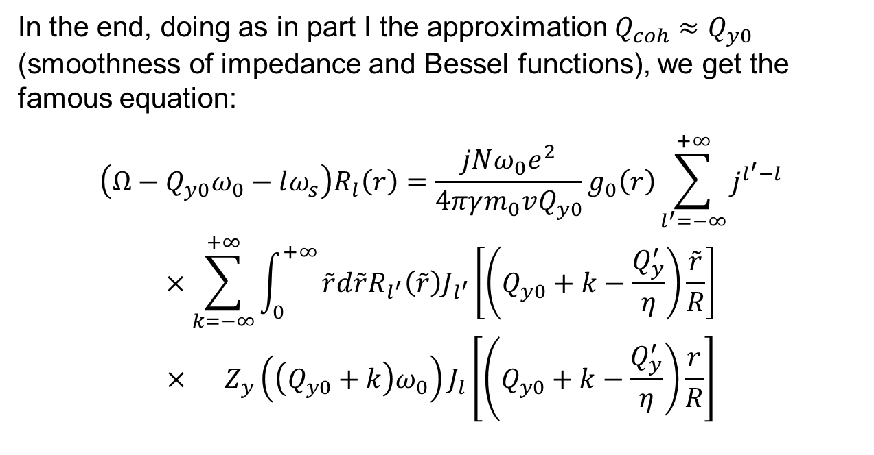
Sacherer integral equation
Hamiltonian
In the end, doing as in part I the approximation $Q_{coh}≈Q_{y0}$ (smoothness of impedance and Bessel functions), we get the famous equation:
$$\begin{aligned}\left(Ω−Q_{y0}ω_{0}−lω_{s}\right)R_{l}\left(r\right)&=\frac{jNω_{0}e^{2}}{4πγm_{0}vQ_{y0}}g_{0}\left(r\right)\sum_{l^{′}=−∞}^{+∞}{j^{l^{′}−l}} \\ \begin{aligned}×\sum_{k=−∞}^{+∞}{\int_{0}^{+∞}{\tilde{r}d\tilde{r}R_{l^{′}}\left(\tilde{r}\right)J_{l^{′}}\left[\left(Q_{y0}+k−\frac{Q_{y}^{′}}{η}\right)\frac{\tilde{r}}{R}\right]}} \\ × Z_{y}\left({\left(Q_{y0}+k\right)ω}_{0}\right)J_{l}\left[\left(\left.Q_{y0}+k−\frac{Q_{y}^{′}}{η}\right)\frac{r}{R}\right.\right]\end{aligned}\end{aligned}$$
Coordinates
Stationary distribution
Linearized Vlasov eq.
Perturbation decomp.
Reduction variables
Impedance force
Final equation

Slide 25
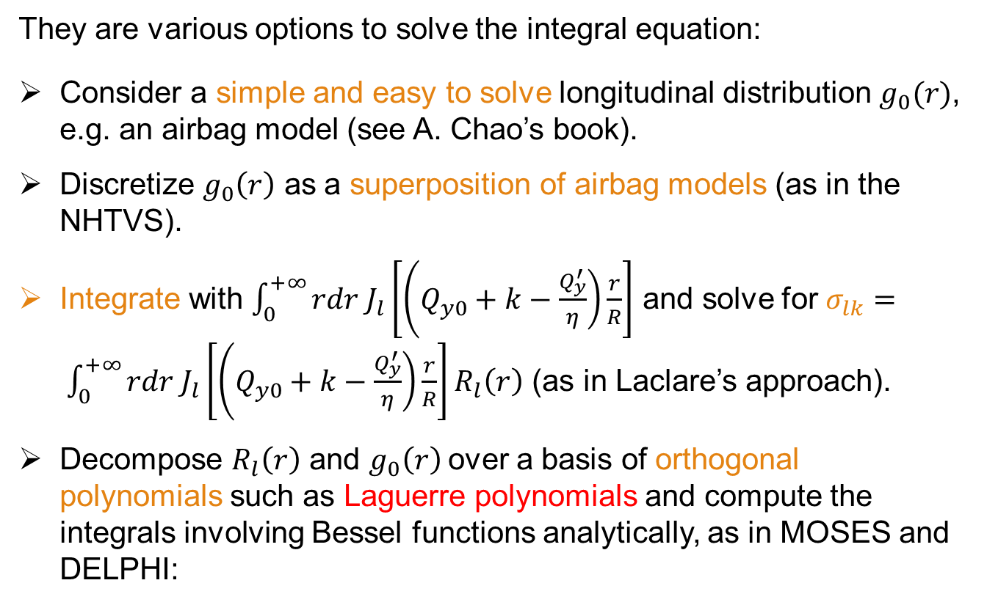
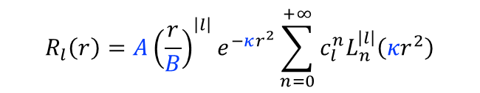
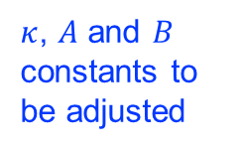
Solving Sacherer integral equation
They are various options to solve the integral equation:
Consider a simple and easy to solve longitudinal distribution $g_{0}(r)$, e.g. an airbag model (see A. Chao’s book).
Discretize $g_{0}\left(r\right)$ as a superposition of airbag models (as in the NHTVS).
Integrate with $\int_{0}^{+∞}{rdr J_{l}\left[\left(\left.Q_{y0}+k−\frac{Q_{y}^{′}}{η}\right)\frac{r}{R}\right.\right]}$ and solve for $σ_{lk}= \int_{0}^{+∞}{rdr J_{l}\left[\left(\left.Q_{y0}+k−\frac{Q_{y}^{′}}{η}\right)\frac{r}{R}\right.\right]R_{l}\left(r\right)}$ (as in Laclare’s approach).
Decompose $R_{l}\left(r\right)$ and $g_{0}\left(r\right)$over a basis of orthogonal polynomials such as Laguerre polynomials and compute the integrals involving Bessel functions analytically, as in MOSES and DELPHI:
$$R_{l}\left(r\right)={A\left(\frac{r}{B}\right)}^{\left|l\right|}e^{−κr^{2}}\sum_{n=0}^{+∞}{c_{l}^{n}L_{n}^{\left|l\right|}\left(κr^{2}\right)}$$
$κ$, $A$ and $B$ constants to be adjusted

Slide 26
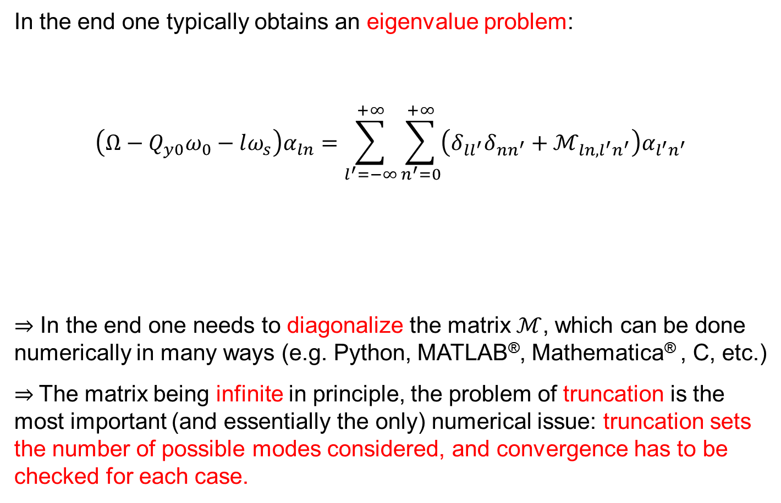

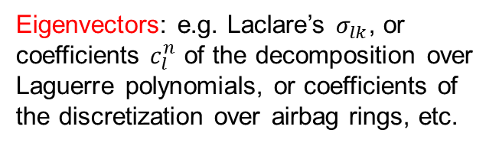
Solving Sacherer integral equation
In the end one typically obtains an eigenvalue problem:
$$\left(Ω−Q_{y0}ω_{0}−lω_{s}\right)α_{ln}=\sum_{l^{′}=−∞}^{+∞}{\sum_{n^{′}=0}^{+∞}{{\left(δ_{ll^{′}}δ_{nn^{′}}+ℳ_{ln,l^{′}n^{′}}\right)α}_{l^{′}n^{′}}}}$$
$⇒$ In the end one needs to diagonalize the matrix $ℳ$, which can be done numerically in many ways (e.g. Python, MATLAB®, Mathematica® , C, etc.)
$⇒$The matrix being infinite in principle, the problem of truncation is the most important (and essentially the only) numerical issue: truncation sets the number of possible modes considered, and convergence has to be checked for each case.
Eigenvalue looked for: angular frequency shift of the mode
Kronecker delta: $δ_{ll^{′}}=0$
$$\text{if} l≠l^{′}, 1 \text{otherwise}$$
Eigenvectors: e.g. Laclare’s $σ_{lk}$, or coefficients $c_{l}^{n}$ of the decomposition over Laguerre polynomials, or coefficients of the discretization over airbag rings, etc.
Matrix, to be computed analytically

Slide 27
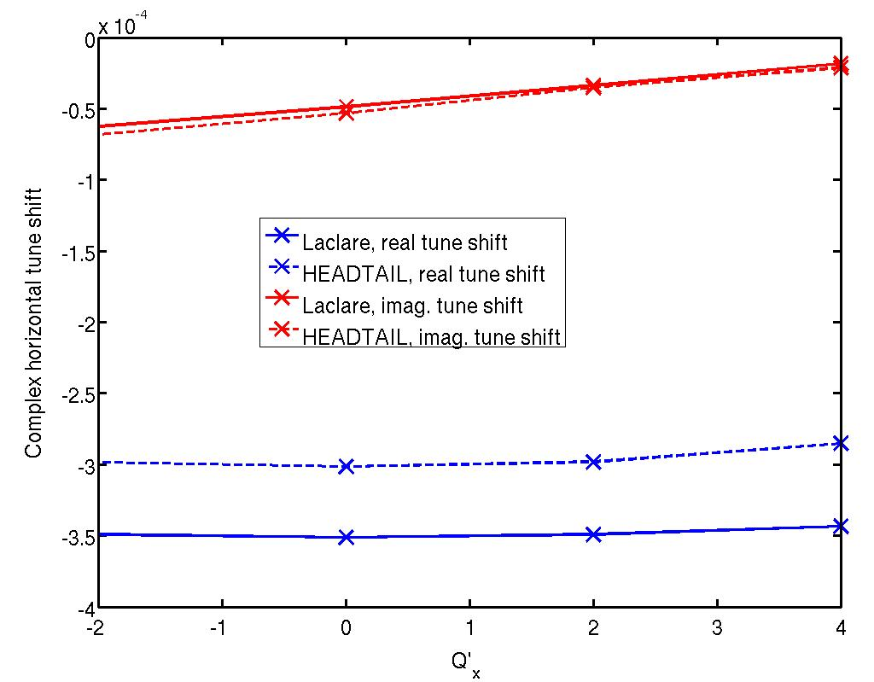
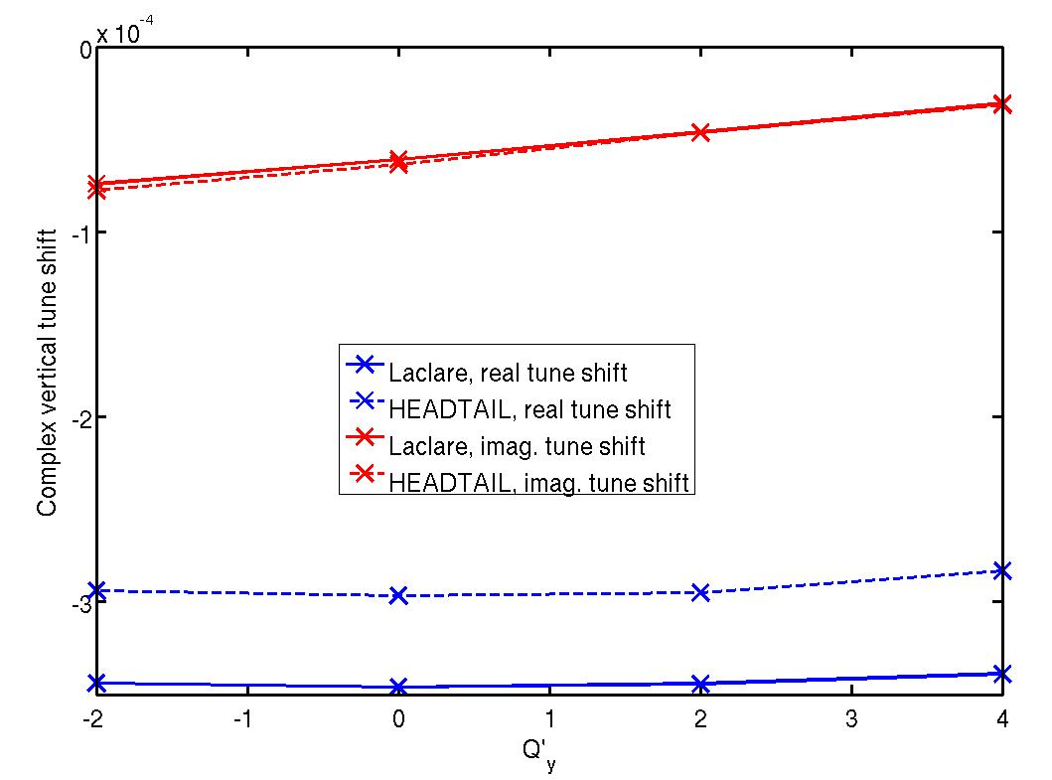
Benchmarks
Vlasov solvers have been heavily benchmarked w.r.t. multi-particle simulations: here HEADTAIL (multi-particle simulation) vs. Laclare’s Vlasov approach, for LHC coupled-bunch instabilities vs. chromaticity

Slide 28
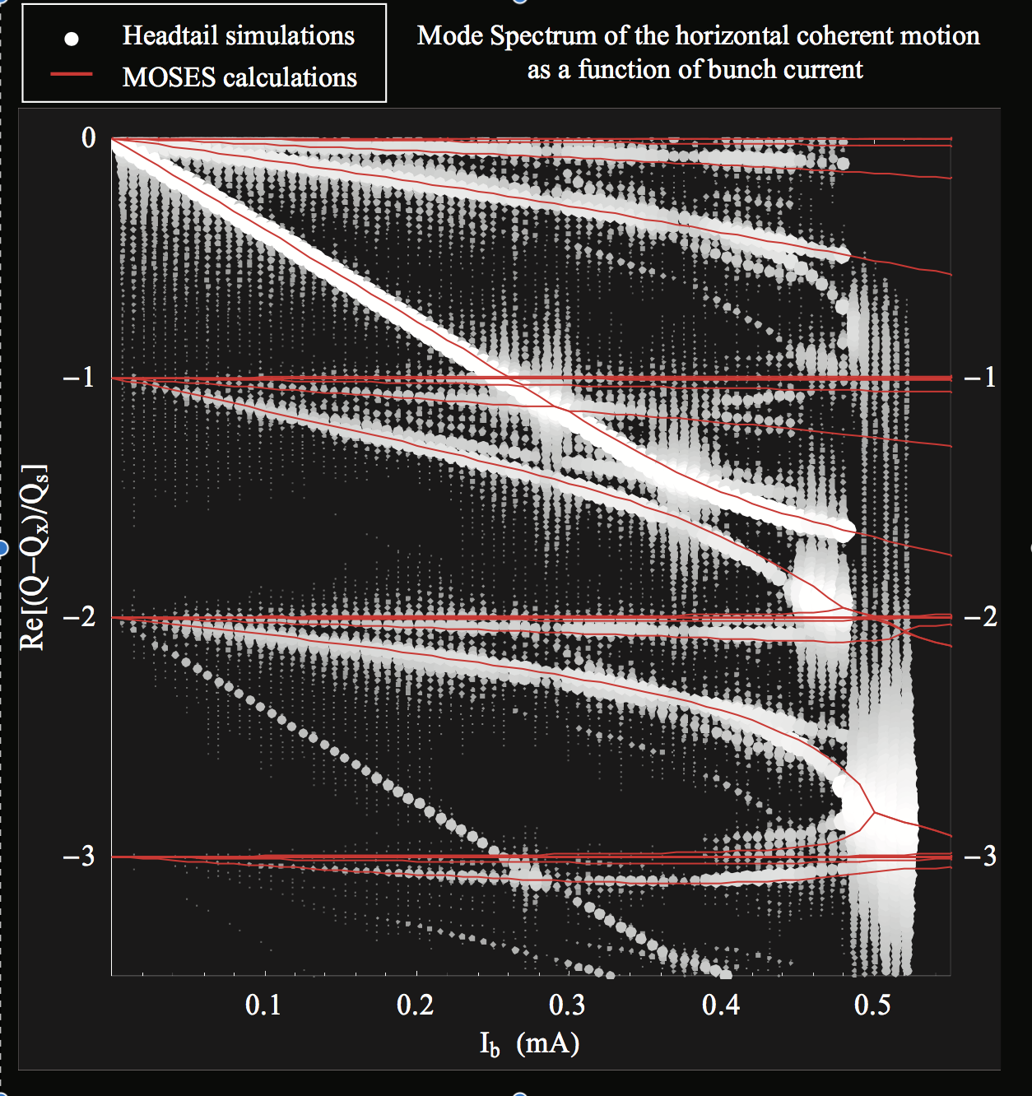
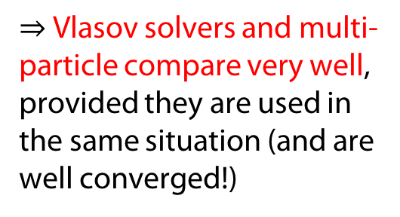
Benchmarks
HEADTAIL vs MOSES (Vlasov solver), for the SPS transverse mode coupling instability:
From B. Salvant’s PhD thesis [EPFL nº4585 (2010)]
$⇒$ Vlasov solvers and multi-particle compare very well, provided they are used in the same situation (and are well converged!)

Slide 29
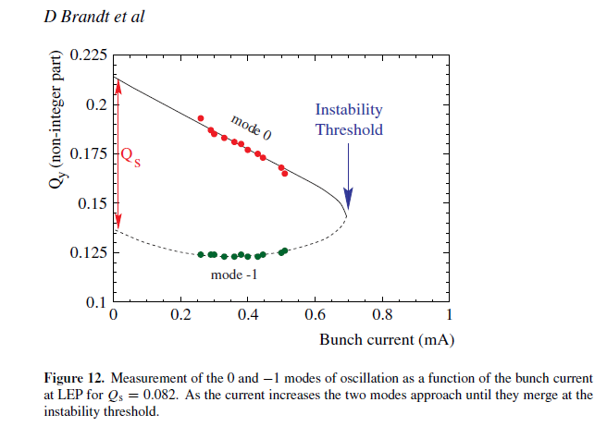
Applications – LEP TMCI with damper
Impedance model: two broad-band resonators (RF cavities + bellows), the rest is relatively small (<10%) [G. Sabbi, 1995].
experimental tune shifts and TMCI threshold (from simple formula) well reproduced,
TMCI threshold slightly less than 1mA.
Transverse feedback damper: several ideas and trials in LEP
reactive feedback (prevent mode 0 to shift down and couple with mode -1) → not more than 5-10 % increase in threshold, despite several attempts and models developed [Danilov-Perevedentsev 1993, Sabbi 1996, Brandt et al 1995],
resistive feedback, first found ineffective [Ruth 1983], tried at LEP but never used in operation.

Slide 30
Applications – LEP TMCI with damper
Instability threshold vs. chromaticity Q’ and damper gain (up to 10 turns) with DELPHI Vlasov solver:
Resistive damper: one cannot do better than the ”natural” (i.e. without damper) TMCI threshold.
Reactive damper: one can do a little better than the ”natural” TMCI.
→ seems to match (qualitatively) LEP observations.

Slide 31
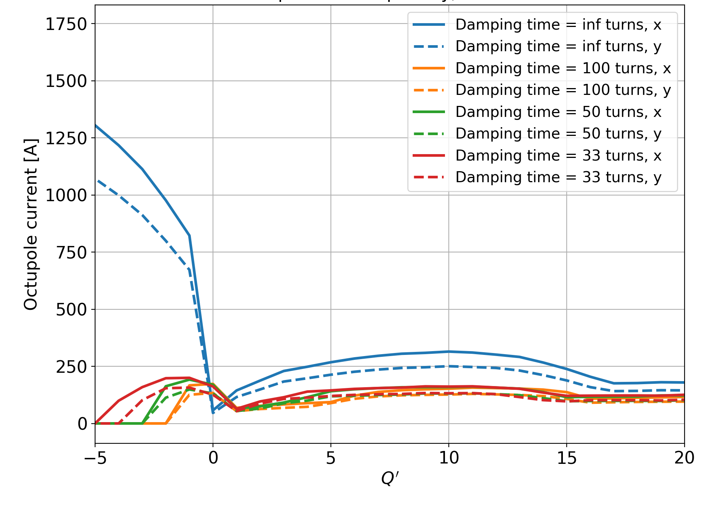

Applications – LHC
Predicting the octupole instability threshold vs. chromaticity Q’ and damper gain, with DELPHI:
… and we can also plot the respective contributions of each machine elements (essentially collimators):

Slide 32
Direct Vlasov solvers – summary part II
We have revisited the theory exposed in part I, introducing Hamiltonians and Poisson brackets to ease up the analytical work.
We have derived Sacherer integral equation within this framework, re-introducing the longitudinal plane.
We went through a few ways to solve Sacherer integral equation, and how to deal with the associated eigenvalue problem.
Finally we have shown benchmarks and applications of Vlasov solvers in CERN synchrotrons (LEP, SPS, LHC).

Slide 33
Appendix

Slide 34

Symplectic transformations
The transformation $(y,y^{′})→(J_{y},θ_{y})$is symplectic:
$y=\sqrt{\frac{2J_{y}R}{Q_{y}}}cos θ_{y}$, $y′=\sqrt{\frac{2J_{y}Q_{y}}{R}}sinθ_{y}$, $J_{y}=\frac{1}{2}\left[y^{2}\frac{Q_{y}}{R}+{y′}^{2}\frac{R}{Q_{y}}\right]$, $θ_{y}=\operatorname{atan}\left(\frac{Ry′}{Q_{y}y}\right)$
$$\text{so} 𝒥=\left(\begin{matrix}\frac{∂J_{y}}{∂y} & \frac{∂J_{y}}{∂y′} \\ \frac{∂θ_{y}}{∂y} & \frac{∂θ_{y}}{∂y′}\end{matrix}\right)=\left(\begin{matrix}\frac{y Q_{y}}{R} & \frac{y′R}{Q_{y}} \\ −\sqrt{\frac{Q_{y}}{2J_{y}R}}\sin{θ_{y}} & \sqrt{\frac{R}{2J_{y}Q_{y}}}\cos{θ_{y}}\end{matrix}\right)$$
and we get
$\left(\begin{matrix}\frac{y Q_{y}}{R} & −\sqrt{\frac{Q_{y}}{2J_{y}R}}\sin{θ_{y}} \\ \frac{y^{′}R}{Q_{y}} & \sqrt{\frac{R}{2J_{y}Q_{y}}}\cos{θ_{y}}\end{matrix}\right)⋅\left(\begin{matrix}0 & 1 \\ −1 & 0\end{matrix}\right)⋅\left(\begin{matrix}\frac{y Q_{y}}{R} & \frac{y^{′}R}{Q_{y}} \\ −\sqrt{\frac{Q_{y}}{2J_{y}R}}\sin{θ_{y}} & \sqrt{\frac{R}{2J_{y}Q_{y}}}\cos{θ_{y}}\end{matrix}\right)=\left(\begin{matrix}\sqrt{\frac{Q_{y}}{2J_{y}R}}\sin{θ_{y}} & \frac{y Q_{y}}{R} \\ −\sqrt{\frac{R}{2J_{y}Q_{y}}}\cos{θ_{y}} & \frac{y^{′}R}{Q_{y}}\end{matrix}\right)⋅\left(\begin{matrix}\frac{y Q_{y}}{R} & \frac{y^{′}R}{Q_{y}} \\ −\sqrt{\frac{Q_{y}}{2J_{y}R}}\sin{θ_{y}} & \sqrt{\frac{R}{2J_{y}Q_{y}}}\cos{θ_{y}}\end{matrix}\right)=\left(\begin{matrix}0 & 1 \\ −1 & 0\end{matrix}\right)$

Slide 35

Symplectic transformations
The transformation $(z,δ)→(J_{z},φ)$is symplectic:
$z=\sqrt{\frac{2J_{z}vη}{ω_{s}}}cos φ$, $δ=\sqrt{\frac{{2J_{z}ω}_{s}}{vη}}sinφ$, $J_{z}=\frac{1}{2}\left({\frac{ω_{s}}{vη}z}^{2}+{\frac{vη}{ω_{s}}δ}^{2}\right)$, $φ=\operatorname{atan}\left(\frac{vηδ}{ω_{s}z}\right)$
$$\text{so} 𝒥=\left(\begin{matrix}\frac{∂J_{z}}{∂z} & \frac{∂J_{z}}{∂δ} \\ \frac{∂φ}{∂z} & \frac{∂φ}{∂δ}\end{matrix}\right)=\left(\begin{matrix}\frac{ω_{s}}{ηv}z & \frac{vη}{ω_{s}}δ \\ −\frac{δ}{2J_{z}} & \frac{z}{2J_{z}}\end{matrix}\right)$$
and we get
$\left(\begin{matrix}\frac{ω_{s}}{ηv}z & −\frac{δ}{2J_{z}} \\ \frac{vη}{ω_{s}}δ & \frac{z}{2J_{z}}\end{matrix}\right)⋅\left(\begin{matrix}0 & 1 \\ −1 & 0\end{matrix}\right)⋅\left(\begin{matrix}\frac{ω_{s}}{ηv}z & \frac{vη}{ω_{s}}δ \\ −\frac{δ}{2J_{z}} & \frac{z}{2J_{z}}\end{matrix}\right)=\left(\begin{matrix}\frac{δ}{2r} & \frac{ω_{s}}{ηv}z \\ −\frac{z}{2J_{z}} & \frac{vη}{ω_{s}}δ\end{matrix}\right)⋅\left(\begin{matrix}\frac{ω_{s}}{ηv}z & \frac{vη}{ω_{s}}δ \\ −\frac{δ}{2J_{z}} & \frac{z}{2J_{z}}\end{matrix}\right)=\left(\begin{matrix}0 & 1 \\ −1 & 0\end{matrix}\right)$

